Slide 1
LIT-REG-02.1 · DIRECTIONAL HMM
Probabilities can work before hidden states look clean
STOP preserved
No market data
No strategy data
Package-native Markov-switching AR(1) · frozen synthetic Stage A · 6 of 8 gates
Notes:
Open with the central tension: the model improved proper forecast scores, but the frozen contract also demanded much stronger hard-state recovery.
[Sources]
- Project results: literature_studies/docs/GEN5_LIT_REG_02_1_DIRECTIONAL_HMM_STAGE_A_RESULTS.md

Slide 2
We had not previously tested a market-direction HMM
LIT-REG-01.1
LIT-REG-01.2
LIT-REG-02.1
Return + normalized range
Stopped during custom-engine synthetic qualification. SPY was never read.
Volatility amplitude only
HiddenMarkov recovered clear states but failed weak/null classification reliability.
Direction first
Markov-switching AR(1), causal H20 probability, planted directional truth.
The prior STOPs informed numerical discipline; they did not supply negative directional evidence.
2
Notes:
This correction is important: 02.1 is a new scientific question, not a post-hoc rescue of a failed directional market model.
[Sources]
- Project decision: literature_studies/docs/GEN5_LIT_REG_02_1_DIRECTIONAL_HMM_DECISION.md
- Project 01.1 results: literature_studies/docs/GEN5_LIT_REG_01_1_HMM_STAGE_A_RESULTS.md
- Project 01.2 results: literature_studies/docs/GEN5_LIT_REG_01_2_HMM_VOLATILITY_STAGE_A_RESULTS.md

Slide 3
The model changes drift, persistence, and noise with a hidden state
TRAIN-only state identity
rₜ = α[Sₜ] + φ[Sₜ] · rₜ₋₁ + σ[Sₜ] · εₜ
Simulate each fitted state forward for 20 steps from return zero.
Lower expected sum → LESS_FAVORABLE
Higher expected sum → MORE_FAVORABLE
OOS outcomes never name or flip a state.
P(Sₜ = j | Sₜ₋₁ = i) = Aᵢⱼ
Primary forecast
P(rₜ₊₁ + … + rₜ₊₂₀ > 0 | information through t)
hmmTMB estimates parameters; Gen5 independently filters causally.
3
Notes:
The state is latent; the operational object is a probability distribution, not an oracle label.
The package uses a lagged return covariate on the state-dependent Gaussian mean.
[Sources]
- Michelot, General dependence structures in hmmTMB, section 'Autoregressive hidden Markov models': https://raw.githubusercontent.com/TheoMichelot/hmmTMB/master/vignettes/hmmTMB_general_structures.Rmd
- Hamilton (1989), Econometrica 57(2), pp. 357-384
- Project contract: literature_studies/docs/GEN5_LIT_REG_02_1_DIRECTIONAL_HMM_POC_CONTRACT.md

Slide 4
Direction is difficult because drift is tiny relative to daily noise
Illustrative favorable state
mean = +0.05% / day
51.7%
57.4%
volatility = 1.20% / day
Approximate chance
next day is positive
Approximate chance
20-session sum is positive
Even perfect state knowledge does not imply perfect candle prediction. Swing aggregation can improve signal-to-noise when the state persists.
4
Notes:
The percentages are Gaussian approximations: Φ(μ/σ) for one day and Φ(√20·μ/σ) when drift persists and innovations are independent.
This motivates H20 probability scoring rather than demanding crisp next-day calls.
[Sources]
- Project decision derivation: literature_studies/docs/GEN5_LIT_REG_02_1_DIRECTIONAL_HMM_DECISION.md

Slide 5
The evidence ladder was designed to move from known truth to unknown markets
1 · Teaching
2 · Frontier
3 · Financial noise
4 · Market OOS
Known persistent directional process
Frozen signal × persistence × history grid
Student-t GARCH misspecification stress
Separate future contract and replication atlas
Stage A stopped at step 1. Steps 2–4 remained unread and cannot be backfilled under 02.1.
5
Notes:
The original plan separated positive-control qualification, power mapping, financial-noise stress, and honest market evidence.
The downstream steps were structurally conditional on all eight Stage A gates.
[Sources]
- Project contract, Evidence Ladder and Stages A-C: literature_studies/docs/GEN5_LIT_REG_02_1_DIRECTIONAL_HMM_POC_CONTRACT.md

Slide 6
The teaching case planted large, persistent directional states
Frozen generator
Primary evidence
10 independent seeds
2,400 sessions each
TRAIN 1,800 · OOS 600
α = −0.30%, +0.30% / day
φ = 0.10 in both states
σ = 1.20% / day
97% daily self-transition
Brier
H2 < constant and AR(1)
Log loss
H2 < constant and AR(1)
State
median accuracy ≥ 85%
Transition
p90 max error ≤ 0.10
6
Notes:
The fixture was meant to be an easy positive control, but the contract required both proper forecast improvement and high daily state/transition recovery.
[Sources]
- Project contract, Stage A: literature_studies/docs/GEN5_LIT_REG_02_1_DIRECTIONAL_HMM_POC_CONTRACT.md

Slide 7
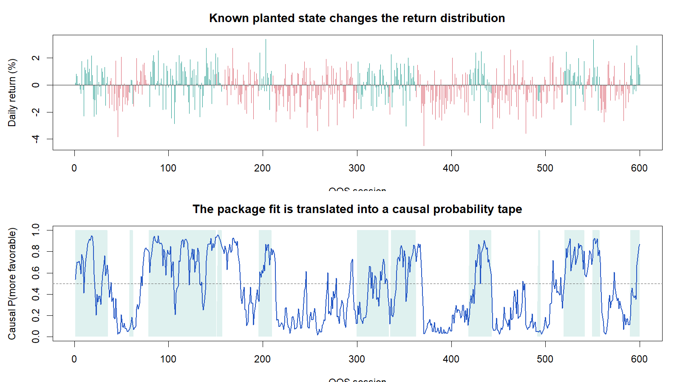
The causal probability tape tracks the planted state without pretending certainty
What to look for
• Blue probability moves with the hidden state.
• Overlapping return distributions create uncertainty near switches and on noisy days.
• The filter never revises earlier dates when future observations are appended.
Causal filtering passed exactly; hard daily labels remained imperfect.
7
Notes:
This is the first teaching seed only; it is representative visualization, not an extra statistical observation.
The shaded truth is available only because the data were simulated.
[Sources]
- Evidence figure: runs/research_workbench/literature_studies/lit_reg_02_1_directional_hmm_poc_20260819/stage_a_teaching_probability_tape.png
- Evidence tape: runs/research_workbench/literature_studies/lit_reg_02_1_directional_hmm_poc_20260819/stage_a_teaching_probability_tape.csv

Slide 8
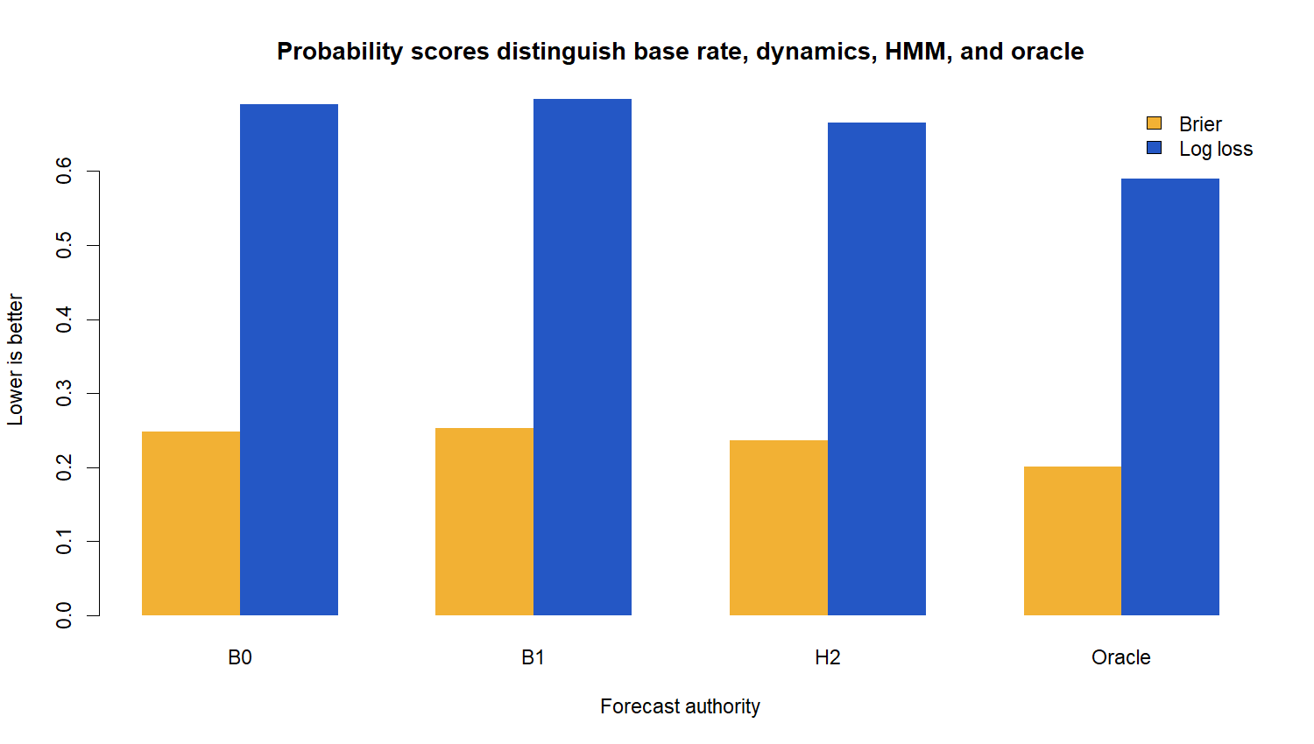
The HMM improved proper H20 probability scores in 9 of 10 cases
0.2363
HMM mean Brier
0.6653
HMM mean log loss
9 / 10
wins vs each baseline
Oracle Brier 0.2003: the fitted model improved on simple baselines but did not recover all planted information.
8
Notes:
Lower Brier and log loss are better.
B0 is the constant TRAIN up frequency; B1 is the one-state Gaussian AR(1); H2 is the fitted Markov-switching AR(1); Oracle knows the true current state and parameters.
[Sources]
- Evidence summary: runs/research_workbench/literature_studies/lit_reg_02_1_directional_hmm_poc_20260819/stage_a_case_summary.csv
- Evidence figure: runs/research_workbench/literature_studies/lit_reg_02_1_directional_hmm_poc_20260819/stage_a_forecast_scores.png

Slide 9
Six gates passed; two recovery gates stopped the lane
Gate
Status
Observed
A1
PASS
10 / 10 valid package fits
A2
PASS
append difference = 0
6 / 8
A3
FAIL
state accuracy 72.1% median; 64.7% p10
A4
FAIL
transition error 0.0344 median; 0.1289 p90
Conjunctive gate
Frontier not run
Stress not run
Market not read
A5
PASS
Brier improved; 9 / 10 wins
A6
PASS
log loss improved; 9 / 10 wins
A7
PASS
oracle remained better; scores finite
A8
PASS
exact deterministic replay
9
Notes:
A5-A6 are the forward probability gates; A3-A4 are the hard state and transition recovery gates.
The contract required every gate, so positive proper-score evidence cannot override the recovery failures.
[Sources]
- Gate table: runs/research_workbench/literature_studies/lit_reg_02_1_directional_hmm_poc_20260819/stage_a_gates.csv
- Project results: literature_studies/docs/GEN5_LIT_REG_02_1_DIRECTIONAL_HMM_STAGE_A_RESULTS.md

Slide 10
Soft forecasts and hard state labels answer different questions
Soft probability
Hard label
“How much evidence favors the more positive state?”
“Which state has probability above 50% today?”
Preserves uncertainty.
Can improve Brier/log loss even when many individual labels are wrong.
Matches risk-aware decision inputs better than an oracle color band.
Throws away probability magnitude.
Penalizes ambiguous dates as fully wrong.
Still useful for checking whether planted structure was actually recovered.
02.1 stopped correctly—but it revealed that a future direction lane should decide whether its scientific aim is decoding or forecasting.
10
Notes:
Do not reinterpret the failed A3/A4 gates as irrelevant after the fact. They were valid safeguards for the frozen decoding-and-forecasting question.
The result instead motivates a separately frozen forecast-first question.
[Sources]
- Project results interpretation: literature_studies/docs/GEN5_LIT_REG_02_1_DIRECTIONAL_HMM_STAGE_A_RESULTS.md

Slide 11
Preserve the STOP; carry the probabilistic clue into the next discussion
STOP_LIT_REG_02_1_DIRECTIONAL_
MECHANISM_QUALIFICATION_FAILED
Separately discuss next
Forecast-first 02.2 detection frontier
Preserve
Real-residual semi-synthetic bridge
• 10/10 valid package fits
• exact causality and replay
• proper-score improvement in 9/10 cases
• imperfect daily decoding and transition-tail recovery
Honest canonical market TRAIN/OOS
Later: duration, covariates, shared states
No gate change, no downstream execution, and no market or strategy claim under 02.1.
11
Notes:
The recommended discussion is whether to open a forecast-first variant whose primary success criterion is calibrated H20 direction probability rather than high daily hard-state accuracy.
No such variant is authorized by this deck.
[Sources]
- Project result and preserved paths: literature_studies/docs/GEN5_LIT_REG_02_1_DIRECTIONAL_HMM_STAGE_A_RESULTS.md
- Pohle et al. (2017), pragmatic HMM order/model checking: https://arxiv.org/abs/1701.08673

