Slide 1
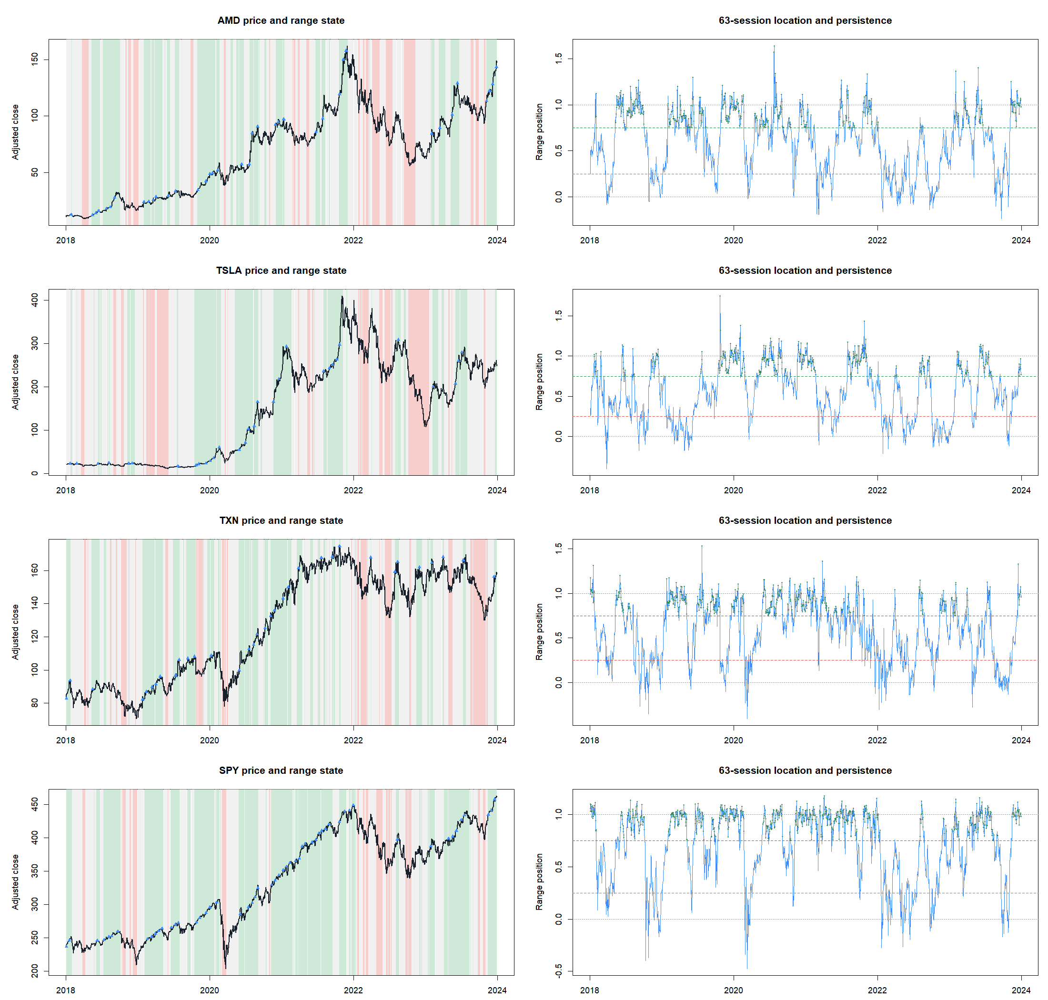
HYP-REG-12.1
A good description—
and a bad entry gate
Upper-range persistence was causal, interpretable, and broadly usable. Requiring it at fresh SMA8/14 crosses destroyed return and failed transport.
MEASUREMENT 7/7 · STRATEGY 3/9 · STOP · 2024+ SEALED
Notes:
Open with the central distinction. The state is a successful measurement artifact, but the precommitted hard entry policy is not useful.
[Sources]
- C:/Users/Franc/OneDrive/Documents/Francis/Peltata Project/Time-Series-Modeling-Gen5/docs/GEN5_HYP_REG_12_1_RANGE_PERSISTENCE_CONTRACT.md
- C:/Users/Franc/OneDrive/Documents/Francis/Peltata Project/Time-Series-Modeling-Gen5/operator_hypothesis_lab/docs/HYP_REG_12_1_RANGE_PERSISTENCE_RESULTS.md

Slide 2
QUESTION AND TAXONOMY
Regime context and breakout entry are different hypotheses
Contextual HYP-REG
Direct HYP-MOM
Measure whether price has resided near the top of its recent range.
Use the state only to admit or reject a separate, unchanged SMA entry.
This is the lane we froze.
Buy because price escaped a prior range.
The breakout itself supplies direction and timing.
That remains a separate, unopened strategy question.
Keeping the actions separate prevents a failed filter from quietly becoming a new strategy after outcomes are visible.
02
Notes:
Brock, Lakonishok, and LeBaron motivate treating trading-range rules as testable hypotheses. Time-series momentum makes persistence economically plausible, while data-snooping evidence argues against searching many channel lengths.
[Sources]
- https://doi.org/10.1111/j.1540-6261.1992.tb04681.x
- https://doi.org/10.1016/j.jfineco.2011.11.003
- https://doi.org/10.1111/0022-1082.00163
- C:/Users/Franc/OneDrive/Documents/Francis/Peltata Project/Time-Series-Modeling-Gen5/docs/GEN5_HYP_REG_12_1_RANGE_PERSISTENCE_CONTRACT.md

Slide 3
CONSTRUCTION
Range position asks where today sits relative to the prior quarter
0
prior range low
Lₜ = min(Pₜ₋₆₃, …, Pₜ₋₁)
Hₜ = max(Pₜ₋₆₃, …, Pₜ₋₁)
0.5
middle of range
RPₜ = (Pₜ − Lₜ) / (Hₜ − Lₜ)
1
prior range high
Today is excluded from both boundaries
>1
upside range escape
The statistic remains uncapped; escape magnitude is retained for audit.
03
Notes:
The 63-session range approximates one trading quarter and was selected before execution. Using preceding closes makes the boundary causal and avoids letting today's close move the goalpost it is tested against.
[Sources]
- C:/Users/Franc/OneDrive/Documents/Francis/Peltata Project/Time-Series-Modeling-Gen5/docs/GEN5_HYP_REG_12_1_RANGE_PERSISTENCE_CONTRACT.md

Slide 4
CAUSAL MECHANICS
Persistence and breakout events answer different questions
Primary state
Descriptive event ledger
UPPER_PERSISTENT
Start
RP crosses above 1
RP ≥ 0.75 today
and at least 3 of the latest 5 observations
Boundary
freeze the old 63-day high
Age
0 through 9; never extended
This state can gate a fresh SMA cross.
Track
hold fraction, deepest breach, retests
Completed outcomes validate meaning; they never flow backward into the live state.
04
Notes:
The event ledger preserves breakout age and fixed-boundary behavior without turning the event into an entry. A new high cannot restart or lengthen the event window.
[Sources]
- C:/Users/Franc/OneDrive/Documents/Francis/Peltata Project/Time-Series-Modeling-Gen5/docs/GEN5_HYP_REG_12_1_RANGE_PERSISTENCE_CONTRACT.md
- C:/Users/Franc/OneDrive/Documents/Francis/Peltata Project/Time-Series-Modeling-Gen5/runs/research_workbench/operator_hypothesis_lab/hyp_reg_12_1_range_persistence_20260817/hyp_reg_12_1_breakout_outcomes.csv

Slide 5
STAGE A GATES
The measurement passed every construction and usability gate
Result
Gate
Observed
PASS
Data boundary
26/26 complete; 2024+ absent
PASS
Synthetic trend
100% clean-up / clean-down recovery
PASS
Hold / fail semantics
100% intended outcome recovery
PASS
Scale invariance
max difference 2.44e−15
PASS
Append causality
19/19 columns exact
PASS
State and event rules
0 semantic violations
PASS
Real-panel usability
24/24 occupancy and cross usable
Stage A authorized strategy contact; it did not predict strategy success.
05
Notes:
Construction, causality, semantic validity, and opportunity contact were all adequate. This is a genuine positive measurement result, even though the policy later fails.
[Sources]
- C:/Users/Franc/OneDrive/Documents/Francis/Peltata Project/Time-Series-Modeling-Gen5/runs/research_workbench/operator_hypothesis_lab/hyp_reg_12_1_range_persistence_20260817/hyp_reg_12_1_stage_a_gates.csv
- C:/Users/Franc/OneDrive/Documents/Francis/Peltata Project/Time-Series-Modeling-Gen5/operator_hypothesis_lab/docs/HYP_REG_12_1_RANGE_PERSISTENCE_RESULTS.md

Slide 6
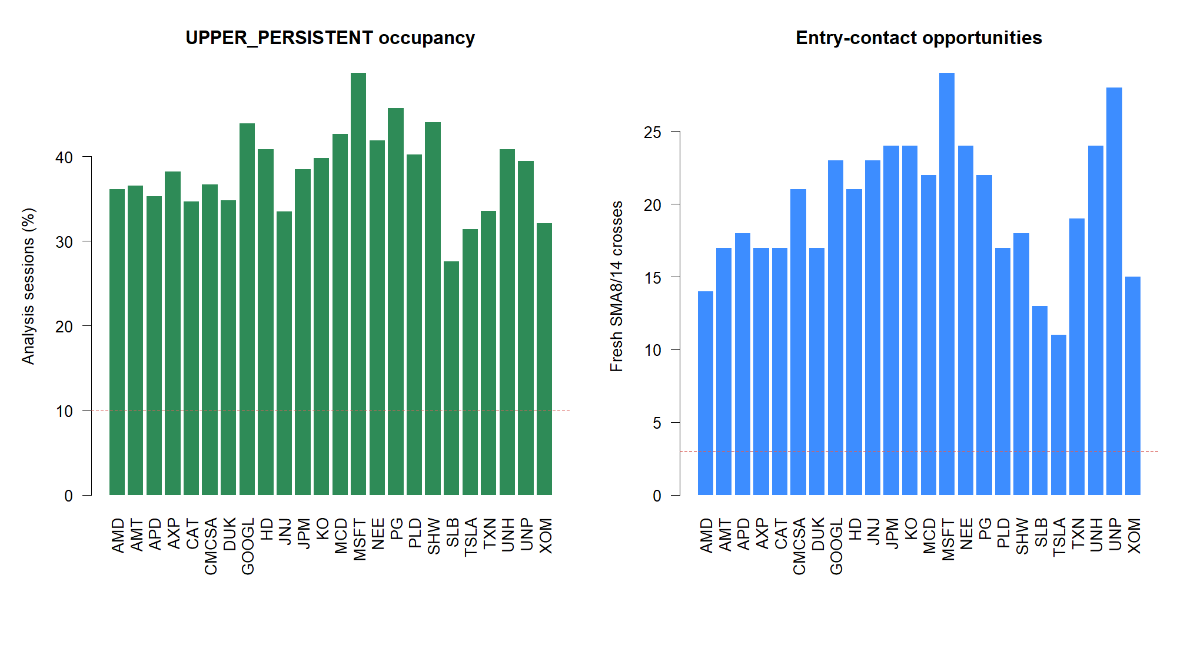
REAL-PANEL MEASUREMENT
Upper-range residence was common and broadly observable
38.3%
median session occupancy
24 / 24
stocks met the occupancy and fresh-cross usability gates
480
parent entries ultimately admitted by the state
06
Notes:
Unlike the prior CUSUM lane, this state is not too sparse. Every primary stock had multiple opportunities, and the strategy overlay ultimately contained 480 trades.
[Sources]
- C:/Users/Franc/OneDrive/Documents/Francis/Peltata Project/Time-Series-Modeling-Gen5/runs/research_workbench/operator_hypothesis_lab/hyp_reg_12_1_range_persistence_20260817/hyp_reg_12_1_state_diagnostics.csv
- C:/Users/Franc/OneDrive/Documents/Francis/Peltata Project/Time-Series-Modeling-Gen5/runs/research_workbench/operator_hypothesis_lab/hyp_reg_12_1_range_persistence_20260817/visuals/state_usability.png
- C:/Users/Franc/OneDrive/Documents/Francis/Peltata Project/Time-Series-Modeling-Gen5/runs/research_workbench/operator_hypothesis_lab/hyp_reg_12_1_range_persistence_20260817/hyp_reg_12_1_trades.csv

Slide 7
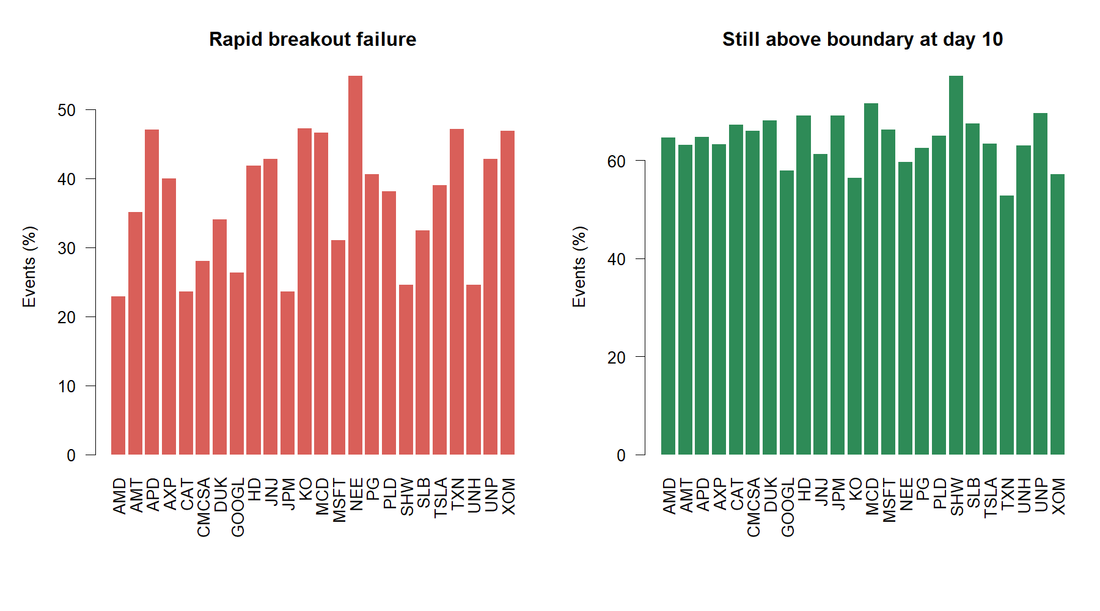
BREAKOUT EVENT AUDIT
Range escapes often held, but failures were still common
940
completed primary-stock events
36.1%
fell back through the frozen boundary within three sessions
63.1%
still above the boundary on session ten
07
Notes:
The event ledger confirms that breakouts are neither uniformly durable nor meaningless. Median hold fraction was 80%, but more than one-third failed rapidly. These are path outcomes, not trading returns.
[Sources]
- C:/Users/Franc/OneDrive/Documents/Francis/Peltata Project/Time-Series-Modeling-Gen5/runs/research_workbench/operator_hypothesis_lab/hyp_reg_12_1_range_persistence_20260817/hyp_reg_12_1_breakout_outcomes.csv
- C:/Users/Franc/OneDrive/Documents/Francis/Peltata Project/Time-Series-Modeling-Gen5/runs/research_workbench/operator_hypothesis_lab/hyp_reg_12_1_range_persistence_20260817/visuals/breakout_behavior.png

Slide 8
STAGE B POLICY
The policy changed entry permission—and nothing else
01
Signal
Fresh SMA8 cross above SMA14 at close t
02
Gate
UPPER_PERSISTENT must already be known at close t
03
Entry
Next open at 1×; rejected signals are skipped
04
Exit
Unchanged next-open parent SMA cross-down
05
Costs
5 bp per side primary; 10 bp stress
06
Controls
200 circular schedules; compare 40 exposure-nearest
No direct breakout entry, range-driven exit, leverage, ATR join, or parameter search.
08
Notes:
The parent strategy and accounting are identical to the earlier trend-indicator lanes. Parent reproduction passed for all 156 annual cells within 4.44e-15.
[Sources]
- C:/Users/Franc/OneDrive/Documents/Francis/Peltata Project/Time-Series-Modeling-Gen5/docs/GEN5_HYP_REG_12_1_RANGE_PERSISTENCE_CONTRACT.md
- C:/Users/Franc/OneDrive/Documents/Francis/Peltata Project/Time-Series-Modeling-Gen5/runs/research_workbench/operator_hypothesis_lab/hyp_reg_12_1_range_persistence_20260817/hyp_reg_12_1_parent_reproduction.csv

Slide 9
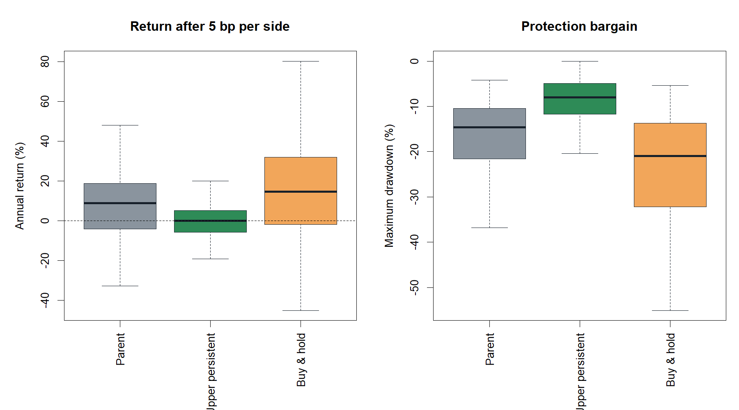
STRATEGY EVIDENCE
The gate cut drawdown by holding cash, not by earning return
8.95% → 0.00%
median annual return
−14.59% → −8.04%
median maximum drawdown
0.642 → −0.132
median Sharpe
1 / 24 assets · 1 / 6 years · 61.3rd timing percentile
09
Notes:
Only JPM improved over the six-year compound comparison. Only 2018 had positive median excess. At 10 bp per side, the overlay median annual return was -0.18%.
[Sources]
- C:/Users/Franc/OneDrive/Documents/Francis/Peltata Project/Time-Series-Modeling-Gen5/runs/research_workbench/operator_hypothesis_lab/hyp_reg_12_1_range_persistence_20260817/hyp_reg_12_1_policy_panel.csv
- C:/Users/Franc/OneDrive/Documents/Francis/Peltata Project/Time-Series-Modeling-Gen5/runs/research_workbench/operator_hypothesis_lab/hyp_reg_12_1_range_persistence_20260817/hyp_reg_12_1_asset_summary.csv
- C:/Users/Franc/OneDrive/Documents/Francis/Peltata Project/Time-Series-Modeling-Gen5/runs/research_workbench/operator_hypothesis_lab/hyp_reg_12_1_range_persistence_20260817/hyp_reg_12_1_year_summary.csv
- C:/Users/Franc/OneDrive/Documents/Francis/Peltata Project/Time-Series-Modeling-Gen5/runs/research_workbench/operator_hypothesis_lab/hyp_reg_12_1_range_persistence_20260817/hyp_reg_12_1_placebo_readout.csv
- C:/Users/Franc/OneDrive/Documents/Francis/Peltata Project/Time-Series-Modeling-Gen5/runs/research_workbench/operator_hypothesis_lab/hyp_reg_12_1_range_persistence_20260817/visuals/policy_performance.png

Slide 10
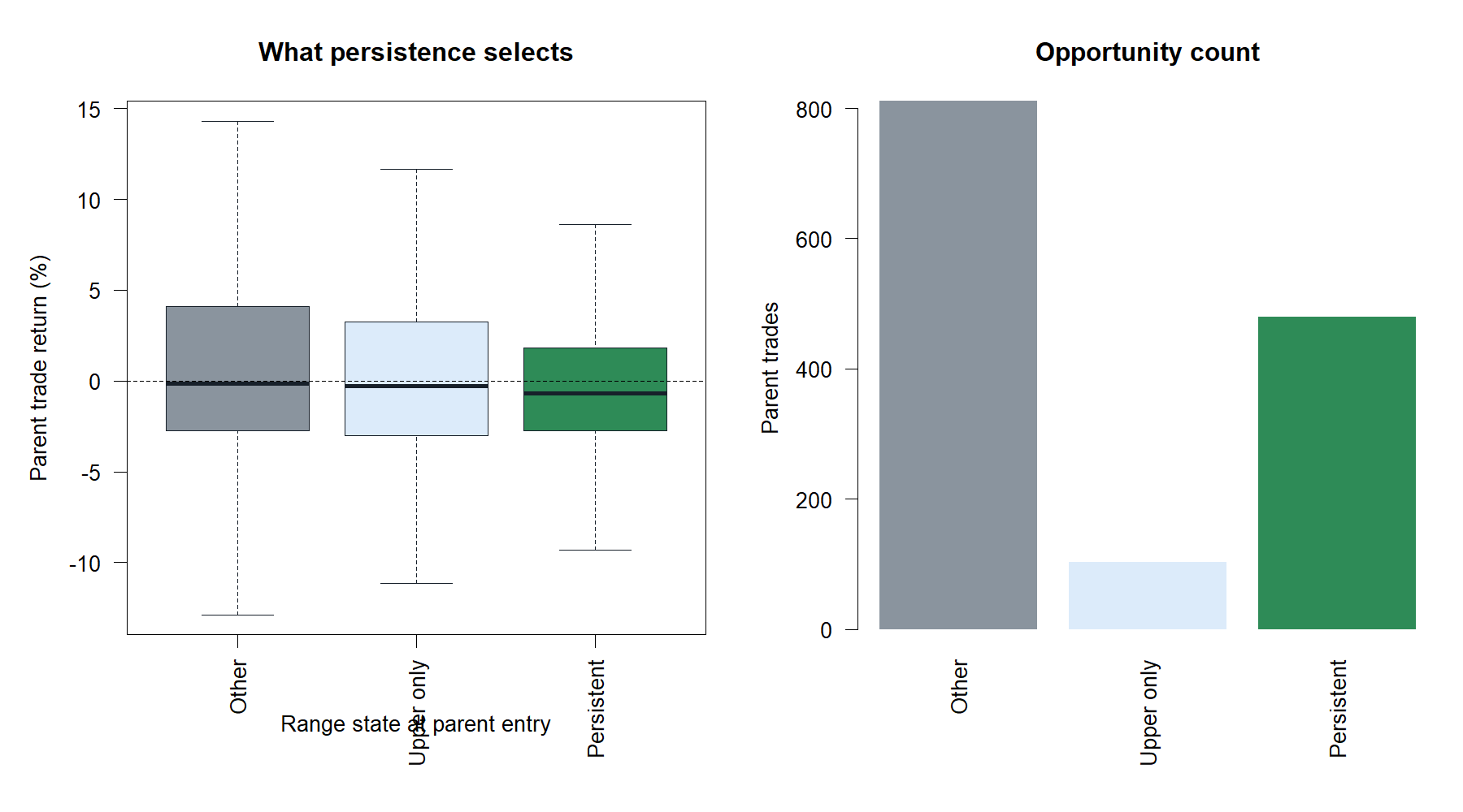
TRADE-LEVEL AUDIT
Upper-range persistence weakened fresh SMA-cross outcomes
Context
Trades
Hit
Other
811 · 48.0%
median −0.15%
Upper only
103 · 45.6%
median −0.28%
Upper persistent
480 · 43.1%
median −0.68%
Interpretation
The state describes strength, but requiring a new short-SMA cross after sustained upper-range residence appears late or extended.
10
Notes:
The trade audit argues against blaming the failure solely on low opportunity count. The admitted set contains 480 trades and has the weakest hit rate and median trade of the three predeclared descriptive groups.
[Sources]
- C:/Users/Franc/OneDrive/Documents/Francis/Peltata Project/Time-Series-Modeling-Gen5/runs/research_workbench/operator_hypothesis_lab/hyp_reg_12_1_range_persistence_20260817/hyp_reg_12_1_entry_state_audit.csv
- C:/Users/Franc/OneDrive/Documents/Francis/Peltata Project/Time-Series-Modeling-Gen5/runs/research_workbench/operator_hypothesis_lab/hyp_reg_12_1_range_persistence_20260817/visuals/entry_state_audit.png
- C:/Users/Franc/OneDrive/Documents/Francis/Peltata Project/Time-Series-Modeling-Gen5/operator_hypothesis_lab/docs/HYP_REG_12_1_RANGE_PERSISTENCE_RESULTS.md

Slide 11
DECISION
Keep the measurement, stop the gate, and move to HMM theory
STOP
Do not rescue
Do not alter 63 sessions, thresholds, persistence, parent mechanics, costs, assets, or ATR%. Do not reinterpret this result as authority for a direct breakout strategy.
Strategy: 3 / 9
Retain
• uncapped causal range-position ledger
• symmetric persistence states
• fixed-boundary breakout events
• synthetic and real usability harness
Next gate
T1–T5 are complete without promotion. Begin a literature-first HMM discussion: filtered versus smoothed states, identifiability, label stability, state count, and the boundary between description and trading authority.
11
Notes:
The series ends with a useful general lesson: causal descriptors can be valid without improving a particular action. HMM is now eligible for discussion, not implementation, and must be grounded before any state model is frozen.
[Sources]
- C:/Users/Franc/OneDrive/Documents/Francis/Peltata Project/Time-Series-Modeling-Gen5/operator_hypothesis_lab/docs/HYP_REG_12_1_RANGE_PERSISTENCE_RESULTS.md
- C:/Users/Franc/OneDrive/Documents/Francis/Peltata Project/Time-Series-Modeling-Gen5/docs/GEN5_TREND_INDICATOR_POC_ROADMAP.md
- C:/Users/Franc/OneDrive/Documents/Francis/Peltata Project/Time-Series-Modeling-Gen5/docs/GEN5_HYP_REG_12_1_RANGE_PERSISTENCE_CONTRACT.md

