Slide 1
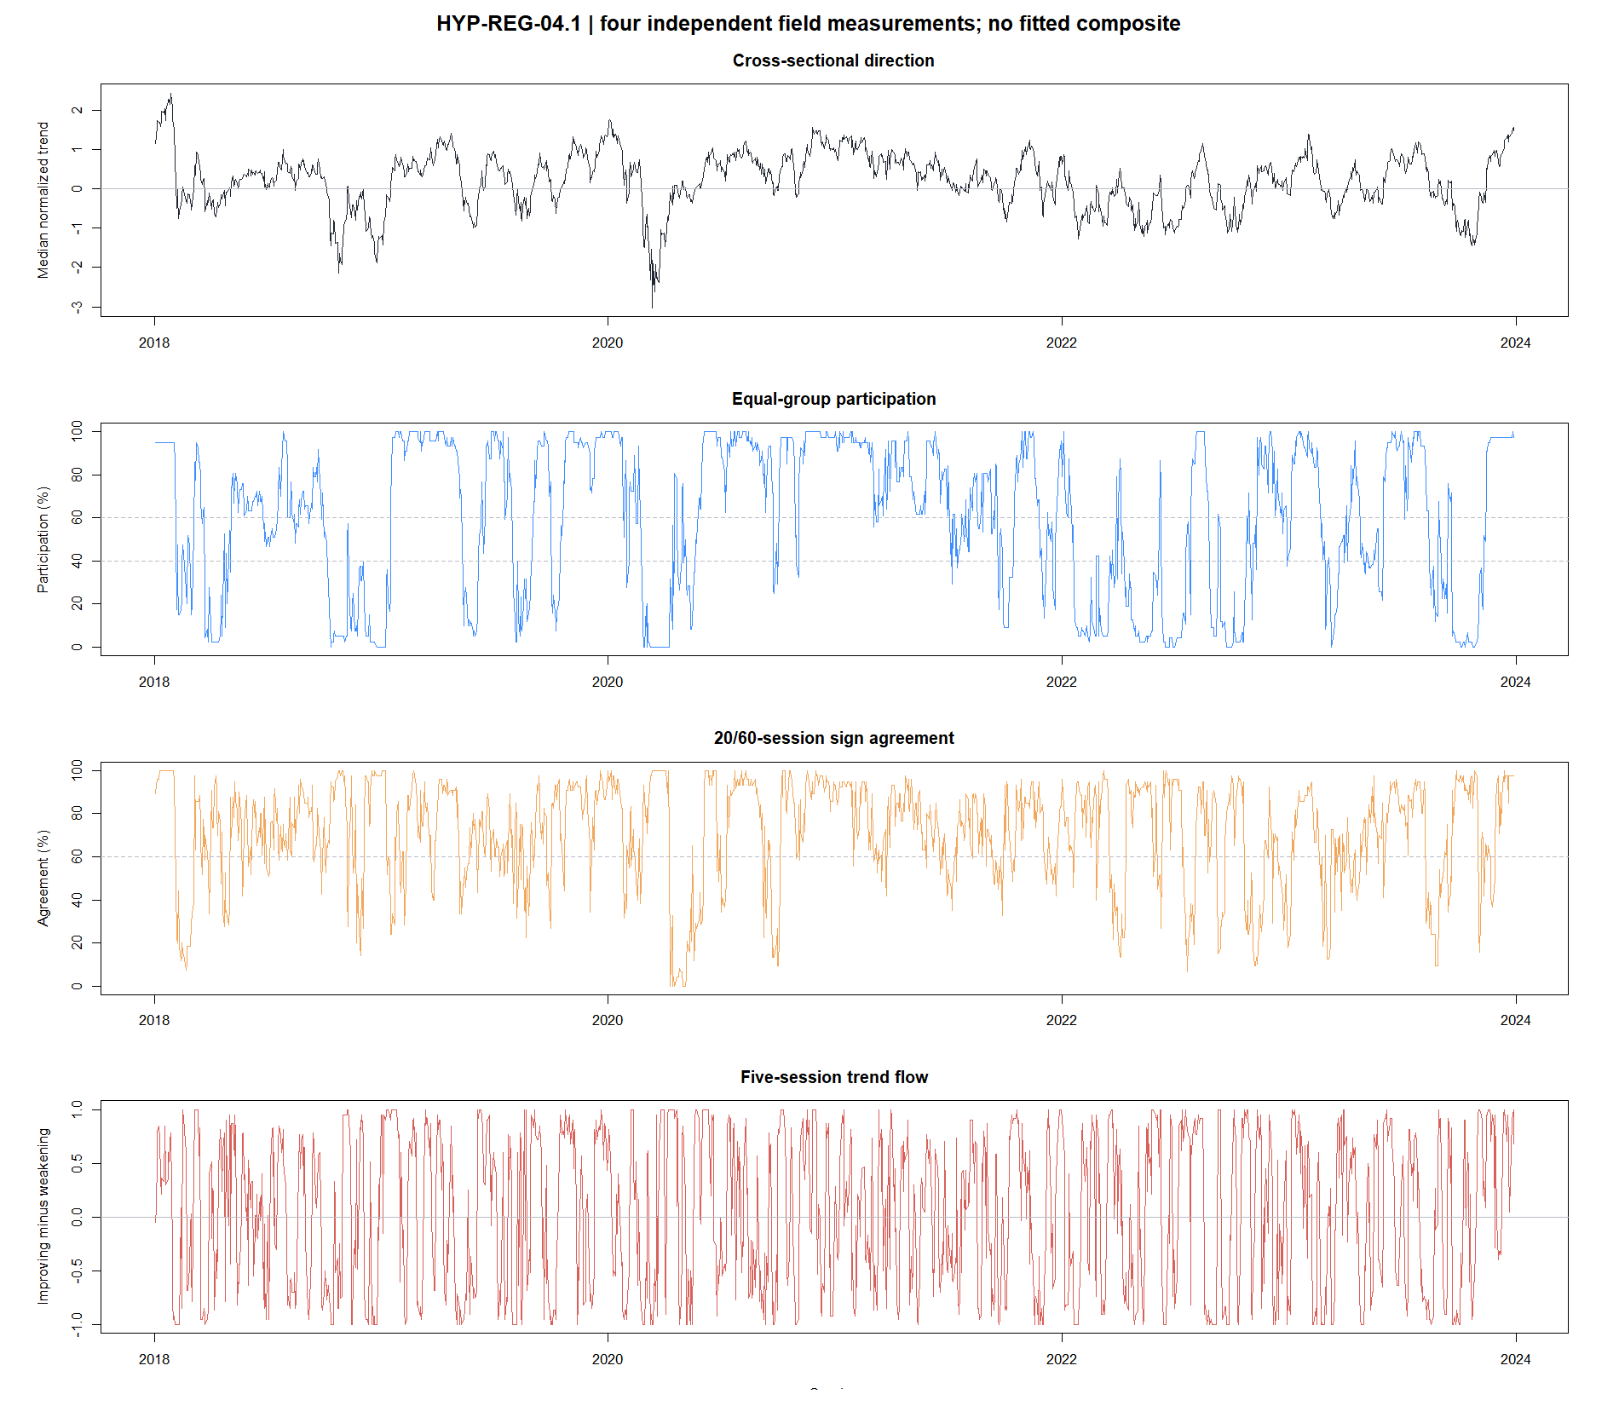
HYP-REG-04.1
A market trend field is not yet a usable asset filter
24 ETFs · four equal economic groups · direction, participation, agreement, and flow
STOP · 1 of 9 gates passed
1
Notes:
Open with the distinction: the field is an interpretable contemporaneous measurement, but this frozen version did not persist into the next month strongly enough to become a permission filter.
[Sources]
- docs/GEN5_HYP_REG_04_1_CROSS_SECTIONAL_TREND_FIELD_CONTRACT.md
- operator_hypothesis_lab/docs/HYP_REG_04_1_CROSS_SECTIONAL_TREND_FIELD_RESULTS.md
- C:/Users/Franc/OneDrive/Documents/Francis/Peltata Project/Time-Series-Modeling-Gen5/runs/research_workbench/operator_hypothesis_lab/hyp_reg_04_1_cross_sectional_trend_field_20260814/hyp_reg_04_1_gates.csv

Slide 2
EVENTUAL REGIME ARCHITECTURE
SPY is a validation surface—not the final operating asset
A future TSLA or AMD decision would require three different authorities.
Market trend field
Asset-relative ATR%
Unchanged asset signal
×
×
Broad direction and health
shared across the equity tape
Low / medium / high
movement magnitude for TSLA
The strategy still creates
entry and exit timing
Only a later unchanged-strategy overlay can validate asset decisions.
2
Notes:
SPY is a liquid external target used to test whether a market-level measurement has directional meaning. Even a passing market diagnostic would not automatically govern TSLA; it would first need an asset-panel overlay with unchanged strategy mechanics and fair controls.
[Sources]
- docs/GEN5_CROSS_SECTIONAL_MARKET_CONTEXT_CANDIDATE_MAP.md
- docs/GEN5_HYP_REG_01_1_ATR_PERCENT_VOLATILITY_POC_CONTRACT.md
- docs/GEN5_HYP_REG_01_2_ATR_PERCENT_STRATEGY_OVERLAY_CONTRACT.md

Slide 3
CANDIDATE MAP
Four compelling multi-asset directions remain conceptually distinct
04.1 · Trend field
05.1 · Latent market mode
Current configuration and flow across stable ETF exposures.
Common factor direction, strength, loading agreement, and fragmentation.
TESTED NOW
UNOPENED
06.1 · Confirmation network
Data upgrade · PIT breadth
Economically distinct risk-appetite ratios without duplicate voting.
Survivorship-safe constituent participation, advances/declines, and new highs/lows.
UNOPENED
SOURCE NEEDED
Testing one family does not grant permission to cycle through the others until something works.
3
Notes:
All serious alternatives are documented, but only the trend field was opened. The point-in-time constituent version is a data-authority upgrade, not a threshold variation on the ETF proxy.
[Sources]
- docs/GEN5_CROSS_SECTIONAL_MARKET_CONTEXT_CANDIDATE_MAP.md
- https://www.spglobal.com/spdji/en/research/article/worth-the-weight/
- https://www.sciencedirect.com/science/article/pii/S1386418115000609
- https://www.reddit.com/r/algotrading/comments/1rvfy12/comment/oawke1k/

Slide 4
FROZEN CONSTRUCTION
Equal group weights prevent ticker-count dominance
Broad / style / size
6 ETFs
Sector / real assets
10 ETFs
Industry / cyclical
6 ETFs
International
2 ETFs
Per asset
mᵢ,ₜ = ½ [ r₂₀ /(σ₆₃,prior√20) + r₆₀ /(σ₆₃,prior√60) ]
Direction
median of the four group-median trend scores
Participation
equal-group mean fraction with mᵢ,ₜ > 0
Agreement
equal-group mean with matching 20/60 signs
Flow
equal-group improving-minus-weakening balance over five sessions
No fitted weights. No scalar health score. SPY excluded from the field.
4
Notes:
Each ticker is normalized by its own prior volatility, then summarized within economic group. The four groups receive equal influence so the ten-sector block cannot overwhelm the two international exposures.
[Sources]
- docs/GEN5_HYP_REG_04_1_CROSS_SECTIONAL_TREND_FIELD_CONTRACT.md
- operator_hypothesis_lab/registries/hyp_reg_04_1_cross_sectional_trend_field_registry.csv

Slide 5
FROZEN VALIDATION
The field had to predict its own semantics before touching a strategy
Primary measurement tests
Secondary external test
Future median return across the same four-group field
Next-open SPY H20 direction asks whether the market state transports outside its own construction.
Future positive participation across the field
Whether improving flow predicts a five-session participation gain
Nine conjunctive gates
Whether 20/60 agreement improves directional persistence
effect size · continuous ordering · 20 offsets · temporal halves · calendar years · circular controls · SPY direction
Pass still means STOP before ATR%, TSLA/AMD, strategy outcomes, or 2024+.
5
Notes:
A regime descriptor must persist over the intended holding horizon before it is allowed to gate an asset strategy. All-daily effect sizes are supported by non-overlapping offsets, temporal transport, and state-timing controls.
[Sources]
- docs/GEN5_HYP_REG_04_1_CROSS_SECTIONAL_TREND_FIELD_CONTRACT.md
- C:/Users/Franc/OneDrive/Documents/Francis/Peltata Project/Time-Series-Modeling-Gen5/runs/research_workbench/operator_hypothesis_lab/hyp_reg_04_1_cross_sectional_trend_field_20260814/hyp_reg_04_1_gates.csv
- C:/Users/Franc/OneDrive/Documents/Francis/Peltata Project/Time-Series-Modeling-Gen5/runs/research_workbench/operator_hypothesis_lab/hyp_reg_04_1_cross_sectional_trend_field_20260814/hyp_reg_04_1_offset_summary.csv

Slide 6
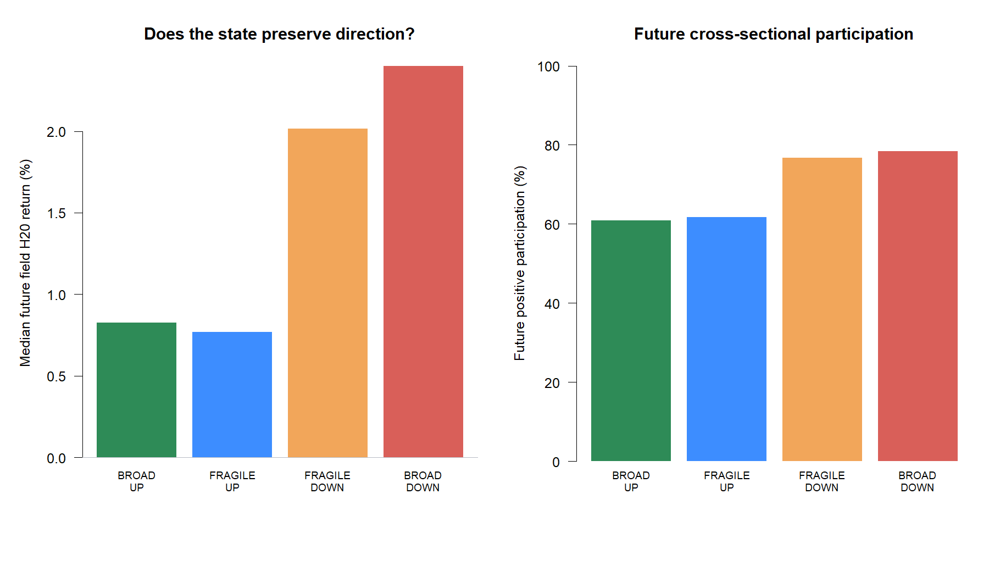
PRIMARY RESULT
The intended direction reversed at the one-month horizon
−1.58 pp
BROAD UP minus BROAD DOWN field return
−17.5 pp
future participation gap
207 / 429
BROAD DOWN / BROAD UP observations
Broad down was followed by the stronger rebound.
6
Notes:
The broad-down state had +2.40% median future field return and 78.33% positive participation, versus +0.83% and 60.83% for broad up. This is the opposite of the frozen trend-persistence hypothesis.
[Sources]
- C:/Users/Franc/OneDrive/Documents/Francis/Peltata Project/Time-Series-Modeling-Gen5/runs/research_workbench/operator_hypothesis_lab/hyp_reg_04_1_cross_sectional_trend_field_20260814/hyp_reg_04_1_state_summary.csv
- C:/Users/Franc/OneDrive/Documents/Francis/Peltata Project/Time-Series-Modeling-Gen5/runs/research_workbench/operator_hypothesis_lab/hyp_reg_04_1_cross_sectional_trend_field_20260814/hyp_reg_04_1_direction_contrast.csv
- operator_hypothesis_lab/docs/HYP_REG_04_1_CROSS_SECTIONAL_TREND_FIELD_RESULTS.md

Slide 7
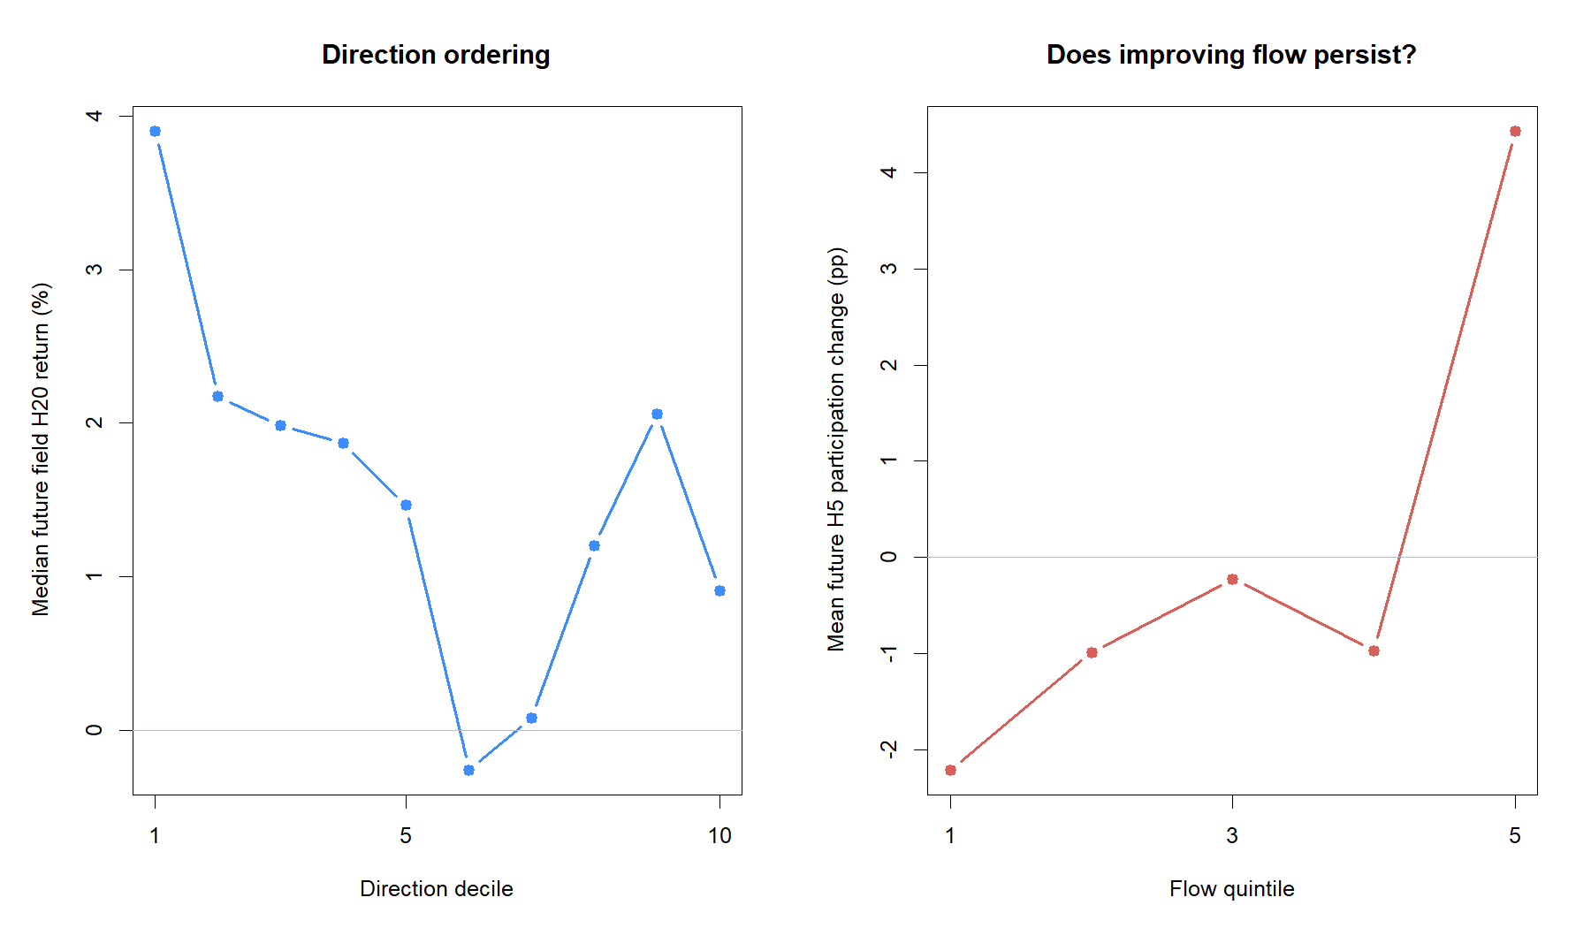
CONTINUOUS + HEALTH EVIDENCE
Participation and agreement did not rescue positive direction
ρ = −0.134
direction versus future field return
ρ = −0.099
participation versus future return
Health contrast
BROAD UP beat FRAGILE UP by only +0.06 pp return and had 0.8 pp less future participation.
7
Notes:
Flow retained the intended positive sign at rho 0.074 but missed its 0.10 gate. Agreement was slightly negatively associated with signed directional persistence. The full positive-health conjunction provided no meaningful advantage over fragile up.
[Sources]
- C:/Users/Franc/OneDrive/Documents/Francis/Peltata Project/Time-Series-Modeling-Gen5/runs/research_workbench/operator_hypothesis_lab/hyp_reg_04_1_cross_sectional_trend_field_20260814/hyp_reg_04_1_continuous_summary.csv
- C:/Users/Franc/OneDrive/Documents/Francis/Peltata Project/Time-Series-Modeling-Gen5/runs/research_workbench/operator_hypothesis_lab/hyp_reg_04_1_cross_sectional_trend_field_20260814/hyp_reg_04_1_health_contrast.csv
- operator_hypothesis_lab/docs/HYP_REG_04_1_CROSS_SECTIONAL_TREND_FIELD_RESULTS.md

Slide 8
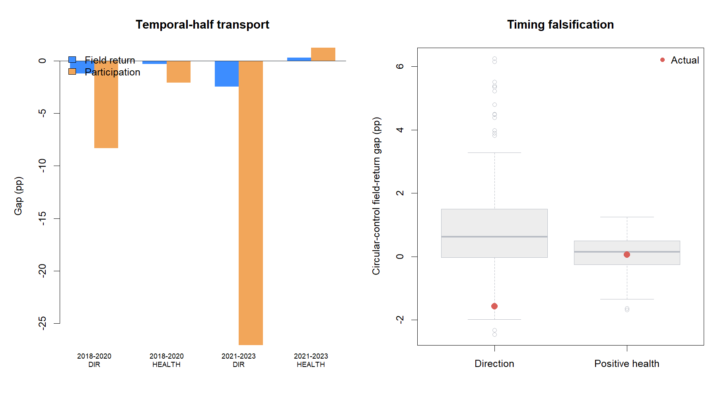
STABILITY + FALSIFICATION
The reversal transported across time and timing controls
6 / 20
offsets jointly positive
1 / 6
direction years jointly positive
Opposite control tail
Actual direction return and participation gaps ranked at the 2.5th and 3.0th percentiles—not the required 90th.
8
Notes:
Direction return and participation gaps were negative in both halves. The circular test shows that the observed state timing was unusually contrarian rather than merely noisy. We do not invert the lane after observing that result.
[Sources]
- C:/Users/Franc/OneDrive/Documents/Francis/Peltata Project/Time-Series-Modeling-Gen5/runs/research_workbench/operator_hypothesis_lab/hyp_reg_04_1_cross_sectional_trend_field_20260814/hyp_reg_04_1_period_summary.csv
- C:/Users/Franc/OneDrive/Documents/Francis/Peltata Project/Time-Series-Modeling-Gen5/runs/research_workbench/operator_hypothesis_lab/hyp_reg_04_1_cross_sectional_trend_field_20260814/hyp_reg_04_1_calendar_summary.csv
- C:/Users/Franc/OneDrive/Documents/Francis/Peltata Project/Time-Series-Modeling-Gen5/runs/research_workbench/operator_hypothesis_lab/hyp_reg_04_1_cross_sectional_trend_field_20260814/hyp_reg_04_1_circular_readout.csv
- C:/Users/Franc/OneDrive/Documents/Francis/Peltata Project/Time-Series-Modeling-Gen5/runs/research_workbench/operator_hypothesis_lab/hyp_reg_04_1_cross_sectional_trend_field_20260814/hyp_reg_04_1_offset_summary.csv

Slide 9
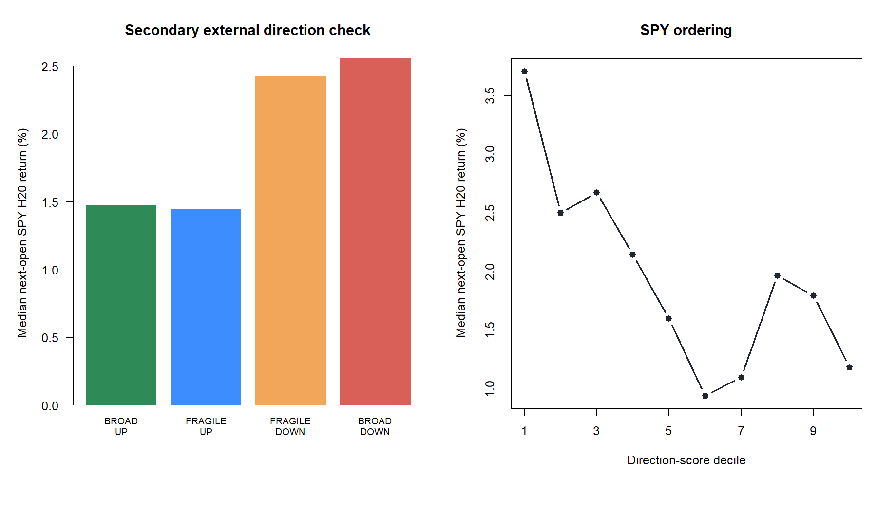
SECONDARY EXTERNAL CHECK
SPY confirmed the failure—but SPY was never the product
−1.08 pp
BROAD UP minus BROAD DOWN SPY return
AUC 0.505
SPY positive-direction discrimination
Why test SPY?
A market field should transport beyond the ETFs used to construct it. That is evidence—not an instruction to trade SPY.
9
Notes:
The SPY result independently mirrors the field reversal: rho -0.135, AUC approximately chance, and negative broad-up versus broad-down gaps in both temporal halves. This blocks any asset-level interpretation.
[Sources]
- C:/Users/Franc/OneDrive/Documents/Francis/Peltata Project/Time-Series-Modeling-Gen5/runs/research_workbench/operator_hypothesis_lab/hyp_reg_04_1_cross_sectional_trend_field_20260814/hyp_reg_04_1_state_summary.csv
- C:/Users/Franc/OneDrive/Documents/Francis/Peltata Project/Time-Series-Modeling-Gen5/runs/research_workbench/operator_hypothesis_lab/hyp_reg_04_1_cross_sectional_trend_field_20260814/hyp_reg_04_1_continuous_summary.csv
- C:/Users/Franc/OneDrive/Documents/Francis/Peltata Project/Time-Series-Modeling-Gen5/runs/research_workbench/operator_hypothesis_lab/hyp_reg_04_1_cross_sectional_trend_field_20260814/hyp_reg_04_1_period_summary.csv
- operator_hypothesis_lab/docs/HYP_REG_04_1_CROSS_SECTIONAL_TREND_FIELD_RESULTS.md

Slide 10
DECISION BOUNDARY
Keep the architecture; retire this trend-field implementation
1 / 9
What the result changes
gates passed
A market descriptor is not automatically a forward permission filter.
This 20/60 field appeared late relative to its H20 target.
STOP_TREND_FIELD_GATES_FAILED_
NO_ATR_JOIN_OR_STRATEGY
Do not invert, retune, or join it to the accepted ATR% state.
Latent market mode and confirmation network remain unopened—not queued rescues.
Future progress needs a newly justified estimand or better point-in-time breadth data.
2024+ remained sealed
The multi-asset architecture remains plausible; this implementation does not earn a place in it.
10
Notes:
Close by separating architecture from implementation. The concept of a market context axis beside per-asset ATR% remains coherent, but this exact 24-ETF, 20/60, H20 field failed every predictive and transport gate.
[Sources]
- operator_hypothesis_lab/docs/HYP_REG_04_1_CROSS_SECTIONAL_TREND_FIELD_RESULTS.md
- docs/GEN5_CROSS_SECTIONAL_MARKET_CONTEXT_CANDIDATE_MAP.md
- docs/GEN5_HYP_REG_04_1_CROSS_SECTIONAL_TREND_FIELD_CONTRACT.md
- docs/GEN5_4_DECISION_DIALOGUE_INDEX.md#d132
- https://www.spglobal.com/spdji/en/research/article/worth-the-weight/
- https://www.sciencedirect.com/science/article/pii/S1386418115000609

