Slide 1
SESSION 13
N1B finds stable uncertainty context;
trading value remains unproven.
12/12 rank + 12/12 separation | mean rho 0.107 | policies/models zero
S13/01
Notes:
SESSION 13 - NEWS RISK MEASUREMENT N1B
Purpose
Test one frozen measurement-only claim: unusually high issuer-local novel-news activity should order unusually wide five-session realized price paths beginning at the next executable open.
Result
All frozen data, leakage, support, and association gates passed. This opens a representation discussion only; it does not create a forecast, signal, exposure rule, or trading policy.
Conversation: codex://threads/019f741e-615f-7fd0-90f7-edce12b5cb66
Find in chat: Proceed
Decision: D35
Contract: docs/GEN5_4_NEWS_RISK_N1B_CONTRACT.md
Report: C:/Users/Franc/OneDrive/Documents/Francis/Peltata Project/Time-Series-Modeling-Gen5/runs/research_workbench/gen54_ml_decision_engine/g54_news_n1b_20260721/n1b_report.md

Slide 2
The test asked one narrow question and froze every clock
NEWS STATE
EXECUTION
OUTCOME
issuer-local TRAIN ECDF
nonzero and >= p80
17:30 decision
following-session open
five-session path
TRAIN-median scaled
Sentiment, direction, search, models, exposure, allocation, and PnL: zero.
D35/02
Notes:
DECISION D35 - FROZEN N1B MEASUREMENT
News state
For each issuer and fold, count admissible novel exact-title clusters in a decision cycle, apply log1p, then map the value through the preceding eight-quarter TRAIN empirical distribution. High intensity requires a nonzero count and percentile at least 0.80.
Outcome
From the following session open, compute the square root of the sum of squared log moves across five sessions, then divide by the issuer's TRAIN median five-session path volatility.
Leakage controls
Outcome paths must end inside the same OOS quarter. ECDFs and volatility scales use TRAIN-complete rows only. FB and META are one issuer with point-in-time ticker validity.
Conversation: codex://threads/019f741e-615f-7fd0-90f7-edce12b5cb66
Find in chat: Proceed
Contract: docs/GEN5_4_NEWS_RISK_N1B_CONTRACT.md

Slide 3
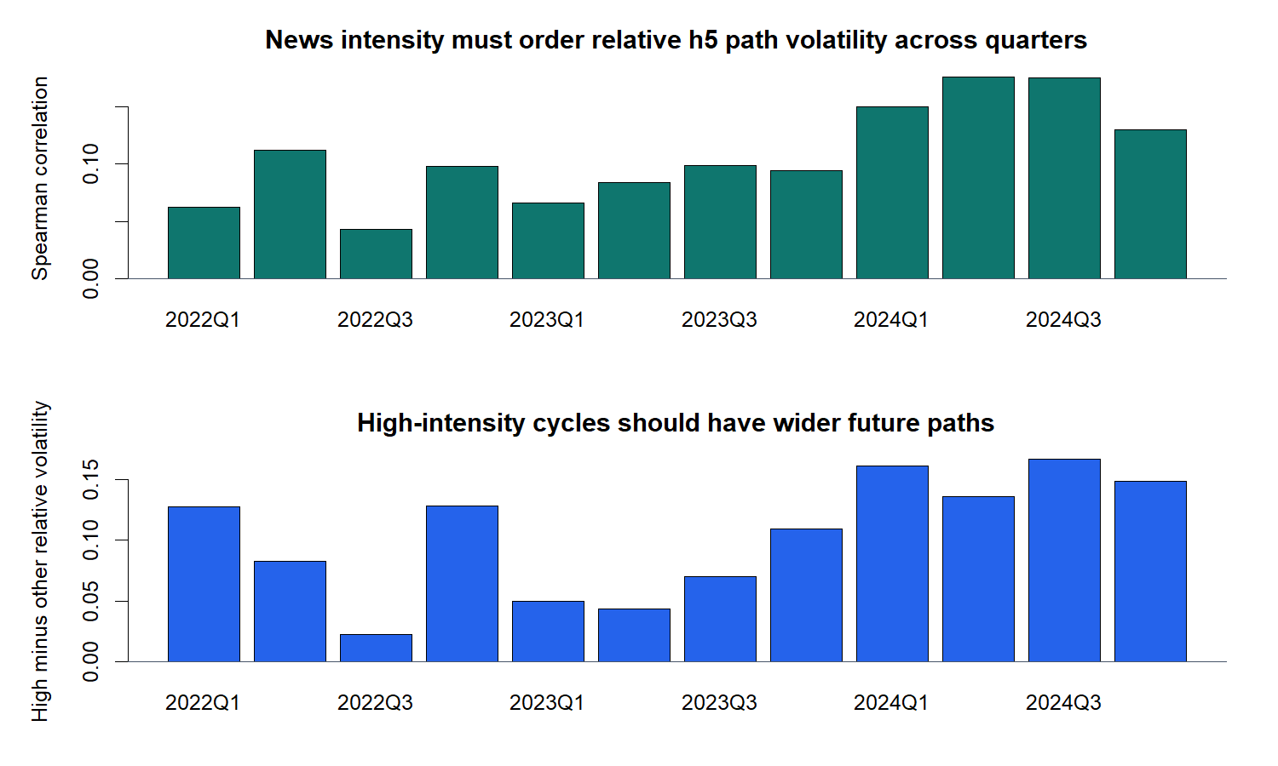
News intensity orders wider future paths in all 12 OOS quarters
D35/03
Notes:
DECISION D35 - ALL THREE FROZEN ASSOCIATION GATES PASS
Evidence
Mean fold Spearman correlation is 0.107321. All 12 OOS quarters have positive rank correlation between issuer-local news intensity and relative future path volatility. All 12 also have positive high-intensity-minus-other separation.
Meaning
The association is modest in rank magnitude but unusually stable across the frozen quarter sequence. Stability, not one pooled headline number, is the core evidence.
Boundary
Five-session outcomes overlap, so daily issuer observations are not independent hypothesis-test trials. No p-value, causal claim, or policy return is asserted.
Report: C:/Users/Franc/OneDrive/Documents/Francis/Peltata Project/Time-Series-Modeling-Gen5/runs/research_workbench/gen54_ml_decision_engine/g54_news_n1b_20260721/n1b_report.md
Conversation: codex://threads/019f741e-615f-7fd0-90f7-edce12b5cb66

Slide 4
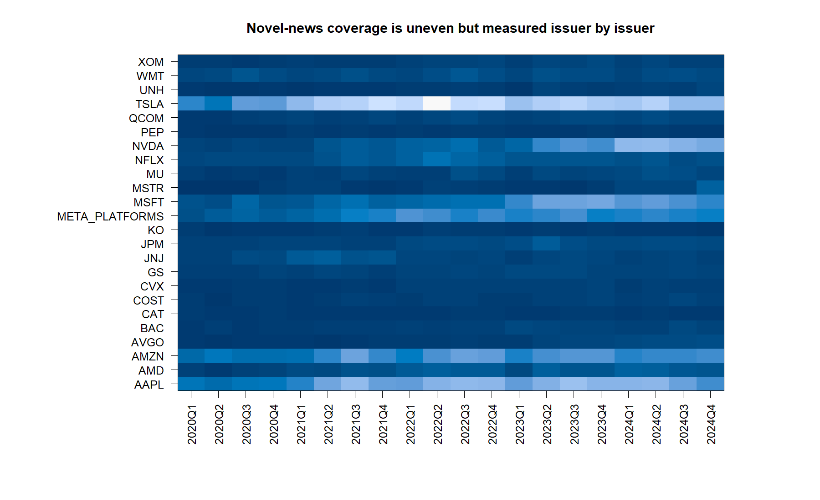
Coverage still varies sharply by issuer and calendar quarter
D35/04
Notes:
DECISION D35 - COVERAGE NON-STATIONARITY REMAINS
Evidence
The FB historical lane adds 4,757 articles before issuer mapping, closing the pre-META ticker-history gap. The final admissible archive supplies 130,763 issuer-news associations after the 24-hour staleness and 72-hour repeat exclusions.
Meaning
Coverage remains strongly issuer- and time-dependent. A pooled article count would still encode vendor attention and company popularity. The N1B pass depends on issuer-local TRAIN normalization, not on treating raw counts as comparable.
Report: C:/Users/Franc/OneDrive/Documents/Francis/Peltata Project/Time-Series-Modeling-Gen5/runs/research_workbench/gen54_ml_decision_engine/g54_news_n1b_20260721/n1b_report.md

Slide 5
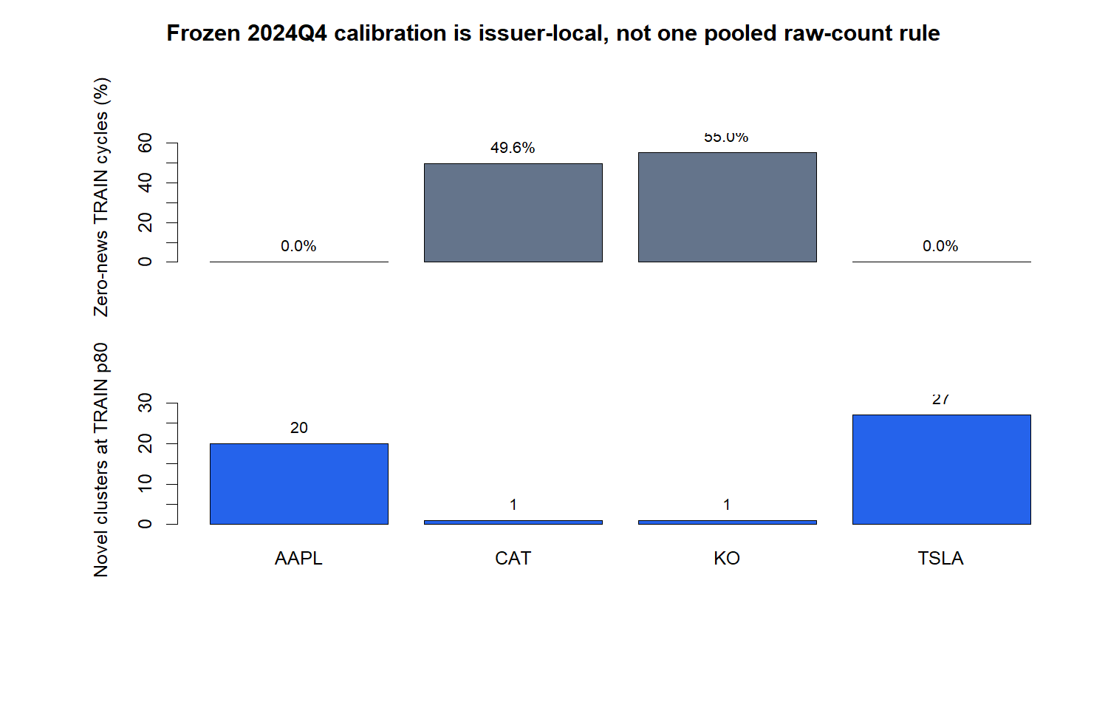
Issuer-local calibration prevents popularity from masquerading as signal
D35/05
Notes:
DECISION D35 - LOCAL CALIBRATION IS ESSENTIAL
Evidence
In the 2024Q4 fold, the p80 raw-count threshold is 20 clusters for AAPL and 27 for TSLA, versus only one for CAT and KO. CAT and KO also have zero-news shares near 50 percent, while AAPL and TSLA have none.
Tie caveat
Counts are discrete. When many TRAIN days share the threshold count, the ECDF rule marks a broader state than a literal top 20 percent. Across OOS quarters, the high-state share ranges from 24.8 percent to 46.8 percent.
Meaning
The frozen gate tested a reproducible high-state definition; it did not prove that 0.80 is an optimal operational cutoff. Threshold search remains closed.
Calibration table: C:/Users/Franc/OneDrive/Documents/Francis/Peltata Project/Time-Series-Modeling-Gen5/runs/research_workbench/gen54_ml_decision_engine/g54_news_n1b_20260721/n1b_train_calibration.csv

Slide 6
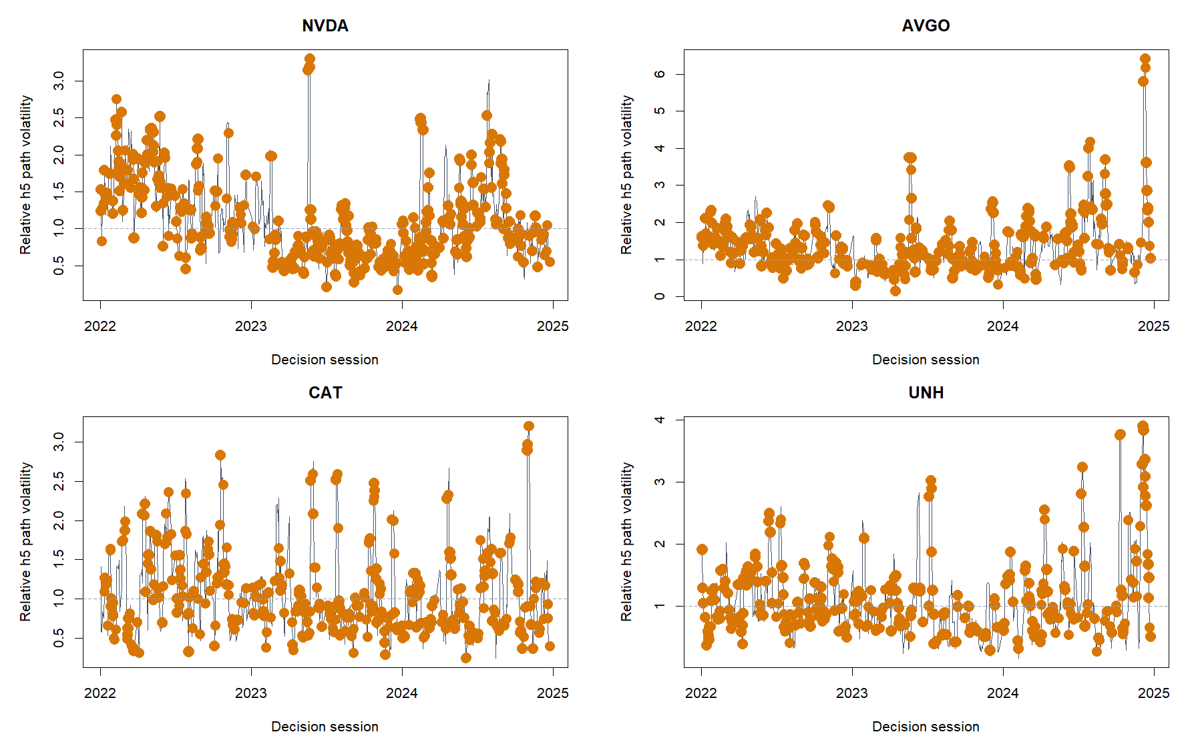
Representative tapes show context—not a deterministic forecast
D35/06
Notes:
DECISION D35 - HUMAN-FACING EVENT TAPE
Reading the chart
The line is each issuer's TRAIN-scaled future five-session path volatility. Orange points mark high-news-intensity decision cycles. A value of one equals the issuer's TRAIN median path volatility for that fold.
Meaning
High-news states frequently coincide with wider paths, but many high states are ordinary and some large volatility bursts occur outside them. This is uncertainty context, not a deterministic event forecast.
Selection
The four panels are the issuers with the most high-intensity OOS observations. They are representative evidence surfaces, not a ranking or investable basket.
Tape: C:/Users/Franc/OneDrive/Documents/Francis/Peltata Project/Time-Series-Modeling-Gen5/runs/research_workbench/gen54_ml_decision_engine/g54_news_n1b_20260721/n1b_representative_event_tape.csv

Slide 7
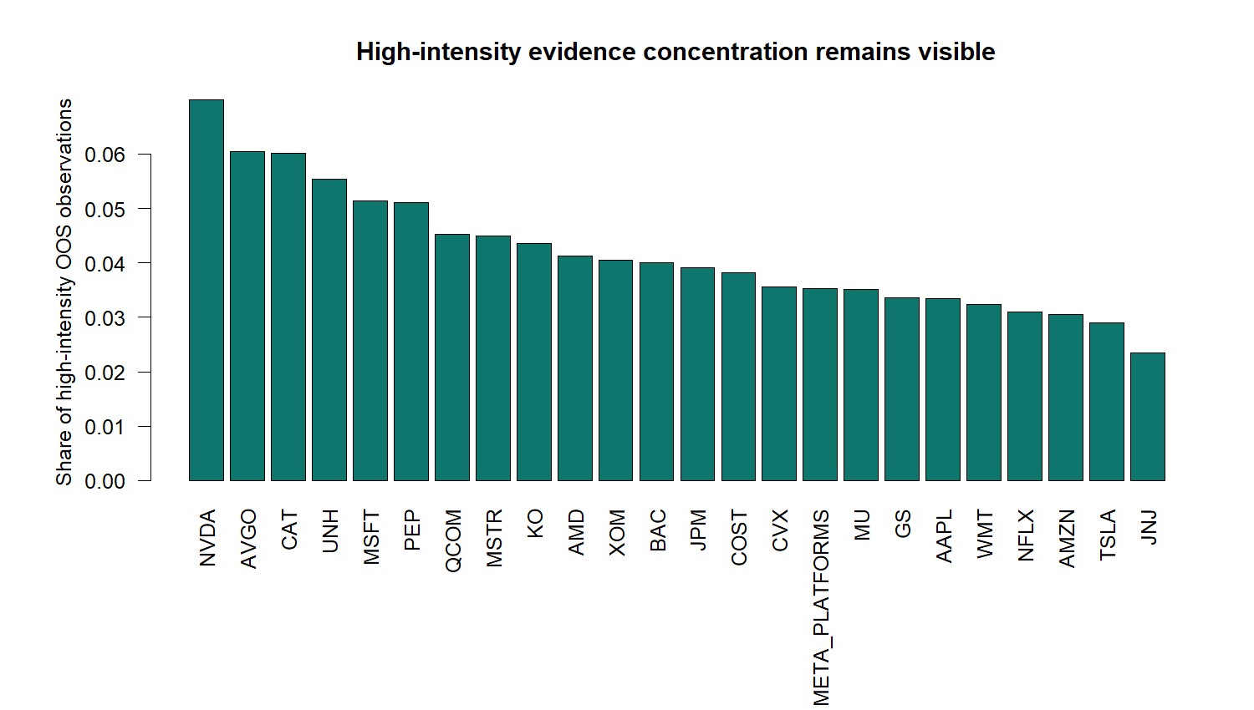
N1B passes the measurement gate; policy design stays closed
OVERALL: PASS TO REPRESENTATION DISCUSSION
PASS 11 / 11 leakage + boundary checks
PASS 12 / 12 positive rank quarters
PASS 12 / 12 positive separation quarters
WATCH p80 ties broaden the high state
WATCH coverage varies by issuer / time
STOP No directional or causal claim
STOP No exposure / allocation / PnL
D35/07
Notes:
DECISION D35 - PASS_N1B_TO_REPRESENTATION_DISCUSSION
Authority
All 24 issuers have complete adjusted bars from 2019-12-20 through 2024-12-31. All 288 issuer-fold TRAIN support checks pass the 400-complete-row and 20-nonzero-cycle minima. All 11 leakage and boundary checks pass. No material cache warning remains after refresh and hot-cache rerun.
Concentration
No single issuer dominates the high-state evidence: NVDA is largest at 6.99 percent, followed by AVGO and CAT near 6 percent. Coverage remains non-uniform, so later representation work must retain issuer identity and local calibration.
Next gate
Discuss whether a minimal representation challenger should add recency, source, or cross-issuer context without opening generic sentiment, embeddings, direction, or policy optimization. Do not convert the p80 measurement boundary directly into an exposure rule.
Conversation: codex://threads/019f741e-615f-7fd0-90f7-edce12b5cb66
Find in chat: Proceed
Decision: D35
Report: C:/Users/Franc/OneDrive/Documents/Francis/Peltata Project/Time-Series-Modeling-Gen5/runs/research_workbench/gen54_ml_decision_engine/g54_news_n1b_20260721/n1b_report.md
Status: PASS_N1B_TO_REPRESENTATION_DISCUSSION.

