Slide 1
LITERATURE-GROUNDED STRATEGY RESEARCH
Dual Momentum
LIT-MOM-03.1
SOURCE
Why established momentum can coexist with our null results—and how to test the published portfolio rule honestly
Recent practitioner study + academic momentum literature
AUTHORITY
Defensible-universe replay
STOP · no edge claim
Study deck · updated 3 September 2026
1
Notes:
This deck records the literature hypothesis, mechanics proof, ETF replay, universe-transport POCs, and the 481-stock ex-ante cohort replay. The latest replay passes its frozen admission gates but does not preserve a material ranking advantage; the exact stock implementation stops.
[Sources]
- https://www.youtube.com/watch?v=c1HDiohiqLU
- C:/Users/Franc/OneDrive/Documents/Francis/Peltata Project/Time-Series-Modeling-Gen5/literature_studies/docs/GEN5_LIT_MOM_03_4_DEFENSIBLE_UNIVERSE_RESULTS.md
- C:/Users/Franc/OneDrive/Documents/Francis/Peltata Project/Time-Series-Modeling-Gen5/runs/research_workbench/literature_grounded/lit_mom_03_4_defensible_universe_20260903/mom034_report.md
- Codex task conversation, 2026-09-03 (defensible-universe approval, result interpretation, and conventional-core huddle)
[/Sources]

Slide 2
LIT-MOM-03.1
The contradiction is only apparent
ESTABLISHED EVIDENCE
OUR EVIDENCE
Momentum appears repeatedly in diversified, carefully constructed portfolios over long samples.
Most of our intuitive daily, intraday, and single-asset variants failed promotion.
A weak average tendency can be real.
That does not test the same proposition.
The unit of analysis, horizon, portfolio construction, and baseline all changed.
2
Notes:
The slide separates a broad literature claim from the narrower Gen5 variants already tested.
[Sources]
- https://doi.org/10.1111/j.1540-6261.1993.tb04702.x
- https://www.aqr.com/Insights/Research/Journal-Article/Time-Series-Momentum
- C:/Users/Franc/OneDrive/Documents/Francis/Peltata Project/Time-Series-Modeling-Gen5/literature_studies/docs/GEN5_LIT_MOM_01_1_INTERDAY_MOMENTUM_RESULTS.md
- C:/Users/Franc/OneDrive/Documents/Francis/Peltata Project/Time-Series-Modeling-Gen5/literature_studies/docs/GEN5_LIT_MOM_01_4_MULTI_MARKET_PREDICTOR_ATLAS_RESULTS.md
- Codex task conversation, 2026-09-02 (operator/assistant momentum interpretation huddle)
[/Sources]

Slide 3
LIT-MOM-03.1
Momentum is a tailwind across a fleet—not a command over one leaf
ONE LEAF
A FLEET
TSLA
next day
noise dominates
A slight repeated bias becomes measurable only after many assets and periods are combined.
A portfolio-level tendency can coexist with an almost featureless single-asset scatterplot.
3
Notes:
Fleet versus leaf is an operator-facing intuition developed in the 2026-09-02 huddle. The academic sources establish portfolio-level cross-sectional and time-series momentum evidence; the metaphor is original to this discussion.
[Sources]
- Codex task conversation, 2026-09-02 (operator/assistant momentum interpretation huddle)
- https://doi.org/10.1111/j.1540-6261.1993.tb04702.x
- https://www.aqr.com/Insights/Research/Journal-Article/Time-Series-Momentum
[/Sources]

Slide 4
LIT-MOM-03.1
Three similar-sounding questions test different objects
CROSS-SECTIONAL MOMENTUM
E[future winners − future losers] > 0
Rank many assets; harvest a relative spread.
TIME-SERIES MOMENTUM
E[sign(own past return) × own future return] > 0
Use one asset's past direction; diversify the bets.
TRADABLE POLICY
Net strategy value-add > an attainable baseline
Add timing, cash, costs, exposure, and an honest comparator.
4
Notes:
The formulas are compact operator-facing statements of three distinct estimands. They are not asserted to be interchangeable.
[Sources]
- https://doi.org/10.1111/j.1540-6261.1993.tb04702.x
- https://www.aqr.com/Insights/Research/Journal-Article/Time-Series-Momentum
- C:/Users/Franc/OneDrive/Documents/Francis/Peltata Project/Time-Series-Modeling-Gen5/AGENTS.md
- Codex task conversation, 2026-09-02 (operator/assistant momentum interpretation huddle)
[/Sources]

Slide 5
LIT-MOM-03.1
Our tests often asked the hardest version of the question
01
Single-asset noise
02
Fast clocks
A small average effect disappears inside one volatile return path.
Daily and 30-minute outcomes can be dominated by reversal and microstructure noise.
03
Long-only constraint
04
High evidence bar
The academic loser leg is unavailable; cash must compete with ownership.
Causal timing, controls, costs, and temporal transport remove fragile wins.
5
Notes:
These are explanations for why the stopped Gen5 implementations do not falsify the broader momentum literature. They do not rescue any stopped rule.
[Sources]
- C:/Users/Franc/OneDrive/Documents/Francis/Peltata Project/Time-Series-Modeling-Gen5/literature_studies/docs/GEN5_LIT_MOM_01_1_INTERDAY_MOMENTUM_RESULTS.md
- C:/Users/Franc/OneDrive/Documents/Francis/Peltata Project/Time-Series-Modeling-Gen5/literature_studies/docs/GEN5_LIT_MOM_01_4_MULTI_MARKET_PREDICTOR_ATLAS_RESULTS.md
- C:/Users/Franc/OneDrive/Documents/Francis/Peltata Project/Time-Series-Modeling-Gen5/literature_studies/docs/GEN5_LIT_MOM_01_2_AUDIT_01_EXPOSURE_SELECTION_RESULTS.md
- https://www.nber.org/papers/w20439
- Codex task conversation, 2026-09-02 (operator/assistant momentum interpretation huddle)
[/Sources]

Slide 6
LIT-MOM-03.1
Long-only timing must beat ownership—not merely cash
An upward-drifting asset gives buy-and-hold a structural head start.
A timing rule can avoid some losses and still lose the comparison by missing rebounds or sitting out drift.
Cash / no trade
Did we earn anything at all?
Drift baseline
Did the predictor add information beyond the average return?
Matched exposure
Was timing better than being invested for the same amount of time?
SPY or buy-and-hold
Did the long-only rule improve on attainable ownership?
6
Notes:
The baseline ladder reflects Gen5's prior long-only attribution work and its no-trade-first research contract.
[Sources]
- C:/Users/Franc/OneDrive/Documents/Francis/Peltata Project/Time-Series-Modeling-Gen5/literature_studies/docs/GEN5_LIT_MOM_01_2_AUDIT_01_EXPOSURE_SELECTION_RESULTS.md
- C:/Users/Franc/OneDrive/Documents/Francis/Peltata Project/Time-Series-Modeling-Gen5/AGENTS.md
- Codex task conversation, 2026-09-02 (operator/assistant momentum interpretation huddle)
[/Sources]

Slide 7
LIT-MOM-03.1
Academic support does not imply a loud or painless signal
Weak average bias
Uncomfortable risk
Real-world friction
A small edge becomes visible through breadth, repeated observations, and disciplined aggregation.
Momentum can suffer violent reversals; bearing that risk may help the premium persist.
Costs, mandates, turnover, and tracking error limit how completely institutions arbitrage it.
Public knowledge can compress an effect without making every implementation worthless—or tradable.
7
Notes:
The persistence mechanisms are plausible interpretations, not proof that the specific Quantpedia implementation will survive Gen5 replication.
[Sources]
- https://www.aqr.com/Insights/Research/Journal-Article/Time-Series-Momentum
- https://www.nber.org/papers/w20439
- https://doi.org/10.2139/ssrn.2042750
[/Sources]

Slide 8
LIT-MOM-03.1
Dual momentum changes the unit of analysis
1 · Relative rank
2 · Absolute veto
3 · Portfolio
Which assets are strongest compared with the rest of the investable fleet?
Is each apparent winner actually rising? If not, its sleeve remains cash.
Combine accepted winners across short and long horizons; rebalance weekly.
Relative momentum finds the winners. Absolute momentum refuses to own a winner that is still losing money.
8
Notes:
In dual momentum, 'dual' means relative plus absolute momentum. The published 10- and 25-week sleeves are an additional horizon ensemble.
[Sources]
- https://doi.org/10.2139/ssrn.2042750
- https://quantpedia.com/active-dual-momentum-gtaa-strategy/
- https://quantpedia.com/dual-vs-single-momentum-in-commodities-enhancing-risk-adjusted-returns-through-absolute-trend-filtering/
[/Sources]

Slide 9
LIT-MOM-03.1
The published rule is simple enough to reproduce exactly
UNIVERSE
SHY · IEF · UUP · GLD · USO · SPY · EFA · QQQ · EEM
SIGNAL CLOCK
TWO SLEEVES
SELECTION
ALLOCATION
Wednesday close
Weekly rebalance
10-week ROC
25-week ROC
Top 3 per sleeve
Positive ROC only
50% per sleeve
Failed slots = cash
An ETF selected by both sleeves can receive one-third of the portfolio; one-sleeve selections receive one-sixth.
9
Notes:
The visible rule reproduces the May 2026 Quantpedia GTAA article referenced by the July 2026 video. It records the publisher's mechanics, not Gen5 evidence.
[Sources]
- https://quantpedia.com/active-dual-momentum-gtaa-strategy/
- https://www.youtube.com/watch?v=c1HDiohiqLU
[/Sources]

Slide 10
LIT-MOM-03.1
Recent publication is useful—not independent confirmation
Feb 2007
Mar 25 2026
May 22 2026
Jul 12 2026
Sep 2 2026
History begins
Publisher cutoff
Study published
Video published
Gen5 freeze
The final 10/25-week, top-three specification was chosen after inspecting multiple horizons and breadths on the same historical sample.
10
Notes:
Inference: because the article evaluates numerous lookbacks and selection breadths before choosing the final specification, its 2008-2026 results are discovery/replication evidence rather than untouched confirmation. Clean temporal evidence begins after the source cutoff and publication.
[Sources]
- https://quantpedia.com/active-dual-momentum-gtaa-strategy/
- https://www.youtube.com/watch?v=c1HDiohiqLU
[/Sources]

Slide 11
LIT-MOM-03.1
The first POC will expose mechanics before performance
OPEN
CLOSED
Reconstruct weekly Wednesday signals
No new horizon or universe search
Rank the frozen nine-ETF universe
No leverage or volatility targeting
Apply the positive-momentum veto
No Sharpe or drawdown gate yet
Show allocation and cash tapes
No strategy or edge promotion
Translate to next-open execution
No post-hoc rescue from the tape
11
Notes:
This is the proposed first technical slice. It is narrower than a backtest: the output is an auditable signal/allocation tape and operator-facing visual sanity check.
[Sources]
- https://quantpedia.com/active-dual-momentum-gtaa-strategy/
- C:/Users/Franc/OneDrive/Documents/Francis/Peltata Project/Time-Series-Modeling-Gen5/AGENTS.md
- Codex task conversation, 2026-09-02 (operator/assistant momentum interpretation huddle)
[/Sources]

Slide 12
LIT-MOM-03.1
Four controls reveal where any value actually comes from
1
Equal-weight all nine
2
Relative-only
Does active selection improve on diversified ownership?
Does ranking help without the absolute veto?
3
Absolute-only
4
Cash / no trade
Does trend permission help without cross-sectional ranking?
Does the complete policy earn anything at all?
12
Notes:
The equal-weight benchmark is publisher-aligned. The relative-only, absolute-only, and cash controls are Gen5 attribution devices and are not claimed as part of the published final strategy.
[Sources]
- https://quantpedia.com/active-dual-momentum-gtaa-strategy/
- https://quantpedia.com/dual-vs-single-momentum-in-commodities-enhancing-risk-adjusted-returns-through-absolute-trend-filtering/
- C:/Users/Franc/OneDrive/Documents/Francis/Peltata Project/Time-Series-Modeling-Gen5/AGENTS.md
- Codex task conversation, 2026-09-02 (operator/assistant momentum interpretation huddle)
[/Sources]

Slide 13
LIT-MOM-03.1
Evidence must cross four bridges before this becomes a strategy
1 · Mechanics
2 · Causal replay
3 · Robustness
4 · Forward use
→
→
→
Exact ranks, vetoes, weights, holidays, and allocation tape.
Next-open fills, controls, modest costs, turnover, and drawdown.
Subperiods, asset attribution, parameter plateau, and concentration.
Post-publication ledger, frozen decision pack, weekly advice only.
Historical reproduction can open the next bridge. It cannot skip one.
13
Notes:
The progression preserves Gen5's research-to-execution separation. Performance analysis, strategy promotion, leverage, and live behavior require later operator gates.
[Sources]
- C:/Users/Franc/OneDrive/Documents/Francis/Peltata Project/Time-Series-Modeling-Gen5/AGENTS.md
- https://quantpedia.com/active-dual-momentum-gtaa-strategy/
- Codex task conversation, 2026-09-02 (operator/assistant momentum interpretation huddle)
[/Sources]

Slide 14
LIT-MOM-03.1
Current decision: reproduce the fleet before judging the edge
LIT-MOM-03.1
NEXT VISIBLE SLICE
Literature-sourced hypothesis
Frozen weekly signal + allocation tape
The video contributes a recent, explicit implementation. The academic literature supplies the broader mechanism. Neither supplies Gen5 confirmation.
Nine ETFs · 10/25 weeks · top three · positive only · next-open translation
No edge, performance, or strategy claim is open in this deck yet.
14
Notes:
This closing slide freezes the study classification and next slice. Future evidence slides should be appended after the mechanics packet is generated and inspected.
[Sources]
- https://www.youtube.com/watch?v=c1HDiohiqLU
- https://quantpedia.com/active-dual-momentum-gtaa-strategy/
- https://doi.org/10.1111/j.1540-6261.1993.tb04702.x
- https://www.aqr.com/Insights/Research/Journal-Article/Time-Series-Momentum
- C:/Users/Franc/OneDrive/Documents/Francis/Peltata Project/Time-Series-Modeling-Gen5/literature_studies/docs/GEN5_LITERATURE_GROUNDED_STRATEGY_RESEARCH_NOMENCLATURE.md
- Codex task conversation, 2026-09-02 (operator/assistant momentum interpretation huddle)
[/Sources]

Slide 15
LIT-MOM-03.1
The rule is reproducible—but the published history is not yet
PASS · LOCAL MECHANICS
STOP · SOURCE-SPAN COVERAGE
508
2008–2015
weekly decisions
remains unreproduced
2016-06-29 → 2026-03-18
All 11 mechanics checks pass
No outcome metrics computed
The Alpaca account returned complete common history only from 2016. The window was narrowed explicitly—not silently.
This slide proves implementation, not profitability.
15
Notes:
The source-described ranking and allocation rule was reproduced on the clean locally admitted window. The attempted refresh did not supply pre-2016 coverage, so the published 2008-2026 span remains an explicit STOP.
[Sources]
- C:/Users/Franc/OneDrive/Documents/Francis/Peltata Project/Time-Series-Modeling-Gen5/runs/research_workbench/literature_grounded/lit_mom_03_1_dual_momentum_mechanics_20260902/mom031_report.md
- C:/Users/Franc/OneDrive/Documents/Francis/Peltata Project/Time-Series-Modeling-Gen5/literature_studies/R/gen5_lit_mom_03_1_dual_momentum_mechanics.R
- C:/Users/Franc/OneDrive/Documents/Francis/Peltata Project/Time-Series-Modeling-Gen5/literature_studies/scripts/run_gen5_lit_mom_03_1_dual_momentum_mechanics.R
- https://quantpedia.com/active-dual-momentum-gtaa-strategy/
- Codex task conversation, 2026-09-02 (operator approval and mechanics readout)
[/Sources]

Slide 16
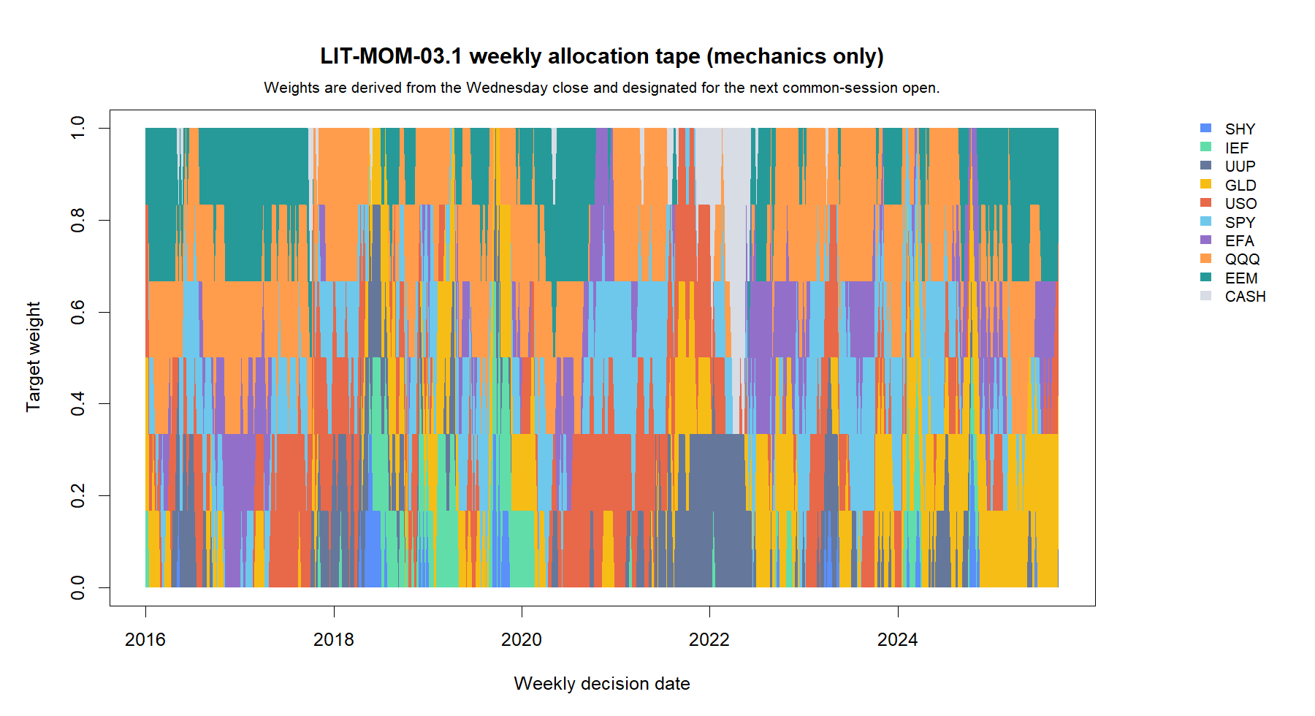
LIT-MOM-03.1
The absolute-momentum veto is an occasional brake—not the normal state
MECHANICS READOUT
463 / 508
weeks fully invested
2.6%
average cash weight
0% → 66.7%
16
Notes:
The chart displays target allocations only. It is not an equity curve and contains no return outcome. Cash appears when one or more top-ranked assets have non-positive momentum in their sleeve.
[Sources]
- C:/Users/Franc/OneDrive/Documents/Francis/Peltata Project/Time-Series-Modeling-Gen5/runs/research_workbench/literature_grounded/lit_mom_03_1_dual_momentum_mechanics_20260902/mom031_report.md
- C:/Users/Franc/OneDrive/Documents/Francis/Peltata Project/Time-Series-Modeling-Gen5/runs/research_workbench/literature_grounded/lit_mom_03_1_dual_momentum_mechanics_20260902/mom031_mechanics_summary.csv
- C:/Users/Franc/OneDrive/Documents/Francis/Peltata Project/Time-Series-Modeling-Gen5/runs/research_workbench/literature_grounded/lit_mom_03_1_dual_momentum_mechanics_20260902/visuals/mom031_allocation_timeline.png
- Codex task conversation, 2026-09-02 (operator approval and mechanics readout)
[/Sources]

Slide 17
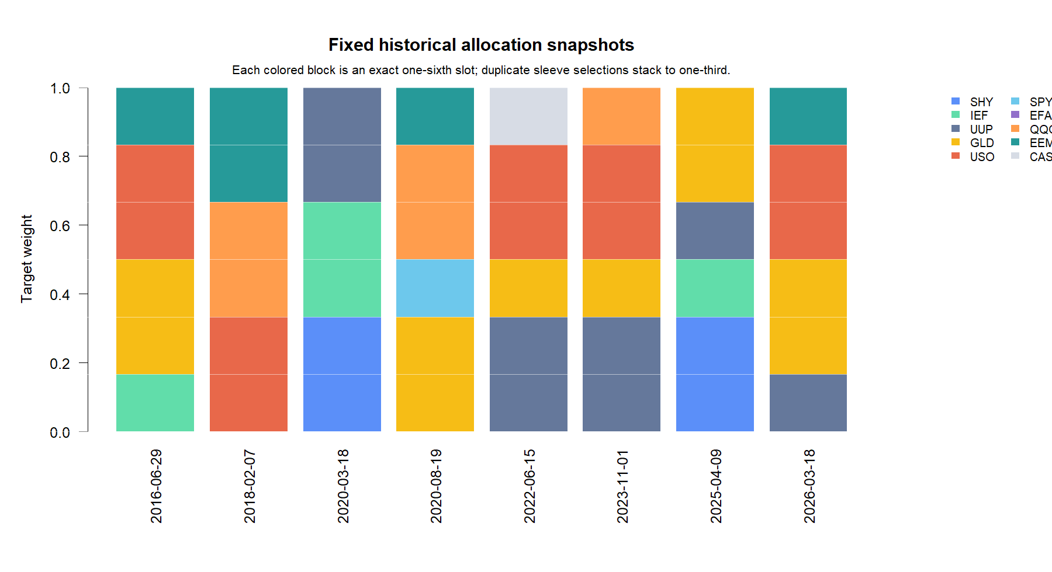
LIT-MOM-03.1
The two horizons usually concentrate on the same winners
SLEEVE OVERLAP
488 / 508
weeks shared ≥1 ETF
Latest decision · 2026-03-18
10w UUP · GLD · USO
25w GLD · USO · EEM
Cash 0%
Shared selections stack: one ETF can receive two one-sixth slots = one-third.
17
Notes:
Representative dates were frozen before rendering the slide. The overlap count is descriptive of allocation mechanics and does not establish that overlap helped returns.
[Sources]
- C:/Users/Franc/OneDrive/Documents/Francis/Peltata Project/Time-Series-Modeling-Gen5/runs/research_workbench/literature_grounded/lit_mom_03_1_dual_momentum_mechanics_20260902/mom031_report.md
- C:/Users/Franc/OneDrive/Documents/Francis/Peltata Project/Time-Series-Modeling-Gen5/runs/research_workbench/literature_grounded/lit_mom_03_1_dual_momentum_mechanics_20260902/mom031_representative_allocations.csv
- C:/Users/Franc/OneDrive/Documents/Francis/Peltata Project/Time-Series-Modeling-Gen5/runs/research_workbench/literature_grounded/lit_mom_03_1_dual_momentum_mechanics_20260902/mom031_weekly_allocation_tape.csv
- Codex task conversation, 2026-09-02 (operator approval and mechanics readout)
[/Sources]

Slide 18
LIT-MOM-03.1
Mechanics are now inspectable; value-add remains the next question
Established
Exact ranks, vetoes, one-sixth slots, duplicate-sleeve stacking, holiday fallback, and next-open designation.
Not established
No returns, costs, turnover drag, drawdown, baseline comparison, parameter robustness, or edge claim.
Coverage STOP
The publisher's 2008–2015 segment is unavailable under the current Alpaca account and provider contract.
Next proposed gate: causal 2016–2026 replay against cash, equal-weight, relative-only, absolute-only, and attainable long-only ownership.
18
Notes:
This slide closes the mechanics-only slice. The next performance gate requires explicit operator authorization under the Gen5 research contract.
[Sources]
- C:/Users/Franc/OneDrive/Documents/Francis/Peltata Project/Time-Series-Modeling-Gen5/runs/research_workbench/literature_grounded/lit_mom_03_1_dual_momentum_mechanics_20260902/mom031_report.md
- C:/Users/Franc/OneDrive/Documents/Francis/Peltata Project/Time-Series-Modeling-Gen5/literature_studies/R/gen5_lit_mom_03_1_dual_momentum_mechanics.R
- C:/Users/Franc/OneDrive/Documents/Francis/Peltata Project/Time-Series-Modeling-Gen5/literature_studies/scripts/run_gen5_lit_mom_03_1_dual_momentum_mechanics.R
- https://quantpedia.com/active-dual-momentum-gtaa-strategy/
- Codex task conversation, 2026-09-02 (operator approval and mechanics readout)
[/Sources]

Slide 19
LIT-MOM-03.1
The replay looks attractive—but the dual layer adds almost nothing
REPLAY · SOURCE RULE
ATTRIBUTION · DUAL LAYER
3.05x
≈ 0
ending wealth
incremental value
12.17% net CAGR
-15.45% max drawdown
507 causal intervals
12.17% vs 12.18% CAGR
Same -15.45% max drawdown
97.44% average exposure
The attractive shape came from relative selection—not the absolute veto.
19
Notes:
This begins the authorized economic replay. The left panel describes the complete source rule. The right panel gives the key component-attribution result: the source and relative-only paths were essentially the same.
[Sources]
- C:/Users/Franc/OneDrive/Documents/Francis/Peltata Project/Time-Series-Modeling-Gen5/runs/research_workbench/literature_grounded/lit_mom_03_1_dual_momentum_replay_20260902/mom031r_report.md
- C:/Users/Franc/OneDrive/Documents/Francis/Peltata Project/Time-Series-Modeling-Gen5/runs/research_workbench/literature_grounded/lit_mom_03_1_dual_momentum_replay_20260902/mom031r_portfolio_metrics.csv
- C:/Users/Franc/OneDrive/Documents/Francis/Peltata Project/Time-Series-Modeling-Gen5/runs/research_workbench/literature_grounded/lit_mom_03_1_dual_momentum_replay_20260902/mom031r_source_control_comparisons.csv
- C:/Users/Franc/OneDrive/Documents/Francis/Peltata Project/Time-Series-Modeling-Gen5/literature_studies/R/gen5_lit_mom_03_1_dual_momentum_replay.R
- C:/Users/Franc/OneDrive/Documents/Francis/Peltata Project/Time-Series-Modeling-Gen5/literature_studies/scripts/run_gen5_lit_mom_03_1_dual_momentum_replay.R
- Codex task conversation, 2026-09-02 (operator approval and replay interpretation)
[/Sources]

Slide 20
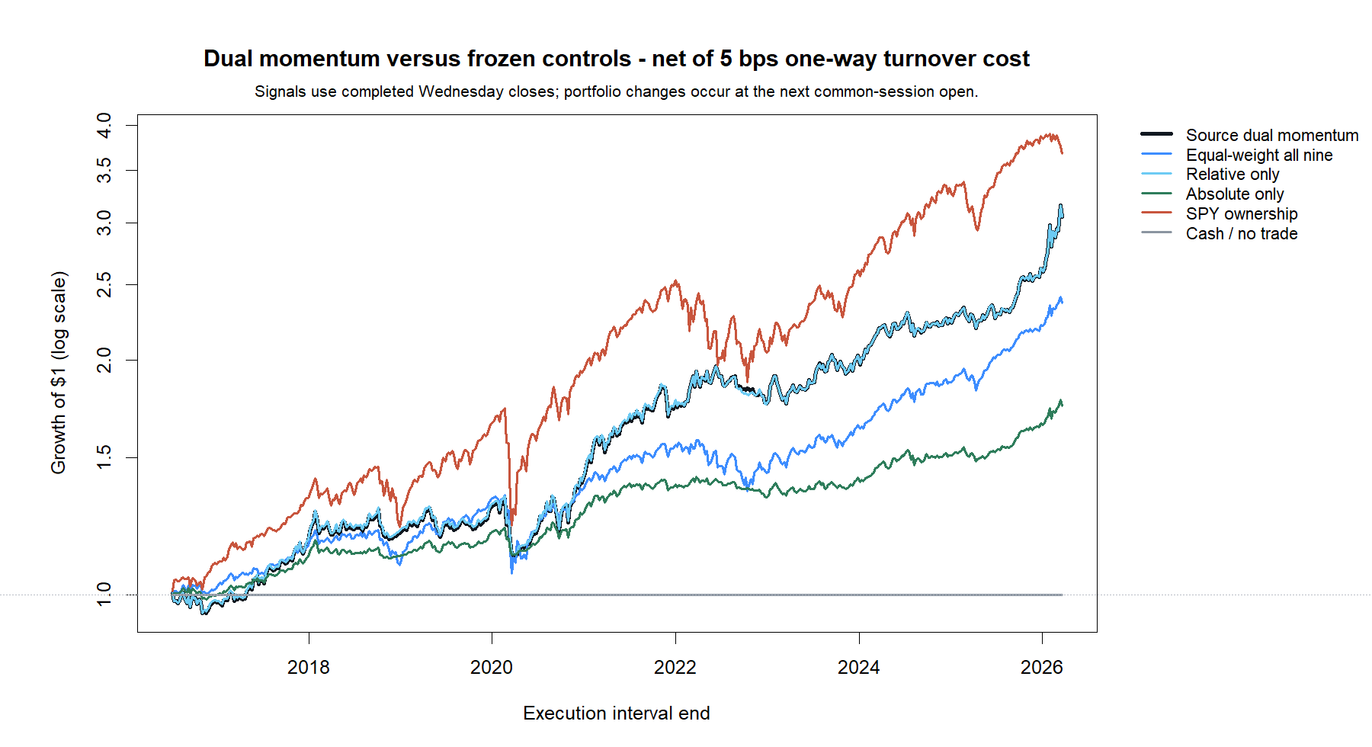
LIT-MOM-03.1
SPY earned more; dual momentum surrendered less in drawdowns
SOURCE RULE
12.17%
net CAGR
-15.45%
maximum drawdown
3.05× ending wealth
20
Notes:
All paths use completed Wednesday-close signals and next-common-open execution. The log-scale chart shows that SPY finished higher, while the source and relative-only lines overlap and experience shallower drawdowns than SPY.
[Sources]
- C:/Users/Franc/OneDrive/Documents/Francis/Peltata Project/Time-Series-Modeling-Gen5/runs/research_workbench/literature_grounded/lit_mom_03_1_dual_momentum_replay_20260902/mom031r_report.md
- C:/Users/Franc/OneDrive/Documents/Francis/Peltata Project/Time-Series-Modeling-Gen5/runs/research_workbench/literature_grounded/lit_mom_03_1_dual_momentum_replay_20260902/mom031r_portfolio_metrics.csv
- C:/Users/Franc/OneDrive/Documents/Francis/Peltata Project/Time-Series-Modeling-Gen5/runs/research_workbench/literature_grounded/lit_mom_03_1_dual_momentum_replay_20260902/visuals/mom031r_growth_of_one.png
- C:/Users/Franc/OneDrive/Documents/Francis/Peltata Project/Time-Series-Modeling-Gen5/literature_studies/R/gen5_lit_mom_03_1_dual_momentum_replay.R
- Codex task conversation, 2026-09-02 (operator approval and replay interpretation)
[/Sources]

Slide 21
LIT-MOM-03.1
The controls identify relative selection as the active ingredient
Relative-only
Source and relative-only were virtually identical: 12.17% vs 12.18% CAGR and the same -15.45% drawdown.
SPY ownership
SPY compounded faster at 14.36% CAGR, but suffered a much deeper -29.16% maximum drawdown.
Equal-weight
Source led by 2.90 CAGR points and cut drawdown by 5.33 points; the weekly-difference interval still crossed zero.
The clearest win is risk shaping—not demonstrated ownership outperformance.
21
Notes:
The five-control decomposition prevents the source endpoint from being mistaken for unique dual-momentum value. Source separated from absolute-only and cash after BH, but not from relative-only, equal-weight all nine, or SPY on the frozen weekly-difference test.
[Sources]
- C:/Users/Franc/OneDrive/Documents/Francis/Peltata Project/Time-Series-Modeling-Gen5/runs/research_workbench/literature_grounded/lit_mom_03_1_dual_momentum_replay_20260902/mom031r_report.md
- C:/Users/Franc/OneDrive/Documents/Francis/Peltata Project/Time-Series-Modeling-Gen5/runs/research_workbench/literature_grounded/lit_mom_03_1_dual_momentum_replay_20260902/mom031r_portfolio_metrics.csv
- C:/Users/Franc/OneDrive/Documents/Francis/Peltata Project/Time-Series-Modeling-Gen5/runs/research_workbench/literature_grounded/lit_mom_03_1_dual_momentum_replay_20260902/mom031r_source_control_comparisons.csv
- Codex task conversation, 2026-09-02 (operator approval and replay interpretation)
[/Sources]

Slide 22
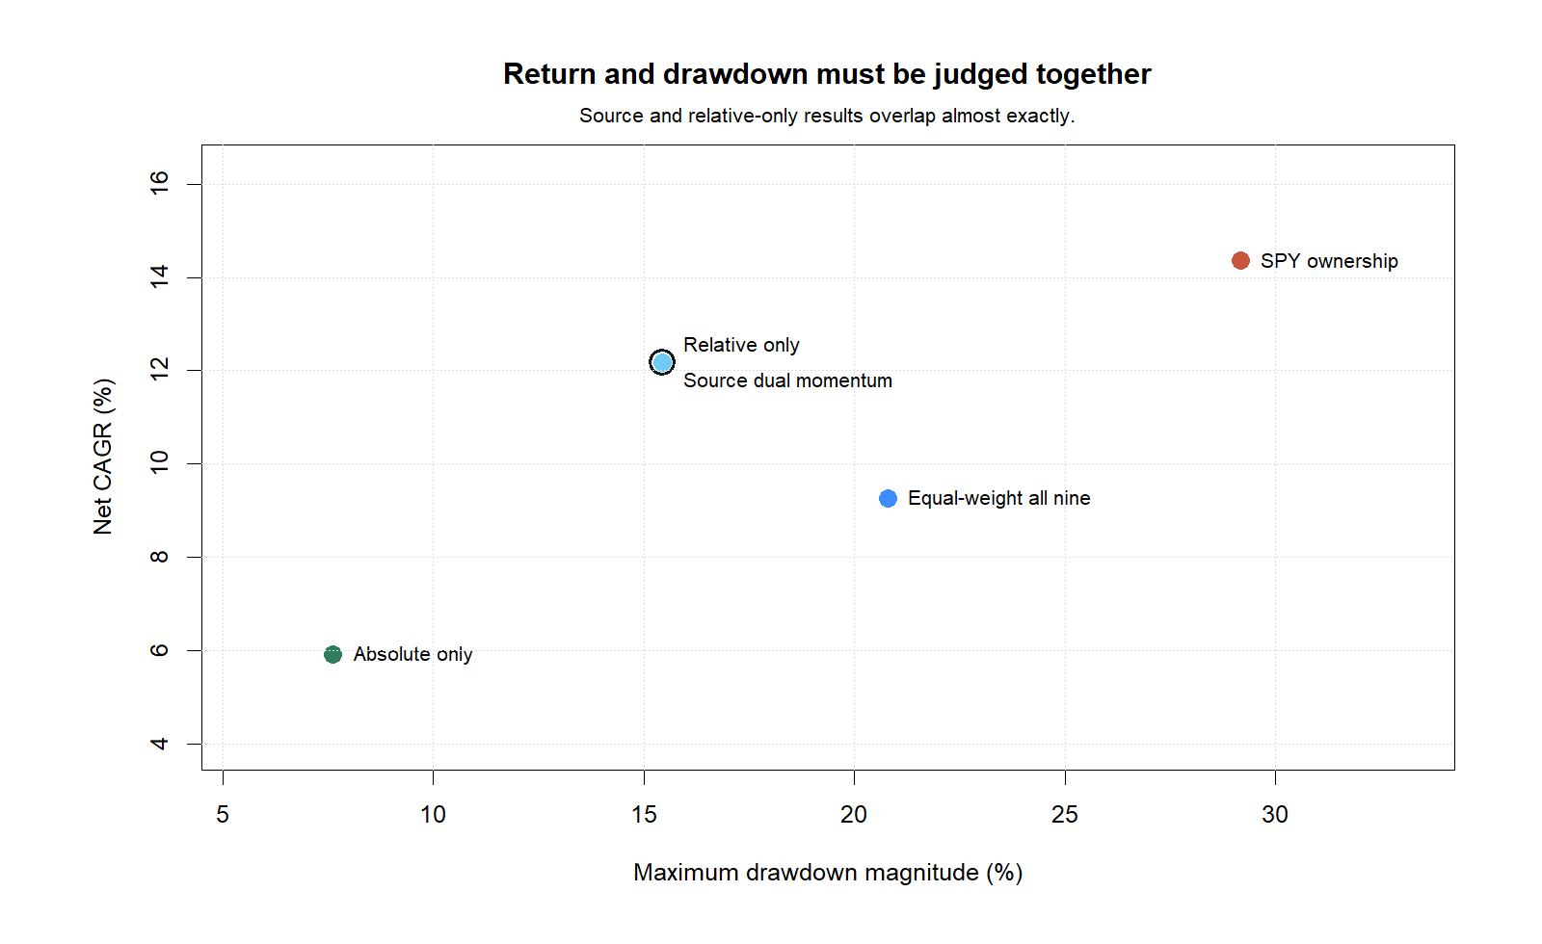
LIT-MOM-03.1
The strategy bought a smoother path—not the highest return
RISK / RETURN
-13.7 pp
max-drawdown gap vs SPY
SPY still led
14.36% CAGR
vs source 12.17%
Whether that tradeoff is valuable depends on the operator’s objective.
22
Notes:
The source occupied an attractive middle ground: similar CAGR to relative-only, higher CAGR than equal-weight, and lower drawdown than both equal-weight and SPY. It did not dominate SPY because SPY had higher CAGR.
[Sources]
- C:/Users/Franc/OneDrive/Documents/Francis/Peltata Project/Time-Series-Modeling-Gen5/runs/research_workbench/literature_grounded/lit_mom_03_1_dual_momentum_replay_20260902/mom031r_report.md
- C:/Users/Franc/OneDrive/Documents/Francis/Peltata Project/Time-Series-Modeling-Gen5/runs/research_workbench/literature_grounded/lit_mom_03_1_dual_momentum_replay_20260902/mom031r_portfolio_metrics.csv
- C:/Users/Franc/OneDrive/Documents/Francis/Peltata Project/Time-Series-Modeling-Gen5/runs/research_workbench/literature_grounded/lit_mom_03_1_dual_momentum_replay_20260902/visuals/mom031r_risk_return.png
- Codex task conversation, 2026-09-02 (operator approval and replay interpretation)
[/Sources]

Slide 23
LIT-MOM-03.1
Performance was broad through time—but still mirrored relative-only
2016–2019
+29.4% source return; relative-only +30.2%. The two paths were already close in the earliest admitted phase.
2020–2022
+36.0% source return; relative-only +35.0%. The absolute veto was most active here, yet changed little.
2023–2026
+73.5% source return; relative-only +73.8%. The near-identity persisted into the latest phase.
Three positive phases strengthen the clue—but do not create untouched confirmation.
23
Notes:
The source result was not confined to one broad phase: each of 2016-2019, 2020-2022, and 2023-2026 was positive. Calendar-year behavior nevertheless reinforces the attribution result because relative-only follows the source almost exactly.
[Sources]
- C:/Users/Franc/OneDrive/Documents/Francis/Peltata Project/Time-Series-Modeling-Gen5/runs/research_workbench/literature_grounded/lit_mom_03_1_dual_momentum_replay_20260902/mom031r_report.md
- C:/Users/Franc/OneDrive/Documents/Francis/Peltata Project/Time-Series-Modeling-Gen5/runs/research_workbench/literature_grounded/lit_mom_03_1_dual_momentum_replay_20260902/mom031r_calendar_years.csv
- C:/Users/Franc/OneDrive/Documents/Francis/Peltata Project/Time-Series-Modeling-Gen5/runs/research_workbench/literature_grounded/lit_mom_03_1_dual_momentum_replay_20260902/mom031r_phases.csv
- Codex task conversation, 2026-09-02 (operator approval and replay interpretation)
[/Sources]

Slide 24
LIT-MOM-03.1
Preserve the clue: this is relative rotation, not confirmed edge
Established
Causal replay, costs, five frozen controls, positive results in all three broad phases, and materially lower drawdown than SPY.
Not established
No incremental absolute-veto value, no stable advantage over equal-weight, no raw-CAGR win over SPY, and no untouched confirmation.
Coverage STOP
The publisher’s 2008–2015 segment is unavailable; this replay overlaps the source’s parameter-selection history.
Next proposed gate: pre-freeze robustness checks for relative rotation—then decide whether an untouched forward test is warranted.
24
Notes:
This closes the authorized retrospective replay. The evidence supports preserving the relative-rotation clue, but the result is neither an independent replication of the publisher's selected rule nor authority for forward use.
[Sources]
- C:/Users/Franc/OneDrive/Documents/Francis/Peltata Project/Time-Series-Modeling-Gen5/runs/research_workbench/literature_grounded/lit_mom_03_1_dual_momentum_replay_20260902/mom031r_report.md
- C:/Users/Franc/OneDrive/Documents/Francis/Peltata Project/Time-Series-Modeling-Gen5/runs/research_workbench/literature_grounded/lit_mom_03_1_dual_momentum_replay_20260902/mom031r_portfolio_metrics.csv
- C:/Users/Franc/OneDrive/Documents/Francis/Peltata Project/Time-Series-Modeling-Gen5/runs/research_workbench/literature_grounded/lit_mom_03_1_dual_momentum_replay_20260902/mom031r_source_control_comparisons.csv
- C:/Users/Franc/OneDrive/Documents/Francis/Peltata Project/Time-Series-Modeling-Gen5/literature_studies/docs/GEN5_LIT_MOM_03_1_DUAL_MOMENTUM_REPLAY_RESULTS.md
- Codex task conversation, 2026-09-02 (operator approval and replay interpretation)
[/Sources]

Slide 25
LIT-MOM-03.2
The same rule does not transport as a return enhancer
FROZEN BREADTH
RETURN TRANSPORT
12
1 / 11
independent fleets
sector wins vs equal weight
1 sector-ETF fleet
11 stock-sector fleets
507 intervals per fleet
Sector ETFs: -3.45 pp
Static-stock evidence only
Universe choice is part of the hypothesis—not a neutral input.
25
Notes:
This section changes only the ranking fleet while freezing the published mechanics. The clean sector-ETF test and the eleven static stock-sector POCs both challenge broad return transport.
[Sources]
- C:/Users/Franc/OneDrive/Documents/Francis/Peltata Project/Time-Series-Modeling-Gen5/runs/research_workbench/literature_grounded/lit_mom_03_2_universe_transport_20260903/mom032_report.md
- C:/Users/Franc/OneDrive/Documents/Francis/Peltata Project/Time-Series-Modeling-Gen5/runs/research_workbench/literature_grounded/lit_mom_03_2_universe_transport_20260903/mom032_transport_summary.csv
- C:/Users/Franc/OneDrive/Documents/Francis/Peltata Project/Time-Series-Modeling-Gen5/runs/research_workbench/literature_grounded/lit_mom_03_2_universe_transport_20260903/mom032_portfolio_metrics.csv
- C:/Users/Franc/OneDrive/Documents/Francis/Peltata Project/Time-Series-Modeling-Gen5/runs/research_workbench/literature_grounded/lit_mom_03_2_universe_transport_20260903/mom032_universe_registry.csv
- C:/Users/Franc/OneDrive/Documents/Francis/Peltata Project/Time-Series-Modeling-Gen5/literature_studies/R/gen5_lit_mom_03_2_universe_transport.R
- C:/Users/Franc/OneDrive/Documents/Francis/Peltata Project/Time-Series-Modeling-Gen5/literature_studies/scripts/run_gen5_lit_mom_03_2_universe_transport.R
- Codex task conversation, 2026-09-03 (operator approval and transport interpretation)
[/Sources]

Slide 26
LIT-MOM-03.2
Only the fleet changes
UNIVERSE
10 sector ETFs + eleven 8-stock sector baskets
FLEETS
SIGNAL
SELECTION
EXECUTION
Frozen before outcomes
Wednesday close
10- & 25-week ROC
Top 3 per sleeve
Positive only
Next open
5 bps one-way
Stock fleets are static survivor-biased POCs; no point-in-time membership claim.
26
Notes:
Every universe uses the same causal 10/25-week, top-three, positive-only signal and the same execution and cost convention. XLC is excluded from the sector-ETF fleet because its inception postdates the requested history.
[Sources]
- C:/Users/Franc/OneDrive/Documents/Francis/Peltata Project/Time-Series-Modeling-Gen5/runs/research_workbench/literature_grounded/lit_mom_03_2_universe_transport_20260903/mom032_report.md
- C:/Users/Franc/OneDrive/Documents/Francis/Peltata Project/Time-Series-Modeling-Gen5/runs/research_workbench/literature_grounded/lit_mom_03_2_universe_transport_20260903/mom032_universe_registry.csv
- C:/Users/Franc/OneDrive/Documents/Francis/Peltata Project/Time-Series-Modeling-Gen5/operator_hypothesis_lab/registries/return_geometry_wide_atlas.csv
- C:/Users/Franc/OneDrive/Documents/Francis/Peltata Project/Time-Series-Modeling-Gen5/literature_studies/R/gen5_lit_mom_03_2_universe_transport.R
- C:/Users/Franc/OneDrive/Documents/Francis/Peltata Project/Time-Series-Modeling-Gen5/literature_studies/scripts/run_gen5_lit_mom_03_2_universe_transport.R
- Codex task conversation, 2026-09-03 (operator approval and transport interpretation)
[/Sources]

Slide 27
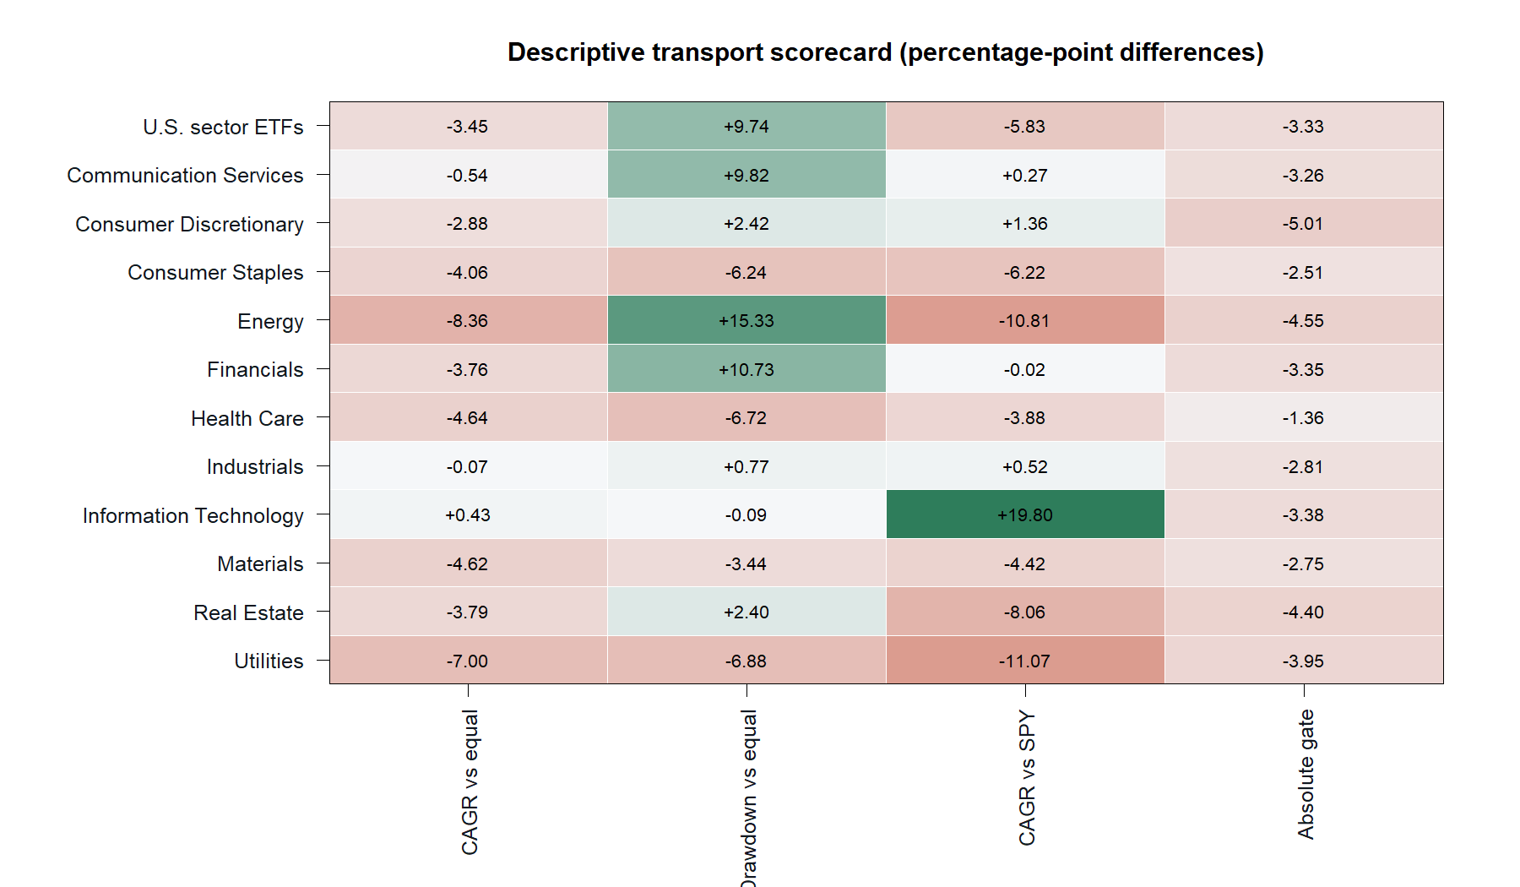
LIT-MOM-03.2
Return transport fails; drawdown protection often survives
TRANSPORT READOUT
1 / 11
stock sectors beat equal weight
-3.45 pp
sector-ETF CAGR gap
6 / 11 shallower drawdown
27
Notes:
The heatmap separates return enhancement from risk shaping. Technology is the only stock fleet with higher source CAGR than equal weight, and its advantage is only 0.43 percentage points. Source drawdown is shallower than equal weight in six of eleven stock sectors.
[Sources]
- C:/Users/Franc/OneDrive/Documents/Francis/Peltata Project/Time-Series-Modeling-Gen5/runs/research_workbench/literature_grounded/lit_mom_03_2_universe_transport_20260903/mom032_report.md
- C:/Users/Franc/OneDrive/Documents/Francis/Peltata Project/Time-Series-Modeling-Gen5/runs/research_workbench/literature_grounded/lit_mom_03_2_universe_transport_20260903/mom032_transport_summary.csv
- C:/Users/Franc/OneDrive/Documents/Francis/Peltata Project/Time-Series-Modeling-Gen5/runs/research_workbench/literature_grounded/lit_mom_03_2_universe_transport_20260903/mom032_portfolio_metrics.csv
- C:/Users/Franc/OneDrive/Documents/Francis/Peltata Project/Time-Series-Modeling-Gen5/runs/research_workbench/literature_grounded/lit_mom_03_2_universe_transport_20260903/visuals/mom032_transport_scorecard.png
- Codex task conversation, 2026-09-03 (operator approval and transport interpretation)
[/Sources]

Slide 28
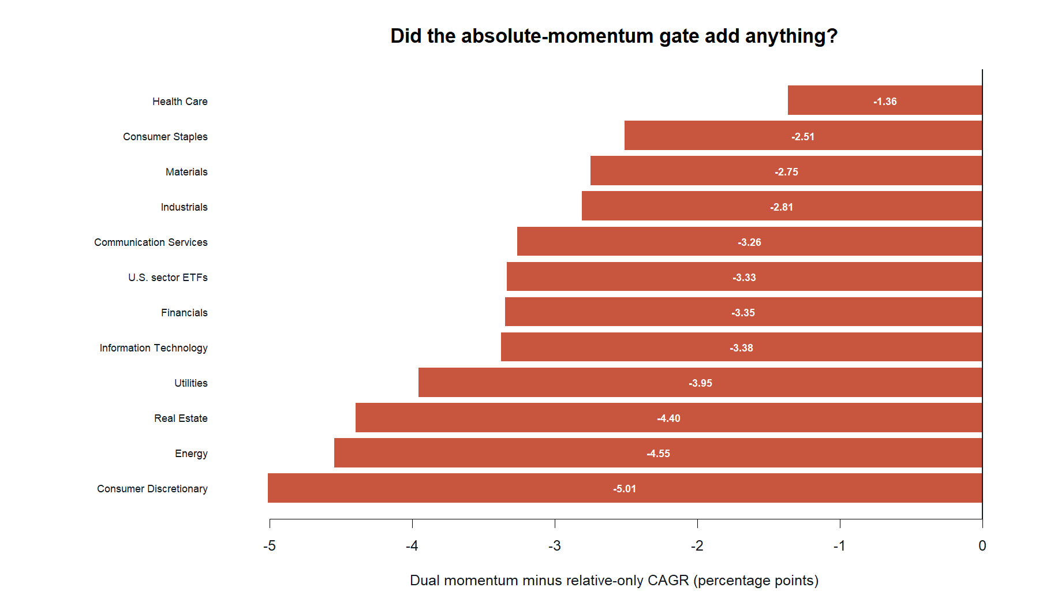
LIT-MOM-03.2
The absolute gate buys defense with return
ABSOLUTE GATE
12 / 12
lower CAGR than relative-only
9 / 12
shallower drawdown
Cash protection is economically active here—but it is not free.
28
Notes:
Unlike the nine-ETF replay, the absolute gate is active across these fleets. It lowers CAGR in every fleet while improving maximum drawdown in nine of twelve, revealing a repeated defense-for-return tradeoff rather than free incremental alpha.
[Sources]
- C:/Users/Franc/OneDrive/Documents/Francis/Peltata Project/Time-Series-Modeling-Gen5/runs/research_workbench/literature_grounded/lit_mom_03_2_universe_transport_20260903/mom032_report.md
- C:/Users/Franc/OneDrive/Documents/Francis/Peltata Project/Time-Series-Modeling-Gen5/runs/research_workbench/literature_grounded/lit_mom_03_2_universe_transport_20260903/mom032_transport_summary.csv
- C:/Users/Franc/OneDrive/Documents/Francis/Peltata Project/Time-Series-Modeling-Gen5/runs/research_workbench/literature_grounded/lit_mom_03_2_universe_transport_20260903/mom032_portfolio_metrics.csv
- C:/Users/Franc/OneDrive/Documents/Francis/Peltata Project/Time-Series-Modeling-Gen5/runs/research_workbench/literature_grounded/lit_mom_03_2_universe_transport_20260903/visuals/mom032_component_attribution.png
- Codex task conversation, 2026-09-03 (operator approval and transport interpretation)
[/Sources]

Slide 29
LIT-MOM-03.2
Curated stock portfolios are experiments—not confirmation
Mechanically valid
Rank-and-rotate mechanics can operate on any comparable liquid asset fleet.
Economically weak
Ten of eleven sector baskets lagged their equal-weight ownership control on CAGR.
Evidence limit
Surviving long-history stocks are not point-in-time membership and cannot establish ex-ante tradeability.
The one green Technology cell is a clue, not permission to cherry-pick.
29
Notes:
Stock portfolios are a legitimate way to test whether a ranking principle is mechanically asset-agnostic. Here, however, the membership list is conditioned on present availability and complete history, so it is explicitly exploratory rather than a clean confirmation panel.
[Sources]
- C:/Users/Franc/OneDrive/Documents/Francis/Peltata Project/Time-Series-Modeling-Gen5/runs/research_workbench/literature_grounded/lit_mom_03_2_universe_transport_20260903/mom032_report.md
- C:/Users/Franc/OneDrive/Documents/Francis/Peltata Project/Time-Series-Modeling-Gen5/runs/research_workbench/literature_grounded/lit_mom_03_2_universe_transport_20260903/mom032_transport_summary.csv
- C:/Users/Franc/OneDrive/Documents/Francis/Peltata Project/Time-Series-Modeling-Gen5/runs/research_workbench/literature_grounded/lit_mom_03_2_universe_transport_20260903/mom032_universe_registry.csv
- C:/Users/Franc/OneDrive/Documents/Francis/Peltata Project/Time-Series-Modeling-Gen5/operator_hypothesis_lab/registries/return_geometry_wide_atlas.csv
- C:/Users/Franc/OneDrive/Documents/Francis/Peltata Project/Time-Series-Modeling-Gen5/literature_studies/docs/GEN5_LIT_MOM_03_2_UNIVERSE_TRANSPORT_RESULTS.md
- Codex task conversation, 2026-09-03 (operator approval and transport interpretation)
[/Sources]

Slide 30
LIT-MOM-03.2
The principle transports as risk shaping—not return edge
Established
The same causal mechanics ran across twelve fleets; a defensive drawdown tradeoff appeared repeatedly.
Not established
No broad CAGR advantage for ETFs or stocks, no Technology exception, and no forward evidence.
Next question
Test cross-sector substitution with breadth-preserving top-N—or compare simpler risk controls.
Huddle before opening either gate; do not search for a basket that turns green.
30
Notes:
The mechanics are not ETF-specific, but their economic value is universe-specific. The cleanest transported finding is that the absolute gate trades return for defense. A new research gate is required before testing a broad stock fleet or alternative risk controls.
[Sources]
- C:/Users/Franc/OneDrive/Documents/Francis/Peltata Project/Time-Series-Modeling-Gen5/runs/research_workbench/literature_grounded/lit_mom_03_2_universe_transport_20260903/mom032_report.md
- C:/Users/Franc/OneDrive/Documents/Francis/Peltata Project/Time-Series-Modeling-Gen5/runs/research_workbench/literature_grounded/lit_mom_03_2_universe_transport_20260903/mom032_transport_summary.csv
- C:/Users/Franc/OneDrive/Documents/Francis/Peltata Project/Time-Series-Modeling-Gen5/runs/research_workbench/literature_grounded/lit_mom_03_2_universe_transport_20260903/mom032_portfolio_metrics.csv
- C:/Users/Franc/OneDrive/Documents/Francis/Peltata Project/Time-Series-Modeling-Gen5/literature_studies/docs/GEN5_LIT_MOM_03_2_UNIVERSE_TRANSPORT_RESULTS.md
- C:/Users/Franc/OneDrive/Documents/Francis/Peltata Project/Time-Series-Modeling-Gen5/literature_studies/R/gen5_lit_mom_03_2_universe_transport.R
- C:/Users/Franc/OneDrive/Documents/Francis/Peltata Project/Time-Series-Modeling-Gen5/literature_studies/scripts/run_gen5_lit_mom_03_2_universe_transport.R
- Codex task conversation, 2026-09-03 (operator approval and transport interpretation)
[/Sources]

Slide 31
LIT-MOM-03.3
One broad contest changes the descriptive shape
FROZEN BREADTH
RANKING CLUE
88
+0.90 pp
stocks compete together
CAGR lift vs equal-weight 88
11 sectors · 8 names each
29 selected per sleeve
507 causal intervals
17.95% vs 17.04%
Descriptive, not promoted
Cross-sector substitution helps ranking—but not the complete source rule.
31
Notes:
LIT-MOM-03.3 changes the competition structure rather than curating a new winning basket. All 88 pre-existing atlas stocks compete together. Relative-only exceeds equal-weight 88 by 0.90 CAGR points, the first positive ranking-versus-fleet point estimate in this transport sequence.
[Sources]
- C:/Users/Franc/OneDrive/Documents/Francis/Peltata Project/Time-Series-Modeling-Gen5/runs/research_workbench/literature_grounded/lit_mom_03_3_broad_stock_fleet_20260903/mom033_report.md
- C:/Users/Franc/OneDrive/Documents/Francis/Peltata Project/Time-Series-Modeling-Gen5/runs/research_workbench/literature_grounded/lit_mom_03_3_broad_stock_fleet_20260903/mom033_broad_fleet_summary.csv
- C:/Users/Franc/OneDrive/Documents/Francis/Peltata Project/Time-Series-Modeling-Gen5/runs/research_workbench/literature_grounded/lit_mom_03_3_broad_stock_fleet_20260903/mom033_portfolio_metrics.csv
- C:/Users/Franc/OneDrive/Documents/Francis/Peltata Project/Time-Series-Modeling-Gen5/runs/research_workbench/literature_grounded/lit_mom_03_3_broad_stock_fleet_20260903/mom033_universe_registry.csv
- C:/Users/Franc/OneDrive/Documents/Francis/Peltata Project/Time-Series-Modeling-Gen5/literature_studies/R/gen5_lit_mom_03_3_broad_stock_fleet.R
- C:/Users/Franc/OneDrive/Documents/Francis/Peltata Project/Time-Series-Modeling-Gen5/literature_studies/scripts/run_gen5_lit_mom_03_3_broad_stock_fleet.R
- Codex task conversation, 2026-09-03 (operator approval and broad-fleet interpretation)
[/Sources]

Slide 32
LIT-MOM-03.3
Breadth scales; the source mechanics do not change
UNIVERSE
One static 88-stock fleet · eleven sectors · eight names each
BREADTH
SIGNAL
PERMISSION
EXECUTION
29 of 88
per sleeve
Wednesday close
10- & 25-week ROC
Positive only
failed slots to cash
Next open
5 bps one-way
Top-N preserves the source one-third fraction; it was frozen before outcomes, not searched.
32
Notes:
The source selects three of nine names in each sleeve. Multiplying that one-third fraction by 88 and freezing 29 preserves selection breadth without opening a top-N search. Signals, timing, allocation, costs, and controls are otherwise unchanged.
[Sources]
- C:/Users/Franc/OneDrive/Documents/Francis/Peltata Project/Time-Series-Modeling-Gen5/runs/research_workbench/literature_grounded/lit_mom_03_3_broad_stock_fleet_20260903/mom033_report.md
- C:/Users/Franc/OneDrive/Documents/Francis/Peltata Project/Time-Series-Modeling-Gen5/runs/research_workbench/literature_grounded/lit_mom_03_3_broad_stock_fleet_20260903/mom033_broad_fleet_summary.csv
- C:/Users/Franc/OneDrive/Documents/Francis/Peltata Project/Time-Series-Modeling-Gen5/runs/research_workbench/literature_grounded/lit_mom_03_3_broad_stock_fleet_20260903/mom033_universe_registry.csv
- C:/Users/Franc/OneDrive/Documents/Francis/Peltata Project/Time-Series-Modeling-Gen5/operator_hypothesis_lab/registries/return_geometry_wide_atlas.csv
- C:/Users/Franc/OneDrive/Documents/Francis/Peltata Project/Time-Series-Modeling-Gen5/literature_studies/R/gen5_lit_mom_03_3_broad_stock_fleet.R
- C:/Users/Franc/OneDrive/Documents/Francis/Peltata Project/Time-Series-Modeling-Gen5/literature_studies/scripts/run_gen5_lit_mom_03_3_broad_stock_fleet.R
- Codex task conversation, 2026-09-03 (operator approval and broad-fleet interpretation)
[/Sources]

Slide 33
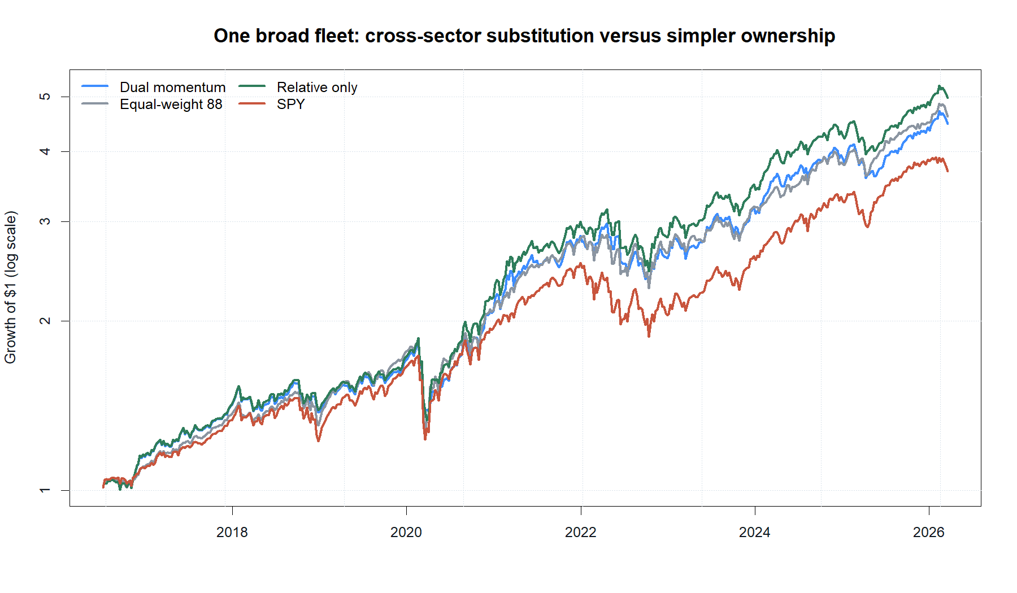
LIT-MOM-03.3
Cross-sector ranking helps; the cash gate gives it back
RELATIVE RANKING
17.95%
net CAGR
+0.90 pp
vs equal-weight 88
4.97× ending wealth
33
Notes:
Relative-only rotation finishes ahead of equal-weight ownership of all 88 stocks and SPY. The source dual-momentum path trails both relative-only and equal-weight near the end because the positive-return gate moves some capital to cash during recoveries.
[Sources]
- C:/Users/Franc/OneDrive/Documents/Francis/Peltata Project/Time-Series-Modeling-Gen5/runs/research_workbench/literature_grounded/lit_mom_03_3_broad_stock_fleet_20260903/mom033_report.md
- C:/Users/Franc/OneDrive/Documents/Francis/Peltata Project/Time-Series-Modeling-Gen5/runs/research_workbench/literature_grounded/lit_mom_03_3_broad_stock_fleet_20260903/mom033_broad_fleet_summary.csv
- C:/Users/Franc/OneDrive/Documents/Francis/Peltata Project/Time-Series-Modeling-Gen5/runs/research_workbench/literature_grounded/lit_mom_03_3_broad_stock_fleet_20260903/mom033_portfolio_metrics.csv
- C:/Users/Franc/OneDrive/Documents/Francis/Peltata Project/Time-Series-Modeling-Gen5/runs/research_workbench/literature_grounded/lit_mom_03_3_broad_stock_fleet_20260903/visuals/mom033_growth_of_one.png
- Codex task conversation, 2026-09-03 (operator approval and broad-fleet interpretation)
[/Sources]

Slide 34
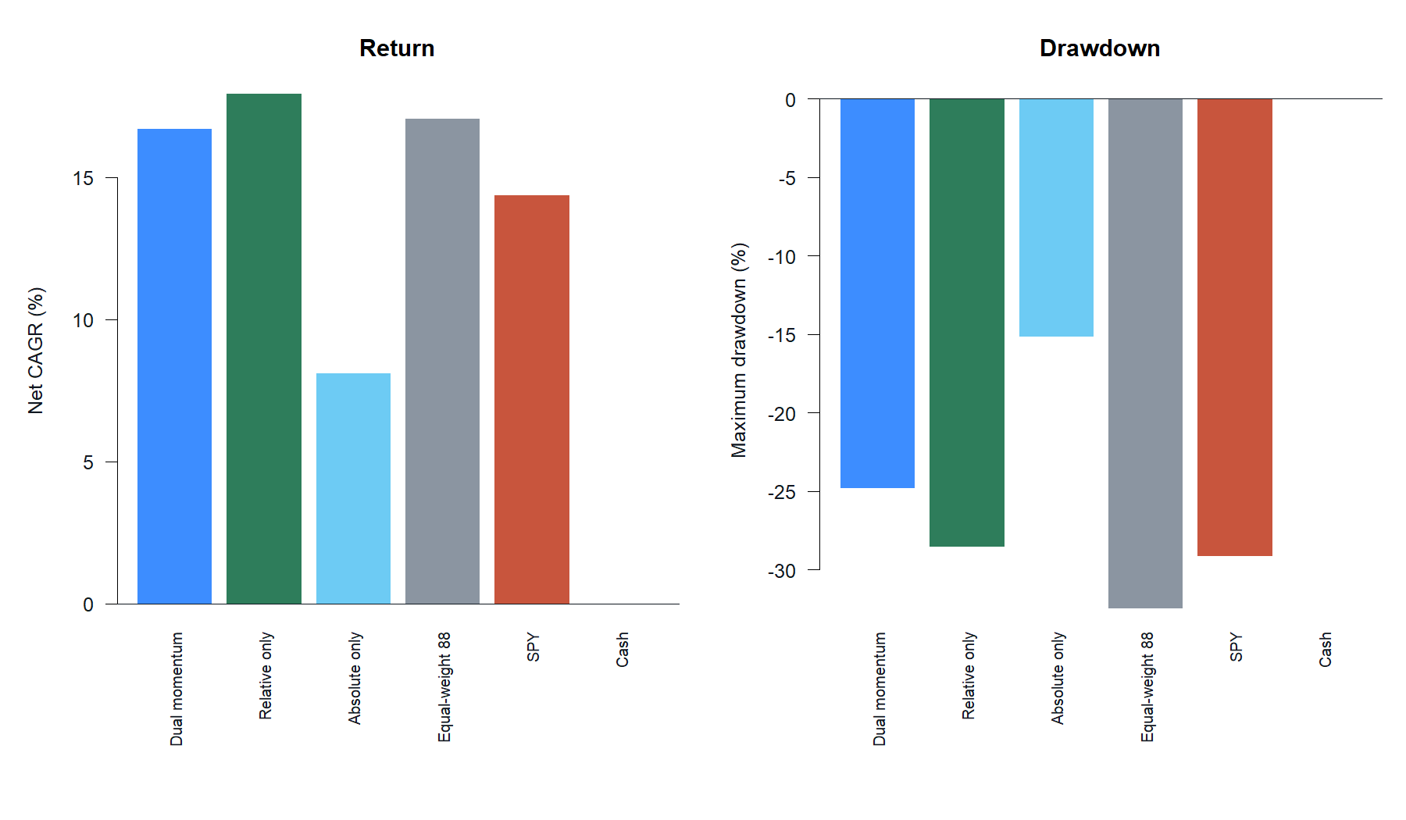
LIT-MOM-03.3
The full rule trades away return for a smaller drawdown
ABSOLUTE GATE
-1.26 pp
CAGR vs relative-only
+3.74 pp
drawdown improvement
-24.83% vs -28.57%
Ranking and the cash gate point in opposite directions.
34
Notes:
The key attribution is relative-only versus equal-weight 88: ranking adds 0.90 CAGR points descriptively. Source versus relative-only isolates the positive-return gate: it costs 1.26 CAGR points while improving maximum drawdown by 3.74 points. The full source rule therefore ends 0.35 points below equal weight despite the ranking clue.
[Sources]
- C:/Users/Franc/OneDrive/Documents/Francis/Peltata Project/Time-Series-Modeling-Gen5/runs/research_workbench/literature_grounded/lit_mom_03_3_broad_stock_fleet_20260903/mom033_report.md
- C:/Users/Franc/OneDrive/Documents/Francis/Peltata Project/Time-Series-Modeling-Gen5/runs/research_workbench/literature_grounded/lit_mom_03_3_broad_stock_fleet_20260903/mom033_broad_fleet_summary.csv
- C:/Users/Franc/OneDrive/Documents/Francis/Peltata Project/Time-Series-Modeling-Gen5/runs/research_workbench/literature_grounded/lit_mom_03_3_broad_stock_fleet_20260903/mom033_portfolio_metrics.csv
- C:/Users/Franc/OneDrive/Documents/Francis/Peltata Project/Time-Series-Modeling-Gen5/runs/research_workbench/literature_grounded/lit_mom_03_3_broad_stock_fleet_20260903/visuals/mom033_control_metrics.png
- Codex task conversation, 2026-09-03 (operator approval and broad-fleet interpretation)
[/Sources]

Slide 35
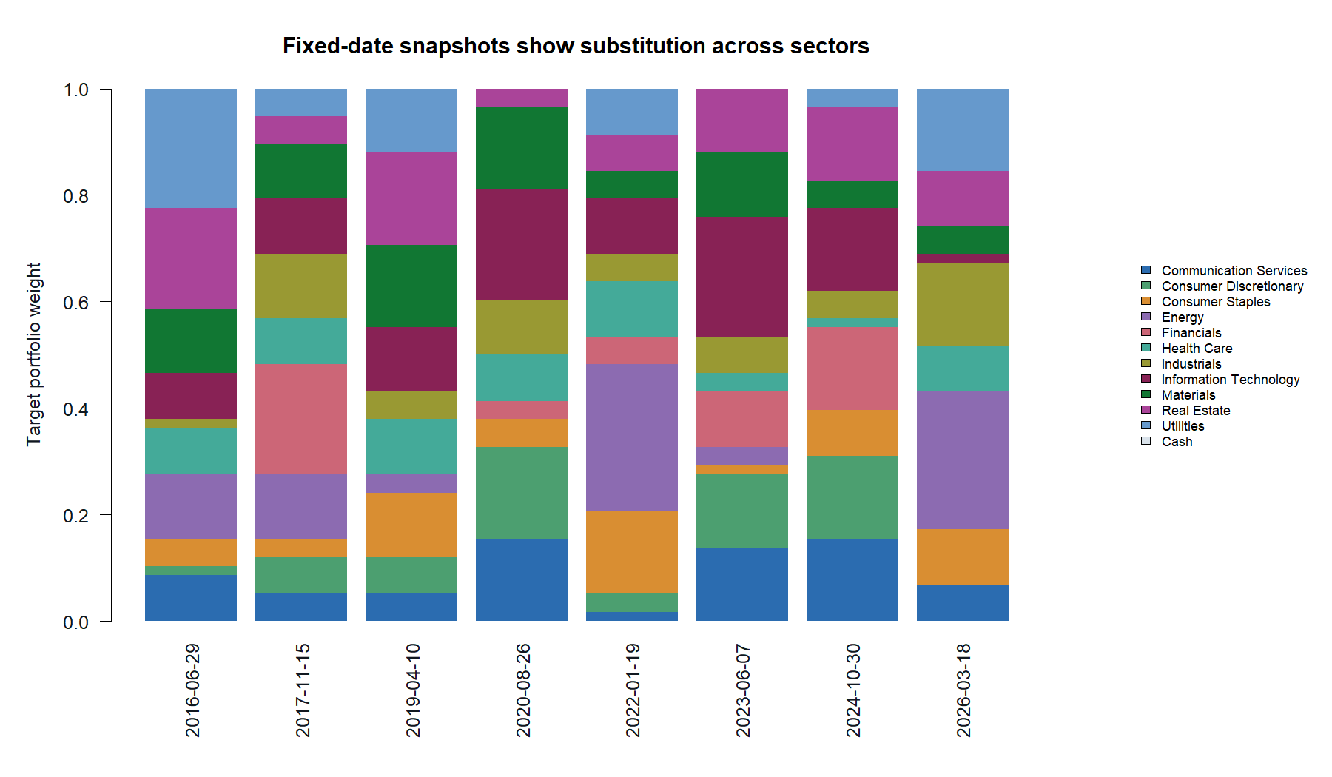
LIT-MOM-03.3
One broad contest reallocates capital across sectors
CROSS-SECTOR
11 sectors
compete together
12.88% average
Technology weight
27.59% max any sector
The portfolio rotates across sectors; no sector holds a fixed quota.
35
Notes:
The fixed-date snapshots are evenly spaced rather than outcome-selected. Information Technology has the highest average source weight at 12.88%, but the largest weekly weight in any sector is 27.59%, so the result is not a permanently concentrated Technology portfolio in disguise.
[Sources]
- C:/Users/Franc/OneDrive/Documents/Francis/Peltata Project/Time-Series-Modeling-Gen5/runs/research_workbench/literature_grounded/lit_mom_03_3_broad_stock_fleet_20260903/mom033_report.md
- C:/Users/Franc/OneDrive/Documents/Francis/Peltata Project/Time-Series-Modeling-Gen5/runs/research_workbench/literature_grounded/lit_mom_03_3_broad_stock_fleet_20260903/mom033_broad_fleet_summary.csv
- C:/Users/Franc/OneDrive/Documents/Francis/Peltata Project/Time-Series-Modeling-Gen5/runs/research_workbench/literature_grounded/lit_mom_03_3_broad_stock_fleet_20260903/mom033_sector_allocation_tape.csv
- C:/Users/Franc/OneDrive/Documents/Francis/Peltata Project/Time-Series-Modeling-Gen5/runs/research_workbench/literature_grounded/lit_mom_03_3_broad_stock_fleet_20260903/mom033_universe_registry.csv
- C:/Users/Franc/OneDrive/Documents/Francis/Peltata Project/Time-Series-Modeling-Gen5/runs/research_workbench/literature_grounded/lit_mom_03_3_broad_stock_fleet_20260903/visuals/mom033_sector_allocation_snapshots.png
- Codex task conversation, 2026-09-03 (operator approval and broad-fleet interpretation)
[/Sources]

Slide 36
LIT-MOM-03.3
A ranking clue survives—but the universe cannot support promotion
Established
Relative-only beat equal-weight 88 by 0.90 CAGR points in the frozen 29-of-88 POC.
Not established
Static survivor-biased membership, no inference or robustness, and the full source rule did not beat equal weight.
Next question
Repair universe bias with point-in-time membership before tuning horizons, breadth, or gates.
Preserve the clue; do not promote or optimize it yet.
36
Notes:
The broad competition structure is promising enough to preserve as a research clue. It is not mathematically defensible as an edge because the atlas is static and survivor-biased and the same retrospective sample informed the question. A point-in-time universe is the cleanest next evidence upgrade; the absolute gate remains a separately named risk control.
[Sources]
- C:/Users/Franc/OneDrive/Documents/Francis/Peltata Project/Time-Series-Modeling-Gen5/runs/research_workbench/literature_grounded/lit_mom_03_3_broad_stock_fleet_20260903/mom033_report.md
- C:/Users/Franc/OneDrive/Documents/Francis/Peltata Project/Time-Series-Modeling-Gen5/runs/research_workbench/literature_grounded/lit_mom_03_3_broad_stock_fleet_20260903/mom033_broad_fleet_summary.csv
- C:/Users/Franc/OneDrive/Documents/Francis/Peltata Project/Time-Series-Modeling-Gen5/runs/research_workbench/literature_grounded/lit_mom_03_3_broad_stock_fleet_20260903/mom033_portfolio_metrics.csv
- C:/Users/Franc/OneDrive/Documents/Francis/Peltata Project/Time-Series-Modeling-Gen5/runs/research_workbench/literature_grounded/lit_mom_03_3_broad_stock_fleet_20260903/mom033_universe_registry.csv
- C:/Users/Franc/OneDrive/Documents/Francis/Peltata Project/Time-Series-Modeling-Gen5/operator_hypothesis_lab/registries/return_geometry_wide_atlas.csv
- C:/Users/Franc/OneDrive/Documents/Francis/Peltata Project/Time-Series-Modeling-Gen5/literature_studies/docs/GEN5_LIT_MOM_03_3_BROAD_STOCK_FLEET_RESULTS.md
- C:/Users/Franc/OneDrive/Documents/Francis/Peltata Project/Time-Series-Modeling-Gen5/literature_studies/R/gen5_lit_mom_03_3_broad_stock_fleet.R
- C:/Users/Franc/OneDrive/Documents/Francis/Peltata Project/Time-Series-Modeling-Gen5/literature_studies/scripts/run_gen5_lit_mom_03_3_broad_stock_fleet.R
- Codex task conversation, 2026-09-03 (operator approval and broad-fleet interpretation)
[/Sources]

Slide 37
LIT-MOM-03.4
A defensible universe must keep the stocks that disappeared
FROZEN COHORT
IDENTITY RISK
481
REAL
stocks known before test
departures stay in evidence
S&P 500 holdings · 2020-09-30
11 contemporaneous sectors
Evaluation begins in 2021
No survivor backfill
No inferred membership
Terminal values bounded
This is an ex-ante, auditable cohort—not a present-day winners list.
37
Notes:
The 481-stock cohort comes from a pre-evaluation Form N-PORT holdings snapshot and a previously frozen identity registry. Later acquisitions, renames, failures, and other disappearances remain in the evidence rather than being silently removed. This is a fixed deployment cohort, not a rolling historical S&P 500 membership panel.
[Sources]
- C:/Users/Franc/OneDrive/Documents/Francis/Peltata Project/Time-Series-Modeling-Gen5/runs/research_workbench/operator_hypothesis_lab/hyp_mom_04_1_deployment_universe_train_20260811/hyp_mom_04_1_frozen_registry.csv
- C:/Users/Franc/OneDrive/Documents/Francis/Peltata Project/Time-Series-Modeling-Gen5/operator_hypothesis_lab/docs/HYP_MOM_04_1_DEPLOYMENT_UNIVERSE_DATA_AUDIT_CONTRACT.md
- C:/Users/Franc/OneDrive/Documents/Francis/Peltata Project/Time-Series-Modeling-Gen5/literature_studies/docs/GEN5_LIT_MOM_03_4_DEFENSIBLE_UNIVERSE_CONTRACT.md
- C:/Users/Franc/OneDrive/Documents/Francis/Peltata Project/Time-Series-Modeling-Gen5/runs/research_workbench/literature_grounded/lit_mom_03_4_defensible_universe_20260903/mom034_report.md
- C:/Users/Franc/OneDrive/Documents/Francis/Peltata Project/Time-Series-Modeling-Gen5/runs/research_workbench/literature_grounded/lit_mom_03_4_defensible_universe_20260903/mom034_terminal_events.csv
- Codex task conversation, 2026-09-03 (defensible-universe approval, result interpretation, and conventional-core huddle)
[/Sources]

Slide 38
LIT-MOM-03.4
The replay freezes every consequential choice before outcomes
UNIVERSE
481 stocks from a 2020-09-30 SEC holdings filing
BREADTH
SIGNAL
PERMISSION
EXECUTION
Top 160
one-third
Wednesday close
10- & 25-week ROC
Positive only
failed slots to cash
Next open
5 bps one-way
No horizon, breadth, gate, or universe search; missing next opens remain cash.
38
Notes:
The source mechanics remain fixed: two sleeves, 10- and 25-week rates of change, a positive-return permission gate, weekly Wednesday decisions, next-session-open execution, and five basis points one-way. One-third selection becomes a causal, dynamic floor of the scoreable cohort and opens at 160 of 481.
[Sources]
- C:/Users/Franc/OneDrive/Documents/Francis/Peltata Project/Time-Series-Modeling-Gen5/literature_studies/docs/GEN5_LIT_MOM_03_4_DEFENSIBLE_UNIVERSE_CONTRACT.md
- C:/Users/Franc/OneDrive/Documents/Francis/Peltata Project/Time-Series-Modeling-Gen5/runs/research_workbench/literature_grounded/lit_mom_03_4_defensible_universe_20260903/mom034_report.md
- C:/Users/Franc/OneDrive/Documents/Francis/Peltata Project/Time-Series-Modeling-Gen5/runs/research_workbench/literature_grounded/lit_mom_03_4_defensible_universe_20260903/mom034_admission_gates.csv
- C:/Users/Franc/OneDrive/Documents/Francis/Peltata Project/Time-Series-Modeling-Gen5/runs/research_workbench/operator_hypothesis_lab/hyp_mom_04_1_deployment_universe_train_20260811/hyp_mom_04_1_frozen_registry.csv
- C:/Users/Franc/OneDrive/Documents/Francis/Peltata Project/Time-Series-Modeling-Gen5/literature_studies/R/gen5_lit_mom_03_4_defensible_universe.R
- C:/Users/Franc/OneDrive/Documents/Francis/Peltata Project/Time-Series-Modeling-Gen5/literature_studies/scripts/run_gen5_lit_mom_03_4_defensible_universe.R
- Codex task conversation, 2026-09-03 (defensible-universe approval, result interpretation, and conventional-core huddle)
[/Sources]

Slide 39
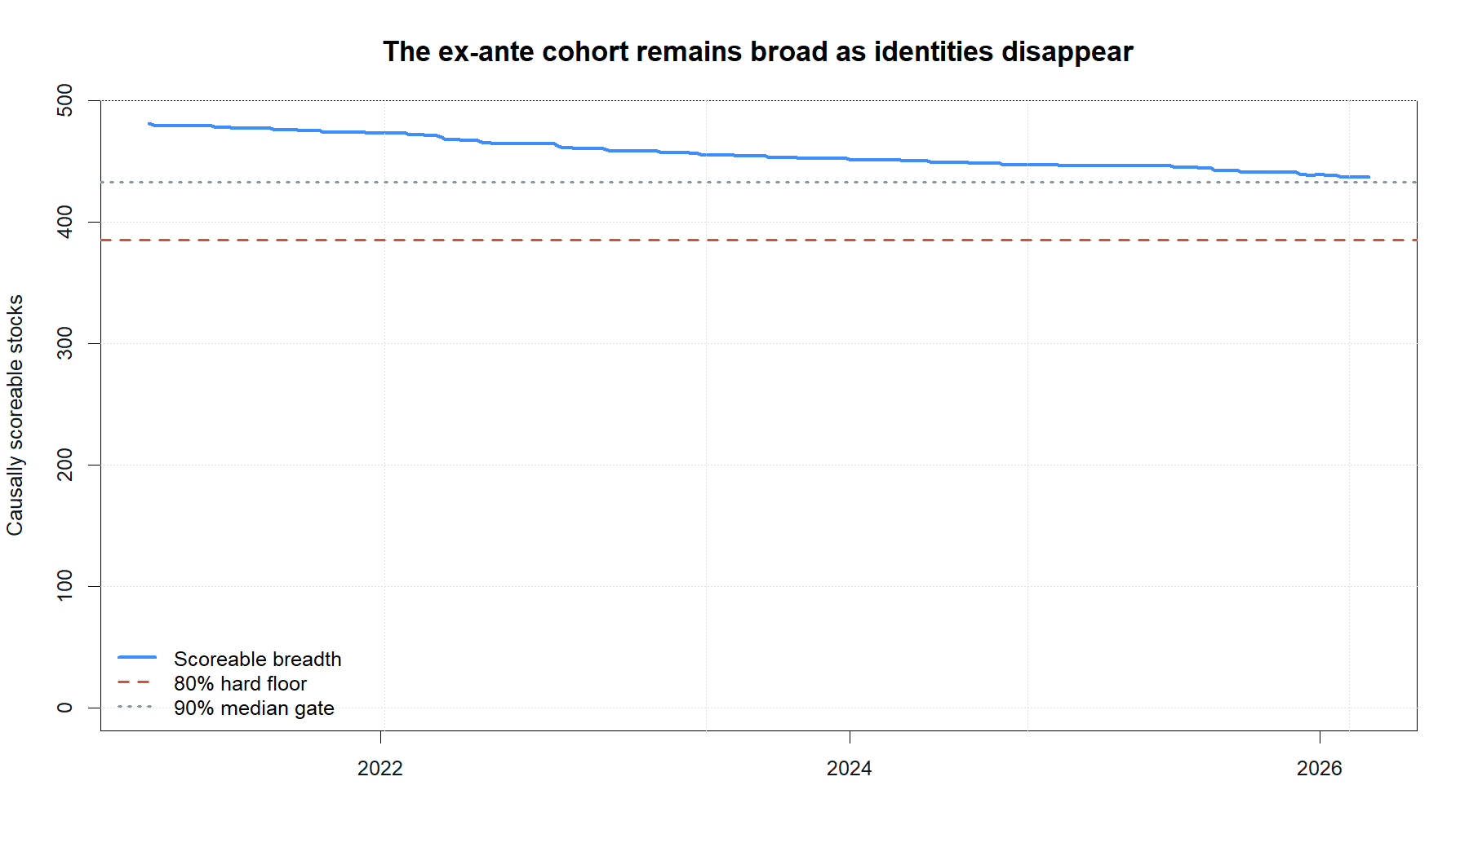
LIT-MOM-03.4
The ex-ante cohort stays broad despite real disappearances
SCOREABLE BREADTH
481
initial
454
median
437 minimum
39
Notes:
All breadth gates pass after the bounded refresh. The cohort starts with 481 scoreable stocks, has a median of 454, and never falls below 437. The raw workbench health remains WARN because genuine post-2020 disappearances cannot cover the requested endpoint; terminal-aware replay keeps those identities rather than deleting them.
[Sources]
- C:/Users/Franc/OneDrive/Documents/Francis/Peltata Project/Time-Series-Modeling-Gen5/runs/research_workbench/literature_grounded/lit_mom_03_4_defensible_universe_20260903/mom034_report.md
- C:/Users/Franc/OneDrive/Documents/Francis/Peltata Project/Time-Series-Modeling-Gen5/runs/research_workbench/literature_grounded/lit_mom_03_4_defensible_universe_20260903/mom034_scoreable_breadth.csv
- C:/Users/Franc/OneDrive/Documents/Francis/Peltata Project/Time-Series-Modeling-Gen5/runs/research_workbench/literature_grounded/lit_mom_03_4_defensible_universe_20260903/mom034_workbench_query_health.csv
- C:/Users/Franc/OneDrive/Documents/Francis/Peltata Project/Time-Series-Modeling-Gen5/runs/research_workbench/literature_grounded/lit_mom_03_4_defensible_universe_20260903/mom034_admission_gates.csv
- C:/Users/Franc/OneDrive/Documents/Francis/Peltata Project/Time-Series-Modeling-Gen5/runs/research_workbench/literature_grounded/lit_mom_03_4_defensible_universe_20260903/mom034_terminal_events.csv
- C:/Users/Franc/OneDrive/Documents/Francis/Peltata Project/Time-Series-Modeling-Gen5/runs/research_workbench/literature_grounded/lit_mom_03_4_defensible_universe_20260903/mom034_terminal_proxy_summary.csv
- C:/Users/Franc/OneDrive/Documents/Francis/Peltata Project/Time-Series-Modeling-Gen5/runs/research_workbench/literature_grounded/lit_mom_03_4_defensible_universe_20260903/visuals/mom034_scoreable_breadth.png
- Codex task conversation, 2026-09-03 (defensible-universe approval, result interpretation, and conventional-core huddle)
[/Sources]

Slide 40
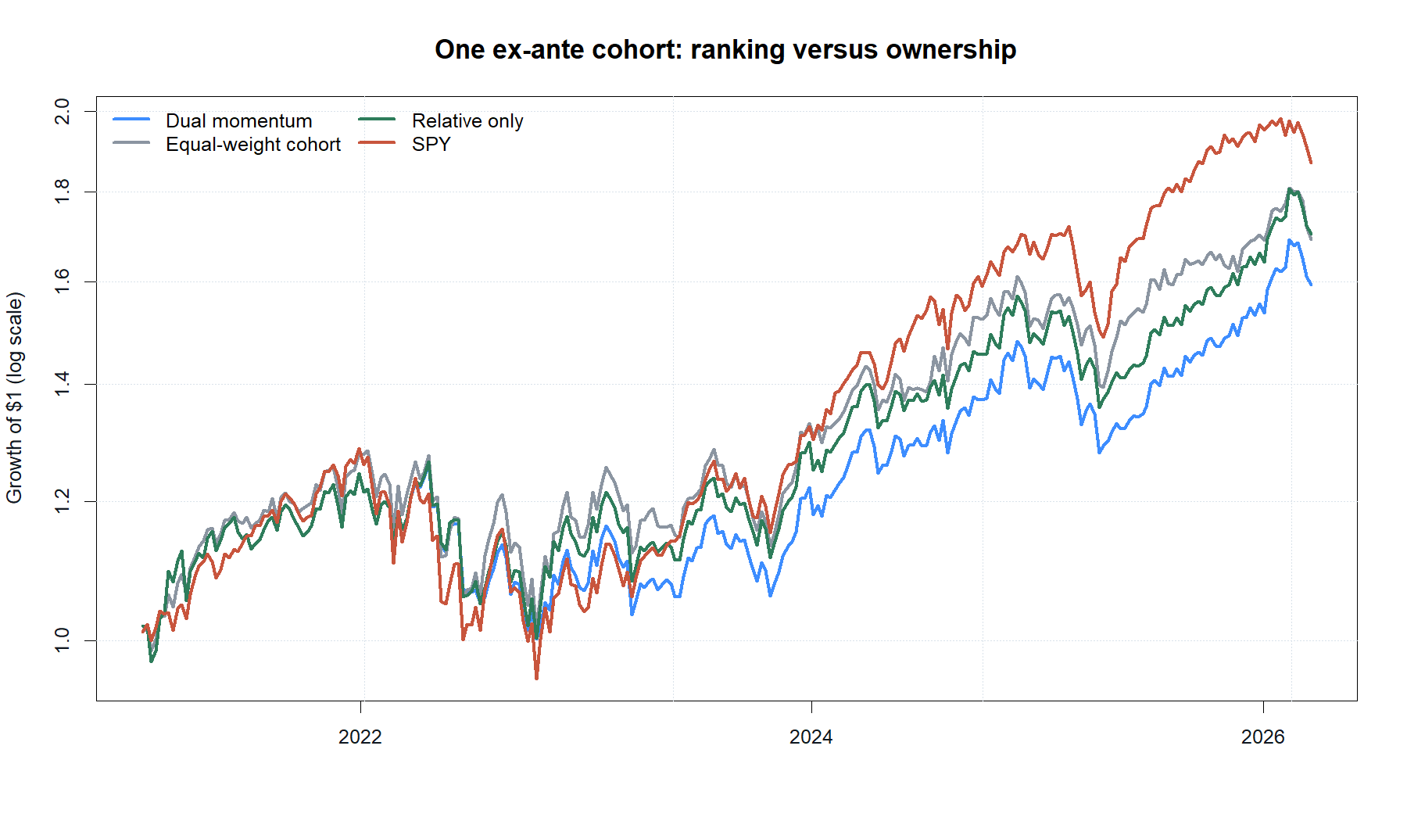
LIT-MOM-03.4
The ranking advantage shrinks to almost zero
RELATIVE RANKING
10.80%
net CAGR
+0.14 pp
vs equal-weight 481
1.70× ending wealth
40
Notes:
Relative-only ranking earns 10.80% net CAGR versus 10.66% for equal-weight ownership of the same ex-ante cohort: a 0.14-point difference. That is far smaller than the prior 0.90-point static-atlas clue and is not a persuasive economic promotion signal. SPY leads return at 12.80% but also has the deepest drawdown.
[Sources]
- C:/Users/Franc/OneDrive/Documents/Francis/Peltata Project/Time-Series-Modeling-Gen5/runs/research_workbench/literature_grounded/lit_mom_03_4_defensible_universe_20260903/mom034_report.md
- C:/Users/Franc/OneDrive/Documents/Francis/Peltata Project/Time-Series-Modeling-Gen5/runs/research_workbench/literature_grounded/lit_mom_03_4_defensible_universe_20260903/mom034_summary.csv
- C:/Users/Franc/OneDrive/Documents/Francis/Peltata Project/Time-Series-Modeling-Gen5/runs/research_workbench/literature_grounded/lit_mom_03_4_defensible_universe_20260903/mom034_portfolio_metrics.csv
- C:/Users/Franc/OneDrive/Documents/Francis/Peltata Project/Time-Series-Modeling-Gen5/runs/research_workbench/literature_grounded/lit_mom_03_4_defensible_universe_20260903/mom034_admission_gates.csv
- C:/Users/Franc/OneDrive/Documents/Francis/Peltata Project/Time-Series-Modeling-Gen5/runs/research_workbench/literature_grounded/lit_mom_03_4_defensible_universe_20260903/visuals/mom034_growth_of_one.png
- Codex task conversation, 2026-09-03 (defensible-universe approval, result interpretation, and conventional-core huddle)
[/Sources]

Slide 41
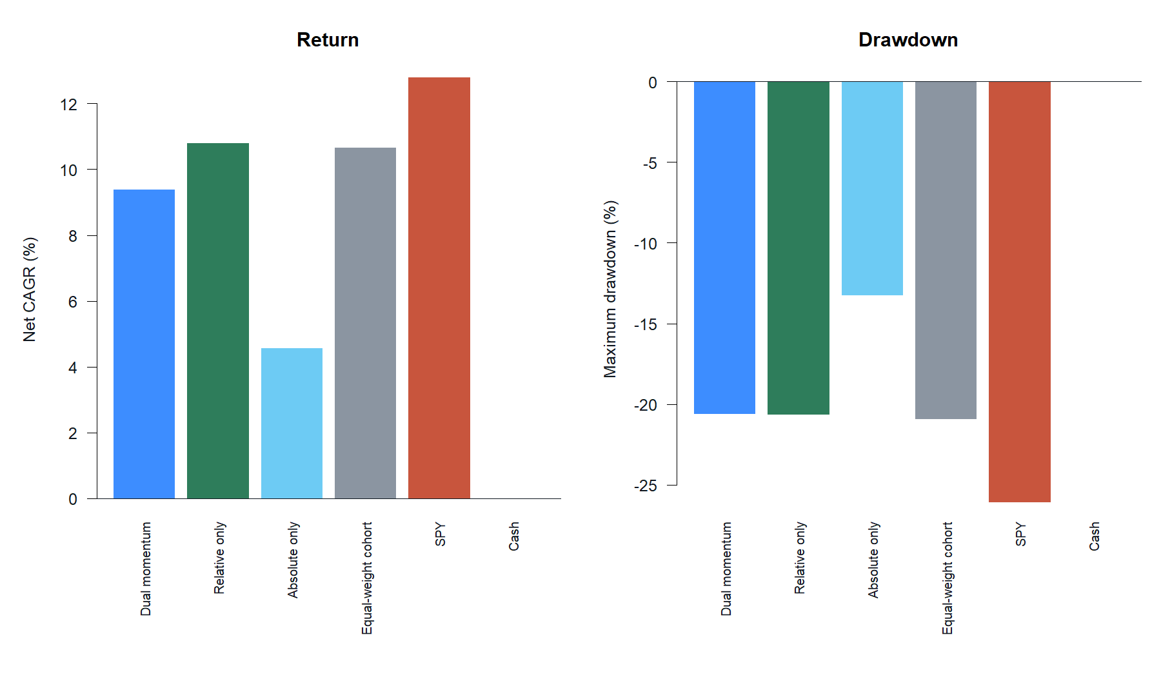
LIT-MOM-03.4
The cash gate costs return without buying meaningful protection
ABSOLUTE GATE
-1.41 pp
CAGR vs relative-only
+0.05 pp
drawdown improvement
-20.62% vs -20.67%
The cash gate gave up return for almost no added drawdown relief.
41
Notes:
Source minus relative-only isolates the absolute-momentum permission gate. It costs 1.41 CAGR points and improves maximum drawdown by only 0.05 points. The full source rule also trails equal-weight 481 by 1.27 CAGR points. In this cohort and period, the gate is not earning its complexity.
[Sources]
- C:/Users/Franc/OneDrive/Documents/Francis/Peltata Project/Time-Series-Modeling-Gen5/runs/research_workbench/literature_grounded/lit_mom_03_4_defensible_universe_20260903/mom034_report.md
- C:/Users/Franc/OneDrive/Documents/Francis/Peltata Project/Time-Series-Modeling-Gen5/runs/research_workbench/literature_grounded/lit_mom_03_4_defensible_universe_20260903/mom034_summary.csv
- C:/Users/Franc/OneDrive/Documents/Francis/Peltata Project/Time-Series-Modeling-Gen5/runs/research_workbench/literature_grounded/lit_mom_03_4_defensible_universe_20260903/mom034_portfolio_metrics.csv
- C:/Users/Franc/OneDrive/Documents/Francis/Peltata Project/Time-Series-Modeling-Gen5/runs/research_workbench/literature_grounded/lit_mom_03_4_defensible_universe_20260903/mom034_admission_gates.csv
- C:/Users/Franc/OneDrive/Documents/Francis/Peltata Project/Time-Series-Modeling-Gen5/runs/research_workbench/literature_grounded/lit_mom_03_4_defensible_universe_20260903/visuals/mom034_control_metrics.png
- Codex task conversation, 2026-09-03 (defensible-universe approval, result interpretation, and conventional-core huddle)
[/Sources]

Slide 42
LIT-MOM-03.4
The replay is admissible—and the exact stock implementation stops
Established
The frozen registry, source timing, breadth, execution, and terminal-value controls passed all 10 gates.
Not established
Ranking added only 0.14 CAGR points; the full rule trailed equal weight by 1.27 points.
Decision
STOP this broad-stock implementation as written; do not tune horizons, breadth, or gates to rescue it.
A clean falsification is progress: the original ranking clue did not survive.
42
Notes:
The replay earns admission, so the negative result is interpretable. It does not promote an edge. The exact broad-stock implementation stops without a robustness or forward gate. The general dual-momentum principle remains conceptually distinct and may be studied elsewhere only under a new frozen hypothesis.
[Sources]
- C:/Users/Franc/OneDrive/Documents/Francis/Peltata Project/Time-Series-Modeling-Gen5/literature_studies/docs/GEN5_LIT_MOM_03_4_DEFENSIBLE_UNIVERSE_CONTRACT.md
- C:/Users/Franc/OneDrive/Documents/Francis/Peltata Project/Time-Series-Modeling-Gen5/literature_studies/docs/GEN5_LIT_MOM_03_4_DEFENSIBLE_UNIVERSE_RESULTS.md
- C:/Users/Franc/OneDrive/Documents/Francis/Peltata Project/Time-Series-Modeling-Gen5/runs/research_workbench/literature_grounded/lit_mom_03_4_defensible_universe_20260903/mom034_report.md
- C:/Users/Franc/OneDrive/Documents/Francis/Peltata Project/Time-Series-Modeling-Gen5/runs/research_workbench/literature_grounded/lit_mom_03_4_defensible_universe_20260903/mom034_summary.csv
- C:/Users/Franc/OneDrive/Documents/Francis/Peltata Project/Time-Series-Modeling-Gen5/runs/research_workbench/literature_grounded/lit_mom_03_4_defensible_universe_20260903/mom034_portfolio_metrics.csv
- C:/Users/Franc/OneDrive/Documents/Francis/Peltata Project/Time-Series-Modeling-Gen5/runs/research_workbench/literature_grounded/lit_mom_03_4_defensible_universe_20260903/mom034_admission_gates.csv
- C:/Users/Franc/OneDrive/Documents/Francis/Peltata Project/Time-Series-Modeling-Gen5/runs/research_workbench/operator_hypothesis_lab/hyp_mom_04_1_deployment_universe_train_20260811/hyp_mom_04_1_frozen_registry.csv
- C:/Users/Franc/OneDrive/Documents/Francis/Peltata Project/Time-Series-Modeling-Gen5/literature_studies/R/gen5_lit_mom_03_4_defensible_universe.R
- C:/Users/Franc/OneDrive/Documents/Francis/Peltata Project/Time-Series-Modeling-Gen5/literature_studies/scripts/run_gen5_lit_mom_03_4_defensible_universe.R
- Codex task conversation, 2026-09-03 (defensible-universe approval, result interpretation, and conventional-core huddle)
[/Sources]

Slide 43
PORTFOLIO HUDDLE
Algorithm research need not hold the ordinary wealth plan hostage
CONVENTIONAL CORE
RESEARCH SLEEVE
NOW
SMALL
build the wealth plan
ring-fence experiments
Emergency and near-term reserve
Low-cost diversified funds
Allocation matched to horizon
Capital capped in advance
No required money or leverage
Scale only after forward evidence
Separate the compounding plan from the research bet.
43
Notes:
This is a non-personalized architecture bookmark, not an allocation recommendation. A conventional core can combine a safety reserve with a diversified, low-cost stock/bond allocation matched to the operator's horizon and ability to tolerate losses. Experimental algorithms belong in a separately capped sleeve until forward evidence exists. Diversification reduces risk but does not prevent losses, and every investment carries risk.
[Sources]
- https://www.investor.gov/introduction-investing/getting-started/asset-allocation
- https://www.investor.gov/introduction-investing/investing-basics/investment-products/mutual-funds-and-exchange-traded-4
- https://www.investor.gov/introduction-investing/investing-basics/save-and-invest/diversify-your-investments
- https://www.investor.gov/introduction-investing
- https://www.investor.gov/introduction-investing/general-resources/news-alerts/alerts-bulletins/investor-bulletins/mutual-fund-and-etf-fees-and-expenses-investor-bulletin
- https://www.treasurydirect.gov/marketable-securities/buying-a-marketable-security/
- Codex task conversation, 2026-09-03 (defensible-universe approval, result interpretation, and conventional-core huddle)
[/Sources]

