Slide 1
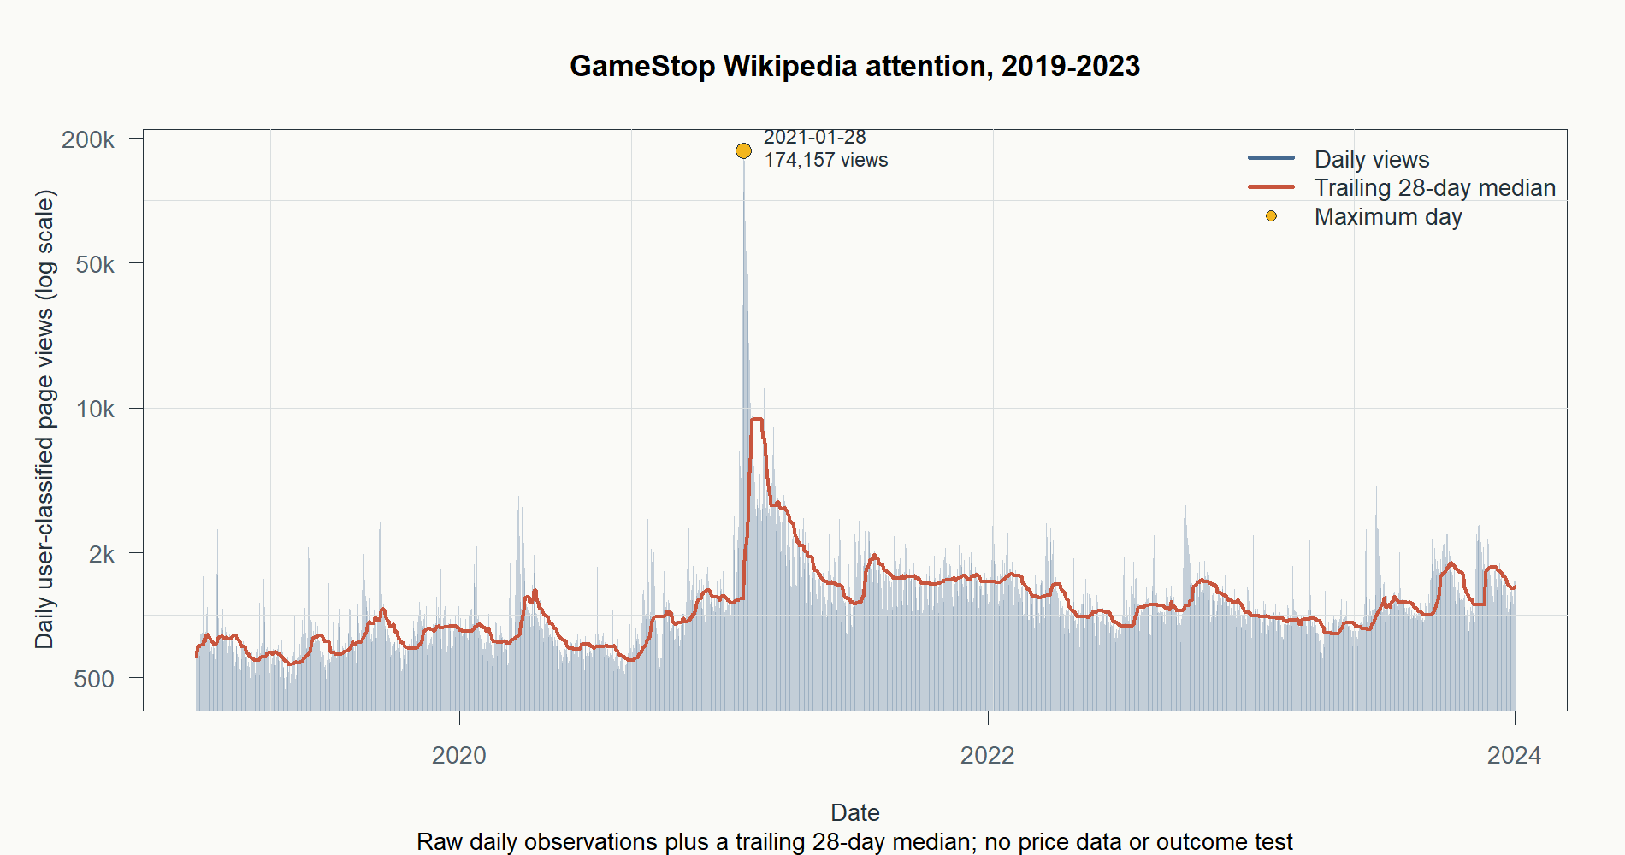
ALTERNATIVE DATA LAB
Wikipedia attention
as a market signal
GameStop collection, directional lead, and magnitude follow-up
2019–2023 research window · causal availability clock · no strategy claim
1
Notes:
This deck records three sequential research slices. It does not establish edge or a trading rule.
[Sources]
- C:/Users/Franc/OneDrive/Documents/Francis/Peltata Project/Time-Series-Modeling-Gen5/runs/research_workbench/alternative_data_lab/wikimedia_attention_gamestop_20260901/report.md
- C:/Users/Franc/OneDrive/Documents/Francis/Peltata Project/Time-Series-Modeling-Gen5/runs/research_workbench/alternative_data_lab/wikimedia_attention_gamestop_20260901/visuals/gamestop_wikipedia_pageviews_2019_2023.png
- https://doc.wikimedia.org/generated-data-platform/aqs/analytics-api/examples/page-metrics.html

Slide 2
The lane asks one causal question at a time
COLLECT
TEST DIRECTION
TEST MAGNITUDE
Can public attention be collected, timestamped, audited, and visualized?
Does an attention surprise precede a positive next-session return?
If direction is unknowable, does attention precede a larger next-session move?
COMPLETE
STOP
STOP
2
Notes:
The sequence is cumulative: each slice changes only the question necessary to interpret the prior result.
[Sources]
- C:/Users/Franc/OneDrive/Documents/Francis/Peltata Project/Time-Series-Modeling-Gen5/runs/research_workbench/alternative_data_lab/wikimedia_attention_gamestop_20260901/report.md
- C:/Users/Franc/OneDrive/Documents/Francis/Peltata Project/Time-Series-Modeling-Gen5/runs/research_workbench/alternative_data_lab/wikimedia_attention_lead_gme_20260901/report.md
- C:/Users/Franc/OneDrive/Documents/Francis/Peltata Project/Time-Series-Modeling-Gen5/runs/research_workbench/alternative_data_lab/wikimedia_attention_magnitude_gme_20260901/report.md

Slide 3
Collection captured a real attention shock
1,826
complete daily observations
174,157
peak views on 2021-01-28
166×
peak versus the daily median
3
Notes:
The 2021 episode is a positive-control sanity check for the data pipeline, not evidence of a leading signal.
[Sources]
- C:/Users/Franc/OneDrive/Documents/Francis/Peltata Project/Time-Series-Modeling-Gen5/runs/research_workbench/alternative_data_lab/wikimedia_attention_gamestop_20260901/report.md
- C:/Users/Franc/OneDrive/Documents/Francis/Peltata Project/Time-Series-Modeling-Gen5/runs/research_workbench/alternative_data_lab/wikimedia_attention_gamestop_20260901/visuals/gamestop_wikipedia_pageviews_2019_2023.png
- https://doc.wikimedia.org/generated-data-platform/aqs/analytics-api/examples/page-metrics.html

Slide 4
The availability clock prevents early use
UTC day d
Day ends
+48 hours
First eligible open
Daily views accumulate; the value is not complete yet.
The measurement becomes a completed historical day.
A fixed safeguard is added because receipt timestamps are absent.
Observe exactly one subsequent open-to-open outcome.
In this historical test, source attention always precedes entry by 3 calendar days.
4
Notes:
The 48-hour safeguard is a conservative research choice. A faster claim would require prospective receipt-time capture.
[Sources]
- C:/Users/Franc/OneDrive/Documents/Francis/Peltata Project/Time-Series-Modeling-Gen5/runs/research_workbench/alternative_data_lab/wikimedia_attention_lead_gme_20260901/report.md
- https://doc.wikimedia.org/generated-data-platform/aqs/analytics-api/examples/page-metrics.html
- https://doc.wikimedia.org/generated-data-platform/aqs/analytics-api/documentation/troubleshooting.html

Slide 5
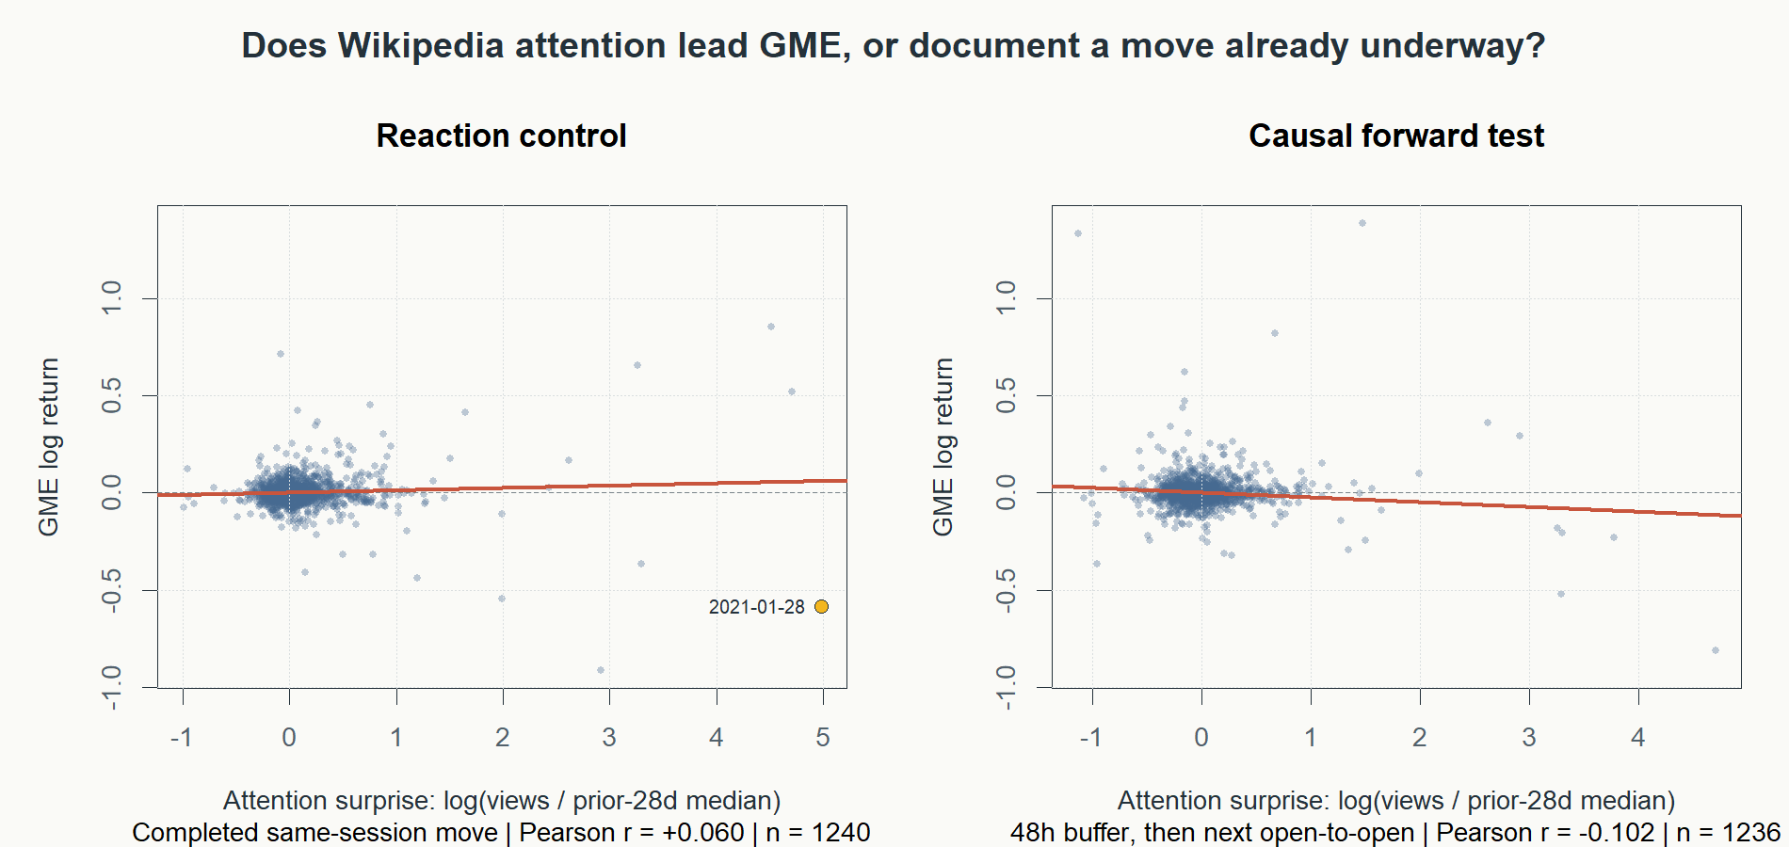
The directional lead did not survive
Causal forward
Pearson
−0.102
Spearman
+0.003
No dependable ordering from more attention to better next-session returns.
5
Notes:
The same-session reaction panel is not tradable; the causal forward panel is the only leading-signal surface.
[Sources]
- C:/Users/Franc/OneDrive/Documents/Francis/Peltata Project/Time-Series-Modeling-Gen5/runs/research_workbench/alternative_data_lab/wikimedia_attention_lead_gme_20260901/report.md
- C:/Users/Franc/OneDrive/Documents/Francis/Peltata Project/Time-Series-Modeling-Gen5/runs/research_workbench/alternative_data_lab/wikimedia_attention_lead_gme_20260901/descriptive_summary.csv
- C:/Users/Franc/OneDrive/Documents/Francis/Peltata Project/Time-Series-Modeling-Gen5/runs/research_workbench/alternative_data_lab/wikimedia_attention_lead_gme_20260901/visuals/attention_reaction_vs_causal_forward.png

Slide 6
A tilted line is not a reliable ordering signal
PEARSON
SPEARMAN
Sensitive to the exact size of extreme observations
Asks whether higher attention usually ranks with a larger outcome
A handful of extraordinary GME episodes can tilt a regression line even when ordinary days show no consistent relationship.
Near-zero rank correlation means the relationship is not dependable across the full set of observations.
For this lane, the rank relationship is the better basic sanity check for a broad continuous signal.
6
Notes:
This explanation is an interpretation of the locally generated scatterplots and correlation summaries.
[Sources]
- C:/Users/Franc/OneDrive/Documents/Francis/Peltata Project/Time-Series-Modeling-Gen5/runs/research_workbench/alternative_data_lab/wikimedia_attention_lead_gme_20260901/report.md
- C:/Users/Franc/OneDrive/Documents/Francis/Peltata Project/Time-Series-Modeling-Gen5/runs/research_workbench/alternative_data_lab/wikimedia_attention_magnitude_gme_20260901/report.md

Slide 7
The second test changed only the response
Direction can be unpredictable while move size remains predictable.
PRIMARY
CONVERGENT DIAGNOSTIC
Absolute next-open return
Entry-session high–low range
Ignores sign; measures the size of the complete one-session move.
Captures intraday expansion even when the session finishes near its starting point.
7
Notes:
Both responses were frozen before the magnitude packet was run; no additional horizon or volume surface was opened.
[Sources]
- C:/Users/Franc/OneDrive/Documents/Francis/Peltata Project/Time-Series-Modeling-Gen5/runs/research_workbench/alternative_data_lab/wikimedia_attention_magnitude_gme_20260901/report.md

Slide 8
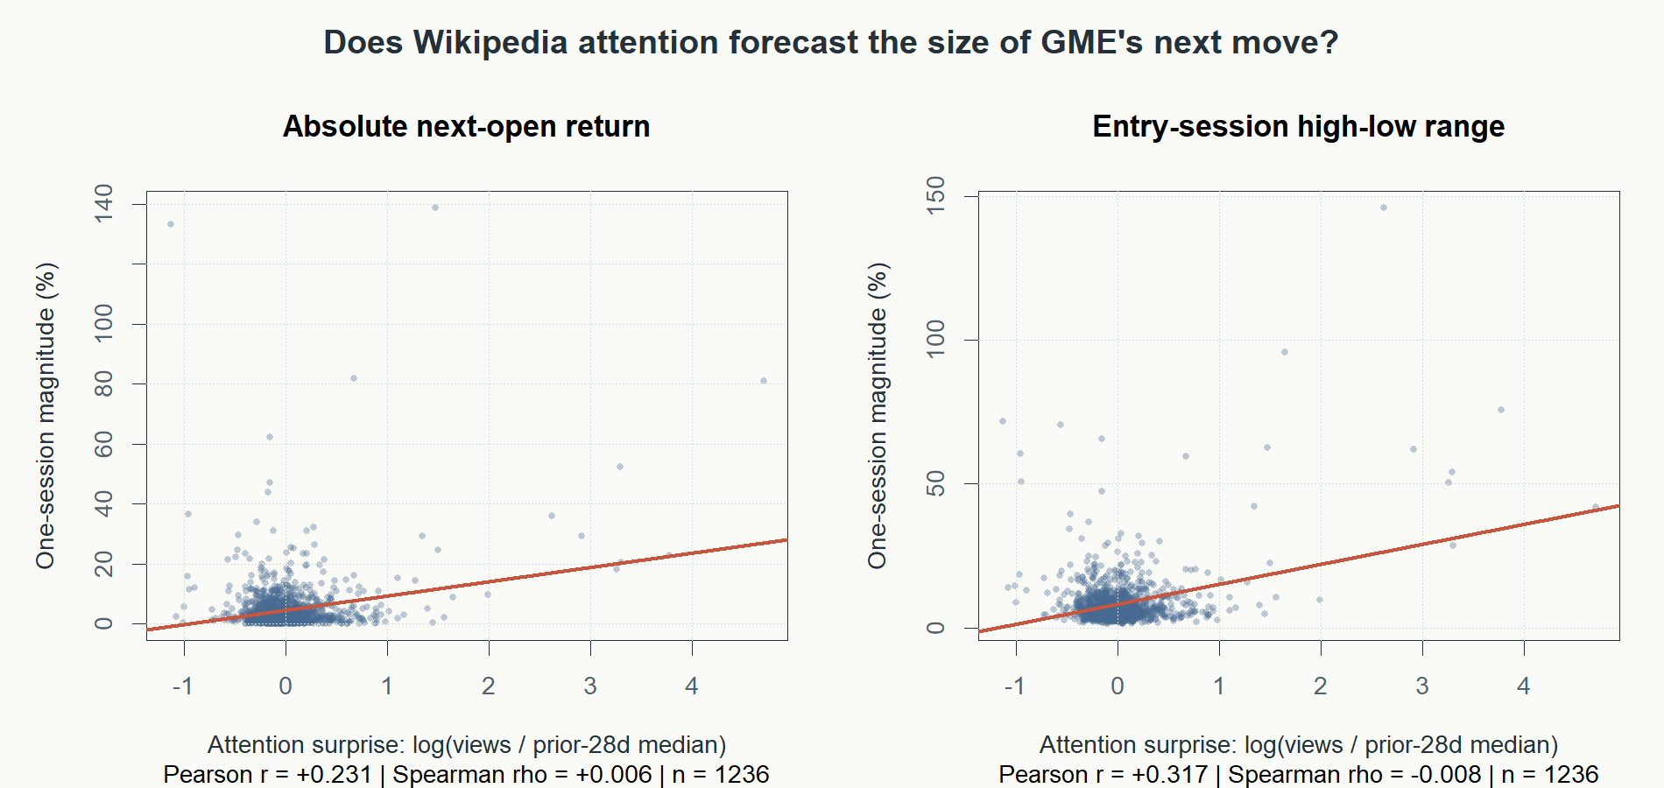
Outliers tilt Pearson; rank ordering disappears
ABSOLUTE RETURN
r = +0.231
ρ = +0.006
HIGH–LOW RANGE
r = +0.317
ρ = −0.008
The positive Pearson slopes are outlier-sensitive; rank ordering is absent.
8
Notes:
The completed same-session magnitude control was much stronger, consistent with attention reacting to extraordinary price episodes.
[Sources]
- C:/Users/Franc/OneDrive/Documents/Francis/Peltata Project/Time-Series-Modeling-Gen5/runs/research_workbench/alternative_data_lab/wikimedia_attention_magnitude_gme_20260901/report.md
- C:/Users/Franc/OneDrive/Documents/Francis/Peltata Project/Time-Series-Modeling-Gen5/runs/research_workbench/alternative_data_lab/wikimedia_attention_magnitude_gme_20260901/descriptive_summary.csv
- C:/Users/Franc/OneDrive/Documents/Francis/Peltata Project/Time-Series-Modeling-Gen5/runs/research_workbench/alternative_data_lab/wikimedia_attention_magnitude_gme_20260901/visuals/attention_vs_future_move_magnitude.png

Slide 9
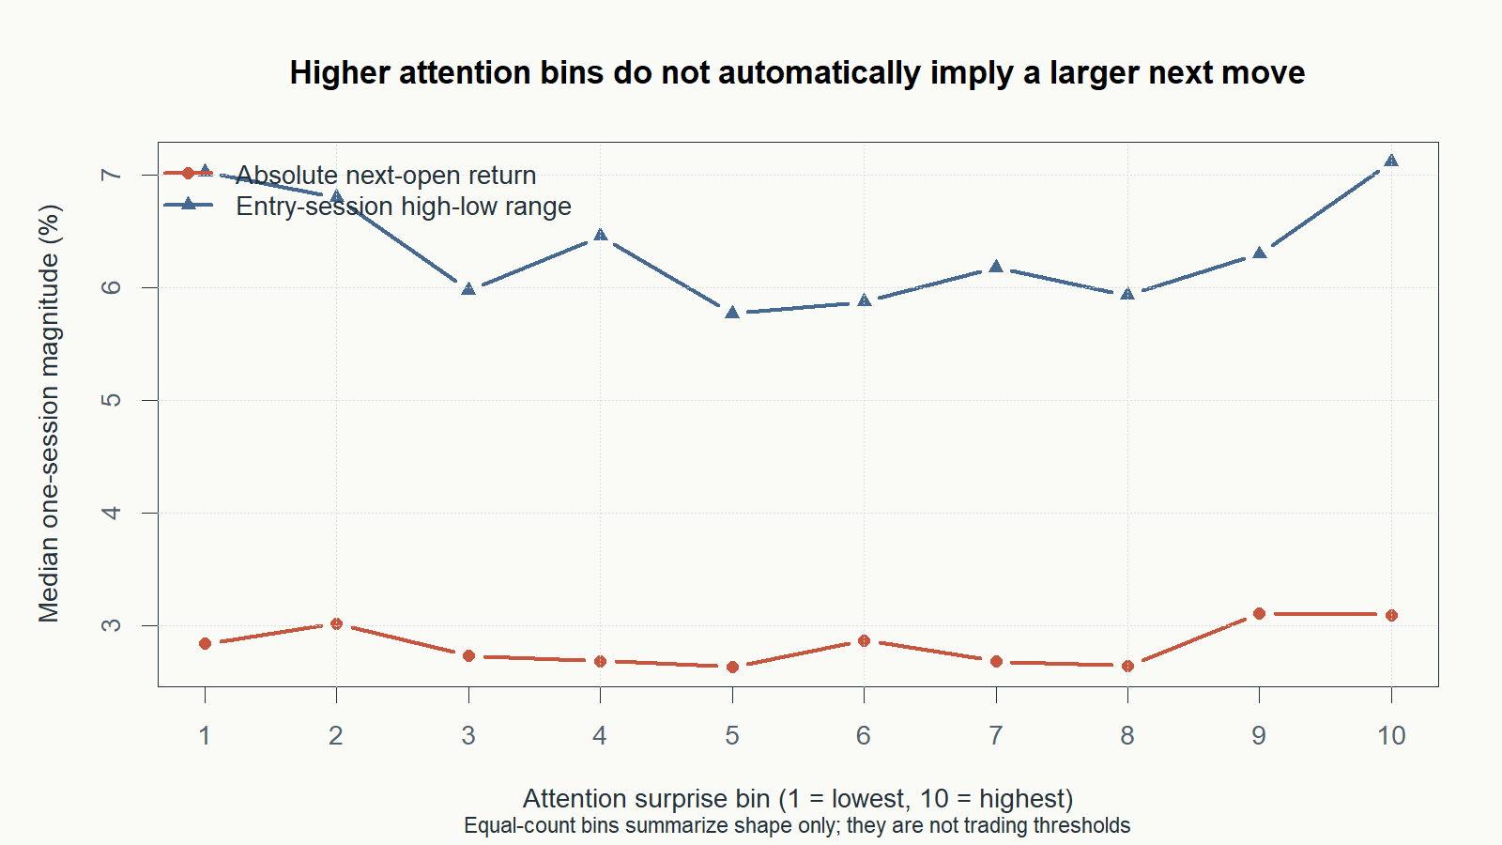
Attention deciles do not order move size
Bins 1–10 summarize shape only; they are not trading thresholds.
9
Notes:
The medians are roughly flat and non-monotone; the highest bin is not uniquely separated from the lowest bins.
[Sources]
- C:/Users/Franc/OneDrive/Documents/Francis/Peltata Project/Time-Series-Modeling-Gen5/runs/research_workbench/alternative_data_lab/wikimedia_attention_magnitude_gme_20260901/report.md
- C:/Users/Franc/OneDrive/Documents/Francis/Peltata Project/Time-Series-Modeling-Gen5/runs/research_workbench/alternative_data_lab/wikimedia_attention_magnitude_gme_20260901/attention_bin_summary.csv
- C:/Users/Franc/OneDrive/Documents/Francis/Peltata Project/Time-Series-Modeling-Gen5/runs/research_workbench/alternative_data_lab/wikimedia_attention_magnitude_gme_20260901/visuals/attention_deciles_vs_future_magnitude.png

Slide 10
The one-session lane now has two clean stops
DIRECTION
MAGNITUDE
More attention → positive return
More attention → larger move
Spearman +0.003
Spearman +0.006 / −0.008
STOP: no broad monotone directional relationship after the causal availability clock.
STOP: outliers tilt Pearson, but ordinary observations do not rank into larger moves.
Neither result authorizes thresholds, trades, or performance replay.
10
Notes:
These stops are specific to the frozen GameStop article feature, conservative historical clock, GME, and one-session outcomes.
[Sources]
- C:/Users/Franc/OneDrive/Documents/Francis/Peltata Project/Time-Series-Modeling-Gen5/runs/research_workbench/alternative_data_lab/wikimedia_attention_lead_gme_20260901/report.md
- C:/Users/Franc/OneDrive/Documents/Francis/Peltata Project/Time-Series-Modeling-Gen5/runs/research_workbench/alternative_data_lab/wikimedia_attention_magnitude_gme_20260901/report.md

Slide 11
Stop this formulation; preserve the learning
What survived
If this lane is reopened
Wikipedia pageviews are collectable, auditable, and capable of registering extraordinary public-attention episodes.
1
Collect receipt timestamps prospectively
This creates a genuinely faster information clock instead of shortening the historical safeguard after inspection.
What stopped
2
Predeclare a new economic question
The obvious causal one-session direction and magnitude relationships are not dependable across ordinary observations.
Do not add outcomes or horizons simply because the current surfaces stopped.
11
Notes:
The recommended next action is a huddle, not another automated scan.
[Sources]
- C:/Users/Franc/OneDrive/Documents/Francis/Peltata Project/Time-Series-Modeling-Gen5/runs/research_workbench/alternative_data_lab/wikimedia_attention_gamestop_20260901/report.md
- C:/Users/Franc/OneDrive/Documents/Francis/Peltata Project/Time-Series-Modeling-Gen5/runs/research_workbench/alternative_data_lab/wikimedia_attention_lead_gme_20260901/report.md
- C:/Users/Franc/OneDrive/Documents/Francis/Peltata Project/Time-Series-Modeling-Gen5/runs/research_workbench/alternative_data_lab/wikimedia_attention_magnitude_gme_20260901/report.md
- https://doc.wikimedia.org/generated-data-platform/aqs/analytics-api/documentation/troubleshooting.html

