Slide 1
LITERATURE-GROUNDED STRATEGY RESEARCH | 29 JUL 2026
LIT-MR-03.1
from pair to triplet
Johansen turns three nonstationary price series into candidate stationary portfolios. Gen5 freezes one TRAIN vector before any OOS replay.
Notes:
This deck is the conceptual sequel to LIT-MR-02.1. It preserves the same theory-first, next-open, cost-aware evidence style while moving from a rolling pair hedge ratio to a TRAIN-frozen three-leg cointegrating vector.
[Sources]
- C:/Users/Franc/OneDrive/Documents/Francis/Peltata Project/Time-Series-Modeling-Gen5/presentations/gen5_lit_mr_02_1_bollinger_evidence.pptx
- C:/Users/Franc/OneDrive/Documents/Francis/Peltata Project/Time-Series-Modeling-Gen5/docs/GEN5_LIT_MR_03_1_JOHANSEN_TRIPLET_POC_CONTRACT.md
- C:/Users/Franc/OneDrive/Documents/Francis/Peltata Project/Time-Series-Modeling-Gen5/docs/GEN5_4_DECISION_DIALOGUE_INDEX.md — D74 and D76

Slide 2
A triplet is one portfolio price built from three share prices
Pairs ask whether one weighted difference is stationary. Triplets let a third asset represent an omitted common driver and ask whether one or more independent stationary portfolios exist.
Pair
Triplet
Same test
sₜ = Yₜ − βXₜ
One fitted hedge ratio
sₜ = β₁P₁,ₜ + β₂P₂,ₜ + β₃P₃,ₜ
One unit-portfolio price
Does today’s deviation predict convergence?
Then does a cost-aware rule exploit it?
2
Notes:
Chan defines the Johansen eigenvector as the share allocation of a unit portfolio. The third leg can encode a common factor that a pair omitted.
[Sources]
- C:/Users/Franc/OneDrive/Documents/Francis/Trading Literature/Algorithmic Trading - Winning Strategies and Their Rationale 2013.pdf, printed pp. 51–59; PDF pp. 69–77
- C:/Users/Franc/OneDrive/Documents/Francis/Peltata Project/Time-Series-Modeling-Gen5/presentations/gen5_lit_mr_02_1_bollinger_evidence.pptx, slides 2–6
- C:/Users/Franc/OneDrive/Documents/Francis/Peltata Project/Time-Series-Modeling-Gen5/docs/GEN5_4_DECISION_DIALOGUE_INDEX.md — D74

Slide 3
Cointegration is a stationary combination—not high correlation
Each price may be I(1): shocks accumulate and the level is nonstationary. Cointegration asks whether a particular non-zero vector cancels the shared stochastic trends.
pₜ ∈ ℝ³
sₜ = βᵀpₜ
sₜ is I(0)
Three adjusted price levels
Individually diagnosed as I(1)
β contains shares, including negative shares
Its scale and sign are arbitrary
A stationary portfolio can mean-revert
Correlation alone does not establish this
3
Notes:
The component I(1) check and stationary-combination concept are distinct. A p-value is interpreted under the null, not as the probability that the hypothesis is true.
[Sources]
- C:/Users/Franc/OneDrive/Documents/Francis/Trading Literature/Algorithmic Trading - Winning Strategies and Their Rationale 2013.pdf, printed pp. 51–55; PDF pp. 69–73
- C:/Users/Franc/OneDrive/Documents/Francis/Peltata Project/Time-Series-Modeling-Gen5/docs/GEN5_LITERATURE_SOURCE_LEDGER.md
- C:/Users/Franc/OneDrive/Documents/Francis/Peltata Project/Time-Series-Modeling-Gen5/docs/GEN5_LIT_MR_03_1_JOHANSEN_TRIPLET_POC_CONTRACT.md

Slide 4
Johansen estimates rank and the portfolio vectors together
With one lag and a constant, the VECM is Δpₜ = Πpₜ₋₁ + c + εₜ, where Π = αβᵀ. The rank of Π counts independent stationary relations.
r = 0
r = 1
r ≥ 2
No detected cointegrating relation
No triplet portfolio to trade
One independent relation
The minimal target in LIT-MR-03.1
Multiple relations require a selection rule
Outside this minimal POC
4
Notes:
The trace statistic is Jtrace(r) = -T Σᵢ₌ᵣ₊₁³ log(1-λᵢ). Gen5 obtains empirical p-values from seeded null simulations instead of importing package-specific tables.
[Sources]
- C:/Users/Franc/OneDrive/Documents/Francis/Trading Literature/Algorithmic Trading - Winning Strategies and Their Rationale 2013.pdf, printed pp. 54–58; PDF pp. 72–76
- C:/Users/Franc/OneDrive/Documents/Francis/Peltata Project/Time-Series-Modeling-Gen5/docs/GEN5_LIT_MR_03_1_JOHANSEN_TRIPLET_POC_CONTRACT.md
- C:/Users/Franc/OneDrive/Documents/Francis/Peltata Project/Time-Series-Modeling-Gen5/R/gen5_lit_mr_03_1_triplet_poc.R

Slide 5
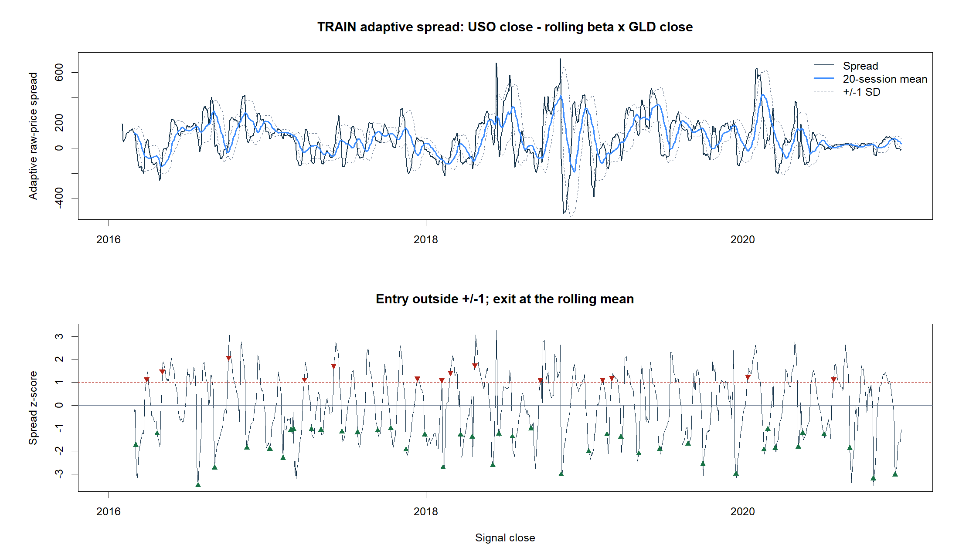
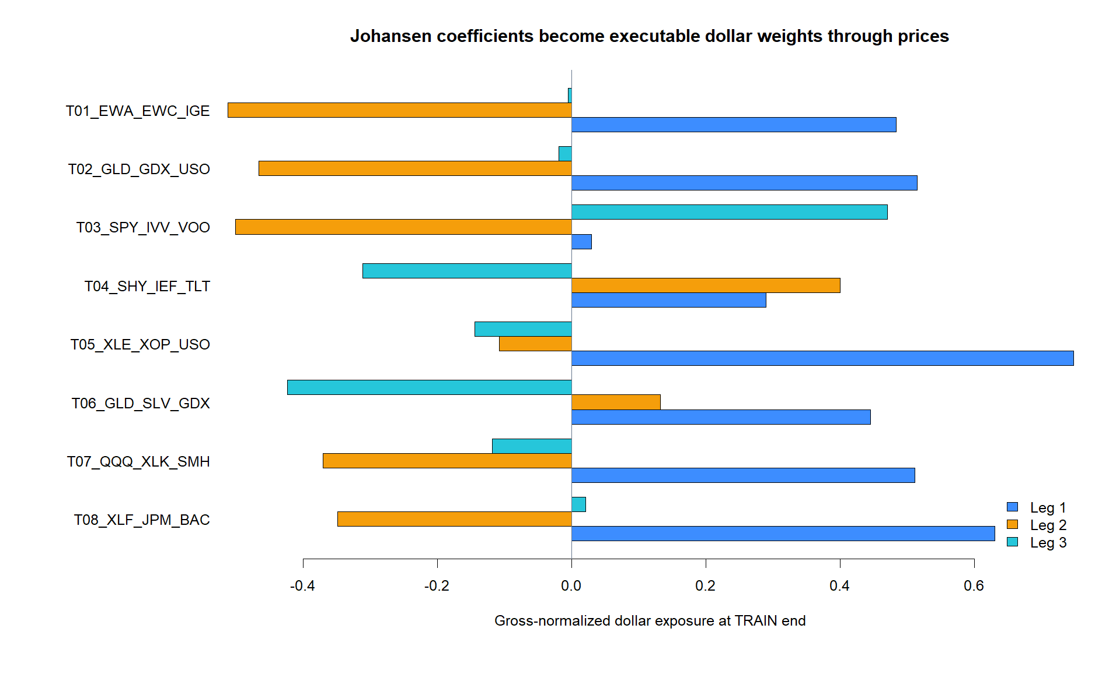
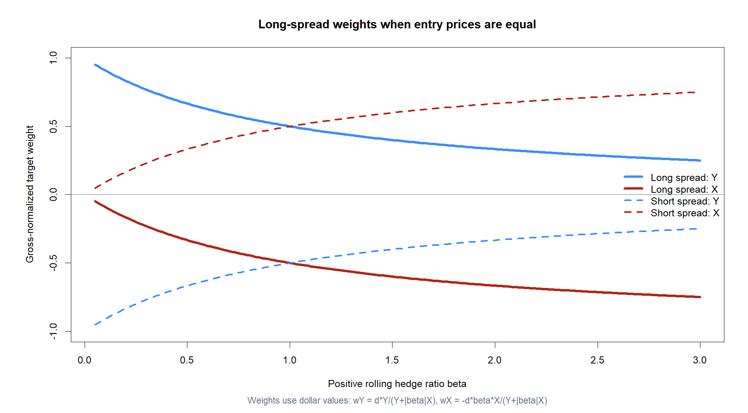
A share vector becomes daily executable dollar weights
TRAIN estimates β̂ once.
Development never refits it.
Unit-portfolio price:
sₜ = β̂ᵀpₜ
For direction d ∈ {−1,+1}:
wᵢ,ₜ = d·β̂ᵢPᵢ,ₜ / Σⱼ|β̂ⱼPⱼ,ₜ|
Signal after close; execute next open.
Gross exposure sums to one.
Primary cost: 5 bp per one-way weight change.
5
Notes:
The eigenvector is in shares, not dollars. Multiplying each coefficient by its price gives dollar exposure; dividing by total absolute dollar exposure makes candidates comparable and keeps the replay at one gross unit.
[Sources]
- C:/Users/Franc/OneDrive/Documents/Francis/Trading Literature/Algorithmic Trading - Winning Strategies and Their Rationale 2013.pdf, printed pp. 55–59; PDF pp. 73–77
- C:/Users/Franc/OneDrive/Documents/Francis/Peltata Project/Time-Series-Modeling-Gen5/runs/research_workbench/literature_grounded/lit_mr_03_1_triplets_20260729/mr03_cointegrating_vectors.csv
- C:/Users/Franc/OneDrive/Documents/Francis/Peltata Project/Time-Series-Modeling-Gen5/runs/research_workbench/literature_grounded/lit_mr_03_1_triplets_20260729/visuals/mr03_train_dollar_exposures.png

Slide 6
Chan’s EWA–EWC–IGE example supplies the direct anchor
Australia and Canada share commodity exposure; IGE adds natural-resource equities. Chan selects the leading Johansen eigenvector, treats it as shares, and reports a 23-day half-life in his sample.
EWA
EWC
IGE
Australian equity ETF
Commodity-sensitive economy
Canadian equity ETF
Commodity-sensitive economy
Natural-resource equity ETF
Potential common driver
6
Notes:
Chan's printed example reports all three relations rejected up to full rank in his sample, then uses the first eigenvector as the strongest relation. Gen5 pushes back: full rank needs careful interpretation, so this POC requires exactly rank one for a minimal unambiguous portfolio.
[Sources]
- C:/Users/Franc/OneDrive/Documents/Francis/Trading Literature/Algorithmic Trading - Winning Strategies and Their Rationale 2013.pdf, printed pp. 55–60; PDF pp. 73–78
- C:/Users/Franc/OneDrive/Documents/Francis/Peltata Project/Time-Series-Modeling-Gen5/docs/GEN5_LIT_MR_03_1_JOHANSEN_TRIPLET_POC_CONTRACT.md
- C:/Users/Franc/OneDrive/Documents/Francis/Peltata Project/Time-Series-Modeling-Gen5/docs/GEN5_4_DECISION_DIALOGUE_INDEX.md — D76

Slide 7
GLD–GDX–USO shows why a third leg can matter
Chan argues that GLD–GDX broke when oil made gold mining unusually expensive. Adding USO tests whether energy costs explain the pair’s failure rather than merely adding a convenient extra asset.
GLD
GDX
USO
Physical-gold proxy
Underlying output value
Gold-miner equities
Output value minus production costs
Oil-futures ETF
Imperfect energy-cost proxy
7
Notes:
This is a scientific omitted-factor hypothesis, not a generic instruction to add more legs. Chan also warns that USO holds futures rather than spot oil, so commodity-producer relationships can fail through roll and basis behavior.
[Sources]
- C:/Users/Franc/OneDrive/Documents/Francis/Trading Literature/Algorithmic Trading - Winning Strategies and Their Rationale 2013.pdf, printed pp. 91–92; PDF pp. 109–110
- C:/Users/Franc/OneDrive/Documents/Francis/Peltata Project/Time-Series-Modeling-Gen5/docs/GEN5_LIT_MR_03_1_JOHANSEN_TRIPLET_POC_CONTRACT.md

Slide 8
Eight predeclared triplets cover anchors, duplicates, curves, and factors
The registry is intentionally small and mechanism-diverse. It is frozen before outcomes, and registry order—not return—would break a tie among full TRAIN passes.
2 anchors
3 complexes
3 structures
EWA–EWC–IGE
GLD–GDX–USO
Treasuries · energy · precious metals
Shared economic drivers
Duplicate claim · technology factor
Financial basket/components
8
Notes:
The registry contains eight candidates and 21 unique US-listed ETF or equity symbols, all with complete 2016–2020 adjusted-daily coverage after refresh.
[Sources]
- C:/Users/Franc/OneDrive/Documents/Francis/Peltata Project/Time-Series-Modeling-Gen5/docs/GEN5_LIT_MR_03_1_JOHANSEN_TRIPLET_POC_CONTRACT.md
- C:/Users/Franc/OneDrive/Documents/Francis/Peltata Project/Time-Series-Modeling-Gen5/runs/research_workbench/literature_grounded/lit_mr_03_1_triplets_20260729/mr03_triplet_registry.csv
- C:/Users/Franc/OneDrive/Documents/Francis/Peltata Project/Time-Series-Modeling-Gen5/runs/research_workbench/literature_grounded/lit_mr_03_1_triplets_20260729/mr03_train_coverage.csv

Slide 9
The leakage boundary is a one-way door
TRAIN may diagnose, estimate, and nominate. It may not generate a simulated OOS claim. Only a full pass freezes one identity and one vector before DEVELOPMENT is queried.
TRAIN
Freeze
DEVELOPMENT
2016–2020
Eight triplets · rank · stability · trading gates
First full pass in registry order
Identity and β̂ locked
2021–2023 queried only after nomination
One replay; no replacement
9
Notes:
CONFIRMATION beginning 2024 remains sealed regardless of the DEVELOPMENT result. Because no candidate fully passed TRAIN, the runner did not query DEVELOPMENT for strategy evaluation.
[Sources]
- C:/Users/Franc/OneDrive/Documents/Francis/Peltata Project/Time-Series-Modeling-Gen5/docs/GEN5_LIT_MR_03_1_JOHANSEN_TRIPLET_POC_CONTRACT.md
- C:/Users/Franc/OneDrive/Documents/Francis/Peltata Project/Time-Series-Modeling-Gen5/runs/research_workbench/literature_grounded/lit_mr_03_1_triplets_20260729/mr03_run_spec.csv
- C:/Users/Franc/OneDrive/Documents/Francis/Peltata Project/Time-Series-Modeling-Gen5/docs/GEN5_4_DECISION_DIALOGUE_INDEX.md — D74 and D77

Slide 10
G1–G4 establish admissibility, integration, rank, and vector stability
A triplet is not admitted merely because one spread looks quiet. The data and execution must be valid, the legs must behave like I(1), rank must be exactly one, and the vector must persist across TRAIN halves.
G1 · integrity
G2–G3 · structure
G4 · cosine ≥.85
13 timing, coverage, weight, cost checks
Mixed-sign vector required
Level/difference ADF-style diagnostics
Seeded rank-null bootstrap
Compare split-TRAIN dollar-exposure vectors
Sign-invariant similarity
10
Notes:
The ADF cutoff, exact-rank rule, and 0.85 cosine are project-designed thresholds. Chan motivates the tests and eigenvectors; he does not publish this admission checklist.
[Sources]
- C:/Users/Franc/OneDrive/Documents/Francis/Trading Literature/Algorithmic Trading - Winning Strategies and Their Rationale 2013.pdf, printed pp. 42–58; PDF pp. 60–76
- C:/Users/Franc/OneDrive/Documents/Francis/Peltata Project/Time-Series-Modeling-Gen5/docs/GEN5_LIT_MR_03_1_JOHANSEN_TRIPLET_POC_CONTRACT.md
- C:/Users/Franc/OneDrive/Documents/Francis/Peltata Project/Time-Series-Modeling-Gen5/runs/research_workbench/literature_grounded/lit_mr_03_1_triplets_20260729/mr03_train_gate_detail.csv

Slide 11
G5–G8 ask whether the stationary portfolio is plausibly tradeable
Statistical structure and strategy performance are separate claims. The remaining gates require a usable time scale, two-sided support, cost-aware return uncertainty, and direct forward convergence.
G5 · 2–60
G6–G7 · trades
G8 · corr <0
Session half-life range
Avoid near-noise and glacial reversion
≥30 completed · ≥10 each direction
Mean net >0 and lower 95% >0
z versus next-five return
Upper 95% bound must stay below zero
11
Notes:
All eight are conjunctive. This deliberately prevents a profitable TRAIN replay from substituting for mechanism evidence, or a cointegration test from substituting for costs.
[Sources]
- C:/Users/Franc/OneDrive/Documents/Francis/Peltata Project/Time-Series-Modeling-Gen5/docs/GEN5_LIT_MR_03_1_JOHANSEN_TRIPLET_POC_CONTRACT.md
- C:/Users/Franc/OneDrive/Documents/Francis/Peltata Project/Time-Series-Modeling-Gen5/runs/research_workbench/literature_grounded/lit_mr_03_1_triplets_20260729/mr03_train_gate_detail.csv

Slide 12
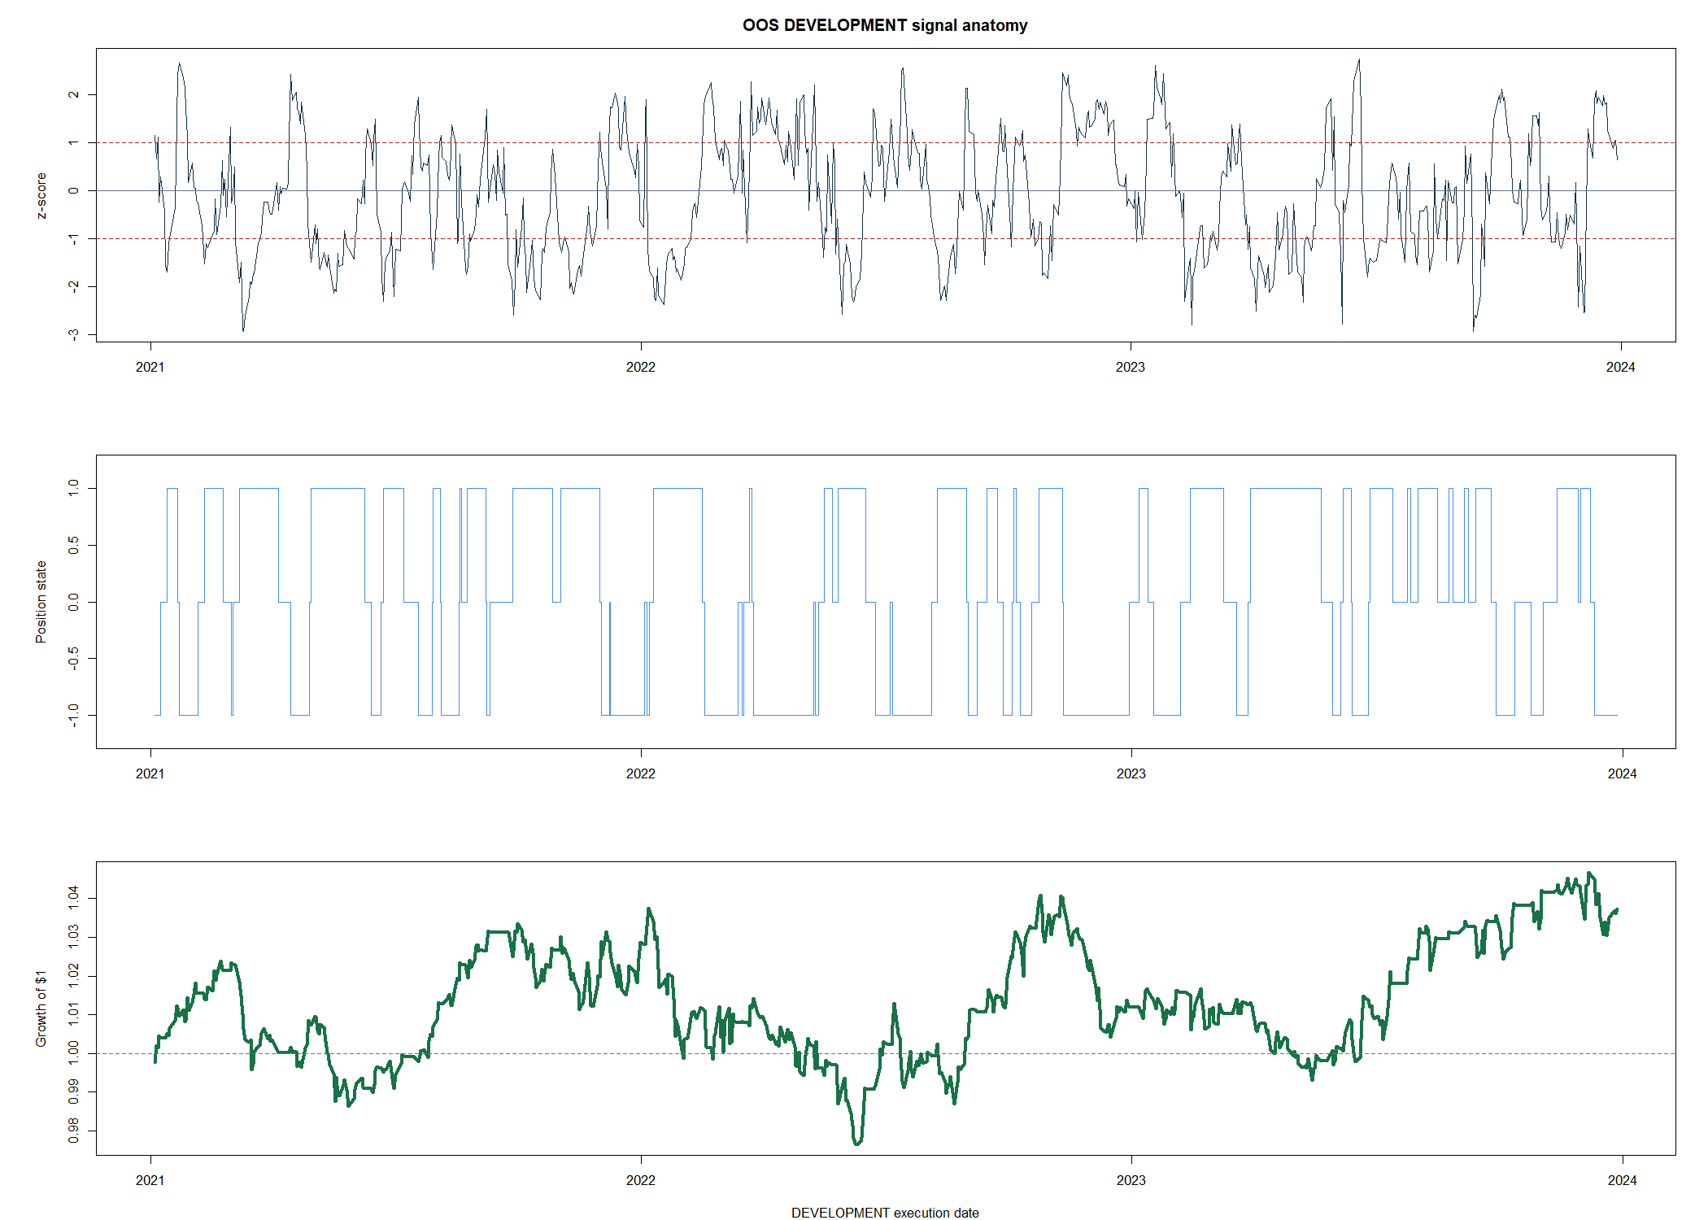
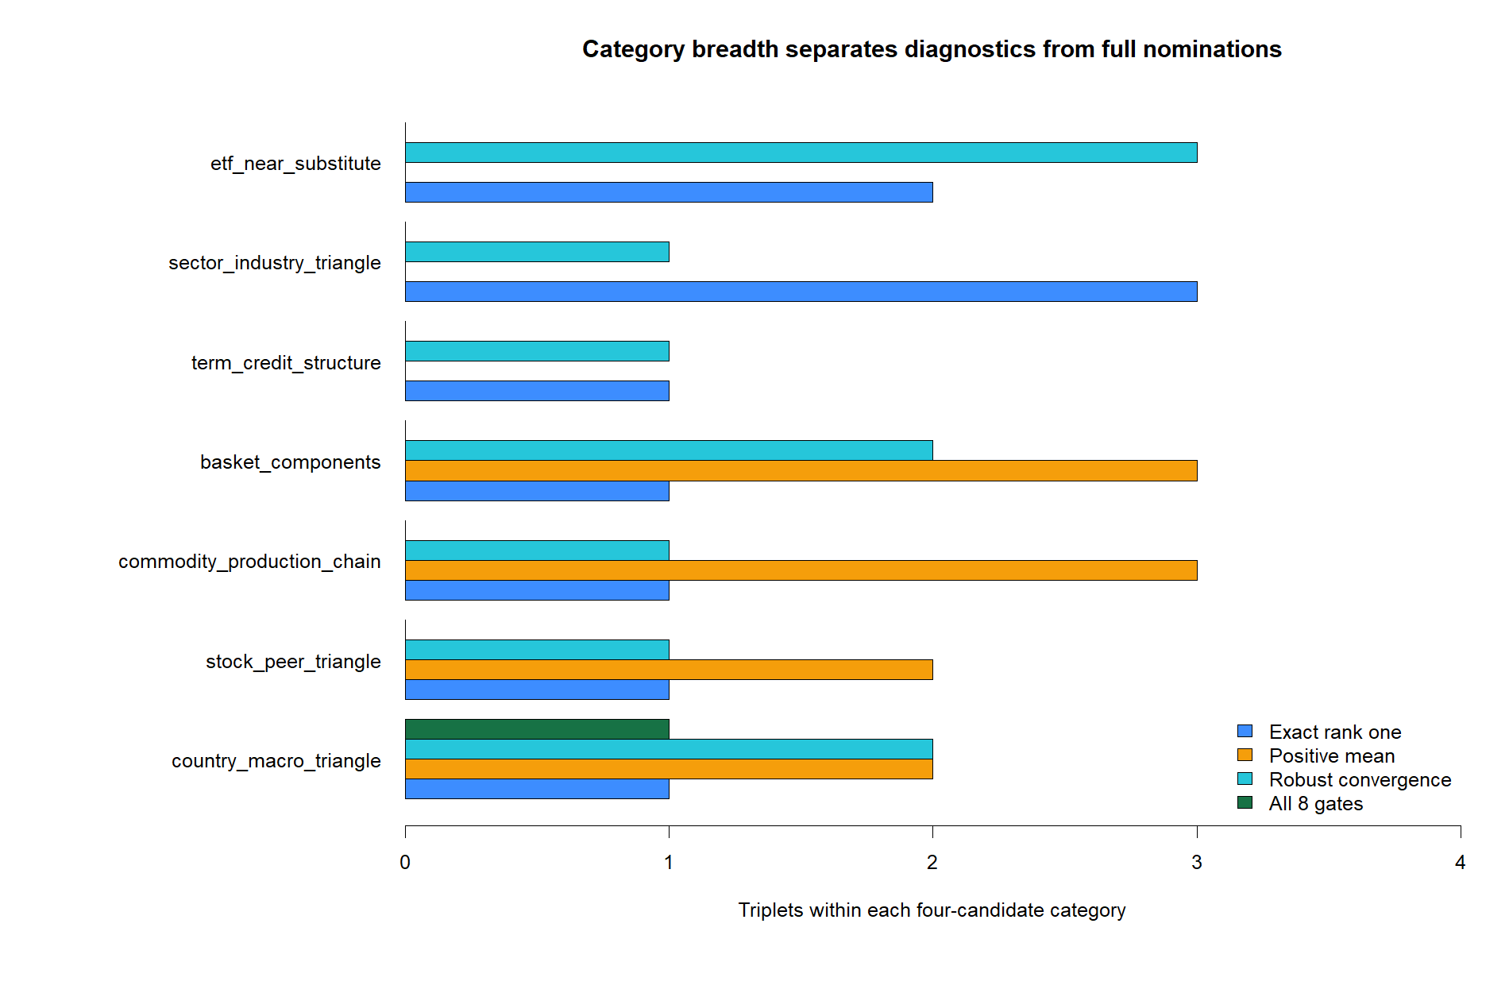
Five of eight triplets met the exact rank-one diagnostic
12
Notes:
Rank one requires rejecting rank 0 while not rejecting rank at most one. EWA–EWC–IGE, GLD–GDX–USO, SHY–IEF–TLT, XLE–XOP–USO, and GLD–SLV–GDX passed this diagnostic.
[Sources]
- C:/Users/Franc/OneDrive/Documents/Francis/Peltata Project/Time-Series-Modeling-Gen5/runs/research_workbench/literature_grounded/lit_mr_03_1_triplets_20260729/mr03_johansen_bootstrap_summary.csv
- C:/Users/Franc/OneDrive/Documents/Francis/Peltata Project/Time-Series-Modeling-Gen5/runs/research_workbench/literature_grounded/lit_mr_03_1_triplets_20260729/visuals/mr03_johansen_rank_diagnostics.png
- C:/Users/Franc/OneDrive/Documents/Francis/Peltata Project/Time-Series-Modeling-Gen5/R/gen5_lit_mr_03_1_triplet_poc.R

Slide 13
The frozen-vector signal has visibly different behavior by triplet
13
Notes:
These are TRAIN diagnostics, not trading claims. The duplicate-claim triplet reverts extremely quickly and fails the exact-rank and half-life gates, illustrating how micro-differences and adjustment noise can mimic an attractive spread.
[Sources]
- C:/Users/Franc/OneDrive/Documents/Francis/Peltata Project/Time-Series-Modeling-Gen5/runs/research_workbench/literature_grounded/lit_mr_03_1_triplets_20260729/mr03_train_summary.csv
- C:/Users/Franc/OneDrive/Documents/Francis/Peltata Project/Time-Series-Modeling-Gen5/runs/research_workbench/literature_grounded/lit_mr_03_1_triplets_20260729/visuals/mr03_train_signal_tapes.png

Slide 14
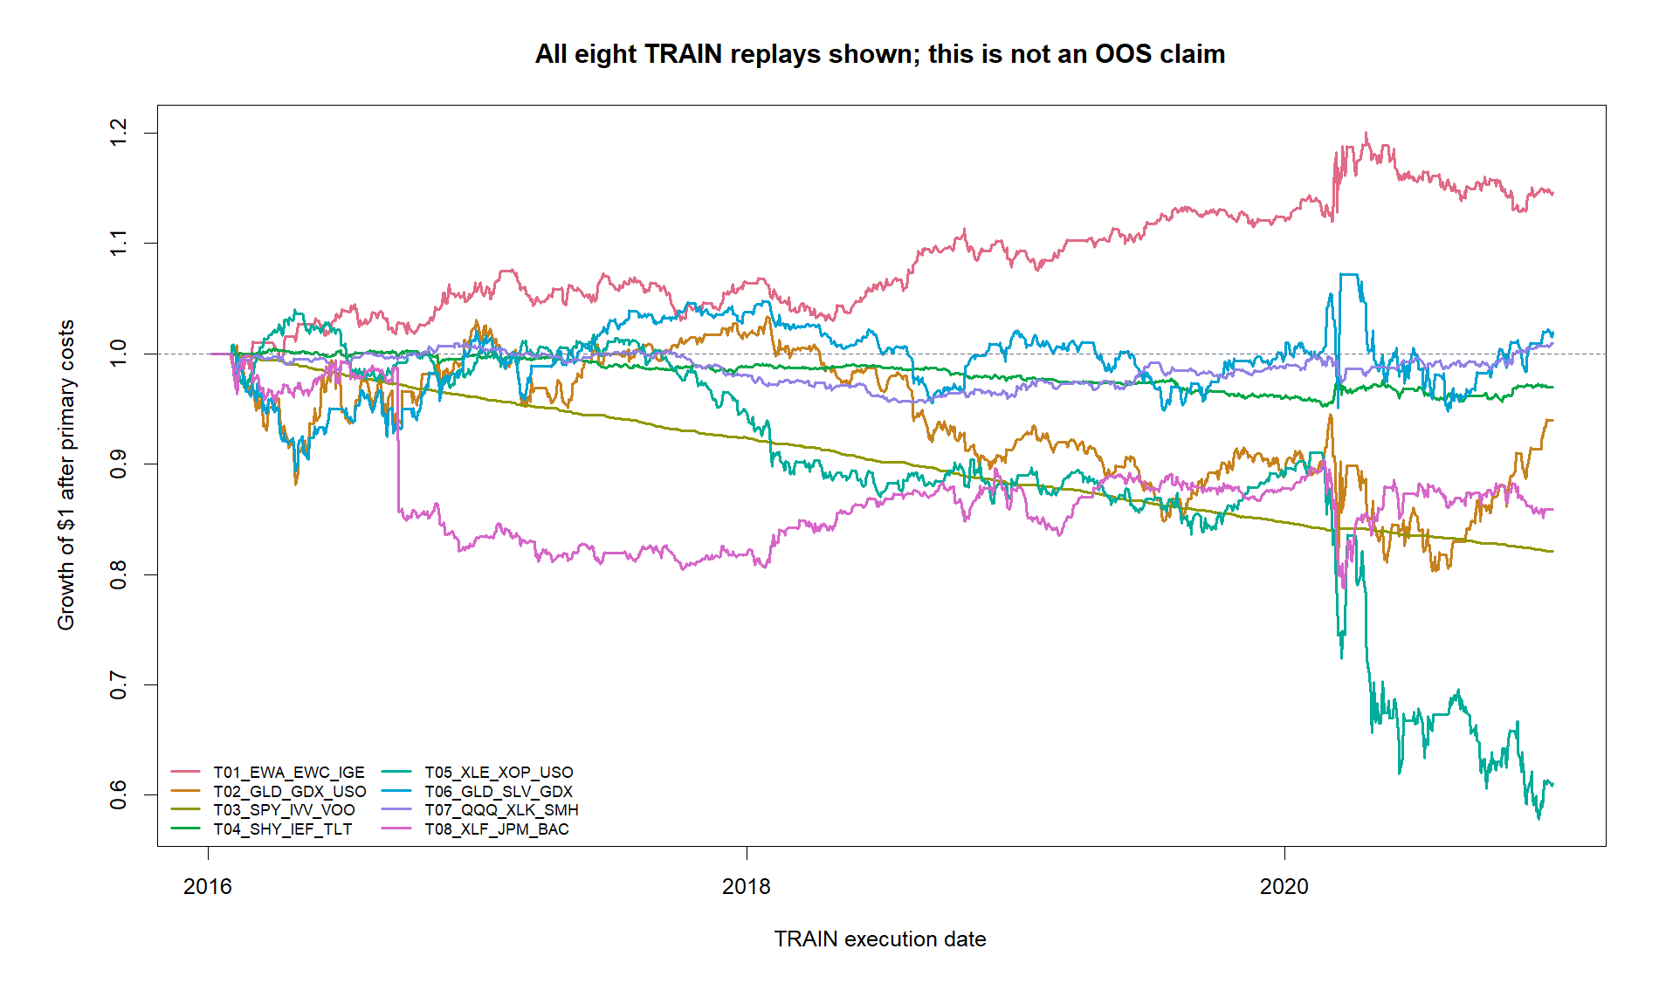
Every TRAIN equity path is shown—and none is OOS
14
Notes:
The curves are shown to connect statistical diagnostics to the implemented strategy. They are explicitly in-sample: TRAIN estimates each vector and evaluates its rule. A positive TRAIN curve cannot be described as simulated trading performance.
[Sources]
- C:/Users/Franc/OneDrive/Documents/Francis/Peltata Project/Time-Series-Modeling-Gen5/runs/research_workbench/literature_grounded/lit_mr_03_1_triplets_20260729/mr03_train_replay.csv
- C:/Users/Franc/OneDrive/Documents/Francis/Peltata Project/Time-Series-Modeling-Gen5/runs/research_workbench/literature_grounded/lit_mr_03_1_triplets_20260729/visuals/mr03_train_equity_curves.png
- C:/Users/Franc/OneDrive/Documents/Francis/Peltata Project/Time-Series-Modeling-Gen5/docs/GEN5_4_DECISION_DIALOGUE_INDEX.md — D77

Slide 15
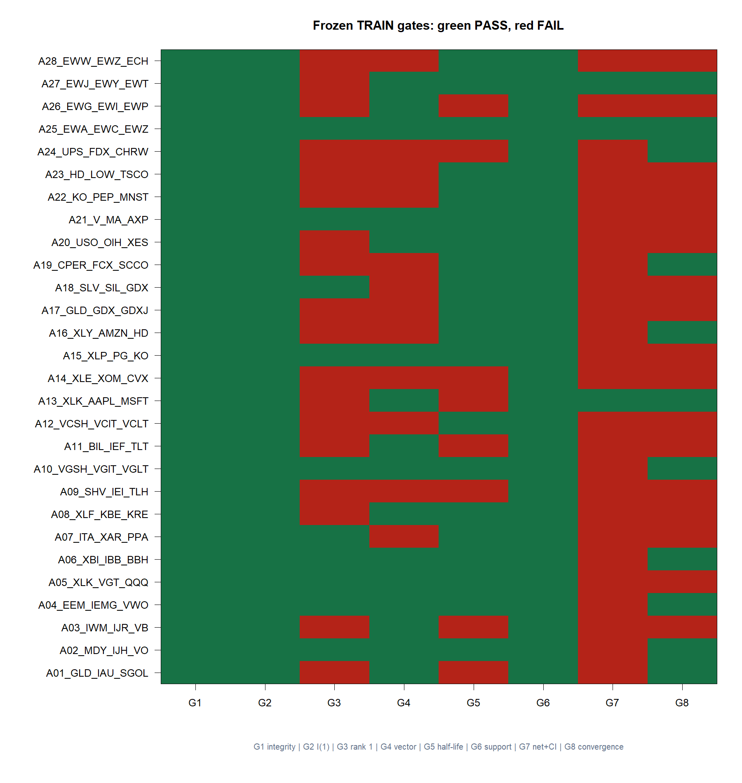
No triplet cleared all eight gates
Five passed exact rank one; three passed vector stability; seven passed half-life; all eight had two-sided support.
Only EWA–EWC–IGE passed cost-aware return uncertainty. Its convergence point estimate was negative, but the 95% upper bound was +0.028.
SHY–IEF–TLT robustly predicted convergence, but its mean net trade return was negative.
No nomination → no DEVELOPMENT replay.
15
Notes:
The two seven-of-eight near-misses fail different gates. That disagreement is precisely why the gate is conjunctive: EWA–EWC–IGE has economic TRAIN performance without robust forward-correlation uncertainty; SHY–IEF–TLT has robust forward convergence without positive net economics.
[Sources]
- C:/Users/Franc/OneDrive/Documents/Francis/Peltata Project/Time-Series-Modeling-Gen5/runs/research_workbench/literature_grounded/lit_mr_03_1_triplets_20260729/mr03_train_gate_detail.csv
- C:/Users/Franc/OneDrive/Documents/Francis/Peltata Project/Time-Series-Modeling-Gen5/runs/research_workbench/literature_grounded/lit_mr_03_1_triplets_20260729/mr03_train_summary.csv
- C:/Users/Franc/OneDrive/Documents/Francis/Peltata Project/Time-Series-Modeling-Gen5/runs/research_workbench/literature_grounded/lit_mr_03_1_triplets_20260729/visuals/mr03_train_gate_heatmap.png
- C:/Users/Franc/OneDrive/Documents/Francis/Peltata Project/Time-Series-Modeling-Gen5/docs/GEN5_4_DECISION_DIALOGUE_INDEX.md — D77

Slide 16
The near-misses are informative, but they do not authorize OOS
EWA–EWC–IGE and SHY–IEF–TLT each passed seven gates for opposite reasons. Reactively dropping one gate would redefine success after seeing the result.
T01 · 7/8
T04 · 7/8
0 nominated
+17.3 bp/trade · lower CI barely >0
G8 upper bound +0.028
G8 upper bound −0.021
Mean net −3.3 bp/trade
DEVELOPMENT not queried for performance
2024+ confirmation sealed
16
Notes:
This is professional pushback against a tempting rescue. T01 may warrant a future substantively different contract, but LIT-MR-03.1 itself stops exactly where frozen.
[Sources]
- C:/Users/Franc/OneDrive/Documents/Francis/Peltata Project/Time-Series-Modeling-Gen5/runs/research_workbench/literature_grounded/lit_mr_03_1_triplets_20260729/mr03_train_summary.csv
- C:/Users/Franc/OneDrive/Documents/Francis/Peltata Project/Time-Series-Modeling-Gen5/runs/research_workbench/literature_grounded/lit_mr_03_1_triplets_20260729/mr03_train_gate_detail.csv
- C:/Users/Franc/OneDrive/Documents/Francis/Peltata Project/Time-Series-Modeling-Gen5/docs/GEN5_LIT_MR_03_1_JOHANSEN_TRIPLET_POC_CONTRACT.md

Slide 17
LIT-MR-03.1 | STOP AT TRAIN
Triplets added structure.
They did not earn OOS.
Record five modern rank-one relationships and two instructive seven-of-eight near-misses. Preserve the TRAIN stop, keep DEVELOPMENT and confirmation sealed, and do not weaken the gates after inspection.
Notes:
The POC concretely tests a different literature mechanism from the rolling pair spread. Its null result is a valid research increment: the implementation works, the statistical distinctions are visible, and no in-sample result is mislabeled as OOS.
[Sources]
- C:/Users/Franc/OneDrive/Documents/Francis/Peltata Project/Time-Series-Modeling-Gen5/runs/research_workbench/literature_grounded/lit_mr_03_1_triplets_20260729/mr03_report.md
- C:/Users/Franc/OneDrive/Documents/Francis/Peltata Project/Time-Series-Modeling-Gen5/docs/GEN5_LIT_MR_03_1_JOHANSEN_TRIPLET_POC_CONTRACT.md
- C:/Users/Franc/OneDrive/Documents/Francis/Peltata Project/Time-Series-Modeling-Gen5/docs/GEN5_4_DECISION_DIALOGUE_INDEX.md — D77

Slide 18
LIT-MR-03.1 INSTANCE BATCH | 29 JUL 2026
Triplet Atlas 01
one strict pass, one OOS replay
Twenty-eight categorized hypotheses entered the unchanged TRAIN gate. EWA–EWC–EWZ alone earned a frozen-vector 2021–2023 replay.
Notes:
This section extends the original eight-triplet POC without changing its mechanics or reversing its STOP. The atlas is a separately frozen breadth batch.
[Sources]
- C:/Users/Franc/OneDrive/Documents/Francis/Peltata Project/Time-Series-Modeling-Gen5/docs/GEN5_LIT_MR_03_1_TRIPLET_ATLAS_01_CONTRACT.md
- C:/Users/Franc/OneDrive/Documents/Francis/Peltata Project/Time-Series-Modeling-Gen5/runs/research_workbench/literature_grounded/lit_mr_03_1_triplet_atlas_01_20260729/mr03_triplet_registry.csv
- C:/Users/Franc/OneDrive/Documents/Francis/Peltata Project/Time-Series-Modeling-Gen5/docs/GEN5_4_DECISION_DIALOGUE_INDEX.md — D78

Slide 19
The generator expands breadth without changing the strategy
Seven economic cells organize four predeclared triplets each. Categories make the hypothesis legible; they do not imply equal cointegration odds or authorize outcome-ranked selection.
7 cells
28 triplets
1 rule
Near substitutes · sector ETFs · curves
Basket/components
Commodity chains · stock peers
Country/macro triangles
Same Johansen rank · frozen vector
Same 20-session rule and eight gates
19
Notes:
The country/macro category is explicitly softer than duplicate-claim or term-structure hypotheses. The registry is finite and frozen in contract order.
[Sources]
- C:/Users/Franc/OneDrive/Documents/Francis/Peltata Project/Time-Series-Modeling-Gen5/docs/GEN5_LIT_MR_03_1_TRIPLET_ATLAS_01_CONTRACT.md
- C:/Users/Franc/OneDrive/Documents/Francis/Peltata Project/Time-Series-Modeling-Gen5/runs/research_workbench/literature_grounded/lit_mr_03_1_triplet_atlas_01_20260729/mr03_triplet_registry.csv
- C:/Users/Franc/OneDrive/Documents/Francis/Peltata Project/Time-Series-Modeling-Gen5/docs/GEN5_4_DECISION_DIALOGUE_INDEX.md — D78

Slide 20
Breadth increases multiplicity—but the leakage door stays one-way
Twenty-eight screens create more chances for an accidental TRAIN pass. The conjunction limits false nominations, while registry order and one-shot OOS prevent return ranking from choosing the winner.
TRAIN
First pass
One OOS
2016–2020 only
Every candidate reported
First 8/8 row in frozen order
Identity and β̂ locked
2021–2023 for that identity only
No replacement · 2024+ sealed
20
Notes:
The eight-gate conjunction is not a formal family-wise-error correction. A TRAIN pass authorizes one OOS test; it is not validation.
[Sources]
- C:/Users/Franc/OneDrive/Documents/Francis/Peltata Project/Time-Series-Modeling-Gen5/docs/GEN5_LIT_MR_03_1_TRIPLET_ATLAS_01_CONTRACT.md
- C:/Users/Franc/OneDrive/Documents/Francis/Peltata Project/Time-Series-Modeling-Gen5/runs/research_workbench/literature_grounded/lit_mr_03_1_triplet_atlas_01_20260729/mr03_run_spec.csv
- C:/Users/Franc/OneDrive/Documents/Francis/Peltata Project/Time-Series-Modeling-Gen5/docs/GEN5_4_DECISION_DIALOGUE_INDEX.md — D78 and D80

Slide 21
Categories separated common diagnostics from a full nomination
21
Notes:
Ten of 28 candidates passed exact rank one. Positive mean returns were concentrated outside near-substitute and curve cells. Only the country/macro cell produced a full eight-gate nomination.
[Sources]
- C:/Users/Franc/OneDrive/Documents/Francis/Peltata Project/Time-Series-Modeling-Gen5/runs/research_workbench/literature_grounded/lit_mr_03_1_triplet_atlas_01_20260729/mr03_category_summary.csv
- C:/Users/Franc/OneDrive/Documents/Francis/Peltata Project/Time-Series-Modeling-Gen5/runs/research_workbench/literature_grounded/lit_mr_03_1_triplet_atlas_01_20260729/visuals/mr03_category_summary.png
- C:/Users/Franc/OneDrive/Documents/Francis/Peltata Project/Time-Series-Modeling-Gen5/docs/GEN5_LIT_MR_03_1_TRIPLET_ATLAS_01_CONTRACT.md

Slide 22
One of 28 rows cleared the complete TRAIN conjunction
All 28 passed integrity, I(1), and two-sided support.
Ten passed exact rank one. Several produced positive means or robust convergence, but not the whole conjunction.
A25 · EWA–EWC–EWZ alone passed G1–G8.
Its identity and full-TRAIN vector were frozen before DEVELOPMENT was queried.
22
Notes:
The data-health WARN reflects bounded 2020 history being stale relative to the explicit 2026 as-of timestamp. All 78 required symbols covered the requested TRAIN interval after refresh.
[Sources]
- C:/Users/Franc/OneDrive/Documents/Francis/Peltata Project/Time-Series-Modeling-Gen5/runs/research_workbench/literature_grounded/lit_mr_03_1_triplet_atlas_01_20260729/mr03_train_gate_detail.csv
- C:/Users/Franc/OneDrive/Documents/Francis/Peltata Project/Time-Series-Modeling-Gen5/runs/research_workbench/literature_grounded/lit_mr_03_1_triplet_atlas_01_20260729/mr03_train_coverage.csv
- C:/Users/Franc/OneDrive/Documents/Francis/Peltata Project/Time-Series-Modeling-Gen5/runs/research_workbench/literature_grounded/lit_mr_03_1_triplet_atlas_01_20260729/mr03_train_workbench_query_health.csv
- C:/Users/Franc/OneDrive/Documents/Francis/Peltata Project/Time-Series-Modeling-Gen5/docs/GEN5_4_DECISION_DIALOGUE_INDEX.md — D79 and D80

Slide 23
EWA–EWC–EWZ earned the only TRAIN nomination
The unit portfolio was frozen as sₜ = EWAₜ − 0.6476·EWCₜ − 0.06286·EWZₜ. Price conversion then produced daily gross-normalized dollar weights without refitting β̂.
8 / 8
+17.7 bp
−0.127
Exact rank one · cosine .9986
Half-life 8.33 sessions
89 completed TRAIN trades
Lower 95% bound +1.81 bp
Forward-five correlation
Upper 95% bound −0.0249
23
Notes:
The TRAIN vector is [1, -0.6476169, -0.0628629]. It was estimated once on 2016–2020 and then held fixed throughout DEVELOPMENT.
[Sources]
- C:/Users/Franc/OneDrive/Documents/Francis/Peltata Project/Time-Series-Modeling-Gen5/runs/research_workbench/literature_grounded/lit_mr_03_1_triplet_atlas_01_20260729/mr03_cointegrating_vectors.csv
- C:/Users/Franc/OneDrive/Documents/Francis/Peltata Project/Time-Series-Modeling-Gen5/runs/research_workbench/literature_grounded/lit_mr_03_1_triplet_atlas_01_20260729/mr03_train_summary.csv
- C:/Users/Franc/OneDrive/Documents/Francis/Peltata Project/Time-Series-Modeling-Gen5/runs/research_workbench/literature_grounded/lit_mr_03_1_triplet_atlas_01_20260729/mr03_train_gate_detail.csv
- C:/Users/Franc/OneDrive/Documents/Francis/Peltata Project/Time-Series-Modeling-Gen5/docs/GEN5_4_DECISION_DIALOGUE_INDEX.md — D80

Slide 24
The frozen vector stayed positive OOS—but the margin was thin
24
Notes:
The sole 2021–2023 OOS replay produced 57 completed trades, +8.50 bp mean net return, 71.9% hit rate, +3.73% cumulative return, 0.283 naive Sharpe, 0.317 autocorrelation-adjusted Sharpe, and -5.88% maximum drawdown.
At the 10 bp stress cost, cumulative return was -3.23%. That cost sensitivity is the central limitation.
[Sources]
- C:/Users/Franc/OneDrive/Documents/Francis/Peltata Project/Time-Series-Modeling-Gen5/runs/research_workbench/literature_grounded/lit_mr_03_1_triplet_atlas_01_20260729/mr03_development_summary.csv
- C:/Users/Franc/OneDrive/Documents/Francis/Peltata Project/Time-Series-Modeling-Gen5/runs/research_workbench/literature_grounded/lit_mr_03_1_triplet_atlas_01_20260729/mr03_development_trades.csv
- C:/Users/Franc/OneDrive/Documents/Francis/Peltata Project/Time-Series-Modeling-Gen5/runs/research_workbench/literature_grounded/lit_mr_03_1_triplet_atlas_01_20260729/visuals/mr03_development_strategy_anatomy.png
- C:/Users/Franc/OneDrive/Documents/Francis/Peltata Project/Time-Series-Modeling-Gen5/docs/GEN5_4_DECISION_DIALOGUE_INDEX.md — D80

Slide 25
LIT-MR-03.1 | OOS DEVELOPMENT COMPLETE
A strict gate found a real OOS candidate.
Costs still set the boundary.
Preserve the modest +3.73% primary-cost OOS result and the −3.23% stress result together. Keep 2024+ sealed, and do not relax pair or triplet gates until a separately frozen discussion becomes a new contract.
Notes:
The atlas demonstrates that strict gating can produce a candidate and an honest OOS result. Its weakness is cost margin, not an inability to pass statistical screens. The current recommendation is DISCUSSION_ONLY_NO_GATE_CHANGE.
[Sources]
- C:/Users/Franc/OneDrive/Documents/Francis/Peltata Project/Time-Series-Modeling-Gen5/runs/research_workbench/literature_grounded/lit_mr_03_1_triplet_atlas_01_20260729/mr03_report.md
- C:/Users/Franc/OneDrive/Documents/Francis/Peltata Project/Time-Series-Modeling-Gen5/docs/GEN5_LIT_MR_03_1_TRIPLET_ATLAS_01_CONTRACT.md
- C:/Users/Franc/OneDrive/Documents/Francis/Peltata Project/Time-Series-Modeling-Gen5/docs/GEN5_LIT_MR_GATE_CALIBRATION_DISCUSSION_BRIEF.md
- C:/Users/Franc/OneDrive/Documents/Francis/Peltata Project/Time-Series-Modeling-Gen5/docs/GEN5_4_DECISION_DIALOGUE_INDEX.md — D80 and D81

