Slide 1
OPERATOR HYPOTHESIS LAB
HYP-MOM-04.3A
Audit the target
before adding features
TRAIN-only target structure audit • 481 stocks • 15 quarters • no 2021+ access
Notes:
This deck connects directly to H04.2. The purpose is to determine whether the outcome definition mixed stock selection with sector and beta exposure—not to rescue the failed model.
[Sources]
- operator_hypothesis_lab/docs/HYP_MOM_04_3A_TARGET_STRUCTURE_AUDIT_CONTRACT.md
- operator_hypothesis_lab/docs/HYP_MOM_04_3A_TARGET_STRUCTURE_AUDIT_RESULTS.md

Slide 2
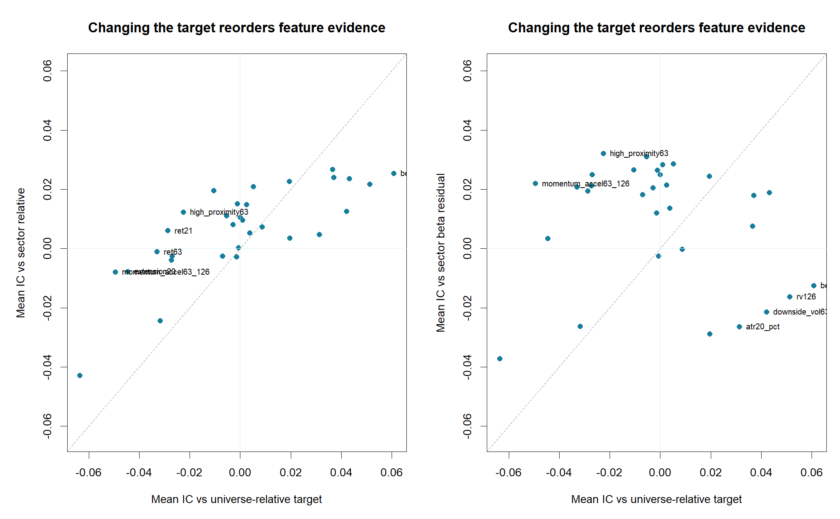
H04.2 exposed instability; H04.3A asks what the model was predicting
The feature atlas failed temporal transport
• Mean nested outer IC: −0.107
• Full-search p-value: 1.000
• Risk features looked attractive only in pooled views
New question
Did the target reward sector leadership and beta exposure rather than stock-specific strength?
2
Notes:
The causal sequence matters: H04.2 failed first. Only then did we open a new diagnostic lane to change the target question. We are not refitting H04.2 after seeing these plots.
[Sources]
- operator_hypothesis_lab/docs/HYP_MOM_04_2_FEATURE_ATLAS_RESULTS.md
- operator_hypothesis_lab/docs/HYP_MOM_04_3A_TARGET_STRUCTURE_AUDIT_CONTRACT.md

Slide 3
Each target answers a different economic question
Let Rᵢ be stock i's next-quarter return and βᵢ its causal 126-session beta at the signal date.
UNIVERSE RELATIVE
SECTOR RELATIVE
SECTOR + BETA RESIDUAL
yᵢ = Rᵢ − mean(R)
yᵢ = Rᵢ − mean(R | sector)
Rᵢ = αsector + γβᵢ + εᵢ
yᵢ = εᵢ
Who beat the eligible universe?
Who beat same-sector peers?
Who beat what sector and beta imply?
The residual target removes more variation—but that does not automatically make it the better investment objective.
3
Notes:
Universe-relative is the actual H04.2 implementation. Earlier conversational shorthand called it SPY-relative. Subtracting SPY would preserve ranks but would change the numerical excess-return level.
[Sources]
- operator_hypothesis_lab/docs/HYP_MOM_04_3A_TARGET_STRUCTURE_AUDIT_CONTRACT.md

Slide 4
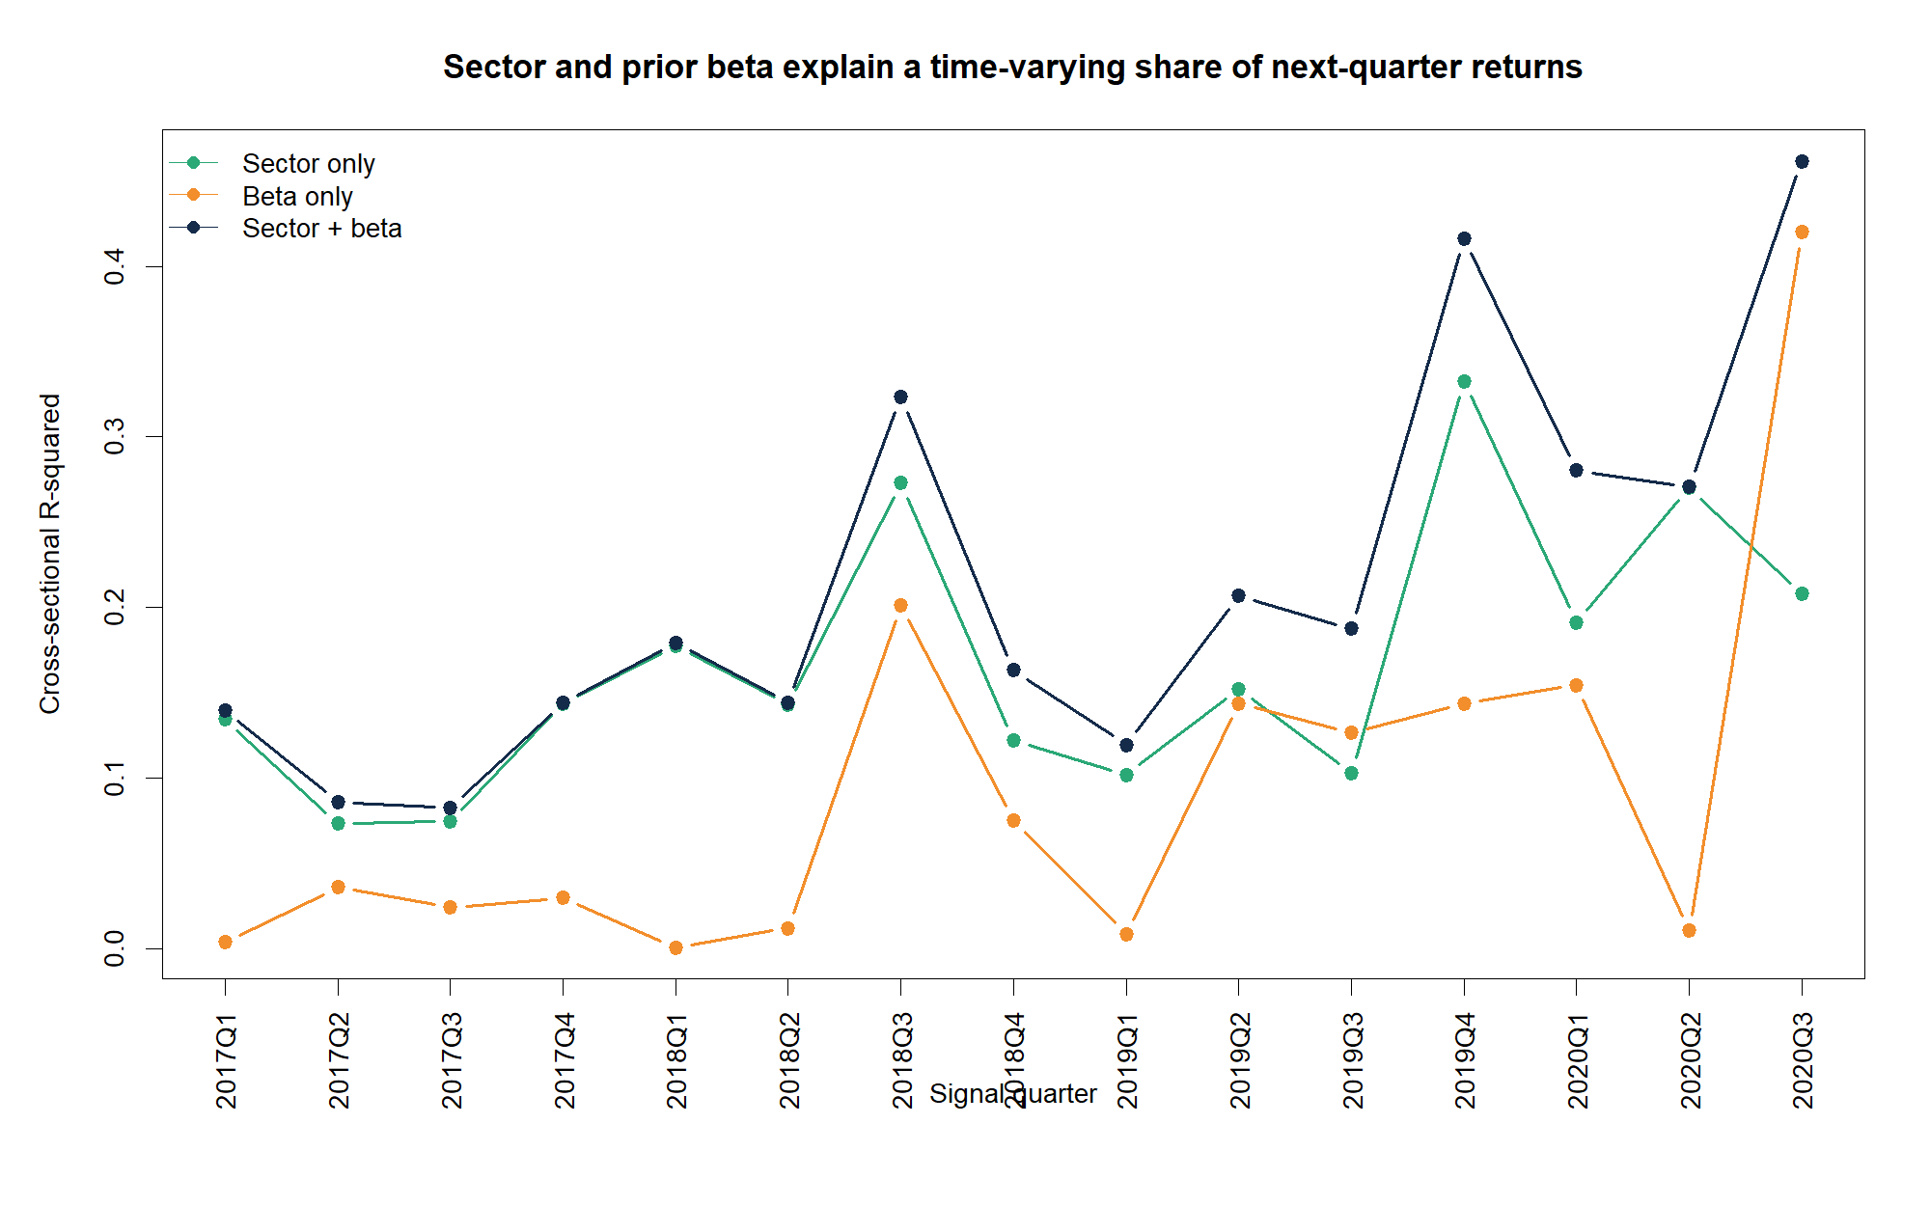
Sector and beta explain 21% on average—and 46% in H04.2's worst quarter
16.7%
average sector-only R²
46.2%
sector + beta R² in 2020Q3
(beta alone: 42.0%)
4
Notes:
This is a quarter-specific cross-sectional decomposition, not a forecast. The 2020Q3 spike matters because H04.2's selected model suffered its sharpest outer reversal in that same quarter.
[Sources]
- runs/research_workbench/operator_hypothesis_lab/hyp_mom_04_3a_target_structure_audit_20260811/hyp_mom_04_3a_return_decomposition_by_quarter.csv
- operator_hypothesis_lab/docs/HYP_MOM_04_2_FEATURE_ATLAS_RESULTS.md

Slide 5
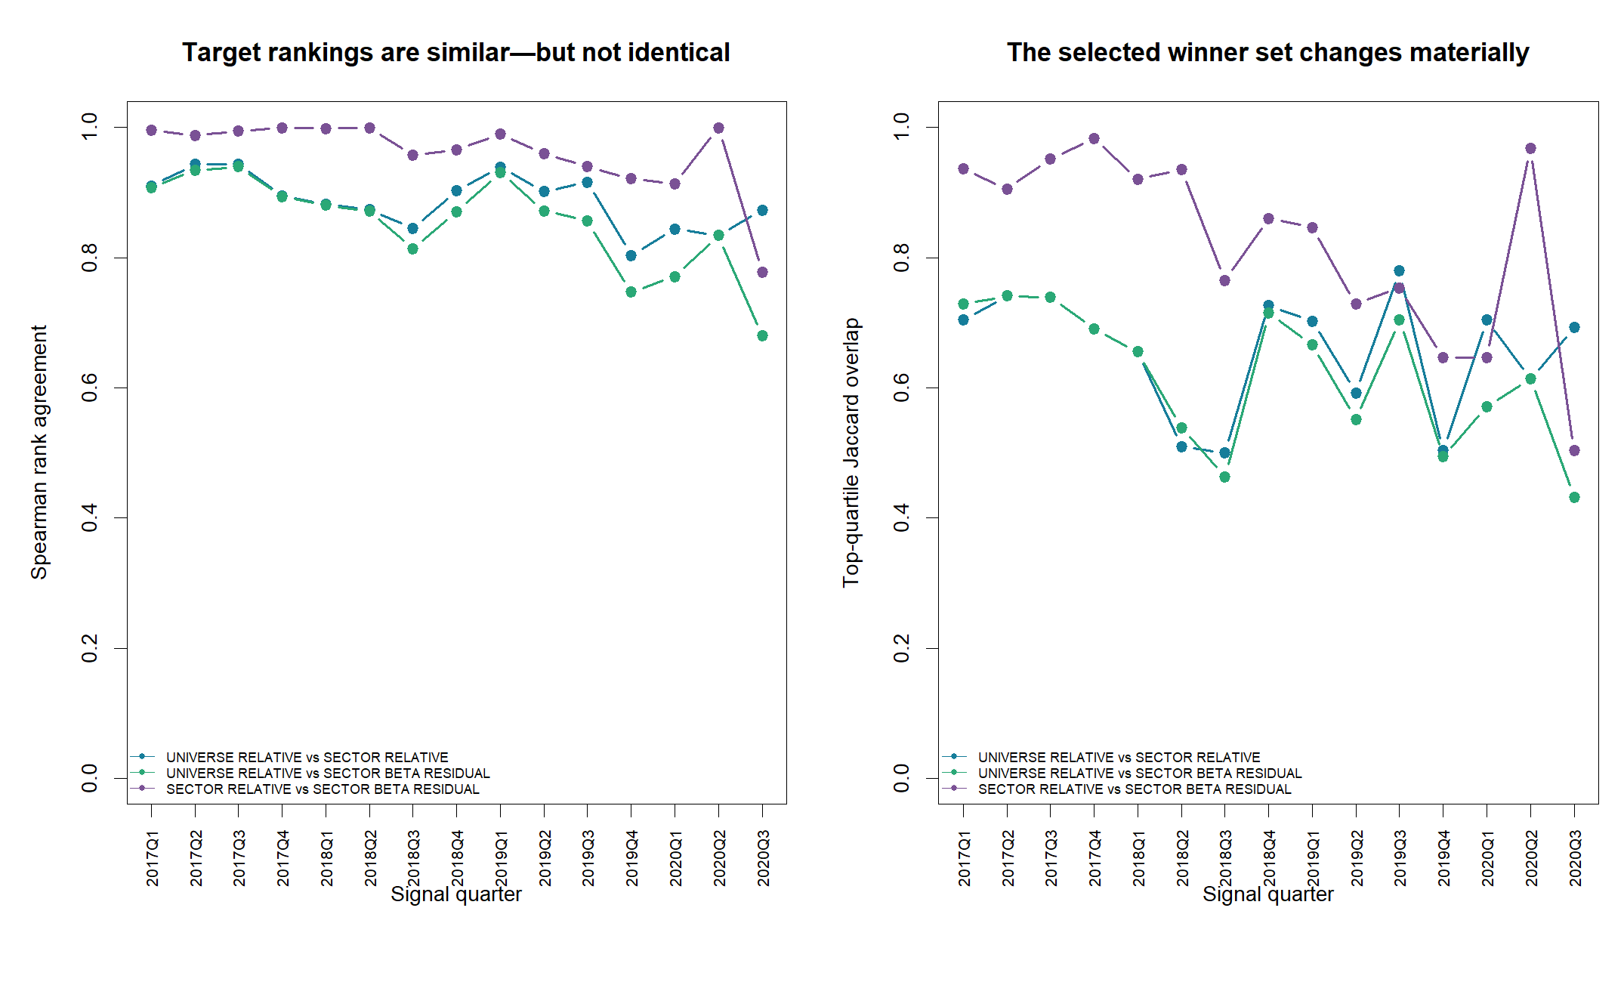
Sector neutralization changes roughly one-third of the realized winner set
Universe → sector
0.887 rank correlation
0.657 top-quartile overlap
Sector → residual
0.960 rank correlation
0.823 top-quartile overlap
Residualization usually adds less reordering—but 2020Q3 is the exception.
5
Notes:
Jaccard overlap compares the identities in each realized top quartile. A 0.657 overlap means the target is not merely relabeling the same winners.
[Sources]
- runs/research_workbench/operator_hypothesis_lab/hyp_mom_04_3a_target_structure_audit_20260811/hyp_mom_04_3a_target_agreement_by_quarter.csv

Slide 6
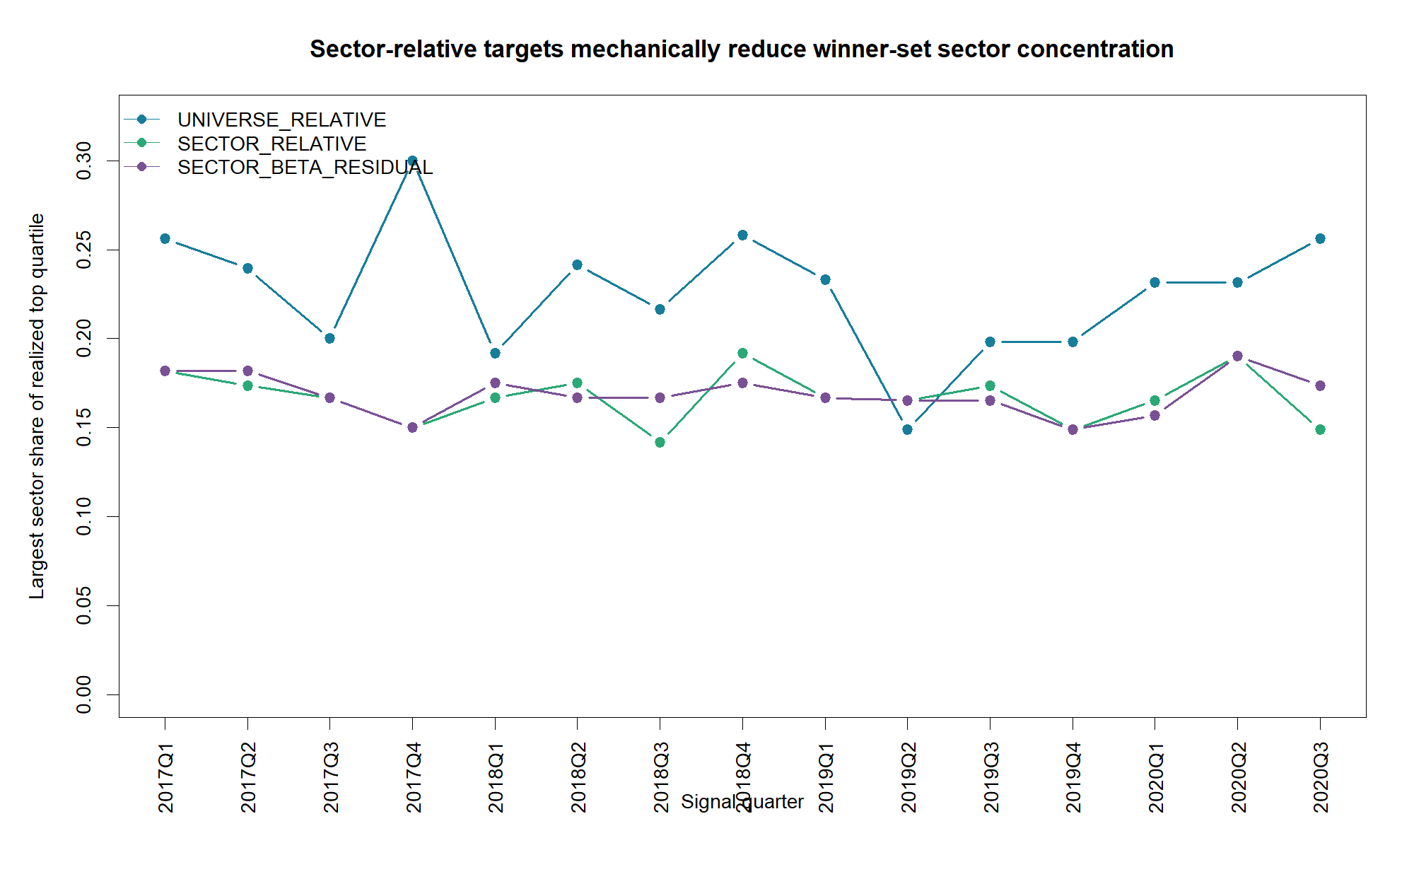
Sector-relative target reduces concentration without beta modeling
22.7%
universe-relative
16.7%
sector-relative
Residual target: 16.9%
6
Notes:
These are realized target top quartiles, not model-selected portfolios. The result shows what the target definition itself does to sector composition.
[Sources]
- runs/research_workbench/operator_hypothesis_lab/hyp_mom_04_3a_target_structure_audit_20260811/hyp_mom_04_3a_sector_concentration_by_quarter.csv

Slide 7
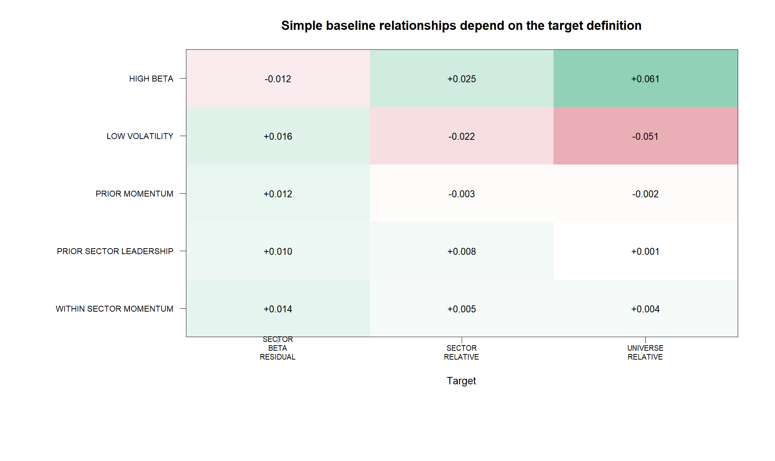
The strongest pooled H04.2 risk signals weaken after neutralization
Mean quarterly feature IC
Feature
Univ.
Sector
Residual
Beta 126
+0.061
+0.025
−0.012
RV 126
+0.051
+0.022
−0.016
Downside vol 63
+0.042
+0.013
−0.021
Interpretation: part of the apparent ‘alpha’ was rewarded exposure. Neutralization is diagnosis, not proof of a new signal.
7
Notes:
Spearman IC does not become exactly zero after OLS beta residualization because OLS enforces linear Pearson orthogonality, not rank orthogonality. The sign and magnitude changes remain informative.
[Sources]
- runs/research_workbench/operator_hypothesis_lab/hyp_mom_04_3a_target_structure_audit_20260811/hyp_mom_04_3a_feature_ic_summary.csv
- runs/research_workbench/operator_hypothesis_lab/hyp_mom_04_3a_target_structure_audit_20260811/hyp_mom_04_3a_baseline_ic_summary.csv

Slide 8
Target choice can reverse a feature conclusion
Largest shift
0.0715 IC
momentum acceleration
−0.0495 → +0.0220
This is a warning against choosing the target that flatters a preferred feature.
8
Notes:
The audit predeclared all 33 features and all three targets. It does not promote the largest shift; it shows that target engineering can become another form of data mining if target and feature selection happen together.
[Sources]
- runs/research_workbench/operator_hypothesis_lab/hyp_mom_04_3a_target_structure_audit_20260811/hyp_mom_04_3a_feature_ic_summary.csv

Slide 9
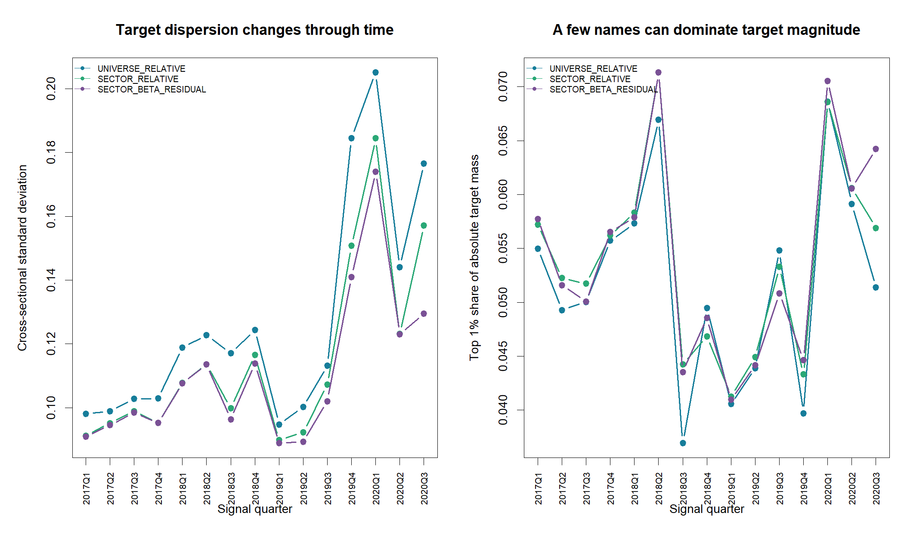
Neutralization reduces dispersion, but it does not remove tail dependence
Mean quarterly SD
12.69% Universe
11.49% Sector
11.05% Residual
Top 1% of names still contribute about 5.2%–5.4% of absolute target magnitude.
Cleaner ≠ noise-free
9
Notes:
Sector and beta removal shrink cross-sectional scale modestly. They do not solve outliers, regime instability, or the small number of independent quarters.
[Sources]
- runs/research_workbench/operator_hypothesis_lab/hyp_mom_04_3a_target_structure_audit_20260811/hyp_mom_04_3a_target_scale_summary.csv
- runs/research_workbench/operator_hypothesis_lab/hyp_mom_04_3a_target_structure_audit_20260811/hyp_mom_04_3a_target_scale_by_quarter.csv

Slide 10
Recommend sector-relative for the next discussion—not yet for OOS
It best balances economic clarity, confound removal, and auditability. Beta residualization remains a challenger for regime diagnosis.
16.7%
0.657
0 models
sector variation removed on average
winner overlap vs universe target
fit in this audit; OOS remains sealed
Next operator gate: explicitly freeze one target and a genuinely new temporal-depth design before any model is rerun.
10
Notes:
Status is TARGET_AUDIT_COMPLETE_SELECTION_NOT_FROZEN. The recommended next conversation is whether sector-relative return matches the intended economic objective and what new time evidence can support a future model test.
[Sources]
- operator_hypothesis_lab/docs/HYP_MOM_04_3A_TARGET_STRUCTURE_AUDIT_RESULTS.md
- operator_hypothesis_lab/docs/HYP_MOM_04_3A_TARGET_STRUCTURE_AUDIT_CONTRACT.md

