Slide 1
LIT-MR-02.2 + LIT-MR-03.2 | 29 JUL 2026
Measured gate easing
pairs and triplets
A preregistered relaxed lane replays prior candidates for curiosity and screens fresh candidates prospectively—without treating retrospective rescue as an alpha-discovery method.
Notes:
The original 02.1 and 03.1 specifications remain intact. This deck documents separate .2 challengers with quantitatively frozen relaxations and unchanged trading mechanics.
[Sources]
- C:/Users/Franc/OneDrive/Documents/Francis/Peltata Project/Time-Series-Modeling-Gen5/docs/GEN5_LIT_MR_RELAXED_GATE_QUANTITATIVE_REVIEW.md
- C:/Users/Franc/OneDrive/Documents/Francis/Peltata Project/Time-Series-Modeling-Gen5/docs/GEN5_LIT_MR_02_2_RELAXED_PAIR_CONTRACT.md
- C:/Users/Franc/OneDrive/Documents/Francis/Peltata Project/Time-Series-Modeling-Gen5/docs/GEN5_LIT_MR_03_2_RELAXED_TRIPLET_CONTRACT.md
- C:/Users/Franc/OneDrive/Documents/Francis/Peltata Project/Time-Series-Modeling-Gen5/docs/GEN5_4_DECISION_DIALOGUE_INDEX.md — D85–D88

Slide 2
Ease uncertainty thresholds—not integrity or identification
A gate should be relaxed only when it plausibly rejects a real but noisy effect. Data integrity, causal ordering, and basic relationship identification are not statistical luxuries.
KEEP
EASE
SEPARATE
Coverage · no leakage · stable sign
I(1) and rank-one logic for triplets
Support · bootstrap quantiles
Convergence and persistence ranges
Retrospective curiosity lane
Fresh preregistered discovery lane
2
Notes:
The firm gates protect test validity or define the object being traded. The softened gates express finite-sample confidence. Hit rate and positive-year counts remain visible diagnostics, but no longer carry mandatory veto power.
[Sources]
- C:/Users/Franc/OneDrive/Documents/Francis/Peltata Project/Time-Series-Modeling-Gen5/docs/GEN5_LIT_MR_RELAXED_GATE_QUANTITATIVE_REVIEW.md
- C:/Users/Franc/OneDrive/Documents/Francis/Peltata Project/Time-Series-Modeling-Gen5/docs/GEN5_LIT_MR_02_2_RELAXED_PAIR_CONTRACT.md
- C:/Users/Franc/OneDrive/Documents/Francis/Peltata Project/Time-Series-Modeling-Gen5/docs/GEN5_LIT_MR_03_2_RELAXED_TRIPLET_CONTRACT.md

Slide 3
LIT-MR-02.2 makes three measured changes to the pair screen
Positive rolling beta coverage (≥95%) and random-sign superiority remain mandatory. Hit rate and positive TRAIN years become diagnostics; mechanics, costs, dates, and the 2024+ seal are unchanged.
24 / 8
q10 > 0
q90 < 0
Completed TRAIN trades
At least eight each direction
One-sided 90% bootstrap
Net trade-return uncertainty
One-sided 90% convergence
Forward spread-change evidence
3
Notes:
Original 02.1 support was 30 total / 10 each direction. Original return and convergence intervals used 95% two-sided bounds. The relaxed contract switches only those confidence and support requirements.
[Sources]
- C:/Users/Franc/OneDrive/Documents/Francis/Peltata Project/Time-Series-Modeling-Gen5/docs/GEN5_LIT_MR_02_2_RELAXED_PAIR_CONTRACT.md
- C:/Users/Franc/OneDrive/Documents/Francis/Peltata Project/Time-Series-Modeling-Gen5/docs/GEN5_LIT_MR_RELAXED_GATE_QUANTITATIVE_REVIEW.md
- C:/Users/Franc/OneDrive/Documents/Francis/Peltata Project/Time-Series-Modeling-Gen5/docs/GEN5_4_DECISION_DIALOGUE_INDEX.md — D85

Slide 4
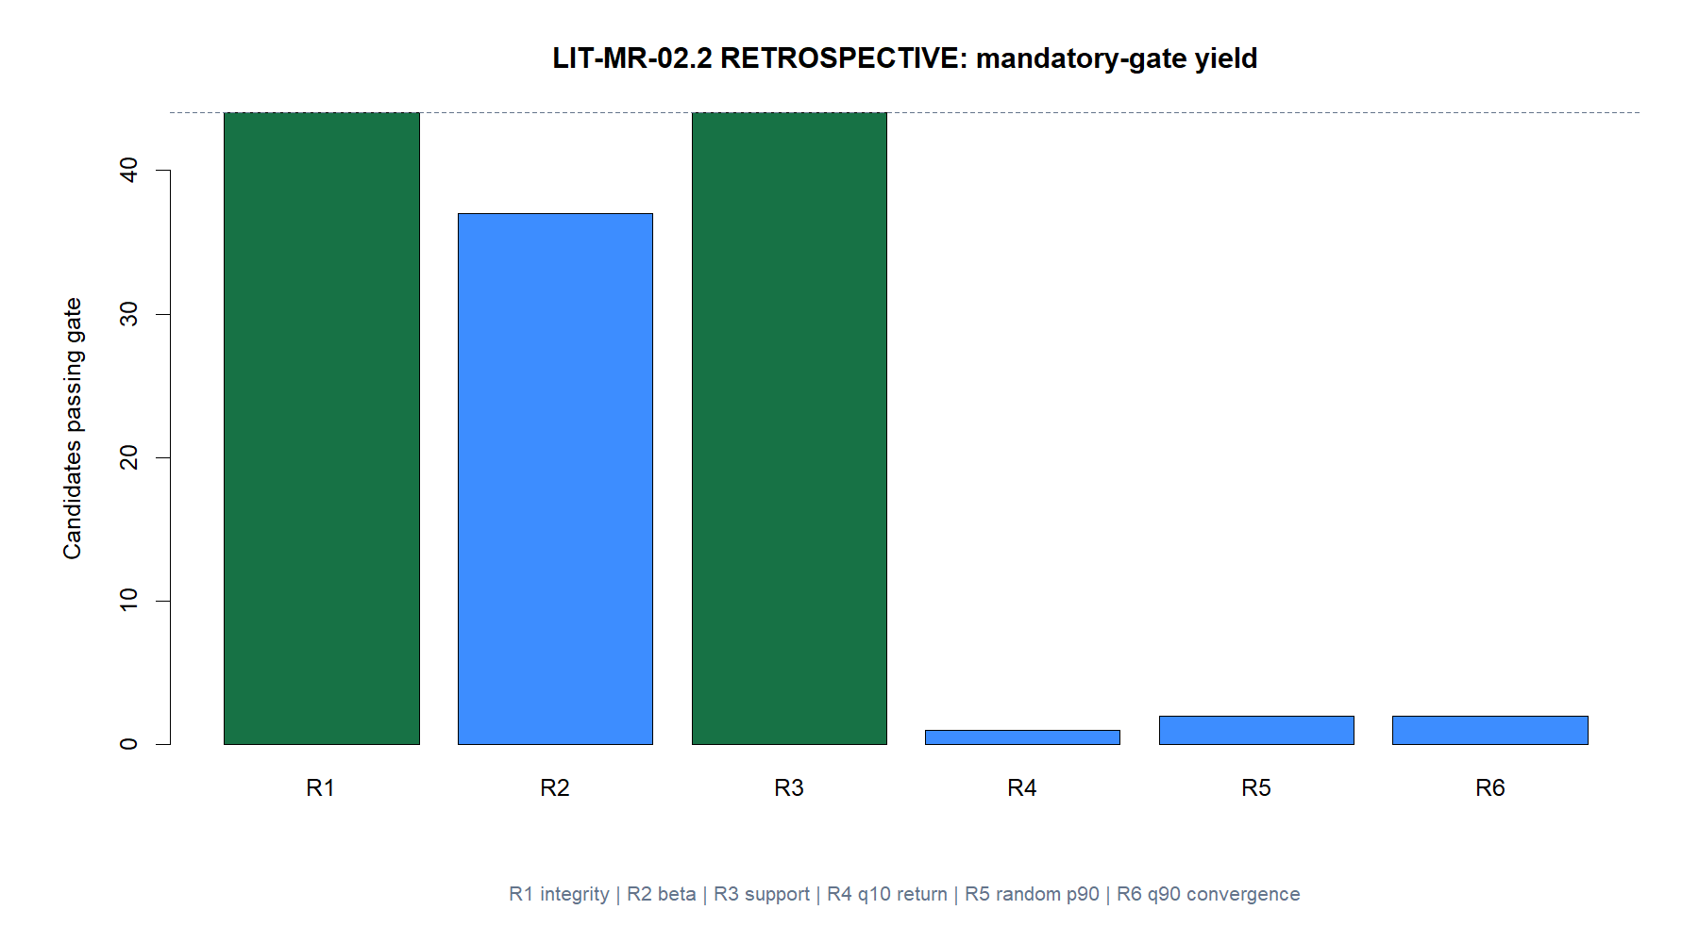
Retrospective pairs: one of 44 prior candidates entered OOS
4
Notes:
SIL–SLV was the sole relaxed full pass. It was not a strict 02.1 pass. The retrospective lane is descriptive: the prior candidate list was known before this challenger, so the result cannot be promoted as a prospective discovery claim.
[Sources]
- C:/Users/Franc/OneDrive/Documents/Francis/Peltata Project/Time-Series-Modeling-Gen5/runs/research_workbench/literature_grounded/lit_mr_02_2_retrospective_20260729/mr022_train_gate_detail.csv
- C:/Users/Franc/OneDrive/Documents/Francis/Peltata Project/Time-Series-Modeling-Gen5/runs/research_workbench/literature_grounded/lit_mr_02_2_retrospective_20260729/mr022_run_spec.csv
- C:/Users/Franc/OneDrive/Documents/Francis/Peltata Project/Time-Series-Modeling-Gen5/docs/GEN5_LIT_MR_02_2_03_2_RELAXED_GATE_RESULTS.md
- C:/Users/Franc/OneDrive/Documents/Francis/Peltata Project/Time-Series-Modeling-Gen5/docs/GEN5_4_DECISION_DIALOGUE_INDEX.md — D85

Slide 5
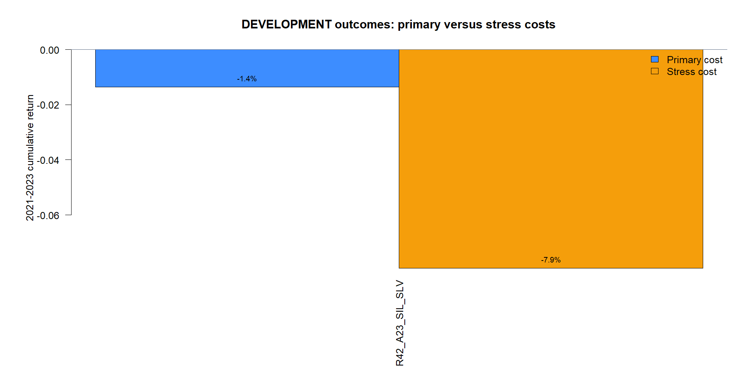
SIL–SLV looked acceptable by trade—and lost money bar by bar
5
Notes:
TRAIN: 69 trades, +56.8 bp mean net return, q10 +3.0 bp, 53.6% hit rate. OOS 2021–2023: 47 trades, +7.7 bp mean trade return and 63.8% hit rate, yet -1.36% primary-cost cumulative return, -7.94% stress return, and -16.34% maximum drawdown.
The divergence is not a contradiction. A completed-trade average and hit rate ignore bar-by-bar exposure, rehedging, path dependence, and compounding. Both accounting views are needed.
[Sources]
- C:/Users/Franc/OneDrive/Documents/Francis/Peltata Project/Time-Series-Modeling-Gen5/runs/research_workbench/literature_grounded/lit_mr_02_2_retrospective_20260729/mr022_development_summary.csv
- C:/Users/Franc/OneDrive/Documents/Francis/Peltata Project/Time-Series-Modeling-Gen5/runs/research_workbench/literature_grounded/lit_mr_02_2_retrospective_20260729/mr022_development_trades.csv
- C:/Users/Franc/OneDrive/Documents/Francis/Peltata Project/Time-Series-Modeling-Gen5/runs/research_workbench/literature_grounded/lit_mr_02_2_retrospective_20260729/visuals/mr022_development_cost_comparison.png
- C:/Users/Franc/OneDrive/Documents/Francis/Peltata Project/Time-Series-Modeling-Gen5/docs/GEN5_4_DECISION_DIALOGUE_INDEX.md — D85

Slide 6
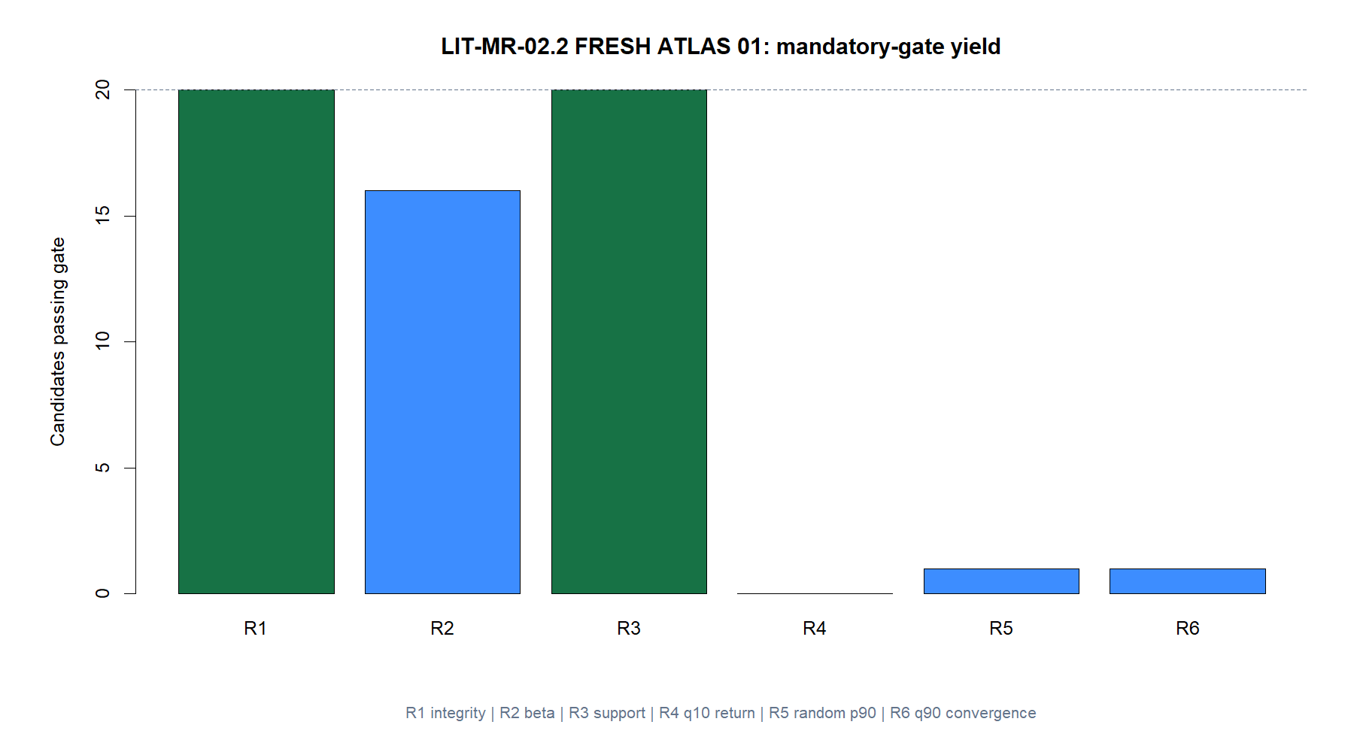
Fresh pairs: broader economic logic still produced no nomination
Twenty preregistered pairs crossed broad substitutes, factors, industries, curves, credit, and stock peers.
All passed integrity and support. Sixteen passed beta coverage.
Zero passed the relaxed q10 return gate. Only one passed random-sign superiority and one robust convergence.
No OOS pair was opened.
6
Notes:
The fresh registry was frozen before evaluation. F17 XOM–CVX reached four of six mandatory gates but missed beta coverage, q10 return, and the full conjunction. The correct outcome is STOP_LIT_MR_02_2_FRESH_ATLAS_01_NO_PASS.
[Sources]
- C:/Users/Franc/OneDrive/Documents/Francis/Peltata Project/Time-Series-Modeling-Gen5/runs/research_workbench/literature_grounded/lit_mr_02_2_fresh_atlas_01_20260729/mr022_registry.csv
- C:/Users/Franc/OneDrive/Documents/Francis/Peltata Project/Time-Series-Modeling-Gen5/runs/research_workbench/literature_grounded/lit_mr_02_2_fresh_atlas_01_20260729/mr022_train_gate_detail.csv
- C:/Users/Franc/OneDrive/Documents/Francis/Peltata Project/Time-Series-Modeling-Gen5/runs/research_workbench/literature_grounded/lit_mr_02_2_fresh_atlas_01_20260729/mr022_report.md
- C:/Users/Franc/OneDrive/Documents/Francis/Peltata Project/Time-Series-Modeling-Gen5/docs/GEN5_LIT_MR_02_2_03_2_RELAXED_GATE_RESULTS.md
- C:/Users/Franc/OneDrive/Documents/Francis/Peltata Project/Time-Series-Modeling-Gen5/docs/GEN5_4_DECISION_DIALOGUE_INDEX.md — D86

Slide 7
LIT-MR-03.2 widens persistence tolerance without changing rank logic
Integrity, all-leg I(1), exact Johansen rank one, support, return uncertainty, and convergence remain mandatory. The cointegrating vector is still estimated only in TRAIN and frozen for OOS.
0.80
2–90
24 / 8
Minimum split-sample cosine
Down from 0.85
Accepted half-life sessions
Upper bound widened from 60
Completed TRAIN trades
With q10 return and q90 convergence
7
Notes:
The exact-rank-one requirement remains because the strategy needs one interpretable stationary combination rather than an unstable or underidentified portfolio. The support, return, and convergence changes mirror the pair challenger.
[Sources]
- C:/Users/Franc/OneDrive/Documents/Francis/Peltata Project/Time-Series-Modeling-Gen5/docs/GEN5_LIT_MR_03_2_RELAXED_TRIPLET_CONTRACT.md
- C:/Users/Franc/OneDrive/Documents/Francis/Peltata Project/Time-Series-Modeling-Gen5/docs/GEN5_LIT_MR_RELAXED_GATE_QUANTITATIVE_REVIEW.md
- C:/Users/Franc/OneDrive/Documents/Francis/Peltata Project/Time-Series-Modeling-Gen5/docs/GEN5_4_DECISION_DIALOGUE_INDEX.md — D86

Slide 8
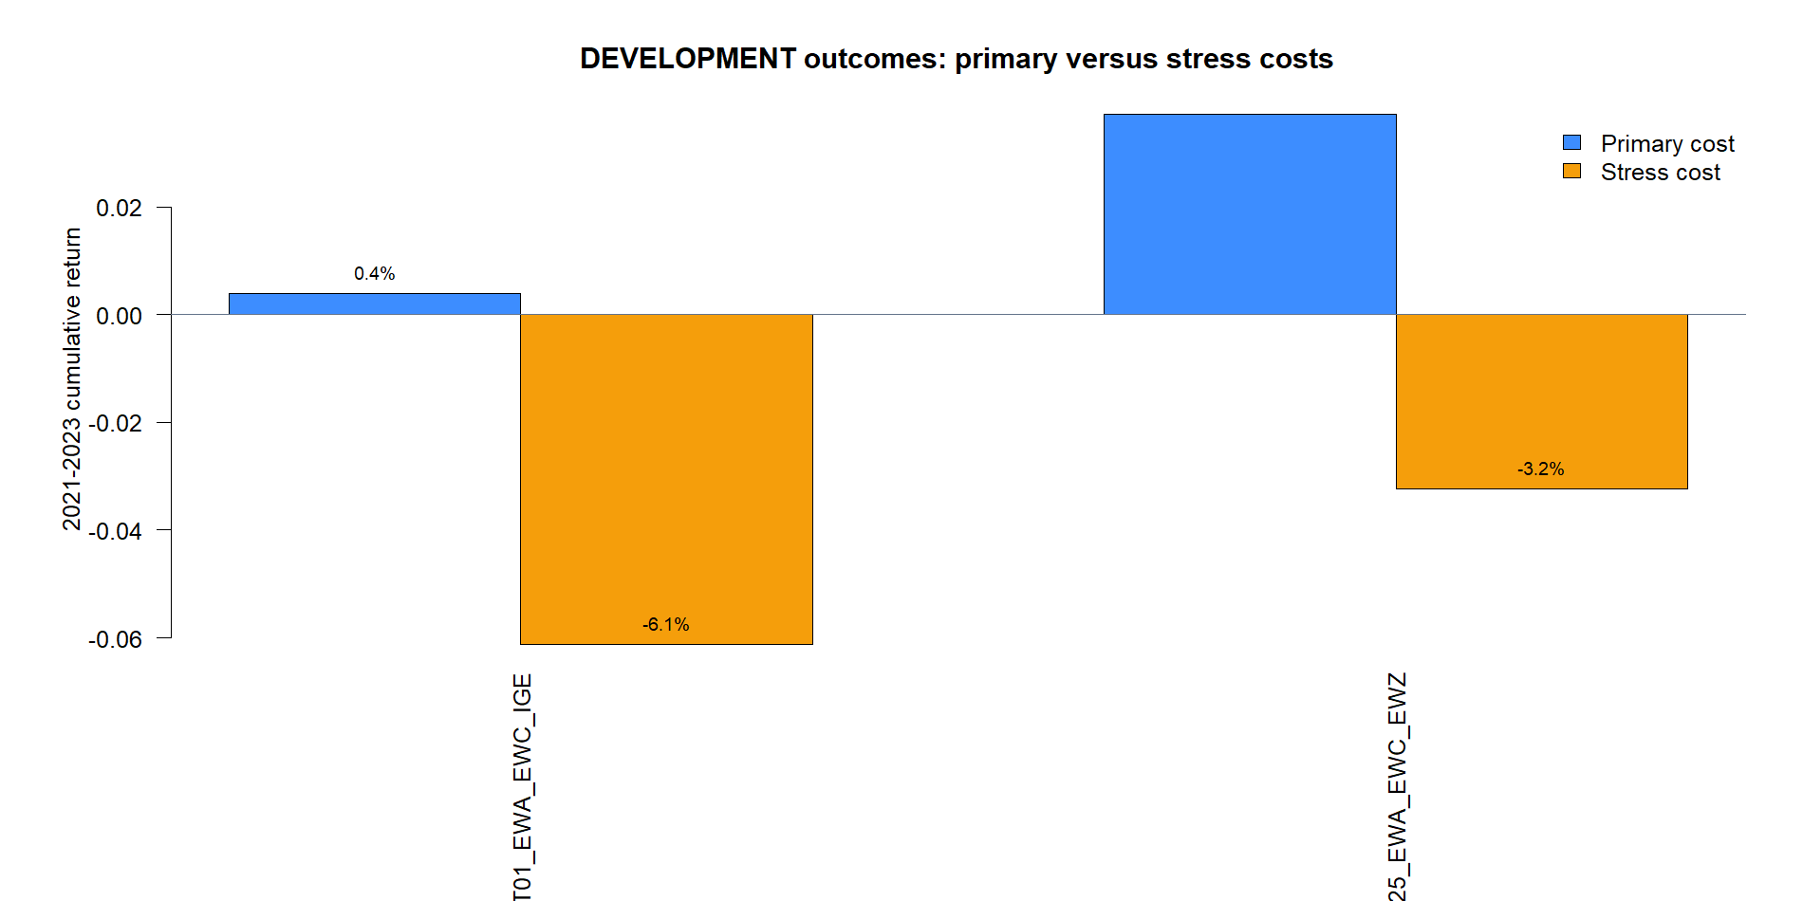
Retrospective triplets: easing added one weak OOS candidate
8
Notes:
Two of 36 prior triplets passed the relaxed conjunction. A25 EWA–EWC–EWZ had already passed all strict gates and remains the known survivor: +3.73% primary, -3.23% stress. T01 EWA–EWC–IGE was added only by q90 convergence: +0.38% primary, -6.13% stress.
This is useful sensitivity evidence, not a discovery victory. The incremental relaxed survivor had almost no primary-cost margin.
[Sources]
- C:/Users/Franc/OneDrive/Documents/Francis/Peltata Project/Time-Series-Modeling-Gen5/runs/research_workbench/literature_grounded/lit_mr_03_2_retrospective_20260729/mr032_train_gate_detail.csv
- C:/Users/Franc/OneDrive/Documents/Francis/Peltata Project/Time-Series-Modeling-Gen5/runs/research_workbench/literature_grounded/lit_mr_03_2_retrospective_20260729/mr032_development_summary.csv
- C:/Users/Franc/OneDrive/Documents/Francis/Peltata Project/Time-Series-Modeling-Gen5/runs/research_workbench/literature_grounded/lit_mr_03_2_retrospective_20260729/visuals/mr032_development_cost_comparison.png
- C:/Users/Franc/OneDrive/Documents/Francis/Peltata Project/Time-Series-Modeling-Gen5/docs/GEN5_LIT_MR_02_2_03_2_RELAXED_GATE_RESULTS.md
- C:/Users/Franc/OneDrive/Documents/Francis/Peltata Project/Time-Series-Modeling-Gen5/docs/GEN5_4_DECISION_DIALOGUE_INDEX.md — D86

Slide 9
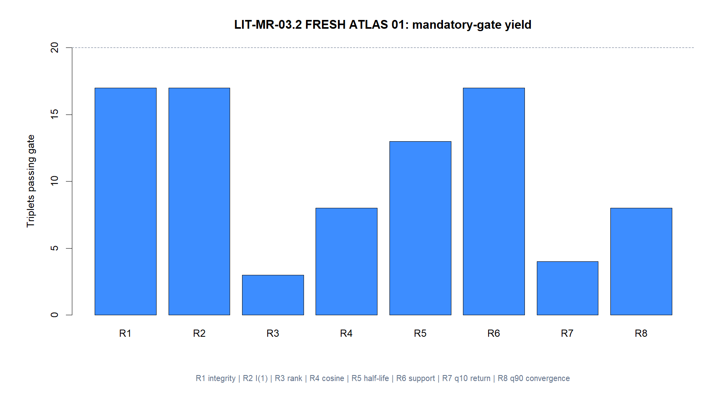
Fresh triplets: one clean TRAIN pass, three honest coverage failures
Twenty frozen hypotheses spanned near substitutes, sectors, curves, basket/components, and stock peers.
SPLG, REMX, and IGIB lacked full TRAIN history. Their three candidates remained in the ledger as ineligible—no replacements.
Among 17 eligible triplets, F20 UNP–CSX–NSC alone passed all relaxed gates.
It also passed every original strict gate.
9
Notes:
Coverage failures were retained rather than silently replaced, preserving the frozen registry. F20 was the first and only full pass in that registry, so its identity and vector were locked before OOS.
[Sources]
- C:/Users/Franc/OneDrive/Documents/Francis/Peltata Project/Time-Series-Modeling-Gen5/runs/research_workbench/literature_grounded/lit_mr_03_2_fresh_atlas_01_20260729/mr032_registry.csv
- C:/Users/Franc/OneDrive/Documents/Francis/Peltata Project/Time-Series-Modeling-Gen5/runs/research_workbench/literature_grounded/lit_mr_03_2_fresh_atlas_01_20260729/mr032_train_coverage.csv
- C:/Users/Franc/OneDrive/Documents/Francis/Peltata Project/Time-Series-Modeling-Gen5/runs/research_workbench/literature_grounded/lit_mr_03_2_fresh_atlas_01_20260729/mr032_train_gate_detail.csv
- C:/Users/Franc/OneDrive/Documents/Francis/Peltata Project/Time-Series-Modeling-Gen5/docs/GEN5_LIT_MR_02_2_03_2_RELAXED_GATE_RESULTS.md
- C:/Users/Franc/OneDrive/Documents/Francis/Peltata Project/Time-Series-Modeling-Gen5/docs/GEN5_4_DECISION_DIALOGUE_INDEX.md — D87

Slide 10
UNP–CSX–NSC was not a marginal relaxed-gate nomination
The full-TRAIN vector was sₜ = UNPₜ + 1.9029·CSXₜ − 1.0922·NSCₜ. It passed both 03.2 and the original 03.1 thresholds before any 2021–2023 result was queried.
8 / 8
+31.1 bp
−0.105
Strict and relaxed gates
Cosine .9828 · half-life 14.75
84 completed TRAIN trades
q10 +15.3 bp · hit 70.2%
Forward-five correlation
q90 convergence −0.0460
10
Notes:
The vector was estimated once on 2016–2020. OOS used the frozen coefficients and unchanged 20-session z-score trading rule. Passing the strict contract eliminates relaxed-threshold leniency as the explanation for the later failure.
[Sources]
- C:/Users/Franc/OneDrive/Documents/Francis/Peltata Project/Time-Series-Modeling-Gen5/runs/research_workbench/literature_grounded/lit_mr_03_2_fresh_atlas_01_20260729/mr032_cointegrating_vectors.csv
- C:/Users/Franc/OneDrive/Documents/Francis/Peltata Project/Time-Series-Modeling-Gen5/runs/research_workbench/literature_grounded/lit_mr_03_2_fresh_atlas_01_20260729/mr032_train_summary.csv
- C:/Users/Franc/OneDrive/Documents/Francis/Peltata Project/Time-Series-Modeling-Gen5/runs/research_workbench/literature_grounded/lit_mr_03_2_fresh_atlas_01_20260729/mr032_train_gate_detail.csv
- C:/Users/Franc/OneDrive/Documents/Francis/Peltata Project/Time-Series-Modeling-Gen5/docs/GEN5_4_DECISION_DIALOGUE_INDEX.md — D87

Slide 11
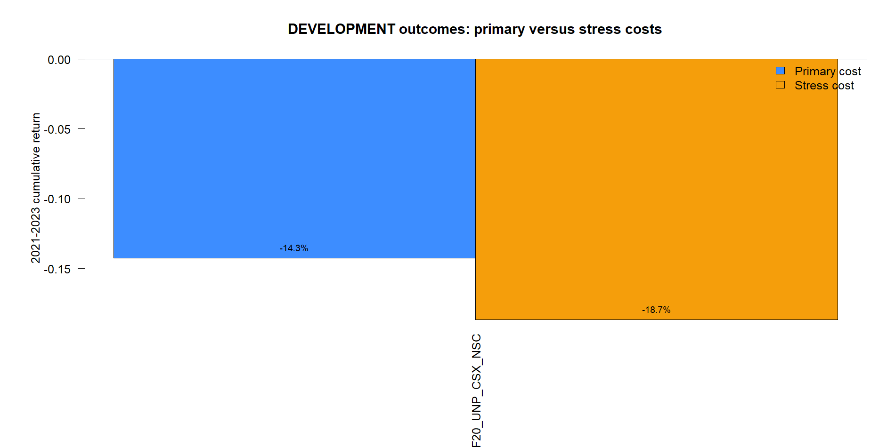
The strongest fresh TRAIN candidate broke decisively OOS
11
Notes:
OOS 2021–2023: 40 completed trades, -36.2 bp mean net return, 52.5% hit rate, +0.0143 forward-five correlation, -14.25% primary-cost cumulative return, -18.68% stress return, -0.870 autocorrelation-adjusted Sharpe, and -19.02% maximum drawdown.
This is the most informative result in the study. A relationship can look statistically coherent throughout TRAIN and still cease to mean-revert in the future.
[Sources]
- C:/Users/Franc/OneDrive/Documents/Francis/Peltata Project/Time-Series-Modeling-Gen5/runs/research_workbench/literature_grounded/lit_mr_03_2_fresh_atlas_01_20260729/mr032_development_summary.csv
- C:/Users/Franc/OneDrive/Documents/Francis/Peltata Project/Time-Series-Modeling-Gen5/runs/research_workbench/literature_grounded/lit_mr_03_2_fresh_atlas_01_20260729/mr032_development_trades.csv
- C:/Users/Franc/OneDrive/Documents/Francis/Peltata Project/Time-Series-Modeling-Gen5/runs/research_workbench/literature_grounded/lit_mr_03_2_fresh_atlas_01_20260729/visuals/mr032_development_cost_comparison.png
- C:/Users/Franc/OneDrive/Documents/Francis/Peltata Project/Time-Series-Modeling-Gen5/docs/GEN5_LIT_MR_02_2_03_2_RELAXED_GATE_RESULTS.md
- C:/Users/Franc/OneDrive/Documents/Francis/Peltata Project/Time-Series-Modeling-Gen5/docs/GEN5_4_DECISION_DIALOGUE_INDEX.md — D87

Slide 12
Gate easing improved sensitivity—but did not solve persistence
The experiment did what a challenger should do: it exposed whether conservative cutoffs were hiding durable effects. The answer was mostly no.
RETRO
FRESH
STOP
Useful counterfactuals
Never rebranded as prospective alpha
One strict-quality triplet failed OOS
Fresh pairs produced no nomination
Do not relax further
The bottleneck is time stability, not gate width
12
Notes:
Retrospective replay helps interpret gate sensitivity and accounting behavior. It is not an admissible way to search backward for candidates and claim prospective alpha. Fresh results show that even strict TRAIN evidence can fail when the relationship changes.
A future contract could examine rolling or expanding requalification, coefficient drift, rank breaks, and a no-trade state. That is a new research gate and remains discussion-only.
[Sources]
- C:/Users/Franc/OneDrive/Documents/Francis/Peltata Project/Time-Series-Modeling-Gen5/docs/GEN5_LIT_MR_02_2_03_2_RELAXED_GATE_RESULTS.md
- C:/Users/Franc/OneDrive/Documents/Francis/Peltata Project/Time-Series-Modeling-Gen5/docs/GEN5_LIT_MR_RELAXED_GATE_QUANTITATIVE_REVIEW.md
- C:/Users/Franc/OneDrive/Documents/Francis/Peltata Project/Time-Series-Modeling-Gen5/docs/GEN5_4_DECISION_DIALOGUE_INDEX.md — D85–D88

Slide 13
DECISION: NO FURTHER EASING | NEXT GATE BELONGS TO THE OPERATOR
Keep the gates where they are.
Study when relationships expire.
LIT-MR-02.2 and 03.2 are complete challengers. Preserve the retrospective/fresh lane boundary, keep 2024+ sealed, and stop before opening any adaptive requalification design.
Notes:
The result is a productive null: finite-sample easing was not the missing mechanism. The next high-signal question is whether relationship validity can be requalified over time without leakage or outcome-driven tuning.
[Sources]
- C:/Users/Franc/OneDrive/Documents/Francis/Peltata Project/Time-Series-Modeling-Gen5/docs/GEN5_LIT_MR_02_2_03_2_RELAXED_GATE_RESULTS.md
- C:/Users/Franc/OneDrive/Documents/Francis/Peltata Project/Time-Series-Modeling-Gen5/docs/GEN5_LIT_MR_RELAXED_GATE_QUANTITATIVE_REVIEW.md
- C:/Users/Franc/OneDrive/Documents/Francis/Peltata Project/Time-Series-Modeling-Gen5/docs/GEN5_4_DECISION_DIALOGUE_INDEX.md — D88

