Slide 1
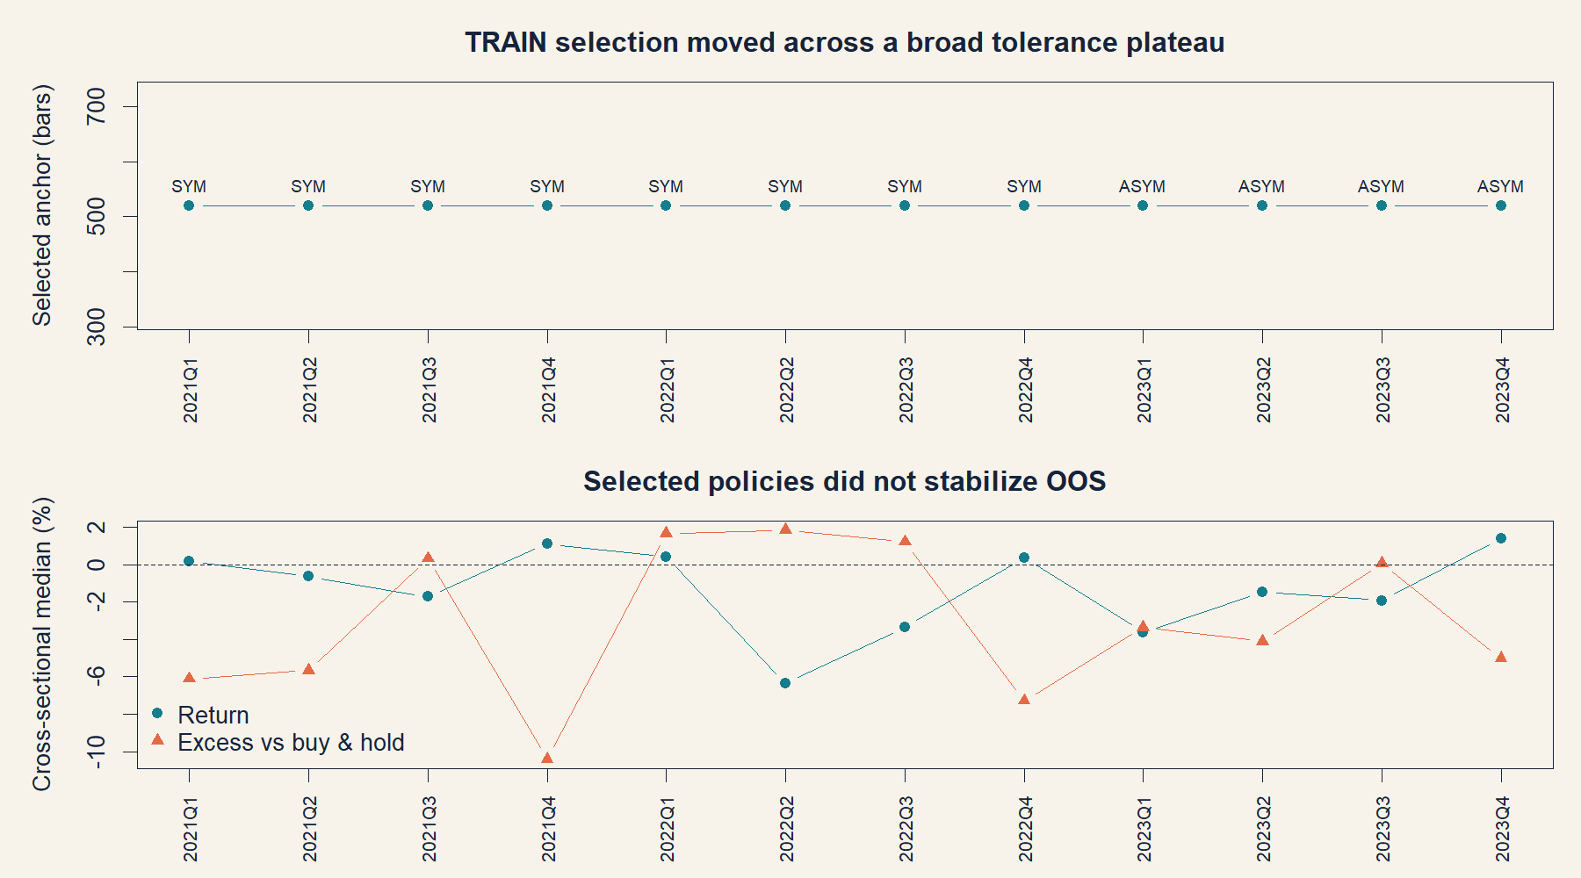
HYP-IMOM-02.1
Can TRAIN choose a portable intraday anchor?
Session-scaled price/SMA crosses with symmetric and faster exits
DEVELOPMENT COMPLETE • STOP
Notes:
[Sources]
- docs/GEN5_INTRADAY_MOMENTUM_POC_SERIES_CONTRACT.md
- operator_hypothesis_lab/docs/GEN5_INTRADAY_MOMENTUM_POC_SERIES_RESULTS.md
- runs/research_workbench/operator_hypothesis_lab/intraday_momentum_poc_series_20260813/visuals/price_selection_oos.png
[/Sources]

Slide 2
The entry asks for a fresh change in long-horizon state
MECHANICS
The anchors represent about 5, 10, 20, and 40 regular sessions. A new completed-bar cross above the slow anchor enters at the next open.
S ∈ {65, 130, 260, 520} bars
symmetric: exit after price crosses below SMA(S)
asymmetric: exit below SMA(round(S/4))
The asymmetric version tries to enter on a slow momentum shift but relinquish risk before the slow anchor fully reverses.
2
Notes:
[Sources]
- docs/GEN5_INTRADAY_MOMENTUM_POC_SERIES_CONTRACT.md
- operator_hypothesis_lab/R/hyp_intraday_momentum_engine.R
[/Sources]

Slide 3
Selection is nested inside expanding TRAIN
SELECTION
1 Score eight candidates
2 Form a tolerance plateau
3 Prefer lower turnover
Five equal-weight yearly ranks: return, positive-stock breadth, Sharpe, drawdown, and buy-and-hold excess.
Keep candidates within one standard error of the best mean TRAIN score.
Within the plateau, choose fewer trades; ties prefer longer anchors, then symmetric exits.
The selected policy is frozen before the next quarter is replayed. The 1.8x path cannot influence selection.
3
Notes:
[Sources]
- docs/GEN5_INTRADAY_MOMENTUM_POC_SERIES_CONTRACT.md
- operator_hypothesis_lab/R/hyp_intraday_momentum_engine.R
[/Sources]

Slide 4
TRAIN consistently preferred the longest anchor
SELECTION
SMA520 symmetric dominated through 2022; the 130-bar exit entered the tolerance set for 2023.
4
Notes:
[Sources]
- operator_hypothesis_lab/docs/GEN5_INTRADAY_MOMENTUM_POC_SERIES_RESULTS.md
- runs/research_workbench/operator_hypothesis_lab/intraday_momentum_poc_series_20260813/price_sma_selections.csv
- runs/research_workbench/operator_hypothesis_lab/intraday_momentum_poc_series_20260813/visuals/price_selection_oos.png
[/Sources]

Slide 5
The selected policy failed to stabilize out of sample
OOS
Across 288 stock-quarters at 1x, the family was less destructive than the 8/14 intraday rule—but still negative in absolute and relative terms.
−0.86%
39.2%
−3.32 pp
median quarter return
positive stock-quarters
median excess vs buy-and-hold
5
Notes:
[Sources]
- operator_hypothesis_lab/docs/GEN5_INTRADAY_MOMENTUM_POC_SERIES_RESULTS.md
- runs/research_workbench/operator_hypothesis_lab/intraday_momentum_poc_series_20260813/series_topline.csv
- runs/research_workbench/operator_hypothesis_lab/intraday_momentum_poc_series_20260813/price_sma_oos_summaries.csv
[/Sources]

Slide 6
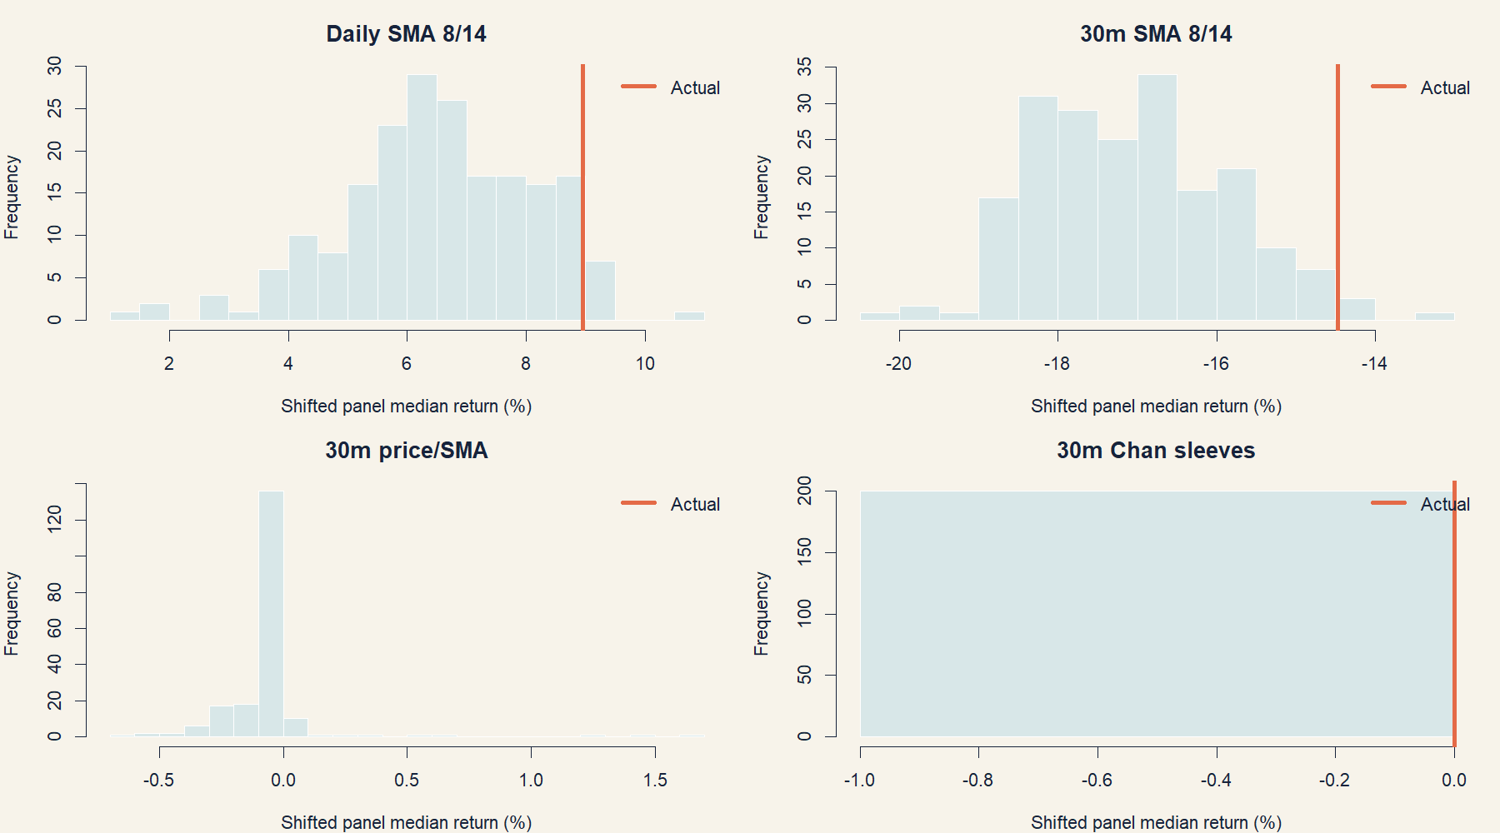
The actual timing was worse than every shifted panel
FALSIFICATION
For HYP-IMOM-02.1, the orange actual line lies below the 200 whole-session timing shifts.
6
Notes:
[Sources]
- operator_hypothesis_lab/docs/GEN5_INTRADAY_MOMENTUM_POC_SERIES_RESULTS.md
- runs/research_workbench/operator_hypothesis_lab/intraday_momentum_poc_series_20260813/timing_control_comparison.csv
- runs/research_workbench/operator_hypothesis_lab/intraday_momentum_poc_series_20260813/visuals/timing_nulls.png
[/Sources]

Slide 7
Costs and one-bar delay both pushed the result lower
ROBUSTNESS
The weak result is not an artifact of one precise next-open fill. Stress costs and an extra completed-bar delay each worsen the median.
−0.86%
−1.85%
−1.30%
primary median
stress-cost median
one-bar-delay median
7
Notes:
[Sources]
- operator_hypothesis_lab/docs/GEN5_INTRADAY_MOMENTUM_POC_SERIES_RESULTS.md
- runs/research_workbench/operator_hypothesis_lab/intraday_momentum_poc_series_20260813/series_sensitivity.csv
[/Sources]

Slide 8
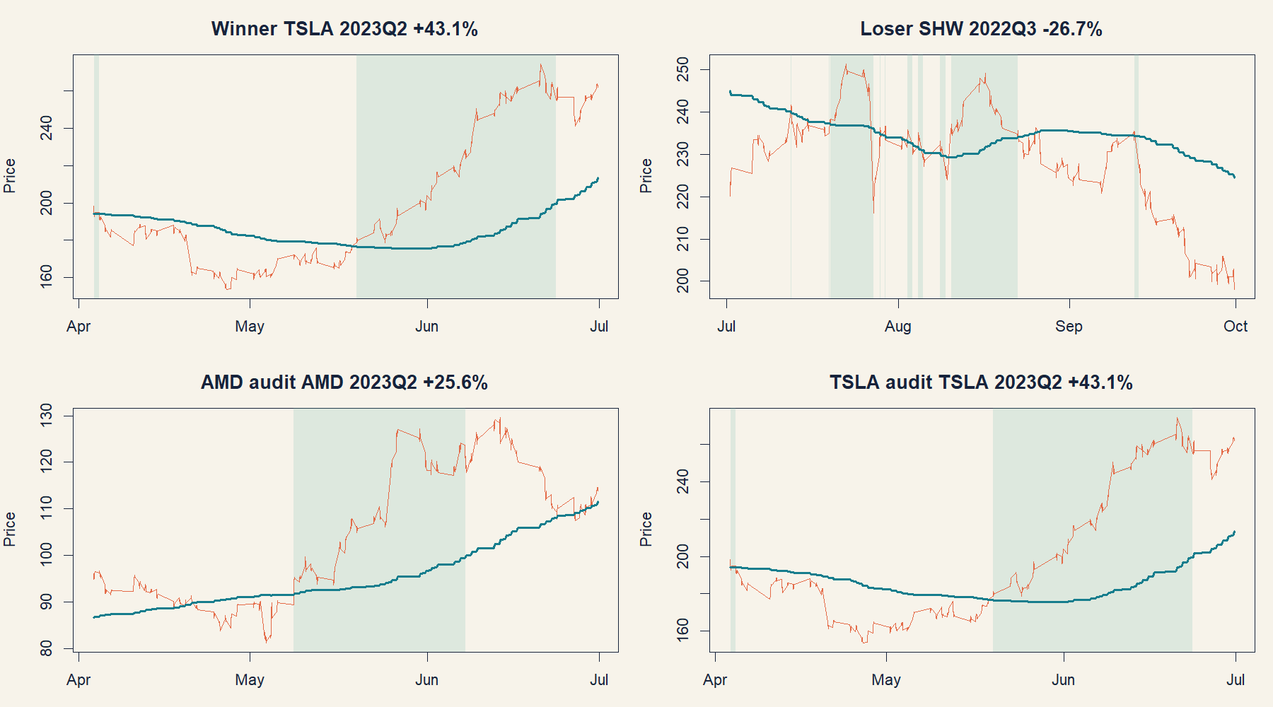
Selected winner tapes do not overturn the panel
AUDIT
TSLA and AMD illustrate why outcome-aware examples are useful for mechanics education but invalid for post hoc asset selection.
8
Notes:
[Sources]
- operator_hypothesis_lab/docs/GEN5_INTRADAY_MOMENTUM_POC_SERIES_RESULTS.md
- runs/research_workbench/operator_hypothesis_lab/intraday_momentum_poc_series_20260813/price_representative_trade_tapes.csv
- runs/research_workbench/operator_hypothesis_lab/intraday_momentum_poc_series_20260813/visuals/price_sma_trade_tapes.png
[/Sources]

Slide 9
Longer anchors reduced churn without creating timing value
DECISION
The selector behaved coherently; the selected family failed economically.
The 520-bar anchor dominated TRAIN, so the process did not flail across many parameters.
OOS median return, direct excess, stress, and shifted controls were all unfavorable.
The result is a clean falsification of this finite family—not of every price/SMA concept.
STOP: preserve the family and 2024+ seal; do not mine anchors, exits, assets, or tapes for rescue.
9
Notes:
[Sources]
- operator_hypothesis_lab/docs/GEN5_INTRADAY_MOMENTUM_POC_SERIES_RESULTS.md
- docs/GEN5_INTRADAY_MOMENTUM_POC_SERIES_CONTRACT.md
[/Sources]

