Slide 1
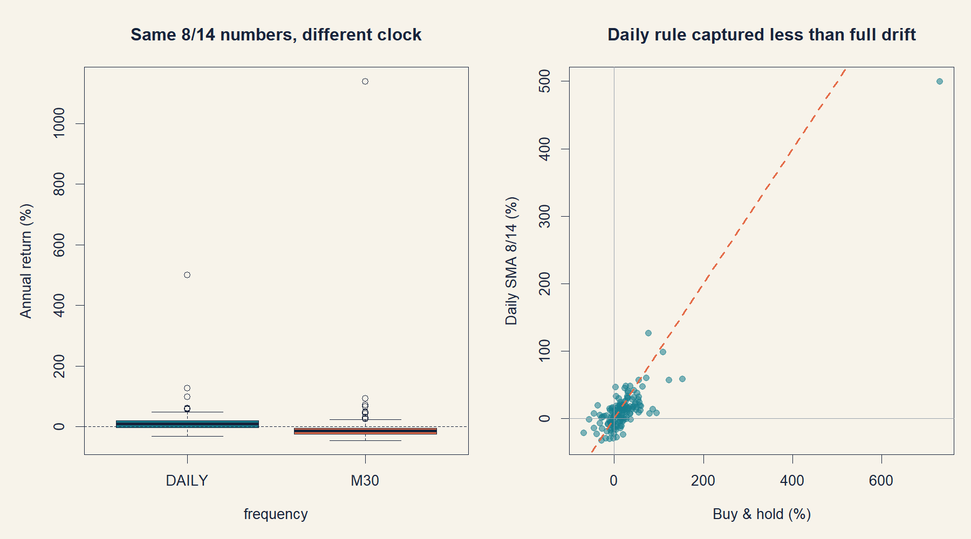
GEN5 OPERATOR HYPOTHESIS LAB
One SMA rule, two clocks
Daily and 30-minute SMA8/SMA14 evidence at 1x and 1.8x
DEVELOPMENT COMPLETE • NO REGIME FILTER
Notes:
[Sources]
- docs/GEN5_INTRADAY_MOMENTUM_POC_SERIES_CONTRACT.md
- operator_hypothesis_lab/docs/GEN5_INTRADAY_MOMENTUM_POC_SERIES_RESULTS.md
- runs/research_workbench/operator_hypothesis_lab/intraday_momentum_poc_series_20260813/visuals/fixed_frequency_contrast.png
[/Sources]

Slide 2
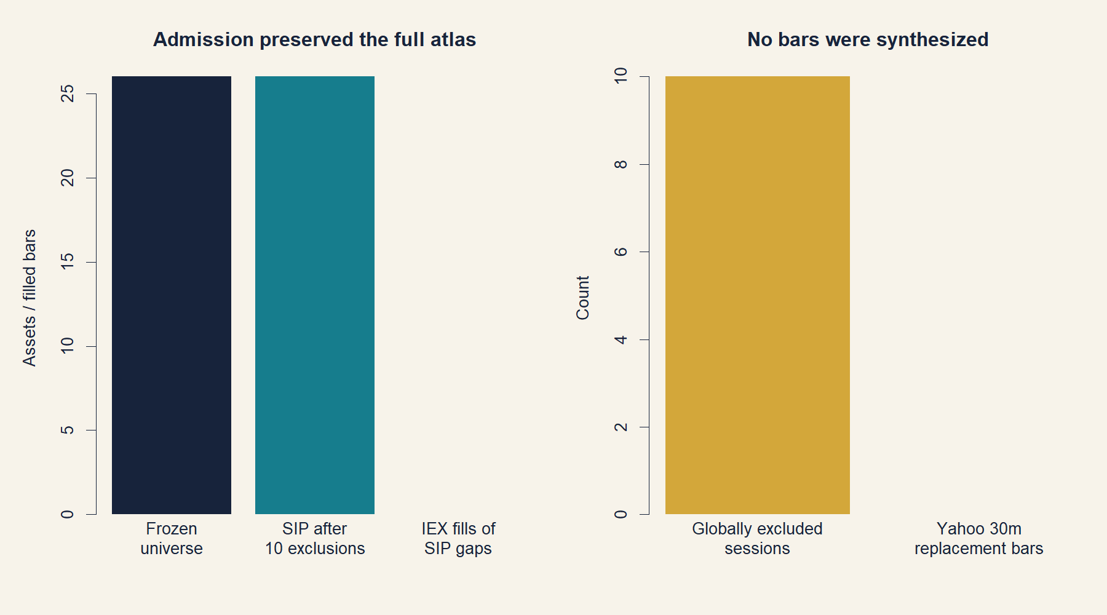
The comparison changes only the clock
CONTRACT
A fresh cross—not inherited state—opens risk
On either clock, a completed-bar SMA8 cross above SMA14 enters long at the next open. A completed-bar cross below exits at the next open. Every block starts in cash, even when price is already above the averages. The 1.8x path uses fixed shares until exit and pays financing on debt.
26 / 26 assets passed after ten common archive-gap sessions were excluded without imputation.
2
Notes:
[Sources]
- docs/GEN5_INTRADAY_MOMENTUM_POC_SERIES_CONTRACT.md
- operator_hypothesis_lab/registries/gen5_intraday_momentum_poc_registry.csv
- runs/research_workbench/operator_hypothesis_lab/intraday_momentum_poc_series_20260813/visuals/data_admission.png
[/Sources]

Slide 3
The formula is identical; the economic horizon is not
MECHANICS
A daily 8/14 pair spans roughly two to three weeks. A 30-minute 8/14 pair spans about four to seven trading hours. Equal numbers do not imply equal memory.
LONGₜ ⇔ SMA₈(t) > SMA₁₄(t)
entry: cross at close of bar t → open of bar t+1
exit: reverse cross at close of bar t → open of bar t+1
This slide isolates the real hypothesis: whether the operator’s remembered 8/14 behavior survives when its clock—not just its asset—is changed.
3
Notes:
[Sources]
- docs/GEN5_INTRADAY_MOMENTUM_POC_SERIES_CONTRACT.md
- operator_hypothesis_lab/R/hyp_intraday_momentum_engine.R
[/Sources]

Slide 4
The corrected calendar preserves the full atlas
DATA
No IEX or Yahoo bar was substituted; the same ten unavailable sessions were removed from every asset.
4
Notes:
[Sources]
- docs/GEN5_INTRADAY_MOMENTUM_POC_SERIES_CONTRACT.md
- runs/research_workbench/operator_hypothesis_lab/intraday_momentum_poc_series_20260813/visuals/data_admission.png
[/Sources]

Slide 5
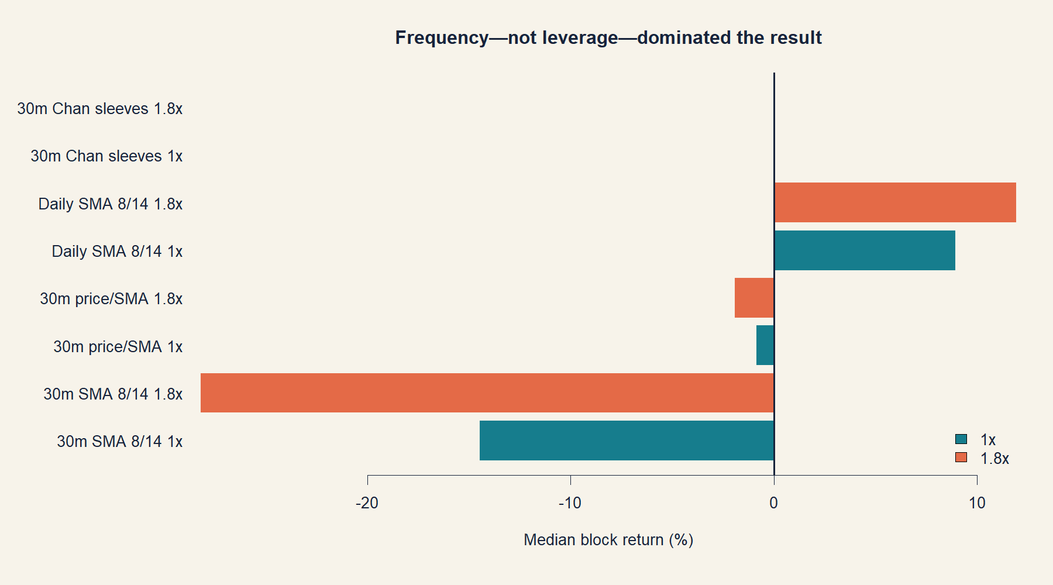
Frequency—not leverage—dominated the outcome
RESULT
Only the daily rule had a positive median return; 1.8x amplified each underlying path.
5
Notes:
[Sources]
- operator_hypothesis_lab/docs/GEN5_INTRADAY_MOMENTUM_POC_SERIES_RESULTS.md
- runs/research_workbench/operator_hypothesis_lab/intraday_momentum_poc_series_20260813/series_topline.csv
- runs/research_workbench/operator_hypothesis_lab/intraday_momentum_poc_series_20260813/visuals/series_topline.png
[/Sources]

Slide 6
The daily rule captured drift, but less than ownership
DAILY
Across 144 stock-years at 1x, the strategy was usually profitable and its timing was unusually good relative to shifted schedules. It still surrendered a meaningful share of buy-and-hold return.
+8.95%
70.1%
−5.83 pp
median annual return
positive stock-years
median excess vs buy-and-hold
6
Notes:
[Sources]
- operator_hypothesis_lab/docs/GEN5_INTRADAY_MOMENTUM_POC_SERIES_RESULTS.md
- runs/research_workbench/operator_hypothesis_lab/intraday_momentum_poc_series_20260813/series_topline.csv
- runs/research_workbench/operator_hypothesis_lab/intraday_momentum_poc_series_20260813/timing_control_comparison.csv
[/Sources]

Slide 7
The intraday clock converted the rule into a turnover problem
30-MINUTE
The 30-minute rule traded more than twelve times as often as the daily rule. Its actual timing beat most shifted schedules, but the entire timing neighborhood was deeply negative.
−14.47%
17,900
−26.62 pp
median annual return
completed trades
median excess vs buy-and-hold
7
Notes:
[Sources]
- operator_hypothesis_lab/docs/GEN5_INTRADAY_MOMENTUM_POC_SERIES_RESULTS.md
- runs/research_workbench/operator_hypothesis_lab/intraday_momentum_poc_series_20260813/series_topline.csv
- runs/research_workbench/operator_hypothesis_lab/intraday_momentum_poc_series_20260813/timing_control_comparison.csv
[/Sources]

Slide 8
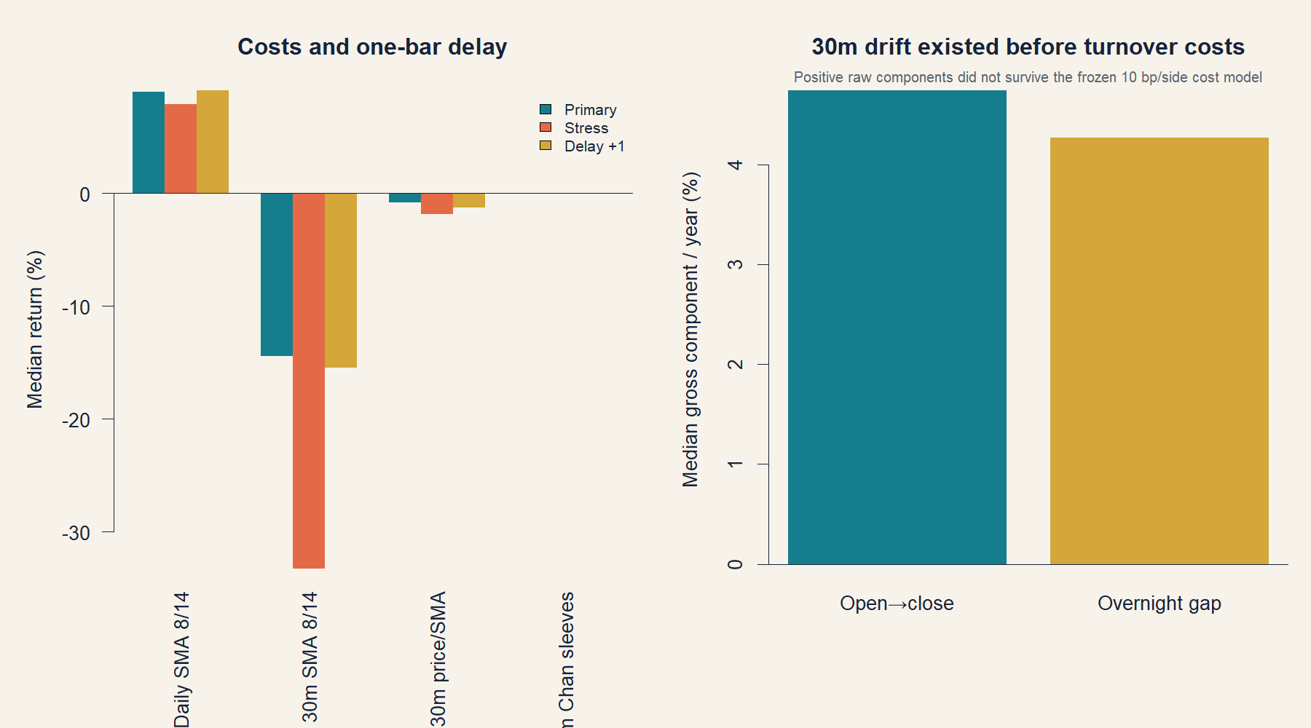
Positive raw drift did not survive intraday turnover costs
ROBUSTNESS
Stress costs worsened the 30-minute median to −33.29%; one-bar delay left the conclusion unchanged.
8
Notes:
[Sources]
- operator_hypothesis_lab/docs/GEN5_INTRADAY_MOMENTUM_POC_SERIES_RESULTS.md
- runs/research_workbench/operator_hypothesis_lab/intraday_momentum_poc_series_20260813/series_sensitivity.csv
- runs/research_workbench/operator_hypothesis_lab/intraday_momentum_poc_series_20260813/intraday_return_components_by_block.csv
- runs/research_workbench/operator_hypothesis_lab/intraday_momentum_poc_series_20260813/visuals/sensitivity_summary.png
[/Sources]

Slide 9
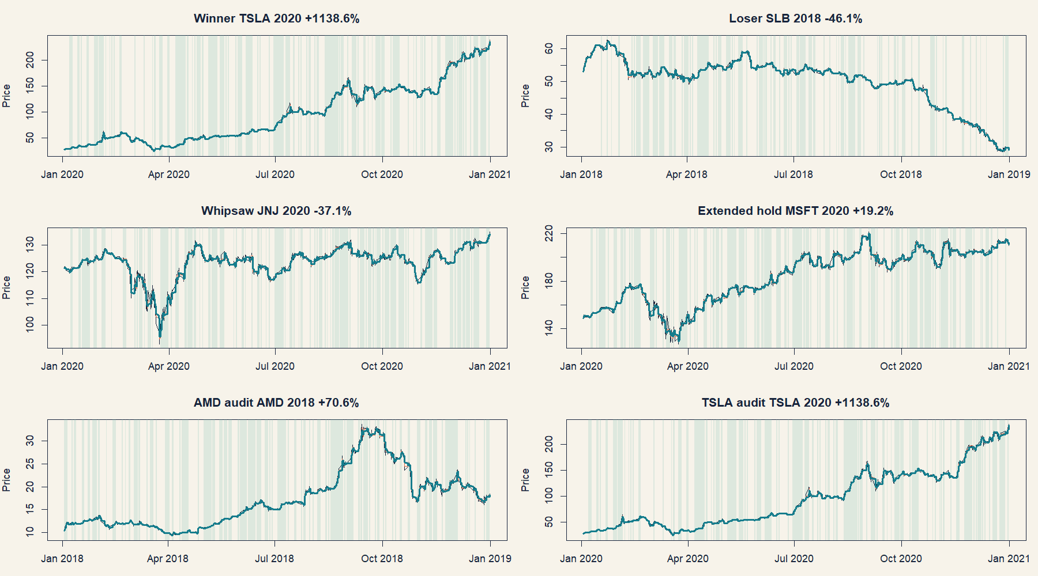
The trade tapes make the whipsaw visible
AUDIT
Green shading is invested state; dense alternation shows why small positive drift could not overcome costs.
9
Notes:
[Sources]
- operator_hypothesis_lab/docs/GEN5_INTRADAY_MOMENTUM_POC_SERIES_RESULTS.md
- runs/research_workbench/operator_hypothesis_lab/intraday_momentum_poc_series_20260813/fixed_representative_trade_tapes.csv
- runs/research_workbench/operator_hypothesis_lab/intraday_momentum_poc_series_20260813/visuals/fixed_m30_trade_tapes.png
[/Sources]

Slide 10
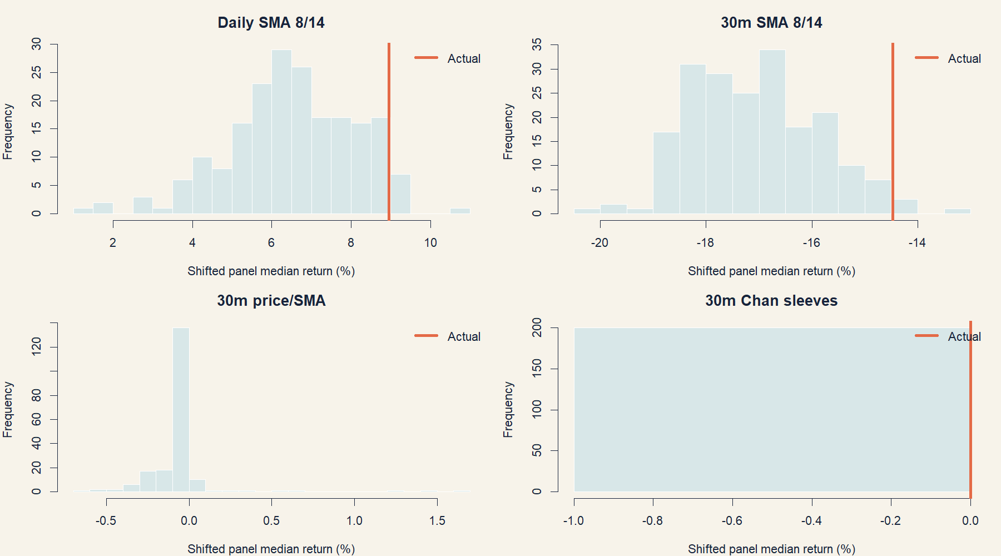
Timing controls refine—but do not reverse—the verdict
FALSIFICATION
Daily timing was near the favorable tail. The 30-minute actual was also better than its shifts—but remained an unusable loss.
10
Notes:
[Sources]
- operator_hypothesis_lab/docs/GEN5_INTRADAY_MOMENTUM_POC_SERIES_RESULTS.md
- runs/research_workbench/operator_hypothesis_lab/intraday_momentum_poc_series_20260813/timing_control_simulations.csv
- runs/research_workbench/operator_hypothesis_lab/intraday_momentum_poc_series_20260813/timing_control_comparison.csv
- runs/research_workbench/operator_hypothesis_lab/intraday_momentum_poc_series_20260813/visuals/timing_nulls.png
[/Sources]

Slide 11
Keep the daily baseline; stop the exact intraday translation
DECISION
This series separates a useful research parent from a failed mechanical port.
Daily SMA8/14 is worth retaining as an unfiltered baseline, not as ownership alpha.
The numeric 8/14 pair is economically mismatched to 30-minute costs and turnover.
Leverage magnified return and drawdown; it did not supply timing edge.
STOP: no horizon tuning, asset selection, confirmation access, portfolio, or regime filter under these identifiers.
11
Notes:
[Sources]
- operator_hypothesis_lab/docs/GEN5_INTRADAY_MOMENTUM_POC_SERIES_RESULTS.md
- docs/GEN5_INTRADAY_MOMENTUM_POC_SERIES_CONTRACT.md
[/Sources]

