Slide 1
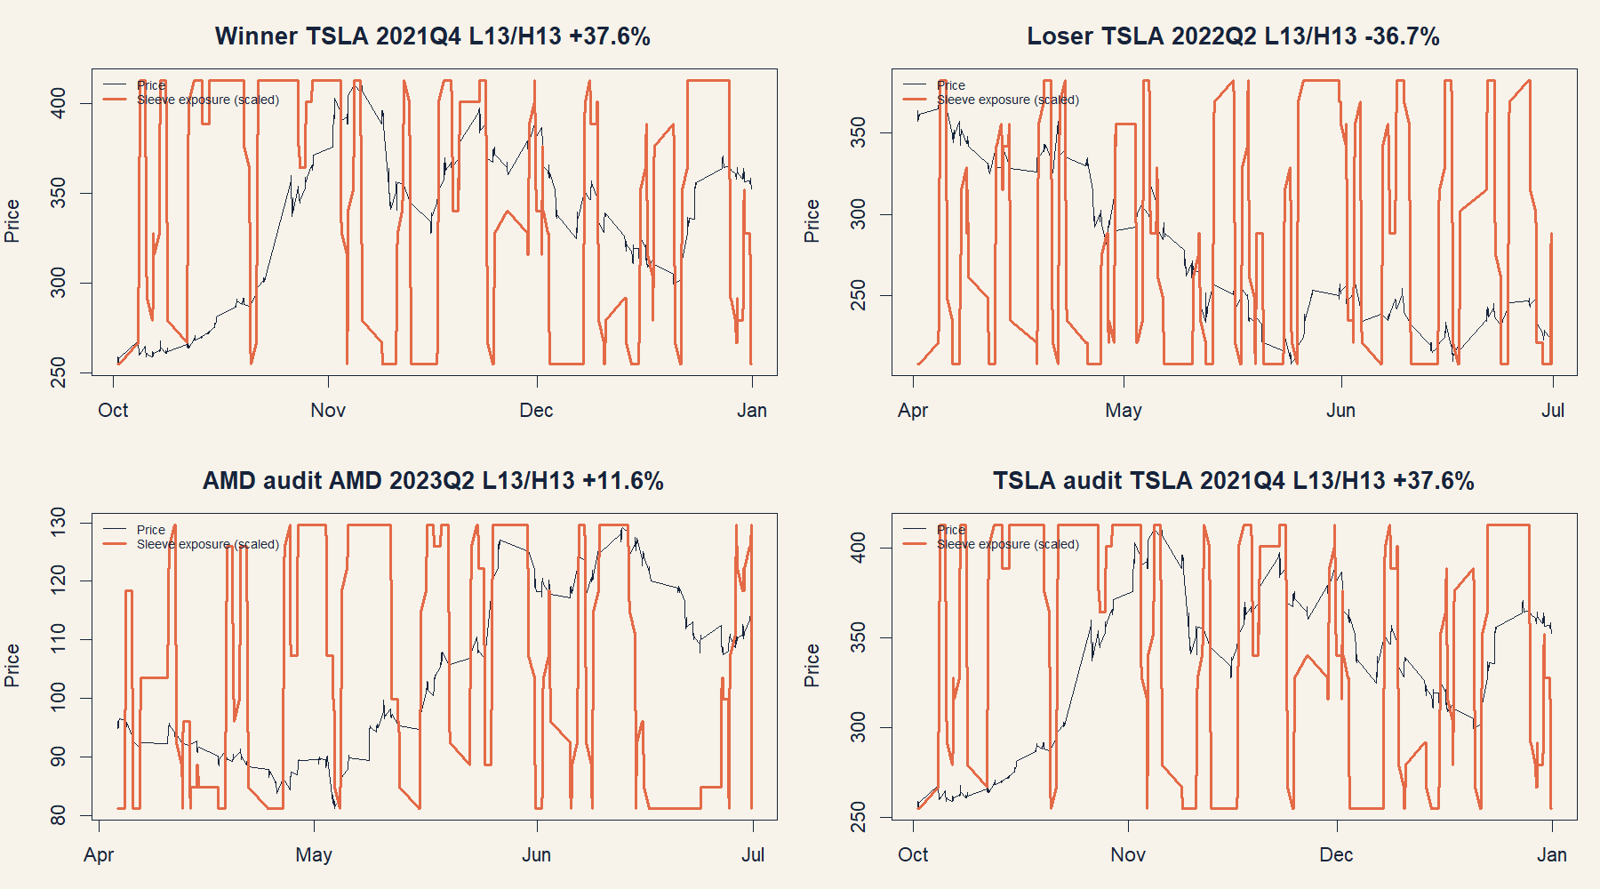
LIT-IMOM-01.1 • CHAN CHAPTER 6 DERIVATIVE
Momentum inference becomes overlapping sleeve execution
A session-scaled 30-minute textbook transport
DEVELOPMENT COMPLETE • STOP
Notes:
[Sources]
- literature_studies/docs/GEN5_LITERATURE_SOURCE_LEDGER.md
- docs/GEN5_INTRADAY_MOMENTUM_POC_SERIES_CONTRACT.md
- operator_hypothesis_lab/docs/GEN5_INTRADAY_MOMENTUM_POC_SERIES_RESULTS.md
- runs/research_workbench/operator_hypothesis_lab/intraday_momentum_poc_series_20260813/visuals/chan_trade_tapes.png
[/Sources]

Slide 2
Chan screens the horizon before trading it
SOURCE
For each L/H pair, the book relates an asset’s own past return to its subsequent return. The familiar 250/25 example follows this table; it is not chosen from nowhere.
Rᵖᵃˢᵗₜ(L) = Cₜ / Cₜ₋ᴸ − 1
Rᶠᵘᵗᵘʳᵉₜ(H) = Cₜ₊ᴴ / Cₜ − 1
screen: corr(Rᵖᵃˢᵗ, Rᶠᵘᵗᵘʳᵉ) and nominal p
Source grounding: Algorithmic Trading, Chapter 6; non-overlap discussion at PDF pages 135–136 / printed 153–154; Example 6.1 at PDF 138–139 / printed 156–157.
2
Notes:
[Sources]
- literature_studies/docs/GEN5_LITERATURE_SOURCE_LEDGER.md
- Ernest P. Chan, Algorithmic Trading, Chapter 6, PDF pp. 133-145 / printed pp. 151-163
[/Sources]

Slide 3
Non-overlap protects the correlation sample—not the execution tape
INFERENCE
Adjacent daily observations would reuse most future-return bars. The primary screen advances the anchor by the shorter interval, preserving more observations while preventing future windows from overlapping.
step = min(L, H)
L ∈ {13, 26, 65, 130, 260}
H ∈ {13, 26, 65}
Predictor windows may still overlap, so the Pearson p-value remains a naive book-style screen. The strategy-level null shifts complete daily timing patterns by whole sessions.
3
Notes:
[Sources]
- literature_studies/docs/GEN5_LITERATURE_SOURCE_LEDGER.md
- docs/GEN5_INTRADAY_MOMENTUM_POC_SERIES_CONTRACT.md
- operator_hypothesis_lab/R/hyp_intraday_momentum_engine.R
[/Sources]

Slide 4
Each new positive signal risks only one H-th of capital
EXECUTION
Execution intentionally permits overlapping evidence. Every completed bar recomputes the L-bar return. A positive signal launches one available sleeve at the next open; that sleeve exits after exactly H bars.
signalₜ = 1[Rᵖᵃˢᵗₜ(L) > 0]
targetₜ = (1/H) · Σ active positive sleeves
0 ≤ targetₜ ≤ 1 • negative signal = no new long sleeve
If only one signal appears, only 1/H of capital is committed. Persistent signals gradually build exposure; they are not treated as independent statistical discoveries.
4
Notes:
[Sources]
- docs/GEN5_INTRADAY_MOMENTUM_POC_SERIES_CONTRACT.md
- operator_hypothesis_lab/R/hyp_intraday_momentum_engine.R
- literature_studies/docs/GEN5_LITERATURE_SOURCE_LEDGER.md
[/Sources]

Slide 5
TRAIN gates decide whether an asset is allowed to trade
SELECTION
The gate is intentionally simple and source-adjacent; the outer quarter is the real falsification surface.
At least 40 non-overlapping return pairs
Select largest correlation t-statistic
Positive Pearson correlation
Tie: shorter H, then shorter L
Nominal p ≤ 0.10
No admissible candidate → cash next quarter
5
Notes:
[Sources]
- docs/GEN5_INTRADAY_MOMENTUM_POC_SERIES_CONTRACT.md
- operator_hypothesis_lab/R/hyp_intraday_momentum_engine.R
[/Sources]

Slide 6
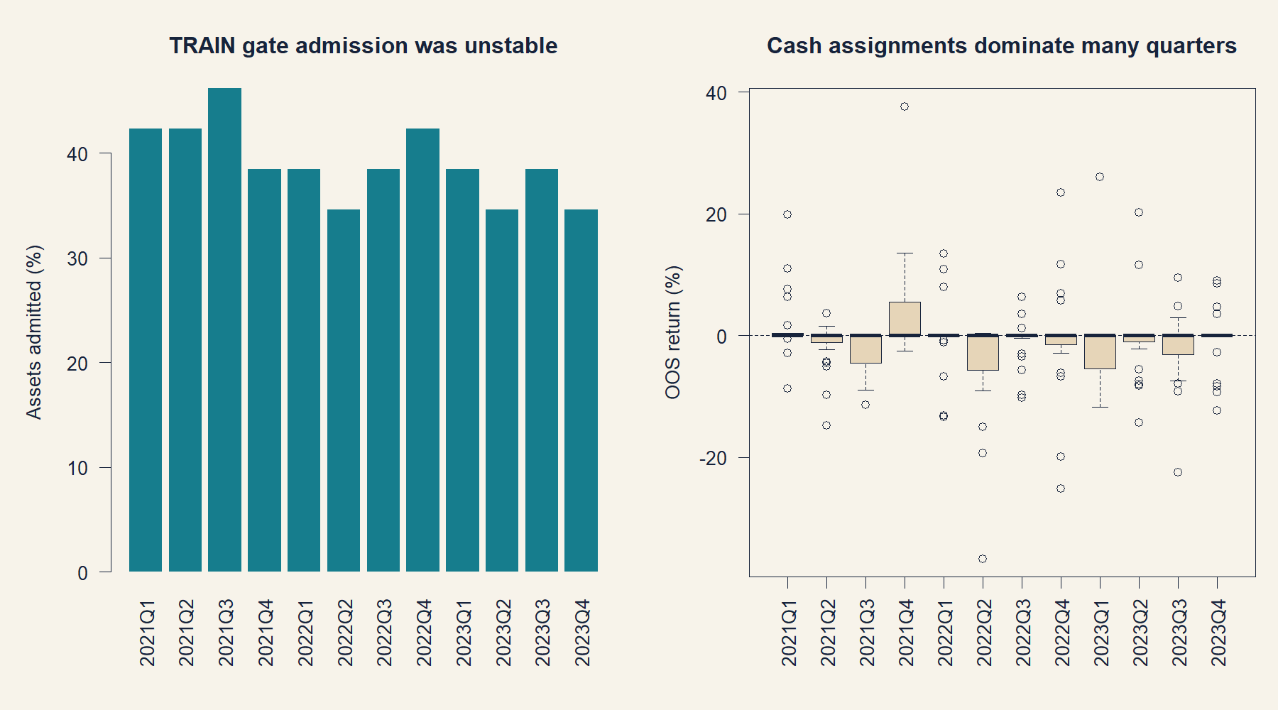
Admission moved between 9 and 12 of 26 assets each quarter
OOS
Cash dominates the all-panel median; the active-only result must be inspected separately.
6
Notes:
[Sources]
- operator_hypothesis_lab/docs/GEN5_INTRADAY_MOMENTUM_POC_SERIES_RESULTS.md
- runs/research_workbench/operator_hypothesis_lab/intraday_momentum_poc_series_20260813/chan_admission_by_fold.csv
- runs/research_workbench/operator_hypothesis_lab/intraday_momentum_poc_series_20260813/chan_oos_summaries.csv
- runs/research_workbench/operator_hypothesis_lab/intraday_momentum_poc_series_20260813/visuals/chan_admission_oos.png
[/Sources]

Slide 7
Trading blocks lost even after cash assignments are removed
ACTIVE BLOCKS
Only 115 of 288 stock-quarters traded at 1x. The zero all-panel median is therefore not neutral evidence; it is a consequence of the admission rule.
−2.79%
35.7%
−6.92 pp
active-block median return
positive active blocks
active median excess vs buy-and-hold
7
Notes:
[Sources]
- operator_hypothesis_lab/docs/GEN5_INTRADAY_MOMENTUM_POC_SERIES_RESULTS.md
- runs/research_workbench/operator_hypothesis_lab/intraday_momentum_poc_series_20260813/chan_active_topline.csv
[/Sources]

Slide 8
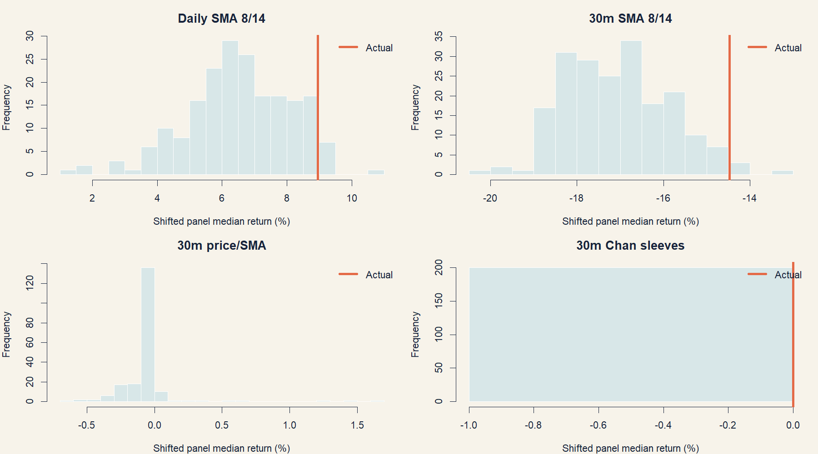
The median timing null is degenerate at cash
FALSIFICATION
Actual and shifted panel medians are both zero; direct excess places the actual policy near the bottom of the shifted controls.
8
Notes:
[Sources]
- operator_hypothesis_lab/docs/GEN5_INTRADAY_MOMENTUM_POC_SERIES_RESULTS.md
- runs/research_workbench/operator_hypothesis_lab/intraday_momentum_poc_series_20260813/timing_control_comparison.csv
- runs/research_workbench/operator_hypothesis_lab/intraday_momentum_poc_series_20260813/visuals/timing_nulls.png
[/Sources]

Slide 9
Overlapping sleeves create a rapidly changing exposure path
AUDIT
Orange is aggregate sleeve exposure scaled into the price range; it is not a second price series.
9
Notes:
[Sources]
- operator_hypothesis_lab/docs/GEN5_INTRADAY_MOMENTUM_POC_SERIES_RESULTS.md
- runs/research_workbench/operator_hypothesis_lab/intraday_momentum_poc_series_20260813/chan_representative_trade_tapes.csv
- runs/research_workbench/operator_hypothesis_lab/intraday_momentum_poc_series_20260813/visuals/chan_trade_tapes.png
[/Sources]

Slide 10
The textbook transport was clean—and economically unsuccessful
DECISION
This is a successful learning exercise and a failed unfiltered strategy POC.
The screen preserved Chan’s L/H logic and non-overlapping future-return inference.
Quarterly admission was unstable, and active blocks lost at the median.
The p-value is a screening statistic; outer OOS performance remains the authority.
STOP: keep 2024+ sealed and do not relax p/support gates, mine horizons, or build a regime filter under LIT-IMOM-01.1.
10
Notes:
[Sources]
- operator_hypothesis_lab/docs/GEN5_INTRADAY_MOMENTUM_POC_SERIES_RESULTS.md
- docs/GEN5_INTRADAY_MOMENTUM_POC_SERIES_CONTRACT.md
- literature_studies/docs/GEN5_LITERATURE_SOURCE_LEDGER.md
[/Sources]

