Slide 1
GEN5.3 RESEARCH SCREEN
Annual continuity replay made the next strategy question sharper
The corrected one-year screen keeps risk-aware context, the workhorse PCA surface, and continuation replay as the control lane. It also shows that the EMA-only pool may be too narrow to judge the broader hypothesis.
Continuity packet: runs/research_workbench/gen53_momentum_context_size/g53_momctx_20260711continuity
Research/inspection only. Not allocation evidence or live-advice behavior.

Slide 2
GEN5.3 MOMENTUM CONTEXT-SIZE SCREEN
The test changed because one quarter was too sparse
The prior slices were useful for mechanics, but they did not give much OOS surface area: a five-symbol live basket can easily look good or bad from a handful of trades in one quarter.
Before
One OOS quarter. Faster, but low resolution for alpha and trade behavior.
Now
Four independent quarterly TRAIN authorities replayed across one year, with open trades carrying until flat.
This keeps the leakage boundary and avoids artificial quarter-end trade resets.
Research/inspection only. Not allocation evidence or live-advice behavior.

Slide 3
GEN5.3 MOMENTUM CONTEXT-SIZE SCREEN
The screen isolates a narrow EMA-only participation hypothesis
Live basket
Context axis
Feature axis
Strategy pool
AMD, NVDA, TSLA, MSTR, AVGO
5 self assets; 12 with high-beta peers; 18 with peers and risk anchors
Workhorse enriched; momentum participation; momentum plus stress; market-relative momentum
EMA cross, EMA trend, no-trade, no-trade exit-immediate
Selection policy stayed fixed at pooled-family asset-variant, so this slice asks about feature design, context size, and replay semantics rather than reopening the whole Gen4-vs-Gen5 selection debate.
Research/inspection only. Not allocation evidence or live-advice behavior.

Slide 4
GEN5.3 MOMENTUM CONTEXT-SIZE SCREEN
The best aggregate lane was risk-aware context plus the workhorse feature set
Best lane: Live + peers + risk anchors + Workhorse enriched + continuation. Mean return 55.9%, mean alpha -35.6 pp, exposure 40.3%.
Context
Feature
Replay
Win years
Mean ret.
Mean alpha
Exposure
Live + peers + risk anchors
Workhorse enriched
continuation
2/4
55.9%
-35.6 pp
40.3%
Live + peers + risk anchors
Workhorse enriched
fresh
1/4
38.6%
-52.9 pp
26.3%
Live + peers + risk anchors
Momentum plus stress
continuation
1/4
33.1%
-58.5 pp
35.0%
Live basket only
Momentum participation
continuation
1/4
30.9%
-60.6 pp
39.3%
Live + high-beta peers
Momentum plus stress
continuation
1/4
29.8%
-61.8 pp
34.0%
Even the best lane did not beat equal-weight high-beta hold on average. The signal is subtler: broader risk-aware context made the specialist less bad against a very hard benchmark and produced positive alpha in two annual windows.
Research/inspection only. Not allocation evidence or live-advice behavior.

Slide 5
GEN5.3 MOMENTUM CONTEXT-SIZE SCREEN
Continuity replay corrected the optimistic annual readout
The independent-stitch packet was useful as a first annual inspection, but it could reset open trades at quarter boundaries. The continuity packet asks the live-like question: keep the quarterly authorities independent, but let open trades carry until flat.
Mean return
Alpha vs basket
Mean exposure
Win years
81.7%
-9.8 pp
64.6%
2/4
independent stitch
independent stitch
independent stitch
independent stitch
55.9%
-35.6 pp
40.3%
2/4
448 symbol/boundary cases carried prior authority until flat, and 4 carried through annual as-of. The boundary mechanic materially changed the evidence.
Research/inspection only. Not allocation evidence or live-advice behavior.

Slide 6
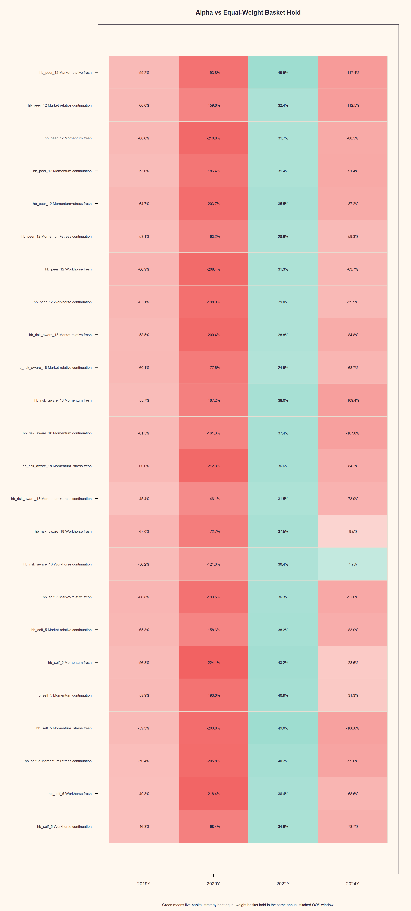
GEN5.3 MOMENTUM CONTEXT-SIZE SCREEN
The annual heatmap shows why this is not a simple feature-set win
What matters
2020 remains punishing because basket hold returned about 227%.
2022 rewards staying out of a falling high-beta basket.
2024 is the clean positive clue for risk-aware workhorse continuation.
New momentum feature sets did not become the aggregate default.
Research/inspection only. Not allocation evidence or live-advice behavior.

Slide 7
GEN5.3 MOMENTUM CONTEXT-SIZE SCREEN
The best lane still tells a mixed window-by-window story
2019
2020
2022
2024
-56.2 pp
-121.3 pp
+30.4 pp
+4.7 pp
alpha vs basket
alpha vs basket
alpha vs basket
alpha vs basket
strategy 2.2%
strategy 106.0%
strategy -22.6%
strategy 138.1%
basket 58.4%
basket 227.3%
basket -53.0%
basket 133.5%
Annual windows reveal a useful profile: strong 2024 participation and decent 2022 defense, but still serious undercapture in 2019 and 2020 high-beta upside.
Research/inspection only. Not allocation evidence or live-advice behavior.

Slide 8
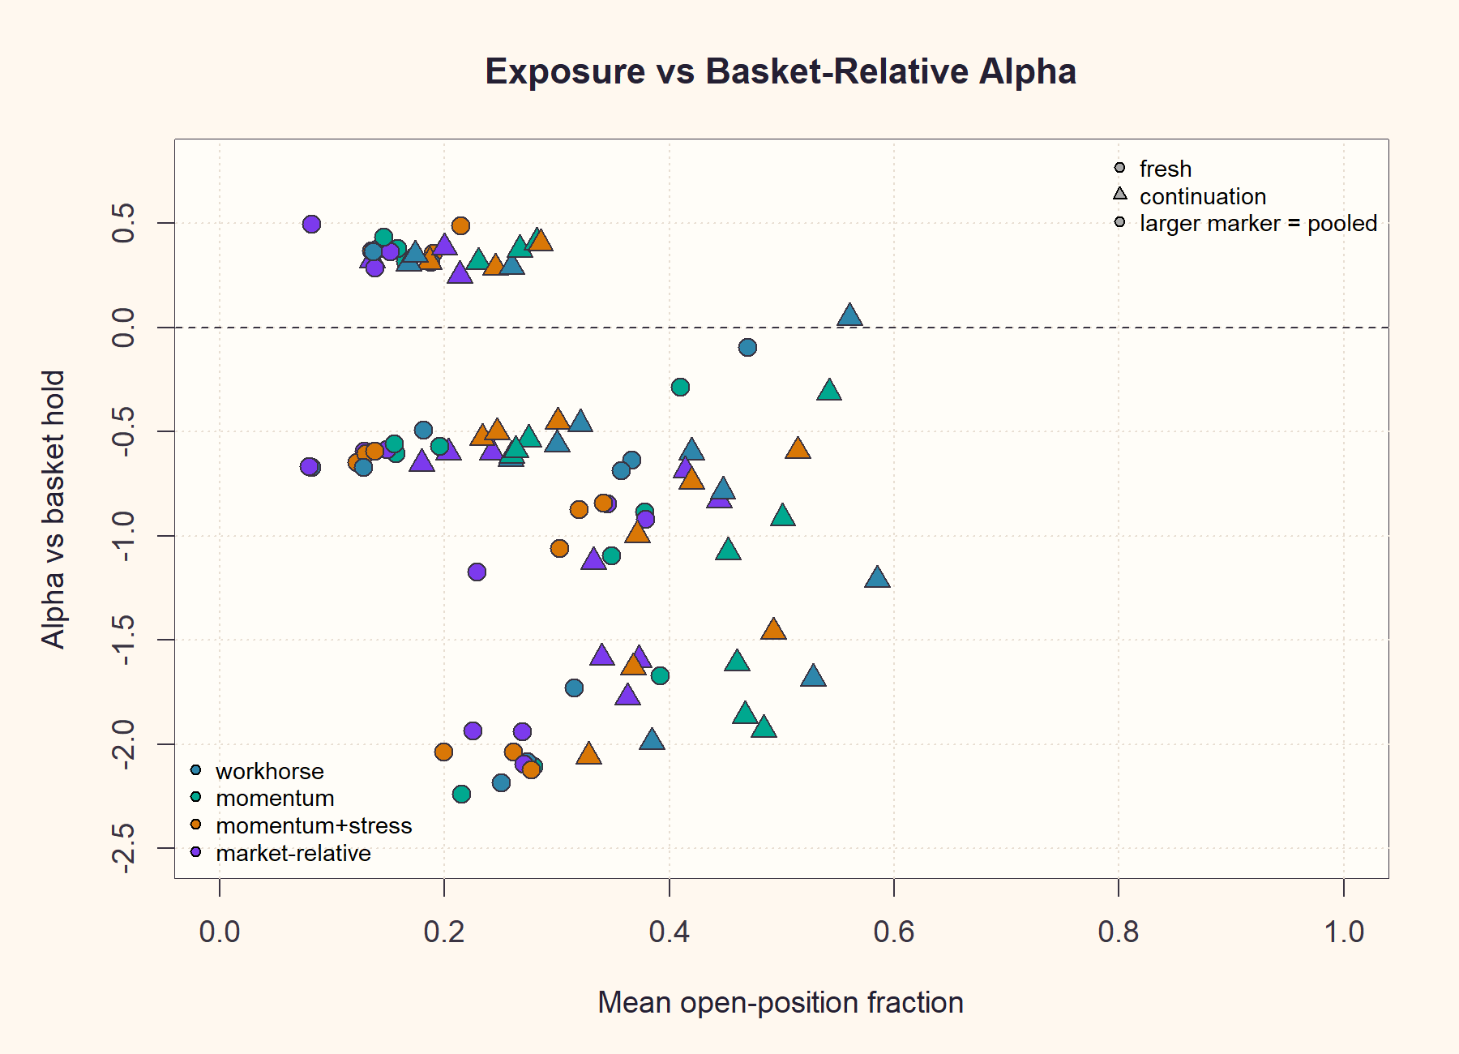
GEN5.3 MOMENTUM CONTEXT-SIZE SCREEN
Exposure helps, but simply being long more is not the whole answer
Readout
Continuation generally lifts exposure, and the better lanes cluster at moderate-to-high participation. But many high-exposure points are still deeply negative versus basket hold, so timing and state discrimination still matter.
Research/inspection only. Not allocation evidence or live-advice behavior.

Slide 9
GEN5.3 MOMENTUM CONTEXT-SIZE SCREEN
The best lane beats in 2022 and 2024, but misses the big upside years
What the chart adds
In 2020, the benchmark was too strong for a timing layer to catch.
In 2022, the system's partial exposure was valuable.
In 2024, the same lane finally beat the high-beta basket while still trading selectively.
Research/inspection only. Not allocation evidence or live-advice behavior.

Slide 10
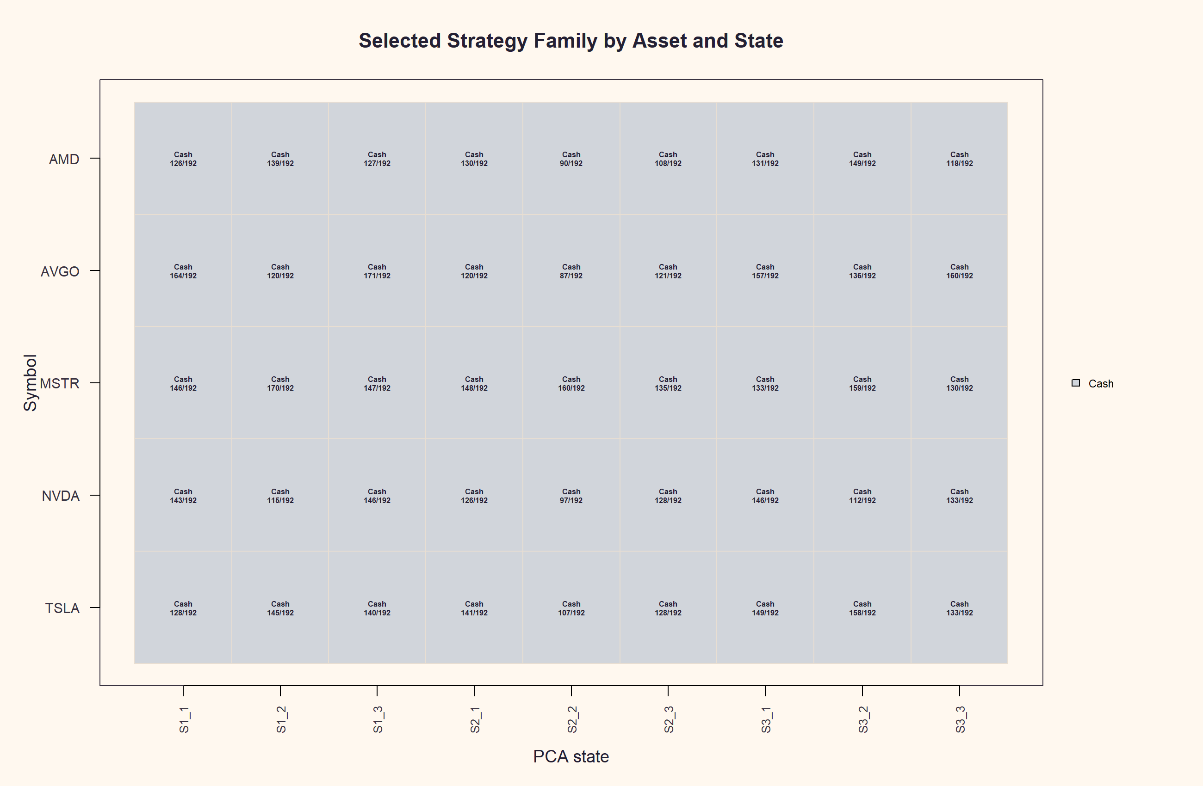
GEN5.3 MOMENTUM CONTEXT-SIZE SCREEN
The authority map is cash-dominant, which explains part of the underparticipation
Sanity check
Across the full annual screen, no-trade remains the dominant selected authority in many asset-state cells. That is philosophically clean for a specialist, but it also means missed upside is expected unless the favorable states are timely and persistent.
Research/inspection only. Not allocation evidence or live-advice behavior.

Slide 11
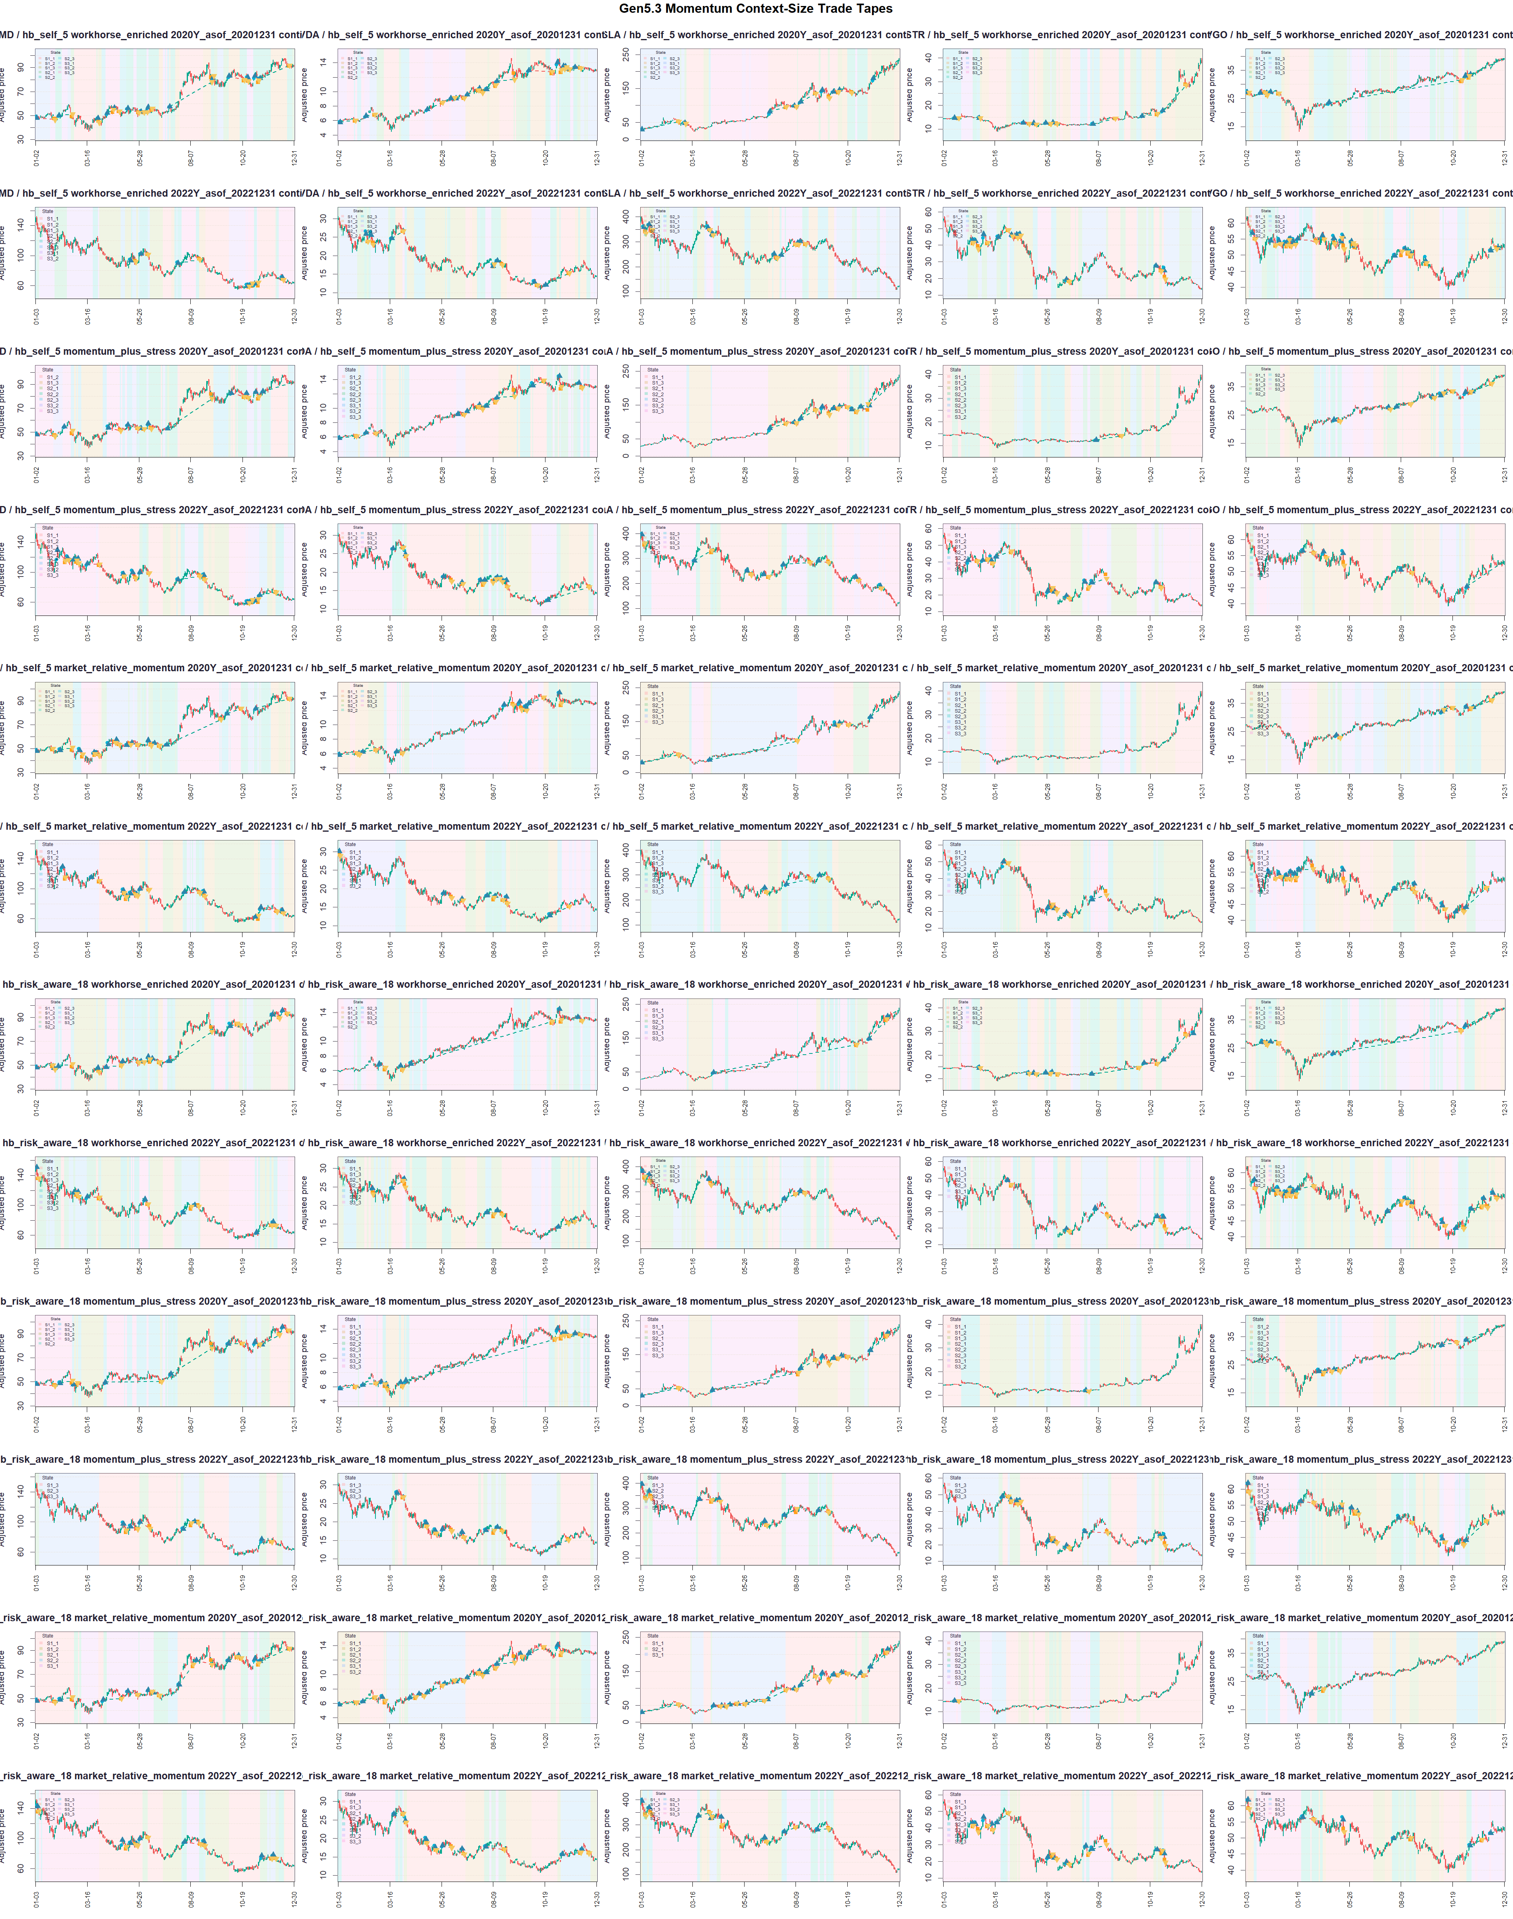
GEN5.3 MOMENTUM CONTEXT-SIZE SCREEN
Representative tapes show both the promise and the weakness
Visual audit
AMD shows churn and missed/stopped participation.
NVDA, TSLA, and MSTR show the lane can ride substantial trends.
Open exit signals at year end should be inspected in the next tape audit.
Research/inspection only. Not allocation evidence or live-advice behavior.

Slide 12
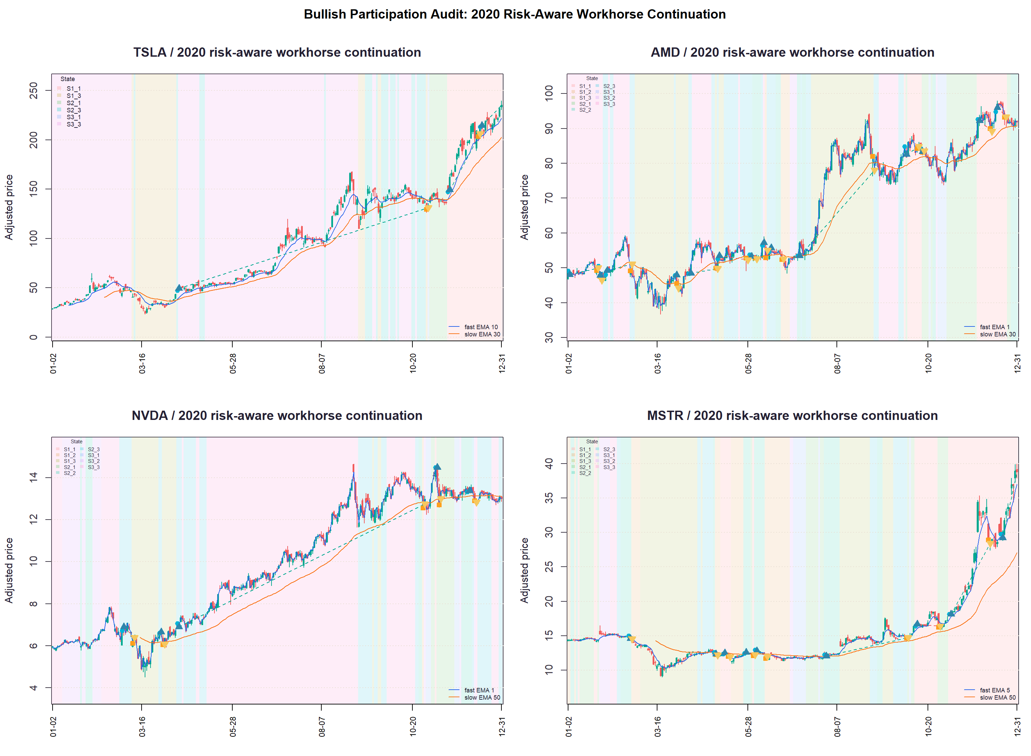
GEN5.3 MOMENTUM CONTEXT-SIZE SCREEN
The 2020 tapes show late and uneven bullish participation
What to notice
TSLA and MSTR rally for long stretches before entries appear.
State bands change often, but many strong stretches stay flat.
EMA overlays show price trend was visible.
The engine did trade, but it did not stay long enough early enough in the strongest bullish year.
Research/inspection only. Not allocation evidence or live-advice behavior.

Slide 13
GEN5.3 MOMENTUM CONTEXT-SIZE SCREEN
The next narrow screen should reopen strategy diversity carefully
Hold fixed
Vary first
Context: hb_risk_aware_18.
EMA-only momentum control.
Feature control: workhorse_enriched.
Trend plus breakout expansion.
Replay: quarter_continuity_replay plus state-switch continuation.
Mean-reversion diagnostic pool.
Benchmark: equal-weight high-beta basket hold.
Classical full reopened pool.
The cleanest next question is whether the strategy pool was too narrow under the now-correct annual continuity surface.
Research/inspection only. Not allocation evidence or live-advice behavior.

Slide 14
GEN5.3 MOMENTUM CONTEXT-SIZE SCREEN
Feature sets should support the strategy question, not explode the grid
Control
Momentum challenger
New diagnostic
workhorse_enriched
momentum_plus_stress
reversion_breakout_context
Keeps the best observed continuity lane intact.
Checks whether richer trend and stress descriptors help once strategies are reopened.
Adds range location, volatility compression, stretch, chop, impulse, and recovery cues for non-EMA families.
If the reopened strategy pools do not help under these feature sets, the next problem is probably state timing/exposure design rather than missing mean-reversion or breakout families.
Research/inspection only. Not allocation evidence or live-advice behavior.

Slide 15
GEN5.3 MOMENTUM CONTEXT-SIZE SCREEN
A targeted EMA feature diagnostic improved returns, but did not clear the benchmark
After the annual continuity control lane was identified, the next quick test held the high-beta risk-aware context, EMA-only pool, and continuation replay fixed while comparing three PCA feature surfaces.
Context
Feature
Replay
Win years
Mean ret.
Mean alpha
Exposure
Live + peers + risk anchors
Reversion-breakout context
continuation
1/4
68.1%
-23.4 pp
48.0%
Live + peers + risk anchors
Workhorse enriched
continuation
2/4
55.9%
-35.6 pp
40.3%
Live + peers + risk anchors
Momentum plus stress
continuation
1/4
33.1%
-58.5 pp
35.0%
Best diagnostic feature set: Reversion-breakout context. It averaged 68.1% return, -23.4 pp alpha versus basket hold, 48.0% exposure, and beat the basket in 1/4 annual windows.
Research/inspection only. Not allocation evidence or live-advice behavior.

Slide 16
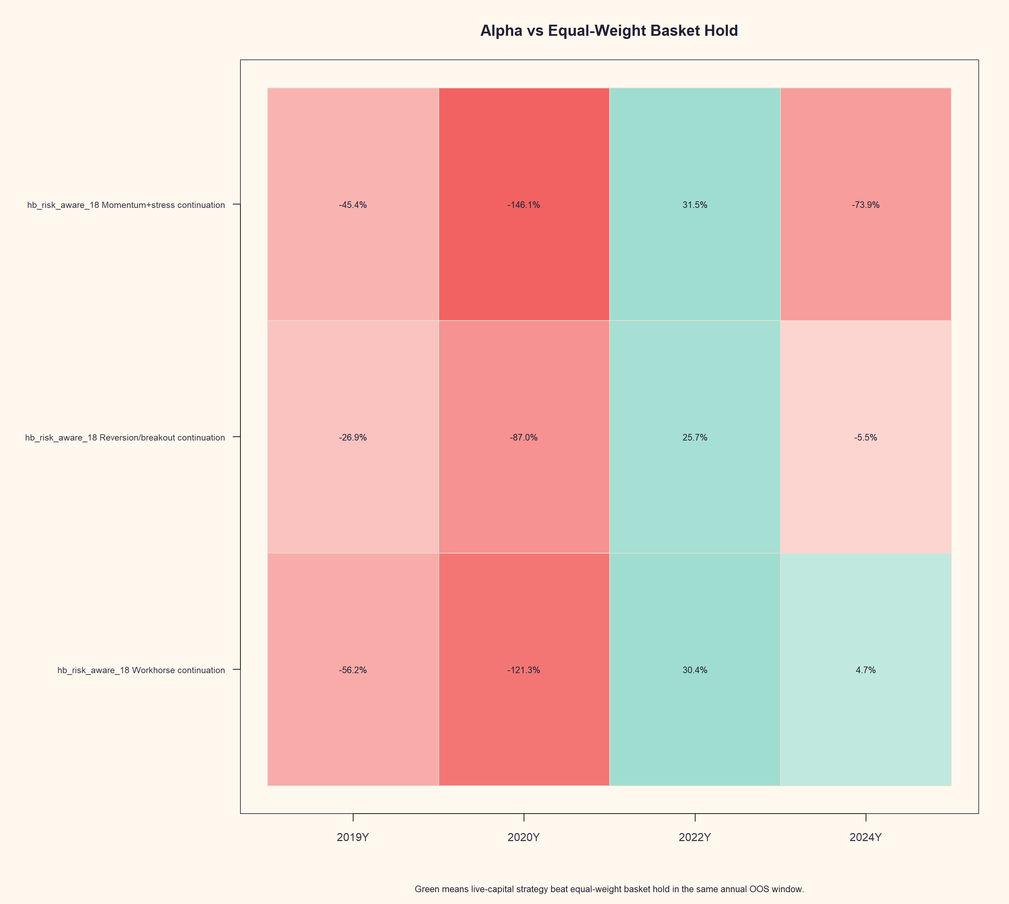
GEN5.3 MOMENTUM CONTEXT-SIZE SCREEN
The reversion-breakout feature set raised participation without solving upside capture
Interpretation
Reversion-breakout context lifted mean return versus the workhorse control.
It came close in 2024 and improved 2019/2020 participation, but still lagged the basket in 3 of 4 years.
This argues for better state timing, not a feature-set promotion yet.
Research/inspection only. Not allocation evidence or live-advice behavior.

Slide 17
GEN5.3 MOMENTUM CONTEXT-SIZE SCREEN
Trend and breakout families made the lane more defensive, not more participatory
Year
Pool
Return
Alpha
Exposure
Drawdown
Entries
2020
EMA-only
106.0%
-121.3 pp
58.5%
-18.0%
36
2020
Trend/breakout
53.3%
-173.9 pp
36.8%
-11.6%
47
2022
EMA-only
-22.6%
+30.4 pp
16.8%
-25.0%
42
2022
Trend/breakout
-10.8%
+42.2 pp
19.3%
-12.8%
19
The reopened pool improved 2022 defense, but it cut 2020 exposure and return sharply. That is useful selectivity evidence, not a solution to the high-beta upside capture problem.
Research/inspection only. Not allocation evidence or live-advice behavior.

Slide 18
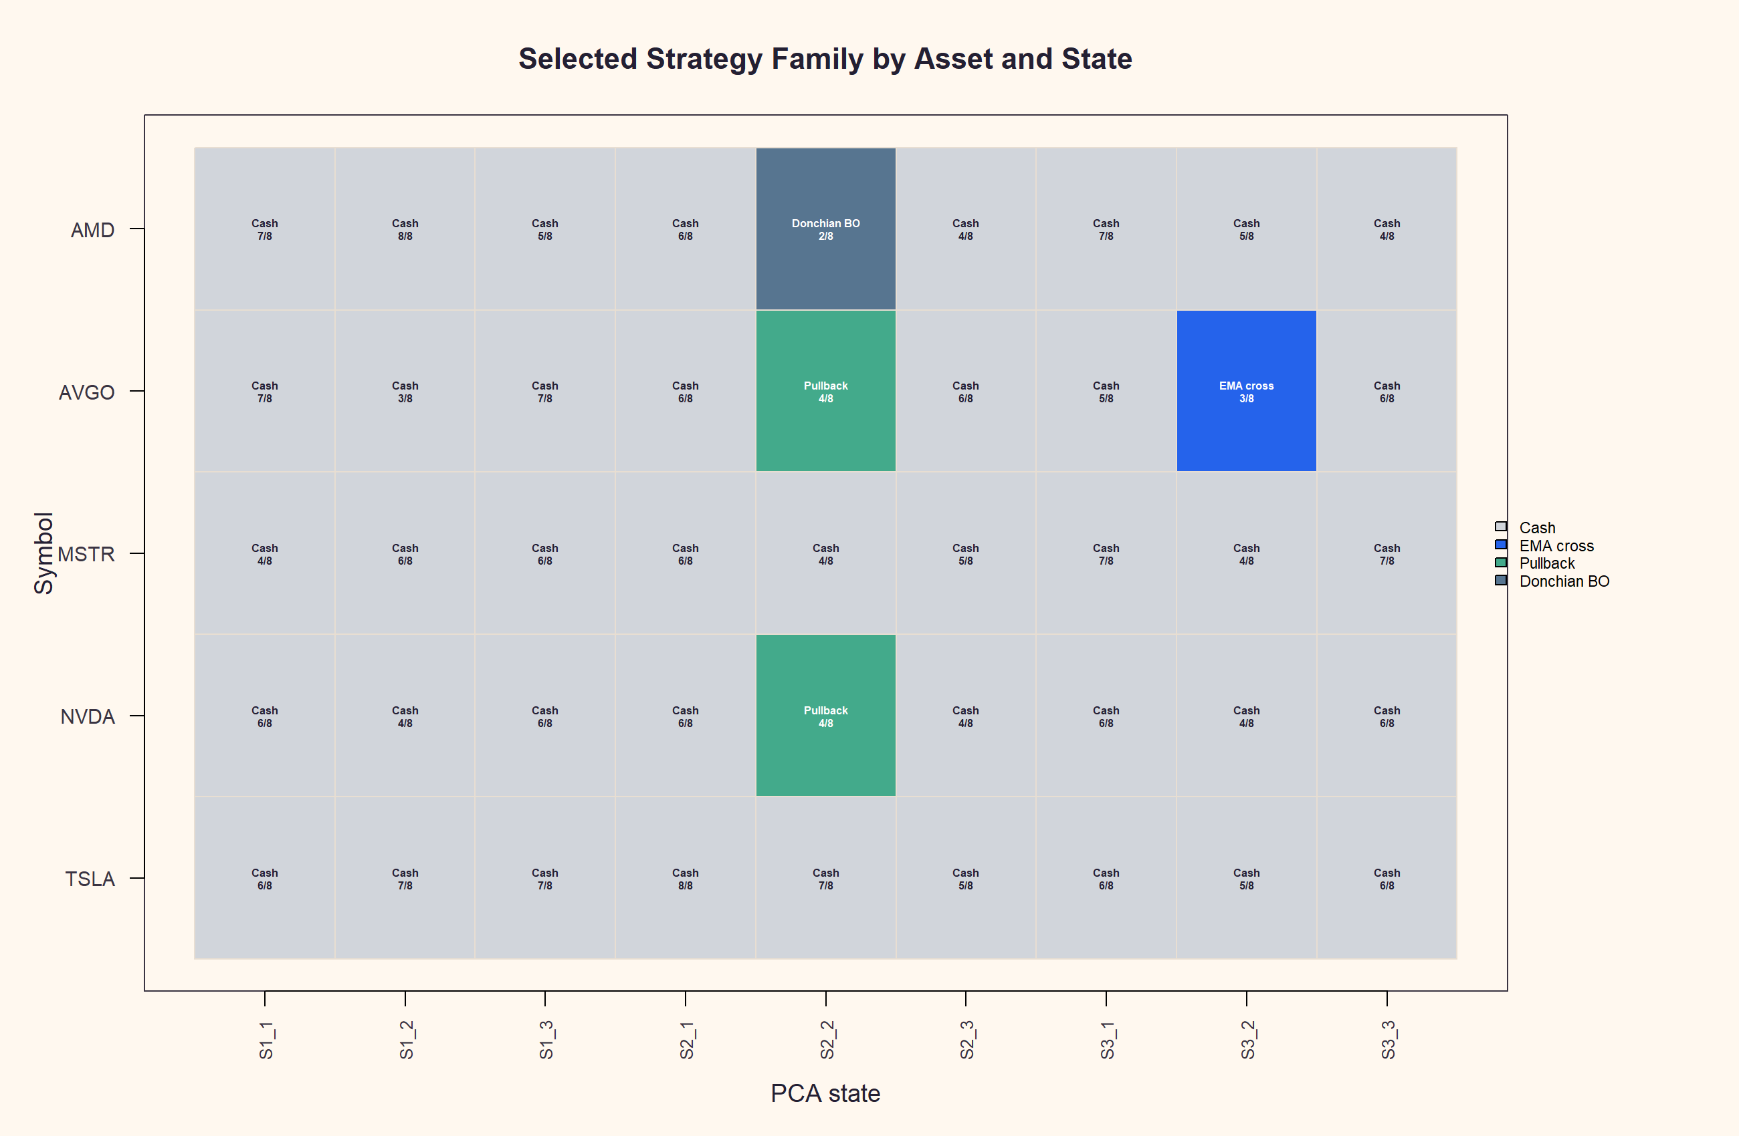
GEN5.3 MOMENTUM CONTEXT-SIZE SCREEN
The strategy map explains the defensive readout
Visual read
Most asset-state cells still select cash.
Breakout additions appear only in narrow pockets.
The pool reduced drawdown but did not keep the system long enough in 2020.
Next question: improve state timing and hold participation directly, instead of assuming a broader family list will create upside capture.
Research/inspection only. Not allocation evidence or live-advice behavior.

Slide 19
GEN5.3 MOMENTUM CONTEXT-SIZE SCREEN
Mean reversion did not solve the upside participation problem
Year
Feature
Return
Alpha
Exposure
Drawdown
Entries
2020
Workhorse
20.3%
-207.0 pp
21.3%
-34.9%
26
2020
Reversion context
13.6%
-213.7 pp
19.8%
-32.0%
30
2022
Workhorse
-12.9%
+40.1 pp
25.9%
-17.6%
41
2022
Reversion context
-17.6%
+35.4 pp
27.3%
-19.5%
44
The diagnostic behaved like a defensive/range-trading probe: it reduced 2022 damage versus basket hold, but it badly lagged the 2020 rally and did not improve on the EMA control.
Research/inspection only. Not allocation evidence or live-advice behavior.

Slide 20
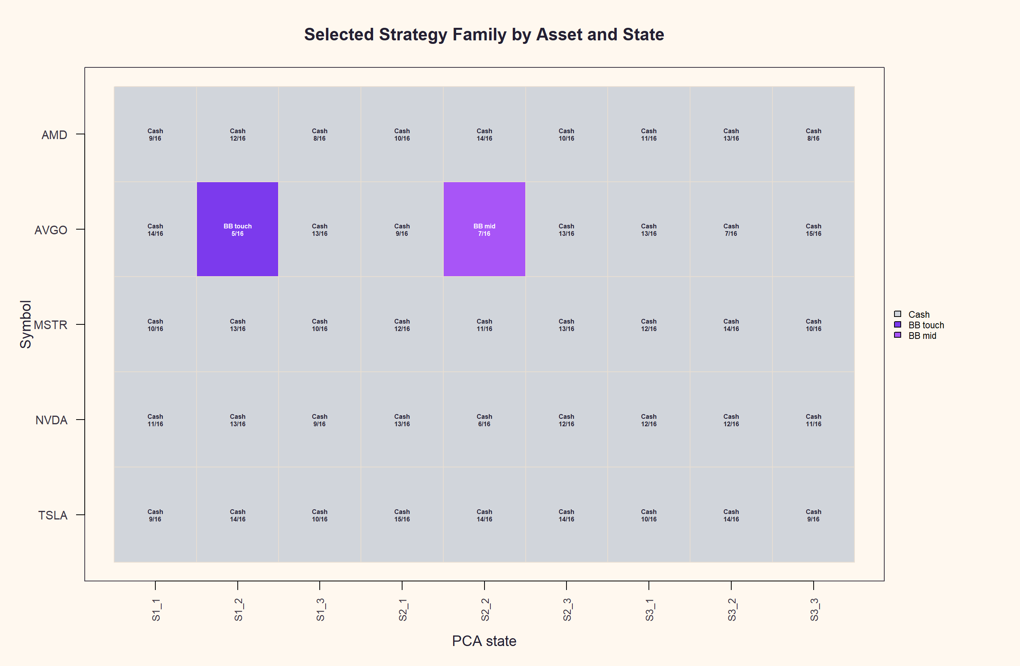
GEN5.3 MOMENTUM CONTEXT-SIZE SCREEN
The mean-reversion map is mostly cash with narrow Bollinger pockets
Visual read
No-trade still dominates many asset-state cells.
Bollinger variants appear in selective pockets, especially AVGO.
RSI and z-return did not become dominant state actions.
This is not a high-beta upside engine in its current form.
The trade tapes reinforce the same story: countertrend chips and defensive abstention, not early sticky participation in a broad high-beta rally.
Research/inspection only. Not allocation evidence or live-advice behavior.

Slide 21
GEN5.3 MOMENTUM CONTEXT-SIZE SCREEN
Leveraged active trading needs a same-leverage passive benchmark
The leverage slice keeps signals, states, entries, exits, and quarterly authority unchanged. Only the portfolio sizing layer changes from 1x to 1.8x.
Wrong read
Fair read
Compare 1.8x active return to 1x basket hold, then call the extra return alpha.
Compare 1.8x active return to 1.8x equal-weight basket hold over the same dates.
This keeps leverage as a risk overlay. It prevents sizing from masquerading as a better entry/exit engine.
Research/inspection only. Not allocation evidence or live-advice behavior.

Slide 22
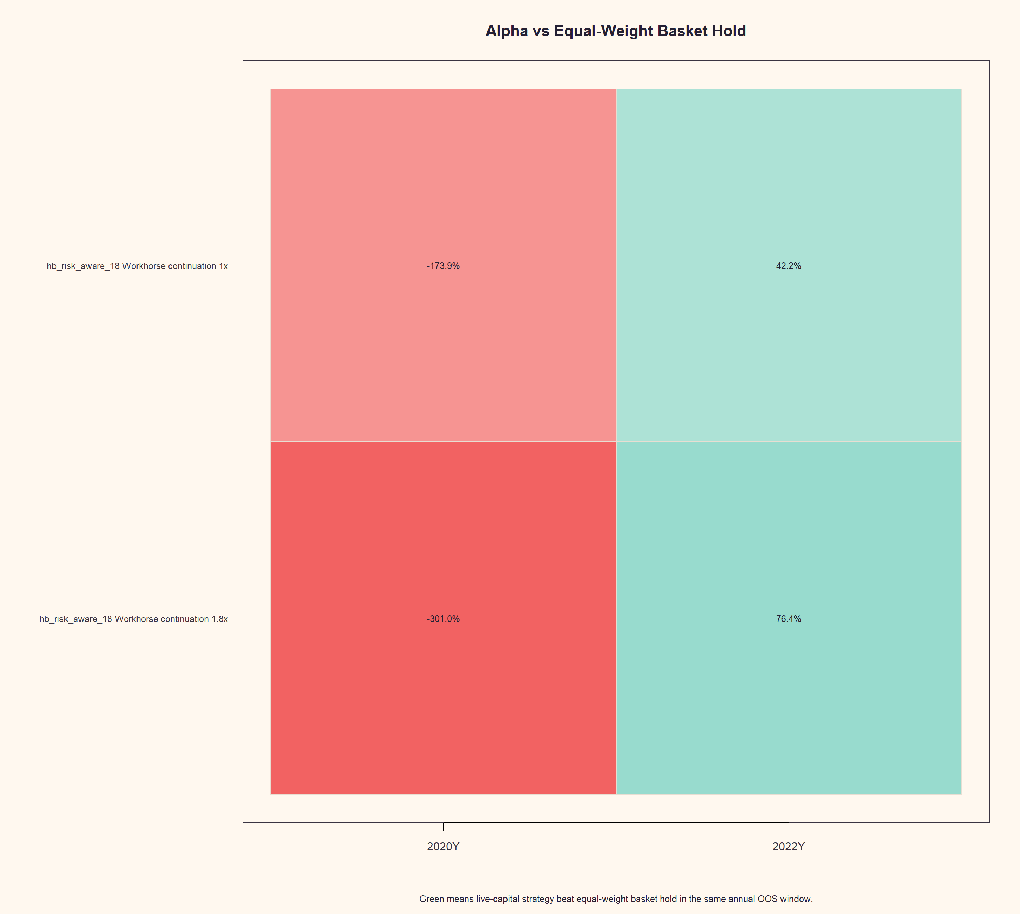
GEN5.3 MOMENTUM CONTEXT-SIZE SCREEN
Trend/breakout leverage made the defensive profile more obvious
Same-leverage read
2020: active 108.1%, but 1.8x basket 409.1%.
2022: +76.4 pp alpha because the levered basket drawdown was severe.
This is defense, not solved upside participation.
At 1.8x, the same lane produced -301.0 pp alpha in 2020 and +76.4 pp in 2022.
Research/inspection only. Not allocation evidence or live-advice behavior.

Slide 23
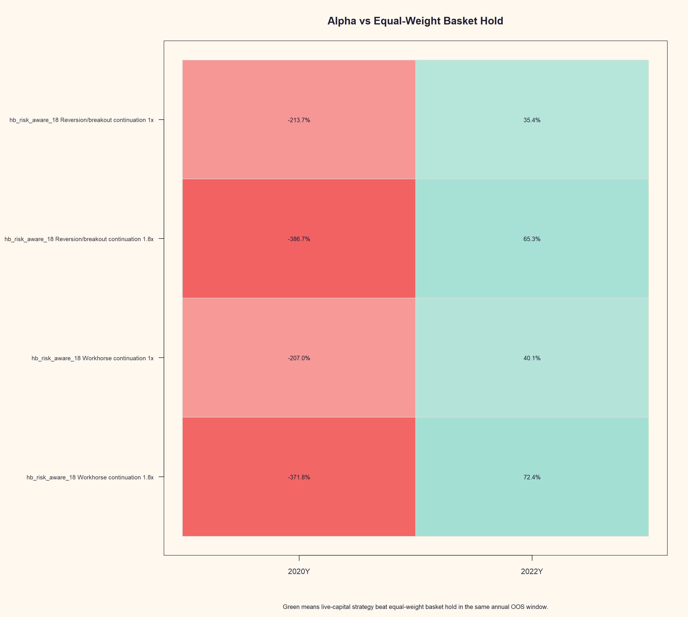
GEN5.3 MOMENTUM CONTEXT-SIZE SCREEN
Mean reversion with leverage still looks like defense, not upside capture
Same-leverage read
2020: active 37.3%, far below the 1.8x basket.
2022: active beat the levered basket by +72.4 pp.
Leverage amplified the defensive value and the rally underparticipation.
At 1.8x, workhorse mean reversion produced -371.8 pp alpha in 2020 and +72.4 pp in 2022.
Research/inspection only. Not allocation evidence or live-advice behavior.

Slide 24
SECTION TRANSITION
Pivot: stop asking technical strategies to do all the timing
The prior sections tested EMA, breakout, mean-reversion, and leverage overlays. The next diagnostic asks whether PCA states themselves can be used as the exposure decision layer.
Binary state packet: runs/research_workbench/gen53_momentum_context_size/g53_momctx_statehold2feat
Research/inspection only. Not allocation evidence or live-advice behavior.

Slide 25
GEN5.3 MOMENTUM CONTEXT-SIZE SCREEN
State-only exposure asks whether PCA states can time the hold decision
The prior lanes asked PCA states to choose a downstream technical strategy, then waited for that strategy to emit entries and exits. This diagnostic removes that second layer.
Favorable state
Unfavorable state
Enter next open if flat. Stay long while selected states remain favorable.
Exit next open if long. Remain flat while cash/exit-cash states persist.
This is a direct test of whether the regime engine itself has enough directional value to act as an exposure switch.
Research/inspection only. Not allocation evidence or live-advice behavior.

Slide 26
GEN5.3 MOMENTUM CONTEXT-SIZE SCREEN
State-only exposure improved rally participation, but still did not beat 2020 basket hold
Year
Feature
Return
Alpha
Exposure
Drawdown
Entries
2020
Workhorse
175.1%
-52.2 pp
85.5%
-37.6%
51
2020
Reversion context
189.8%
-37.5 pp
78.7%
-39.4%
54
2022
Workhorse
-50.9%
+2.1 pp
98.9%
-52.9%
10
2022
Reversion context
-49.8%
+3.2 pp
99.0%
-51.9%
10
This is the strongest 2020 participation read so far, but the equal-weight high-beta basket still won. In 2022, the state-only policy stayed almost fully exposed, so its edge over the falling basket was small.
Research/inspection only. Not allocation evidence or live-advice behavior.

Slide 27
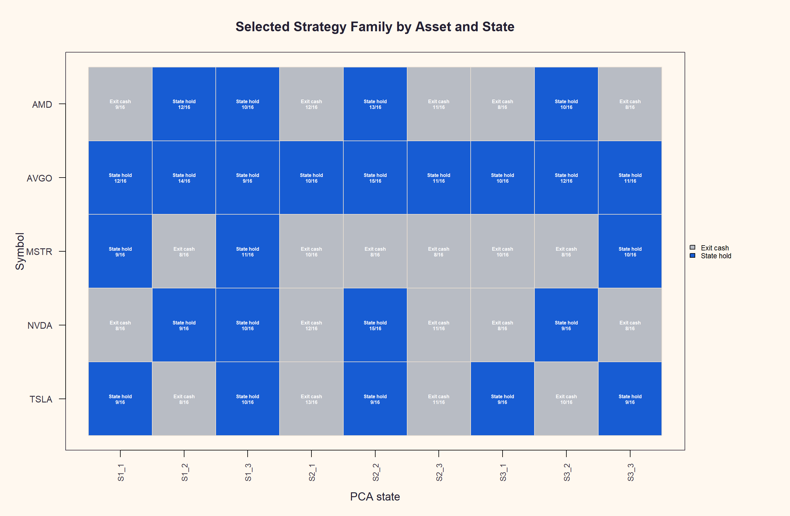
GEN5.3 MOMENTUM CONTEXT-SIZE SCREEN
The state-only map is a true binary exposure policy
Sanity check
Selections are only State hold or Exit cash.
AVGO was almost always favorable.
MSTR and TSLA were more selective.
Cash states force exit, not passive holding.
Research/inspection only. Not allocation evidence or live-advice behavior.

Slide 28
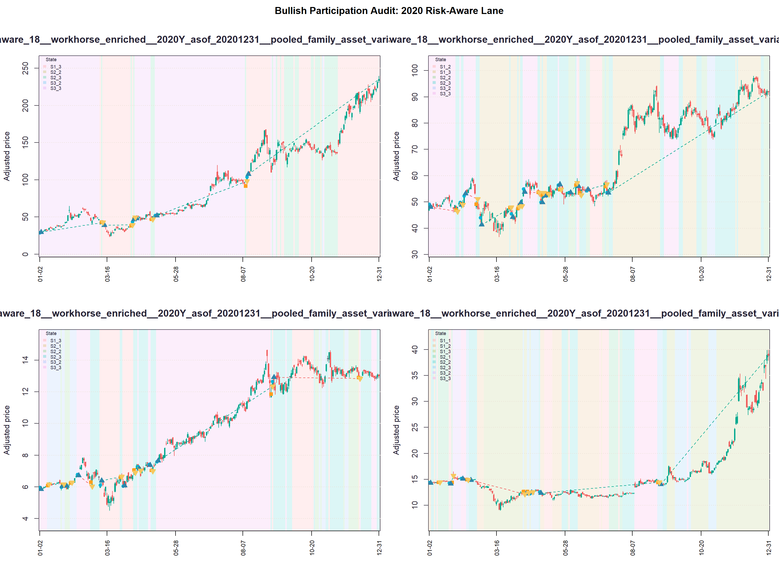
GEN5.3 MOMENTUM CONTEXT-SIZE SCREEN
The visual audit shows why this deserves a wider but careful follow-up
Interpretation
Much stronger 2020 upside participation.
Too much 2022 exposure.
Next: test a hold-only middle action.
Research/inspection only. Not allocation evidence or live-advice behavior.

Slide 29
SECTION TRANSITION
Pivot: add a neutral gear to the state policy
The binary state-only run treated every non-favorable state as an exit. The next slice tests a three-action policy: enter/hold, hold-only/no-new-entry, and exit/flat.
Three-action packet: runs/research_workbench/gen53_momentum_context_size/g53_momctx_state3action2feat
Research/inspection only. Not allocation evidence or live-advice behavior.

Slide 30
GEN5.3 MOMENTUM CONTEXT-SIZE SCREEN
The three-action policy made the state map more realistic
This slice keeps the same two windows, context, features, and annual continuity replay as the binary diagnostic. Only the state action grammar changes.
Enter / hold
Hold only
Exit / flat
State selected state_buy_hold. Enter next open if flat; stay long while no exit state appears.
State selected state_hold_only. Do not open a new trade, but allow an existing trade to continue.
State selected no_trade_exit_immediate. Exit next open if long; remain flat while the state persists.
The policy is still TRAIN-only: cash states are converted to exit only when state-hold TRAIN evidence is negative; otherwise they become hold-only.
Research/inspection only. Not allocation evidence or live-advice behavior.

Slide 31
GEN5.3 MOMENTUM CONTEXT-SIZE SCREEN
Three-action improved nuance, but did not solve 2022 over-participation
Feature
Window
Binary
3-action
3-action alpha
Exposure
Workhorse
2020
175.1%
185.3%
-42.0 pp
90.8%
Workhorse
2022
-50.9%
-52.5%
+0.6 pp
99.6%
Rev/BO
2020
189.8%
187.2%
-40.1 pp
86.1%
Rev/BO
2022
-49.8%
-51.6%
+1.5 pp
99.4%
The neutral gear reduced entry churn, but 2022 exposure stayed around 99%. That points back to feature/state discrimination, not merely the lack of a hold-only action.
Research/inspection only. Not allocation evidence or live-advice behavior.

Slide 32
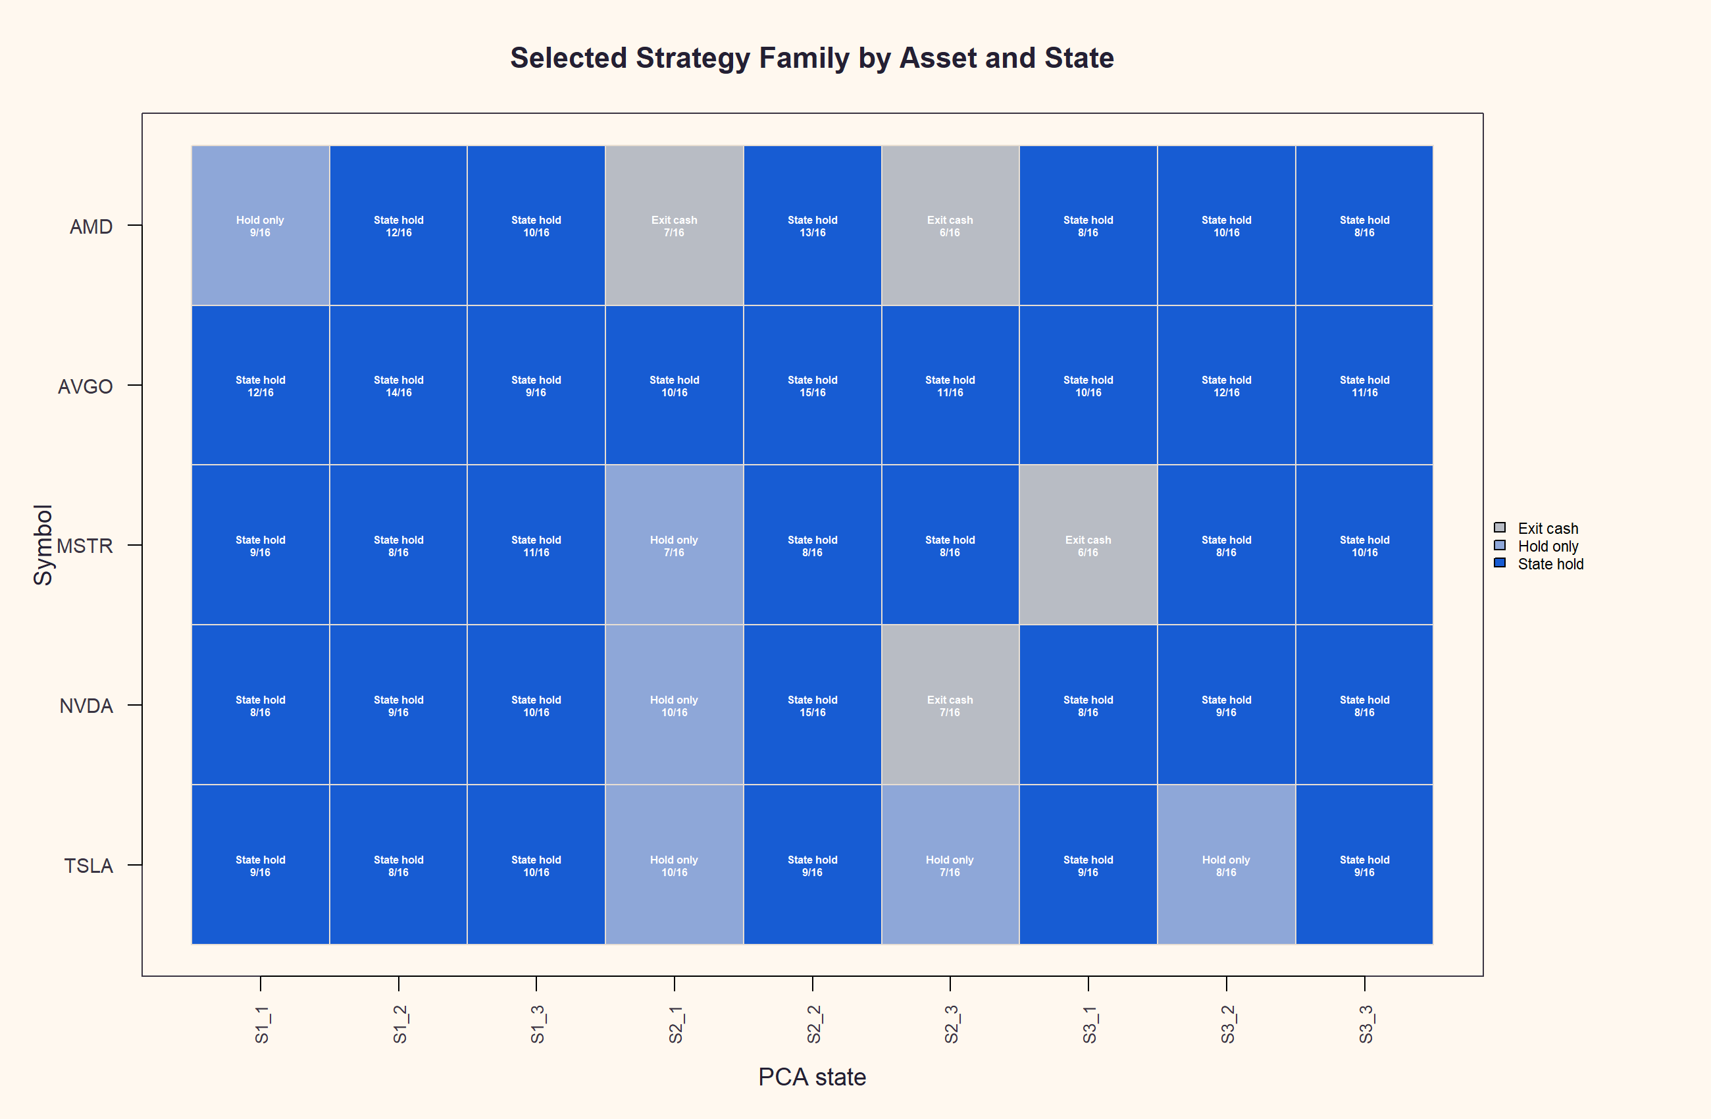
GEN5.3 MOMENTUM CONTEXT-SIZE SCREEN
The action map confirms the neutral gear is active
Action counts
State hold: 399
Hold only: 213
Exit cash: 108
This is not just relabeling. The map contains all three actions, but the dominant action remains state hold, especially in the 2022 authorities.
Research/inspection only. Not allocation evidence or live-advice behavior.

Slide 33
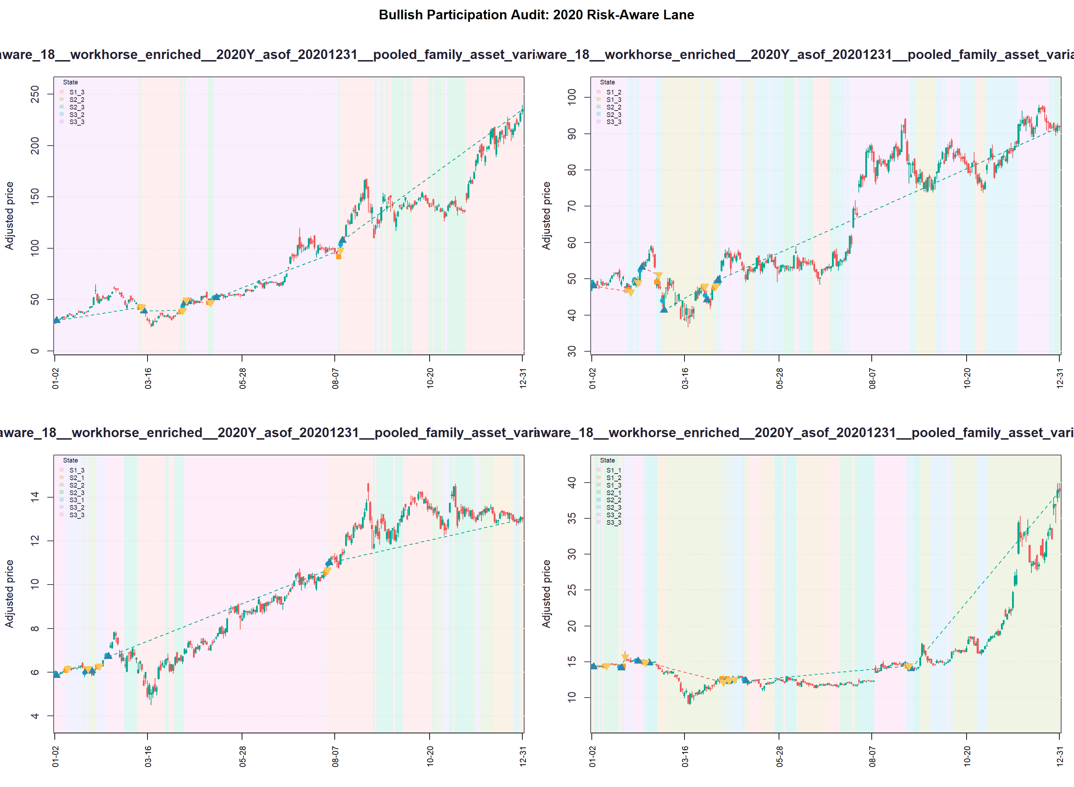
GEN5.3 MOMENTUM CONTEXT-SIZE SCREEN
Visual audit: the policy still participates too much when defense matters
Interpretation
Fewer entries
2020 still strong
2022 still lacks risk-off
Next: features
Research/inspection only. Not allocation evidence or live-advice behavior.

