Slide 1
SESSION 7
Risk is more forecastable than return;
that still does not guarantee a scaler.
Alpha vs risk • executable basket • two horizons • frozen STOP
S7/01
Notes:
SESSION 7 - C1 PORTFOLIO-RISK FORECASTING
Purpose
Correct the exposure layer's job: estimate portfolio risk rather than predict five-day return direction.
Conversation: codex://threads/019f741e-615f-7fd0-90f7-edce12b5cb66
Find in chat: the exposure layer should probably control risk
Artifact: docs/GEN5_4_CROSS_SECTIONAL_ASSET_SELECTION_POC_PLAN.md
Boundary: diagnostic evidence only; no scaler, allocation, return replay, or live authority.

Slide 2
C1 asks whether stress orders risk - not whether prices go up
RISK INPUTS
EXECUTABLE LABEL
PROMOTION
Four OHLCV stress measures
available after close t
h5 + h20 realized volatility
after next-open execution
Both horizons + 12 / 20 folds
with TRAIN-only medians
No scaler, return replay, target volatility, allocation, or live change.
D24/02
Notes:
DECISION D24 - FROZEN C1 CONTRACT
Inputs
Trailing 20-session equal-weight basket realized volatility; trailing 20-session SPY downside volatility; SPY drawdown from its trailing 126-session high; and trailing 60-session average cross-sectional correlation.
Target
Annualized realized volatility of the executable, daily rebalanced equal-weight reference basket over the next 5 and 20 open-to-open sessions. An observed basket return uses individual eligibility frozen two sessions before its ending open.
Coverage
At least 18 of the 24 names must be individually point-in-time eligible. The first pre-interpretation render incorrectly inherited X1's 20-name ranking minimum and blanked most of 2023Q3; it is discarded.
Promotion
At each horizon: positive mean fold rank correlation, positive mean high-minus-low risk separation, at least 12 of 20 positive-correlation folds, at least 12 of 20 positive-separation folds, and a 25%-75% high-state share. Both horizons must pass.
Conversation: codex://threads/019f741e-615f-7fd0-90f7-edce12b5cb66
Find in chat: the exposure layer should probably control risk
Run spec: C:/Users/Franc/OneDrive/Documents/Francis/Peltata Project/Time-Series-Modeling-Gen5/runs/research_workbench/gen54_ml_decision_engine/g54_xs_c1_risk_20260719v2/c1_run_spec.csv

Slide 3
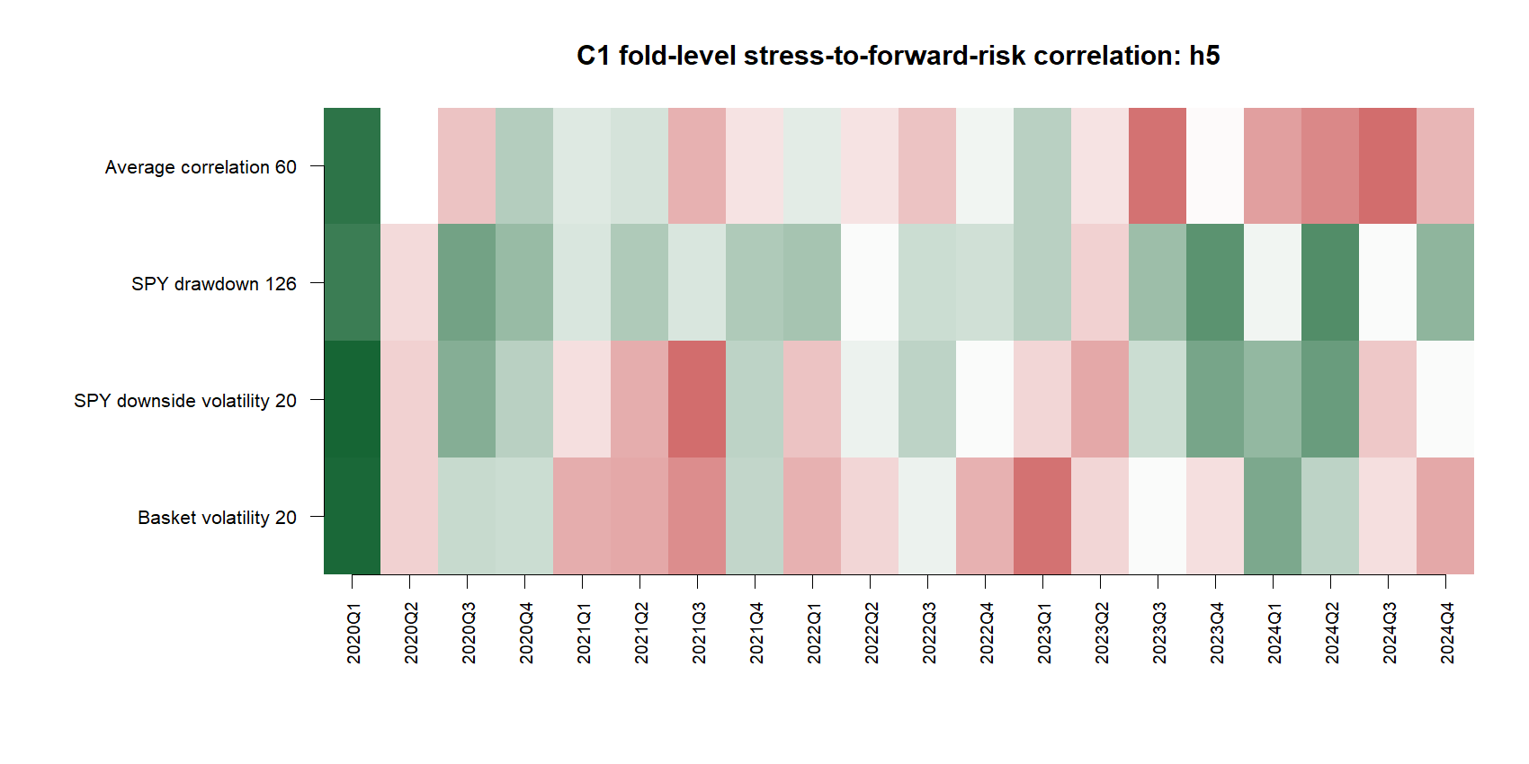
SPY drawdown is a credible h5 risk diagnostic
C1-h5/03
Notes:
C1 H5 EVIDENCE
SPY drawdown 126 passed h5
Positive rank correlation in 18/20 folds; positive high-minus-low risk separation in 12/20; mean fold rank correlation 0.244; annualized realized-volatility separation +0.082; high-state share 43.9%.
Other features
SPY downside volatility reached 12/20 positive-correlation folds but only 8/20 positive-separation folds. Basket volatility reached 8/20 and 7/20. Average correlation reached 7/20 and 3/20.
Meaning
Recent market drawdown contains repeatable short-horizon risk information. This is a risk diagnostic, not evidence that returns will be negative.
Conversation: codex://threads/019f741e-615f-7fd0-90f7-edce12b5cb66
Find in chat: I agree with your recommendations
Report: C:/Users/Franc/OneDrive/Documents/Francis/Peltata Project/Time-Series-Modeling-Gen5/runs/research_workbench/gen54_ml_decision_engine/g54_xs_c1_risk_20260719v2/c1_report.md

Slide 4
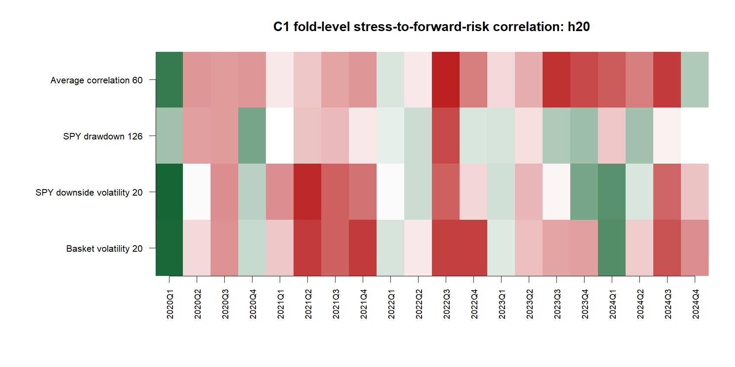
The same signal does not survive h20
C1-h20/04
Notes:
C1 H20 EVIDENCE
SPY drawdown 126 stopped at h20
Positive rank correlation in 9/20 folds; positive high-minus-low separation in 7/20; mean fold rank correlation 0.002; annualized realized-volatility separation +0.019; high-state share 42.2%.
Other features also stopped
Basket volatility: 5/20 positive-correlation folds and 4/20 positive-separation folds, mean correlation -0.262.
SPY downside volatility: 9/20 and 3/20, mean correlation -0.108.
Average correlation: 3/20 and 3/20, mean correlation -0.352.
Meaning
The apparent risk persistence is horizon-specific. A single OHLCV scaler cannot be justified across the agreed holding horizons.
Conversation: codex://threads/019f741e-615f-7fd0-90f7-edce12b5cb66
Find in chat: I agree with your recommendations
Report: C:/Users/Franc/OneDrive/Documents/Francis/Peltata Project/Time-Series-Modeling-Gen5/runs/research_workbench/gen54_ml_decision_engine/g54_xs_c1_risk_20260719v2/c1_report.md

Slide 5
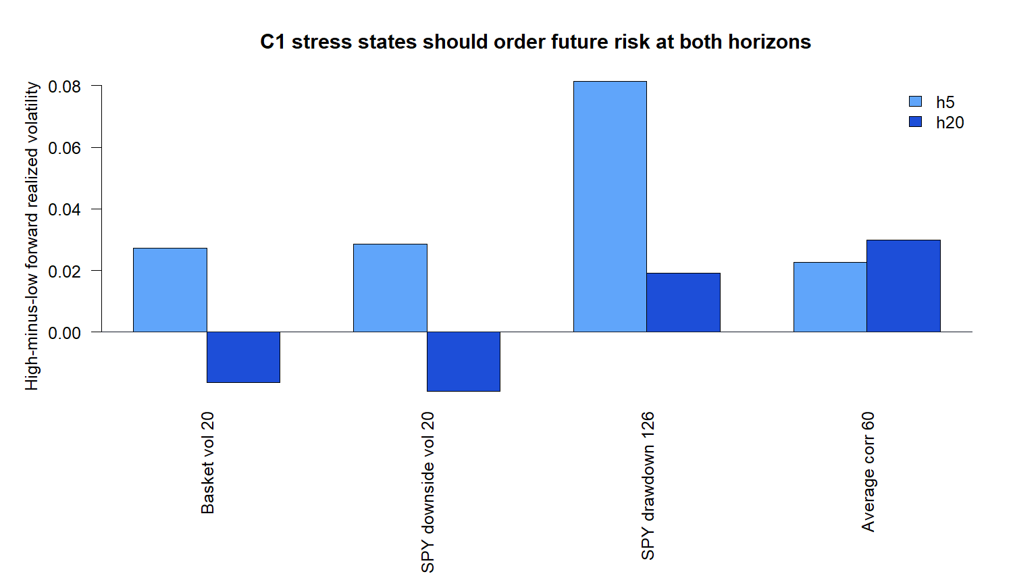
Horizon specificity stops the scaler
OVERALL: STOP BEFORE RISK SCALER
PASS 9 / 9 leakage checks
PASS SPY drawdown at h5
STOP SPY drawdown at h20
STOP Three other primitives
STOP No scaler or replay
Policy fits: 0
D25/05
Notes:
DECISION D25 - STOP BEFORE RISK-SCALER DESIGN
Readout
One short-horizon result is credible: SPY drawdown orders h5 realized risk. No primitive passed the complete two-horizon contract.
Why STOP
C1 required a risk primitive to pass both h5 and h20 before a continuous exposure scaler could be discussed. The h20 failure is not deleted after seeing the h5 success.
Authority
Data health INFO; 20 quarterly OOS authorities; eight-quarter TRAIN medians; nine of nine leakage and authority checks passed. Model, scaler, return replay, allocation, and live counts are zero.
Next theory gate
Decide whether an intentionally h5-only controller is economically coherent or whether multi-horizon stability requires an independent macro/credit risk family. Do not answer by retuning C1.
Conversation: codex://threads/019f741e-615f-7fd0-90f7-edce12b5cb66
Find in chat: I agree with your recommendations
Report: C:/Users/Franc/OneDrive/Documents/Francis/Peltata Project/Time-Series-Modeling-Gen5/runs/research_workbench/gen54_ml_decision_engine/g54_xs_c1_risk_20260719v2/c1_report.md
Status: STOP_BEFORE_RISK_SCALER_DESIGN.

