Slide 1
EDGE DISCOVERY LAB · FIRST JOINT LLM / OPERATOR CANDIDATE
Rule 201
Reclaim
−10%
prior-close
threshold
A fixed market-structure threshold meets same-day price recovery.
Discovery question
When a volatile stock breaches a salient rule threshold but recovers before the close, does the next tradable session behave differently?
DISCOVERY SLICE COMPLETE · NO EDGE CLAIM
Notes:
This opens the Edge Discovery Lab. The purpose is to let the operator and LLM interrogate one narrow mechanism visually before any broad statistical gate is opened.
[Sources]
- SEC, Division of Trading and Markets, Responses to Frequently Asked Questions Concerning Rule 201 of Regulation SHO, https://www.sec.gov/rules-regulations/staff-guidance/trading-markets-frequently-asked-questions-7
- Nasdaq Trader, Short Sale Circuit Breaker, https://nasdaqtrader.com/trader.aspx?id=ShortSaleCircuitBreaker
- Local discovery packet: runs/research_workbench/edge_discovery_lab/edl_ms_01_rule201_reclaim_discovery_20260830/report.md
[/Sources]

Slide 2
EDGE DISCOVERY LAB · EDL-MS-01
The candidate joins price stress to a real market-structure threshold
PRICE PATH
Intraday low
≤ −10%
Close-location
value
Next open
is tradable
Prior close
What Rule 201 contributes
What it does not contribute
A fixed threshold anchored to the prior close—not a fitted indicator.
It is not a ban on short selling; eligible short-sale executions are price constrained.
A plausible change in the short-sale execution environment after activation.
A daily low is only a proxy for official exchange activation status.
Discovery slice · adjusted daily bars · 2018–2023 TRAIN only
02
Notes:
Rule 201 generally activates after a 10 percent decline from the prior close and applies for the remainder of that day and the following trading day. This study uses adjusted daily bars, so the trigger is explicitly labeled a proxy rather than official exchange status.
[Sources]
- SEC, Division of Trading and Markets, Responses to Frequently Asked Questions Concerning Rule 201 of Regulation SHO, https://www.sec.gov/rules-regulations/staff-guidance/trading-markets-frequently-asked-questions-7
- Nasdaq Trader, Short Sale Circuit Breaker, https://nasdaqtrader.com/trader.aspx?id=ShortSaleCircuitBreaker
- Local discovery packet: runs/research_workbench/edge_discovery_lab/edl_ms_01_rule201_reclaim_discovery_20260830/report.md
[/Sources]

Slide 3
EDGE DISCOVERY LAB · EDL-MS-01
The first slice freezes a small, interpretable discovery surface
10
2018–23
−12%…−8%
1 / 3 / 5
volatile equities
TRAIN window
visual band
forward sessions
TSLA, AMD, NVDA, GME, AMC…
post-2023 remains sealed
around the −10% proxy
next-open entry convention
MEASURED NOW
DELIBERATELY NOT OPENED
Trigger proxy: daily low / prior close − 1 ≤ −10%.
No significance tests, multiplicity gates, costs, sizing, or executable strategy.
Reclaim strength: where the close lands inside that day’s high–low range.
No outcome-selected tapes and no post-2023 inspection.
Context only: abnormal dollar volume versus the strictly prior 20-session median.
No claim that this basket represents the broader market.
Discovery slice · adjusted daily bars · 2018–2023 TRAIN only
03
Notes:
The basket is an explicit operator-style discovery surface rather than a representative atlas. The point of this slice is construction validity and visual intelligibility.
[Sources]
- Local frozen run specification: runs/research_workbench/edge_discovery_lab/edl_ms_01_rule201_reclaim_discovery_20260830/run_spec.csv
- Local discovery packet: runs/research_workbench/edge_discovery_lab/edl_ms_01_rule201_reclaim_discovery_20260830/report.md
[/Sources]

Slide 4
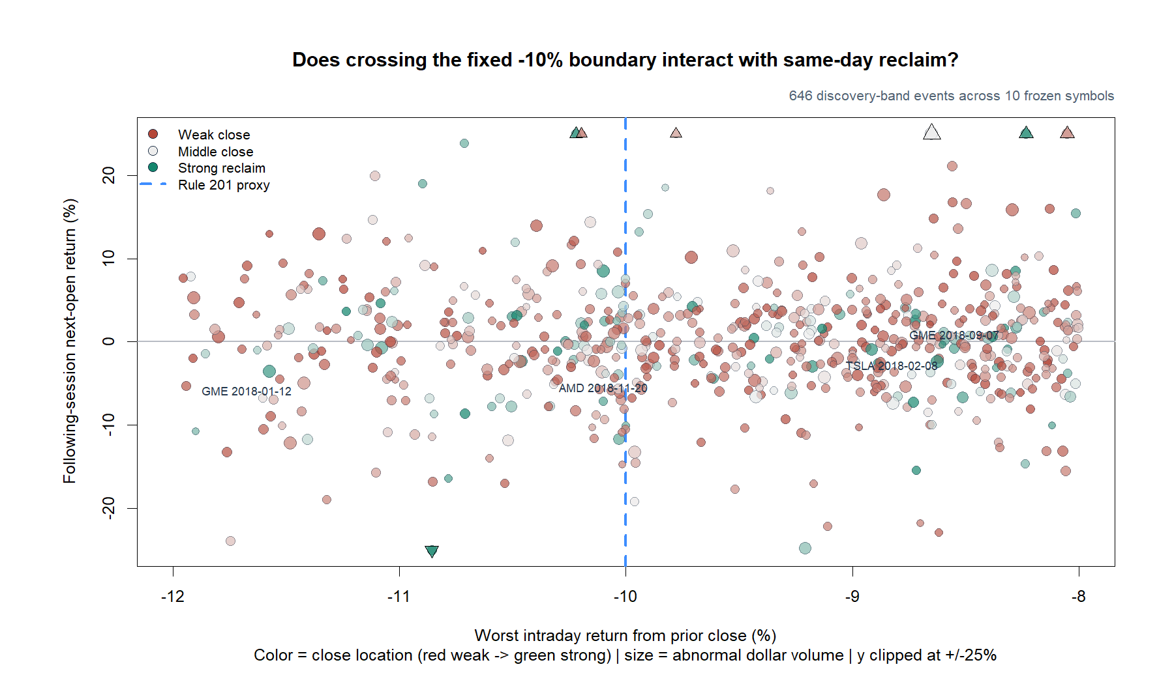
EDGE DISCOVERY LAB · EDL-MS-01
The threshold is visible; a following-return cliff is not
646
band events
−12% through −8%
239
proxy-triggered
low drawdown ≤ −10%
24
strong reclaims
triggered + CLV ≥ 0.75
Visual read: dispersion dominates any abrupt separation at the rule threshold.
Discovery slice · adjusted daily bars · 2018–2023 TRAIN only
04
Notes:
There are enough events to inspect the construction, but only 24 proxy-triggered strong-reclaim observations. The scatter does not show an obvious discontinuity in next-session returns at the negative 10 percent line.
[Sources]
- Local event ledger: runs/research_workbench/edge_discovery_lab/edl_ms_01_rule201_reclaim_discovery_20260830/event_ledger.csv
- Local discovery packet: runs/research_workbench/edge_discovery_lab/edl_ms_01_rule201_reclaim_discovery_20260830/report.md
[/Sources]

Slide 5
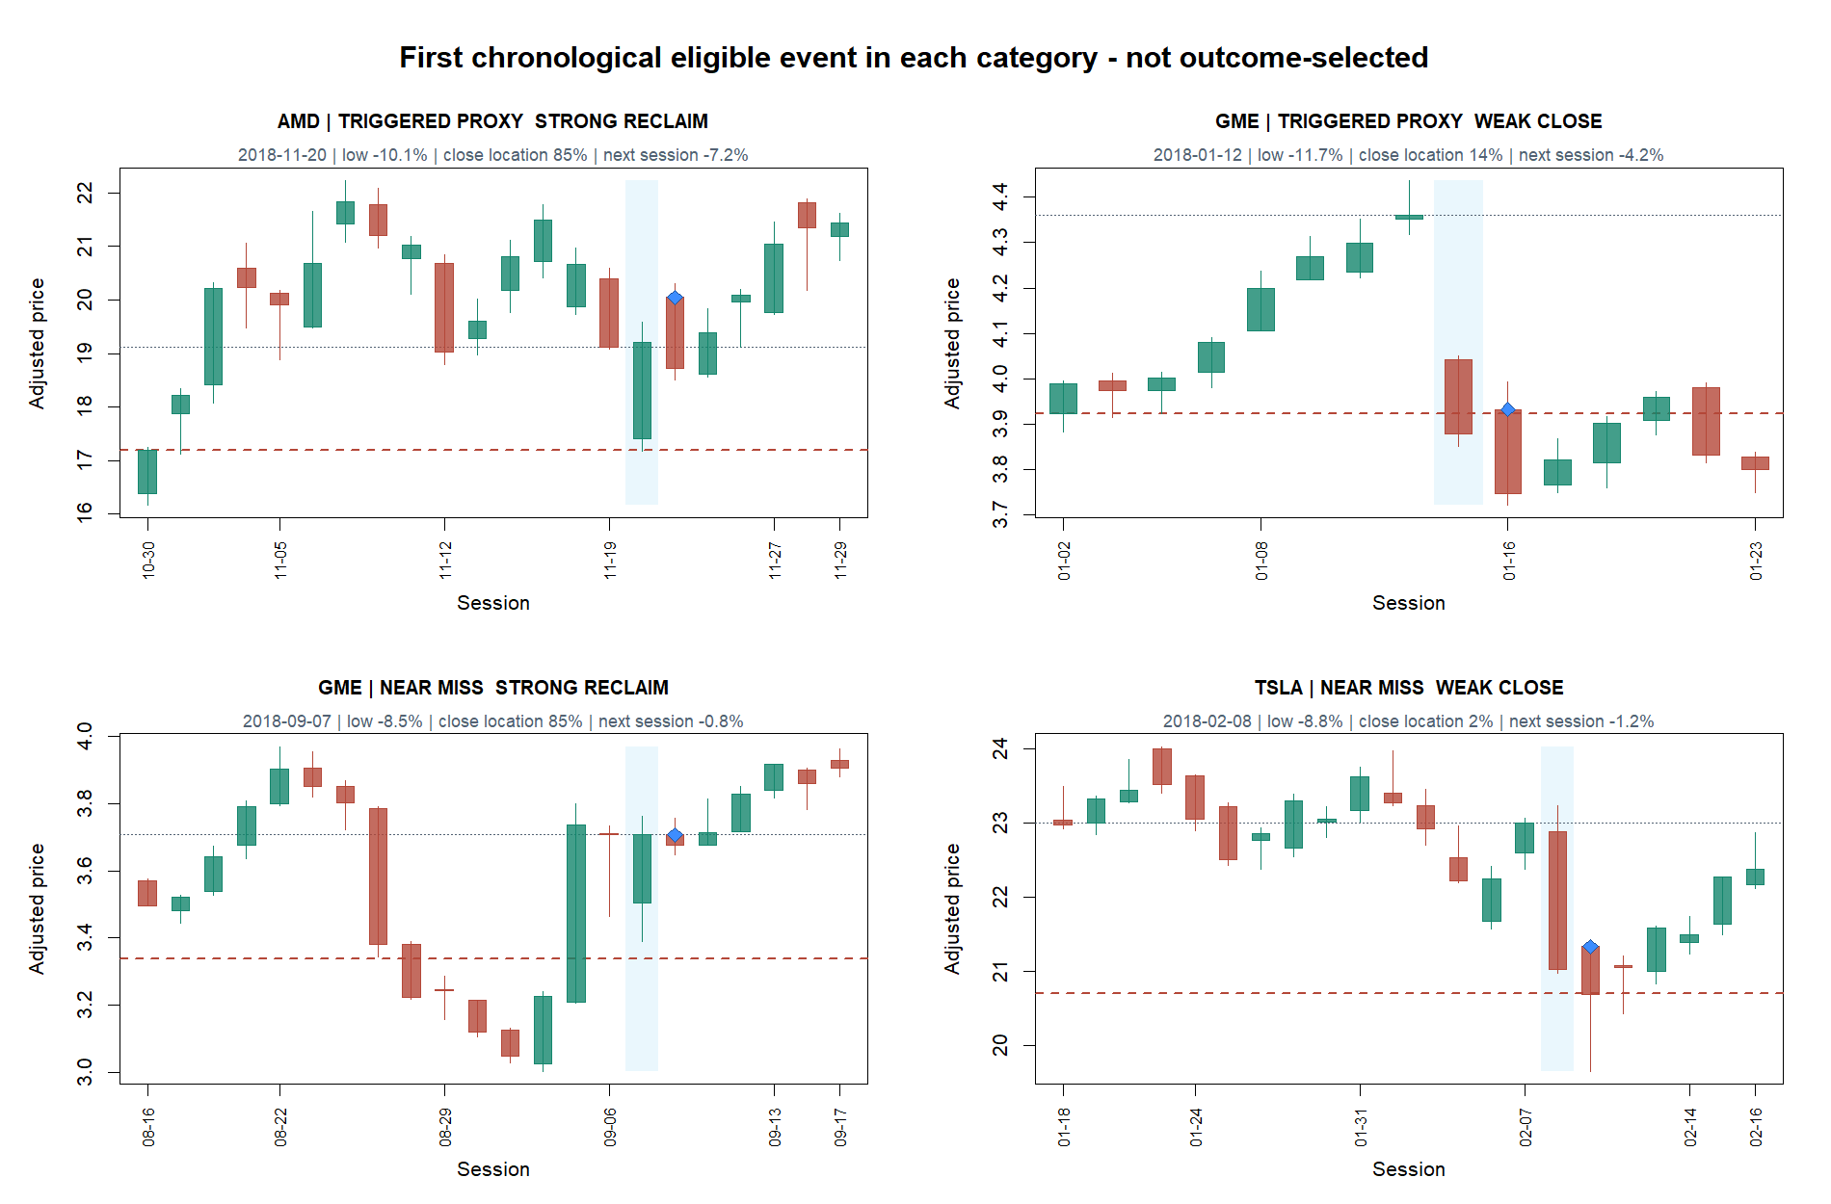
EDGE DISCOVERY LAB · EDL-MS-01
The first tapes challenge the immediate-next-session story
All four examples fell in the immediately following session; three were positive by five sessions. That is a horizon question—not a rescue.
Discovery slice · adjusted daily bars · 2018–2023 TRAIN only
05
Notes:
The tapes are the first chronological example of each predeclared category, not the best or worst outcomes. Their common next-session weakness makes the immediate-rebound story less compelling, while three positive five-session outcomes motivate keeping horizon and mechanism separate in the next discussion.
[Sources]
- Local deterministic tape selection: runs/research_workbench/edge_discovery_lab/edl_ms_01_rule201_reclaim_discovery_20260830/selected_event_tapes.csv
- Local discovery packet: runs/research_workbench/edge_discovery_lab/edl_ms_01_rule201_reclaim_discovery_20260830/report.md
[/Sources]

Slide 6
EDGE DISCOVERY LAB · EDL-MS-01
The slice earns a sharper question—not an edge claim
VISIBLE NOW
STILL UNKNOWN
The construction works.
Whether a tradable effect exists.
A real fixed threshold can be interrogated without fitting it.
Does exact exchange activation sharpen the proxy?
Close-location value cleanly distinguishes reclaim from weak-close events.
Is there any reproducible distinction by reclaim strength or horizon?
The tape view exposes timing that a single summary return would hide.
Does the idea survive a predeclared atlas, costs, and untouched data?
STATUS
DISCOVERY SLICE COMPLETE · NO PASS / STOP · NO EDGE CLAIM
Discovery slice · adjusted daily bars · 2018–2023 TRAIN only
06
Notes:
This is a successful lab slice because it creates a transparent mechanism, validated construction, and operator-facing evidence. The next research gate remains an operator decision.
[Sources]
- Local discovery packet: runs/research_workbench/edge_discovery_lab/edl_ms_01_rule201_reclaim_discovery_20260830/report.md
- Local frozen run specification: runs/research_workbench/edge_discovery_lab/edl_ms_01_rule201_reclaim_discovery_20260830/run_spec.csv
[/Sources]

