Slide 1
GEN5.4 / EVENT-REACTION DEVELOPMENT AUDIT
E1 stops before prospective confirmation
Signal construction is leakage-safe and well supported. The frozen matched-control gate is not.
Notes:
Opening result: E1 is a development mechanics audit. It correctly stops because only 26.2% of eligible signals receive a control under the frozen design.
Dialogue reference: D48 - codex://threads/019f741e-615f-7fd0-90f7-edce12b5cb66
[Sources]
- C:/Users/Franc/OneDrive/Documents/Francis/Peltata Project/Time-Series-Modeling-Gen5/docs/GEN5_4_EVENT_REACTION_E1_CONTRACT.md
- C:/Users/Franc/OneDrive/Documents/Francis/Peltata Project/Time-Series-Modeling-Gen5/runs/research_workbench/gen54_ml_decision_engine/g54_event_e1_20260727/e1_report.md
[/Sources]

Slide 2
GEN5.4 / E1 EVENT-REACTION AUDIT
The estimand respects when each fact becomes knowable
positive SPY-adjusted overnight + positive SPY-adjusted intraday
17:30 close
next open
next close
following open
+5 sessions
unusual news cycle
known
overnight reaction
observed
intraday reaction observed;
signal becomes known
earliest entry
endpoint open
Outcome: entry-open to endpoint-open return minus SPY over the identical interval.
No close-to-close shortcut. No same-close execution.
Notes:
The signal is not actionable until the next-session close. The earliest permitted entry is the following open, which prevents using an observation and trading at the same timestamp.
Dialogue reference: D47 - codex://threads/019f741e-615f-7fd0-90f7-edce12b5cb66
[Sources]
- C:/Users/Franc/OneDrive/Documents/Francis/Peltata Project/Time-Series-Modeling-Gen5/docs/GEN5_4_EVENT_REACTION_E1_CONTRACT.md
- C:/Users/Franc/OneDrive/Documents/Francis/Peltata Project/Time-Series-Modeling-Gen5/R/gen54_event_reaction_e1.R
[/Sources]

Slide 3
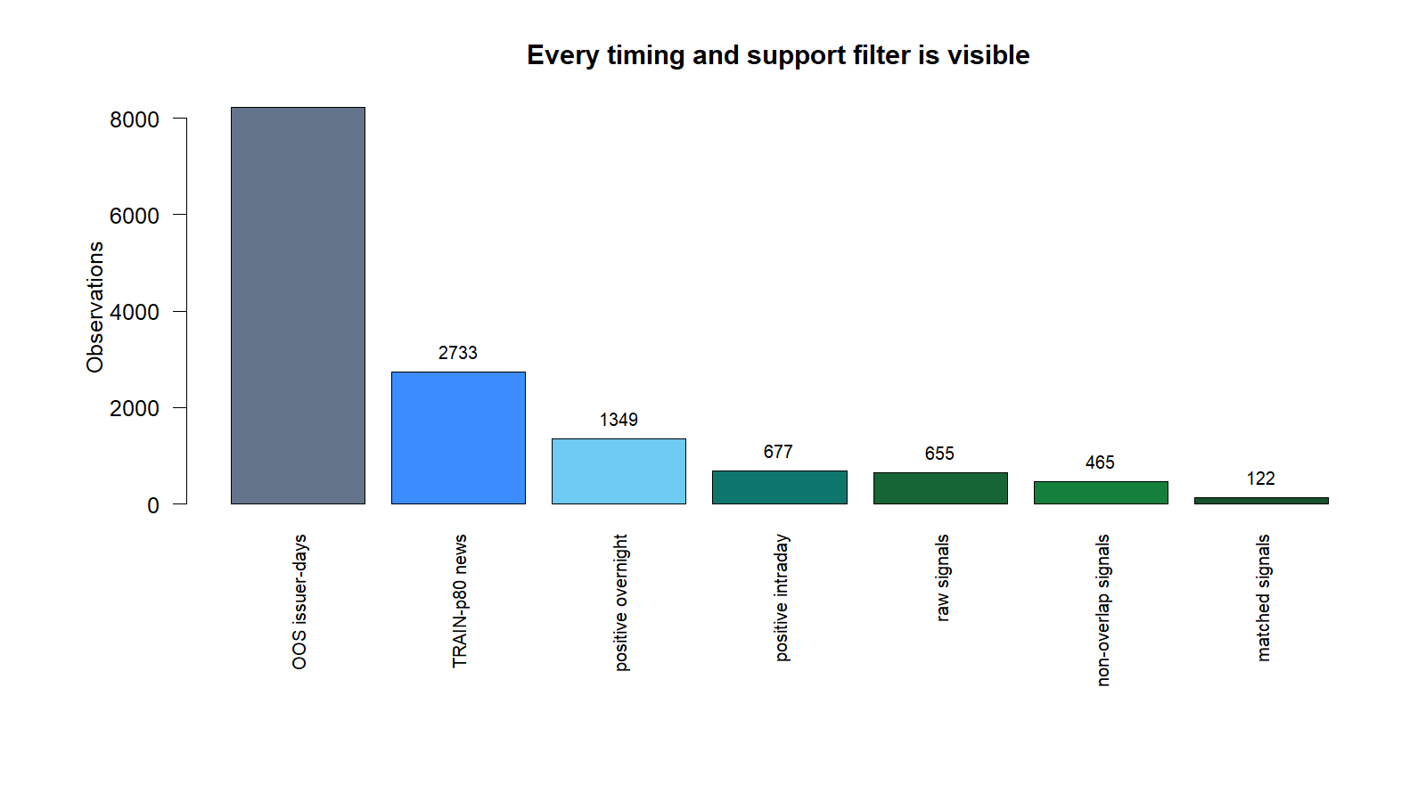
GEN5.4 / E1 EVENT-REACTION AUDIT
The unusual-news reaction funnel has broad support
465
non-overlapping signals
24 / 24 issuers
6 / 6 quarters
Development window:
2025Q1-2026Q2
Notes:
The event and price-reaction construction itself is not data-starved: support exceeds the frozen minimum counts, issuer coverage, and quarter coverage.
Dialogue reference: D48 - codex://threads/019f741e-615f-7fd0-90f7-edce12b5cb66
[Sources]
- C:/Users/Franc/OneDrive/Documents/Francis/Peltata Project/Time-Series-Modeling-Gen5/runs/research_workbench/gen54_ml_decision_engine/g54_event_e1_20260727/e1_signal_funnel.csv
- C:/Users/Franc/OneDrive/Documents/Francis/Peltata Project/Time-Series-Modeling-Gen5/runs/research_workbench/gen54_ml_decision_engine/g54_event_e1_20260727/visuals/e1_signal_funnel.png
[/Sources]

Slide 4
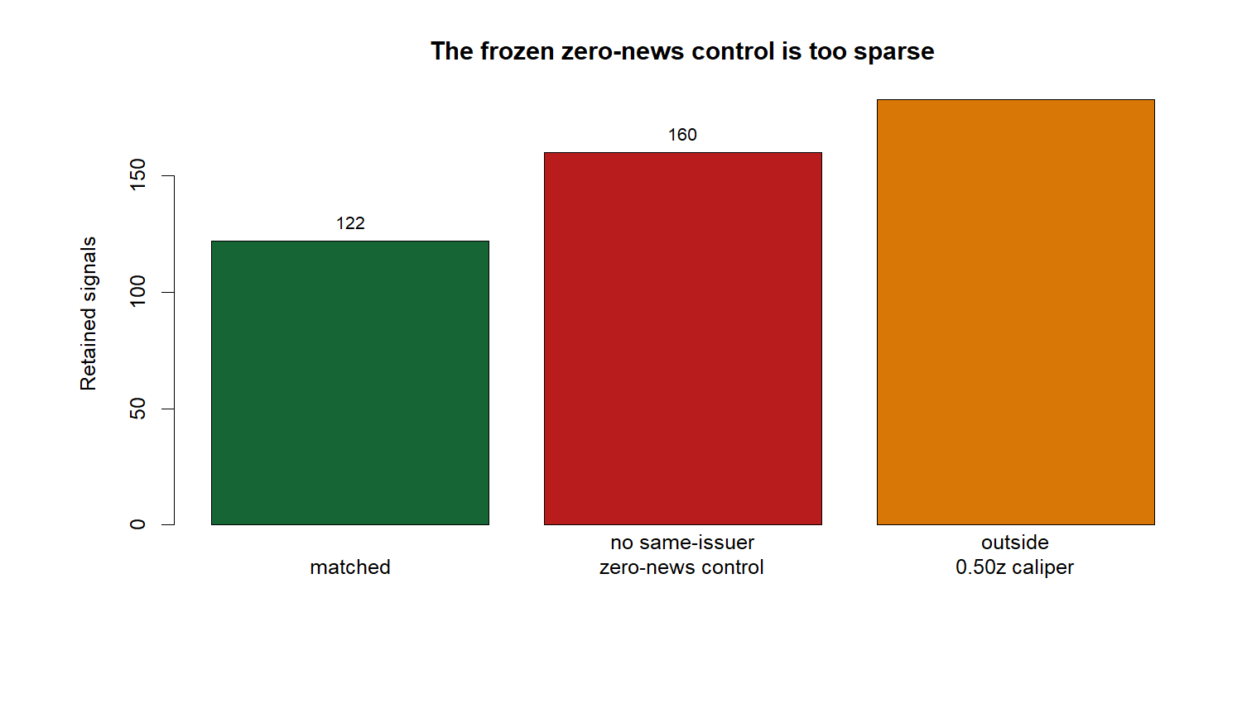
GEN5.4 / E1 EVENT-REACTION AUDIT
The zero-news control is too sparse to carry the claim
26.2%
matched vs. frozen 70% minimum
122 matched
160 had no same-issuer zero-news candidate
183 had candidates only outside the 0.50z caliper
STOP / DO NOT RELAX AFTER SEEING
Notes:
The failure is not repaired by widening the caliper or changing zero-news after seeing the result. That would change the frozen experiment post hoc.
Dialogue reference: D48 - codex://threads/019f741e-615f-7fd0-90f7-edce12b5cb66
[Sources]
- C:/Users/Franc/OneDrive/Documents/Francis/Peltata Project/Time-Series-Modeling-Gen5/runs/research_workbench/gen54_ml_decision_engine/g54_event_e1_20260727/e1_match_support_diagnostic.csv
- C:/Users/Franc/OneDrive/Documents/Francis/Peltata Project/Time-Series-Modeling-Gen5/runs/research_workbench/gen54_ml_decision_engine/g54_event_e1_20260727/visuals/e1_match_support.png
- C:/Users/Franc/OneDrive/Documents/Francis/Peltata Project/Time-Series-Modeling-Gen5/runs/research_workbench/gen54_ml_decision_engine/g54_event_e1_20260727/e1_integrity_audit.csv
[/Sources]

Slide 5
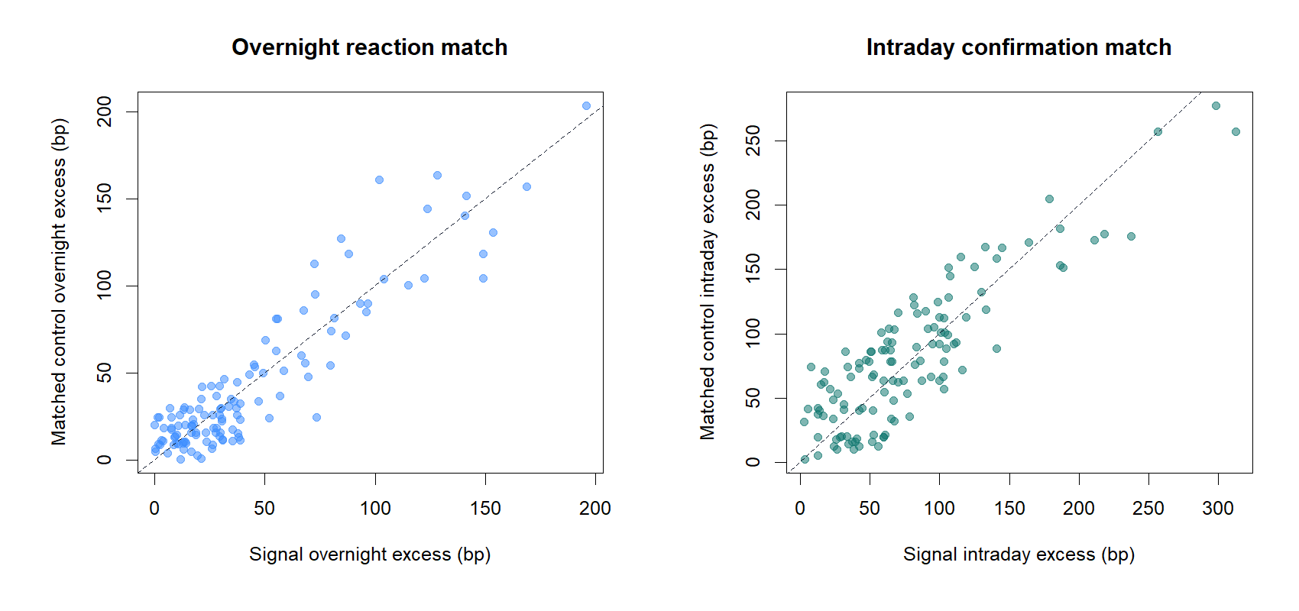
GEN5.4 / E1 EVENT-REACTION AUDIT
Accepted controls are close on the frozen price pattern
What passed
Same issuer and fold
Zero news at the decision
Positive overnight reaction
Positive intraday reaction
Each robust-z distance <= 0.50
No outcome used in matching
Good local matches do not compensate for missing controls on 73.8% of signals.
Notes:
This chart checks the quality of the 122 accepted matches. It must not be read as evidence that the matched subset represents the full E1 signal population.
Dialogue reference: D48 - codex://threads/019f741e-615f-7fd0-90f7-edce12b5cb66
[Sources]
- C:/Users/Franc/OneDrive/Documents/Francis/Peltata Project/Time-Series-Modeling-Gen5/runs/research_workbench/gen54_ml_decision_engine/g54_event_e1_20260727/e1_matched_controls.csv
- C:/Users/Franc/OneDrive/Documents/Francis/Peltata Project/Time-Series-Modeling-Gen5/runs/research_workbench/gen54_ml_decision_engine/g54_event_e1_20260727/visuals/e1_match_quality.png
[/Sources]

Slide 6
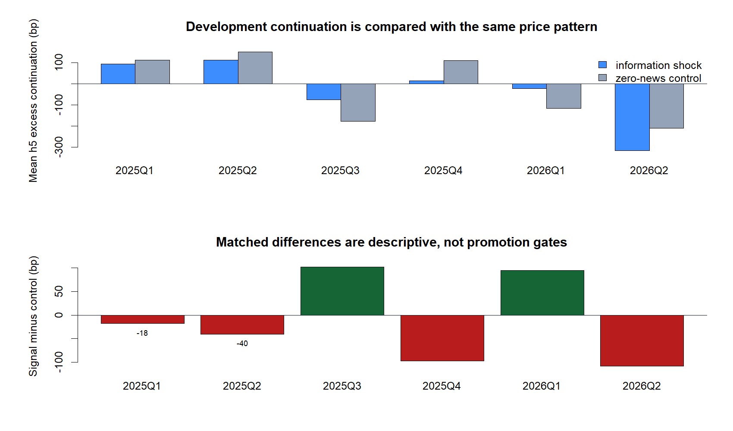
GEN5.4 / E1 EVENT-REACTION AUDIT
The development-only effect is unstable across quarters
-0.4 bp
pooled mean difference
Signal: -39.4 bp
Control: -39.0 bp
Quarter effects change sign and exceed +/-90 bp. This is descriptive development evidence only.
Notes:
The pooled difference is nearly zero and the fold effects are heterogeneous. Because the match-support gate failed, these values cannot promote or reject a predictive theory.
Dialogue reference: D48 - codex://threads/019f741e-615f-7fd0-90f7-edce12b5cb66
[Sources]
- C:/Users/Franc/OneDrive/Documents/Francis/Peltata Project/Time-Series-Modeling-Gen5/runs/research_workbench/gen54_ml_decision_engine/g54_event_e1_20260727/e1_fold_summary.csv
- C:/Users/Franc/OneDrive/Documents/Francis/Peltata Project/Time-Series-Modeling-Gen5/runs/research_workbench/gen54_ml_decision_engine/g54_event_e1_20260727/visuals/e1_fold_readout.png
[/Sources]

Slide 7
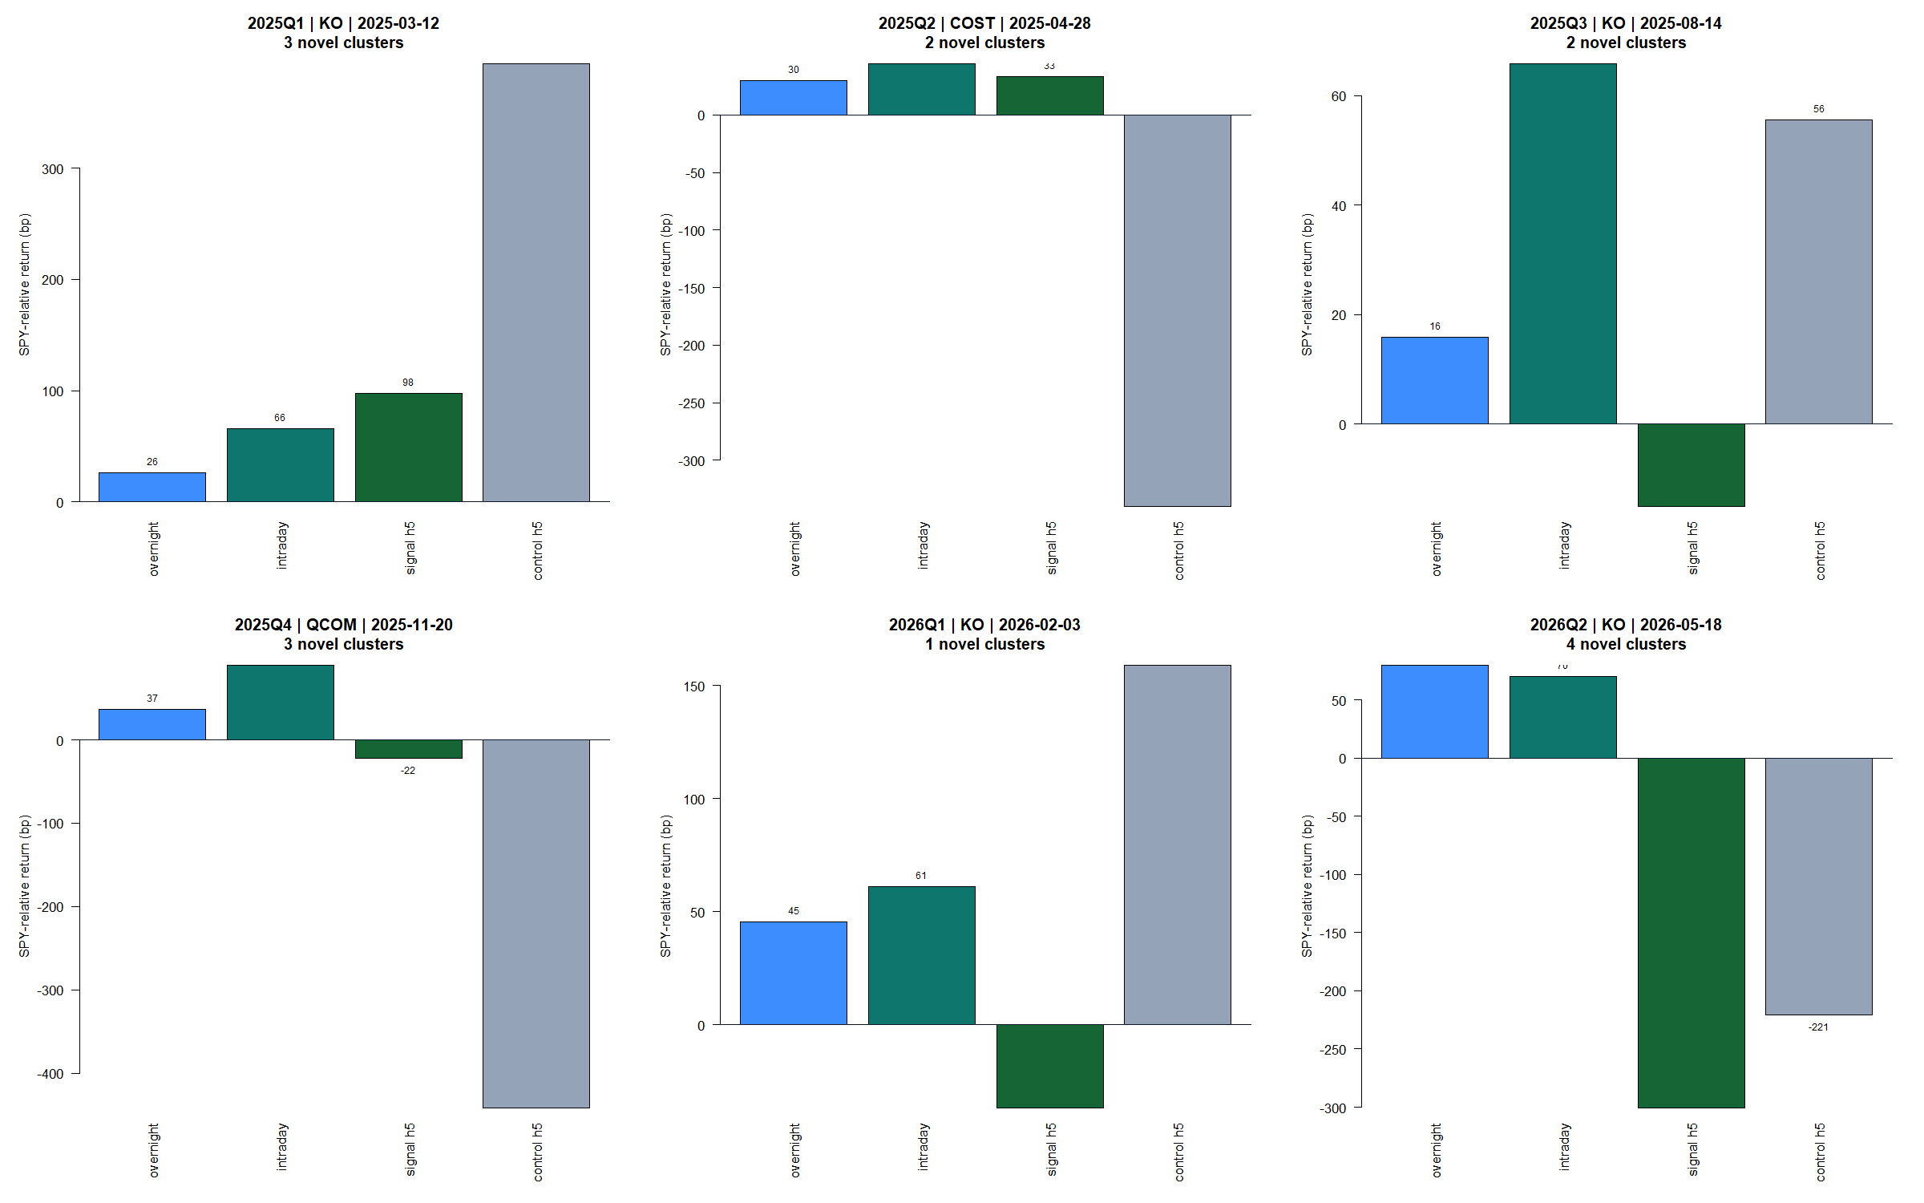
GEN5.4 / E1 EVENT-REACTION AUDIT
Representative tapes expose the full timing chain
Notes:
These panels make the mechanics inspectable: information intensity, overnight and intraday reactions, delayed entry, matched control, and five-session relative continuation.
Dialogue reference: D48 - codex://threads/019f741e-615f-7fd0-90f7-edce12b5cb66
[Sources]
- C:/Users/Franc/OneDrive/Documents/Francis/Peltata Project/Time-Series-Modeling-Gen5/runs/research_workbench/gen54_ml_decision_engine/g54_event_e1_20260727/e1_representative_tape.csv
- C:/Users/Franc/OneDrive/Documents/Francis/Peltata Project/Time-Series-Modeling-Gen5/runs/research_workbench/gen54_ml_decision_engine/g54_event_e1_20260727/visuals/e1_representative_event_reaction_tapes.png
[/Sources]

Slide 8
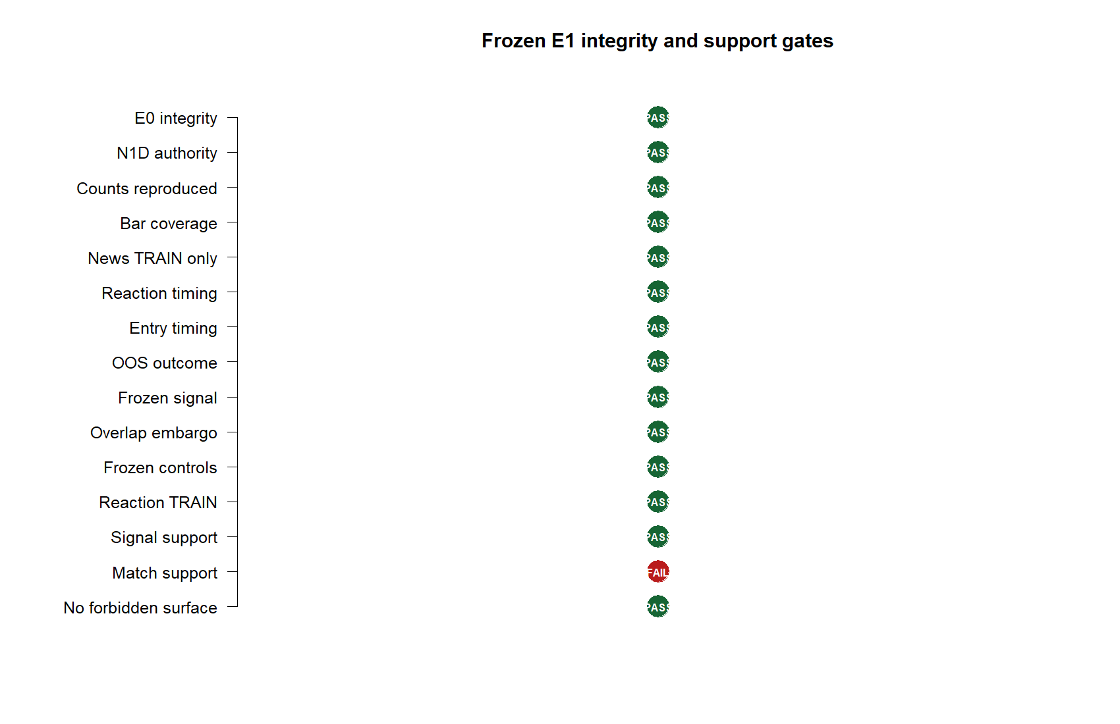
GEN5.4 / E1 EVENT-REACTION AUDIT
Fourteen gates pass; one gate determines the decision
14 / 15
frozen gates pass
Passed:
source authority
point-in-time timing
TRAIN-only thresholds/scales
signal support
coverage and overlap controls
outcome-free matching
STOP_E1_DEVELOPMENT_MECHANICS
Notes:
A frozen gate is meaningful only if one failure can stop the program. E1 therefore does not advance to prospective confirmation as currently defined.
Dialogue reference: D48 - codex://threads/019f741e-615f-7fd0-90f7-edce12b5cb66
[Sources]
- C:/Users/Franc/OneDrive/Documents/Francis/Peltata Project/Time-Series-Modeling-Gen5/runs/research_workbench/gen54_ml_decision_engine/g54_event_e1_20260727/e1_integrity_audit.csv
- C:/Users/Franc/OneDrive/Documents/Francis/Peltata Project/Time-Series-Modeling-Gen5/runs/research_workbench/gen54_ml_decision_engine/g54_event_e1_20260727/visuals/e1_gate_summary.png
- C:/Users/Franc/OneDrive/Documents/Francis/Peltata Project/Time-Series-Modeling-Gen5/runs/research_workbench/gen54_ml_decision_engine/g54_event_e1_20260727/e1_report.md
[/Sources]

Slide 9
GEN5.4 / E1 EVENT-REACTION AUDIT
The next step is a theory choice, not a parameter tweak
Recommended redesign
Real alternative
Same issuer, same fold, similar positive price reaction - but ordinary news intensity below the TRAIN p80 threshold.
Keep zero-news controls, but permit a predeclared economic peer group when same-issuer support is absent.
New estimand: does unusually intense information arrival differ from ordinary information arrival when the issuer and initial price reaction are comparable?
This preserves the zero-news comparison but weakens issuer comparability and requires a new, point-in-time group definition.
Do not widen the 0.50z caliper, change the current outcome, or treat the empty shadow schema as confirmation.
Notes:
The recommended redesign changes the scientific question openly: unusual versus ordinary information intensity within issuer. It must be agreed before implementation.
Dialogue reference: D48 - codex://threads/019f741e-615f-7fd0-90f7-edce12b5cb66
[Sources]
- C:/Users/Franc/OneDrive/Documents/Francis/Peltata Project/Time-Series-Modeling-Gen5/docs/GEN5_4_EVENT_REACTION_E1_CONTRACT.md
- C:/Users/Franc/OneDrive/Documents/Francis/Peltata Project/Time-Series-Modeling-Gen5/runs/research_workbench/gen54_ml_decision_engine/g54_event_e1_20260727/e1_match_support_diagnostic.csv
- C:/Users/Franc/OneDrive/Documents/Francis/Peltata Project/Time-Series-Modeling-Gen5/runs/research_workbench/gen54_ml_decision_engine/g54_event_e1_20260727/e1_prospective_shadow_status.csv
[/Sources]

