Slide 1
SESSION 8
VIX measures risk across both horizons;
the median state still fails.
Official VIX | continuous ordering | incremental evidence | frozen STOP
S8/01
Notes:
SESSION 8 - C2 OPTION-IMPLIED RISK
Purpose
Test one retail-accessible non-OHLCV primitive without opening a model, scaler, allocation rule, or live change.
Conversation: codex://threads/019f741e-615f-7fd0-90f7-edce12b5cb66
Find in chat: small proof of concept using non-technical or non-OHLCV indicators
Artifact: docs/GEN5_4_CROSS_SECTIONAL_ASSET_SELECTION_POC_PLAN.md
Boundary: official Cboe VIX is research-only; Alpaca remains the canonical adjusted daily OHLCV provider.

Slide 2
C2 adds one official VIX primitive without changing the trading-data contract
RISK INPUT
EXECUTABLE LABEL
PROMOTION
Official VIX close / 100
exact-date join; no fill
h5 + h20 realized volatility
after next-open execution
Direct + partial ordering
and median-state stability
Alpaca preflight: VIX returned 0 bars. VIXY was rejected because it tracks rolling VIX futures, not spot VIX.
D26/02
Notes:
DECISION D26 - PROVIDER BOUNDARY AND FROZEN C2 CONTRACT
Provider decision
The existing Alpaca stock-bars path returned zero VIX bars for 2024-01-02 through 2024-01-10. VIXY returned seven bars but is a futures-roll ETF and cannot substitute for spot VIX. C2 therefore uses the official Cboe daily VIX history as a research-only input. Alpaca remains canonical for adjusted daily OHLCV.
Feature
Same-session official VIX close divided by 100, known after close t. Dates are joined exactly; there is no carry-forward or backward fill.
Target and folds
Same 18-of-24 executable equal-weight reference basket, next-open h5 and h20 realized volatility, 20 quarterly OOS folds from 2020Q1 through 2024Q4, and the preceding eight quarters as TRAIN.
Promotion
At both horizons: positive mean direct Spearman correlation, at least 12/20 positive direct folds, positive mean high-minus-low realized-volatility separation, at least 12/20 positive-separation folds, and 25%-75% high-state share. Incremental evidence additionally requires positive partial correlation controlling SPY drawdown and at least 12/20 positive partial folds.
Official sources
Alpaca stock bars: https://docs.alpaca.markets/us/v1.1/reference/stockbars
Alpaca options history: https://docs.alpaca.markets/us/docs/historical-option-data
Cboe VIX history: https://www.cboe.com/tradable_products/vix/vix_historical_data
Cboe VIX methodology: https://www.cboe.com/tradable_products/vix/faqs
ProShares VIXY: https://www.proshares.com/our-etfs/strategic/vixy
Conversation: codex://threads/019f741e-615f-7fd0-90f7-edce12b5cb66
Find in chat: this data should be available through the Alpaca API
Run spec: C:/Users/Franc/OneDrive/Documents/Francis/Peltata Project/Time-Series-Modeling-Gen5/runs/research_workbench/gen54_ml_decision_engine/g54_c2_vix_risk_20260721/c2_run_spec.csv

Slide 3
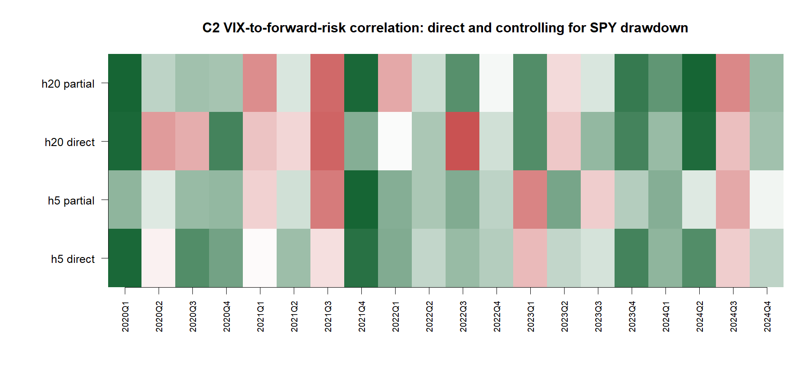
VIX adds continuous risk ordering beyond SPY drawdown
D27/03
Notes:
DECISION D27 - CONTINUOUS ORDERING PASSES
h5
Direct: 15/20 positive folds; mean rank correlation 0.272.
Partial controlling SPY drawdown: 15/20 positive folds; mean partial rank correlation 0.155.
h20
Direct: 12/20 positive folds; mean rank correlation 0.131.
Partial controlling SPY drawdown: 15/20 positive folds; mean partial rank correlation 0.220.
Meaning
Official VIX contains multi-horizon risk information and is not merely a restatement of recent SPY drawdown. This is measurement evidence, not yet an exposure rule.
Conversation: codex://threads/019f741e-615f-7fd0-90f7-edce12b5cb66
Find in chat: I agree with this direction
Report: C:/Users/Franc/OneDrive/Documents/Francis/Peltata Project/Time-Series-Modeling-Gen5/runs/research_workbench/gen54_ml_decision_engine/g54_c2_vix_risk_20260721/c2_report.md

Slide 4
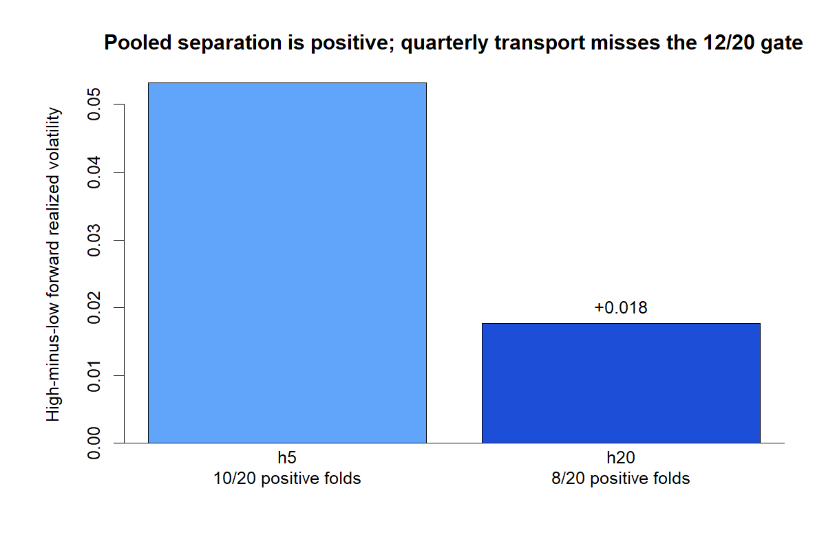
The frozen median state does not transport
D27/04
Notes:
DECISION D27 - MEDIAN-STATE SEPARATION STOPS
h5
Positive high-minus-low separation in 10/20 folds; mean separation +0.053 annualized realized volatility; high-state share 47.4%.
h20
Positive separation in 8/20 folds; mean separation +0.018; high-state share 45.1%.
Meaning
The pooled direction is sensible, but the binary conversion is not stable across quarterly authorities. The frozen gate required at least 12/20 positive-separation folds at both horizons.
Why not tune now
Choosing a new threshold, quantile, smoothing rule, or nonlinear map after inspecting these folds would convert diagnostic evidence into selection leakage.
Conversation: codex://threads/019f741e-615f-7fd0-90f7-edce12b5cb66
Find in chat: I agree with this direction
Report: C:/Users/Franc/OneDrive/Documents/Francis/Peltata Project/Time-Series-Modeling-Gen5/runs/research_workbench/gen54_ml_decision_engine/g54_c2_vix_risk_20260721/c2_report.md

Slide 5
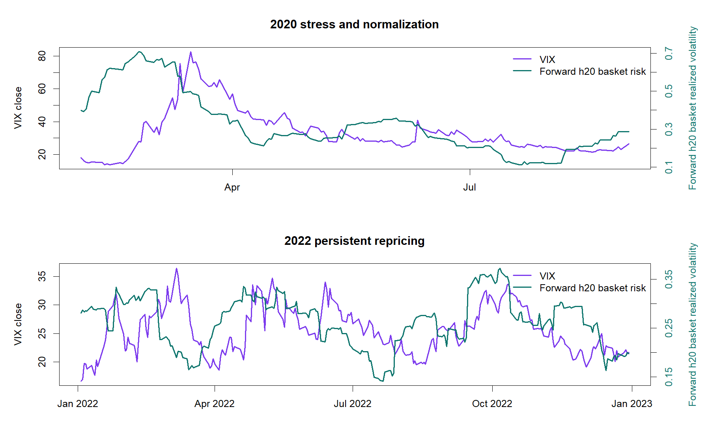
Measurement passes; policy conversion stops
OVERALL: STOP THRESHOLD INSTABILITY
PASS 9 / 9 leakage checks
PASS Direct ordering at h5 + h20
PASS Incremental ordering at h5 + h20
STOP Median state: 10 / 20 at h5
STOP Median state: 8 / 20 at h20
STOP No scaler, replay, or allocation
Policy fits: 0
D27/05
Notes:
DECISION D27 - STOP_THRESHOLD_INSTABILITY
Readout
Official VIX is a credible continuous risk measurement across both horizons and retains information after controlling SPY drawdown. The frozen TRAIN-median high/low state does not transport consistently enough to become policy.
Authority
Cboe HTTP 200; 1,780 accepted rows from 2018-01-02 through 2024-12-31; 100% exact-date join coverage; zero filled dates; zero duplicates; zero future rows admitted. Alpaca OHLCV health INFO. Nine of nine leakage checks passed. Model, scaler, replay, allocation, and live counts are zero.
Next theory gate
Either predeclare one monotone calibration rule and evaluate it only on untouched post-2024 data, or stop the risk-policy lane. Do not choose a threshold or mapping from the inspected 2020-2024 folds.
Conversation: codex://threads/019f741e-615f-7fd0-90f7-edce12b5cb66
Find in chat: this data should be available through the Alpaca API
Report: C:/Users/Franc/OneDrive/Documents/Francis/Peltata Project/Time-Series-Modeling-Gen5/runs/research_workbench/gen54_ml_decision_engine/g54_c2_vix_risk_20260721/c2_report.md
Status: STOP_THRESHOLD_INSTABILITY.

