Slide 1
GEN5.3 PLANNING BRIEF
Bullish Momentum Specialist
Narrow the PCA engine before expanding it: first test whether a high-beta bullish participation specialist can beat the simple act of holding strong assets.
Core shift
Use PCA less as a universal market-regime oracle and more as a participation filter around a narrow momentum hypothesis set.
Research only. Not allocation evidence or live-execution approval.

Slide 2
GEN5.3 PCA RESEARCH PIVOT
The broad engine is asking one PCA layer to solve too many market types
Current broad ambition
Observed bottleneck
Dynamic bull markets
Positive tactical trades can still lag basket hold
Quiet bull markets
Upside windows expose underparticipation
Sideways mean reversion
Large strategy grids make interpretation noisy
Turbulent ranges and breakouts
Feature quality is hard to judge through one universal score
Rallies inside downtrends
The next useful question is not whether PCA can trade everything. It is whether PCA can help us participate better when the target opportunity is already defined.

Slide 3
GEN5.3 PCA RESEARCH PIVOT
The specialist narrows the mandate to bullish high-beta participation
Curate bullish high-beta assets
Build PCA participation states
Route momentum-only hypotheses
Audit against basket hold
The specialization is intentional
The engine can stay out of non-bullish conditions because an earlier selection layer has already chosen assets where upside participation is the point.

Slide 4
GEN5.3 PCA RESEARCH PIVOT
The same PCA machinery gets a different job
Universal router
Momentum specialist
Each state may imply trend, mean reversion, breakout, risk-off, or noise
Each state asks whether bullish participation is favorable, stalled, extended, or risky
Many strategy families compete downstream
Only momentum-compatible families compete
A state can be useful even when simple forward return looks poor
Forward path metrics become more directly relevant
Interpretation comes late and can be messy
Interpretation is narrower and easier to falsify

Slide 5
GEN5.3 PCA RESEARCH PIVOT
This resembles how a real momentum trader narrows the problem
Screen first
Filter exposure
Benchmark honestly
Trade a list of liquid, strong, volatile assets rather than the whole market.
Use trend, breadth, volatility, and risk context to decide when participation is still healthy.
A bullish specialist must compete with simply holding the bullish basket.
The narrowing does not make the system less serious. It makes the hypothesis test cleaner.

Slide 6
GEN5.3 PCA RESEARCH PIVOT
Feature sets should be audited through participation, not only point-to-point return
State mechanics
Forward path
Momentum fit
Portfolio replay
Population
Return
Family by state
Live capital
Persistence
Volatility
Spec stability
Basket alpha
Fold stability
Favorable excursion
Trend exposure
Time in market
State transitions
Adverse excursion
No-trade discipline
Trade tapes
The final judge remains strategy-conditioned replay, but cheaper diagnostics should explain why a feature set did or did not help.

Slide 7
GEN5.3 PCA RESEARCH PIVOT
The first run should be small enough to fail clearly
Recommended baseline
Success diagnostics
Basket: AMD, NVDA, TSLA, AAPL, MSTR
Benchmark-relative alpha versus equal-weight hold
PCA: behavioral pool, 3x3 quantile states
Upside capture during bullish windows
Context: active-plus-risk
Downside avoidance during stalls
Families: implemented momentum candidates plus no-trade
State and family heatmaps
Accounting: true live-capital replay
Representative trade tapes

Slide 8
GEN5.3 PCA RESEARCH PIVOT
The narrow specialist has clear weaknesses that should stay visible
Main risks
Guardrails
Overfits to high-beta bull windows
Keep benchmark hold as the primary comparator
Exits too often and lags hold
Separate curation, PCA states, and replay
Selects assets after momentum is exhausted
Do not add SMA or mean reversion yet
Fails in slow or range-bound markets
Report failures as useful falsification
Concentrates risk in a few themes
Keep live bridge walled off

Slide 9
GEN5.3 PCA RESEARCH PIVOT
The next decision is a research gate, not a performance conclusion
Default next slice
Run the small momentum-specialist baseline and compare it to equal-weight basket hold with participation and trade-tape diagnostics.
STOP decisions before implementation
Confirm Gen5.3 naming for this research lane
Exclude mean-reversion families from the first specialist baseline
Defer SMA until EMA and breakout-only evidence exists
Use hand-picked basket first, then add TRAIN-only curation
If the specialist cannot improve participation in its own chosen domain, the broader universal router should not be trusted to solve it by accident.

Slide 10
GEN5.3 PCA RESEARCH PIVOT
The feature-set screen keeps the mechanics fixed and changes only the PCA inputs
Held fixed
Varied deliberately
High-beta basket: AMD, NVDA, TSLA, AAPL, MSTR
Workhorse enriched
Context: basket + SPY/QQQ/IWM/SMH/TLT/GLD
Momentum participation
PCA: behavioral-pool, 3x3 quantile states
Momentum plus stress
Policy: pooled-family asset-variant
Same strategy grid and replay semantics for every lane
Families: EMA, breakout, pullback, volatility breakout, no-trade
Same equal-weight basket-hold benchmark

Slide 11
GEN5.3 PCA RESEARCH PIVOT
Each feature set asks a different question about bullish participation
Workhorse enriched
Momentum participation
Momentum plus stress
Can the existing broad Gen5 state surface do the job without modification?
Can trend strength, impulse, persistence, range location, drawdown, and recovery sharpen entries?
Can the participation surface improve upside while keeping volatility and stress context for drawdown windows?
The feature taxonomy CSV records the exact columns used in each lane, so the interpretation does not depend on memory.

Slide 12
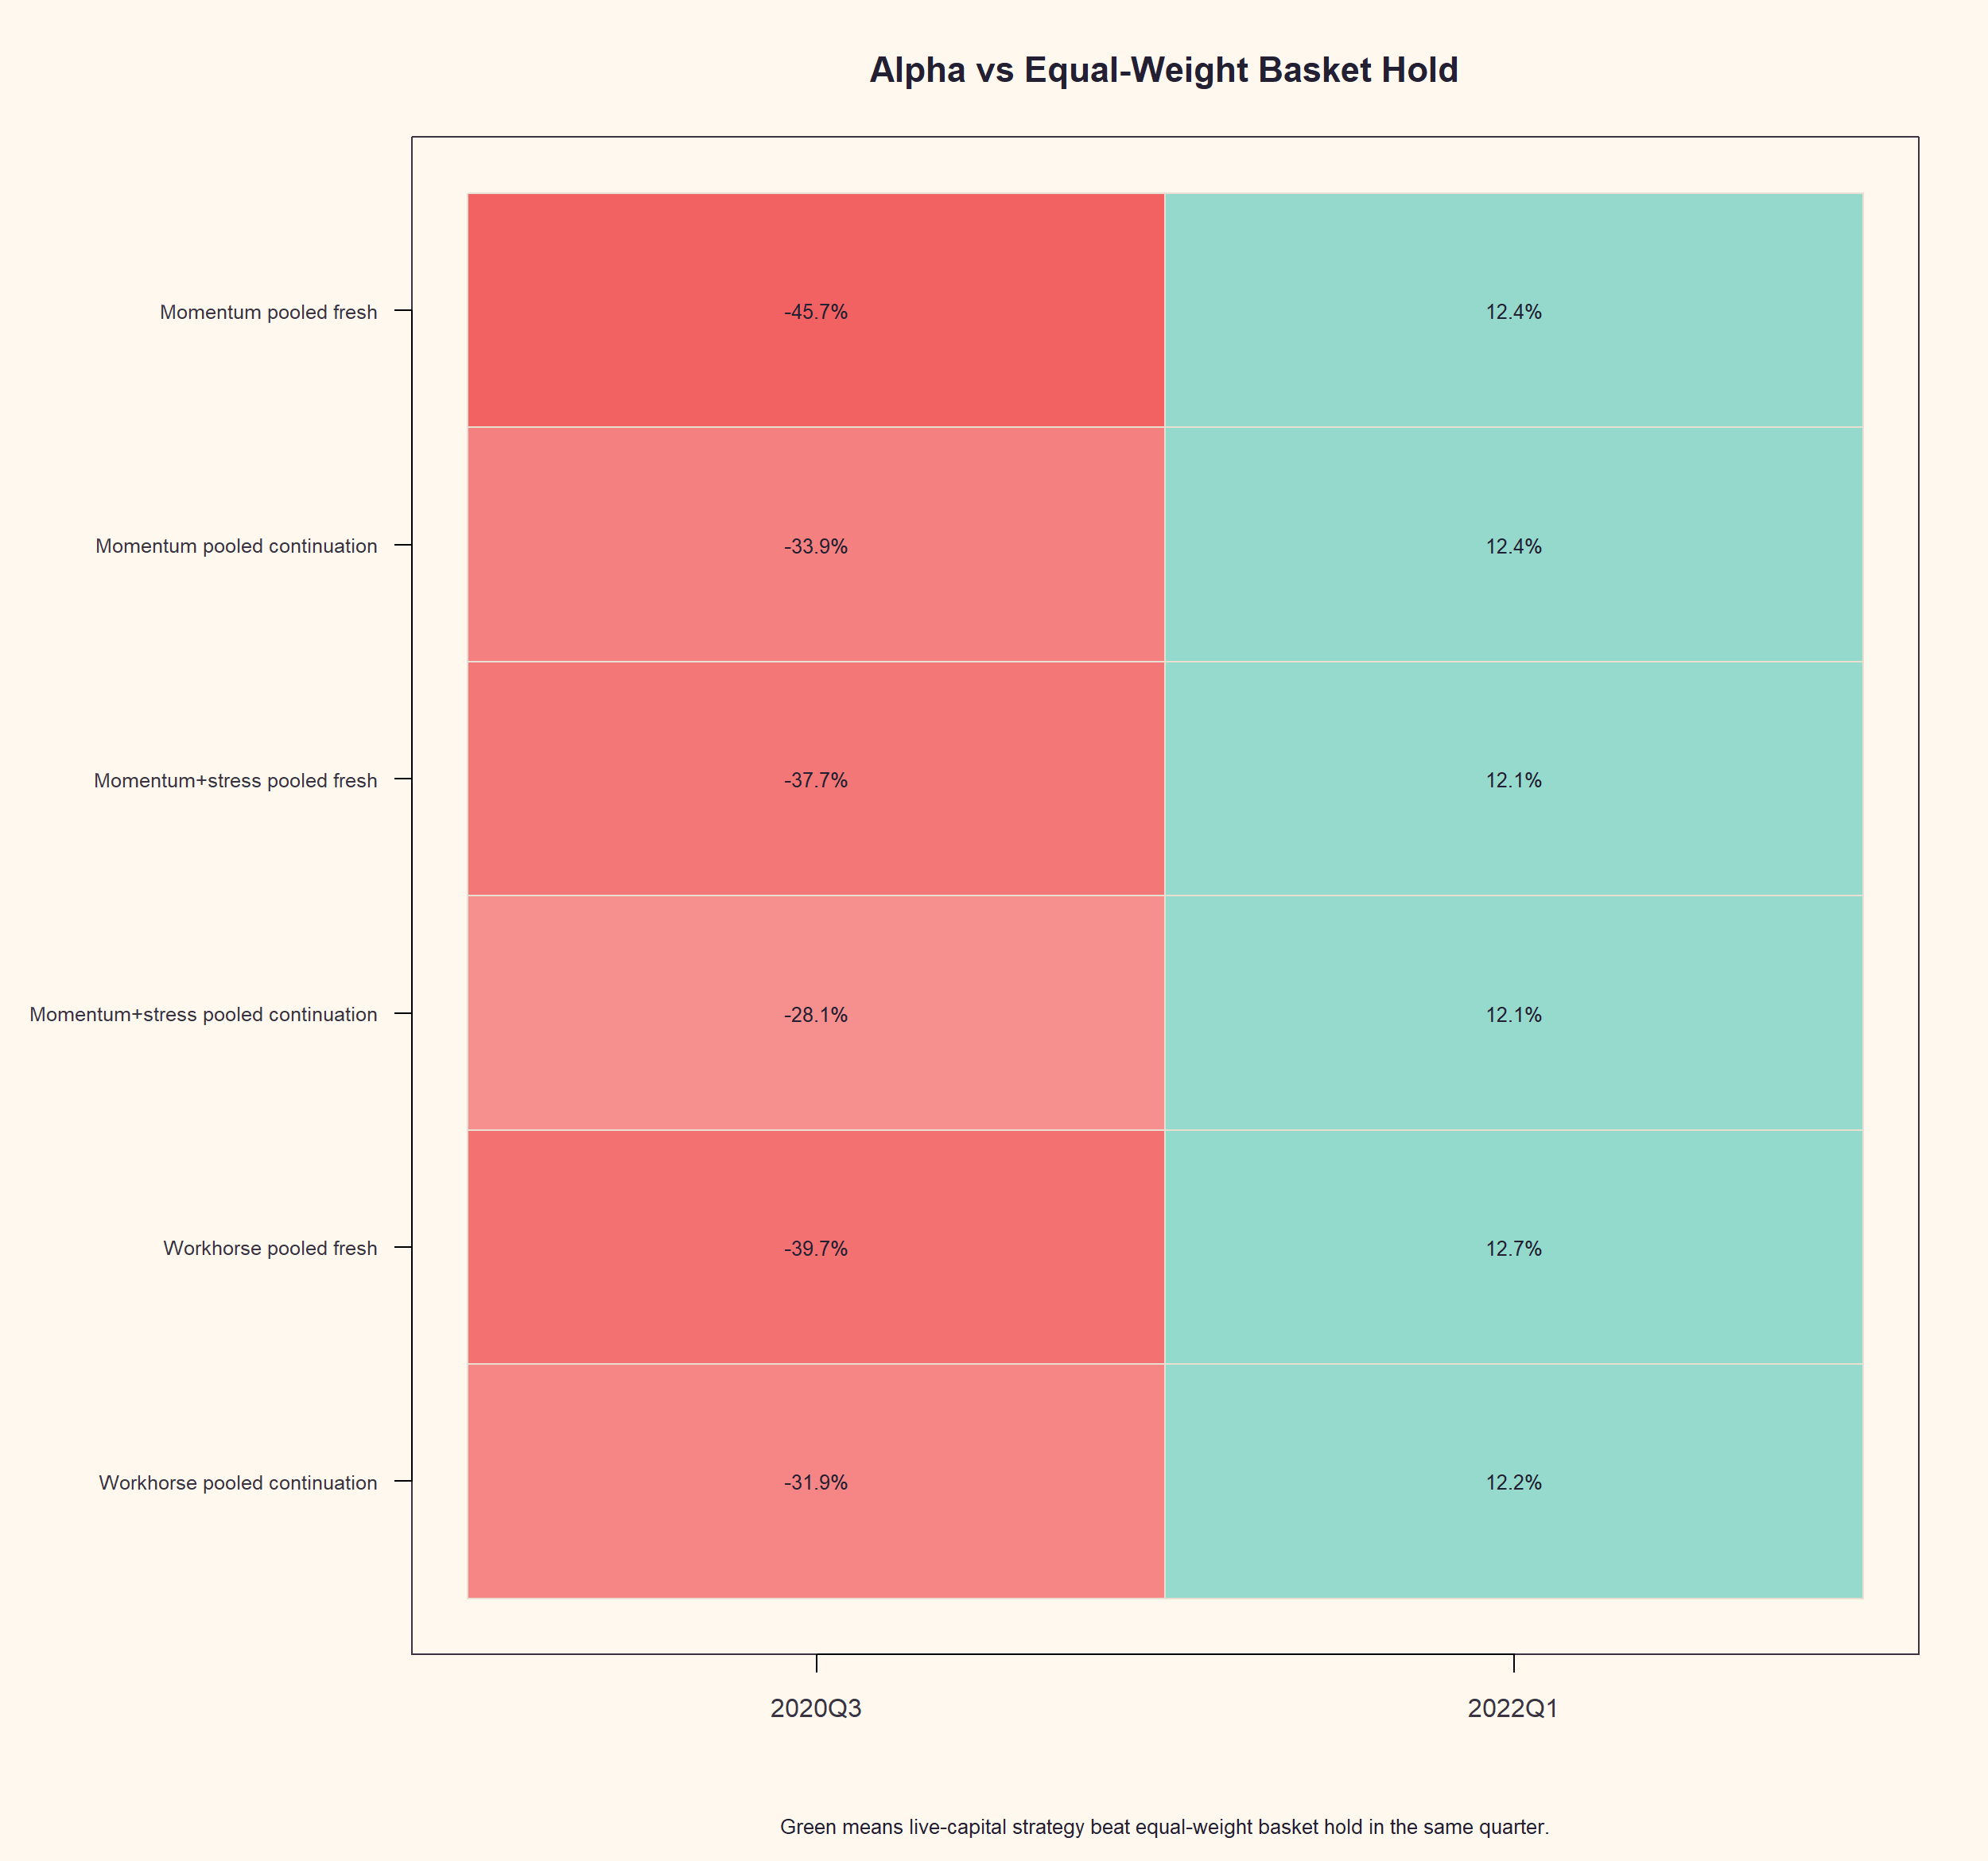
GEN5.3 PCA RESEARCH PIVOT
Momentum plus stress improved upside capture without losing the stress-window protection
-28.1 pp
55.9%
Momentum+stress continuation alpha in 2020Q3
Momentum+stress exposure in 2020Q3
+12.1 pp
12.9%
Momentum+stress continuation alpha in 2022Q1
Momentum+stress exposure in 2022Q1
Against workhorse continuation, momentum+stress improved mean alpha from -9.8 pp to -8.0 pp. It is still not benchmark-beating, but the feature layer moved in the desired direction.

Slide 13
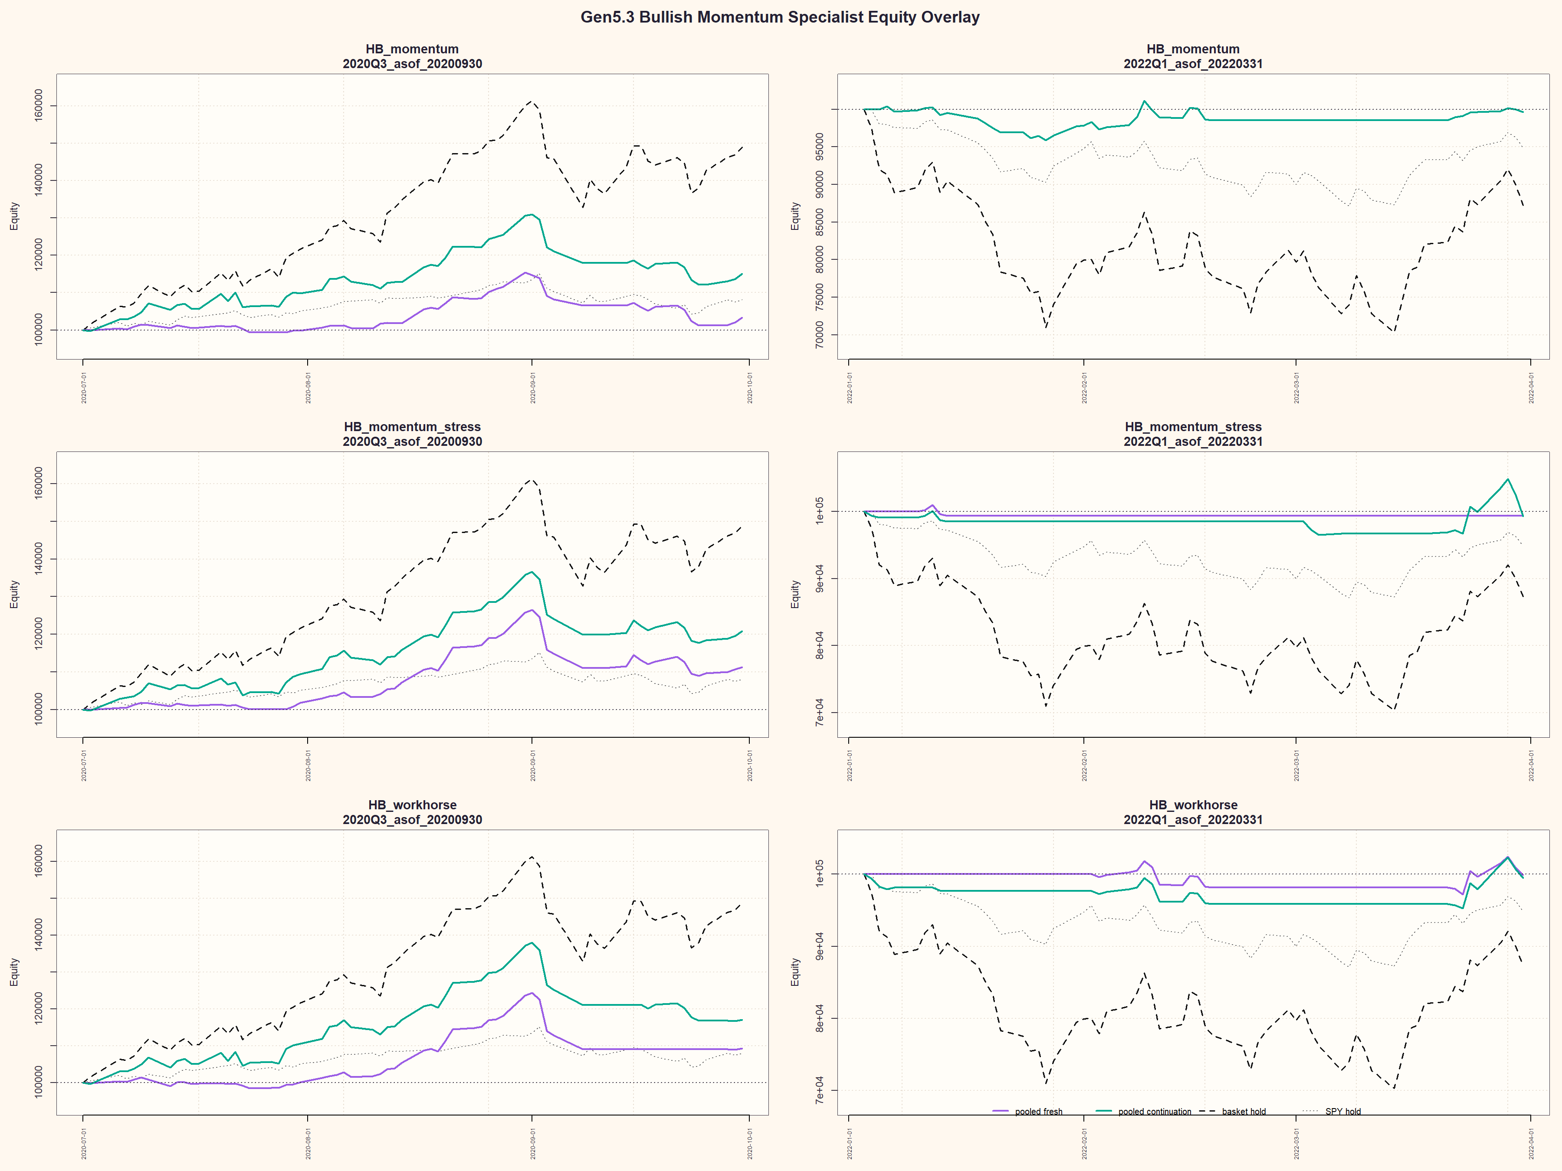
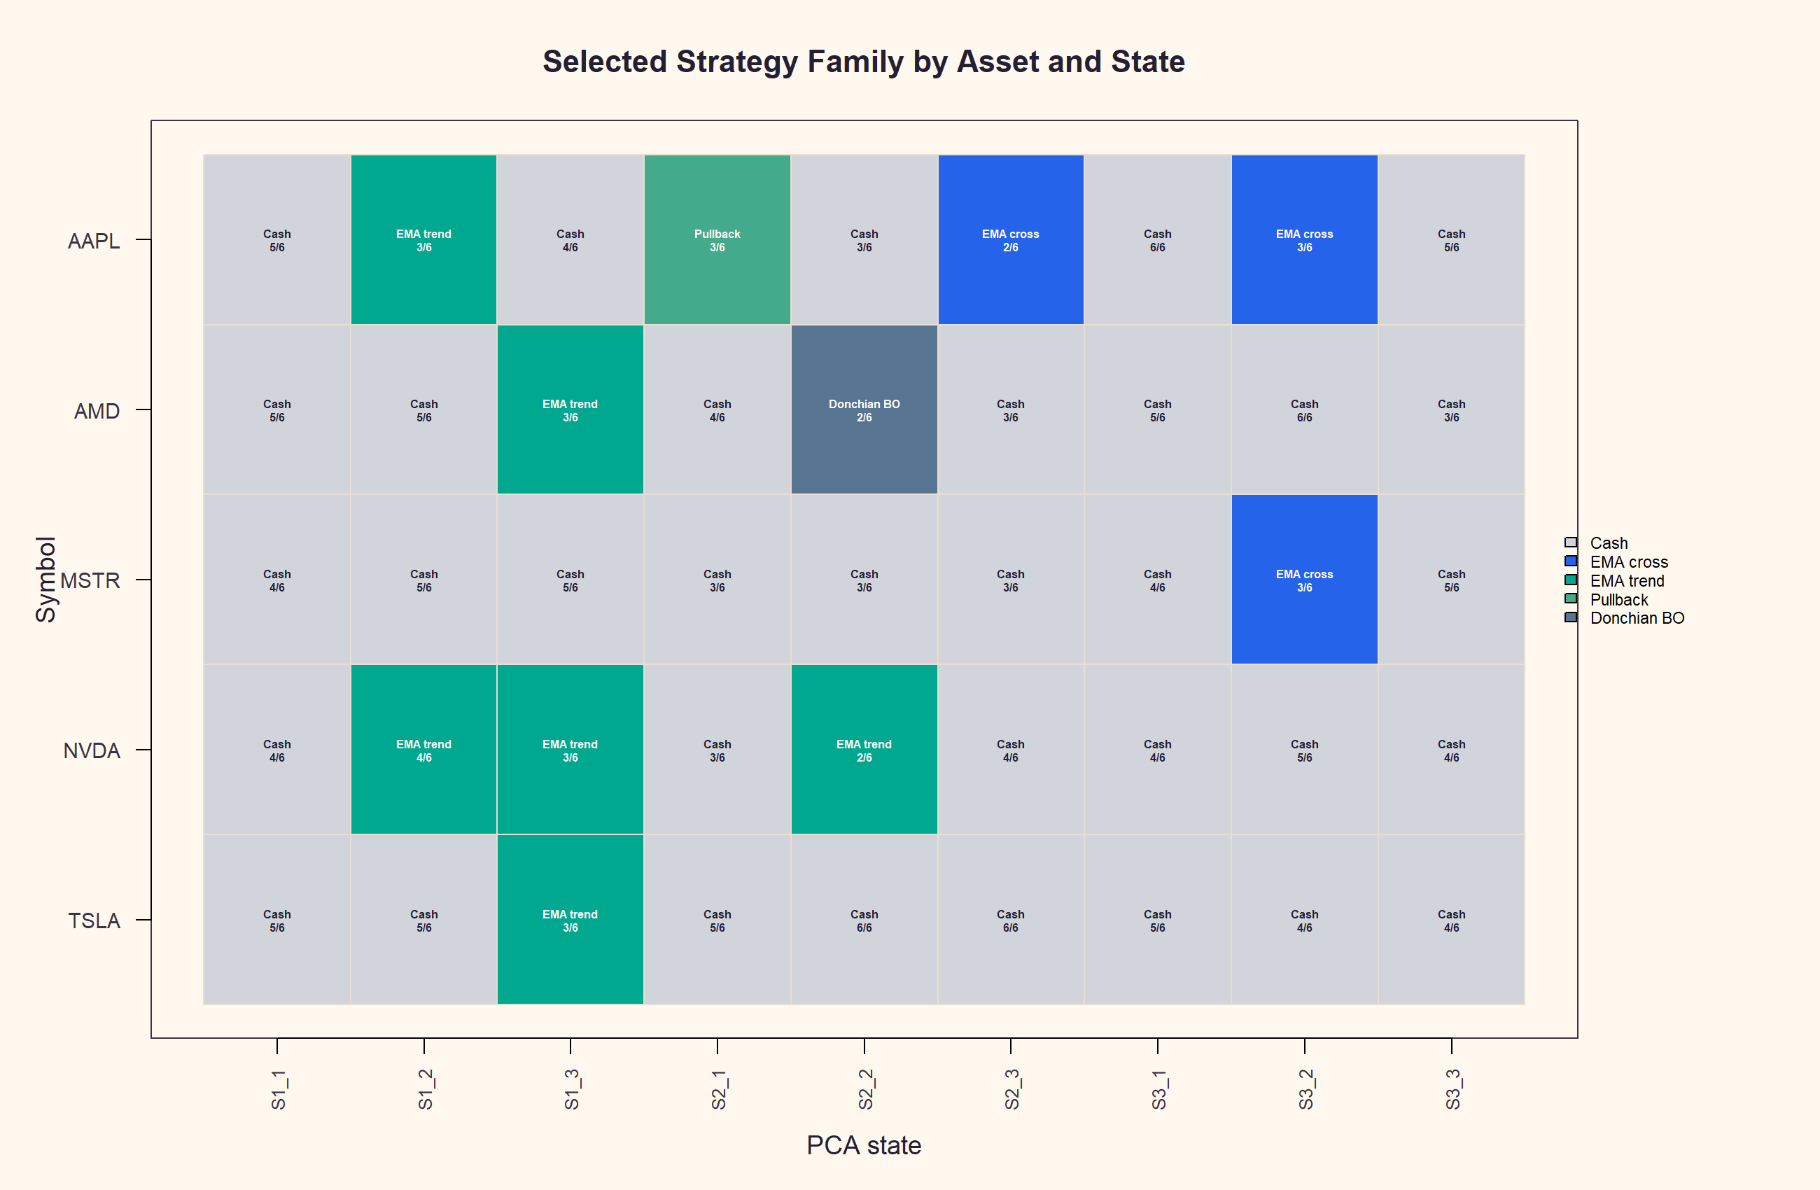
GEN5.3 PCA RESEARCH PIVOT
The audit points to participation timing, not just strategy availability
The challenger improved participation but still lagged basket hold. That means the feature layer is probably relevant, but not sufficient by itself. The next useful tests should confirm across more windows and inspect whether entries remain late.

Slide 14
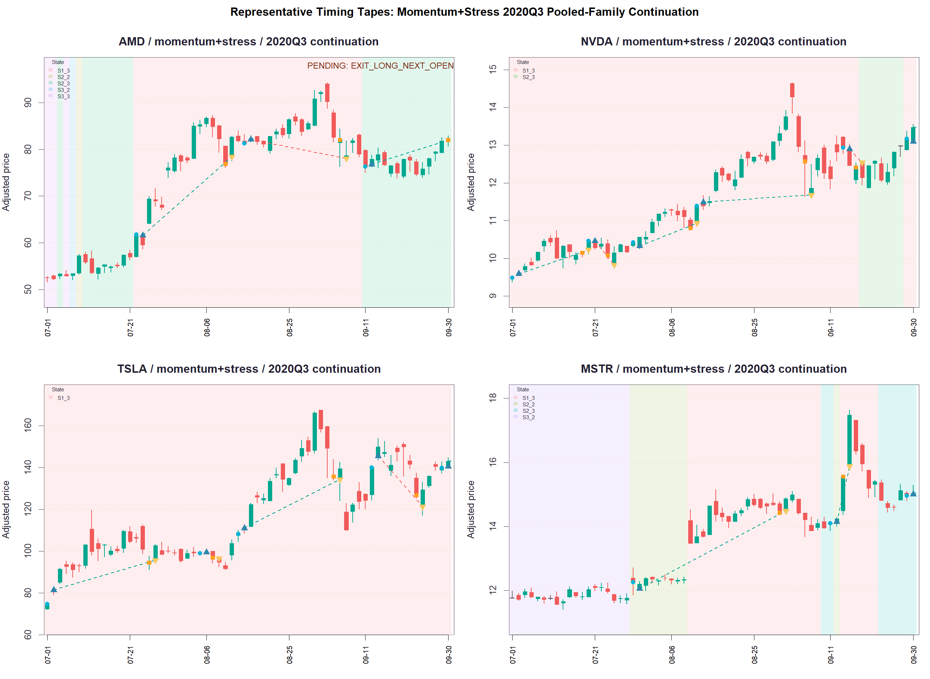
GEN5.3 PCA RESEARCH PIVOT
Representative trade tapes show the system joined the move but did not stay with enough of it
What to look for
Blue markers are entries; yellow markers are exits.
Dashed lines trace completed or open trades.
State bands often change after the trend is underway.
Continuation helps, but it still misses part of the move.
For exploratory POCs, include representative trade tapes whenever timing, participation, or state behavior is central.

Slide 15
GEN5.3 PCA RESEARCH PIVOT
Next Gen5.3 slice: confirm the feature signal before widening the grid
Recommended next question
The first challenger moved in the right direction, but it still did not beat the high-beta basket hold. The next question is whether that improvement survives more windows and whether the trade tapes show earlier participation.
Keep momentum plus stress as the leading feature challenger.
Add several adjacent and non-adjacent high-beta windows before changing strategy parameters.
Use representative trade tapes to verify whether entries actually move earlier.
A wider strategy grid is still a later confirmation tool. Right now the higher-signal question is whether the state features consistently improve timing.

