Slide 1
OUTCOME-AWARE DESCRIPTIVE SAMPLE | 2021-2023 | AUDIT STOP REMAINS
LIT-MOM-01.2 / AUDIT 01 TRADE TAPES
Eight representative paths for intuitive mechanical and behavioral review
Notes:
This companion deck makes the already completed Audit 01 behavior inspectable through time. It does not reopen the strategy or replace the governing 2/11 attribution STOP. The eight examples were selected by a frozen deterministic contract before any individual tape was viewed.
[Sources]
- C:/Users/Franc/OneDrive/Documents/Francis/Peltata Project/Time-Series-Modeling-Gen5/literature_studies/docs/GEN5_LIT_MOM_01_2_AUDIT_01_TRADE_TAPE_REVIEW_CONTRACT.md
- C:\Users\Franc\OneDrive\Documents\Francis\Peltata Project\Time-Series-Modeling-Gen5\runs\research_workbench\literature_grounded\lit_mom_01_2_audit_01_representative_trade_tapes_20260803/trade_tape_selection_manifest.csv
- C:/Users/Franc/OneDrive/Documents/Francis/Peltata Project/Time-Series-Modeling-Gen5/literature_studies/docs/GEN5_LIT_MOM_01_2_AUDIT_01_EXPOSURE_SELECTION_RESULTS.md

Slide 2
Eight frozen archetypes prevent an anecdotal winner reel
Selection is deliberately outcome-aware but deterministic. It spans the center, contrasting failures, unusual survivors, drawdown risk, cohort behavior, and state asymmetry. No tape estimates how often an outcome occurs.
ANCHORS
FAILURES
EDGES
SHY tutorial + stock medoid
Mechanics and typical behavior
Exposure-dominated + random disappointment
Positive is not sufficient
Survivor, deep drawdown, attention medoid
and countercyclical mix
2
Notes:
The eight archetypes are SHY; the robust cross-sectional medoid; positive-but-exposure-dominated; balanced attribution survivor; positive-but-bottom-quintile random timing; deep-drawdown positive finish; frozen retail-attention medoid; and the largest supported asset-level down/flat-minus-up trade-return gap. Duplicates are prohibited and ties break by symbol.
[Sources]
- C:/Users/Franc/OneDrive/Documents/Francis/Peltata Project/Time-Series-Modeling-Gen5/literature_studies/docs/GEN5_LIT_MOM_01_2_AUDIT_01_TRADE_TAPE_REVIEW_CONTRACT.md
- C:/Users/Franc/OneDrive/Documents/Francis/Peltata Project/Time-Series-Modeling-Gen5/literature_studies/R/gen5_lit_mom_01_2_audit_01_trade_tapes.R
- C:\Users\Franc\OneDrive\Documents\Francis\Peltata Project\Time-Series-Modeling-Gen5\runs\research_workbench\literature_grounded\lit_mom_01_2_audit_01_representative_trade_tapes_20260803/trade_tape_selection_manifest.csv

Slide 3
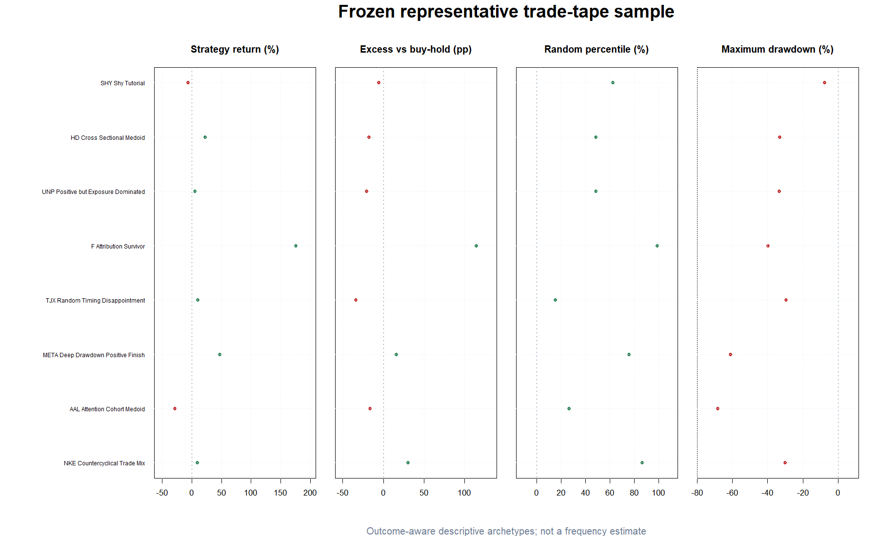
Read each tape from exposure to path risk to individual outcomes
TOP
Blue is selected-policy wealth; gray is buy-and-hold. Pale green/red spans are profitable/losing executed blocks. Flat blue sections are cash.
MIDDLE
Selected and buy-and-hold drawdowns show the pain hidden by endpoint returns.
BOTTOM
Every trade is placed at its exit date. Stem color is profit/loss; point fill is the SPY 60-session trend at the signal close.
HEADER
L/H, trades, exposure, returns, random percentile, drawdown, beta, and alpha remain visible.
3
Notes:
Normalized wealth starts at one. Selected-policy wealth compounds the exact audited daily strategy returns; buy-and-hold compounds the asset's open-to-open return. Entry-to-exit spans and trade-return stems come from the frozen selected trade schedule. Signal-state point fills come from the already computed causal environment labels.
[Sources]
- C:/Users/Franc/OneDrive/Documents/Francis/Peltata Project/Time-Series-Modeling-Gen5/literature_studies/docs/GEN5_LIT_MOM_01_2_AUDIT_01_TRADE_TAPE_REVIEW_CONTRACT.md
- C:\Users\Franc\OneDrive\Documents\Francis\Peltata Project\Time-Series-Modeling-Gen5\runs\research_workbench\literature_grounded\lit_mom_01_2_audit_01_representative_trade_tapes_20260803/trade_tape_selection_manifest.csv
- C:\Users\Franc\OneDrive\Documents\Francis\Peltata Project\Time-Series-Modeling-Gen5\runs\research_workbench\literature_grounded\lit_mom_01_2_audit_01_representative_trade_tapes_20260803\visuals/trade_tape_archetype_matrix.png
- C:\Users\Franc\OneDrive\Documents\Francis\Peltata Project\Time-Series-Modeling-Gen5\runs\research_workbench\literature_grounded\lit_mom_01_2_audit_01_exposure_selection_20260802/audit01_daily_paths.csv
- C:\Users\Franc\OneDrive\Documents\Francis\Peltata Project\Time-Series-Modeling-Gen5\runs\research_workbench\literature_grounded\lit_mom_01_2_audit_01_exposure_selection_20260802/audit01_selected_trades.csv

Slide 4
RETROSPECTIVE VISUAL AUDIT | QUESTIONS, NOT NEW GATES
Eight tapes, eight visibly different path mechanisms
Read chronologically. Ask whether the path reflects cost erosion, ordinary exposure, missed recovery, a few concentrated winners, crash avoidance, or genuine-looking state asymmetry—without converting the answer into a filter.
Notes:
The tape sequence begins with the mechanics anchor and median stock, then moves through two ordinary attribution failures, two superficially attractive winners with different risks, the attention-cohort center, and the strongest frozen countercyclical trade-mix example.
[Sources]
- C:/Users/Franc/OneDrive/Documents/Francis/Peltata Project/Time-Series-Modeling-Gen5/literature_studies/docs/GEN5_LIT_MOM_01_2_AUDIT_01_TRADE_TAPE_REVIEW_CONTRACT.md
- C:\Users\Franc\OneDrive\Documents\Francis\Peltata Project\Time-Series-Modeling-Gen5\runs\research_workbench\literature_grounded\lit_mom_01_2_audit_01_representative_trade_tapes_20260803/trade_tape_selection_manifest.csv

Slide 5
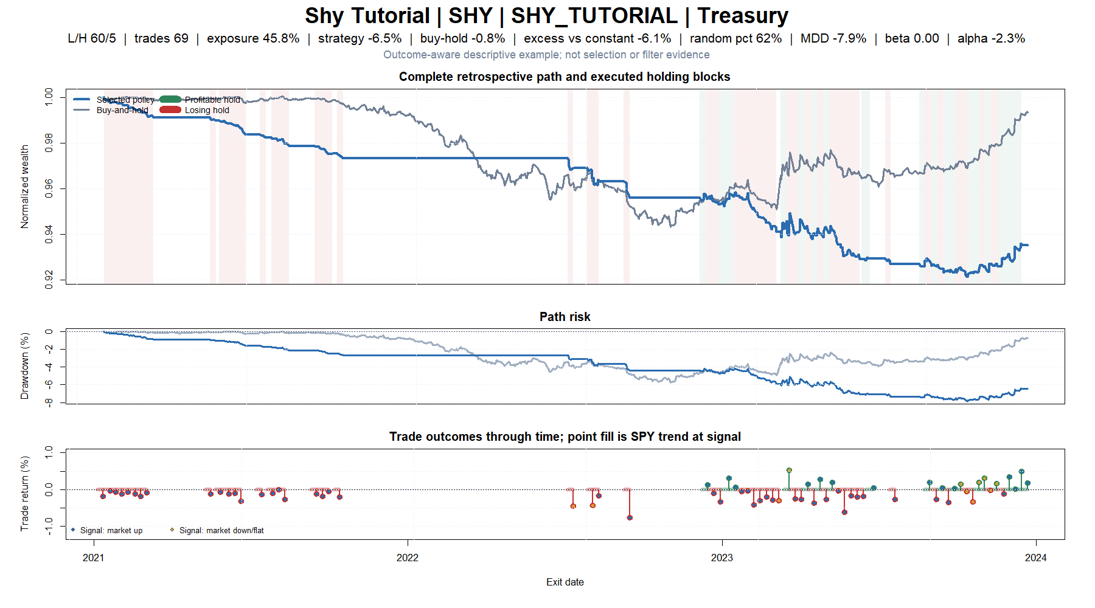
SHY: frequent tiny trades turn a flat asset into steady cost erosion
5
Notes:
SHY is the cleanest mechanics example. Sixty-nine five-session long blocks create only 45.8% calendar participation, yet the selected path loses 6.46% while buy-and-hold is nearly flat. The tape shows many tiny negative trades and a stepwise downward wealth path: the signal does not produce enough gross edge to pay literal round-trip costs.
[Sources]
- C:\Users\Franc\OneDrive\Documents\Francis\Peltata Project\Time-Series-Modeling-Gen5\runs\research_workbench\literature_grounded\lit_mom_01_2_audit_01_representative_trade_tapes_20260803/trade_tape_selection_manifest.csv
- C:\Users\Franc\OneDrive\Documents\Francis\Peltata Project\Time-Series-Modeling-Gen5\runs\research_workbench\literature_grounded\lit_mom_01_2_audit_01_exposure_selection_20260802/audit01_asset_summary.csv
- C:\Users\Franc\OneDrive\Documents\Francis\Peltata Project\Time-Series-Modeling-Gen5\runs\research_workbench\literature_grounded\lit_mom_01_2_audit_01_exposure_selection_20260802/audit01_selected_trades.csv
- C:\Users\Franc\OneDrive\Documents\Francis\Peltata Project\Time-Series-Modeling-Gen5\runs\research_workbench\literature_grounded\lit_mom_01_2_audit_01_exposure_selection_20260802/audit01_daily_paths.csv
- C:\Users\Franc\OneDrive\Documents\Francis\Peltata Project\Time-Series-Modeling-Gen5\runs\research_workbench\literature_grounded\lit_mom_01_2_audit_01_representative_trade_tapes_20260803\visuals/trade_tape_01_shy_tutorial_shy.png

Slide 6
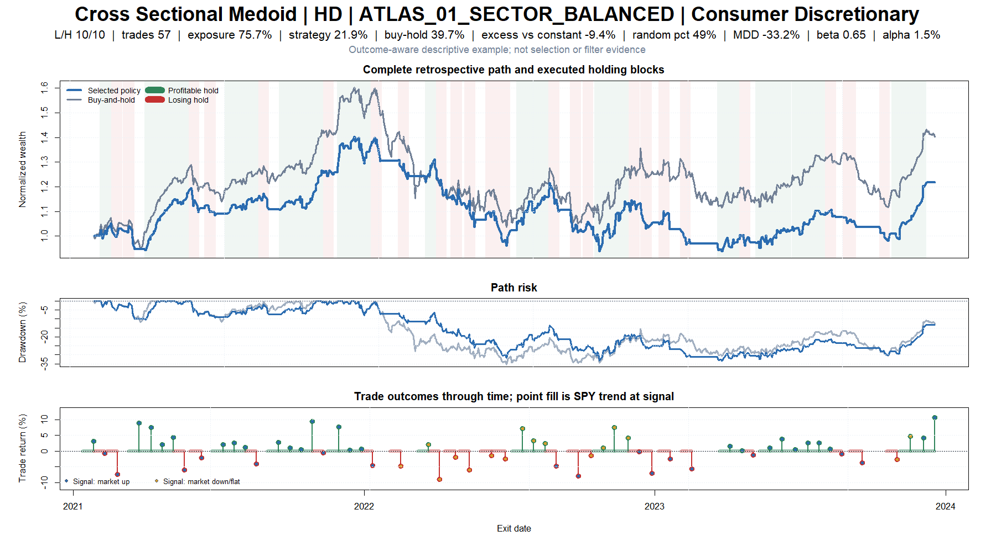
HD: the typical path made money but missed much of the asset's recovery
6
Notes:
HD is the robust multivariate stock-path center, not a handpicked stock. It earns 21.9% but trails buy-and-hold by 17.8 percentage points and matched constant exposure by 9.4 points; its random percentile is 48.6%. The selected path broadly shadows the asset through the 2021-2022 decline and misses part of the late-2023 recovery, which is visually consistent with ordinary exposure rather than special timing.
[Sources]
- C:\Users\Franc\OneDrive\Documents\Francis\Peltata Project\Time-Series-Modeling-Gen5\runs\research_workbench\literature_grounded\lit_mom_01_2_audit_01_representative_trade_tapes_20260803/trade_tape_selection_manifest.csv
- C:\Users\Franc\OneDrive\Documents\Francis\Peltata Project\Time-Series-Modeling-Gen5\runs\research_workbench\literature_grounded\lit_mom_01_2_audit_01_exposure_selection_20260802/audit01_asset_summary.csv
- C:\Users\Franc\OneDrive\Documents\Francis\Peltata Project\Time-Series-Modeling-Gen5\runs\research_workbench\literature_grounded\lit_mom_01_2_audit_01_exposure_selection_20260802/audit01_selected_trades.csv
- C:\Users\Franc\OneDrive\Documents\Francis\Peltata Project\Time-Series-Modeling-Gen5\runs\research_workbench\literature_grounded\lit_mom_01_2_audit_01_exposure_selection_20260802/audit01_daily_paths.csv
- C:\Users\Franc\OneDrive\Documents\Francis\Peltata Project\Time-Series-Modeling-Gen5\runs\research_workbench\literature_grounded\lit_mom_01_2_audit_01_representative_trade_tapes_20260803\visuals/trade_tape_02_cross_sectional_medoid_hd.png

Slide 7
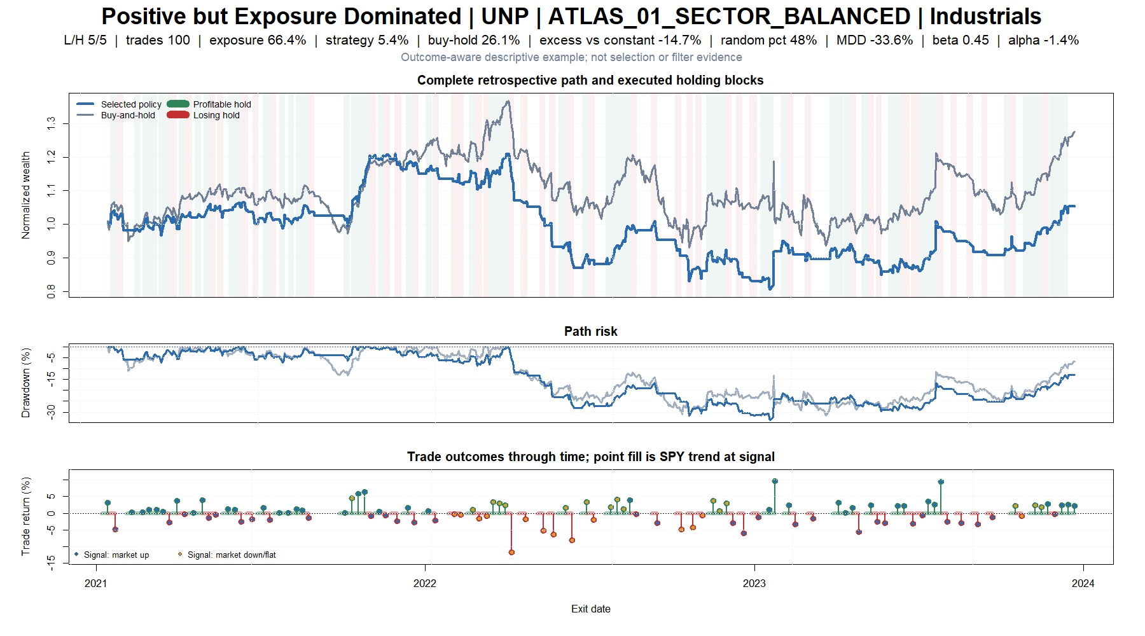
UNP: 100 five-day blocks create churn without timing advantage
7
Notes:
UNP demonstrates why a positive endpoint is insufficient. One hundred five-session trades finish +5.4%, while buy-and-hold earns +26.1% and matched constant exposure beats the strategy by 14.7 percentage points. The random percentile is 48.3% and estimated alpha is negative. Dense entry blocks turn the policy into high-frequency exposure sampling without evidence that the chosen dates helped.
[Sources]
- C:\Users\Franc\OneDrive\Documents\Francis\Peltata Project\Time-Series-Modeling-Gen5\runs\research_workbench\literature_grounded\lit_mom_01_2_audit_01_representative_trade_tapes_20260803/trade_tape_selection_manifest.csv
- C:\Users\Franc\OneDrive\Documents\Francis\Peltata Project\Time-Series-Modeling-Gen5\runs\research_workbench\literature_grounded\lit_mom_01_2_audit_01_exposure_selection_20260802/audit01_asset_summary.csv
- C:\Users\Franc\OneDrive\Documents\Francis\Peltata Project\Time-Series-Modeling-Gen5\runs\research_workbench\literature_grounded\lit_mom_01_2_audit_01_exposure_selection_20260802/audit01_selected_trades.csv
- C:\Users\Franc\OneDrive\Documents\Francis\Peltata Project\Time-Series-Modeling-Gen5\runs\research_workbench\literature_grounded\lit_mom_01_2_audit_01_exposure_selection_20260802/audit01_daily_paths.csv
- C:\Users\Franc\OneDrive\Documents\Francis\Peltata Project\Time-Series-Modeling-Gen5\runs\research_workbench\literature_grounded\lit_mom_01_2_audit_01_representative_trade_tapes_20260803\visuals/trade_tape_03_positive_but_exposure_dominated_unp.png

Slide 8
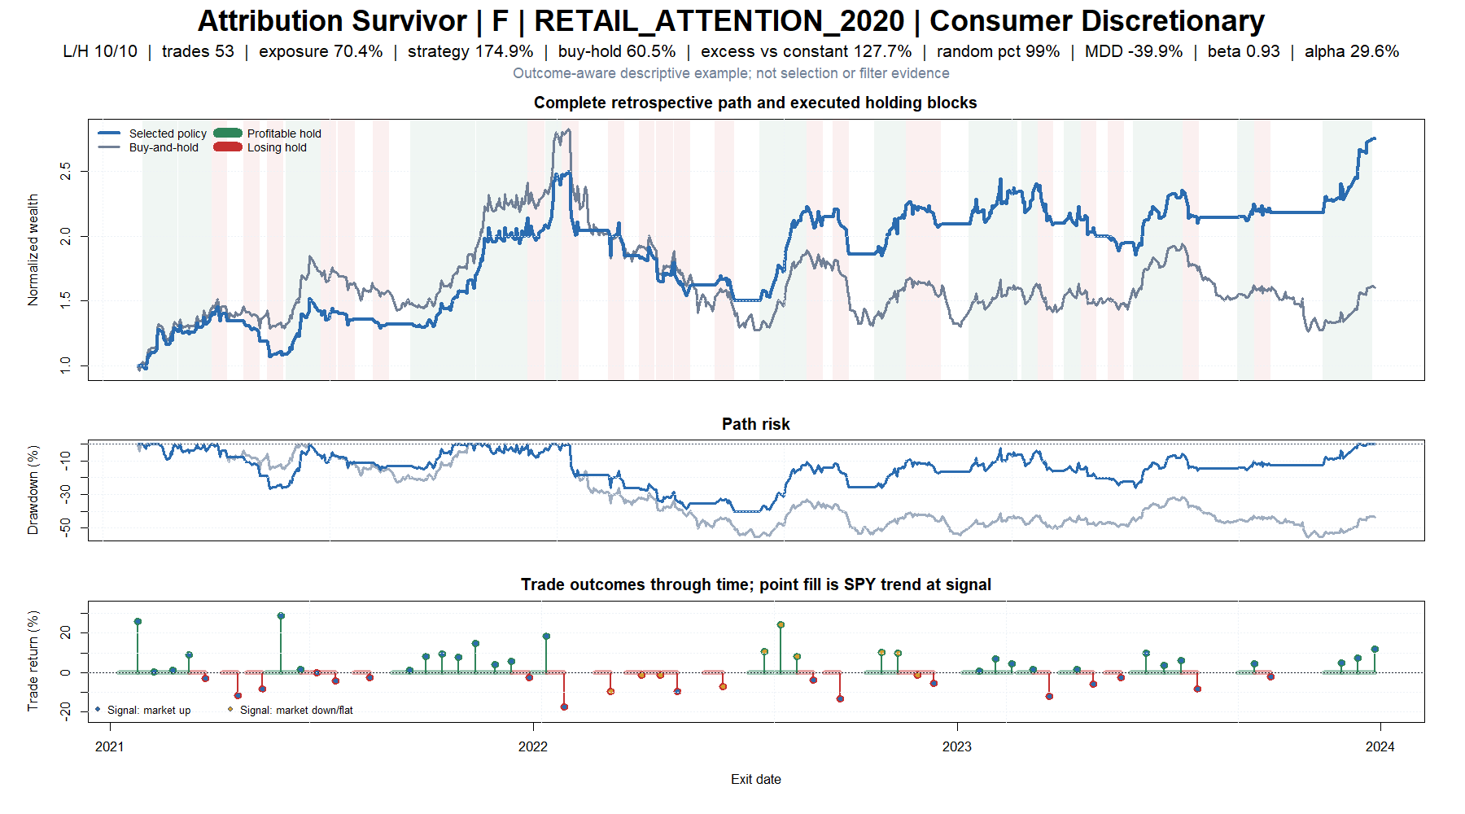
F: a few outsized winners create a genuine-looking survivor
8
Notes:
Ford is the strongest balanced survivor under the frozen rule: +174.9%, +114.5 percentage points versus buy-and-hold, 98.9th random percentile, and +29.6% annualized SPY intercept. The tape also shows that much of the outcome is carried by a small number of 20-30% winning blocks, while the selected path still suffers a 39.9% drawdown. The organic question is trade-contribution concentration, not whether Ford should be selected.
[Sources]
- C:\Users\Franc\OneDrive\Documents\Francis\Peltata Project\Time-Series-Modeling-Gen5\runs\research_workbench\literature_grounded\lit_mom_01_2_audit_01_representative_trade_tapes_20260803/trade_tape_selection_manifest.csv
- C:\Users\Franc\OneDrive\Documents\Francis\Peltata Project\Time-Series-Modeling-Gen5\runs\research_workbench\literature_grounded\lit_mom_01_2_audit_01_exposure_selection_20260802/audit01_asset_summary.csv
- C:\Users\Franc\OneDrive\Documents\Francis\Peltata Project\Time-Series-Modeling-Gen5\runs\research_workbench\literature_grounded\lit_mom_01_2_audit_01_exposure_selection_20260802/audit01_selected_trades.csv
- C:\Users\Franc\OneDrive\Documents\Francis\Peltata Project\Time-Series-Modeling-Gen5\runs\research_workbench\literature_grounded\lit_mom_01_2_audit_01_exposure_selection_20260802/audit01_daily_paths.csv
- C:\Users\Franc\OneDrive\Documents\Francis\Peltata Project\Time-Series-Modeling-Gen5\runs\research_workbench\literature_grounded\lit_mom_01_2_audit_01_representative_trade_tapes_20260803\visuals/trade_tape_04_attribution_survivor_f.png

Slide 9
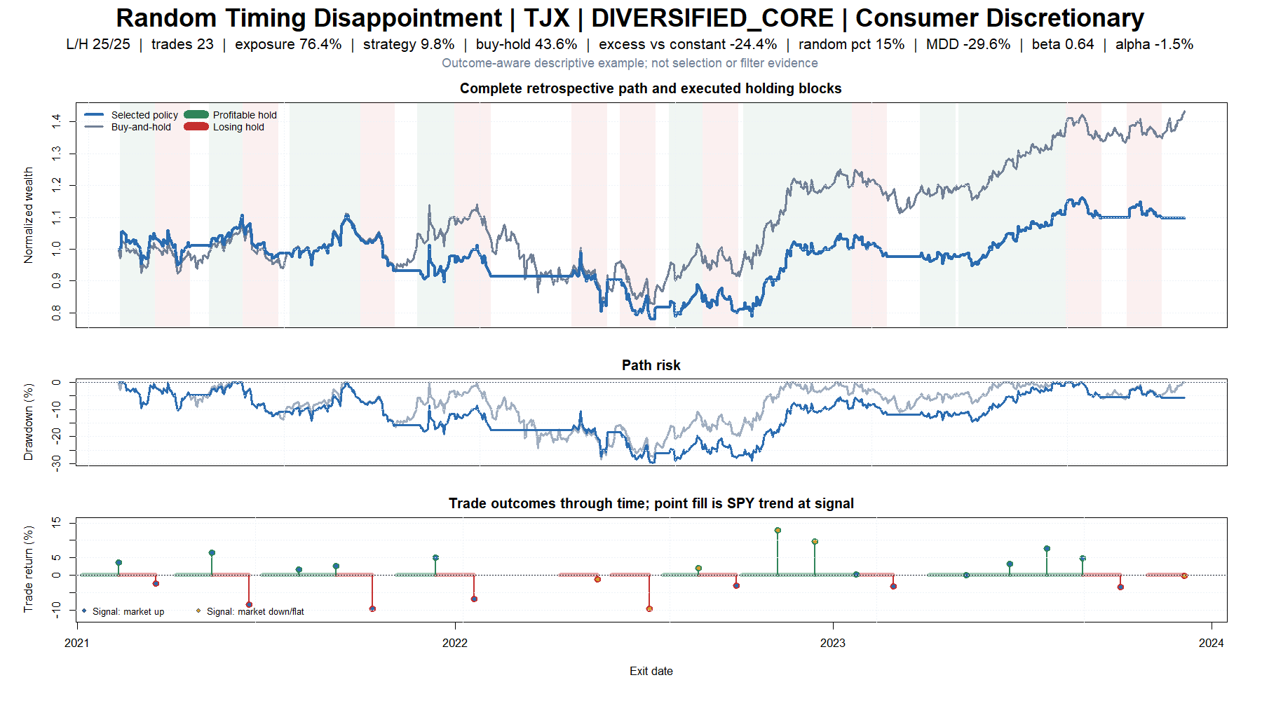
TJX: positive endpoint, but matched random calendars usually did better
9
Notes:
TJX earns 9.8%, which looks acceptable in isolation, but buy-and-hold earns 43.6%, matched constant exposure beats it by 24.4 percentage points, and its observed calendar sits at only the 15.4th percentile of matched random schedules. The tape shows participation in 2022 losses and only partial participation in the 2023 rally.
[Sources]
- C:\Users\Franc\OneDrive\Documents\Francis\Peltata Project\Time-Series-Modeling-Gen5\runs\research_workbench\literature_grounded\lit_mom_01_2_audit_01_representative_trade_tapes_20260803/trade_tape_selection_manifest.csv
- C:\Users\Franc\OneDrive\Documents\Francis\Peltata Project\Time-Series-Modeling-Gen5\runs\research_workbench\literature_grounded\lit_mom_01_2_audit_01_exposure_selection_20260802/audit01_asset_summary.csv
- C:\Users\Franc\OneDrive\Documents\Francis\Peltata Project\Time-Series-Modeling-Gen5\runs\research_workbench\literature_grounded\lit_mom_01_2_audit_01_exposure_selection_20260802/audit01_selected_trades.csv
- C:\Users\Franc\OneDrive\Documents\Francis\Peltata Project\Time-Series-Modeling-Gen5\runs\research_workbench\literature_grounded\lit_mom_01_2_audit_01_exposure_selection_20260802/audit01_daily_paths.csv
- C:\Users\Franc\OneDrive\Documents\Francis\Peltata Project\Time-Series-Modeling-Gen5\runs\research_workbench\literature_grounded\lit_mom_01_2_audit_01_representative_trade_tapes_20260803\visuals/trade_tape_05_random_timing_disappointment_tjx.png

Slide 10
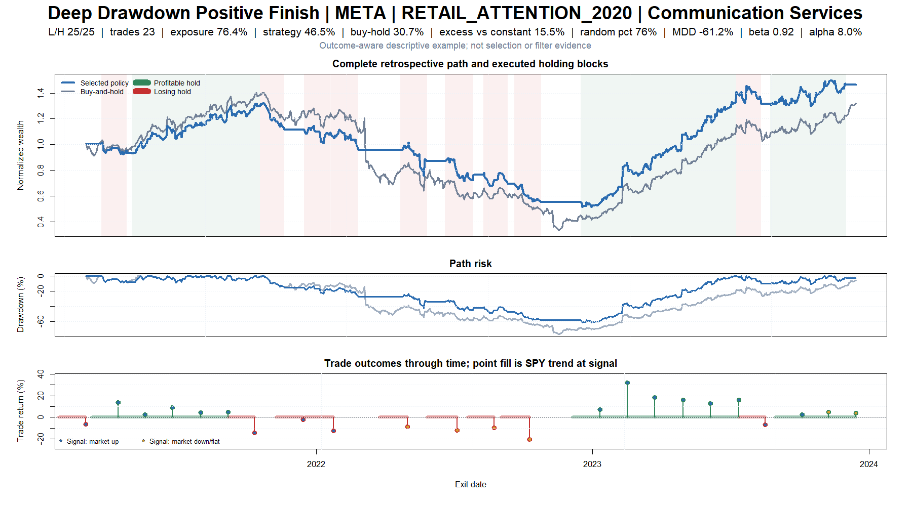
META: the apparent win requires surviving a 61% strategy drawdown
10
Notes:
META ends +46.5% and exceeds both buy-and-hold and matched constant exposure, but its selected path falls roughly 61% from peak before recovering. The strategy does not cleanly avoid the 2022 collapse; the eventual result depends on remaining viable long enough to capture the 2023 rebound. Endpoint merit and path usability are separate questions.
[Sources]
- C:\Users\Franc\OneDrive\Documents\Francis\Peltata Project\Time-Series-Modeling-Gen5\runs\research_workbench\literature_grounded\lit_mom_01_2_audit_01_representative_trade_tapes_20260803/trade_tape_selection_manifest.csv
- C:\Users\Franc\OneDrive\Documents\Francis\Peltata Project\Time-Series-Modeling-Gen5\runs\research_workbench\literature_grounded\lit_mom_01_2_audit_01_exposure_selection_20260802/audit01_asset_summary.csv
- C:\Users\Franc\OneDrive\Documents\Francis\Peltata Project\Time-Series-Modeling-Gen5\runs\research_workbench\literature_grounded\lit_mom_01_2_audit_01_exposure_selection_20260802/audit01_selected_trades.csv
- C:\Users\Franc\OneDrive\Documents\Francis\Peltata Project\Time-Series-Modeling-Gen5\runs\research_workbench\literature_grounded\lit_mom_01_2_audit_01_exposure_selection_20260802/audit01_daily_paths.csv
- C:\Users\Franc\OneDrive\Documents\Francis\Peltata Project\Time-Series-Modeling-Gen5\runs\research_workbench\literature_grounded\lit_mom_01_2_audit_01_representative_trade_tapes_20260803\visuals/trade_tape_06_deep_drawdown_positive_finish_meta.png

Slide 11
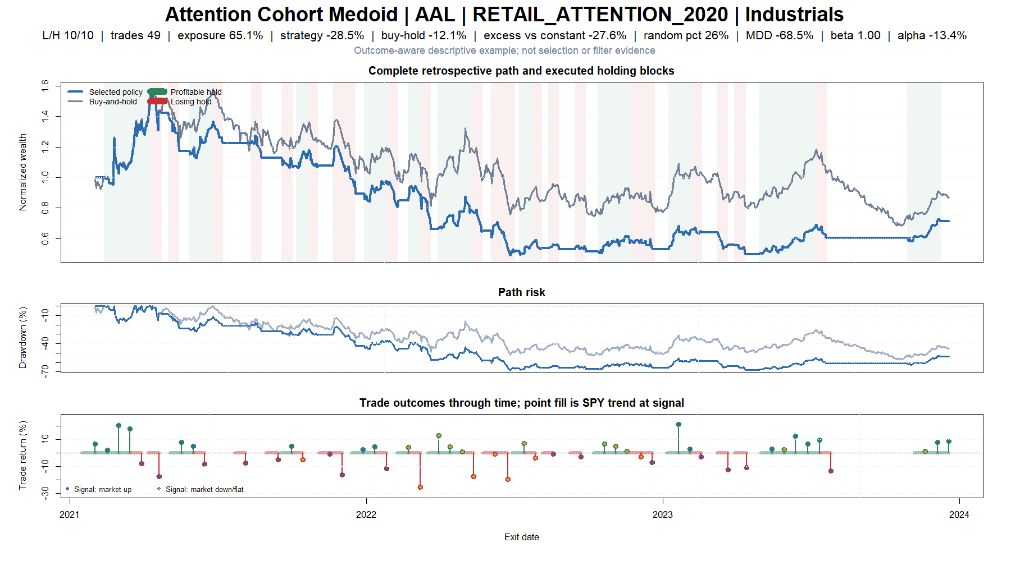
AAL: early gains devolve into a prolonged high-beta loss
11
Notes:
AAL is the robust center of the eligible 2020 retail-attention cohort. Early gains above 50% reverse into a -28.5% endpoint and -68.5% maximum drawdown. Buy-and-hold also loses, but the selected policy trails matched constant exposure by 27.6 percentage points and has negative estimated alpha. The tape looks like serial cyclicality and whipsaw rather than protected momentum.
[Sources]
- C:\Users\Franc\OneDrive\Documents\Francis\Peltata Project\Time-Series-Modeling-Gen5\runs\research_workbench\literature_grounded\lit_mom_01_2_audit_01_representative_trade_tapes_20260803/trade_tape_selection_manifest.csv
- C:\Users\Franc\OneDrive\Documents\Francis\Peltata Project\Time-Series-Modeling-Gen5\runs\research_workbench\literature_grounded\lit_mom_01_2_audit_01_exposure_selection_20260802/audit01_asset_summary.csv
- C:\Users\Franc\OneDrive\Documents\Francis\Peltata Project\Time-Series-Modeling-Gen5\runs\research_workbench\literature_grounded\lit_mom_01_2_audit_01_exposure_selection_20260802/audit01_selected_trades.csv
- C:\Users\Franc\OneDrive\Documents\Francis\Peltata Project\Time-Series-Modeling-Gen5\runs\research_workbench\literature_grounded\lit_mom_01_2_audit_01_exposure_selection_20260802/audit01_daily_paths.csv
- C:\Users\Franc\OneDrive\Documents\Francis\Peltata Project\Time-Series-Modeling-Gen5\runs\research_workbench\literature_grounded\lit_mom_01_2_audit_01_representative_trade_tapes_20260803\visuals/trade_tape_07_attention_cohort_medoid_aal.png

Slide 12
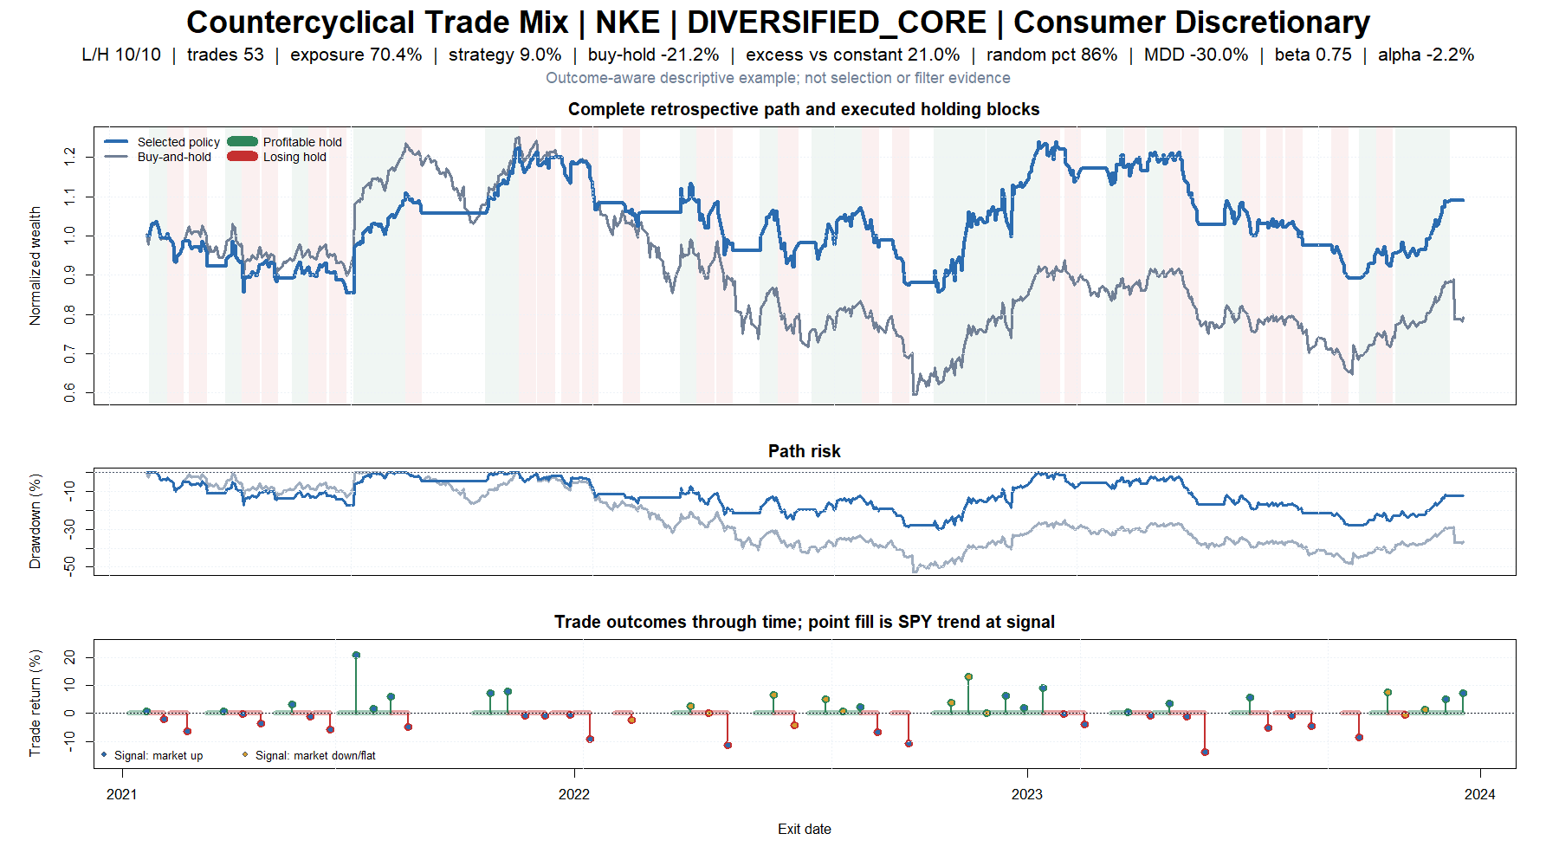
NKE: selective loss avoidance looks more important than ordinary trend capture
12
Notes:
NKE is the largest supported asset-level market-state contrast: thirteen trades signaled in SPY down/flat states average +2.57%, while forty signaled in positive states average -0.37%, a +2.94 percentage-point gap. The selected path ends +9.0% while buy-and-hold loses 21.2%, and its random percentile is 86.5%. Estimated SPY alpha remains negative, so the tape motivates a question about selective loss avoidance and state asymmetry; it does not validate a regime filter.
[Sources]
- C:\Users\Franc\OneDrive\Documents\Francis\Peltata Project\Time-Series-Modeling-Gen5\runs\research_workbench\literature_grounded\lit_mom_01_2_audit_01_representative_trade_tapes_20260803/trade_tape_selection_manifest.csv
- C:\Users\Franc\OneDrive\Documents\Francis\Peltata Project\Time-Series-Modeling-Gen5\runs\research_workbench\literature_grounded\lit_mom_01_2_audit_01_exposure_selection_20260802/audit01_asset_summary.csv
- C:\Users\Franc\OneDrive\Documents\Francis\Peltata Project\Time-Series-Modeling-Gen5\runs\research_workbench\literature_grounded\lit_mom_01_2_audit_01_exposure_selection_20260802/audit01_selected_trades.csv
- C:\Users\Franc\OneDrive\Documents\Francis\Peltata Project\Time-Series-Modeling-Gen5\runs\research_workbench\literature_grounded\lit_mom_01_2_audit_01_exposure_selection_20260802/audit01_daily_paths.csv
- C:\Users\Franc\OneDrive\Documents\Francis\Peltata Project\Time-Series-Modeling-Gen5\runs\research_workbench\literature_grounded\lit_mom_01_2_audit_01_representative_trade_tapes_20260803\visuals/trade_tape_08_countercyclical_trade_mix_nke.png

Slide 13
The tapes do not express one stable mechanism
13
Notes:
The sample spans -28.5% to +174.9% selected returns, -33.9 to +114.5 percentage points versus buy-and-hold, 15th to 99th random percentiles, and -7.9% to -68.5% maximum drawdowns. SHY is cost erosion; HD and UNP are ordinary exposure failures; TJX is unlucky timing; Ford is concentrated large-winner dependence; META is drawdown-and-recovery dependence; AAL is cyclicality and whipsaw; NKE is selective avoidance/state asymmetry. This heterogeneity argues against one generic momentum-refinement story.
[Sources]
- C:\Users\Franc\OneDrive\Documents\Francis\Peltata Project\Time-Series-Modeling-Gen5\runs\research_workbench\literature_grounded\lit_mom_01_2_audit_01_representative_trade_tapes_20260803/trade_tape_selection_manifest.csv
- C:\Users\Franc\OneDrive\Documents\Francis\Peltata Project\Time-Series-Modeling-Gen5\runs\research_workbench\literature_grounded\lit_mom_01_2_audit_01_representative_trade_tapes_20260803\visuals/trade_tape_archetype_matrix.png

Slide 14
VISUAL REVIEW COMPLETE | 2024+ SEALED | NO ASSET OR FILTER NOMINATION
The useful next questions are about trade concentration, crash avoidance, and state asymmetry—not generic momentum.
The tapes may inspire separately frozen diagnostics, but they do not reopen LIT-MOM-01.2, authorize a filter, or alter the 2/11 attribution STOP.
Notes:
Three high-signal questions emerge organically: how much of each positive path is supplied by its top one to five trades; whether apparent winners earn through crash avoidance, rebound capture, or both; and whether state asymmetry survives predeclared cross-asset aggregation and untouched data. Those are candidate research questions only. The governing conclusion remains STOP_LIT_MOM_01_2_AUDIT_01_NO_INCREMENTAL_TIMING.
[Sources]
- C:/Users/Franc/OneDrive/Documents/Francis/Peltata Project/Time-Series-Modeling-Gen5/literature_studies/docs/GEN5_LIT_MOM_01_2_AUDIT_01_TRADE_TAPE_REVIEW_RESULTS.md
- C:/Users/Franc/OneDrive/Documents/Francis/Peltata Project/Time-Series-Modeling-Gen5/literature_studies/docs/GEN5_LIT_MOM_01_2_AUDIT_01_EXPOSURE_SELECTION_RESULTS.md
- C:/Users/Franc/OneDrive/Documents/Francis/Peltata Project/Time-Series-Modeling-Gen5/docs/GEN5_1_POC_PROGRESS_LOG.md
- C:/Users/Franc/OneDrive/Documents/Francis/Peltata Project/Time-Series-Modeling-Gen5/docs/GEN5_4_DECISION_DIALOGUE_INDEX.md

