Slide 1
GEN5.4 • CROSS-SECTIONAL RANKING
The two-feature
linear ranker failed
Leakage-safe confirmation • 2025Q1–2026Q2
Notes:
D44 — X2a evidence summary.
Conversation: codex://threads/019f741e-615f-7fd0-90f7-edce12b5cb66
[Sources]
- C:\Users\Franc\OneDrive\Documents\Francis\Peltata Project\Time-Series-Modeling-Gen5\runs\research_workbench\gen54_ml_decision_engine\g54_xs_x2a_20260726\x2a_report.md
- C:\Users\Franc\OneDrive\Documents\Francis\Peltata Project\Time-Series-Modeling-Gen5\docs\GEN5_4_CROSS_SECTIONAL_X2A_LINEAR_RANKER_CONTRACT.md
[/Sources]

Slide 2
The test was deliberately smaller than a trading system
GEN5.4 • X2a CONFIRMATION
2
6
0
predictive inputs
quarterly folds
portfolio outputs
Only the two previously admitted OHLCV ranks entered the model.
Each OOS quarter used the preceding eight quarters for TRAIN.
No PnL, exposure, costs, allocation, or live behavior was computed.
2
Notes:
D43 — Freeze the smallest serious ranking model.
Conversation: codex://threads/019f741e-615f-7fd0-90f7-edce12b5cb66
[Sources]
- C:\Users\Franc\OneDrive\Documents\Francis\Peltata Project\Time-Series-Modeling-Gen5\docs\GEN5_4_CROSS_SECTIONAL_X2A_LINEAR_RANKER_CONTRACT.md
- C:\Users\Franc\OneDrive\Documents\Francis\Peltata Project\Time-Series-Modeling-Gen5\runs\research_workbench\gen54_ml_decision_engine\g54_xs_x2a_20260726\x2a_run_spec.csv
[/Sources]

Slide 3
Every prediction respects the next-open boundary
GEN5.4 • X2a CONFIRMATION
Close t
Open t+1
Open t+6
Quarter edge
Features frozen
Hypothetical execution
Relative h5 label ends
Crossing labels excluded
PASS
TRAIN only
Same date
all integrity and leakage checks
six independent model fits
OOS predictions ranked cross-sectionally
3
Notes:
D43 — Timing and label-purge contract.
Conversation: codex://threads/019f741e-615f-7fd0-90f7-edce12b5cb66
[Sources]
- C:\Users\Franc\OneDrive\Documents\Francis\Peltata Project\Time-Series-Modeling-Gen5\runs\research_workbench\gen54_ml_decision_engine\g54_xs_x2a_20260726\x2a_leakage_audit.csv
- C:\Users\Franc\OneDrive\Documents\Francis\Peltata Project\Time-Series-Modeling-Gen5\runs\research_workbench\gen54_ml_decision_engine\g54_xs_x2a_20260726\x2a_fold_spec.csv
[/Sources]

Slide 4
Four frozen competitors faced one conservative hurdle
GEN5.4 • X2a CONFIRMATION
A
B
C
D
Group momentum
Intraday structure
Fixed composite
Linear ranker
Raw group-relative 20-session rank
Raw intraday-minus-overnight rank
Transparent 50/50 average
OLS intercept + two main effects
Promotion required ≥0.005 mean IC lift over the best of A, B, and C—not merely a positive model result.
4
Notes:
D43 — Frozen competitors and conservative comparator hurdle.
Conversation: codex://threads/019f741e-615f-7fd0-90f7-edce12b5cb66
[Sources]
- C:\Users\Franc\OneDrive\Documents\Francis\Peltata Project\Time-Series-Modeling-Gen5\docs\GEN5_4_CROSS_SECTIONAL_X2A_LINEAR_RANKER_CONTRACT.md
[/Sources]

Slide 5
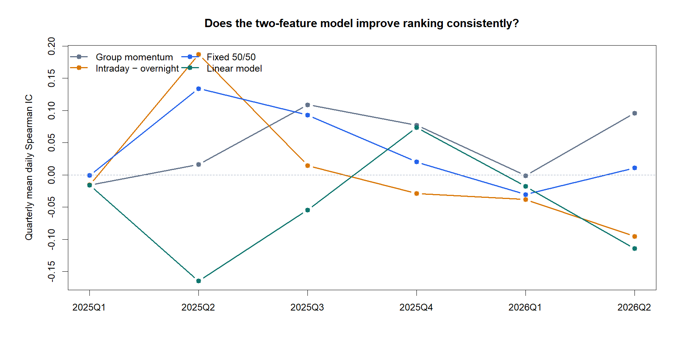
The trained model failed five of six confirmation quarters
GEN5.4 • X2a CONFIRMATION
−0.0485
linear-model mean OOS IC
1 / 6
quarters with positive IC
−0.0965
IC lift vs best comparator
5
Notes:
D44 — The model did not transport.
Conversation: codex://threads/019f741e-615f-7fd0-90f7-edce12b5cb66
[Sources]
- C:\Users\Franc\OneDrive\Documents\Francis\Peltata Project\Time-Series-Modeling-Gen5\runs\research_workbench\gen54_ml_decision_engine\g54_xs_x2a_20260726\x2a_fold_summary.csv
- C:\Users\Franc\OneDrive\Documents\Francis\Peltata Project\Time-Series-Modeling-Gen5\runs\research_workbench\gen54_ml_decision_engine\g54_xs_x2a_20260726\x2a_method_summary.csv
- C:\Users\Franc\OneDrive\Documents\Francis\Peltata Project\Time-Series-Modeling-Gen5\runs\research_workbench\gen54_ml_decision_engine\g54_xs_x2a_20260726\visuals\x2a_fold_rank_ic.png
[/Sources]

Slide 6
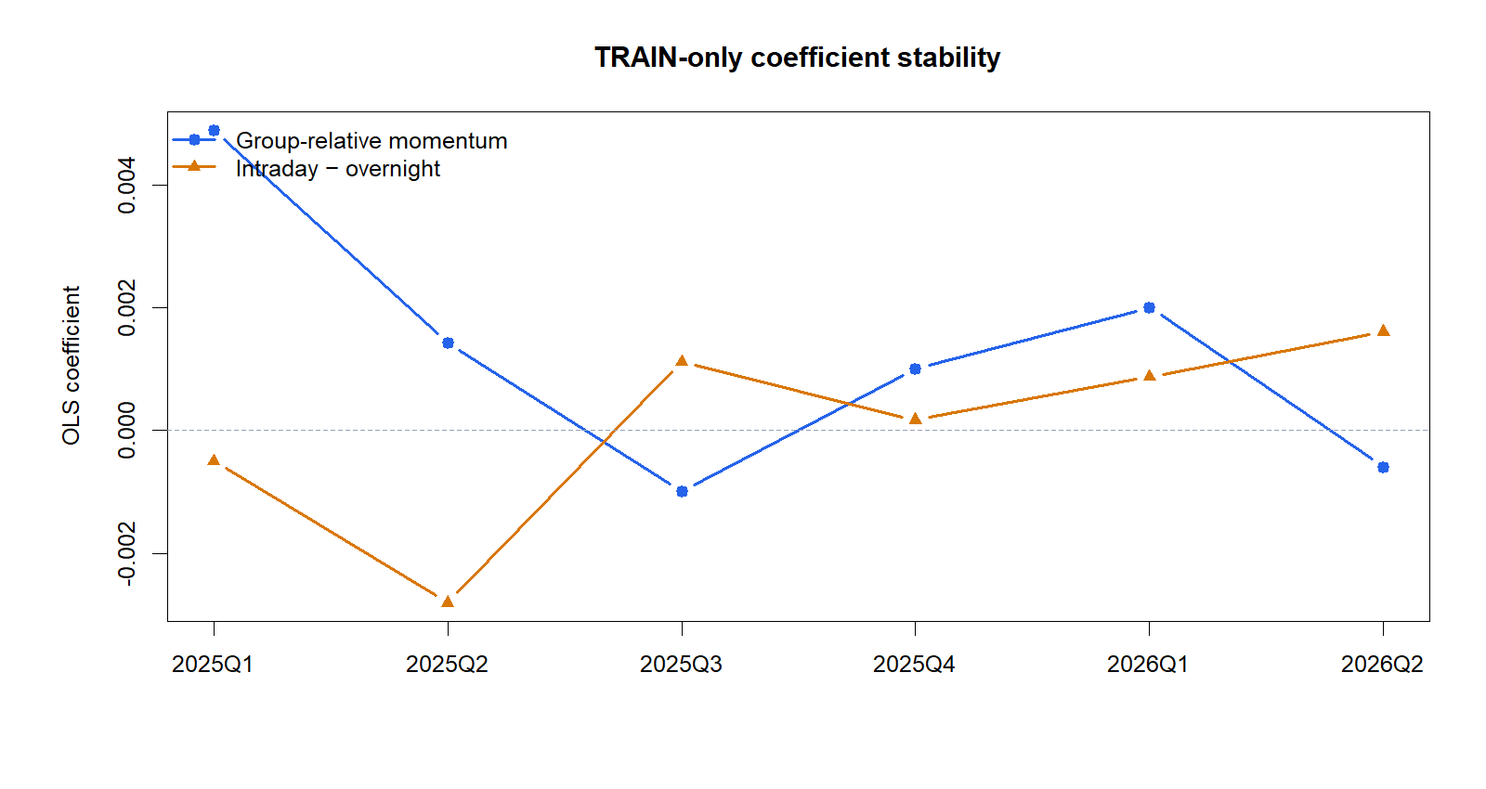
The learned weights did not transport
GEN5.4 • X2a CONFIRMATION
Both slopes changed sign
The model learned a moving historical relationship and then ranked the fresh quarter in the wrong direction. That is exactly the kind of instability walk-forward confirmation is meant to expose.
35.6
16.6
max group share (%)
max symbol share (%)
6
Notes:
D44 — Coefficient signs changed across TRAIN windows; concentration gates still passed.
Conversation: codex://threads/019f741e-615f-7fd0-90f7-edce12b5cb66
[Sources]
- C:\Users\Franc\OneDrive\Documents\Francis\Peltata Project\Time-Series-Modeling-Gen5\runs\research_workbench\gen54_ml_decision_engine\g54_xs_x2a_20260726\x2a_fold_coefficients.csv
- C:\Users\Franc\OneDrive\Documents\Francis\Peltata Project\Time-Series-Modeling-Gen5\runs\research_workbench\gen54_ml_decision_engine\g54_xs_x2a_20260726\x2a_gate_audit.csv
- C:\Users\Franc\OneDrive\Documents\Francis\Peltata Project\Time-Series-Modeling-Gen5\runs\research_workbench\gen54_ml_decision_engine\g54_xs_x2a_20260726\visuals\x2a_coefficients.png
[/Sources]

Slide 7
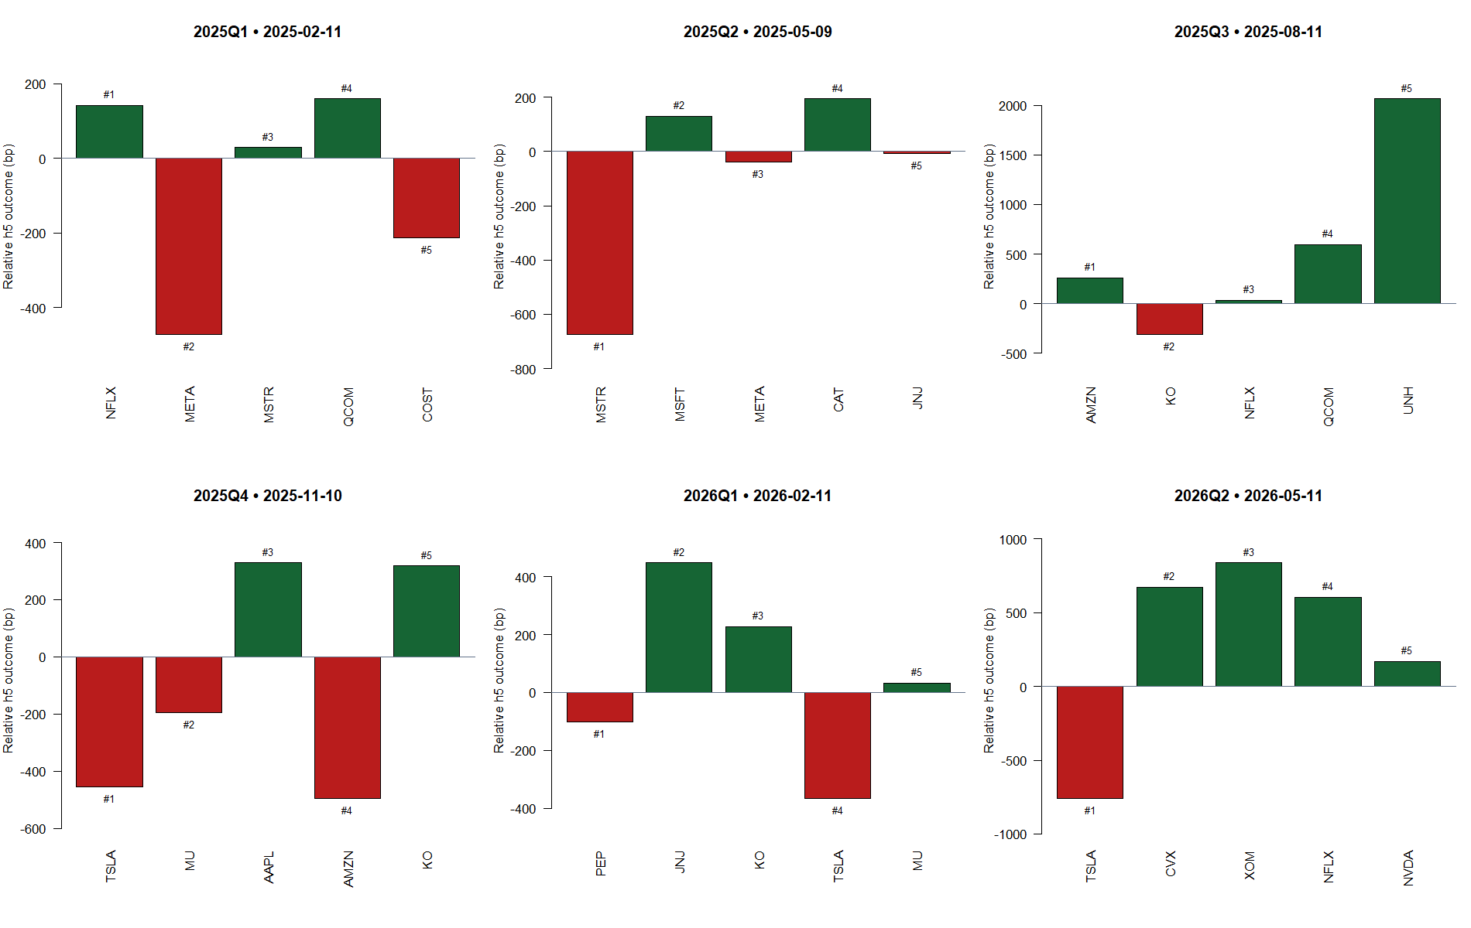
Representative tapes make the unstable ordering tangible
GEN5.4 • X2a CONFIRMATION
Read each panel as a ranking diagnostic
Bars show the later relative h5 outcome of the model’s top five on one representative date.
They are not trades or PnL. The mix of green and red outcomes illustrates why a visually plausible score still needs cross-quarter validation.
7
Notes:
D44 — Representative diagnostic tapes; not portfolio evidence.
Conversation: codex://threads/019f741e-615f-7fd0-90f7-edce12b5cb66
[Sources]
- C:\Users\Franc\OneDrive\Documents\Francis\Peltata Project\Time-Series-Modeling-Gen5\runs\research_workbench\gen54_ml_decision_engine\g54_xs_x2a_20260726\x2a_representative_ranking_tapes.csv
- C:\Users\Franc\OneDrive\Documents\Francis\Peltata Project\Time-Series-Modeling-Gen5\runs\research_workbench\gen54_ml_decision_engine\g54_xs_x2a_20260726\visuals\x2a_representative_ranking_tapes.png
[/Sources]

Slide 8
DECISION • D44
Stop the multivariate
ranking lane
What remains valid
• Raw group-relative momentum remains a useful research comparator.
• The next theory session must choose a genuinely different information mechanism—or stop this ranking architecture.
Do not rescue this result with tuned weights, interactions, regularization, nonlinear ML, or a top-five portfolio replay.
Notes:
D44 — Final stop state and next theory boundary.
Conversation: codex://threads/019f741e-615f-7fd0-90f7-edce12b5cb66
[Sources]
- C:\Users\Franc\OneDrive\Documents\Francis\Peltata Project\Time-Series-Modeling-Gen5\runs\research_workbench\gen54_ml_decision_engine\g54_xs_x2a_20260726\x2a_gate_audit.csv
- C:\Users\Franc\OneDrive\Documents\Francis\Peltata Project\Time-Series-Modeling-Gen5\runs\research_workbench\gen54_ml_decision_engine\g54_xs_x2a_20260726\x2a_report.md
- C:\Users\Franc\OneDrive\Documents\Francis\Peltata Project\Time-Series-Modeling-Gen5\docs\GEN5_4_DECISION_DIALOGUE_INDEX.md
[/Sources]

