Slide 1
SESSION 12
N1L live-path feasibility now passes;
predictive value remains untested.
13/13 gates | 2 × 300 seconds | 1 live article | 1 exact REST match
S12/01
Notes:
SESSION 12 - N1L SHADOW CONFIRMATION
Question
Can a longer bounded premarket observation capture a complete live Alpaca news payload and reconcile it to REST without inspecting any market outcome?
Result
All 13 hard gates passed. Connection 2 received one complete live article, and the REST overlap matched the same article ID exactly on headline and symbol metadata. N1L now records PASS_N1L_LIVE_PATH_READY.
Boundary
This proves the operational path, not predictive value.
Contract: docs/GEN5_4_NEWS_LIVE_FEASIBILITY_N1L_CONTRACT.md
Report: C:/Users/Franc/OneDrive/Documents/Francis/Peltata Project/Time-Series-Modeling-Gen5/runs/research_workbench/gen54_ml_decision_engine/g54_news_n1l_shadow_20260721_0439et/n1l_report.md
Conversation: codex://threads/019f741e-615f-7fd0-90f7-edce12b5cb66
Find in chat: Proceed

Slide 2
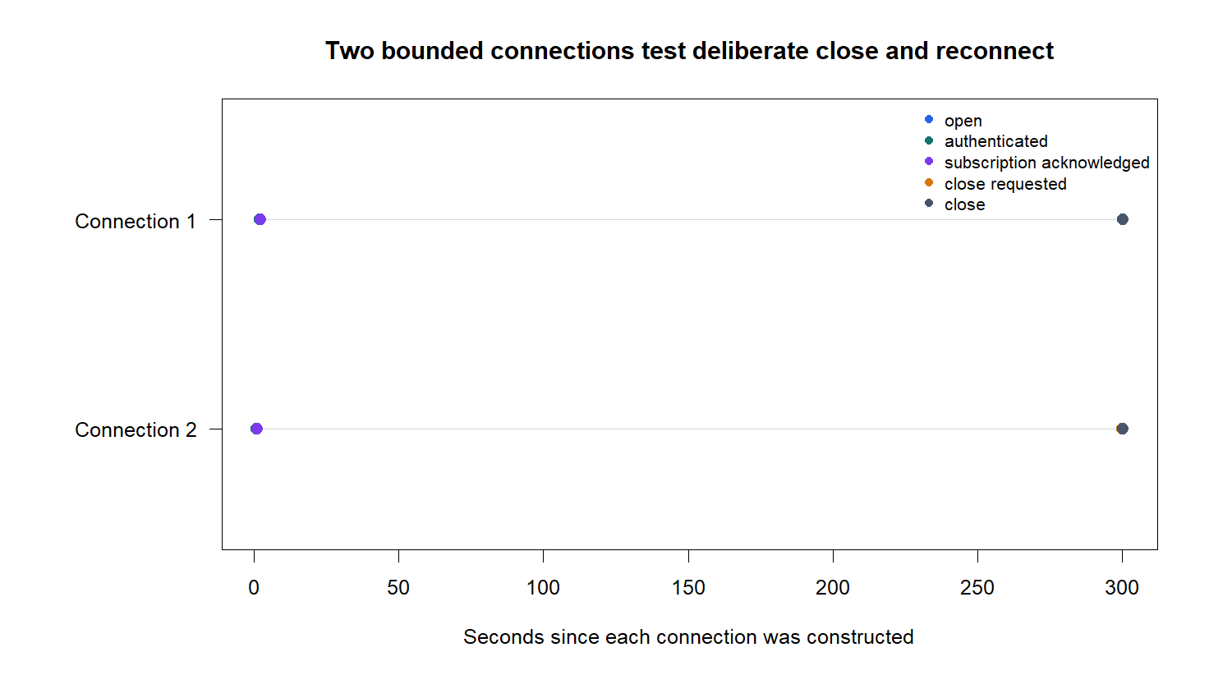
Transport repeats across two five-minute connections
D34/02
Notes:
DECISION D34 - TRANSPORT PASS REPEATS
Evidence
Both five-minute connections opened, authenticated, and acknowledged all 25 requested point-in-time symbol keys. Connection 1 closed cleanly with code 1000 before connection 2 opened.
Meaning
The earlier transport result was reproducible at a longer duration. Seven frames were preserved with local UTC receipt timestamps and parsed without error.
Lifecycle: C:/Users/Franc/OneDrive/Documents/Francis/Peltata Project/Time-Series-Modeling-Gen5/runs/research_workbench/gen54_ml_decision_engine/g54_news_n1l_shadow_20260721_0439et/n1l_connection_lifecycle.csv

Slide 3
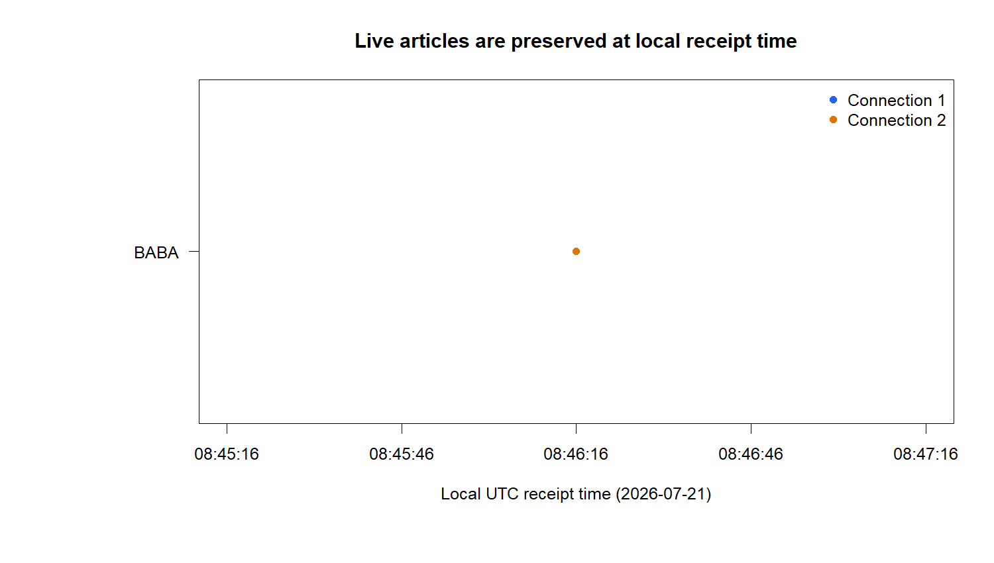
One live payload establishes prospective receipt evidence
D34/03
Notes:
DECISION D34 - LIVE PAYLOAD OBSERVED
Evidence
Connection 2 received article 60569812 with a complete ID, headline, source, symbols, created_at, updated_at, URL, connection ID, and local received_at.
Timing rule
The local receipt timestamp preceded provider created_at metadata by approximately 5.8 seconds. This is retained as clock or timestamp skew evidence. Local receipt time is the prospective availability authority near a decision boundary.
Live article: C:/Users/Franc/OneDrive/Documents/Francis/Peltata Project/Time-Series-Modeling-Gen5/runs/research_workbench/gen54_ml_decision_engine/g54_news_n1l_shadow_20260721_0439et/n1l_live_news_articles.csv
Health: C:/Users/Franc/OneDrive/Documents/Francis/Peltata Project/Time-Series-Modeling-Gen5/runs/research_workbench/gen54_ml_decision_engine/g54_news_n1l_shadow_20260721_0439et/n1l_health.csv

Slide 4
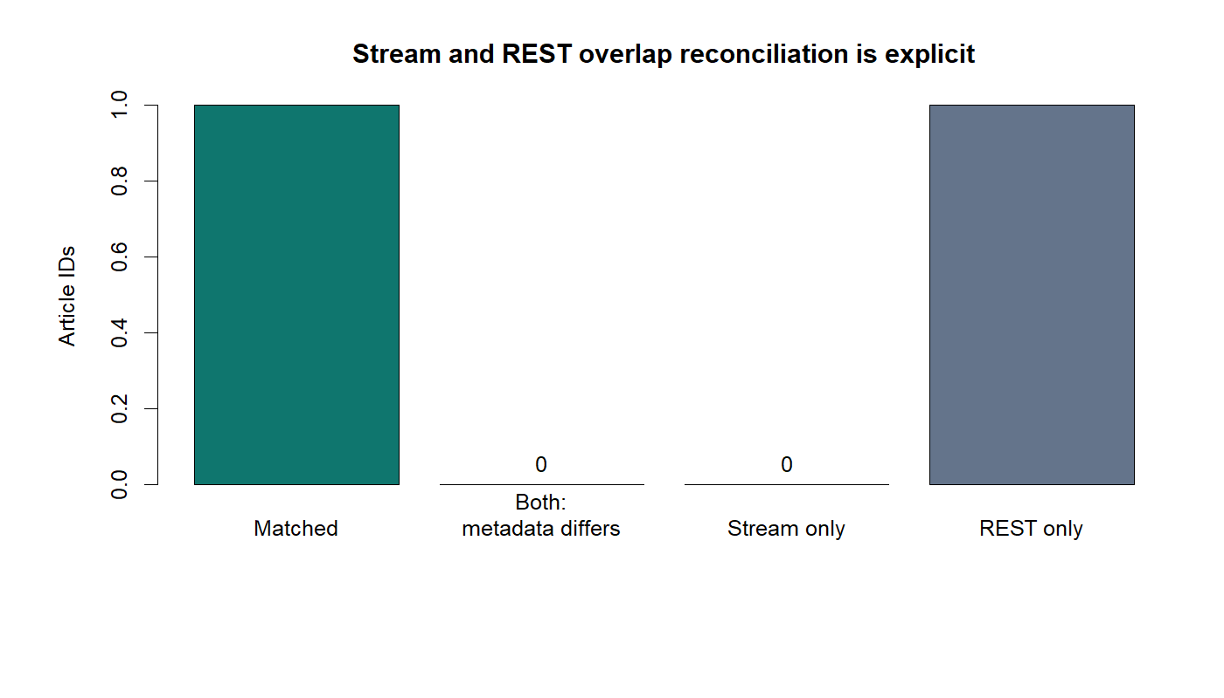
REST match closes N1L; predictive claims remain closed
OVERALL: PASS
PASS 13 / 13 hard gates
PASS 2 authenticated subscriptions
PASS 1 live candidate article
PASS 1 exact REST match
NOTE receipt leads provider time 5.8s
OPEN frozen N1B measurement POC
STOP predictive and policy claims
D34/04
Notes:
DECISION D34 - PASS_N1L_LIVE_PATH_READY
What passed
Connection, authentication, subscription, deliberate reconnect, local receipt metadata, frame parsing, live required fields, REST HTTP/pagination, and same-version conflict gates.
Reconciliation
REST returned two articles. One predated subscription and remained REST-only. The live article matched REST by ID, headline, and symbol metadata with no conflict.
Next gate
The operational data-path STOP in the frozen N1B contract is removed. N1B remains a measurement-only association POC: no sentiment, direction, horizon search, exposure, allocation, or live advice.
Reconciliation: C:/Users/Franc/OneDrive/Documents/Francis/Peltata Project/Time-Series-Modeling-Gen5/runs/research_workbench/gen54_ml_decision_engine/g54_news_n1l_shadow_20260721_0439et/n1l_reconciliation.csv
Conversation: codex://threads/019f741e-615f-7fd0-90f7-edce12b5cb66

