Slide 1
HYP-REG-01.2
A valid volatility sensor can still be a bad entry gate
ATR LOW off × daily SMA8/SMA14 · 24 stocks · 2018–2023 DEVELOPMENT
Drawdown improved. Return, Sharpe, breadth, and regime specificity did not.
1
Notes:
Open with the core teaching point: HYP-REG-01.1 validated a directionless volatility classifier. HYP-REG-01.2 asks the stronger question of whether LOW should veto entries for one specific strategy.
[Sources]
- docs/GEN5_HYP_REG_01_2_ATR_PERCENT_STRATEGY_OVERLAY_CONTRACT.md
- operator_hypothesis_lab/docs/HYP_REG_01_2_ATR_PERCENT_STRATEGY_OVERLAY_RESULTS.md
- Chat D128: Agreed. Minimal first, with a well characterized strategy that intuitively overlaps with what the volatility filter is characterizing. Proceed

Slide 2
The experiment changed one thing—and only one thing
FROZEN AUTHORITY BOUNDARY
Parent authorities
New permission rule
ATR14 / close; prior-252 percentile; 30/40 and 60/70 hysteresis
LOW
Skip that fresh entry permanently
Daily SMA8/SMA14 fresh cross; next-open entry; cross-down exit
MEDIUM / HIGH
Allow the unchanged entry
Long or cash; 5 bp per side; 1x primary
24 stocks × six annual cells = 144 primary observations
Open trades ignore later state changes. Exits are never modified. No deferred entry.
2
Notes:
This slide prevents a common misunderstanding: the regime label is not a position-sizing signal and does not manage an open trade. It only grants or denies a fresh entry at the signal close.
[Sources]
- docs/GEN5_HYP_REG_01_2_ATR_PERCENT_STRATEGY_OVERLAY_CONTRACT.md
- operator_hypothesis_lab/R/hyp_reg_01_2_strategy_overlay.R

Slide 3
Two accepted data surfaces meet at the signal close
CAUSAL JOIN AND FALSIFICATION
Strategy surface
Signal-close join
State surface
Accepted 30-minute SIP archive
↓
reconstructed daily opens/closes
↓
SMA8/SMA14 signals
signal at close t
+ state dated t
↓
entry, if allowed, at open t+1
Accepted adjusted-daily ledger
↓
ATR14% percentile
↓
LOW / MEDIUM / HIGH
Primary counterfactual
Regime-specificity counterfactual
Sealed boundary
same strategy, no state veto
200 circular state shifts; evaluate 40 nearest exposure
No 2024+ outcome accessed
3
Notes:
The state sequence is real and causal; circular shifts preserve its occupancy and run structure while breaking the calendar alignment. Exposure-nearest shifts ask whether the actual LOW dates matter beyond simply trading less.
[Sources]
- docs/GEN5_HYP_REG_01_2_ATR_PERCENT_STRATEGY_OVERLAY_CONTRACT.md
- C:/Users/Franc/OneDrive/Documents/Francis/Peltata Project/Time-Series-Modeling-Gen5/runs/research_workbench/operator_hypothesis_lab/hyp_reg_01_2_strategy_overlay_20260814/hyp_reg_01_2_parent_reproduction.csv
- C:/Users/Franc/OneDrive/Documents/Francis/Peltata Project/Time-Series-Modeling-Gen5/runs/research_workbench/operator_hypothesis_lab/hyp_reg_01_2_strategy_overlay_20260814/hyp_reg_01_2_placebo_panel.csv

Slide 4
The parent replay is exact
INTEGRITY BEFORE PERFORMANCE
The overlay result is not an implementation artifact. All strategy rows map to one causal state; ten extra state-ledger sessions are the predeclared SIP archive-gap dates excluded from execution.
156 / 156
4.44e−15
144 / 144
parent summary rows reproduced
maximum absolute return difference
primary stock asset-year cells
4
Notes:
The exact reproduction gate is essential because the overlay joins an adjusted-daily state ledger to a daily strategy reconstructed from the accepted 30-minute archive. The result is not caused by an accidental rewrite of the parent.
[Sources]
- C:/Users/Franc/OneDrive/Documents/Francis/Peltata Project/Time-Series-Modeling-Gen5/runs/research_workbench/operator_hypothesis_lab/hyp_reg_01_2_strategy_overlay_20260814/hyp_reg_01_2_parent_reproduction.csv
- C:/Users/Franc/OneDrive/Documents/Francis/Peltata Project/Time-Series-Modeling-Gen5/runs/research_workbench/operator_hypothesis_lab/hyp_reg_01_2_strategy_overlay_20260814/hyp_reg_01_2_gates.csv
- docs/GEN5_HYP_REG_01_2_ATR_PERCENT_STRATEGY_OVERLAY_CONTRACT.md

Slide 5
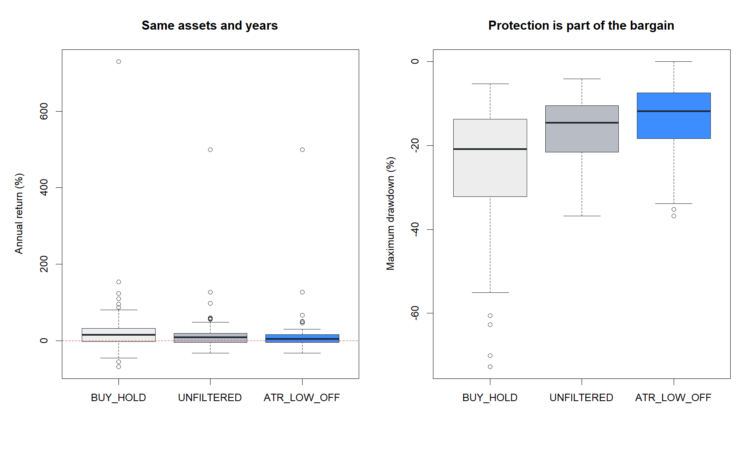
Protection improved, but the return bargain deteriorated
PRIMARY 1X DEVELOPMENT READOUT
8.95% → 4.44%
median annual return
−14.59% → −11.85%
median maximum drawdown
0.642 → 0.485
median Sharpe
Fewer trades reduced risk—but surrendered too much upside.
5
Notes:
The overlay remains positive in absolute median return, but that is not the promotion question. It must improve the unchanged strategy's return/protection bargain, and it does not.
[Sources]
- C:/Users/Franc/OneDrive/Documents/Francis/Peltata Project/Time-Series-Modeling-Gen5/runs/research_workbench/operator_hypothesis_lab/hyp_reg_01_2_strategy_overlay_20260814/hyp_reg_01_2_policy_panel.csv
- C:/Users/Franc/OneDrive/Documents/Francis/Peltata Project/Time-Series-Modeling-Gen5/runs/research_workbench/operator_hypothesis_lab/hyp_reg_01_2_strategy_overlay_20260814/visuals/policy_return_drawdown.png

Slide 6
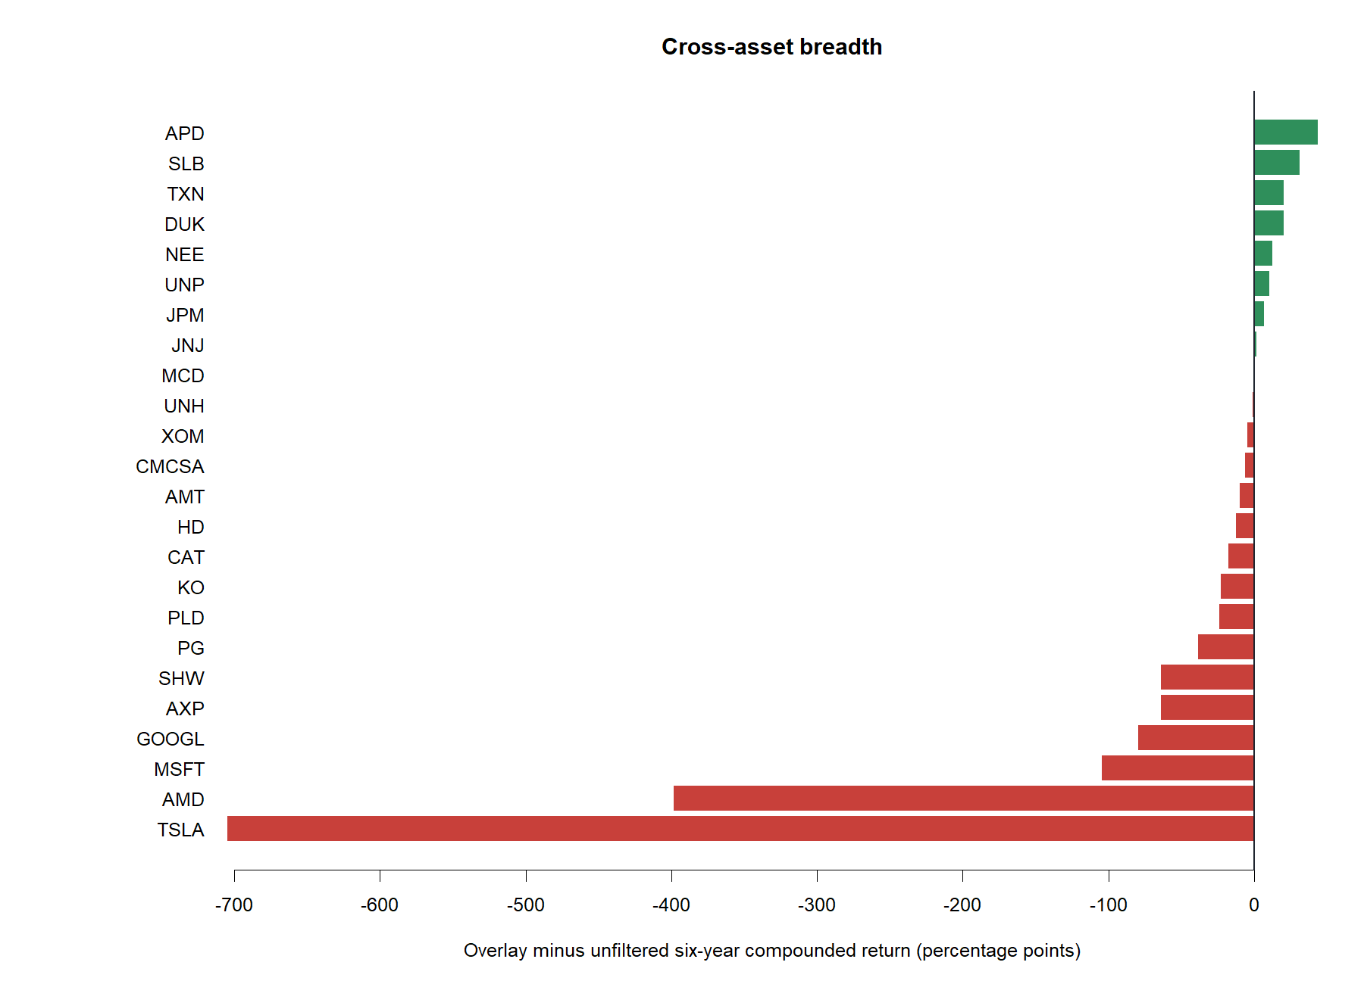
Only 9 of 24 stocks improved over the full six-year window
CROSS-ASSET BREADTH
9 / 24
stocks improved
The largest lost opportunities occurred in the same volatile momentum names that made the parent rule economically interesting.
Breadth gate required ≥15 / 24
6
Notes:
TSLA and AMD dominate the negative tail because skipping early quiet-state entries can miss later trend expansions. The gate also fails broadly, so this is not just a two-name anomaly.
[Sources]
- C:/Users/Franc/OneDrive/Documents/Francis/Peltata Project/Time-Series-Modeling-Gen5/runs/research_workbench/operator_hypothesis_lab/hyp_reg_01_2_strategy_overlay_20260814/hyp_reg_01_2_asset_compound.csv
- C:/Users/Franc/OneDrive/Documents/Francis/Peltata Project/Time-Series-Modeling-Gen5/runs/research_workbench/operator_hypothesis_lab/hyp_reg_01_2_strategy_overlay_20260814/visuals/asset_compounded_excess.png

Slide 7
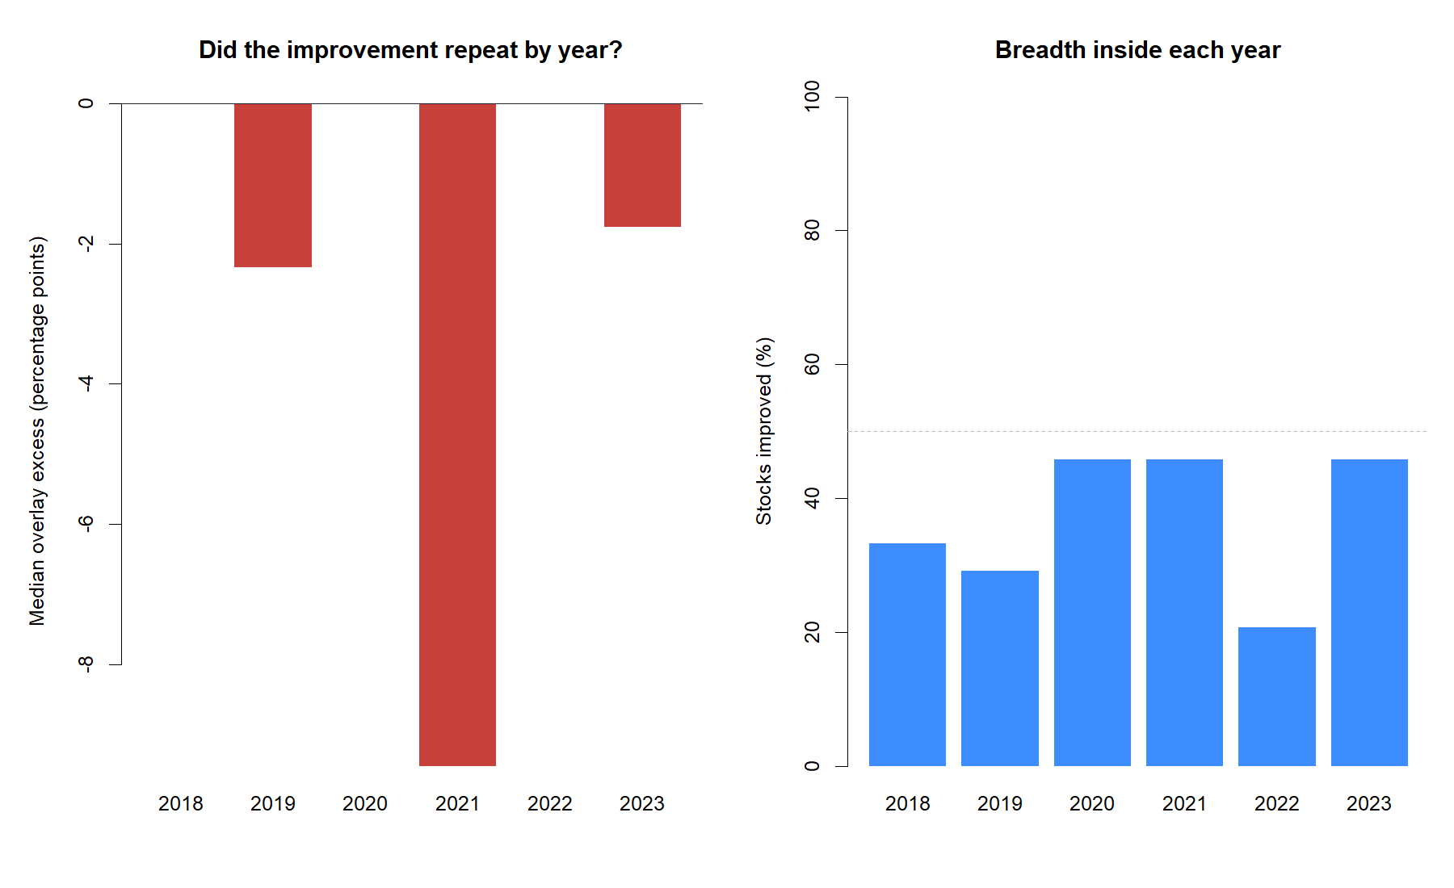
The overlay never produced positive panel-median excess in a year
CALENDAR BREADTH
0 / 6
positive median-excess years
21%–46%
stock improvement share by year
Required: positive in ≥4 of 6 years
7
Notes:
Near-zero years are still not wins under the frozen gate. The calendar test asks whether the overlay improvement repeats, not whether one favorable period can be found.
[Sources]
- C:/Users/Franc/OneDrive/Documents/Francis/Peltata Project/Time-Series-Modeling-Gen5/runs/research_workbench/operator_hypothesis_lab/hyp_reg_01_2_strategy_overlay_20260814/hyp_reg_01_2_year_summary.csv
- C:/Users/Franc/OneDrive/Documents/Francis/Peltata Project/Time-Series-Modeling-Gen5/runs/research_workbench/operator_hypothesis_lab/hyp_reg_01_2_strategy_overlay_20260814/visuals/calendar_breadth.png

Slide 8
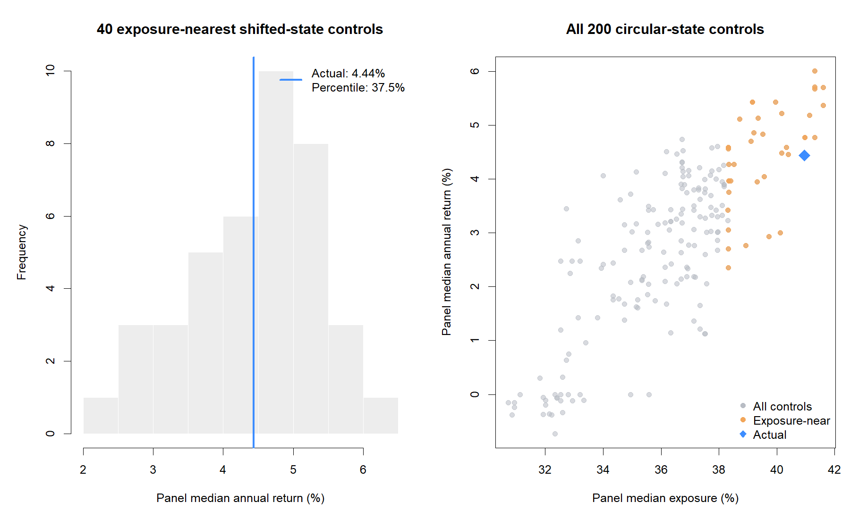
Actual LOW dates do not beat exposure-matched shifts
REGIME SPECIFICITY
37.5th
percentile among 40 exposure-nearest controls
−0.15 pp
versus their median return
Gate required ≥80th percentile
8
Notes:
This is the strongest falsification result. The ATR gate's drawdown benefit is explainable by lower exposure. Its actual calendar alignment does not add value beyond exposure-near shifted masks.
[Sources]
- C:/Users/Franc/OneDrive/Documents/Francis/Peltata Project/Time-Series-Modeling-Gen5/runs/research_workbench/operator_hypothesis_lab/hyp_reg_01_2_strategy_overlay_20260814/hyp_reg_01_2_placebo_panel.csv
- C:/Users/Franc/OneDrive/Documents/Francis/Peltata Project/Time-Series-Modeling-Gen5/runs/research_workbench/operator_hypothesis_lab/hyp_reg_01_2_strategy_overlay_20260814/visuals/regime_alignment_placebo.png

Slide 9
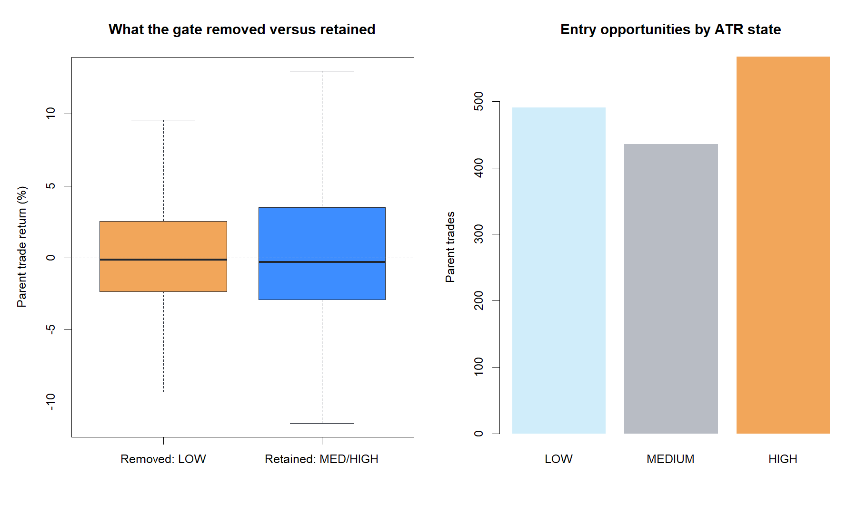
LOW-state trades were not the clearly inferior population
TRADE-LEVEL AUDIT
491
LOW trades removed
48.1%
removed-trade hit rate
+1.08%
removed-trade mean return
Quiet entries sometimes became large right-tail trends.
9
Notes:
Median trades are slightly negative in every state, as expected for a trend system with occasional large winners. The LOW veto removed a meaningful right tail; hit rate alone would miss that.
[Sources]
- C:/Users/Franc/OneDrive/Documents/Francis/Peltata Project/Time-Series-Modeling-Gen5/runs/research_workbench/operator_hypothesis_lab/hyp_reg_01_2_strategy_overlay_20260814/hyp_reg_01_2_trade_audit.csv
- C:/Users/Franc/OneDrive/Documents/Francis/Peltata Project/Time-Series-Modeling-Gen5/runs/research_workbench/operator_hypothesis_lab/hyp_reg_01_2_strategy_overlay_20260814/visuals/removed_retained_trade_audit.png

Slide 10
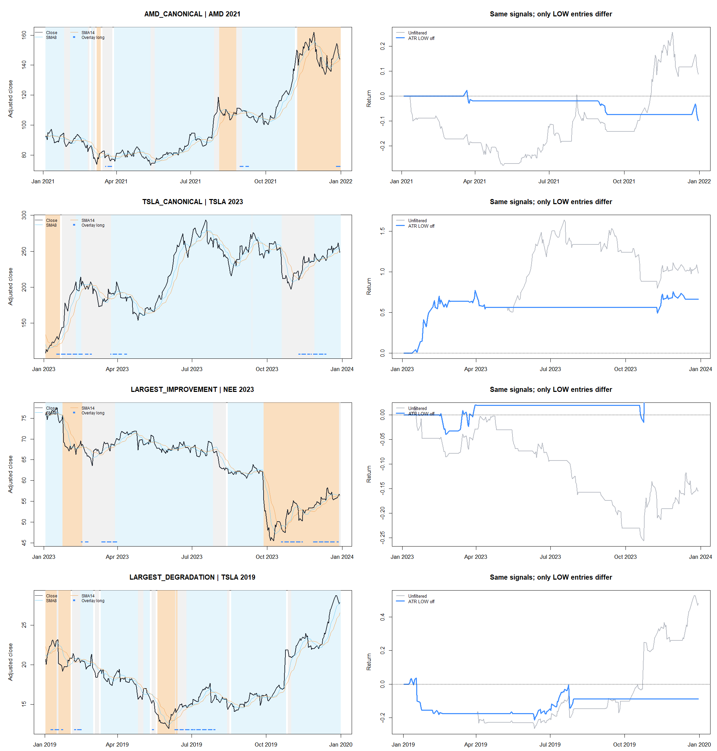
The tapes reveal the missed-expansion mechanism
REPRESENTATIVE BEHAVIOR
Missed expansions
AMD 2021 and TSLA 2019 began important trends from entries the LOW veto suppressed.
Useful protection
NEE 2023 shows the other side: sometimes the veto successfully avoided a losing sequence.
Mixed behavior is exactly why breadth and placebo gates matter.
10
Notes:
Read the left side as the asset and state history and the right side as the strategy consequence. AMD 2021 and TSLA 2019 show large trends that the LOW veto failed to enter; NEE 2023 shows the kind of protection the veto can provide. The mechanism is mixed, not uniformly helpful.
[Sources]
- C:/Users/Franc/OneDrive/Documents/Francis/Peltata Project/Time-Series-Modeling-Gen5/runs/research_workbench/operator_hypothesis_lab/hyp_reg_01_2_strategy_overlay_20260814/hyp_reg_01_2_representative_selection.csv
- C:/Users/Franc/OneDrive/Documents/Francis/Peltata Project/Time-Series-Modeling-Gen5/runs/research_workbench/operator_hypothesis_lab/hyp_reg_01_2_strategy_overlay_20260814/visuals/representative_overlay_tapes.png

Slide 11
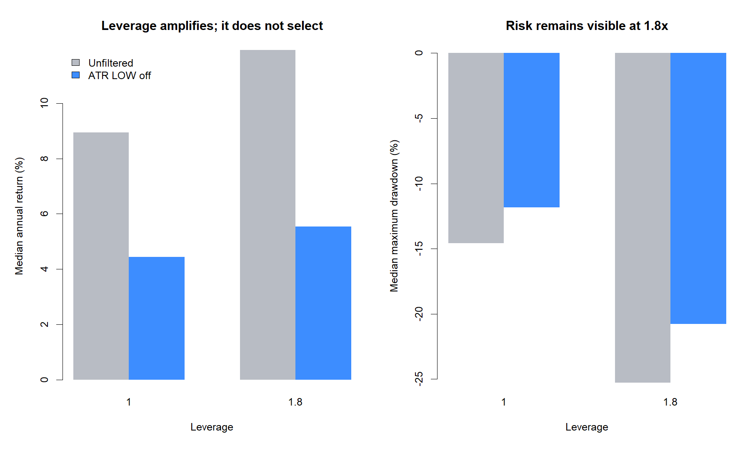
Leverage amplifies the same selection problem
SECONDARY 1.8X VIEW
11.94%
unfiltered 1.8x return
5.53%
overlay 1.8x return
0
strategy maintenance-proxy breaches
11
Notes:
The 1.8x result is deliberately secondary and cannot select the policy. Financing and maintenance-risk accounting are retained from the parent series. The overlay remains weaker after leverage.
[Sources]
- C:/Users/Franc/OneDrive/Documents/Francis/Peltata Project/Time-Series-Modeling-Gen5/runs/research_workbench/operator_hypothesis_lab/hyp_reg_01_2_strategy_overlay_20260814/hyp_reg_01_2_secondary_summary.csv
- C:/Users/Franc/OneDrive/Documents/Francis/Peltata Project/Time-Series-Modeling-Gen5/runs/research_workbench/operator_hypothesis_lab/hyp_reg_01_2_strategy_overlay_20260814/visuals/leverage_secondary_view.png

Slide 12
Preserve the classifier; reject this entry veto
DECISION BOUNDARY
STOP
PASS
FAIL
Integrity
Panel return
HYP-REG-01.2
Parent reproduction
Asset breadth
DEVELOPMENT gates failed
confirmation not run
Calendar breadth
Absolute viability
Protection + Sharpe
Regime specificity
HYP-REG-01.1 still predicts movement magnitude. It does not imply that LOW volatility is hostile to this momentum rule.
12
Notes:
Close without weakening either finding. The classifier is a clean positive diagnostic. The overlay is a clean negative strategy result. Do not try HIGH-only, alternate thresholds, or favorable assets on the same evidence, and do not access 2024+ confirmation.
[Sources]
- operator_hypothesis_lab/docs/HYP_REG_01_2_ATR_PERCENT_STRATEGY_OVERLAY_RESULTS.md
- C:/Users/Franc/OneDrive/Documents/Francis/Peltata Project/Time-Series-Modeling-Gen5/runs/research_workbench/operator_hypothesis_lab/hyp_reg_01_2_strategy_overlay_20260814/hyp_reg_01_2_gates.csv
- docs/GEN5_HYP_REG_01_2_ATR_PERCENT_STRATEGY_OVERLAY_CONTRACT.md

