Slide 1
OPERATOR HYPOTHESIS LAB | HYP-MOM-02.1
Fresh crosses,
at a price
What happened when 119 stocks waited for a new SMA200 cross?
Notes:
This corrected deck begins every asset in cash and admits only fresh in-window crosses. Removing warm starts materially lowered exposure and return, while strengthening the drawdown-defense interpretation.
[Sources]
- C:\Users\Franc\OneDrive\Documents\Francis\Peltata Project\Time-Series-Modeling-Gen5\operator_hypothesis_lab\docs\HYP_MOM_02_1_SMA200_CROSS_WIDE_DISCOVERY_CONTRACT.md
- C:\Users\Franc\OneDrive\Documents\Francis\Peltata Project\Time-Series-Modeling-Gen5\operator_hypothesis_lab\docs\HYP_MOM_02_1_SMA200_CROSS_WIDE_DISCOVERY_RESULTS.md

Slide 2
A fresh completed-close cross determines the next-open trade
SMA200(t) = mean[Close(t-199), ..., Close(t)]
CROSS ABOVE
CROSS BELOW
Buy at the next open
then remain long
Sell at the next open
then remain cash
Every path starts in cash | adjusted daily | 5 bp/side primary | 10 bp/side stress
2
Notes:
The SMA uses 200 completed adjusted closes. A cross above completed after the discovery window begins triggers entry at the following open; a cross below triggers exit at the following open. Being above at the boundary is ignored, so no warm-start trade remains.
[Sources]
- C:\Users\Franc\OneDrive\Documents\Francis\Peltata Project\Time-Series-Modeling-Gen5\operator_hypothesis_lab\docs\HYP_MOM_02_1_SMA200_CROSS_WIDE_DISCOVERY_CONTRACT.md

Slide 3
A slow average changes the ownership path; it does not promise prediction
WHAT IT CAN DO
WHAT IT CANNOT GUARANTEE
Avoid parts of prolonged declines
Stay with unusually persistent trends
Reduce time exposed to the market
A high hit rate
Fast reaction to reversals
Better returns than ownership
Independence from market regime
The estimand is the cross-triggered return / drawdown / exposure tradeoff after costs.
3
Notes:
SMA200 is a lagging trigger. The corrected question is not whether every above-SMA state earns a return, but whether trades begun by fresh crosses create a worthwhile return, drawdown, exposure, and whipsaw exchange.
[Sources]
- C:\Users\Franc\OneDrive\Documents\Francis\Peltata Project\Time-Series-Modeling-Gen5\operator_hypothesis_lab\docs\HYP_MOM_02_1_SMA200_CROSS_WIDE_DISCOVERY_CONTRACT.md
- C:\Users\Franc\OneDrive\Documents\Francis\Peltata Project\Time-Series-Modeling-Gen5\operator_hypothesis_lab\docs\HYP_MOM_02_1_SMA200_CROSS_WIDE_DISCOVERY_RESULTS.md

Slide 4
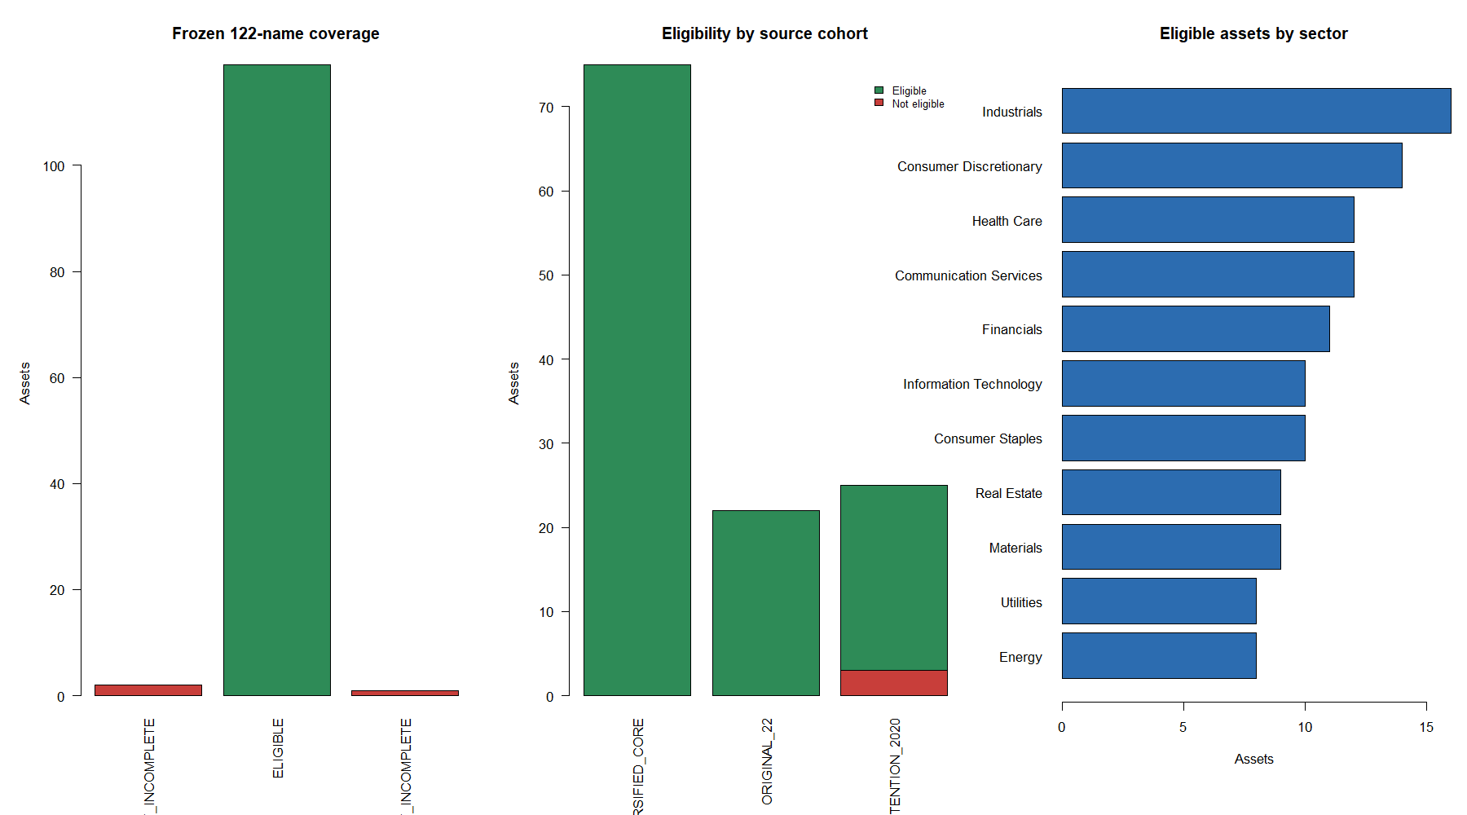
The study began wide: 119 of 122 frozen stocks were eligible
4
Notes:
The combined registry contains the original 22-stock panel plus a previously frozen 100-stock breadth-attention registry. APHA and SNE lack the full discovery window; LI lacks the required prehistory. A bounded provider refresh left the same 119 eligible assets. No failure was replaced.
[Sources]
- C:\Users\Franc\OneDrive\Documents\Francis\Peltata Project\Time-Series-Modeling-Gen5\runs\research_workbench\operator_hypothesis_lab\hyp_mom_02_1_sma200_cross_wide_discovery_20260808\hyp_mom_02_1_coverage.csv
- C:\Users\Franc\OneDrive\Documents\Francis\Peltata Project\Time-Series-Modeling-Gen5\runs\research_workbench\operator_hypothesis_lab\hyp_mom_02_1_sma200_cross_wide_discovery_20260808\hyp_mom_02_1_query_health.csv
- C:\Users\Franc\OneDrive\Documents\Francis\Peltata Project\Time-Series-Modeling-Gen5\runs\research_workbench\operator_hypothesis_lab\hyp_mom_02_1_sma200_cross_wide_discovery_20260808\visuals\coverage_and_composition.png

Slide 5
Fresh-cross paths lost money typically and still reduced drawdown
-2.73%
-21.76 pp
43.48%
+5.98 pp
median strategy return
median excess return
median exposure
median DD improvement
versus +20.79% buy-and-hold
only 26 of 119 beat ownership
cash for more than half of sessions
-28.11% versus -36.73% ownership
52/119 positive paths | 88/119 reduced drawdown | 50/119 remained positive at stress costs
5
Notes:
The cross-only result is more defensive and less profitable than the warm-start readout. Median strategy return was -2.73% versus +20.79% ownership. Drawdown improved in 88 assets, but only 26 beat ownership.
[Sources]
- C:\Users\Franc\OneDrive\Documents\Francis\Peltata Project\Time-Series-Modeling-Gen5\runs\research_workbench\operator_hypothesis_lab\hyp_mom_02_1_sma200_cross_wide_discovery_20260808\hyp_mom_02_1_panel_summary.csv
- C:\Users\Franc\OneDrive\Documents\Francis\Peltata Project\Time-Series-Modeling-Gen5\runs\research_workbench\operator_hypothesis_lab\hyp_mom_02_1_sma200_cross_wide_discovery_20260808\hyp_mom_02_1_asset_summary.csv
- C:\Users\Franc\OneDrive\Documents\Francis\Peltata Project\Time-Series-Modeling-Gen5\operator_hypothesis_lab\docs\HYP_MOM_02_1_SMA200_CROSS_WIDE_DISCOVERY_RESULTS.md

Slide 6
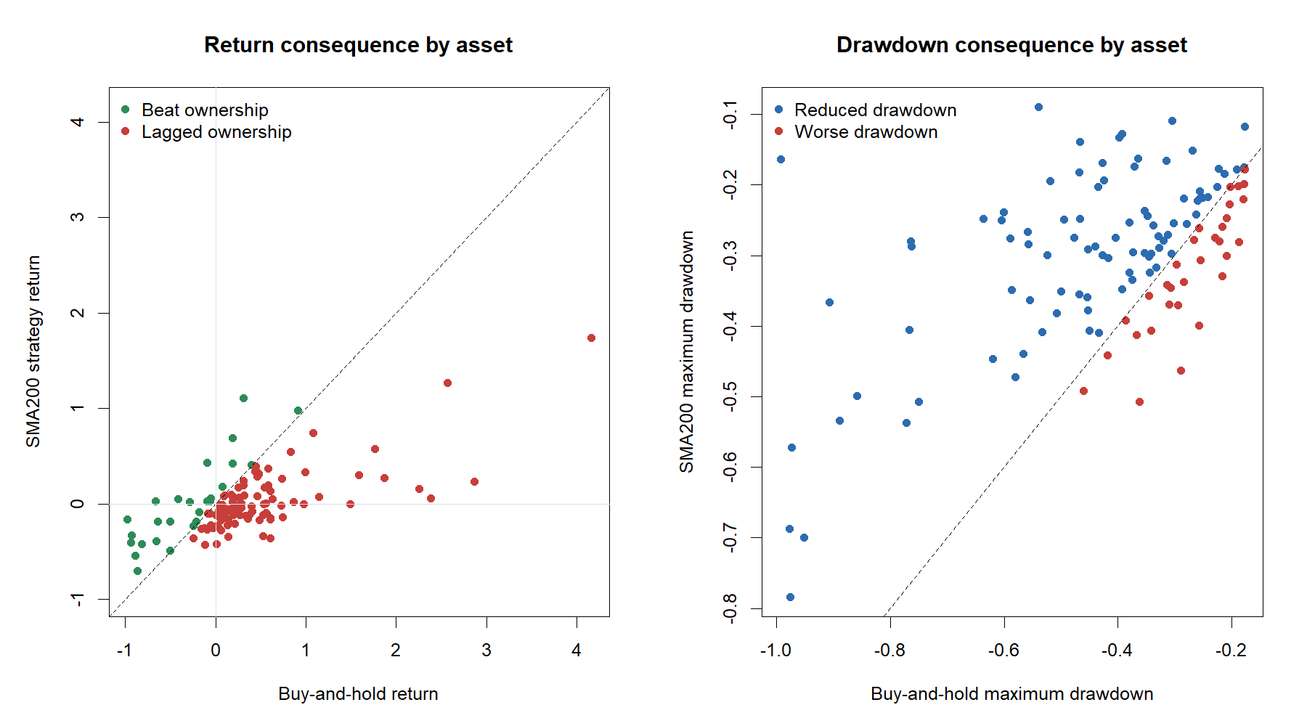
Return improvement was rare; drawdown improvement was common
6
Notes:
The left panel compares full-window returns; the right compares maximum drawdowns. Only 26 assets beat buy-and-hold, while 88 reduced maximum drawdown. All 26 return winners also improved drawdown.
[Sources]
- C:\Users\Franc\OneDrive\Documents\Francis\Peltata Project\Time-Series-Modeling-Gen5\runs\research_workbench\operator_hypothesis_lab\hyp_mom_02_1_sma200_cross_wide_discovery_20260808\hyp_mom_02_1_asset_summary.csv
- C:\Users\Franc\OneDrive\Documents\Francis\Peltata Project\Time-Series-Modeling-Gen5\runs\research_workbench\operator_hypothesis_lab\hyp_mom_02_1_sma200_cross_wide_discovery_20260808\visuals\strategy_vs_buy_hold.png

Slide 7
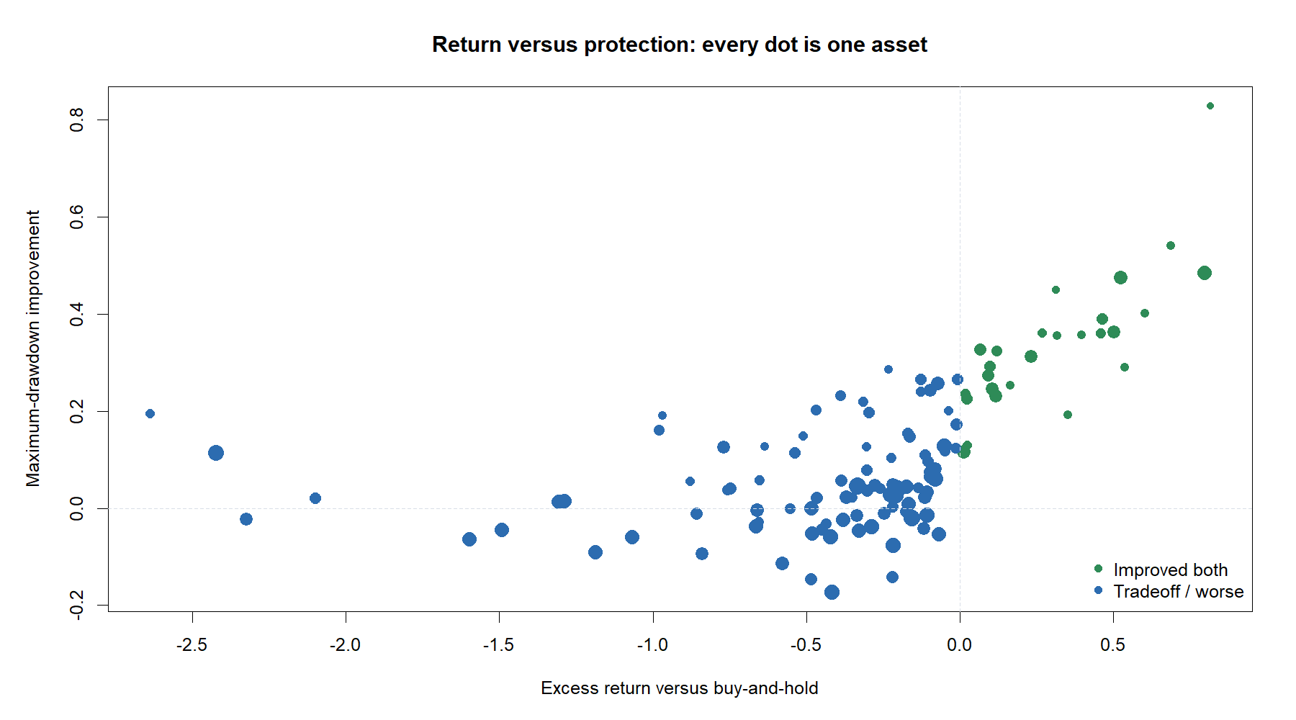
Most assets paid for protection with foregone upside
7
Notes:
Every point is one asset. The upper-right quadrant contains 26 assets that improved both return and maximum drawdown. Another 62 reduced drawdown while still lagging ownership. Point size reflects corrected cross-only exposure.
[Sources]
- C:\Users\Franc\OneDrive\Documents\Francis\Peltata Project\Time-Series-Modeling-Gen5\runs\research_workbench\operator_hypothesis_lab\hyp_mom_02_1_sma200_cross_wide_discovery_20260808\hyp_mom_02_1_asset_summary.csv
- C:\Users\Franc\OneDrive\Documents\Francis\Peltata Project\Time-Series-Modeling-Gen5\runs\research_workbench\operator_hypothesis_lab\hyp_mom_02_1_sma200_cross_wide_discovery_20260808\visuals\return_drawdown_tradeoff.png

Slide 8
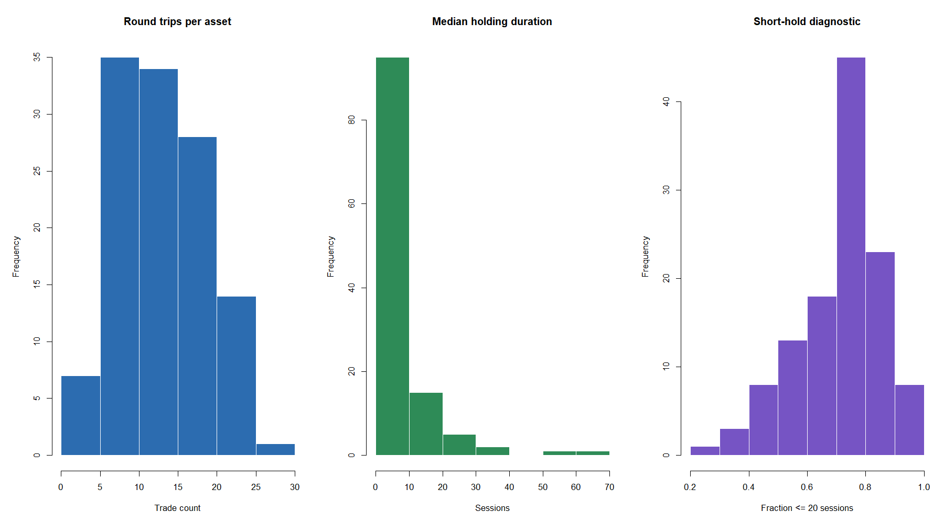
Only 23% of fresh crosses won—and the mean trade was barely positive
23.2%
pooled hit rate
-1.35% median trade
+0.15% mean trade
4-session median hold
74.7% lasted <=20 sessions
A few longer trends barely offset many short false starts.
8
Notes:
The observed trade distribution is right-skewed: the median trade lost 1.35%, while a smaller set of longer winners lifted the mean to only +0.15%. In mathematics, convexity means increasing payoff slope, or positive second derivative where defined. This run demonstrates asymmetric right-skewed outcomes; it does not formally estimate payoff curvature.
[Sources]
- C:\Users\Franc\OneDrive\Documents\Francis\Peltata Project\Time-Series-Modeling-Gen5\runs\research_workbench\operator_hypothesis_lab\hyp_mom_02_1_sma200_cross_wide_discovery_20260808\hyp_mom_02_1_trades.csv
- C:\Users\Franc\OneDrive\Documents\Francis\Peltata Project\Time-Series-Modeling-Gen5\runs\research_workbench\operator_hypothesis_lab\hyp_mom_02_1_sma200_cross_wide_discovery_20260808\visuals\trade_mechanics_distribution.png
- C:\Users\Franc\OneDrive\Documents\Francis\Peltata Project\Time-Series-Modeling-Gen5\operator_hypothesis_lab\docs\HYP_MOM_02_1_SMA200_CROSS_WIDE_DISCOVERY_RESULTS.md

Slide 9
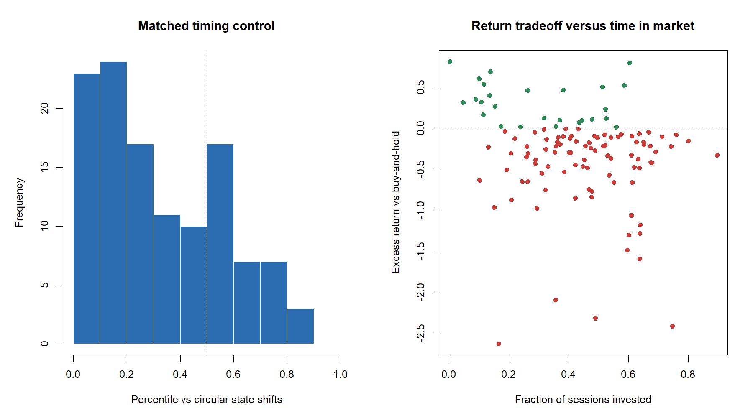
The actual SMA timing usually lagged matched placements of the same exposure
9
Notes:
Each circular shift preserves the corrected cross-triggered exposure fraction and serial block structure. The median observed percentile is 27.4%; 34 assets exceed the median shift, while ADBE, CHTR, and GE exceed the 80th percentile. These are diagnostics, not executable strategies or p-values.
[Sources]
- C:\Users\Franc\OneDrive\Documents\Francis\Peltata Project\Time-Series-Modeling-Gen5\runs\research_workbench\operator_hypothesis_lab\hyp_mom_02_1_sma200_cross_wide_discovery_20260808\hyp_mom_02_1_asset_summary.csv
- C:\Users\Franc\OneDrive\Documents\Francis\Peltata Project\Time-Series-Modeling-Gen5\runs\research_workbench\operator_hypothesis_lab\hyp_mom_02_1_sma200_cross_wide_discovery_20260808\hyp_mom_02_1_random_controls.csv
- C:\Users\Franc\OneDrive\Documents\Francis\Peltata Project\Time-Series-Modeling-Gen5\runs\research_workbench\operator_hypothesis_lab\hyp_mom_02_1_sma200_cross_wide_discovery_20260808\visuals\timing_controls_and_exposure.png

Slide 10
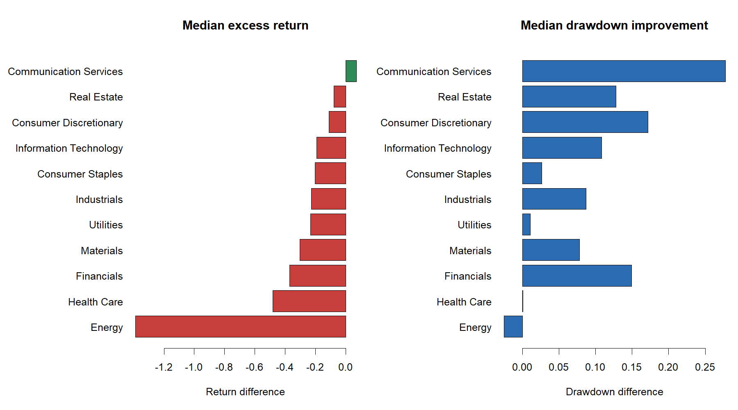
The filter helped collapsing stocks lose less and strong sectors capture less
ATTENTION COHORT
-18.7% strategy
-31.3% ownership
+27.9 pp median DD improvement
ENERGY
+25% strategy
+167% ownership
Descriptive context—not a sector-selection rule.
10
Notes:
The attention cohort illustrates protection rather than success: median strategy return was -18.7%, but less negative than ownership. Energy illustrates foregone upside: median strategy return was about +25% versus +167% ownership. Neither view authorizes selection.
[Sources]
- C:\Users\Franc\OneDrive\Documents\Francis\Peltata Project\Time-Series-Modeling-Gen5\runs\research_workbench\operator_hypothesis_lab\hyp_mom_02_1_sma200_cross_wide_discovery_20260808\hyp_mom_02_1_panel_summary.csv
- C:\Users\Franc\OneDrive\Documents\Francis\Peltata Project\Time-Series-Modeling-Gen5\runs\research_workbench\operator_hypothesis_lab\hyp_mom_02_1_sma200_cross_wide_discovery_20260808\hyp_mom_02_1_sector_summary.csv
- C:\Users\Franc\OneDrive\Documents\Francis\Peltata Project\Time-Series-Modeling-Gen5\runs\research_workbench\operator_hypothesis_lab\hyp_mom_02_1_sma200_cross_wide_discovery_20260808\visuals\sector_descriptive_outcomes.png

Slide 11
PATH AUDIT
“Better” depends on
what the path avoided—
and what it missed
Six frozen roles map to four unique assets—duplicates remain visible, not replaced.
11
Notes:
The six archetype roles remain exactly as frozen. The corrected outcomes cause CGC to occupy both highest-excess and best-drawdown roles, while MPC occupies both lowest-excess and longest-hold roles. Duplicates are retained transparently rather than replaced after inspection.
[Sources]
- C:\Users\Franc\OneDrive\Documents\Francis\Peltata Project\Time-Series-Modeling-Gen5\operator_hypothesis_lab\docs\HYP_MOM_02_1_SMA200_CROSS_WIDE_DISCOVERY_CONTRACT.md
- C:\Users\Franc\OneDrive\Documents\Francis\Peltata Project\Time-Series-Modeling-Gen5\runs\research_workbench\operator_hypothesis_lab\hyp_mom_02_1_sma200_cross_wide_discovery_20260808\hyp_mom_02_1_tape_manifest.csv

Slide 12
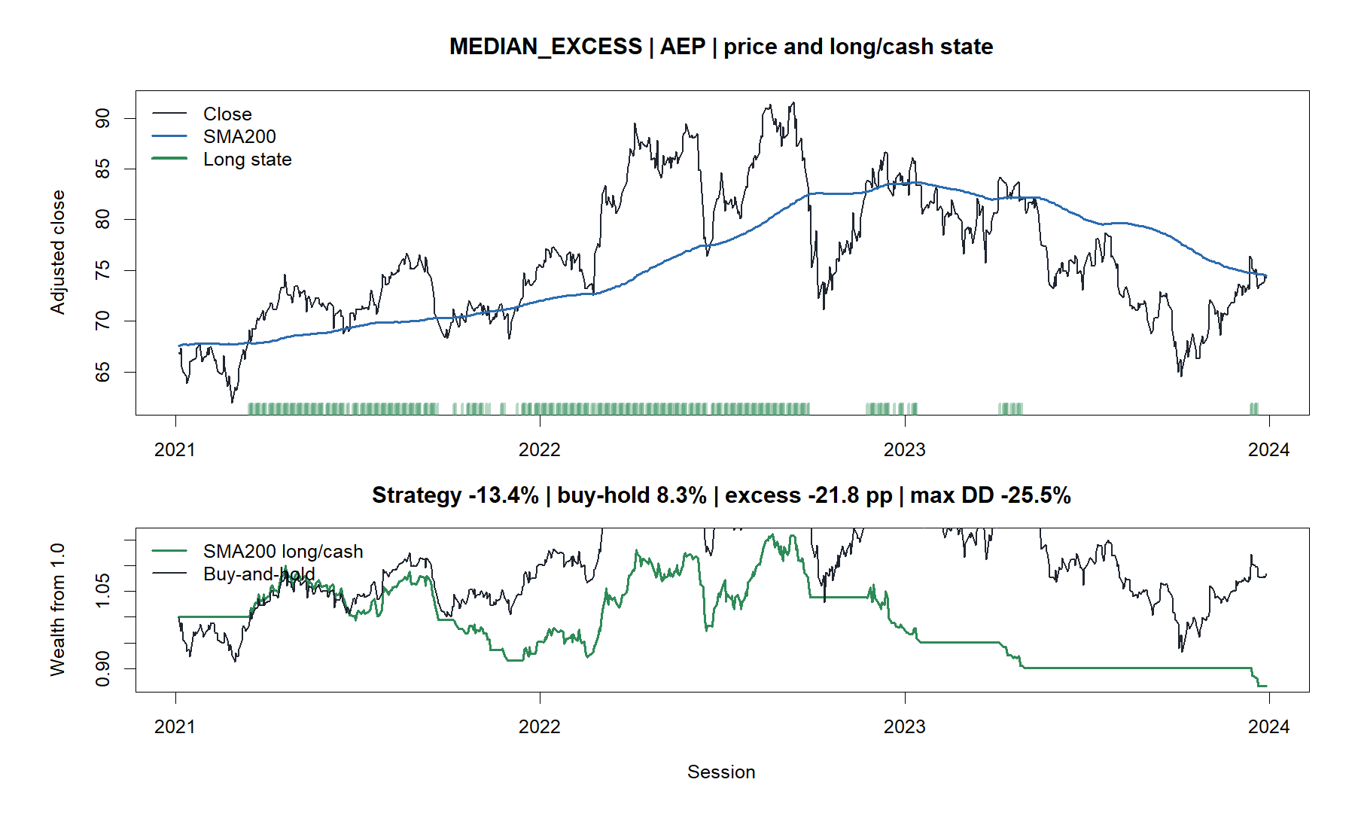
The median asset lost 13% while ownership gained 8%
12
Notes:
AEP is the corrected median-excess asset. The strategy lost 13.4% while ownership gained 8.3%, a 21.8-point relative shortfall despite modest drawdown improvement.
[Sources]
- C:\Users\Franc\OneDrive\Documents\Francis\Peltata Project\Time-Series-Modeling-Gen5\runs\research_workbench\operator_hypothesis_lab\hyp_mom_02_1_sma200_cross_wide_discovery_20260808\hyp_mom_02_1_tape_manifest.csv
- C:\Users\Franc\OneDrive\Documents\Francis\Peltata Project\Time-Series-Modeling-Gen5\runs\research_workbench\operator_hypothesis_lab\hyp_mom_02_1_sma200_cross_wide_discovery_20260808\visuals\sma200_tape_01_median_excess_cl.png

Slide 13
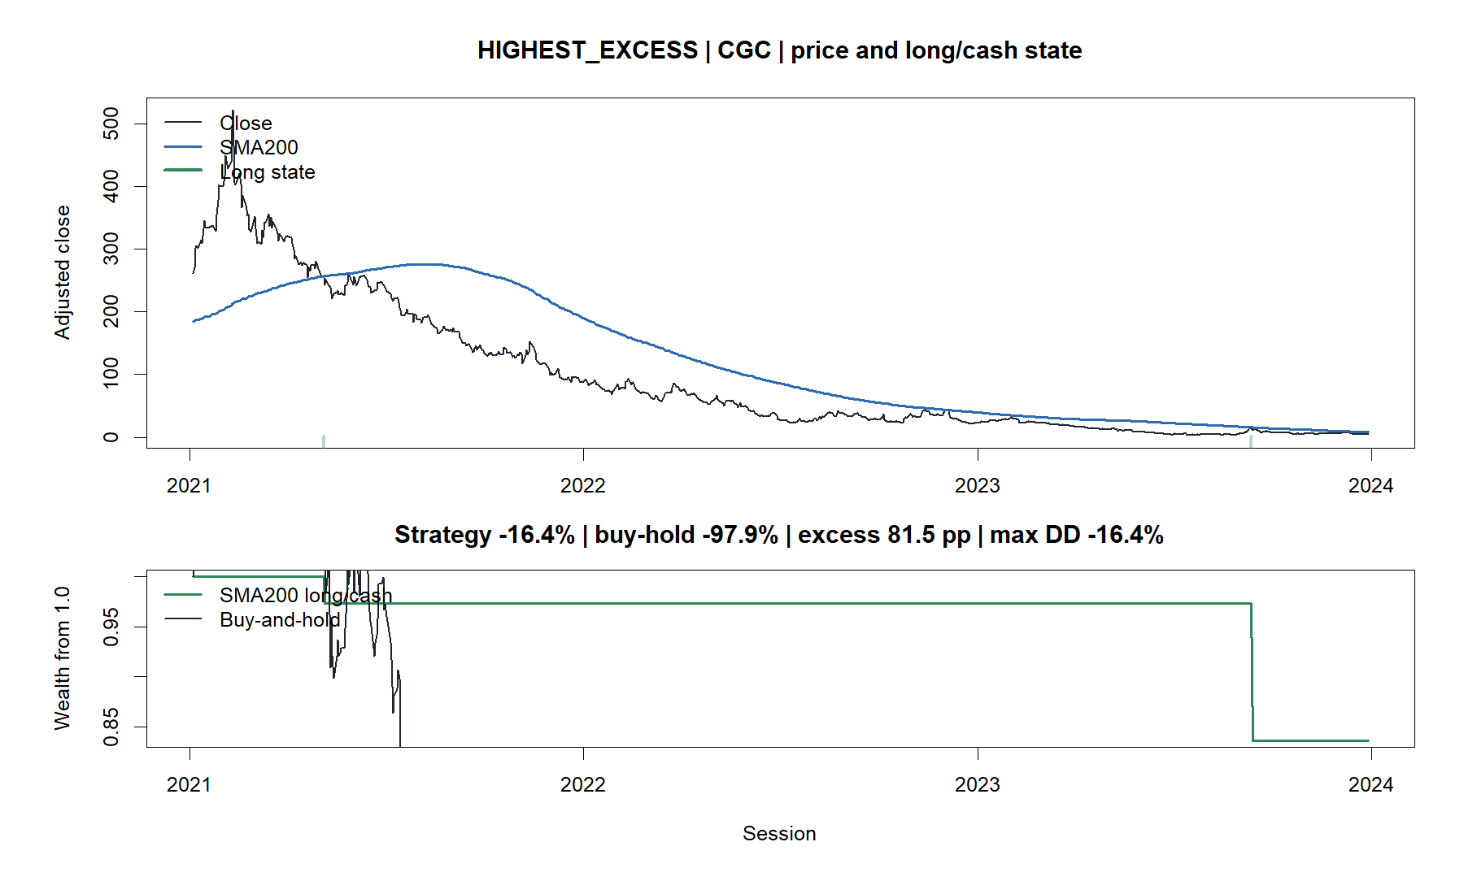
The best relative rescue still lost money
13
Notes:
CGC's corrected strategy loss was -16.4% versus -97.9% ownership. It is both the highest-excess and best-drawdown-improvement asset. That is dramatic protection, not a profitable strategy path.
[Sources]
- C:\Users\Franc\OneDrive\Documents\Francis\Peltata Project\Time-Series-Modeling-Gen5\runs\research_workbench\operator_hypothesis_lab\hyp_mom_02_1_sma200_cross_wide_discovery_20260808\hyp_mom_02_1_tape_manifest.csv
- C:\Users\Franc\OneDrive\Documents\Francis\Peltata Project\Time-Series-Modeling-Gen5\runs\research_workbench\operator_hypothesis_lab\hyp_mom_02_1_sma200_cross_wide_discovery_20260808\visuals\sma200_tape_02_highest_excess_cgc.png

Slide 14
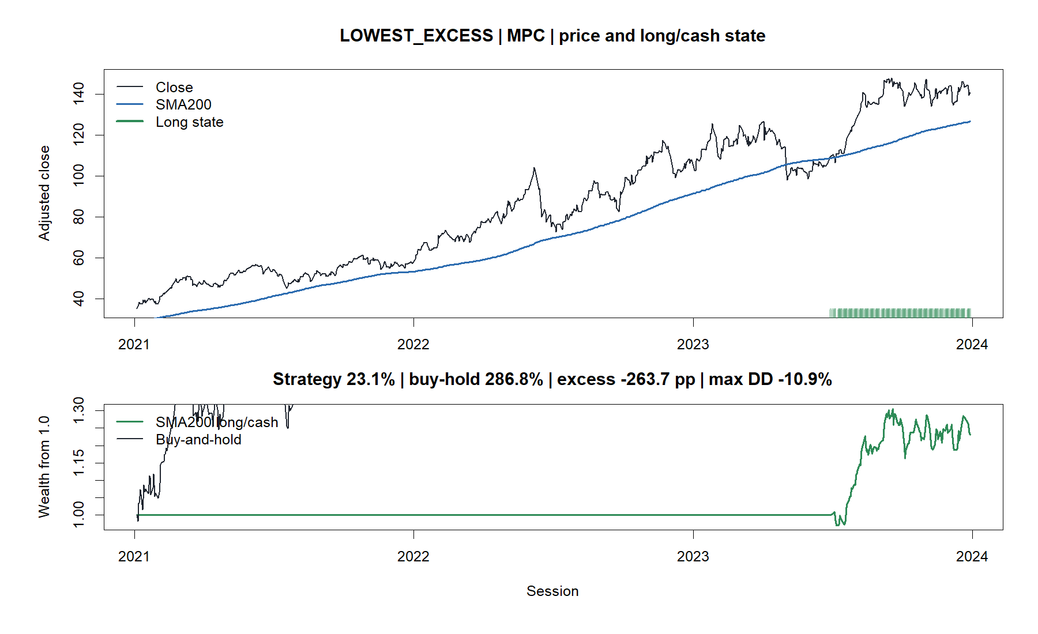
A profitable path can still miss almost the entire trend
14
Notes:
MPC gained 23.1% under the cross-only rule, but ownership gained 286.8%. Waiting for the first fresh cross left the strategy in cash through most of the exceptional trend.
[Sources]
- C:\Users\Franc\OneDrive\Documents\Francis\Peltata Project\Time-Series-Modeling-Gen5\runs\research_workbench\operator_hypothesis_lab\hyp_mom_02_1_sma200_cross_wide_discovery_20260808\hyp_mom_02_1_tape_manifest.csv
- C:\Users\Franc\OneDrive\Documents\Francis\Peltata Project\Time-Series-Modeling-Gen5\runs\research_workbench\operator_hypothesis_lab\hyp_mom_02_1_sma200_cross_wide_discovery_20260808\visuals\sma200_tape_03_lowest_excess_cprx.png

Slide 15
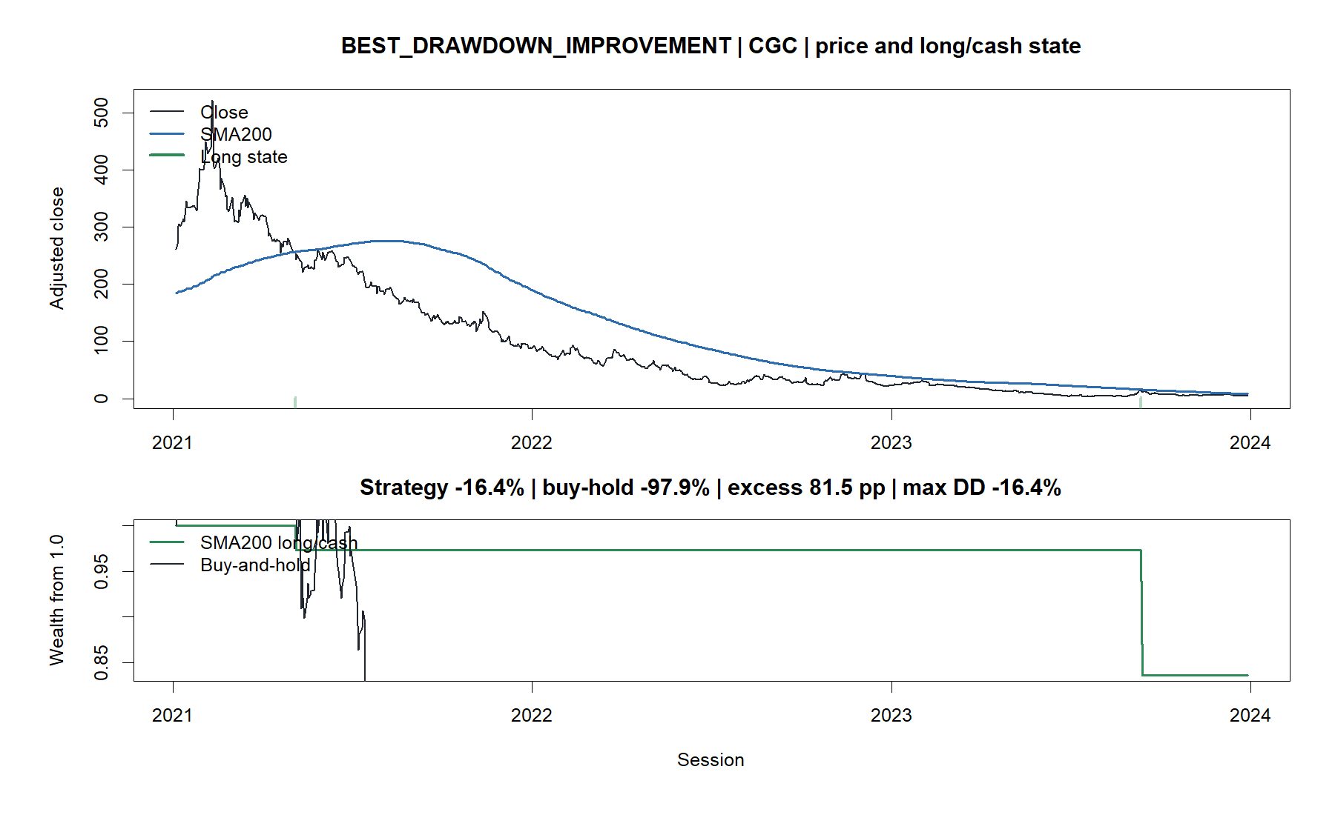
The strongest drawdown rescue is the same losing CGC path
15
Notes:
CGC legitimately repeats because it also has the greatest drawdown improvement. The duplicate is evidence about the frozen selection rules, not a second independent success case.
[Sources]
- C:\Users\Franc\OneDrive\Documents\Francis\Peltata Project\Time-Series-Modeling-Gen5\runs\research_workbench\operator_hypothesis_lab\hyp_mom_02_1_sma200_cross_wide_discovery_20260808\hyp_mom_02_1_tape_manifest.csv
- C:\Users\Franc\OneDrive\Documents\Francis\Peltata Project\Time-Series-Modeling-Gen5\runs\research_workbench\operator_hypothesis_lab\hyp_mom_02_1_sma200_cross_wide_discovery_20260808\visuals\sma200_tape_04_best_drawdown_improvement_meta.png

Slide 16
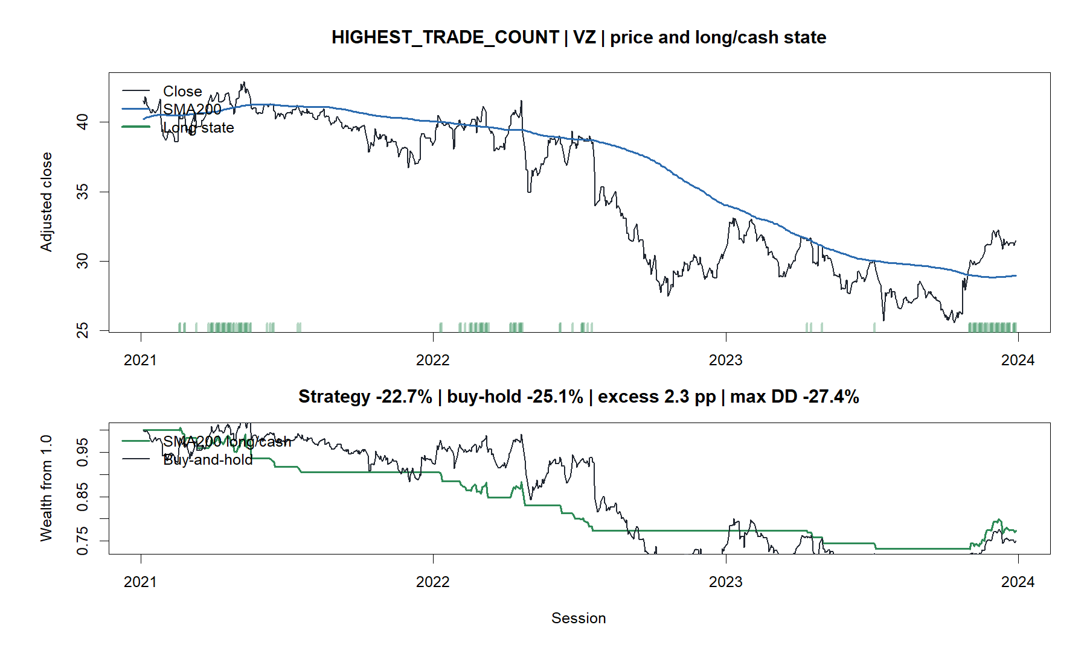
Frequent crossings can add activity without adding value
16
Notes:
VZ generated 26 round trips, the most in the panel. The strategy lost 22.7% versus -25.1% ownership and reduced drawdown, but frequent crossings still failed to produce a profitable path.
[Sources]
- C:\Users\Franc\OneDrive\Documents\Francis\Peltata Project\Time-Series-Modeling-Gen5\runs\research_workbench\operator_hypothesis_lab\hyp_mom_02_1_sma200_cross_wide_discovery_20260808\hyp_mom_02_1_tape_manifest.csv
- C:\Users\Franc\OneDrive\Documents\Francis\Peltata Project\Time-Series-Modeling-Gen5\runs\research_workbench\operator_hypothesis_lab\hyp_mom_02_1_sma200_cross_wide_discovery_20260808\visuals\sma200_tape_05_highest_trade_count_vz.png

Slide 17
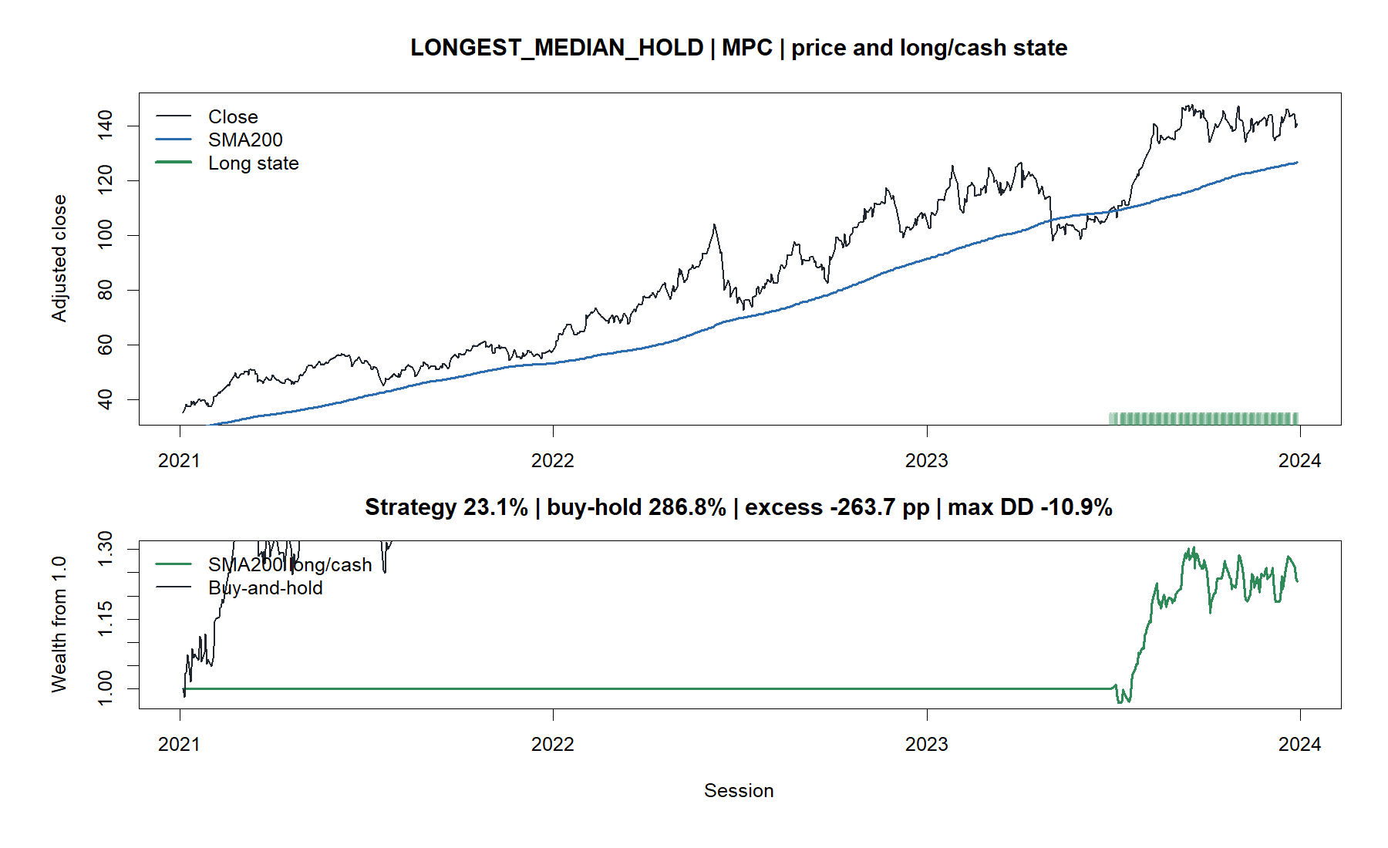
The longest median hold is also the worst relative miss
17
Notes:
MPC legitimately repeats because its two trades had the longest median holding duration. It is also the worst relative result, showing that a long hold is useful only when it captures enough of the trend.
[Sources]
- C:\Users\Franc\OneDrive\Documents\Francis\Peltata Project\Time-Series-Modeling-Gen5\runs\research_workbench\operator_hypothesis_lab\hyp_mom_02_1_sma200_cross_wide_discovery_20260808\hyp_mom_02_1_tape_manifest.csv
- C:\Users\Franc\OneDrive\Documents\Francis\Peltata Project\Time-Series-Modeling-Gen5\runs\research_workbench\operator_hypothesis_lab\hyp_mom_02_1_sma200_cross_wide_discovery_20260808\visuals\sma200_tape_06_longest_median_hold_jpm.png

Slide 18
Fresh SMA200 crosses reduced drawdown—but did not show a timing edge
WHAT THE WIDE STUDY SUPPORTS
WHAT IT DOES NOT SUPPORT
Drawdown improved in 88/119 assets
Cross-only paths spent 43% invested
Cash intervals softened some collapses
Generic outperformance versus ownership
Favorable alignment versus matched shifts
Sector, cohort, buffer, or SMA-length selection
Portfolio or live authority
Next research must declare whether its objective is growth, protection, or a frozen combination of both.
18
Notes:
Record WIDE_DISCOVERY_COMPLETE_NO_PROMOTION_AUTHORITY with CROSS_TRIGGERED_ONLY_NO_WARM_START as authoritative. Fresh crosses did not demonstrate generic timing value. Do not tune the average, add buffers, select favorable groups, or inspect 2024+ from this reused discovery result.
[Sources]
- C:\Users\Franc\OneDrive\Documents\Francis\Peltata Project\Time-Series-Modeling-Gen5\operator_hypothesis_lab\docs\HYP_MOM_02_1_SMA200_CROSS_WIDE_DISCOVERY_RESULTS.md
- C:\Users\Franc\OneDrive\Documents\Francis\Peltata Project\Time-Series-Modeling-Gen5\operator_hypothesis_lab\docs\HYP_MOM_02_1_SMA200_CROSS_WIDE_DISCOVERY_CONTRACT.md
- C:\Users\Franc\OneDrive\Documents\Francis\Peltata Project\Time-Series-Modeling-Gen5\runs\research_workbench\operator_hypothesis_lab\hyp_mom_02_1_sma200_cross_wide_discovery_20260808\hyp_mom_02_1_panel_summary.csv
- C:\Users\Franc\OneDrive\Documents\Francis\Peltata Project\Time-Series-Modeling-Gen5\runs\research_workbench\operator_hypothesis_lab\hyp_mom_02_1_sma200_cross_wide_discovery_20260808\hyp_mom_02_1_asset_summary.csv

