Slide 1
SESSION 11
N1L proves the live path;
live payload remains unobserved.
13/13 gates | 2 × 120 seconds | 0 live articles | outcomes and models: zero
S11/01
Notes:
SESSION 11 - NEWS LIVE FEASIBILITY N1L
Question
Can the Alpaca account receive locally timestamped real-time news, reconnect deliberately, and reconcile a REST overlap before any market outcome is inspected?
Result
All 13 hard transport and reconciliation gates passed. No live candidate article arrived during two 120-second connections, so the predeclared result is a partial pass rather than full prospective payload equivalence.
Contract: docs/GEN5_4_NEWS_LIVE_FEASIBILITY_N1L_CONTRACT.md
Report: C:/Users/Franc/OneDrive/Documents/Francis/Peltata Project/Time-Series-Modeling-Gen5/runs/research_workbench/gen54_ml_decision_engine/g54_news_n1l_20260721/n1l_report.md
Conversation: codex://threads/019f741e-615f-7fd0-90f7-edce12b5cb66
Find in chat: These are all wonderful suggestions. Let's proceed

Slide 2
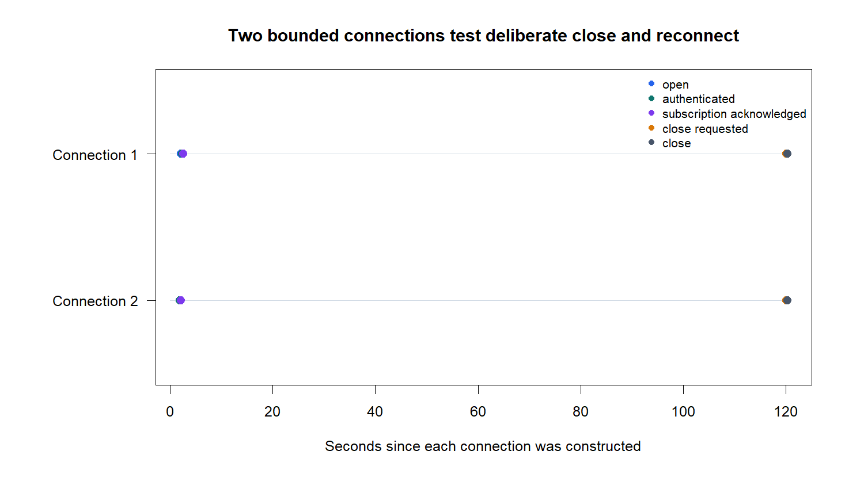
Authentication and reconnect work as designed
D33/02
Notes:
DECISION D33 - TRANSPORT GATES PASS
Evidence
Both connections opened, authenticated, and received Alpaca subscription acknowledgements for all 25 requested symbol keys. The first connection closed with code 1000 and the second connection then opened.
Receipt authority
Every received frame was stored with a local UTC receipt timestamp and connection ID before parsing. Six control frames parsed without error.
Boundary
Transport evidence is not predictive evidence and does not itself prove a live news article payload.
Lifecycle: C:/Users/Franc/OneDrive/Documents/Francis/Peltata Project/Time-Series-Modeling-Gen5/runs/research_workbench/gen54_ml_decision_engine/g54_news_n1l_20260721/n1l_connection_lifecycle.csv
Official stream: https://docs.alpaca.markets/us/docs/streaming-real-time-news

Slide 3
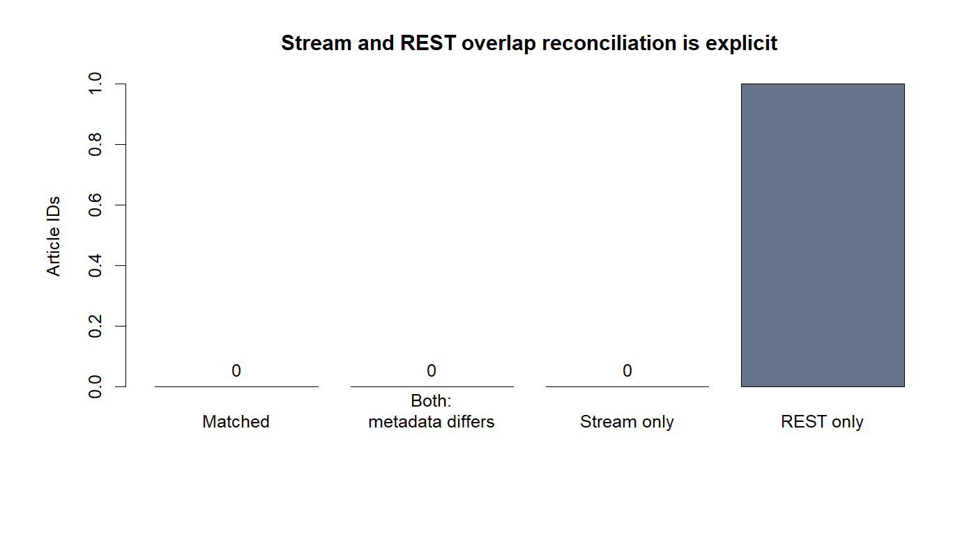
The corrected overlap confirms a quiet candidate window
D33/03
Notes:
DECISION D33 - NO LIVE ARTICLE OBSERVED
Evidence
The explicit REST window ran from 06:58:55.963Z through 07:18:01.044Z and exhausted one HTTP 200 page. Its one candidate article was updated at 07:13:09Z, before the first subscription acknowledgement.
Meaning
REST confirms that the archive path was active, but it cannot manufacture a stream match for an article that predated subscription. Zero live articles is therefore a quiet-window observation, not a transport failure.
Correction
An earlier interrupted run exposed local-time parsing in the REST start boundary. The authority packet uses the corrected UTC parser and exact 15-minute start.
Reconciliation: C:/Users/Franc/OneDrive/Documents/Francis/Peltata Project/Time-Series-Modeling-Gen5/runs/research_workbench/gen54_ml_decision_engine/g54_news_n1l_20260721/n1l_reconciliation.csv

Slide 4
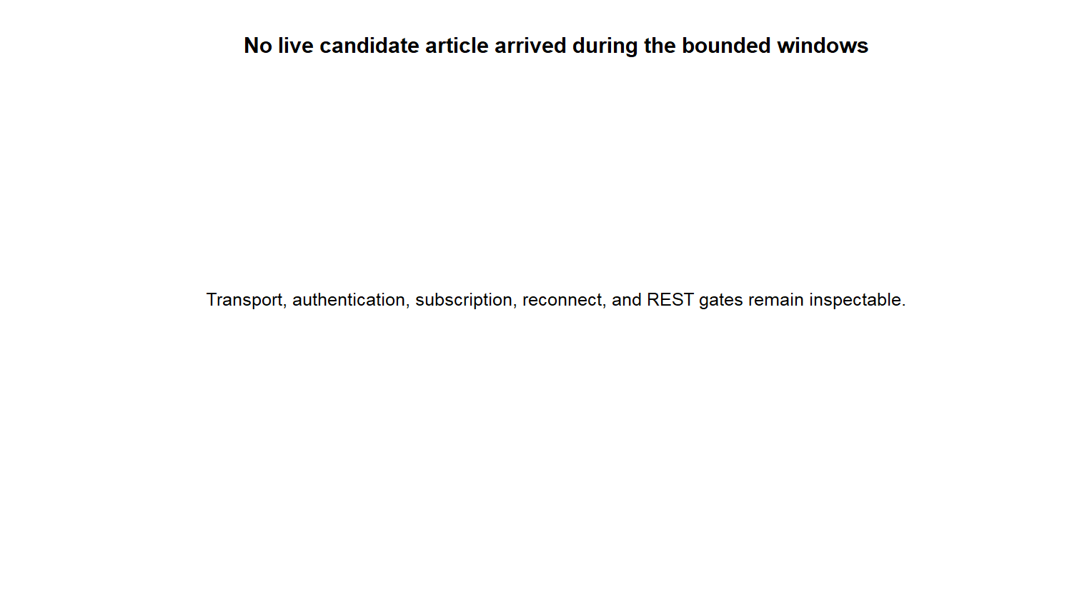
Transport passes; N1B outcome testing remains closed
OVERALL: PARTIAL PASS
PASS 13 / 13 hard gates
PASS 2 authenticated subscriptions
PASS deliberate reconnect + REST
WATCH 0 live candidate articles
WATCH 1 REST-only pre-subscription
STOP no news / outcome join
NEXT observe one live payload
D33/04
Notes:
DECISION D33 - PARTIAL_PASS_N1L_TRANSPORT_READY_NO_LIVE_ARTICLE
What passed
Connection, authentication, subscription, deliberate reconnect, local receipt metadata, frame parsing, REST HTTP/pagination, and same-version conflict gates.
What did not occur
No candidate article arrived after subscription during the combined four-minute observation. Full live payload equivalence remains unobserved.
Recommendation
Run a later bounded shadow observation during an active US news window. Do not open the frozen N1B outcome join by assumption. The operator may explicitly accept the limitation, but the recommended default is to observe one valid live candidate payload first.
Still zero
Sentiment, features, outcomes, OHLCV joins, correlations, models, allocation, and live advice.
Report: C:/Users/Franc/OneDrive/Documents/Francis/Peltata Project/Time-Series-Modeling-Gen5/runs/research_workbench/gen54_ml_decision_engine/g54_news_n1l_20260721/n1l_report.md
Conversation: codex://threads/019f741e-615f-7fd0-90f7-edce12b5cb66

