Slide 1
LONG ONLY | 49 L/H cells per asset | 2021-2023 retrospective
LIT-MOM-01.2
Long-only single-position momentum: SHY plus 22-stock and 100-name retrospective atlases
Notes:
This is the authoritative long-only LIT-MOM-01.2 evidence deck. The earlier long/short deck remains an archived pre-correction diagnostic in git history. The communication job is to separate the unchanged symmetric selector from the corrected long-or-cash execution policy, then show all three known-window readouts without promoting retrospective winners.
[Sources]
- C:/Users/Franc/OneDrive/Documents/Francis/Peltata Project/Time-Series-Modeling-Gen5/literature_studies/docs/GEN5_LIT_MOM_01_2_SINGLE_POSITION_RETROSPECTIVE_CONTRACT.md
- C:/Users/Franc/OneDrive/Documents/Francis/Peltata Project/Time-Series-Modeling-Gen5/literature_studies/docs/GEN5_LIT_MOM_01_2_SINGLE_POSITION_RETROSPECTIVE_RESULTS.md
- C:/Users/Franc/OneDrive/Documents/Francis/Peltata Project/Time-Series-Modeling-Gen5/literature_studies/docs/GEN5_LIT_MOM_01_2_STOCK_ATLAS_02_2020_BREADTH_ATTENTION_CONTRACT.md

Slide 2
01.2 now means long-only; the earlier short lane stays archived
The operator removed short exposure as a preference-driven scope correction. The statistical question, 49-cell selector, timing, exact-H hold, costs, and compounding remain fixed.
PRESERVE
REMOVE
AUDIT
Nomenclature + mechanics
Explicit operator correction
Short exposure
Negative and zero mean cash
Git history
70f1c20 remains recoverable
2
Notes:
A decimal change would normally be reasonable because exposure is substantive. The operator explicitly directed that 01.2 remain the name. We therefore preserve the earlier long/short result as PRE_CORRECTION_LONG_SHORT_DIAGNOSTIC and make the current long-only contract authoritative. This was prompted by exposure preference, not by selecting better outcomes.
[Sources]
- C:/Users/Franc/OneDrive/Documents/Francis/Peltata Project/Time-Series-Modeling-Gen5/literature_studies/docs/GEN5_LIT_MOM_01_2_SINGLE_POSITION_RETROSPECTIVE_CONTRACT.md
- C:/Users/Franc/OneDrive/Documents/Francis/Peltata Project/Time-Series-Modeling-Gen5/docs/GEN5_4_DECISION_DIALOGUE_INDEX.md
- git commit 70f1c20

Slide 3
The selector stays symmetric; the policy is long-only
Negative TRAIN observations still inform the return-correlation estimate. They simply cannot create a position. This keeps the source-style statistical question fixed while making exposure long-or-cash.
SELECTOR
CALLS
P&L
All-sign returns
Negative observations retained
Positive signals only
Long-call accuracy audited
Long or cash
Net return after round trips
3
Notes:
This distinction prevents a quiet extra degree of freedom. The selected L/H pair still maximizes the same symmetric TRAIN correlation t-statistic. A long-only-aware selector might be a legitimate future hypothesis, but it is not part of this correction. Report all-sign correlation, positive-call accuracy, and implementable long-only P&L separately.
[Sources]
- C:/Users/Franc/OneDrive/Documents/Francis/Peltata Project/Time-Series-Modeling-Gen5/literature_studies/R/gen5_lit_mom_01_2_single_position_poc.R
- C:/Users/Franc/OneDrive/Documents/Francis/Peltata Project/Time-Series-Modeling-Gen5/literature_studies/docs/GEN5_LIT_MOM_01_2_SINGLE_POSITION_RETROSPECTIVE_CONTRACT.md

Slide 4
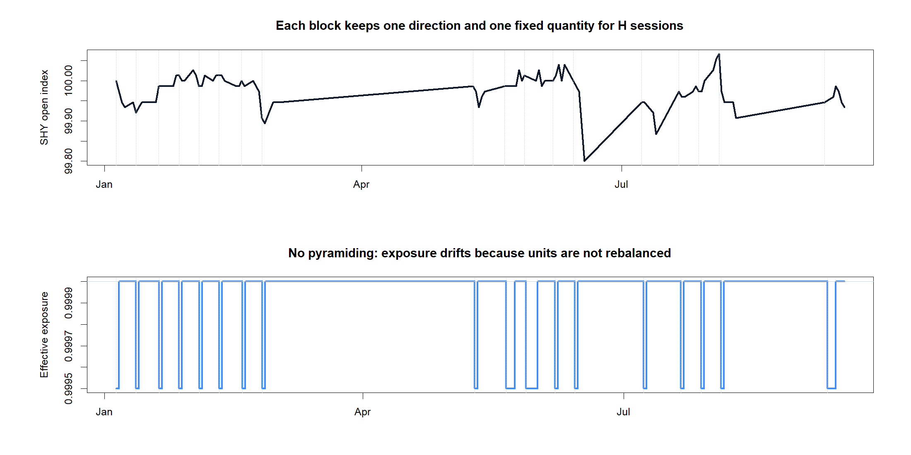
A positive signal owns the account for exactly H opens
r_L(t) = C_t / C_(t-L) - 1
If r_L(t) > 0 after close t:
enter long at the next open with current equity;
freeze quantity; hold exactly H open intervals; exit.
If r_L(t) <= 0: hold cash and keep scanning.
E_(k+1) = E_k + long P&L - costs
No short. No pyramiding. No intra-trade rebalance.
The next trade reinvests the account's current equity.
4
Notes:
A signal is generated from close data and enters only at the next adjusted open. During a trade the number of shares is fixed, so effective exposure drifts slightly. The policy can re-enter at the same open as an exit only when the preceding close has a positive signal. Profits and losses are fully reinvested in the next accepted trade.
[Sources]
- C:/Users/Franc/OneDrive/Documents/Francis/Peltata Project/Time-Series-Modeling-Gen5/literature_studies/docs/GEN5_LIT_MOM_01_2_SINGLE_POSITION_RETROSPECTIVE_CONTRACT.md
- C:/Users/Franc/OneDrive/Documents/Francis/Peltata Project/Time-Series-Modeling-Gen5/literature_studies/R/gen5_lit_mom_01_2_single_position_poc.R
- C:\Users\Franc\OneDrive\Documents\Francis\Peltata Project\Time-Series-Modeling-Gen5\runs\research_workbench\literature_grounded\lit_mom_01_2_long_only_single_position_retrospective_20260802/retrospective_trades.csv
- C:\Users\Franc\OneDrive\Documents\Francis\Peltata Project\Time-Series-Modeling-Gen5\runs\research_workbench\literature_grounded\lit_mom_01_2_long_only_single_position_retrospective_20260802/visuals/retrospective_trade_tape.png

Slide 5
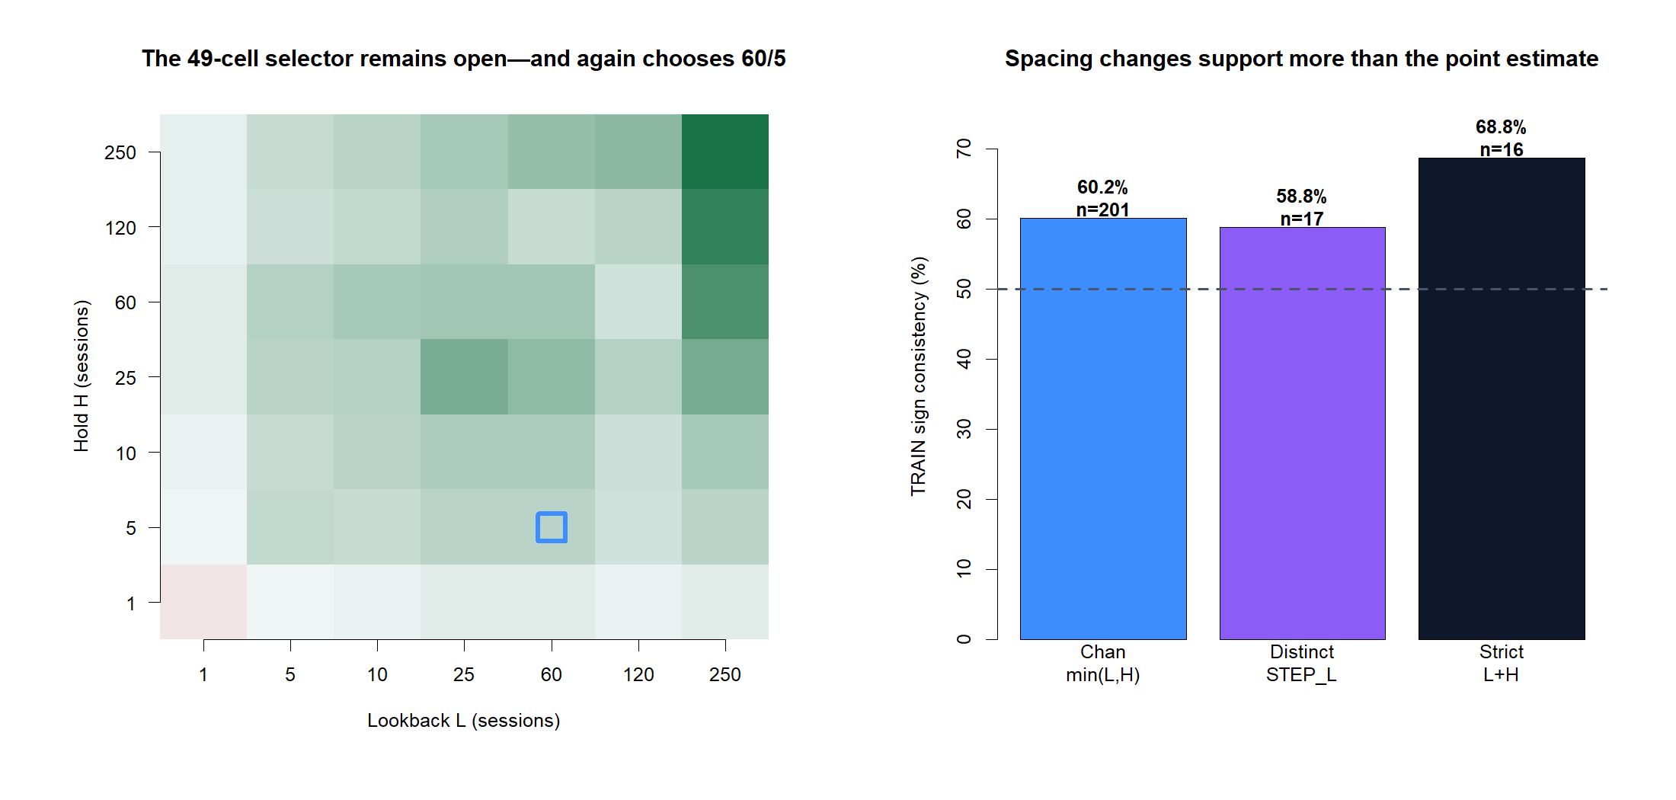
The open 49-cell TRAIN search still selects SHY 60/5
5
Notes:
The exposure correction does not change TRAIN selection. All 49 combinations remain open, H below five remains ineligible, and the symmetric CHAN_MIN_STEP screen again selects L=60 and H=5. STEP_L and L+H remain robustness views, not separate strategies.
[Sources]
- C:\Users\Franc\OneDrive\Documents\Francis\Peltata Project\Time-Series-Modeling-Gen5\runs\research_workbench\literature_grounded\lit_mom_01_2_long_only_single_position_retrospective_20260802/lit_mom_01_2_train_horizon_screen.csv
- C:\Users\Franc\OneDrive\Documents\Francis\Peltata Project\Time-Series-Modeling-Gen5\runs\research_workbench\literature_grounded\lit_mom_01_2_long_only_single_position_retrospective_20260802/lit_mom_01_2_selected_candidate.csv
- C:\Users\Franc\OneDrive\Documents\Francis\Peltata Project\Time-Series-Modeling-Gen5\runs\research_workbench\literature_grounded\lit_mom_01_2_long_only_single_position_retrospective_20260802/train_inference_summary.csv
- C:\Users\Franc\OneDrive\Documents\Francis\Peltata Project\Time-Series-Modeling-Gen5\runs\research_workbench\literature_grounded\lit_mom_01_2_long_only_single_position_retrospective_20260802/visuals/lit_mom_01_2_horizon_and_spacing.png

Slide 6
RETROSPECTIVE EXPLORATION | NOT FRESH OOS
Now ask what long-only execution actually did
Replay the selected 60/5 policy through 2021-2023 as one full-capital long block at a time. Preserve causality, costs, cash gaps, and compounding—but do not call the known window confirmation.
Notes:
The 2021-2023 window was already inspected under the parent exercise. This section can teach us about long-only mechanics and path behavior, but it cannot upgrade evidential status.
[Sources]
- C:\Users\Franc\OneDrive\Documents\Francis\Peltata Project\Time-Series-Modeling-Gen5\runs\research_workbench\literature_grounded\lit_mom_01_2_long_only_single_position_retrospective_20260802/lit_mom_01_2_run_spec.csv
- C:\Users\Franc\OneDrive\Documents\Francis\Peltata Project\Time-Series-Modeling-Gen5\runs\research_workbench\literature_grounded\lit_mom_01_2_long_only_single_position_retrospective_20260802/lit_mom_01_2_integrity_audit.csv
- C:\Users\Franc\OneDrive\Documents\Francis\Peltata Project\Time-Series-Modeling-Gen5\runs\research_workbench\literature_grounded\lit_mom_01_2_long_only_single_position_retrospective_20260802/lit_mom_01_2_report.md

Slide 7
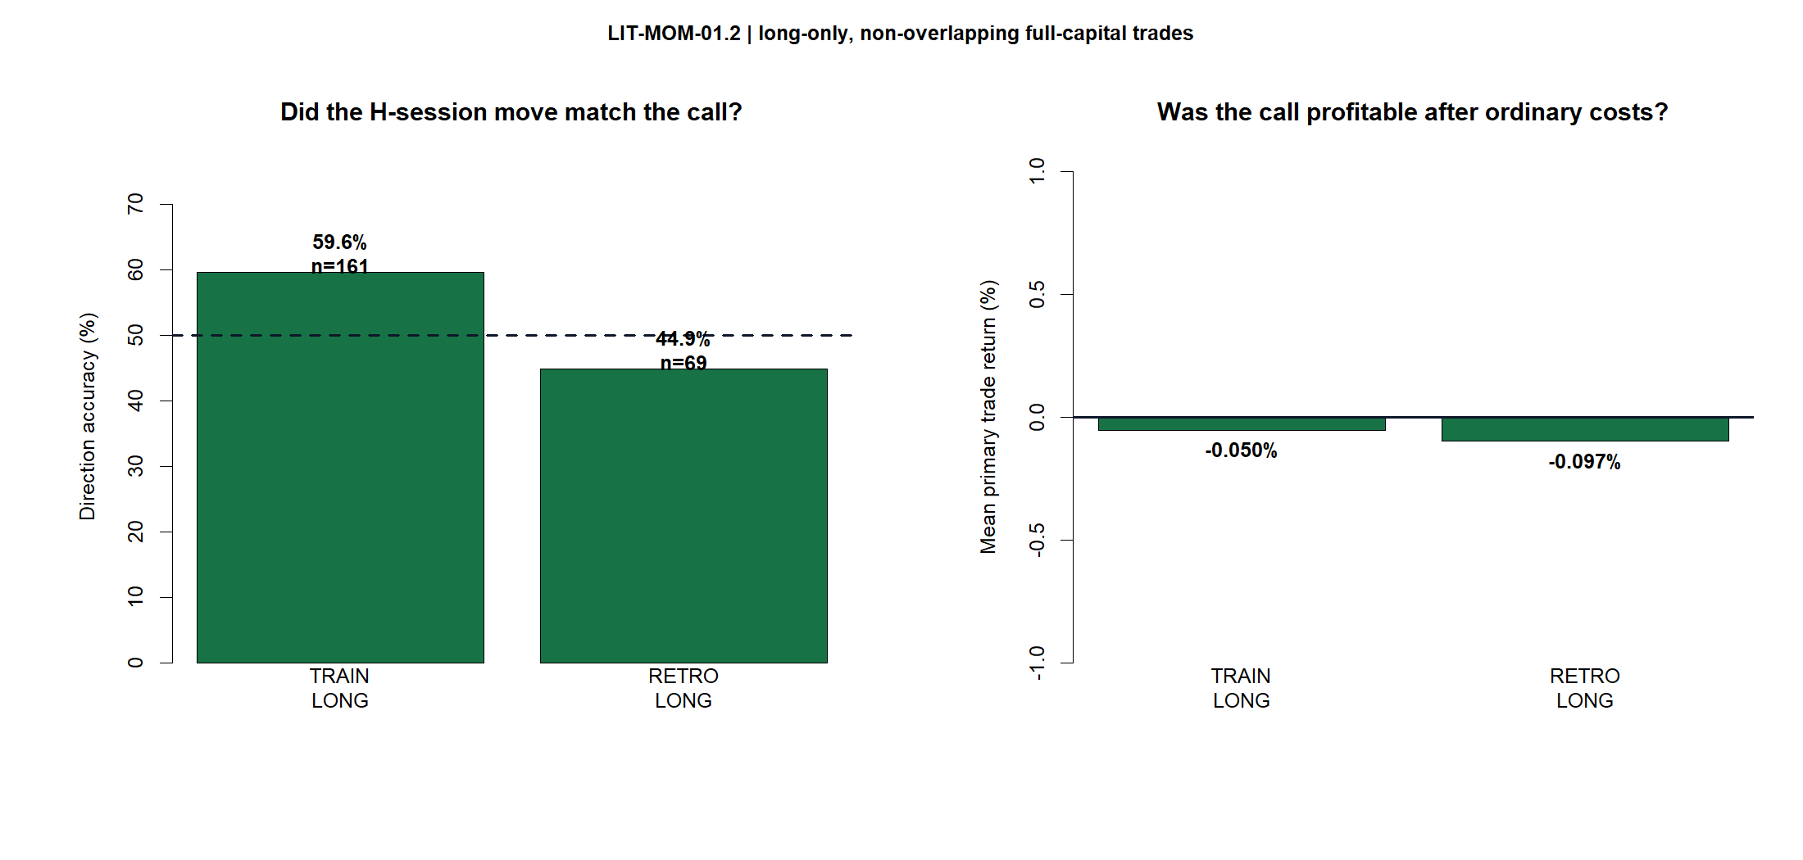
SHY stayed a clean tutorial—and remained cost-fragile
SHY completed 69 long blocks. Gross return was only +0.22%; literal 5 bp-per-side round trips turned that into -6.46%. Retrospective positive-call accuracy was 44.9%, and every integrity check passed.
-6.46%
-7.87%
PRIMARY RETURN
69 long blocks
MAX DRAWDOWN
Zero borrow cost
7
Notes:
The long-only correction roughly halves the number of blocks because negative signals become cash. SHY ends at -6.46% primary and -12.70% stress, with no short exposure or borrow cost. This is cleaner operationally but still a negative known-window result.
[Sources]
- C:\Users\Franc\OneDrive\Documents\Francis\Peltata Project\Time-Series-Modeling-Gen5\runs\research_workbench\literature_grounded\lit_mom_01_2_long_only_single_position_retrospective_20260802/retrospective_performance_metrics.csv
- C:\Users\Franc\OneDrive\Documents\Francis\Peltata Project\Time-Series-Modeling-Gen5\runs\research_workbench\literature_grounded\lit_mom_01_2_long_only_single_position_retrospective_20260802/retrospective_direction_audit.csv
- C:\Users\Franc\OneDrive\Documents\Francis\Peltata Project\Time-Series-Modeling-Gen5\runs\research_workbench\literature_grounded\lit_mom_01_2_long_only_single_position_retrospective_20260802/retrospective_trades.csv
- C:\Users\Franc\OneDrive\Documents\Francis\Peltata Project\Time-Series-Modeling-Gen5\runs\research_workbench\literature_grounded\lit_mom_01_2_long_only_single_position_retrospective_20260802/lit_mom_01_2_integrity_audit.csv

Slide 8
22 STOCKS | 11 SECTORS | 1,078 TRAIN CELLS
SHY is still the tutorial—not the research destination
Repeat the complete process across the frozen 22-stock sector-balanced panel: all 49 TRAIN cells per stock, one frozen horizon each, then one long-or-cash replay in the same known window.
Notes:
Atlas01 widens breadth without imposing SHY's 60/5 pair. Each asset independently receives the same full TRAIN search and freezes its own horizon before retrospective replay.
[Sources]
- C:/Users/Franc/OneDrive/Documents/Francis/Peltata Project/Time-Series-Modeling-Gen5/literature_studies/docs/GEN5_LIT_MOM_01_2_STOCK_ATLAS_01_RETROSPECTIVE_CONTRACT.md
- C:/Users/Franc/OneDrive/Documents/Francis/Peltata Project/Time-Series-Modeling-Gen5/literature_studies/registries/gen5_lit_mom_01_1_stock_atlas_01_registry.csv

Slide 9
Each Atlas01 asset gets its own full TRAIN search and long-only replay
The frozen panel was selected for sector breadth, liquidity, history, and economic diversity before 01.2 outcomes. Every asset advances its deterministic maximum TRAIN row—even when that row is weak.
UNIVERSE
TRAIN
REPLAY
22 stocks
Exactly two per sector
49 L/H cells each
1,078 total rows
Long or cash
Known 2021-2023 window
9
Notes:
Every selected row is replayed because the purpose is process description rather than gate admission. A per-asset 'winner' means only the deterministic maximum under the frozen rule; it is not a claim that the horizon is attractive.
[Sources]
- C:\Users\Franc\OneDrive\Documents\Francis\Peltata Project\Time-Series-Modeling-Gen5\runs\research_workbench\literature_grounded\lit_mom_01_2_long_only_stock_atlas_01_retrospective_20260802/stock_atlas_01_registry.csv
- C:\Users\Franc\OneDrive\Documents\Francis\Peltata Project\Time-Series-Modeling-Gen5\runs\research_workbench\literature_grounded\lit_mom_01_2_long_only_stock_atlas_01_retrospective_20260802/stock_atlas_01_train_horizon_screen.csv
- C:\Users\Franc\OneDrive\Documents\Francis\Peltata Project\Time-Series-Modeling-Gen5\runs\research_workbench\literature_grounded\lit_mom_01_2_long_only_stock_atlas_01_retrospective_20260802/stock_atlas_01_selected_horizons.csv

Slide 10
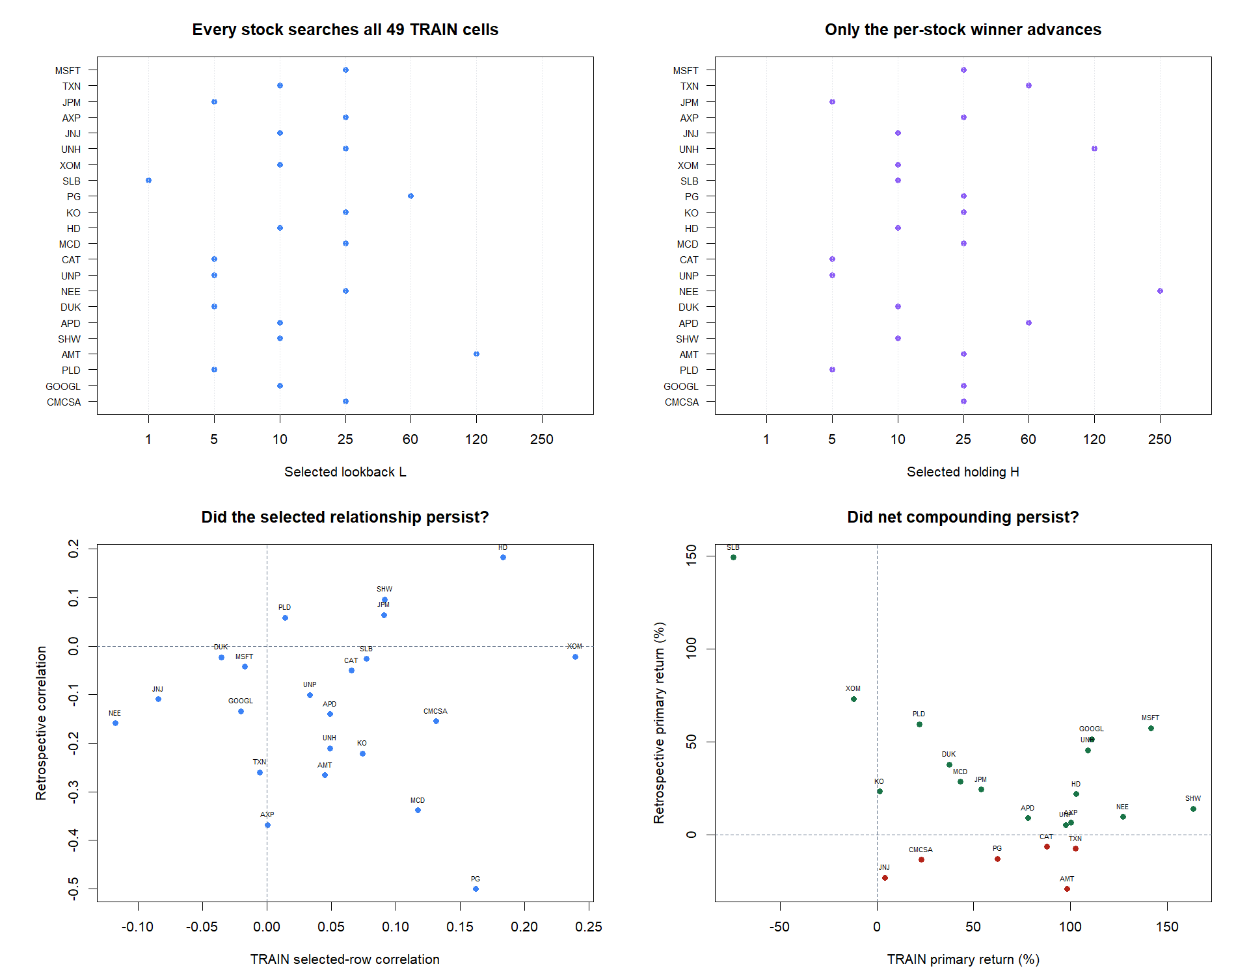
Horizons varied; selected correlations still weakened
10
Notes:
The selected L/H pairs remain heterogeneous because every asset searches independently. The exposure correction does not alter selected rows, so this slide continues to diagnose transfer of the same symmetric TRAIN relationship. The net-compounding panel is now long-only.
[Sources]
- C:\Users\Franc\OneDrive\Documents\Francis\Peltata Project\Time-Series-Modeling-Gen5\runs\research_workbench\literature_grounded\lit_mom_01_2_long_only_stock_atlas_01_retrospective_20260802/stock_atlas_01_selected_horizons.csv
- C:\Users\Franc\OneDrive\Documents\Francis\Peltata Project\Time-Series-Modeling-Gen5\runs\research_workbench\literature_grounded\lit_mom_01_2_long_only_stock_atlas_01_retrospective_20260802/stock_atlas_01_summary.csv
- C:\Users\Franc\OneDrive\Documents\Francis\Peltata Project\Time-Series-Modeling-Gen5\runs\research_workbench\literature_grounded\lit_mom_01_2_long_only_stock_atlas_01_retrospective_20260802/visuals/stock_atlas_01_selection_and_continuity.png

Slide 11
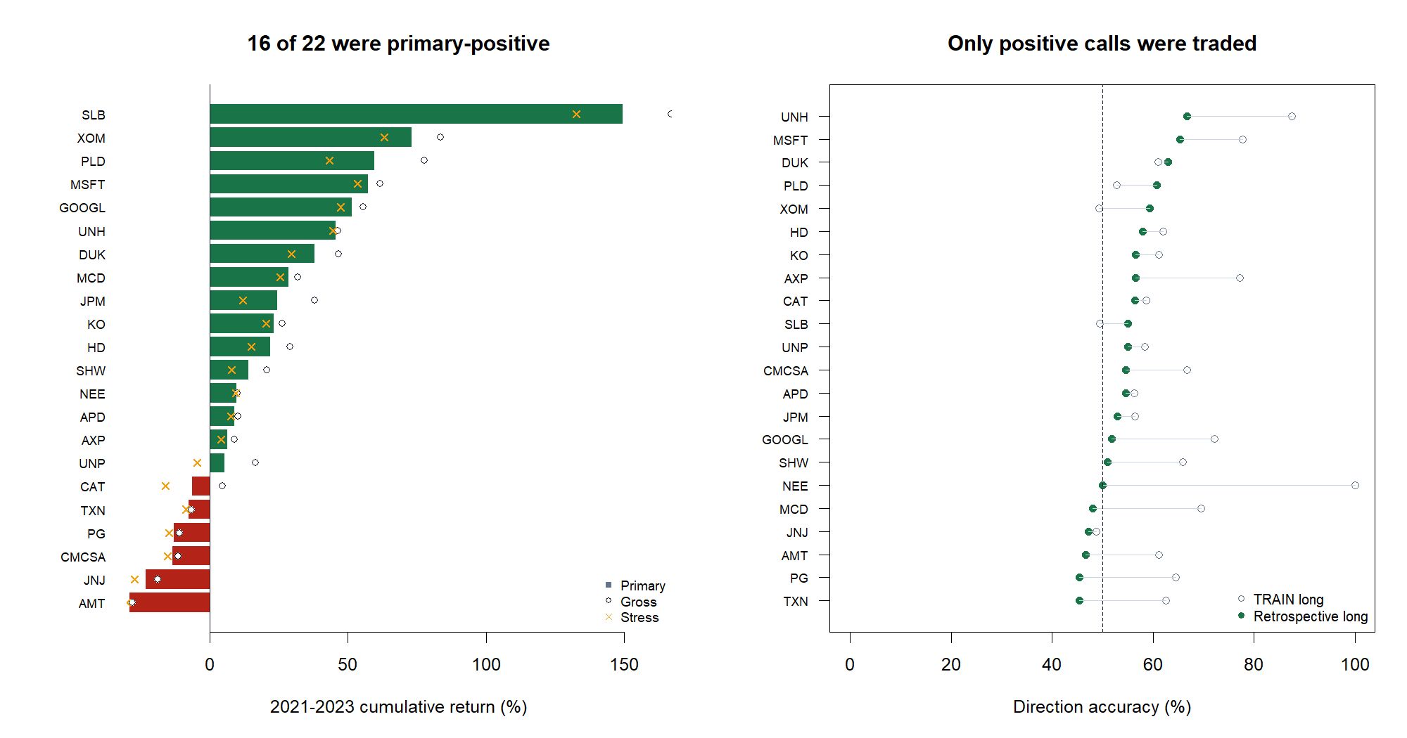
Long-only changed Atlas01: 16 of 22 finished primary-positive
11
Notes:
Atlas01's long-only known-window result is materially stronger than the archived long/short path: 16 of 22 positive after primary costs, median +17.96%, mean +23.82%. The worst maximum drawdown remains -49.73%, so endpoint breadth does not erase path risk. The right panel compares only executed long calls in TRAIN and retrospective data. Do not nominate the best bars.
[Sources]
- C:\Users\Franc\OneDrive\Documents\Francis\Peltata Project\Time-Series-Modeling-Gen5\runs\research_workbench\literature_grounded\lit_mom_01_2_long_only_stock_atlas_01_retrospective_20260802/stock_atlas_01_batch_summary.csv
- C:\Users\Franc\OneDrive\Documents\Francis\Peltata Project\Time-Series-Modeling-Gen5\runs\research_workbench\literature_grounded\lit_mom_01_2_long_only_stock_atlas_01_retrospective_20260802/stock_atlas_01_summary.csv
- C:\Users\Franc\OneDrive\Documents\Francis\Peltata Project\Time-Series-Modeling-Gen5\runs\research_workbench\literature_grounded\lit_mom_01_2_long_only_stock_atlas_01_retrospective_20260802/stock_atlas_01_retrospective_direction_audit.csv
- C:\Users\Franc\OneDrive\Documents\Francis\Peltata Project\Time-Series-Modeling-Gen5\runs\research_workbench\literature_grounded\lit_mom_01_2_long_only_stock_atlas_01_retrospective_20260802/visuals/stock_atlas_01_return_and_direction.png

Slide 12
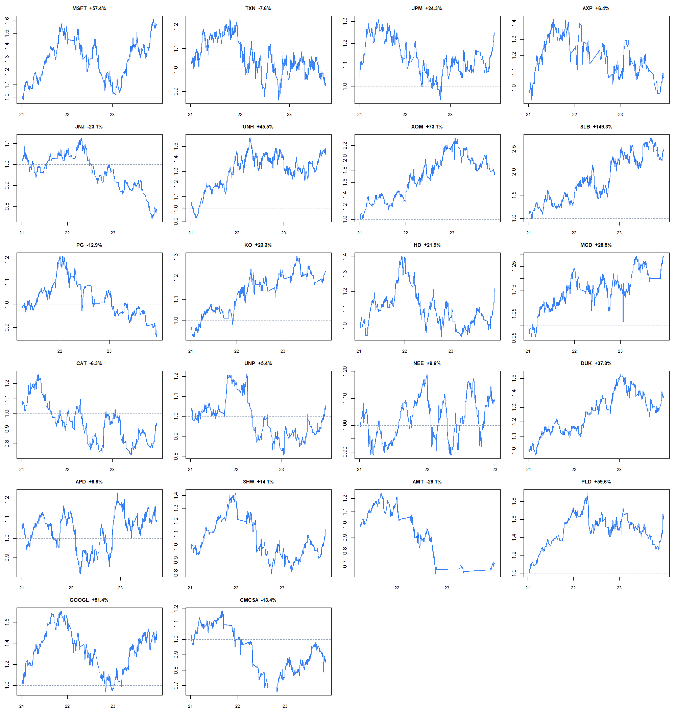
All 22 long-only paths remain visible—no winner is selected
12
Notes:
These are 22 independent one-dollar hypothetical paths, not a portfolio. Showing every path prevents positive endpoints from obscuring drawdowns and unstable trajectories. No stock is promoted from this already known window.
[Sources]
- C:\Users\Franc\OneDrive\Documents\Francis\Peltata Project\Time-Series-Modeling-Gen5\runs\research_workbench\literature_grounded\lit_mom_01_2_long_only_stock_atlas_01_retrospective_20260802/stock_atlas_01_retrospective_bar_replay.csv
- C:\Users\Franc\OneDrive\Documents\Francis\Peltata Project\Time-Series-Modeling-Gen5\runs\research_workbench\literature_grounded\lit_mom_01_2_long_only_stock_atlas_01_retrospective_20260802/stock_atlas_01_summary.csv
- C:\Users\Franc\OneDrive\Documents\Francis\Peltata Project\Time-Series-Modeling-Gen5\runs\research_workbench\literature_grounded\lit_mom_01_2_long_only_stock_atlas_01_retrospective_20260802/visuals/stock_atlas_01_primary_equity_paths.png

Slide 13
ATLAS02 | FROZEN 2020 BREADTH + ATTENTION
Now widen breadth without changing the policy
Add 100 point-in-time-justified names: 75 diversified core exposures and 25 stocks documented as receiving retail attention by TRAIN end. Keep the same windows, selector, long-only execution, and evidence label.
Notes:
Atlas02 adds breadth, not a new strategy variant. The registry was frozen from a June 2020 SEC SPY holding schedule and contemporaneous Robinhood/Robintrack coverage. Missing histories receive coverage STOPs and are not replaced.
[Sources]
- C:/Users/Franc/OneDrive/Documents/Francis/Peltata Project/Time-Series-Modeling-Gen5/literature_studies/docs/GEN5_LIT_MOM_01_2_STOCK_ATLAS_02_2020_BREADTH_ATTENTION_CONTRACT.md
- C:/Users/Franc/OneDrive/Documents/Francis/Peltata Project/Time-Series-Modeling-Gen5/literature_studies/registries/gen5_lit_mom_01_2_stock_atlas_02_2020_breadth_attention_registry.csv

Slide 14
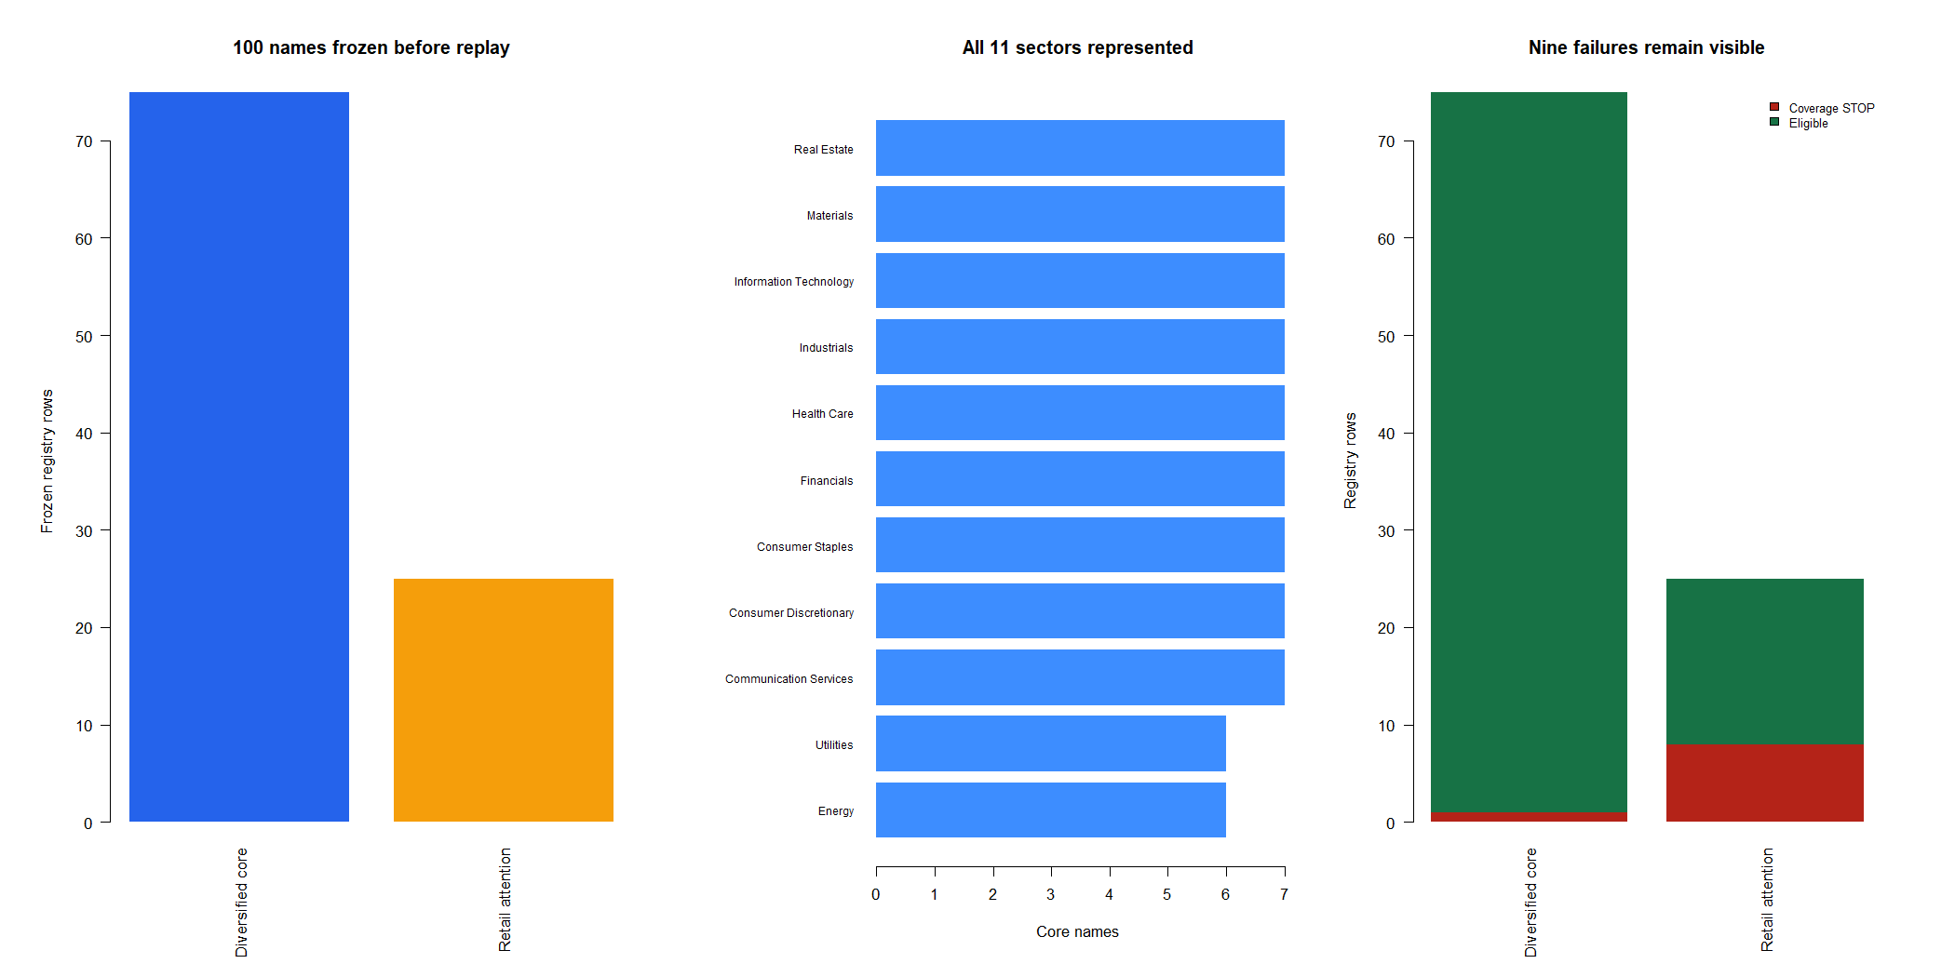
100 frozen names span 11 sectors and a 2020 attention cohort
14
Notes:
The frozen registry contains 75 diversified-core and 25 retail-attention names. Exact SPY-session coverage admits 74 core and 17 attention histories. Nine failures—LIN, ACB, SNAP, CGC, BYND, APHA, SNE, SPCE, and LI—remain visible and unreplaced.
[Sources]
- C:\Users\Franc\OneDrive\Documents\Francis\Peltata Project\Time-Series-Modeling-Gen5\runs\research_workbench\literature_grounded\lit_mom_01_2_long_only_stock_atlas_02_2020_breadth_attention_20260802/stock_atlas_02_registry.csv
- C:\Users\Franc\OneDrive\Documents\Francis\Peltata Project\Time-Series-Modeling-Gen5\runs\research_workbench\literature_grounded\lit_mom_01_2_long_only_stock_atlas_02_2020_breadth_attention_20260802/stock_atlas_02_registry_checks.csv
- C:\Users\Franc\OneDrive\Documents\Francis\Peltata Project\Time-Series-Modeling-Gen5\runs\research_workbench\literature_grounded\lit_mom_01_2_long_only_stock_atlas_02_2020_breadth_attention_20260802/stock_atlas_02_coverage.csv
- C:/Users/Franc/OneDrive/Documents/Francis/Peltata Project/Time-Series-Modeling-Gen5/literature_studies/docs/GEN5_LIT_MOM_01_2_STOCK_ATLAS_02_2020_BREADTH_ATTENTION_CONTRACT.md

Slide 15
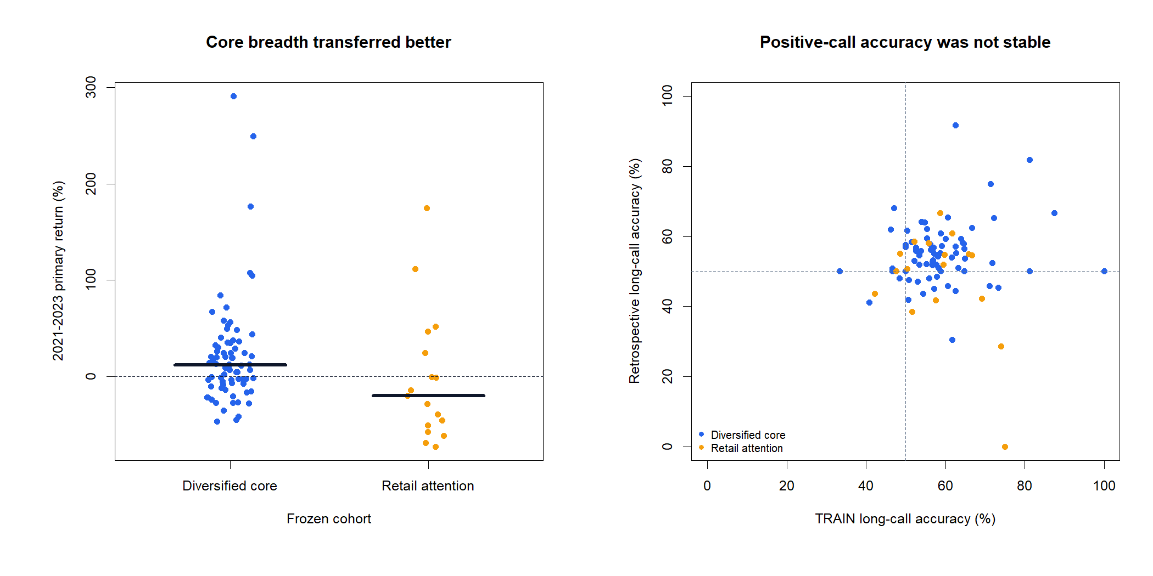
50 of 91 were positive—but the frozen cohorts diverged
The 74-name diversified core produced 45 primary-positive paths and a +11.69% median. Only 5 of 17 attention names were positive; their median was -19.95%. Accuracy also shifted from TRAIN to replay.
+11.69%
-19.95%
CORE MEDIAN
45 of 74 positive
ATTENTION MEDIAN
5 of 17 positive
15
Notes:
Across all 91 eligible histories, 50 are primary-positive, median return is +6.92%, mean +17.01%, and worst maximum drawdown is -86.30%. The cohort contrast is descriptive: the core is survivor-prone and the attention group has only 17 eligible histories. It is not a basis for allocation or a cohort-selection rule.
[Sources]
- C:\Users\Franc\OneDrive\Documents\Francis\Peltata Project\Time-Series-Modeling-Gen5\runs\research_workbench\literature_grounded\lit_mom_01_2_long_only_stock_atlas_02_2020_breadth_attention_20260802/stock_atlas_02_batch_summary.csv
- C:\Users\Franc\OneDrive\Documents\Francis\Peltata Project\Time-Series-Modeling-Gen5\runs\research_workbench\literature_grounded\lit_mom_01_2_long_only_stock_atlas_02_2020_breadth_attention_20260802/stock_atlas_02_cohort_summary.csv
- C:\Users\Franc\OneDrive\Documents\Francis\Peltata Project\Time-Series-Modeling-Gen5\runs\research_workbench\literature_grounded\lit_mom_01_2_long_only_stock_atlas_02_2020_breadth_attention_20260802/stock_atlas_02_summary.csv
- C:\Users\Franc\OneDrive\Documents\Francis\Peltata Project\Time-Series-Modeling-Gen5\runs\research_workbench\literature_grounded\lit_mom_01_2_long_only_stock_atlas_02_2020_breadth_attention_20260802/visuals/stock_atlas_02_cohort_return_and_accuracy_deck.png

Slide 16
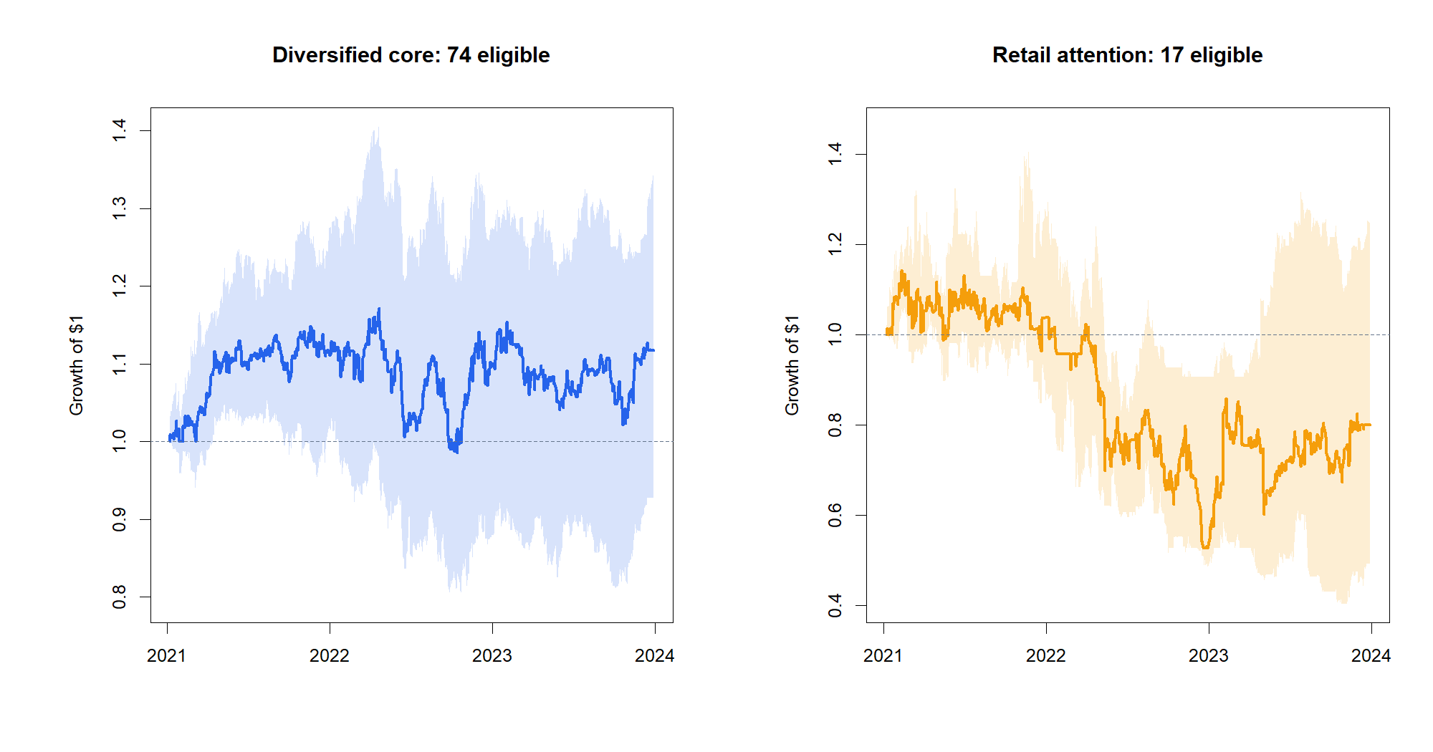
Median paths show a cohort split—not a tradable portfolio
16
Notes:
The line is the cross-sectional median hypothetical wealth and the shaded band is the interquartile range. It is not a funded portfolio and it does not assume cross-asset allocation. The core median ends above one while the attention median ends near 0.80; wide bands emphasize dispersion and path risk.
[Sources]
- C:\Users\Franc\OneDrive\Documents\Francis\Peltata Project\Time-Series-Modeling-Gen5\runs\research_workbench\literature_grounded\lit_mom_01_2_long_only_stock_atlas_02_2020_breadth_attention_20260802/stock_atlas_02_retrospective_bar_replay.csv
- C:\Users\Franc\OneDrive\Documents\Francis\Peltata Project\Time-Series-Modeling-Gen5\runs\research_workbench\literature_grounded\lit_mom_01_2_long_only_stock_atlas_02_2020_breadth_attention_20260802/stock_atlas_02_summary.csv
- C:\Users\Franc\OneDrive\Documents\Francis\Peltata Project\Time-Series-Modeling-Gen5\runs\research_workbench\literature_grounded\lit_mom_01_2_long_only_stock_atlas_02_2020_breadth_attention_20260802/visuals/stock_atlas_02_cohort_equity_envelopes_deck.png

Slide 17
5,586 TRAIN CELLS | 114 HISTORIES | ZERO SHORTS | EVERY INTEGRITY CHECK PASSED
Keep LIT-MOM-01.2 as long-only retrospective breadth evidence. Do not promote known-window winners.
The next valid gate is an untouched-window question—not more tuning inside 2021-2023.
Notes:
The scope correction is complete: current 01.2 is long-only, all official schedules contain only long trades, and borrow cost is zero. The SHY tutorial remains negative; Atlas01 and the core Atlas02 cohort are descriptively positive; attention names lag. Because all outcomes come from a repeatedly inspected window, none authorizes a portfolio, live advice, or a claim of confirmed alpha. Preserve 2024+ until a separate operator-approved confirmation design.
[Sources]
- C:/Users/Franc/OneDrive/Documents/Francis/Peltata Project/Time-Series-Modeling-Gen5/literature_studies/docs/GEN5_LIT_MOM_01_2_SINGLE_POSITION_RETROSPECTIVE_RESULTS.md
- C:\Users\Franc\OneDrive\Documents\Francis\Peltata Project\Time-Series-Modeling-Gen5\runs\research_workbench\literature_grounded\lit_mom_01_2_long_only_single_position_retrospective_20260802/lit_mom_01_2_integrity_audit.csv
- C:\Users\Franc\OneDrive\Documents\Francis\Peltata Project\Time-Series-Modeling-Gen5\runs\research_workbench\literature_grounded\lit_mom_01_2_long_only_stock_atlas_01_retrospective_20260802/stock_atlas_01_batch_summary.csv
- C:\Users\Franc\OneDrive\Documents\Francis\Peltata Project\Time-Series-Modeling-Gen5\runs\research_workbench\literature_grounded\lit_mom_01_2_long_only_stock_atlas_02_2020_breadth_attention_20260802/stock_atlas_02_batch_summary.csv
- C:/Users/Franc/OneDrive/Documents/Francis/Peltata Project/Time-Series-Modeling-Gen5/docs/GEN5_1_POC_PROGRESS_LOG.md

