Slide 1
SIDEWAYS LOSS REBOUND
A separate mean-reversion line after continuation stops
Can inefficient sideways movement add information beyond loss alone?
2018–2023 TRAIN • next-open • matched controls • post-2023 sealed
1
Notes:
This deck closes the continuation interpretation and opens a distinct rebound hypothesis. The question is deliberately incremental: after a negative 20-session return, does low path efficiency identify a better rebound environment than the negative return alone?
[Sources]
- operator_hypothesis_lab/docs/RETURN_GEOMETRY_SIDEWAYS_LOSS_REBOUND_2018_2023.md
- C:/Users/Franc/OneDrive/Documents/Francis/Peltata Project/Time-Series-Modeling-Gen5/runs/research_workbench/operator_hypothesis_lab/return_geometry_sideways_loss_rebound_baseline_20260829/run_spec.csv
[/Sources]

Slide 2
NEW REBOUND LINE
Same negative anchor, different market path
Persistent selloff and inefficient loss are sibling hypotheses—not the same rule
Continuation closed • rebound identity separated • post-2023 sealed
2
Notes:
The earlier rebound lead emphasized a persistent directional selloff. This new line asks about a negative return accumulated through an inefficient, back-and-forth path. Both begin with loss, but they encode different path geometry and require separate controls.
[Sources]
- operator_hypothesis_lab/docs/RETURN_GEOMETRY_DAILY_CONTINUATION_MICROSCOPE_2018_2023.md
- operator_hypothesis_lab/docs/RETURN_GEOMETRY_SIDEWAYS_LOSS_REBOUND_2018_2023.md
[/Sources]

Slide 3
FROZEN MATCH
The missing control is negative return alone
PRIMARY
Inefficient loss
R20 < 0 and ER20 < 0.30
NEGATIVE ONLY
Matched sign control
R20 < 0; no ER20 gate
TRENDING NEGATIVE
Opposite path state
R20 < 0 and ER20 ≥ 0.30
STATE CONTROL
SIDEWAYS_ALL uses ER20 < 0.30 regardless of sign. All rules: close t signal → open t+1 entry → 20 sessions → 10 bp.
129 instruments | 88-stock equal-sector core | 2018–2023 TRAIN
3
Notes:
The primary must beat ordinary drift and the negative-return-only control. Otherwise the result belongs to the negative prior return, not specifically to inefficient sideways movement. Trending-negative and sideways-all help separate path state from return sign.
[Sources]
- C:/Users/Franc/OneDrive/Documents/Francis/Peltata Project/Time-Series-Modeling-Gen5/runs/research_workbench/operator_hypothesis_lab/return_geometry_sideways_loss_rebound_baseline_20260829/run_spec.csv
- C:/Users/Franc/OneDrive/Documents/Francis/Peltata Project/Time-Series-Modeling-Gen5/runs/research_workbench/operator_hypothesis_lab/return_geometry_sideways_loss_rebound_baseline_20260829/construction_checks.csv
[/Sources]

Slide 4
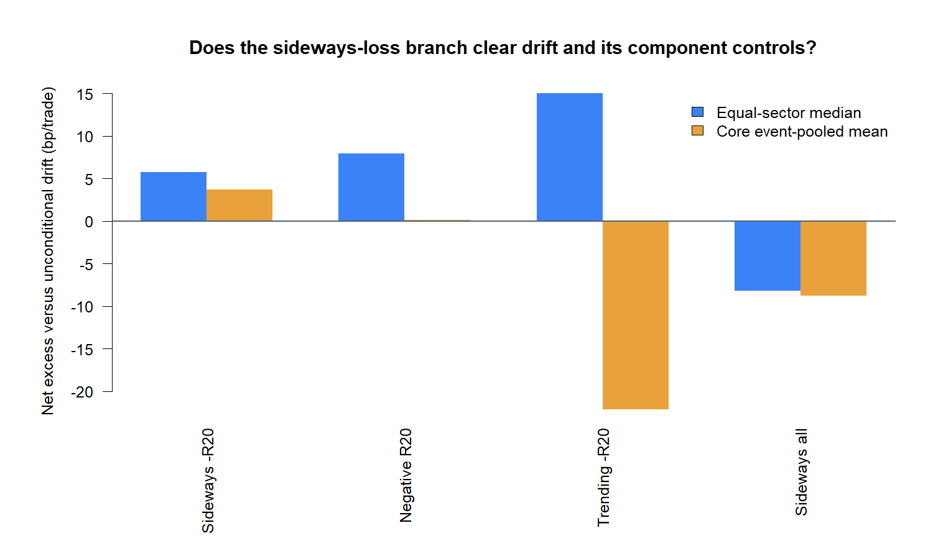
MATCHED CONTROLS
The primary clears drift—but so does negative-only
Excess versus same-asset 20d open-to-open drift | bp/trade
4
Notes:
SIDEWAYS_NEGATIVE is positive versus drift under both lenses: about +5.8 basis points equal-sector and +3.7 basis points event-pooled. NEGATIVE_ALL is also positive: about +7.9 and +0.1 basis points. The primary therefore has absolute context but has not yet established that the ER20 gate is the source of the result.
[Sources]
- C:/Users/Franc/OneDrive/Documents/Francis/Peltata Project/Time-Series-Modeling-Gen5/runs/research_workbench/operator_hypothesis_lab/return_geometry_sideways_loss_rebound_baseline_20260829/equal_sector_rule_summary.csv
- C:/Users/Franc/OneDrive/Documents/Francis/Peltata Project/Time-Series-Modeling-Gen5/runs/research_workbench/operator_hypothesis_lab/return_geometry_sideways_loss_rebound_baseline_20260829/core_event_pooled_rule_summary.csv
- C:/Users/Franc/OneDrive/Documents/Francis/Peltata Project/Time-Series-Modeling-Gen5/runs/research_workbench/operator_hypothesis_lab/return_geometry_sideways_loss_rebound_baseline_20260829/visuals/matched_control_excess_both_lenses.png
[/Sources]

Slide 5
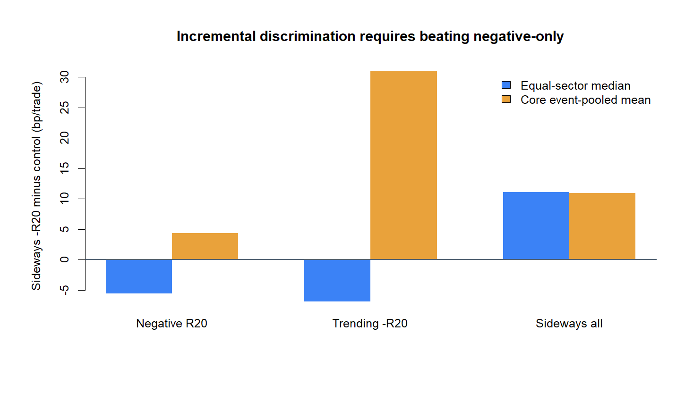
INCREMENTAL TEST
The sideways gate fails the incremental test
SIDEWAYS_NEGATIVE minus matched control | bp/trade
5
Notes:
Against NEGATIVE_ALL, the primary is about 5.6 basis points worse under equal-sector aggregation and 4.3 basis points better event-pooled. That sign disagreement is the decisive weakness. The primary beats SIDEWAYS_ALL, confirming that negative prior return matters, but it does not robustly show that inefficient sideways movement adds value beyond that loss.
[Sources]
- C:/Users/Franc/OneDrive/Documents/Francis/Peltata Project/Time-Series-Modeling-Gen5/runs/research_workbench/operator_hypothesis_lab/return_geometry_sideways_loss_rebound_baseline_20260829/pairwise_readout.csv
- C:/Users/Franc/OneDrive/Documents/Francis/Peltata Project/Time-Series-Modeling-Gen5/runs/research_workbench/operator_hypothesis_lab/return_geometry_sideways_loss_rebound_baseline_20260829/visuals/primary_lift_vs_controls.png
[/Sources]

Slide 6
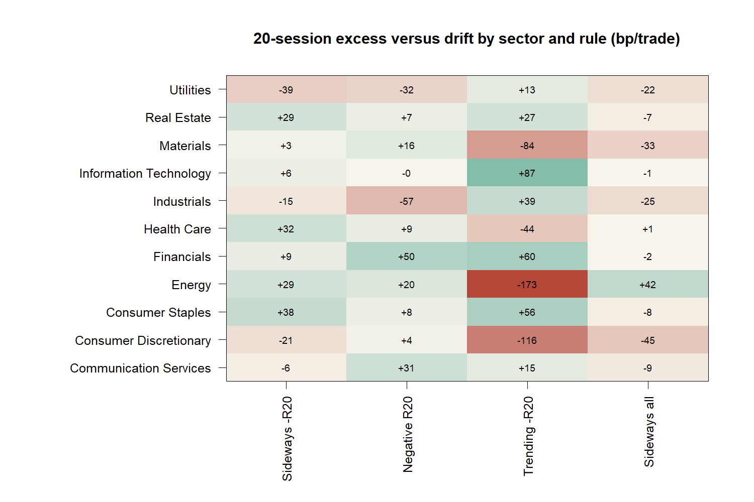
SECTOR BREADTH
Sector breadth is real but not uniquely sideways
Sector median excess versus same-asset drift | bp/trade
6
Notes:
The primary is above drift in seven of eleven sector medians, but NEGATIVE_ALL is above drift in eight. Trending-negative also clears drift in seven sectors. Breadth therefore supports a broad negative-return rebound behavior, not a uniquely inefficient-sideways mechanism.
[Sources]
- C:/Users/Franc/OneDrive/Documents/Francis/Peltata Project/Time-Series-Modeling-Gen5/runs/research_workbench/operator_hypothesis_lab/return_geometry_sideways_loss_rebound_baseline_20260829/core_sector_rule_summary.csv
- C:/Users/Franc/OneDrive/Documents/Francis/Peltata Project/Time-Series-Modeling-Gen5/runs/research_workbench/operator_hypothesis_lab/return_geometry_sideways_loss_rebound_baseline_20260829/visuals/sector_matched_control_heatmap.png
[/Sources]

Slide 7
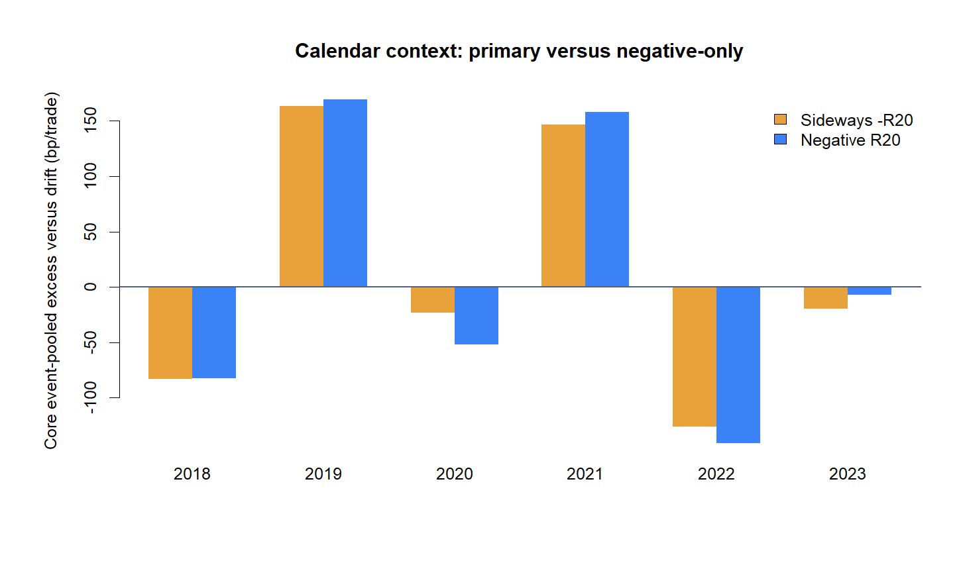
CALENDAR STABILITY
Only two of six TRAIN years clear drift
Equal-sector excess versus drift by signal year | bp/trade
7
Notes:
The primary clears drift only in 2019 and 2021. It is below drift in 2018, 2020, 2022, and 2023. This weak calendar stability is an independent reason to stop before rule refinement or sealed-data testing.
[Sources]
- C:/Users/Franc/OneDrive/Documents/Francis/Peltata Project/Time-Series-Modeling-Gen5/runs/research_workbench/operator_hypothesis_lab/return_geometry_sideways_loss_rebound_baseline_20260829/calendar_rule_summary.csv
- C:/Users/Franc/OneDrive/Documents/Francis/Peltata Project/Time-Series-Modeling-Gen5/runs/research_workbench/operator_hypothesis_lab/return_geometry_sideways_loss_rebound_baseline_20260829/visuals/calendar_primary_vs_negative_only.png
[/Sources]

Slide 8
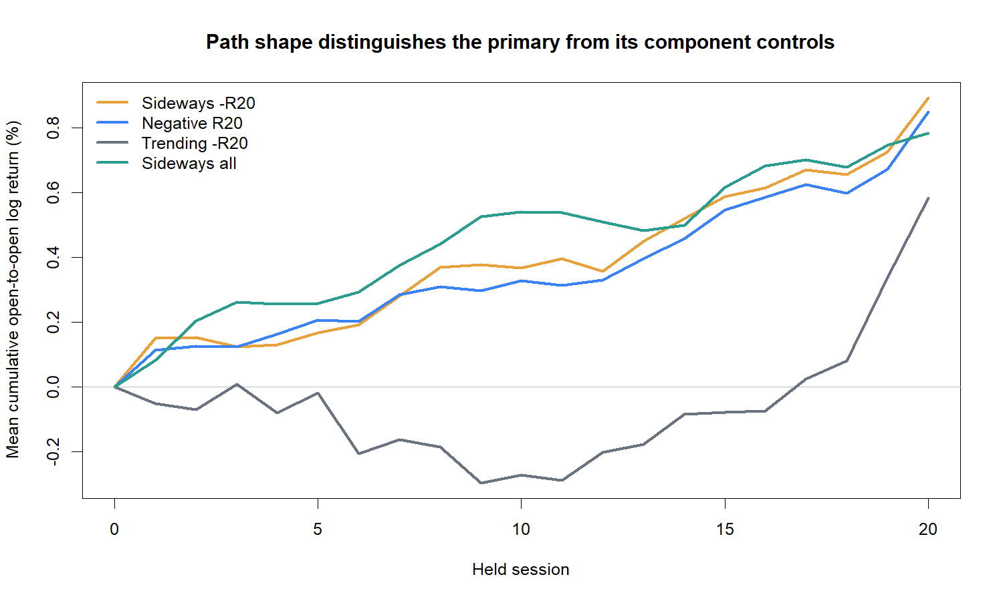
PATH TIMING
The state difference is mostly path timing
Core event-pooled mean executable path | 20-session hold
8
Notes:
The primary and negative-only paths are close for much of the hold. Trending-negative suffers more initially and then recovers later. The visual suggests different recovery timing, but not a clean, persistent advantage attributable to the sideways gate.
[Sources]
- C:/Users/Franc/OneDrive/Documents/Francis/Peltata Project/Time-Series-Modeling-Gen5/runs/research_workbench/operator_hypothesis_lab/return_geometry_sideways_loss_rebound_baseline_20260829/trade_path_summary.csv
- C:/Users/Franc/OneDrive/Documents/Francis/Peltata Project/Time-Series-Modeling-Gen5/runs/research_workbench/operator_hypothesis_lab/return_geometry_sideways_loss_rebound_baseline_20260829/visuals/matched_control_trade_paths.png
[/Sources]

Slide 9
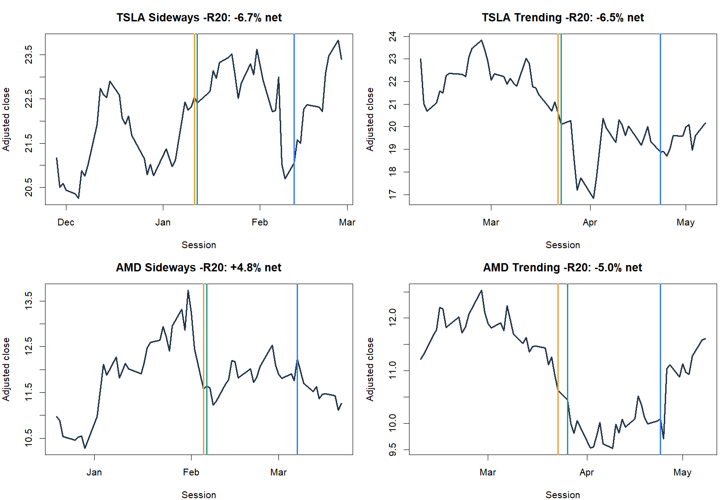
TRADE TAPES
Representative trades keep the aggregates grounded
First eligible events | deterministic, not outcome-selected
9
Notes:
These first eligible examples are deterministic rather than selected for favorable outcomes. They show the actual next-open timing and the mixture of recoveries and failures that sits beneath a small aggregate excess-return estimate.
[Sources]
- C:/Users/Franc/OneDrive/Documents/Francis/Peltata Project/Time-Series-Modeling-Gen5/runs/research_workbench/operator_hypothesis_lab/return_geometry_sideways_loss_rebound_baseline_20260829/trade_ledger.csv
- C:/Users/Franc/OneDrive/Documents/Francis/Peltata Project/Time-Series-Modeling-Gen5/runs/research_workbench/operator_hypothesis_lab/return_geometry_sideways_loss_rebound_baseline_20260829/visuals/representative_rebound_trade_tapes.png
[/Sources]

Slide 10
MATCHED-CONTROL READOUT
A distinct idea opens—and stops at its first control
BASELINE
Primary clears ordinary drift
+5.8 / +3.7 bp by weighting lens
INCREMENT
ER20 gate is not robustly additive
−5.6 / +4.3 bp vs negative-only
STABILITY
Broad sectors, weak calendar
7/11 sectors; only 2/6 years
STATUS
STOP before rule selection or OOS. Negative prior return drives more of the result than inefficient sideways movement; do not rescue by tuning ER, horizon, severity, sector, or year.
2018–2023 TRAIN | next-open | 129 instruments | post-2023 sealed
10
Notes:
This is a successful falsification slice. The new hypothesis received its own identity and the correct matched control. The primary clears unconditional drift, but its advantage over negative-return-only changes sign across weighting lenses and appears in only two of six TRAIN years. Keep the behavioral lead documented; do not promote or tune it.
[Sources]
- C:/Users/Franc/OneDrive/Documents/Francis/Peltata Project/Time-Series-Modeling-Gen5/runs/research_workbench/operator_hypothesis_lab/return_geometry_sideways_loss_rebound_baseline_20260829/report.md
- C:/Users/Franc/OneDrive/Documents/Francis/Peltata Project/Time-Series-Modeling-Gen5/runs/research_workbench/operator_hypothesis_lab/return_geometry_sideways_loss_rebound_baseline_20260829/pairwise_readout.csv
- C:/Users/Franc/OneDrive/Documents/Francis/Peltata Project/Time-Series-Modeling-Gen5/runs/research_workbench/operator_hypothesis_lab/return_geometry_sideways_loss_rebound_baseline_20260829/calendar_rule_summary.csv
- operator_hypothesis_lab/docs/RETURN_GEOMETRY_SIDEWAYS_LOSS_REBOUND_2018_2023.md
[/Sources]

