Slide 1
SESSION 15
Recency resolves count ties;
it does not improve uncertainty ordering.
5/6 positive recency | mean lift -0.0018 | retain equal count
S15/01
Notes:
SESSION 15 - NEWS RECENCY REPRESENTATION N1D
Purpose
Test exactly one fixed 24-hour exponential-recency representation against the accepted equal-count news measure on untouched 2025Q1-2026Q2 data.
Result
Integrity passed 15/15. Recency remained positive in 5/6 quarters, but mean conditional ordering fell from 0.038762 to 0.036938. Mean lift was -0.001824 and positive in only 3/6 quarters.
Decision
Retain equal count and close representation expansion.
Conversation: codex://threads/019f741e-615f-7fd0-90f7-edce12b5cb66
Find in chat: Please try again
Decision: D39
[Sources]
- runs/research_workbench/gen54_ml_decision_engine/g54_news_n1d_20260725/n1d_report.md
- docs/GEN5_4_NEWS_RECENCY_N1D_CONTRACT.md
[/Sources]

Slide 2
N1D changed one representation and froze the confirmation clock
CHALLENGER
CONFIRMATION
COMPLEXITY GATES
24-hour exponential decay
same admissible novel clusters
2025Q1 through 2026Q2
issuer-local TRAIN ECDF
positive + improvement
mean lift >= 0.01 and 4 / 6
Alternate decay, sentiment, source weights, embeddings, models, exposure, allocation, and PnL: zero.
D38/02
Notes:
DECISION D38 - FROZEN N1D CONTRACT
Challenger
Each accepted novel cluster receives weight 2^(-age_hours/24) at the scheduled 17:30 America/New_York cutoff. The cycle weights are summed and mapped through an issuer-local eight-quarter TRAIN ECDF.
Unchanged authority
Article admissibility, stale-update and novelty rules, issuer identity, future h5 path-volatility outcome, prior-h5 path-volatility control, current/prior-60 dollar-volume control, and next-open alignment remain frozen.
Confirmation
Only 2025Q1 through 2026Q2 are evaluated. Success requires all integrity checks, positive mean recency ordering, positive recency ordering in at least 4/6 quarters, mean lift of at least 0.01, and positive lift in at least 4/6 quarters.
[Sources]
- docs/GEN5_4_NEWS_RECENCY_N1D_CONTRACT.md
- runs/research_workbench/gen54_ml_decision_engine/g54_news_n1d_20260725/n1d_report.md
[/Sources]

Slide 3
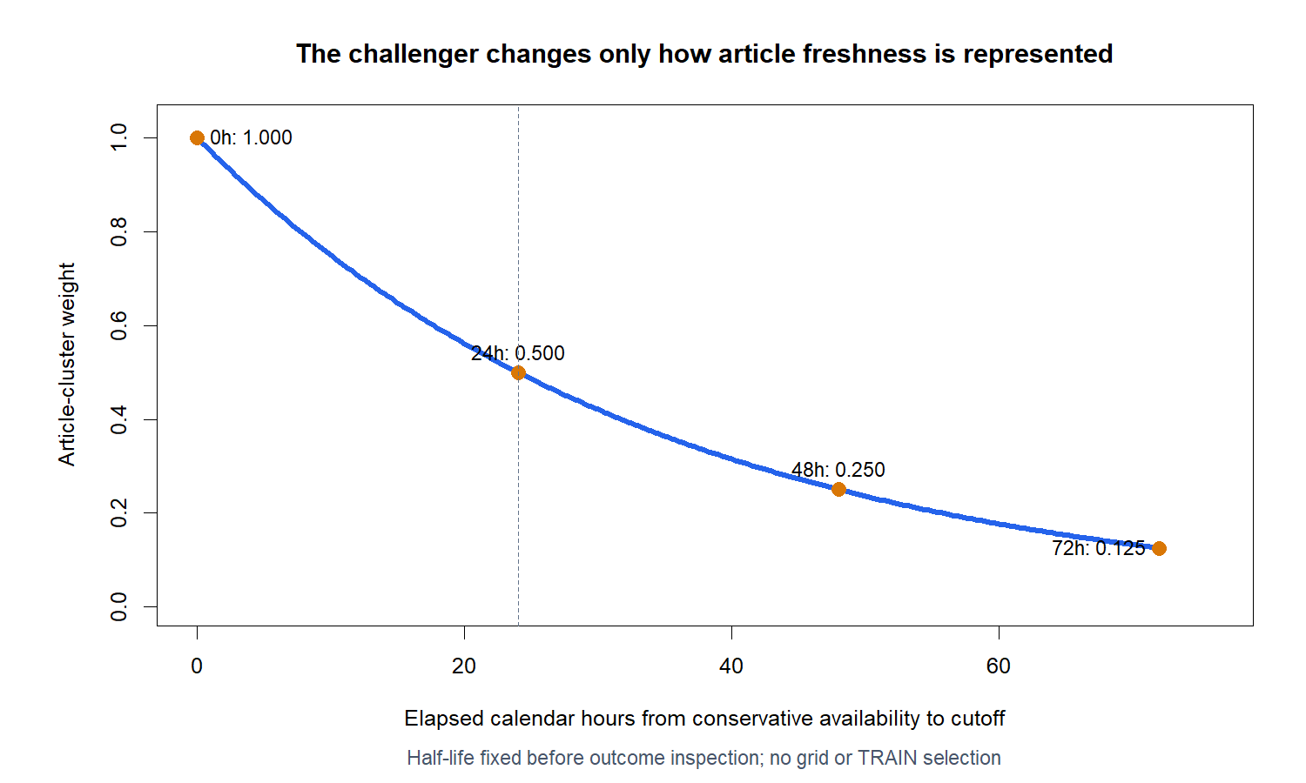
The challenger makes freshness explicit without changing admissibility
D38/03
Notes:
DECISION D38 - FIXED DECAY SEMANTICS
Reading the curve
An article cluster at the cutoff receives weight 1.0; the weight halves every 24 calendar hours. At 72 hours the weight is 0.125.
Why this form
The clock-time decay is simple, monotone, auditable, and fixed before confirmation inspection. It expresses the hypothesis that recently arrived information may remain less resolved.
Boundary
No grid search, TRAIN selection, alternate half-life, market-hours clock, source weighting, sentiment, or text model was evaluated.
[Sources]
- docs/GEN5_4_NEWS_RECENCY_N1D_CONTRACT.md
- runs/research_workbench/gen54_ml_decision_engine/g54_news_n1d_20260725/n1d_report.md
[/Sources]

Slide 4
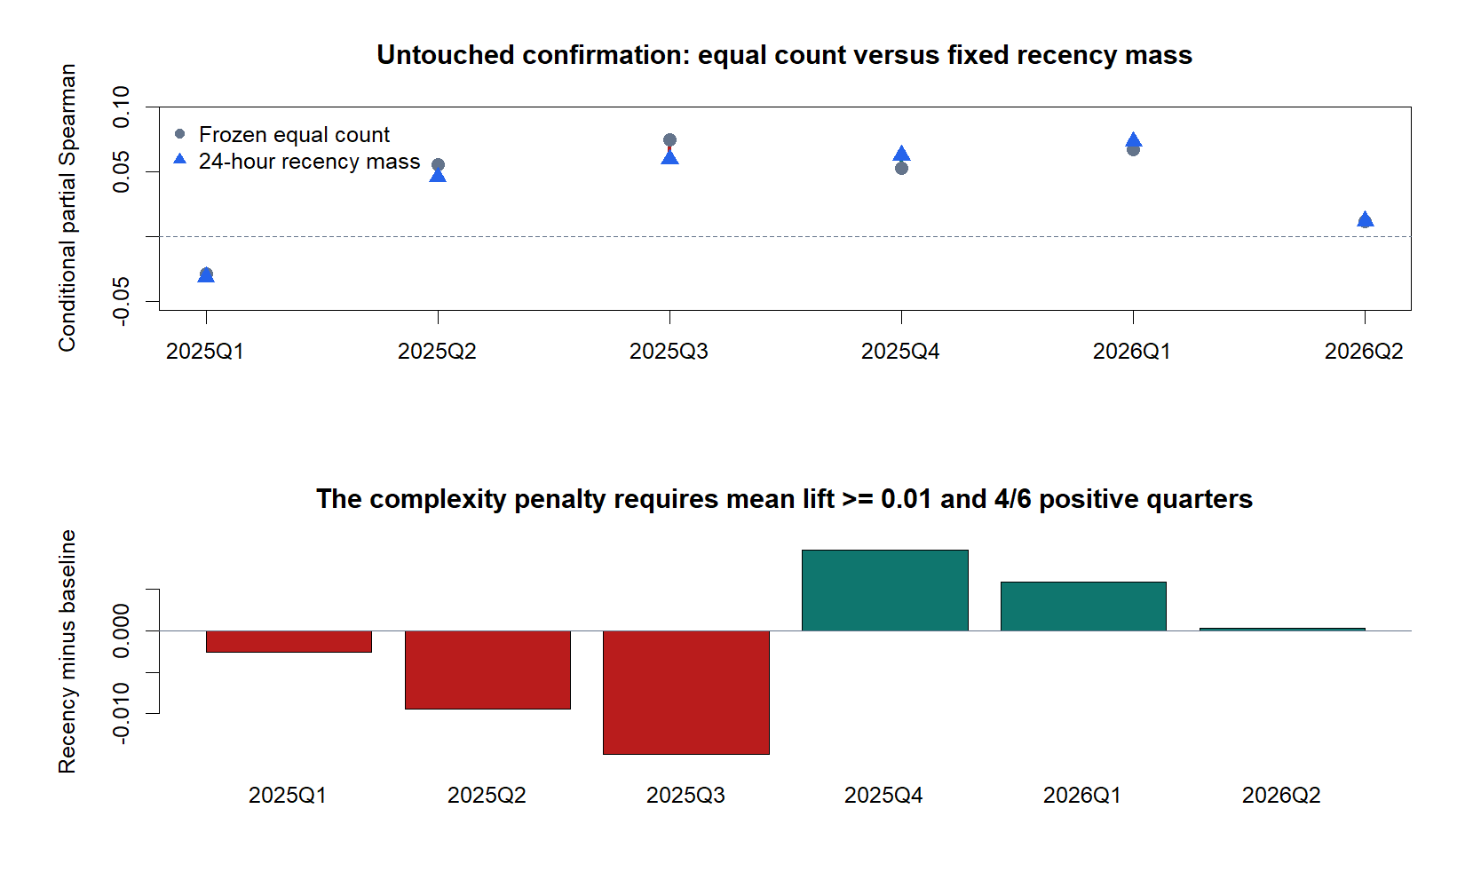
Recency stays positive, but fails to improve on equal count
D39/04
Notes:
DECISION D39 - PRIMARY CONFIRMATION EVIDENCE
Absolute ordering
Recency partial Spearman is positive in 5/6 quarters and averages 0.036938, so the representation still carries modest uncertainty context.
Relative ordering
Equal count averages 0.038762. Recency lift averages -0.001824, not the required +0.01. Lift is positive in only 3/6 quarters, not the required 4/6.
Decision logic
The challenger must beat the simpler accepted measure, not merely remain positive. Both complexity-penalty gates fail.
[Sources]
- runs/research_workbench/gen54_ml_decision_engine/g54_news_n1d_20260725/n1d_report.md
- runs/research_workbench/gen54_ml_decision_engine/g54_news_n1d_20260725/n1d_fold_summary.csv
[/Sources]

Slide 5
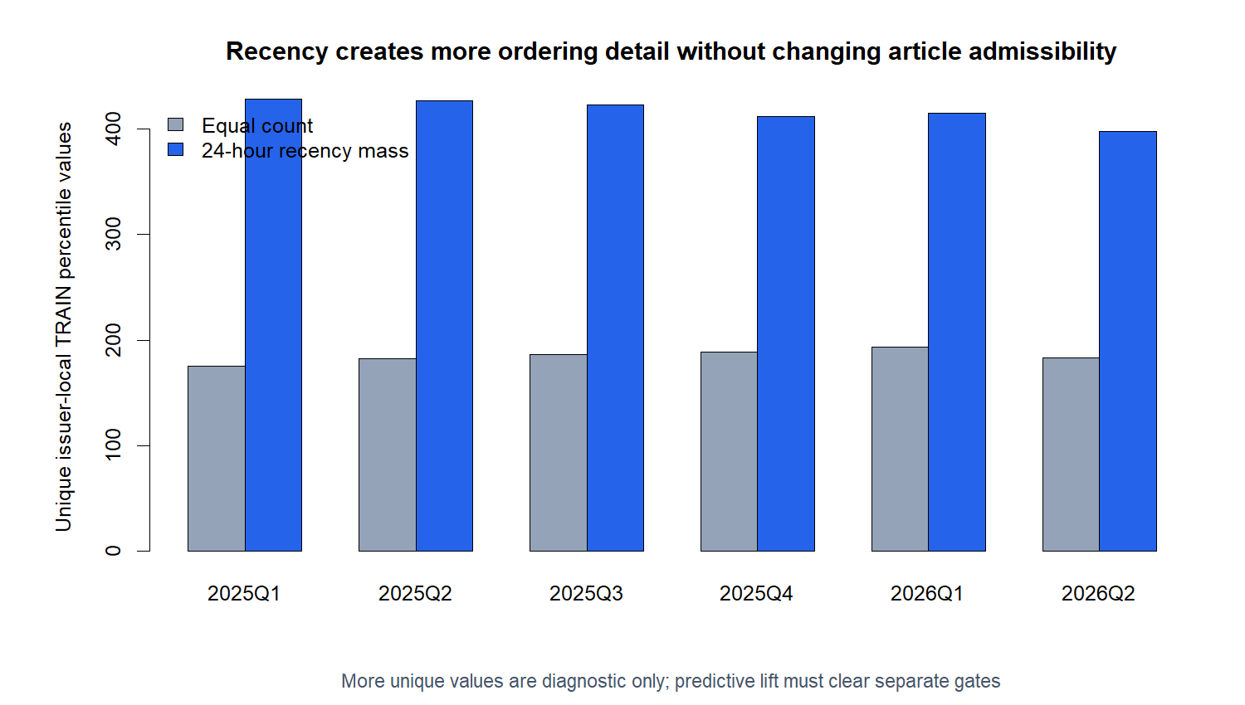
More percentile resolution does not mean more predictive ordering
D39/05
Notes:
DECISION D39 - TIE RESOLUTION IS DIAGNOSTIC
Evidence
The recency representation produces substantially more distinct issuer-local TRAIN percentile values in every confirmation quarter than equal count.
Meaning
Recency does what it was mechanically intended to do: it distinguishes cycles with equal article counts but different timing. That additional granularity did not improve conditional future-volatility ordering.
Teaching point
Feature richness, variance, and tie resolution are not substitutes for incremental predictive evidence.
[Sources]
- runs/research_workbench/gen54_ml_decision_engine/g54_news_n1d_20260725/n1d_report.md
- runs/research_workbench/gen54_ml_decision_engine/g54_news_n1d_20260725/n1d_fold_summary.csv
[/Sources]

Slide 6
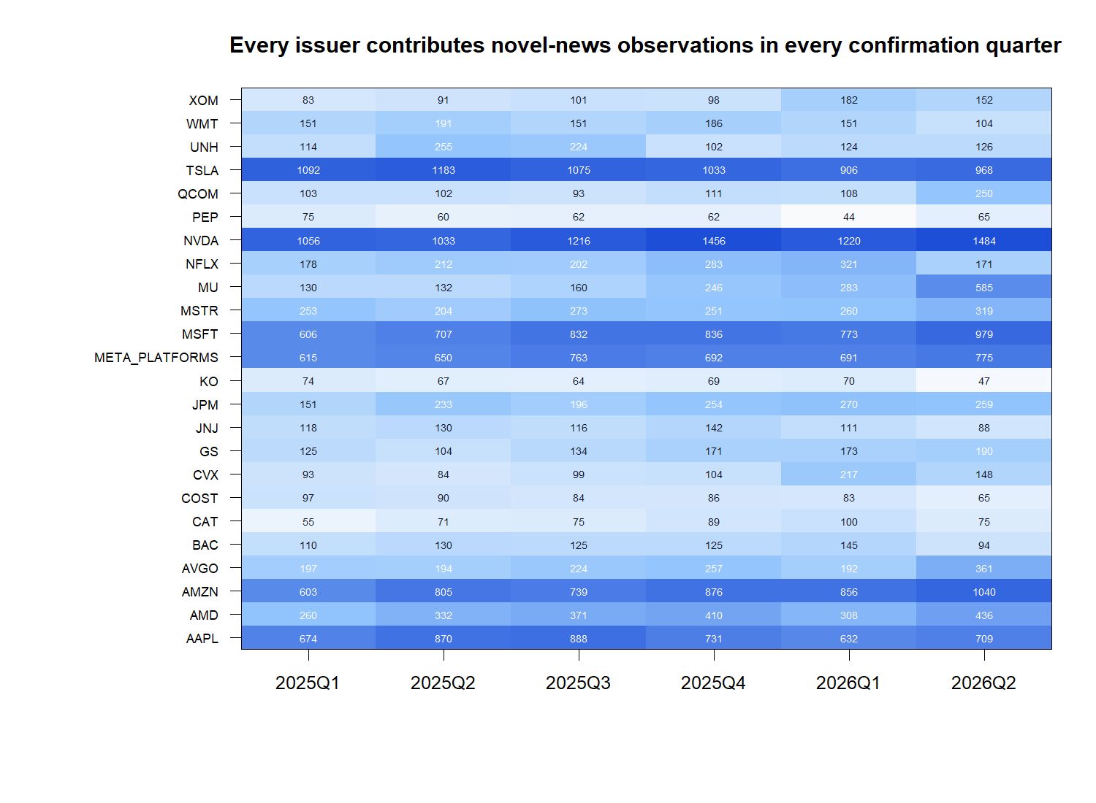
The STOP is not caused by issuer or quarter coverage gaps
D39/06
Notes:
DECISION D39 - CONFIRMATION COVERAGE
Evidence
Every one of the 24 issuers contributes admissible novel-news observations in every confirmation quarter. There are zero issuer-quarter coverage failures and zero representation or control TRAIN-support failures.
Concentration boundary
Coverage volume is still uneven across issuers, as expected from the historical archive. The gate asks whether the intended panel is represented, not whether article counts are uniform.
Interpretation
The N1D STOP is evidence about the fixed challenger, not an artifact of a missing issuer or quarter.
[Sources]
- runs/research_workbench/gen54_ml_decision_engine/g54_news_n1d_20260725/n1d_confirmation_news_coverage.csv
- runs/research_workbench/gen54_ml_decision_engine/g54_news_n1d_20260725/n1d_report.md
[/Sources]

Slide 7
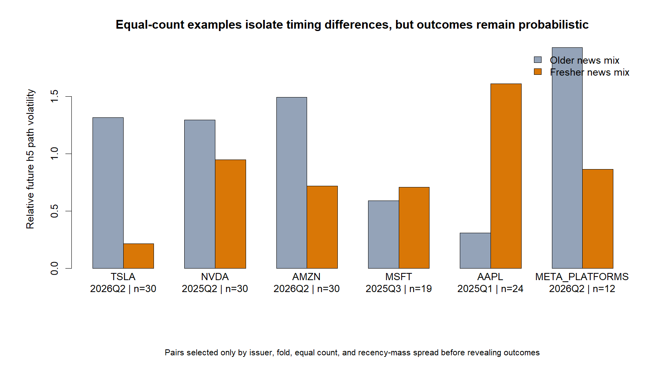
Equal-count pairs show why timing remains probabilistic, not deterministic
D39/07
Notes:
DECISION D39 - HUMAN-FACING TIMING EXAMPLES
Selection rule
Pairs were selected only by issuer, fold, equal count, and recency-mass spread before revealing future outcomes. The examples do not enter the statistic or gates.
Reading the chart
Fresher news mixes sometimes precede wider future paths and sometimes do not. Equal counts can hide timing differences, but timing alone is not a deterministic volatility forecast.
Boundary
These examples explain the tested mechanism; they do not rescue a challenger that failed its aggregate frozen gates.
[Sources]
- runs/research_workbench/gen54_ml_decision_engine/g54_news_n1d_20260725/n1d_equal_count_timing_pairs.csv
- runs/research_workbench/gen54_ml_decision_engine/g54_news_n1d_20260725/n1d_report.md
[/Sources]

Slide 8
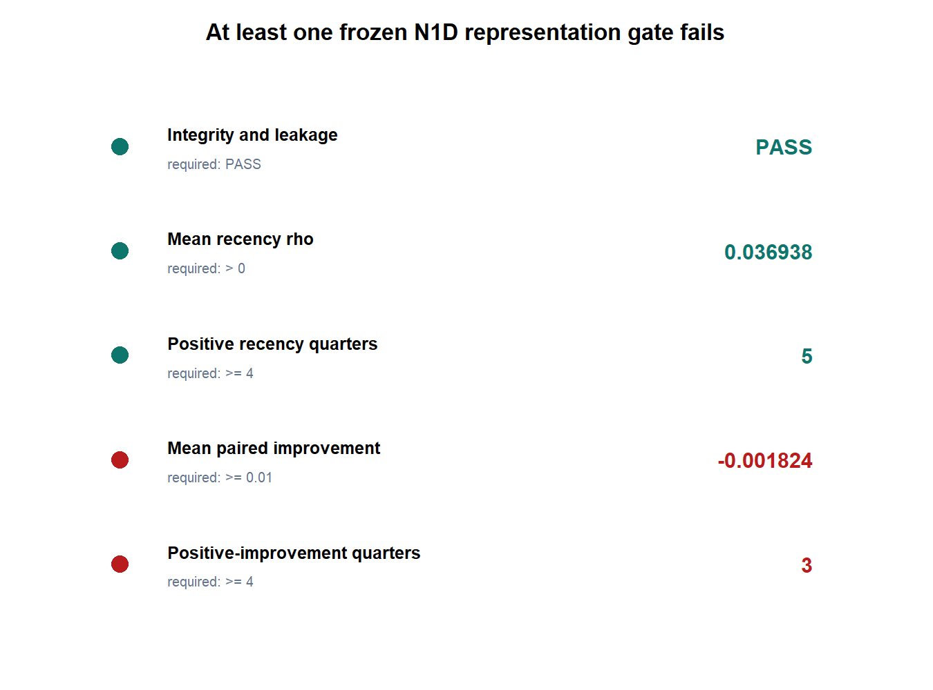
N1D fails the complexity penalty; retain the simpler representation
OVERALL: STOP RECENCY
REPRESENTATION EXPANSION
PASS 15 / 15 integrity checks
PASS recency positive in 5 / 6 quarters
FAIL mean lift -0.0018 vs +0.0100
FAIL positive lift 3 / 6 vs 4 / 6
KEEP frozen equal count
STOP no alternate decay / text rescue
STOP no model / exposure / allocation / PnL
D39/08
Notes:
DECISION D39 - STOP_N1D_KEEP_EQUAL_COUNT_AND_CLOSE_REPRESENTATION_EXPANSION
Authority
All 15 timing, population, TRAIN-support, control, data, and leakage checks pass. The untouched confirmation contains 8,232 observations across all 24 issuers and six quarters.
Decision
Recency passes the integrity and absolute-ordering gates but fails both incremental-improvement gates. Retain equal count as the simpler descriptive uncertainty-context measurement.
Next boundary
Do not try another half-life, sentiment, source weight, embedding, model, policy, exposure, allocation, PnL, or live-facing change on these outcomes. A future news test requires a genuinely new economic hypothesis and fresh uninspected data.
Conversation: codex://threads/019f741e-615f-7fd0-90f7-edce12b5cb66
Find in chat: Please try again
Decision: D39
[Sources]
- runs/research_workbench/gen54_ml_decision_engine/g54_news_n1d_20260725/n1d_report.md
- runs/research_workbench/gen54_ml_decision_engine/g54_news_n1d_20260725/n1d_success_gates.csv
- runs/research_workbench/gen54_ml_decision_engine/g54_news_n1d_20260725/n1d_leakage_audit.csv
- docs/GEN5_4_NEWS_RECENCY_N1D_CONTRACT.md
[/Sources]

