Slide 1
OPERATOR HYPOTHESIS LAB • WALK-FORWARD DEVELOPMENT
HYP-MOM-05.2
27
Can historical data select
a useful triple-SMA rule?
triplets
6
half-year blocks
4 outer tests
A frozen 27-triplet grid, global training-only selection, and four causal half-year tests across a 122-stock registry.
13 AUG 2026
Notes:
Purpose: explain why parameter selection is itself a model, how the frozen selector works, whether it transported, and why 2024+ remains sealed.
[Sources]
- C:/Users/Franc/OneDrive/Documents/Francis/Peltata Project/Time-Series-Modeling-Gen5/operator_hypothesis_lab/docs/HYP_MOM_05_2_TRIPLE_SMA_GRID_WFA_CONTRACT.md
- C:/Users/Franc/OneDrive/Documents/Francis/Peltata Project/Time-Series-Modeling-Gen5/runs/research_workbench/operator_hypothesis_lab/hyp_mom_05_2_triple_sma_grid_wfa_20260813/hyp_mom_05_2_run_spec.csv

Slide 2
A parameter grid changes the hypothesis
H05.1
H05.2
Does one fixed
15 / 30 / 45 rule work?
Can TRAIN select a portable
member of a frozen family?
One rule was frozen before outcomes. Its negative result could mean either the mechanics were weak or the chosen horizons were unrepresentative.
The model now includes the grid, training score, uncertainty tolerance, tie-break, refit schedule, and trading rule. Every component must generalize together.
Finding the best full-sample triplet would answer only “what won retrospectively?” Walk-forward selection asks whether the choice could have been made before the next block occurred.
02
Notes:
H05.2 is numbered as a substantive same-family revision because training-time parameter selection becomes part of the strategy model. It is not a minor tuning pass.
[Sources]
- C:/Users/Franc/OneDrive/Documents/Francis/Peltata Project/Time-Series-Modeling-Gen5/operator_hypothesis_lab/docs/HYP_MOM_05_2_TRIPLE_SMA_GRID_WFA_CONTRACT.md
- C:/Users/Franc/OneDrive/Documents/Francis/Peltata Project/Time-Series-Modeling-Gen5/operator_hypothesis_lab/docs/HYP_MOM_05_2_TRIPLE_SMA_GRID_WFA_RESULTS.md

Slide 3
The grid varies horizons—not mechanics
FROZEN FAMILY
Fast ∈ {10, 15, 20}
Medium ∈ {30, 40, 50}
Slow ∈ {60, 90, 120}
UNCHANGED STATE MACHINE
ORDERED(t) = SMAF(t) > SMAM(t) > SMAS(t)
1 Fresh ordered activation + Close > SMAM
→ enter next open
2 Close ≤ SMAM
→ exit next open
3 After exit, fresh SMAM reclaim while ordered
→ re-enter next open
All 27 combinations satisfy Fast < Medium < Slow. Longer slow averages test whether 15/30/45 viewed price at overly similar speeds.
Every half-year starts and ends in cash; no position crosses a parameter-refit boundary.
03
Notes:
The grid does not include delays, slopes, volatility filters, other moving-average types, asset-specific parameters, or exit changes. Those would be new mechanisms rather than horizon selection.
[Sources]
- C:/Users/Franc/OneDrive/Documents/Francis/Peltata Project/Time-Series-Modeling-Gen5/operator_hypothesis_lab/docs/HYP_MOM_05_2_TRIPLE_SMA_GRID_WFA_CONTRACT.md
- C:/Users/Franc/OneDrive/Documents/Francis/Peltata Project/Time-Series-Modeling-Gen5/operator_hypothesis_lab/R/hyp_mom_05_2_triple_sma_grid_wfa.R

Slide 4
Selection rewards strength, breadth, and restraint
FIVE EQUAL-WEIGHT TRAIN RANKS
Return
Positive-asset breadth
Daily Sharpe
Maximum drawdown
Excess vs stronger trend baseline
ONE-STANDARD-ERROR SELECTION
Threshold = Scorebest − SEbest
Keep every candidate above the threshold. Inside that tolerance set, choose the lowest median trade count; remaining ties prefer slower horizons.
Within each block, each metric becomes a fractional rank across the 27 candidates. Their mean is the block composite; training blocks are then averaged.
Why? Tiny TRAIN differences should not force a fragile winner. A broad plateau is more credible than one isolated hot cell.
Selection uses only 1× primary-cost evidence; leverage can never choose the winner.
04
Notes:
The score is deliberately a simple rank composite, not a tuned utility function. Candidate-specific SMA-medium and ordered-stack controls ensure the hybrid must add value beyond its component trend rules during TRAIN.
[Sources]
- C:/Users/Franc/OneDrive/Documents/Francis/Peltata Project/Time-Series-Modeling-Gen5/operator_hypothesis_lab/docs/HYP_MOM_05_2_TRIPLE_SMA_GRID_WFA_CONTRACT.md
- C:/Users/Franc/OneDrive/Documents/Francis/Peltata Project/Time-Series-Modeling-Gen5/operator_hypothesis_lab/R/hyp_mom_05_2_triple_sma_grid_wfa.R

Slide 5
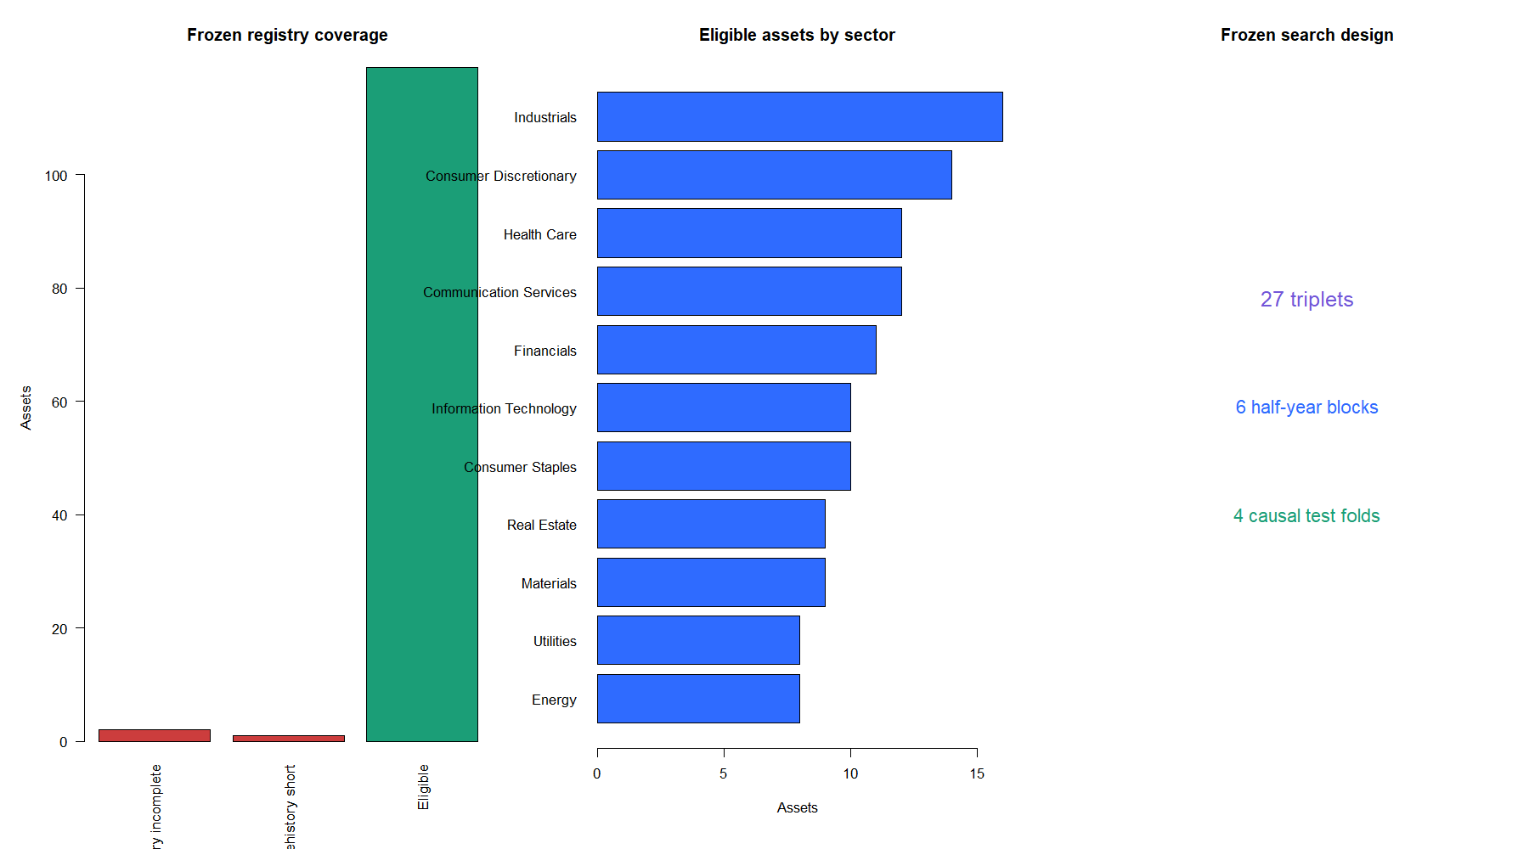
Longer horizons retained 119 of 122 stocks
APHA and SNE lacked complete development history. LI had 108 prehistory sessions—short of the 130 required for SMA120. No replacements were added.
05
Notes:
The cache was already refreshed for H05.1. The three exclusions follow frozen coverage requirements; the remaining 119 assets have the full SPY-session development calendar and sufficient prehistory.
[Sources]
- C:/Users/Franc/OneDrive/Documents/Francis/Peltata Project/Time-Series-Modeling-Gen5/runs/research_workbench/operator_hypothesis_lab/hyp_mom_05_2_triple_sma_grid_wfa_20260813/hyp_mom_05_2_run_spec.csv
- C:/Users/Franc/OneDrive/Documents/Francis/Peltata Project/Time-Series-Modeling-Gen5/runs/research_workbench/operator_hypothesis_lab/hyp_mom_05_2_triple_sma_grid_wfa_20260813/hyp_mom_05_2_coverage.csv
- C:/Users/Franc/OneDrive/Documents/Francis/Peltata Project/Time-Series-Modeling-Gen5/runs/research_workbench/operator_hypothesis_lab/hyp_mom_05_2_triple_sma_grid_wfa_20260813/hyp_mom_05_2_integrity.csv
- C:/Users/Franc/OneDrive/Documents/Francis/Peltata Project/Time-Series-Modeling-Gen5/runs/research_workbench/operator_hypothesis_lab/hyp_mom_05_2_triple_sma_grid_wfa_20260813/hyp_mom_05_2_query_health.csv

Slide 6
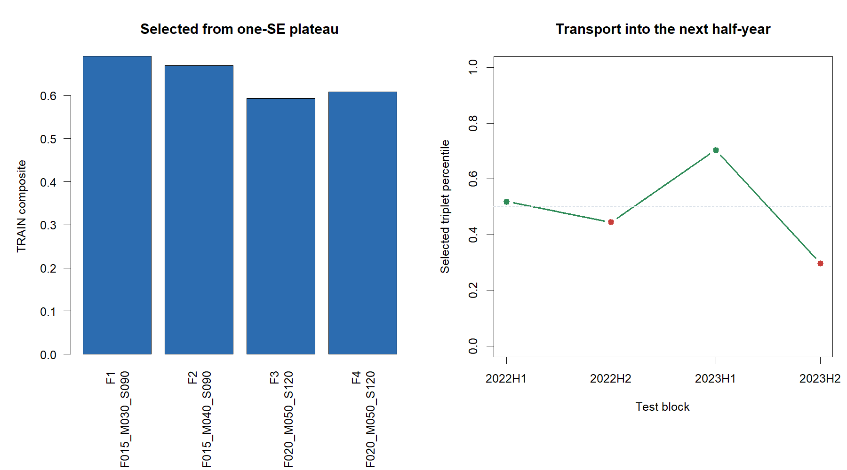
TRAIN moved slower, but the choices did not transport
Selected sequence: 15/30/90 → 15/40/90 → 20/50/120 → 20/50/120. Next-block ranks were only 52nd, 44th, 70th, and 30th percentile.
06
Notes:
The 20/50/120 repetition is evidence that the training preference became more stable, not that it was profitable. The selected cell was never the best candidate in its next block.
[Sources]
- C:/Users/Franc/OneDrive/Documents/Francis/Peltata Project/Time-Series-Modeling-Gen5/runs/research_workbench/operator_hypothesis_lab/hyp_mom_05_2_triple_sma_grid_wfa_20260813/hyp_mom_05_2_selections.csv
- C:/Users/Franc/OneDrive/Documents/Francis/Peltata Project/Time-Series-Modeling-Gen5/runs/research_workbench/operator_hypothesis_lab/hyp_mom_05_2_triple_sma_grid_wfa_20260813/hyp_mom_05_2_selection_surface.csv
- C:/Users/Franc/OneDrive/Documents/Francis/Peltata Project/Time-Series-Modeling-Gen5/runs/research_workbench/operator_hypothesis_lab/hyp_mom_05_2_triple_sma_grid_wfa_20260813/hyp_mom_05_2_block_scorecard.csv

Slide 7
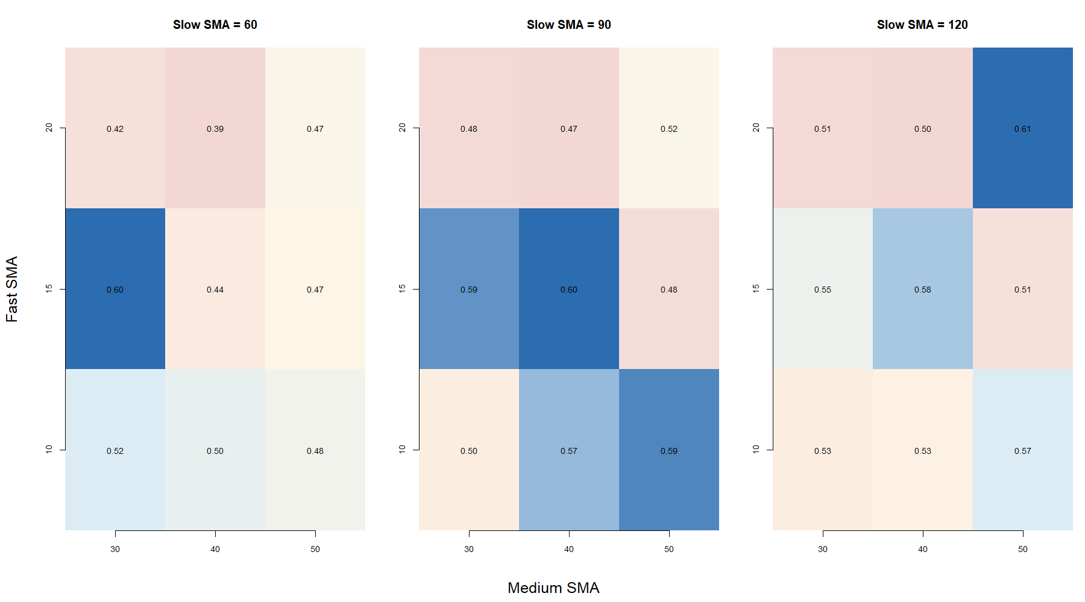
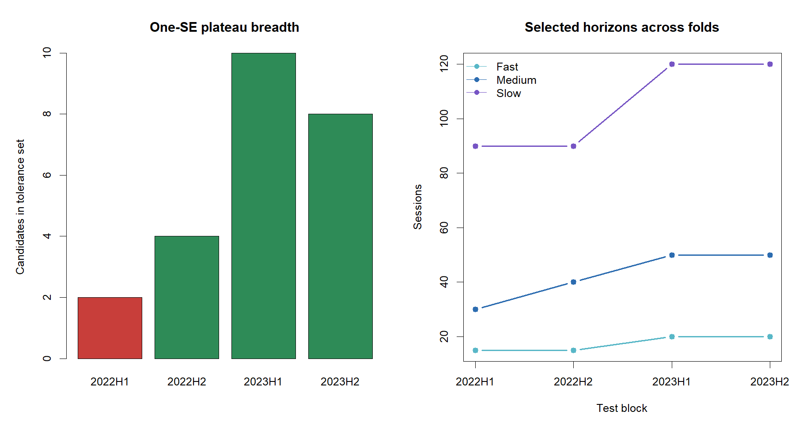
The latest TRAIN surface was broad—but not smooth
20/50/120 scored 0.61, while a separate 15/30/60 cell scored 0.60. Tolerance-set size was 2, 4, 10, and 8; fold 1 failed the frozen minimum-three plateau gate.
07
Notes:
The broad later plateaus protect against an isolated single-cell optimum, but the surface is multi-modal rather than one coherent ridge. One early fold contained only two admissible cells.
[Sources]
- C:/Users/Franc/OneDrive/Documents/Francis/Peltata Project/Time-Series-Modeling-Gen5/runs/research_workbench/operator_hypothesis_lab/hyp_mom_05_2_triple_sma_grid_wfa_20260813/hyp_mom_05_2_selection_surface.csv
- C:/Users/Franc/OneDrive/Documents/Francis/Peltata Project/Time-Series-Modeling-Gen5/runs/research_workbench/operator_hypothesis_lab/hyp_mom_05_2_triple_sma_grid_wfa_20260813/hyp_mom_05_2_selections.csv

Slide 8
Selected policy failed every return gate
Four causally selected half-years, compounded per asset at 1× primary costs
−7.25%
34 / 119
15th
Median compounded return
Positive assets
Median matched-shift percentile
0 / 4
outer blocks with positive median return
1 / 7 gates passed
0 / 119 assets above the 80th timing-control percentile
08
Notes:
The 1× median Sharpe was -0.448, median maximum drawdown -14.04%, median exposure 12.6%, and median hit rate 25%. Only integrity passed.
[Sources]
- C:/Users/Franc/OneDrive/Documents/Francis/Peltata Project/Time-Series-Modeling-Gen5/runs/research_workbench/operator_hypothesis_lab/hyp_mom_05_2_triple_sma_grid_wfa_20260813/hyp_mom_05_2_panel_summary.csv
- C:/Users/Franc/OneDrive/Documents/Francis/Peltata Project/Time-Series-Modeling-Gen5/runs/research_workbench/operator_hypothesis_lab/hyp_mom_05_2_triple_sma_grid_wfa_20260813/hyp_mom_05_2_fold_panel.csv
- C:/Users/Franc/OneDrive/Documents/Francis/Peltata Project/Time-Series-Modeling-Gen5/runs/research_workbench/operator_hypothesis_lab/hyp_mom_05_2_triple_sma_grid_wfa_20260813/hyp_mom_05_2_gates.csv

Slide 9
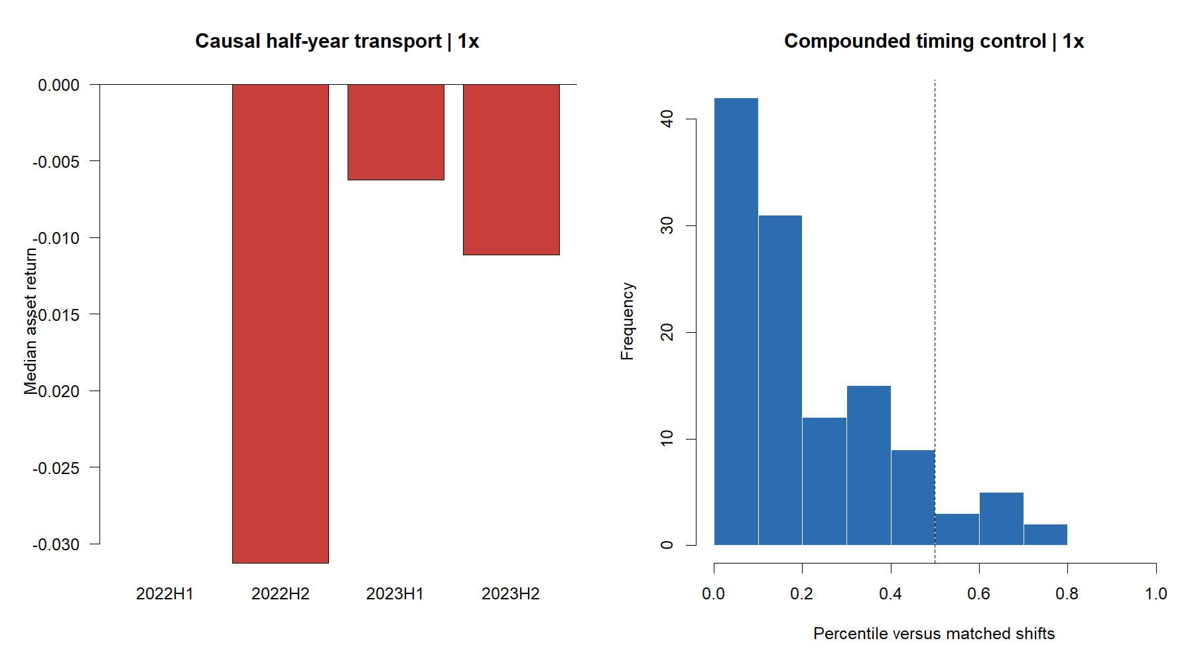
Every outer block was weak; timing lagged shifts
2022H1's zero median reflects broad non-participation—not a successful defensive signal. Only 22 of 119 assets were positive, and median Sharpe was −0.84.
09
Notes:
The 500 circular shifts preserve each selected schedule's exposure pattern within its fold and compound like-numbered simulations across folds. They are matched timing diagnostics, not a formal market null.
[Sources]
- C:/Users/Franc/OneDrive/Documents/Francis/Peltata Project/Time-Series-Modeling-Gen5/runs/research_workbench/operator_hypothesis_lab/hyp_mom_05_2_triple_sma_grid_wfa_20260813/hyp_mom_05_2_fold_panel.csv
- C:/Users/Franc/OneDrive/Documents/Francis/Peltata Project/Time-Series-Modeling-Gen5/runs/research_workbench/operator_hypothesis_lab/hyp_mom_05_2_triple_sma_grid_wfa_20260813/hyp_mom_05_2_panel_summary.csv
- C:/Users/Franc/OneDrive/Documents/Francis/Peltata Project/Time-Series-Modeling-Gen5/runs/research_workbench/operator_hypothesis_lab/hyp_mom_05_2_triple_sma_grid_wfa_20260813/hyp_mom_05_2_random_compounded.csv

Slide 10
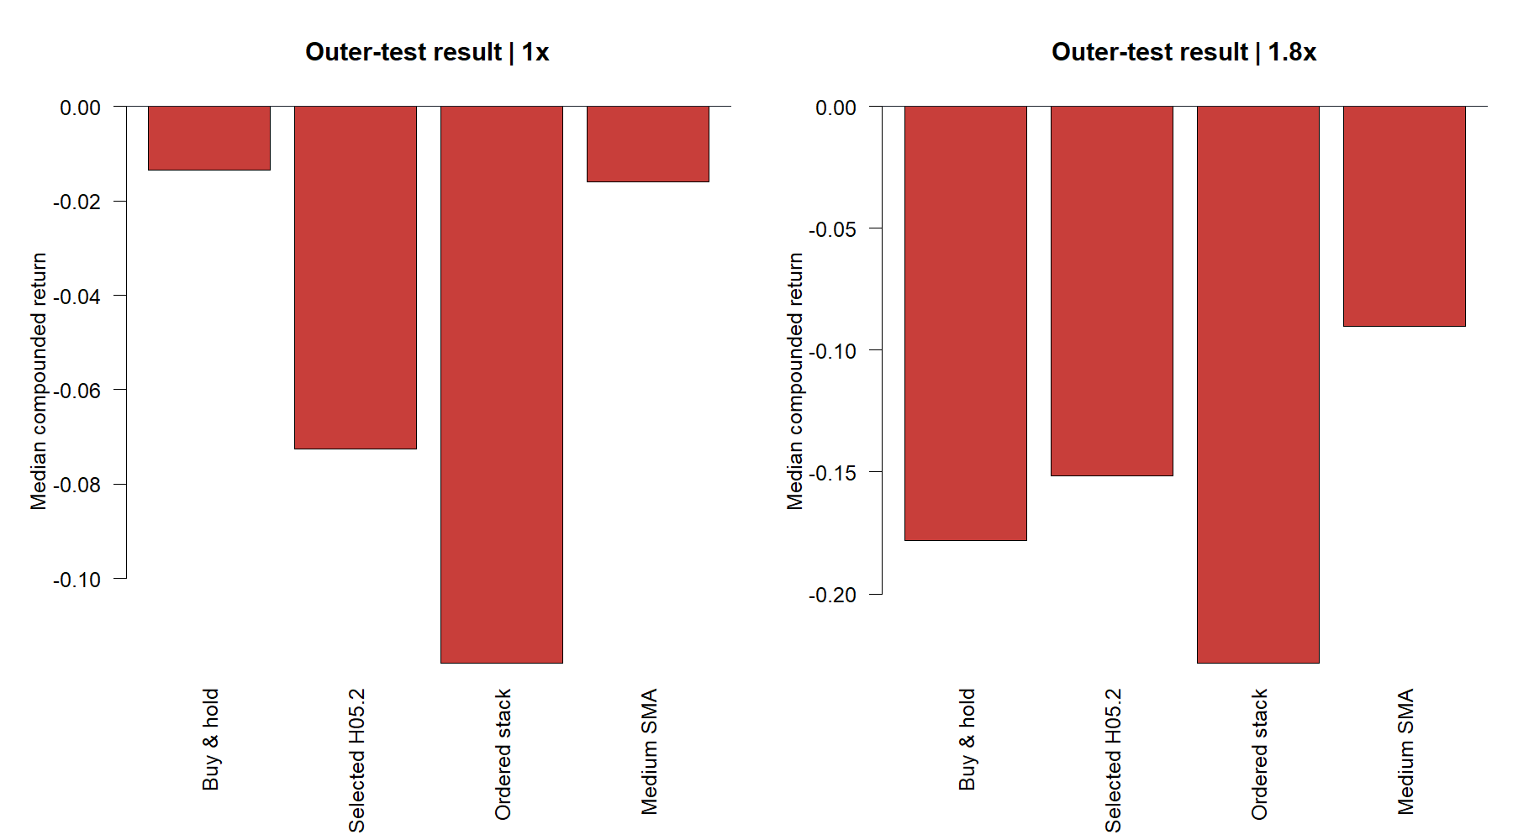
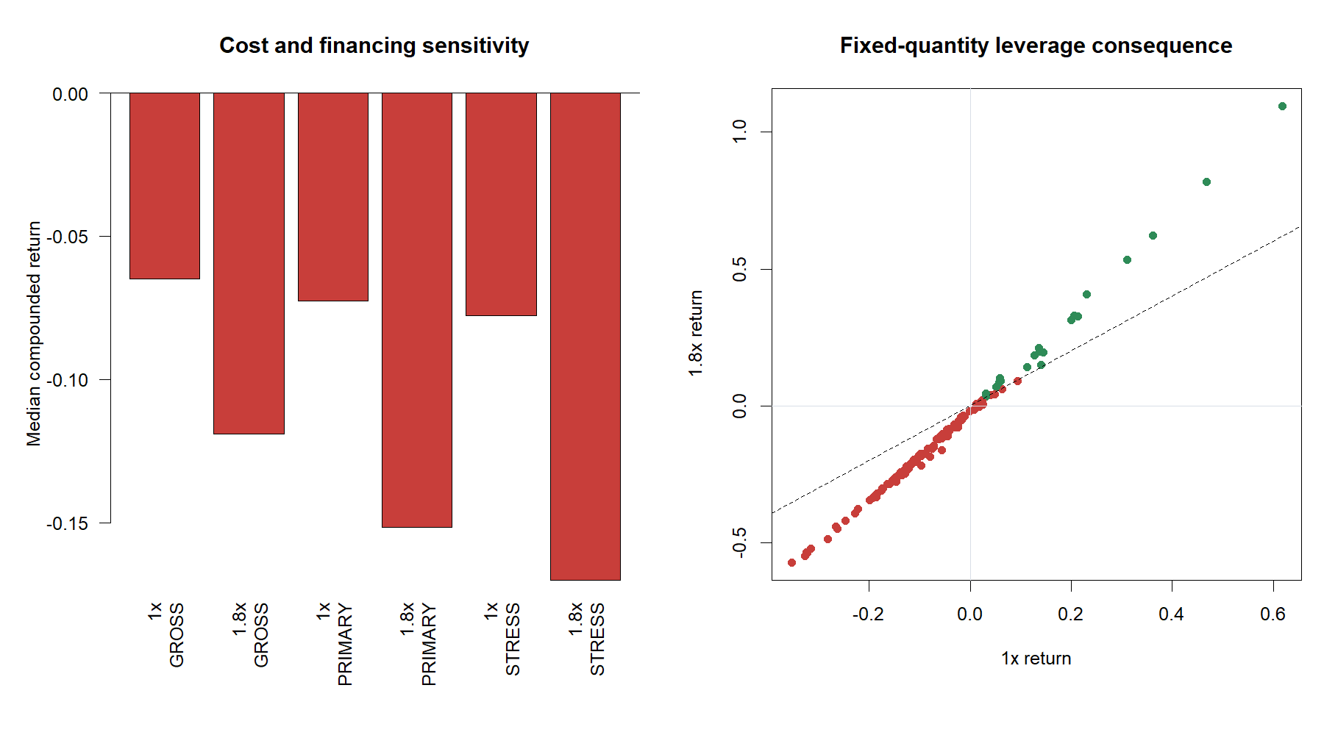
Costs aggravated the failure; leverage amplified it
At 1×, H05.2 lagged buy-and-hold by 4.80 pp and medium-SMA timing by 3.32 pp; it beat only the weakest ordered-stack baseline. Gross median return was still −6.49%.
Fixed-quantity 1.8× cut median return to −15.17% and deepened median drawdown to −24.77%. No maintenance-proxy breach occurred—but no leverage value-add emerged.
10
Notes:
At 1×, median excess return was -4.80 pp vs buy-and-hold, -3.32 pp vs medium-SMA-only, and +3.80 pp vs ordered-stack-only. Stress costs reduced median return to -7.77%. Median 1.8× financing cost was 1.16% of initial wealth.
[Sources]
- C:/Users/Franc/OneDrive/Documents/Francis/Peltata Project/Time-Series-Modeling-Gen5/runs/research_workbench/operator_hypothesis_lab/hyp_mom_05_2_triple_sma_grid_wfa_20260813/hyp_mom_05_2_baseline_comparisons.csv
- C:/Users/Franc/OneDrive/Documents/Francis/Peltata Project/Time-Series-Modeling-Gen5/runs/research_workbench/operator_hypothesis_lab/hyp_mom_05_2_triple_sma_grid_wfa_20260813/hyp_mom_05_2_cost_summary.csv
- C:/Users/Franc/OneDrive/Documents/Francis/Peltata Project/Time-Series-Modeling-Gen5/runs/research_workbench/operator_hypothesis_lab/hyp_mom_05_2_triple_sma_grid_wfa_20260813/hyp_mom_05_2_panel_summary.csv

Slide 11
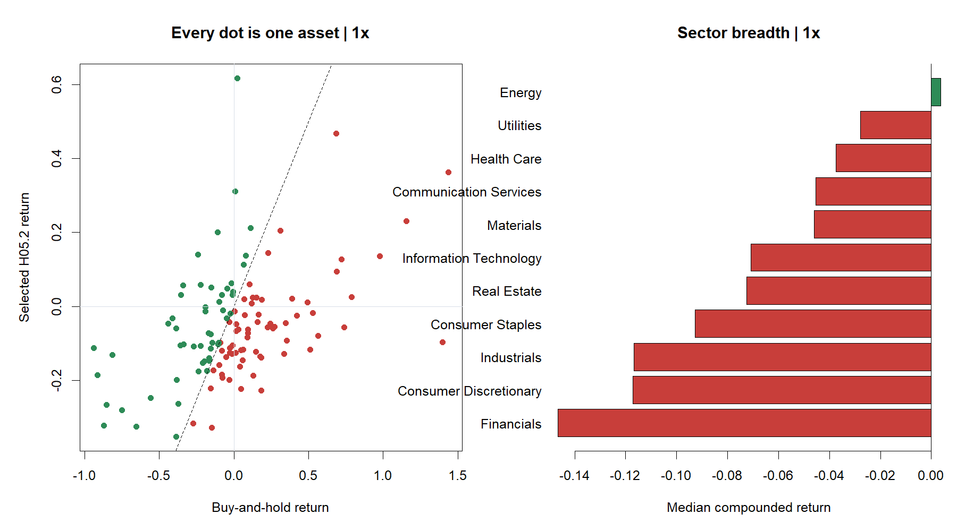
Wider spacing reduced churn—not bad entries
INITIAL ACTIVATION
MEDIUM-SMA RECLAIM
369 trades
289 trades
WHAT CHANGED FROM H05.1
Reclaims fell from 89% to 44% of trades. The slower grid removed some repeated reclaim churn—but initial activations remained worse in median magnitude.
27.4% hit rate
−2.27% median trade
12-session median hold
27.7% hit rate
−1.07% median trade
3-session median hold
11
Notes:
Only Energy had a positive sector median (+0.38%). The original-22 median was -1.86%, diversified-core -6.29%, and retail-attention -18.59%. These are diagnostics, not subgroup-selection authority.
[Sources]
- C:/Users/Franc/OneDrive/Documents/Francis/Peltata Project/Time-Series-Modeling-Gen5/runs/research_workbench/operator_hypothesis_lab/hyp_mom_05_2_triple_sma_grid_wfa_20260813/hyp_mom_05_2_entry_summary.csv
- C:/Users/Franc/OneDrive/Documents/Francis/Peltata Project/Time-Series-Modeling-Gen5/runs/research_workbench/operator_hypothesis_lab/hyp_mom_05_2_triple_sma_grid_wfa_20260813/hyp_mom_05_2_fold_trades.csv
- C:/Users/Franc/OneDrive/Documents/Francis/Peltata Project/Time-Series-Modeling-Gen5/runs/research_workbench/operator_hypothesis_lab/hyp_mom_05_2_triple_sma_grid_wfa_20260813/hyp_mom_05_2_sector_summary.csv
- C:/Users/Franc/OneDrive/Documents/Francis/Peltata Project/Time-Series-Modeling-Gen5/runs/research_workbench/operator_hypothesis_lab/hyp_mom_05_2_triple_sma_grid_wfa_20260813/hyp_mom_05_2_stitched_summaries.csv

Slide 12
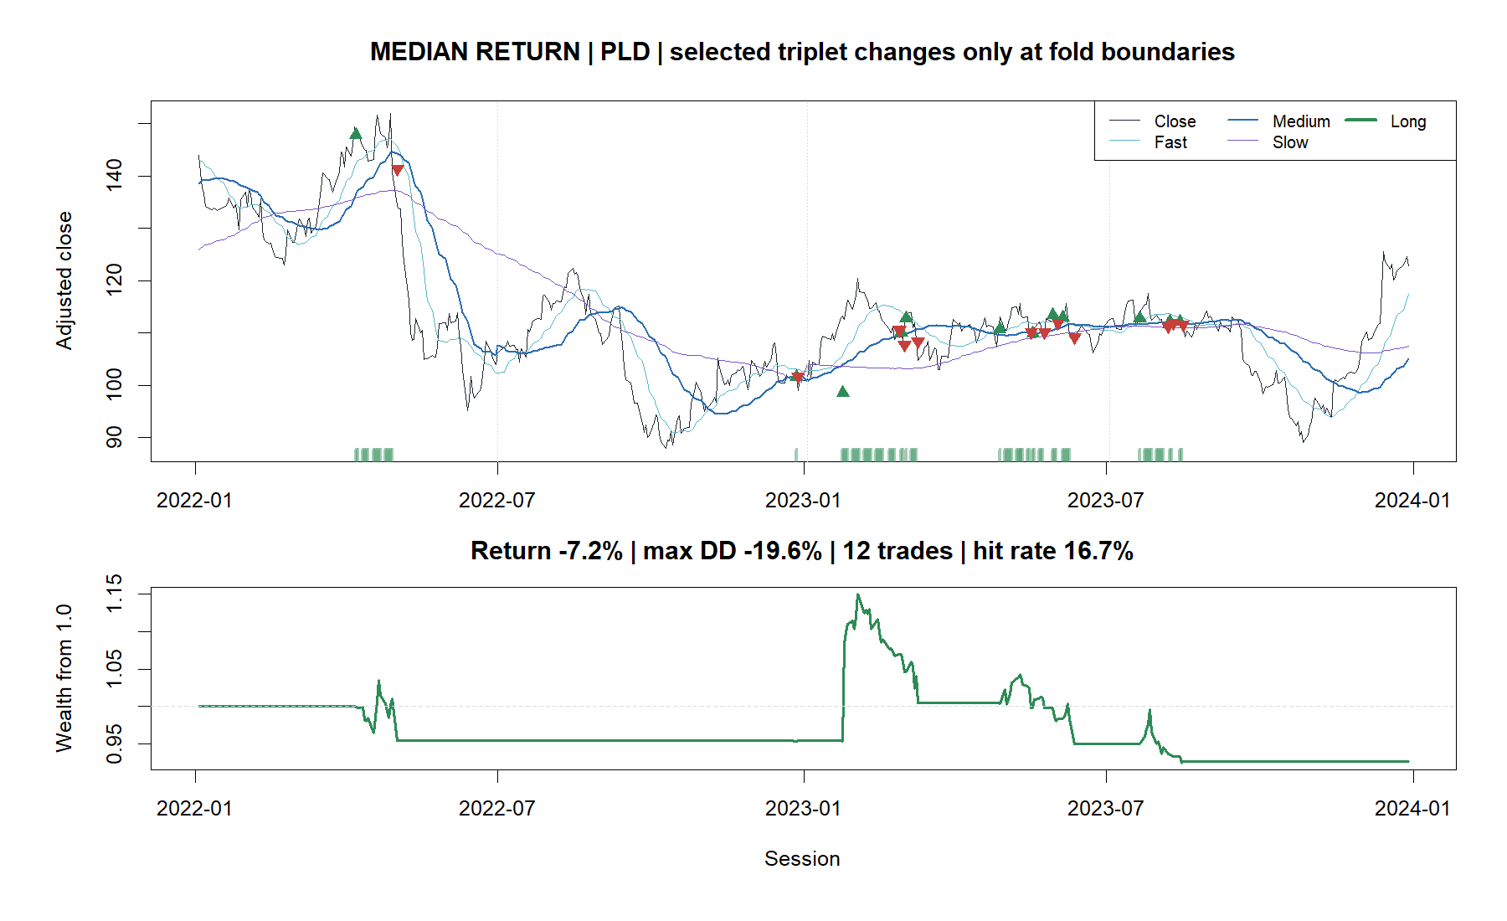
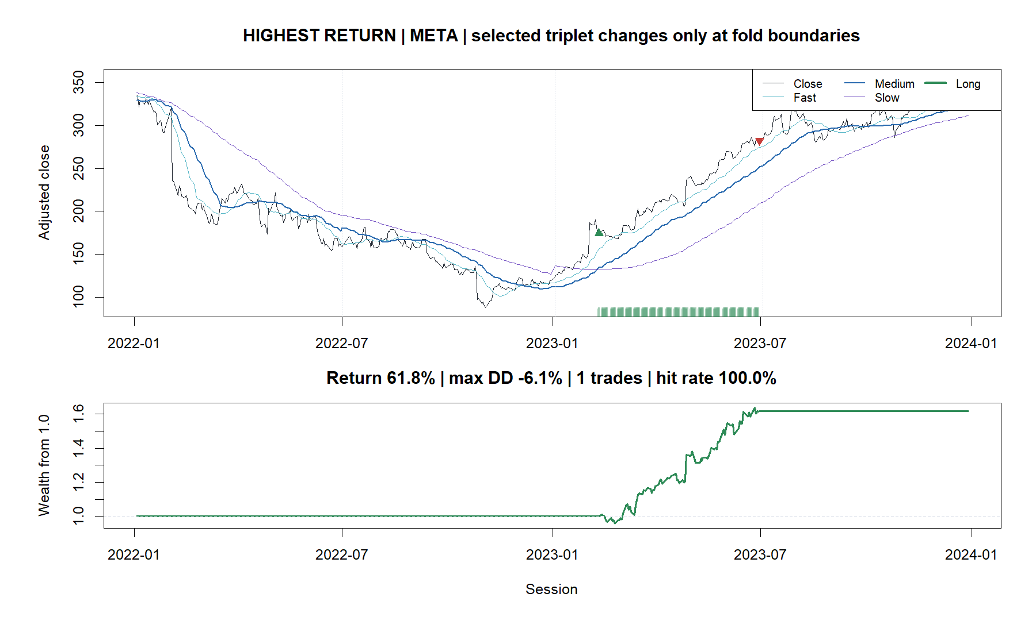
PLD shows the median path; META shows the outlier
PLD: −7.25% • 12 trades • 17.6% exposure
META: +61.79% • one 96-session activation trade
12
Notes:
These tapes illustrate behavior and are not asset nominees. META's result came from one long activation trade; its matched-shift percentile was only 3%, showing that the exact timing did not beat most exposure-matched placements.
[Sources]
- C:/Users/Franc/OneDrive/Documents/Francis/Peltata Project/Time-Series-Modeling-Gen5/runs/research_workbench/operator_hypothesis_lab/hyp_mom_05_2_triple_sma_grid_wfa_20260813/hyp_mom_05_2_tape_manifest.csv
- C:/Users/Franc/OneDrive/Documents/Francis/Peltata Project/Time-Series-Modeling-Gen5/runs/research_workbench/operator_hypothesis_lab/hyp_mom_05_2_triple_sma_grid_wfa_20260813/hyp_mom_05_2_fold_summaries.csv
- C:/Users/Franc/OneDrive/Documents/Francis/Peltata Project/Time-Series-Modeling-Gen5/runs/research_workbench/operator_hypothesis_lab/hyp_mom_05_2_triple_sma_grid_wfa_20260813/hyp_mom_05_2_fold_trades.csv

Slide 13
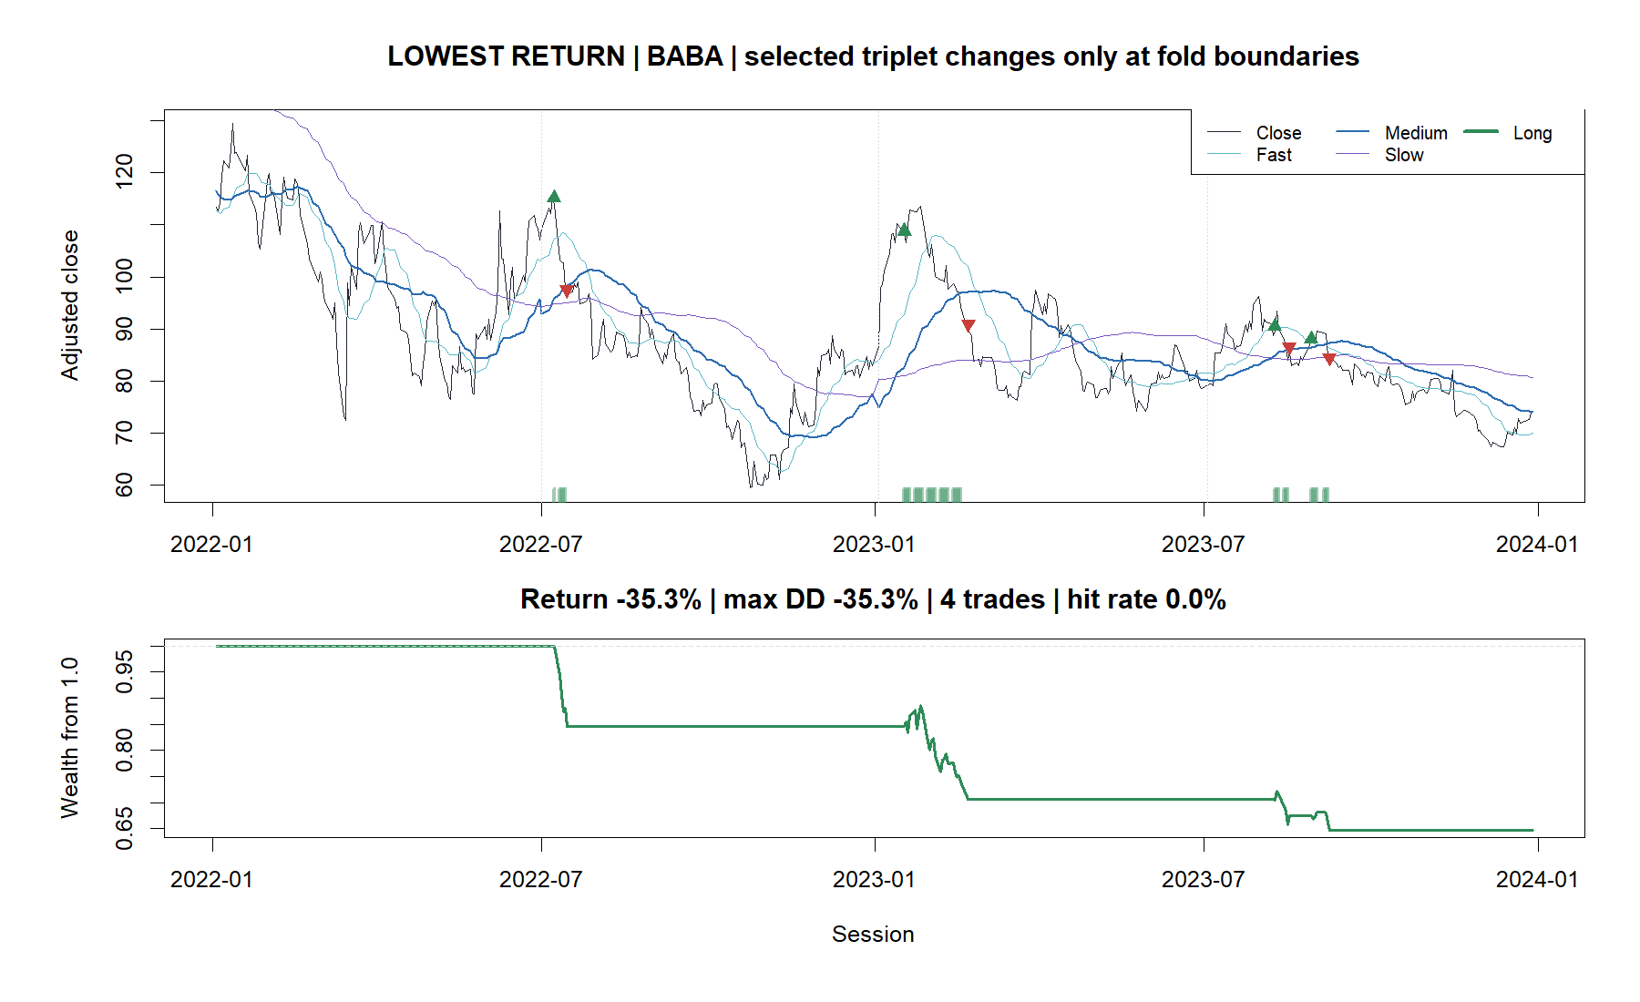
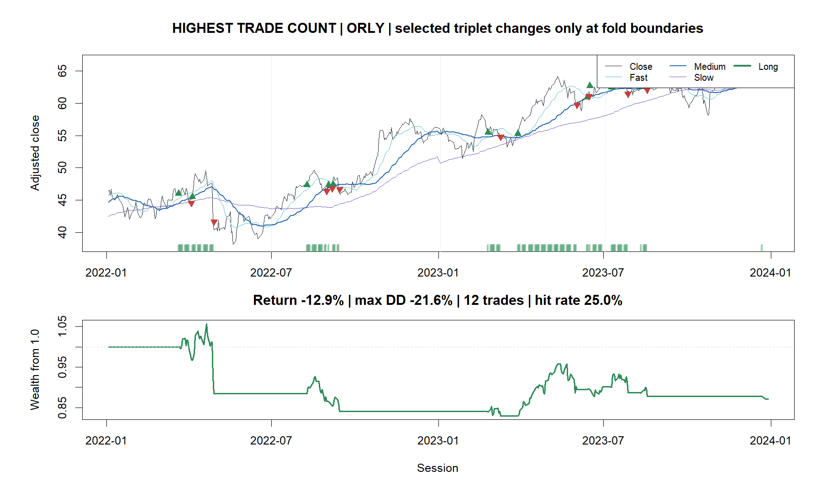
BABA and ORLY expose loss and repeated re-entry
BABA: −35.34% • 0 / 4 winning trades
ORLY: −12.92% • 12 trades • 25% hit rate
13
Notes:
BABA is the minimum-return asset. ORLY ties for the maximum trade count and was chosen as the distinct representative after enforcing unique tape identities.
[Sources]
- C:/Users/Franc/OneDrive/Documents/Francis/Peltata Project/Time-Series-Modeling-Gen5/runs/research_workbench/operator_hypothesis_lab/hyp_mom_05_2_triple_sma_grid_wfa_20260813/hyp_mom_05_2_tape_manifest.csv
- C:/Users/Franc/OneDrive/Documents/Francis/Peltata Project/Time-Series-Modeling-Gen5/runs/research_workbench/operator_hypothesis_lab/hyp_mom_05_2_triple_sma_grid_wfa_20260813/hyp_mom_05_2_fold_trades.csv

Slide 14
Set down the horizon grid; keep 2024+ sealed
DECISION
STOP DEVELOPMENT WFA
CONFIRMATION NOT RUN
WHAT WE LEARNED
1 Parameter selection is part of the model
2 Slower separation was a real TRAIN preference
3 That preference did not transport
4 Both activation and reclaim entries were weak
5 A wider grid would increase search—not repair theory
The fixed-triplet null was not rescued by a compact, conservative training selector. This is evidence against portable horizon selection for the current entry/exit mechanics—not proof that all trend following fails.
Any persistence, slope, volatility, or alternative-entry idea needs a new mechanism-level hypothesis and frozen identifier—not another H05.2 scan.
14
Notes:
Only integrity passed (1/7 gates). Do not access 2024+ confirmation, widen the parameter grid, or select favorable cells, assets, sectors, or cohorts under HYP-MOM-05.2.
[Sources]
- C:/Users/Franc/OneDrive/Documents/Francis/Peltata Project/Time-Series-Modeling-Gen5/operator_hypothesis_lab/docs/HYP_MOM_05_2_TRIPLE_SMA_GRID_WFA_RESULTS.md
- C:/Users/Franc/OneDrive/Documents/Francis/Peltata Project/Time-Series-Modeling-Gen5/runs/research_workbench/operator_hypothesis_lab/hyp_mom_05_2_triple_sma_grid_wfa_20260813/hyp_mom_05_2_gates.csv
- C:/Users/Franc/OneDrive/Documents/Francis/Peltata Project/Time-Series-Modeling-Gen5/runs/research_workbench/operator_hypothesis_lab/hyp_mom_05_2_triple_sma_grid_wfa_20260813/hyp_mom_05_2_panel_summary.csv
- C:/Users/Franc/OneDrive/Documents/Francis/Peltata Project/Time-Series-Modeling-Gen5/runs/research_workbench/operator_hypothesis_lab/hyp_mom_05_2_triple_sma_grid_wfa_20260813/hyp_mom_05_2_entry_summary.csv

