Slide 1
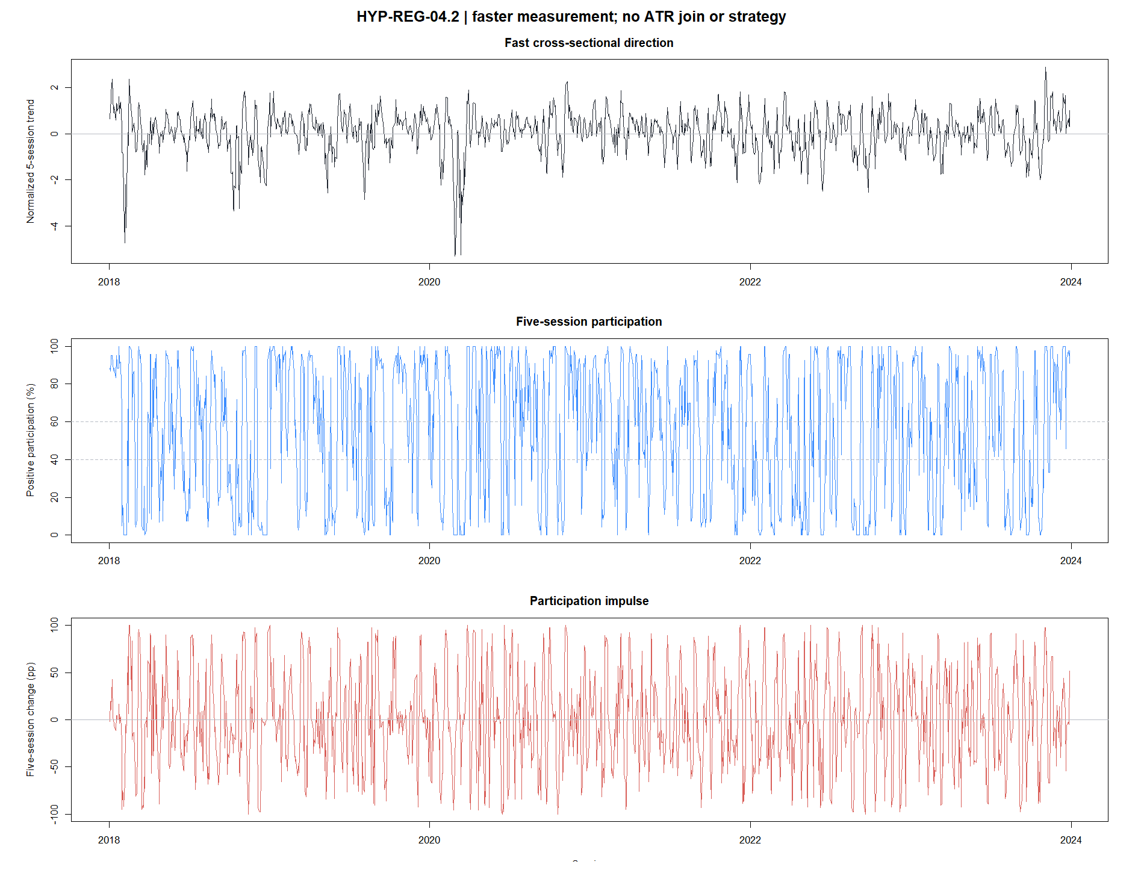
HYP-REG-04.2
Faster measurement did not restore trend continuity
5-session direction, participation, and breadth impulse · 24 ETFs · H5 primary
STOP · 1 of 10 gates passed
1
Notes:
Open with the result, not the machinery. Shortening the measurement horizon created a narrow H5 clue, but it did not produce a stable forward permission filter. H10 reversed and the frozen promotion gates failed.
[Sources]
- docs/GEN5_HYP_REG_04_2_FAST_CROSS_SECTIONAL_TREND_IMPULSE_CONTRACT.md
- operator_hypothesis_lab/docs/HYP_REG_04_2_FAST_CROSS_SECTIONAL_TREND_IMPULSE_RESULTS.md
- C:/Users/Franc/OneDrive/Documents/Francis/Peltata Project/Time-Series-Modeling-Gen5/runs/research_workbench/operator_hypothesis_lab/hyp_reg_04_2_fast_cross_sectional_trend_impulse_20260815/hyp_reg_04_2_gates.csv

Slide 2
WHY TEST FASTER?
The derivative question was reactivity—not a rescue grid
04.1 suggested the 20/60 field might describe a move after the useful transition had already occurred.
Lag hypothesis
Noise cost
Frozen boundary
A 5-session field may detect a newly broadening move before a 20/60 state matures.
Faster estimates are more responsive, but less stable and more vulnerable to reversal.
One speed only; no horizon grid, ATR% join, asset strategy, or 2024+ inspection.
A faster indicator earns promotion only if the forward behavior persists outside a single convenient cut.
2
Notes:
This lane answers a clean derivative question: does a more reactive cross-sectional measurement improve near-term continuity? It is not permission to search many speeds after seeing outcomes.
[Sources]
- docs/GEN5_CROSS_SECTIONAL_MARKET_CONTEXT_CANDIDATE_MAP.md
- docs/GEN5_HYP_REG_04_2_FAST_CROSS_SECTIONAL_TREND_IMPULSE_CONTRACT.md
- operator_hypothesis_lab/presentations/hyp_reg_04_1_cross_sectional_trend_field_evidence.pptx

Slide 3
FROZEN CONSTRUCTION
The fast field separates level, change, and slow context
Per asset fast direction
z⁽⁵⁾ᵢ,ₜ = rᵢ,ₜ₋₄:ₜ ÷ (σᵢ,₆₃,prior √5)
D5 · fast direction
median of four economic-group medians of z⁽⁵⁾
P5 · participation
equal-group mean fraction with z⁽⁵⁾ > 0
I5 · breadth impulse
P5ₜ − P5ₜ₋₅
D20 · slow context
same construction using a 20-session normalized return
Equal group weights preserve the same 24-ETF economic field; SPY remains external.
3
Notes:
D5 measures very recent normalized direction. P5 measures how broadly that direction is shared. I5 asks whether participation expanded over the prior five sessions. D20 is a label for continuation versus reversal, not a tunable second signal.
[Sources]
- docs/GEN5_HYP_REG_04_2_FAST_CROSS_SECTIONAL_TREND_IMPULSE_CONTRACT.md
- operator_hypothesis_lab/registries/hyp_reg_04_2_fast_cross_sectional_trend_impulse_registry.csv

Slide 4
STATE MAP + TARGETS
States make the hypothesis falsifiable before strategy contact
Forward validation
BROAD UP IMPULSE
D5 > 0 · P5 high · I5 > 0
H5 primary: field return, participation, negative rate
BROAD DOWN IMPULSE
D5 < 0 · negative participation broad · I5 < 0
H10 durability: the clue must not immediately reverse
H20 decay only: diagnostic, not a rescue target
OTHER UP / DOWN
direction present without the full impulse conjunction
Five H5 offsets + ten H10 offsets
Years, halves, circular controls, and SPY external check
Ten conjunctive gates · all required
Passing H5 alone is insufficient.
4
Notes:
Broad-up and broad-down impulse states test directional symmetry. The context label asks whether D5 agrees with D20. H5 is the primary estimand, H10 tests durability, and H20 only shows decay. No horizon can replace another after seeing results.
[Sources]
- docs/GEN5_HYP_REG_04_2_FAST_CROSS_SECTIONAL_TREND_IMPULSE_CONTRACT.md
- C:/Users/Franc/OneDrive/Documents/Francis/Peltata Project/Time-Series-Modeling-Gen5/runs/research_workbench/operator_hypothesis_lab/hyp_reg_04_2_fast_cross_sectional_trend_impulse_20260815/hyp_reg_04_2_gates.csv
- C:/Users/Franc/OneDrive/Documents/Francis/Peltata Project/Time-Series-Modeling-Gen5/runs/research_workbench/operator_hypothesis_lab/hyp_reg_04_2_fast_cross_sectional_trend_impulse_20260815/hyp_reg_04_2_offset_summary.csv

Slide 5
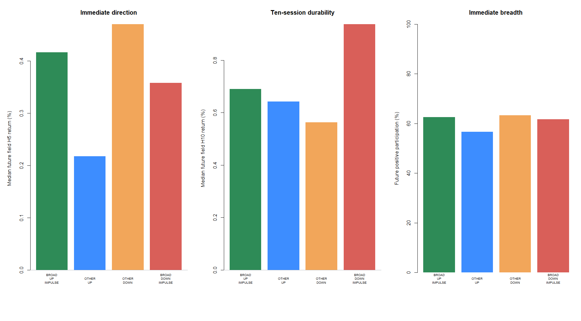
PRIMARY H5 RESULT
The H5 directional contrast was real but economically tiny
+0.058 pp
H5 field-return gap
+0.833 pp
H5 future-participation gap
541 / 444
broad-up / broad-down observations
Direction alone did not clear the frozen effect-size gates.
5
Notes:
Broad-up impulse modestly exceeded broad-down impulse over H5, including a roughly 2.4 percentage-point lower future negative-return rate. Those signs are directionally favorable, but the return and participation gaps are far below the frozen promotion thresholds.
[Sources]
- C:/Users/Franc/OneDrive/Documents/Francis/Peltata Project/Time-Series-Modeling-Gen5/runs/research_workbench/operator_hypothesis_lab/hyp_reg_04_2_fast_cross_sectional_trend_impulse_20260815/hyp_reg_04_2_state_summary.csv
- C:/Users/Franc/OneDrive/Documents/Francis/Peltata Project/Time-Series-Modeling-Gen5/runs/research_workbench/operator_hypothesis_lab/hyp_reg_04_2_fast_cross_sectional_trend_impulse_20260815/hyp_reg_04_2_direction_contrast.csv
- operator_hypothesis_lab/docs/HYP_REG_04_2_FAST_CROSS_SECTIONAL_TREND_IMPULSE_RESULTS.md

Slide 6
NARROW CLUE · NOT PROMOTION
A narrower positive-impulse comparison produced the only attractive clue
+0.198 pp
+5.833 pp
−1.919 pp
BROAD UP IMPULSE minus OTHER UP H5 return
future positive-participation gap
future negative-rate gap
What it suggests
Breadth expansion may distinguish stronger from weaker positive fast states at H5.
Why it still stops
The clue was secondary, unstable by year, weak in circular rank, and reversed at H10.
A promising slice cannot overrule a failed frozen evidence package.
6
Notes:
The broad-up versus other-up comparison is worth recording because it isolates participation impulse inside positive direction. It is not enough to promote the lane: only two of six years were jointly positive, and the H10 relationship reversed.
[Sources]
- C:/Users/Franc/OneDrive/Documents/Francis/Peltata Project/Time-Series-Modeling-Gen5/runs/research_workbench/operator_hypothesis_lab/hyp_reg_04_2_fast_cross_sectional_trend_impulse_20260815/hyp_reg_04_2_positive_impulse_contrast.csv
- C:/Users/Franc/OneDrive/Documents/Francis/Peltata Project/Time-Series-Modeling-Gen5/runs/research_workbench/operator_hypothesis_lab/hyp_reg_04_2_fast_cross_sectional_trend_impulse_20260815/hyp_reg_04_2_calendar_summary.csv
- operator_hypothesis_lab/docs/HYP_REG_04_2_FAST_CROSS_SECTIONAL_TREND_IMPULSE_RESULTS.md

Slide 7
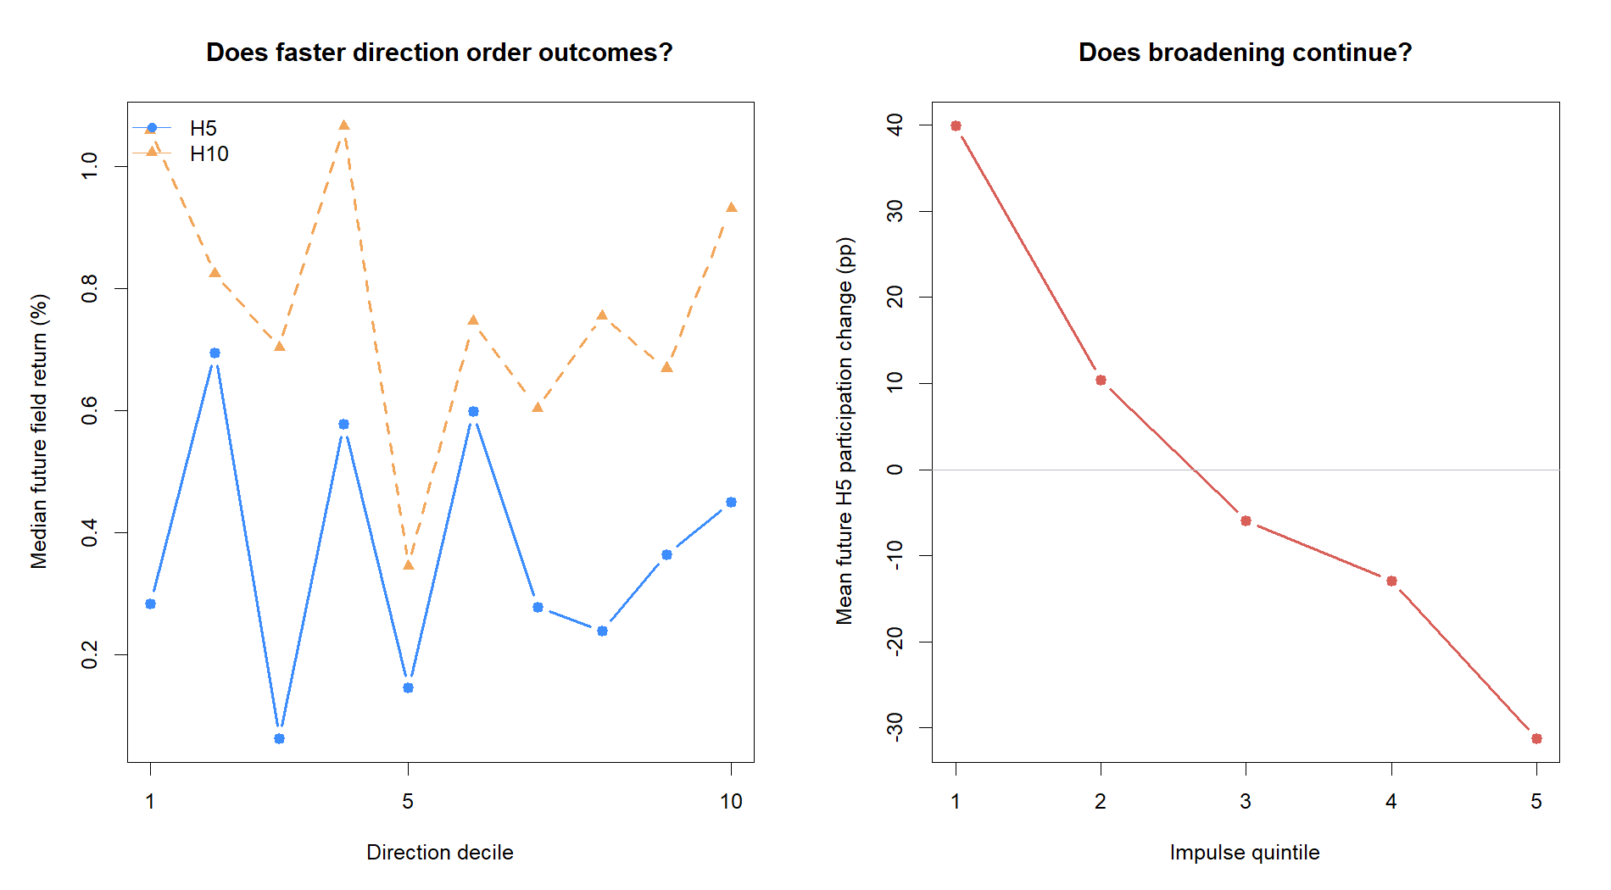
CONTINUITY AUDIT
Continuous ordering showed no durable trend prediction
ρ = −0.024
D5 vs H5 field return
ρ = −0.008
P5 vs H5 field return
ρ = −0.477
I5 vs next H5 participation change
I5 and the future participation change share Pₜ with opposite signs; bounded participation also mean-reverts. Treat the negative rho as failed continuation—not a contrarian signal.
7
Notes:
The continuous tests are the strongest check against a result created by a hand-drawn state boundary. D5 and P5 were effectively unordered. The large negative I5 correlation includes a shared-endpoint algebraic tendency because I5 equals P_t minus P_t-5 while the target equals P_t+5 minus P_t, plus empirical mean reversion in bounded participation.
[Sources]
- C:/Users/Franc/OneDrive/Documents/Francis/Peltata Project/Time-Series-Modeling-Gen5/runs/research_workbench/operator_hypothesis_lab/hyp_reg_04_2_fast_cross_sectional_trend_impulse_20260815/hyp_reg_04_2_continuous_summary.csv
- operator_hypothesis_lab/docs/HYP_REG_04_2_FAST_CROSS_SECTIONAL_TREND_IMPULSE_RESULTS.md
- docs/GEN5_HYP_REG_04_2_FAST_CROSS_SECTIONAL_TREND_IMPULSE_CONTRACT.md

Slide 8
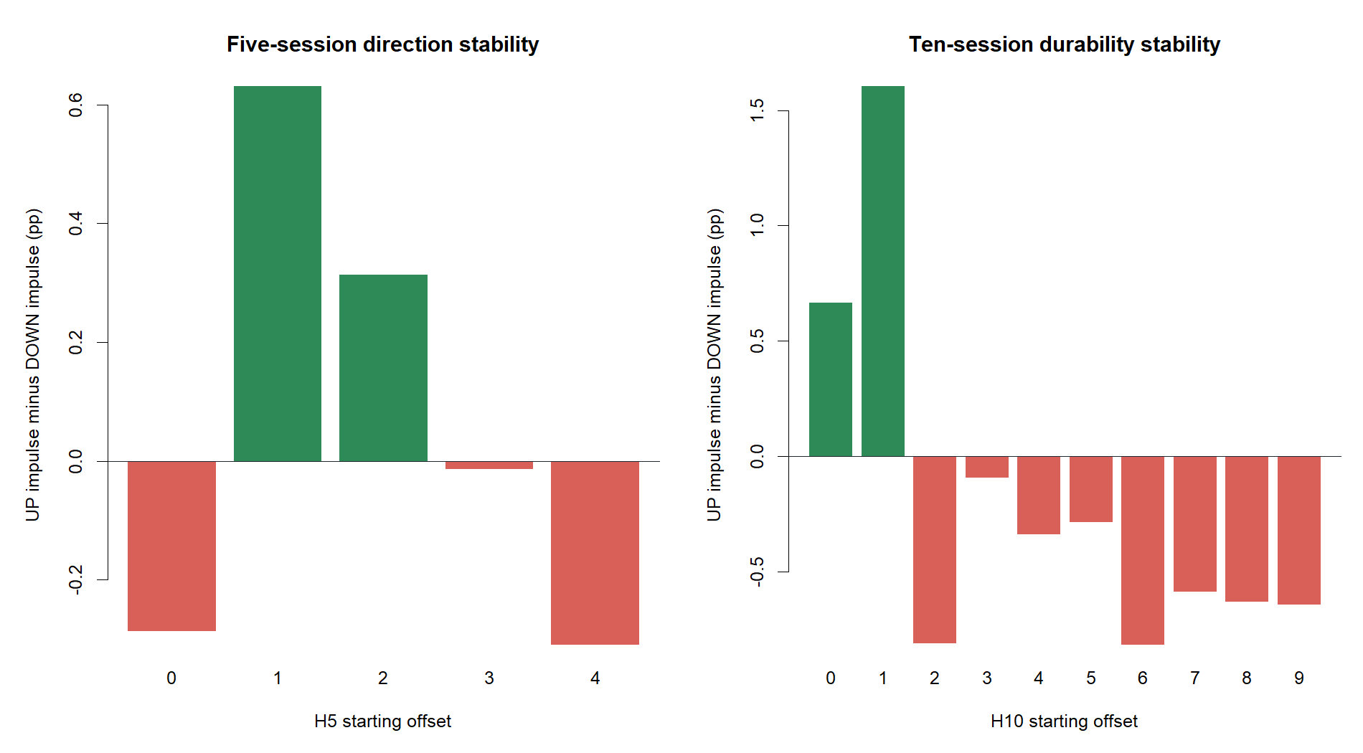
DURABILITY + OFFSETS
The H5 clue reversed by H10 and failed timing transport
−0.247 pp
H10 field-return gap
−8.750 pp
H10 participation gap
2 / 10
H10 offsets jointly positive
Only the first two H10 offsets were positive; the remaining eight were negative.
8
Notes:
This is the decisive continuity failure. The favorable H5 comparison did not merely weaken—it changed sign over H10. Timing transport was poor: two of five H5 offsets and two of ten H10 offsets were jointly positive.
[Sources]
- C:/Users/Franc/OneDrive/Documents/Francis/Peltata Project/Time-Series-Modeling-Gen5/runs/research_workbench/operator_hypothesis_lab/hyp_reg_04_2_fast_cross_sectional_trend_impulse_20260815/hyp_reg_04_2_horizon_summary.csv
- C:/Users/Franc/OneDrive/Documents/Francis/Peltata Project/Time-Series-Modeling-Gen5/runs/research_workbench/operator_hypothesis_lab/hyp_reg_04_2_fast_cross_sectional_trend_impulse_20260815/hyp_reg_04_2_offset_summary.csv
- operator_hypothesis_lab/docs/HYP_REG_04_2_FAST_CROSS_SECTIONAL_TREND_IMPULSE_RESULTS.md

Slide 9
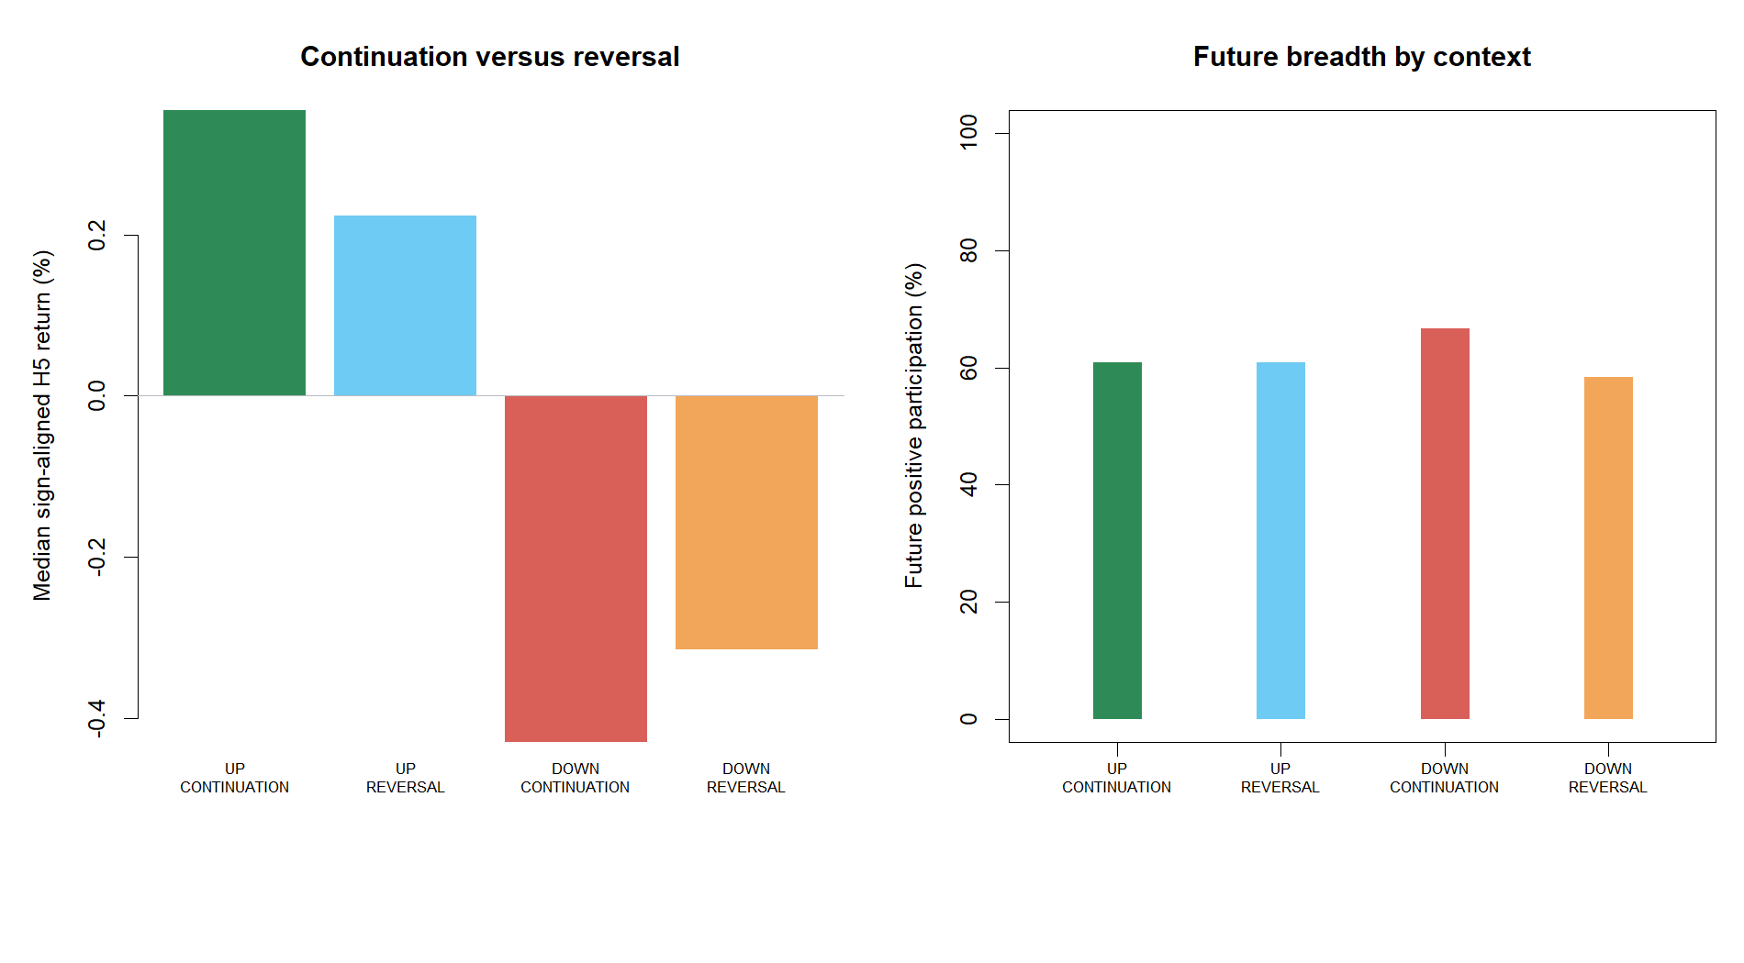
CONTINUATION VS REVERSAL
Fast/slow agreement described context but did not predict persistence
ρ = +0.020
alignment vs H5 signed persistence
+0.355%
UP CONTINUATION H5 median return
−0.431%
DOWN CONTINUATION H5 median return
The labels are intuitive summaries of what was happening; alignment added almost no forward discrimination.
9
Notes:
Continuation and reversal labels make the field behavior legible, but the continuous alignment-persistence correlation was only 0.020. This supports the user's concern: a descriptor can organize the present or recent past without reliably saying what comes next.
[Sources]
- C:/Users/Franc/OneDrive/Documents/Francis/Peltata Project/Time-Series-Modeling-Gen5/runs/research_workbench/operator_hypothesis_lab/hyp_reg_04_2_fast_cross_sectional_trend_impulse_20260815/hyp_reg_04_2_context_summary.csv
- C:/Users/Franc/OneDrive/Documents/Francis/Peltata Project/Time-Series-Modeling-Gen5/runs/research_workbench/operator_hypothesis_lab/hyp_reg_04_2_fast_cross_sectional_trend_impulse_20260815/hyp_reg_04_2_continuous_summary.csv
- operator_hypothesis_lab/docs/HYP_REG_04_2_FAST_CROSS_SECTIONAL_TREND_IMPULSE_RESULTS.md

Slide 10
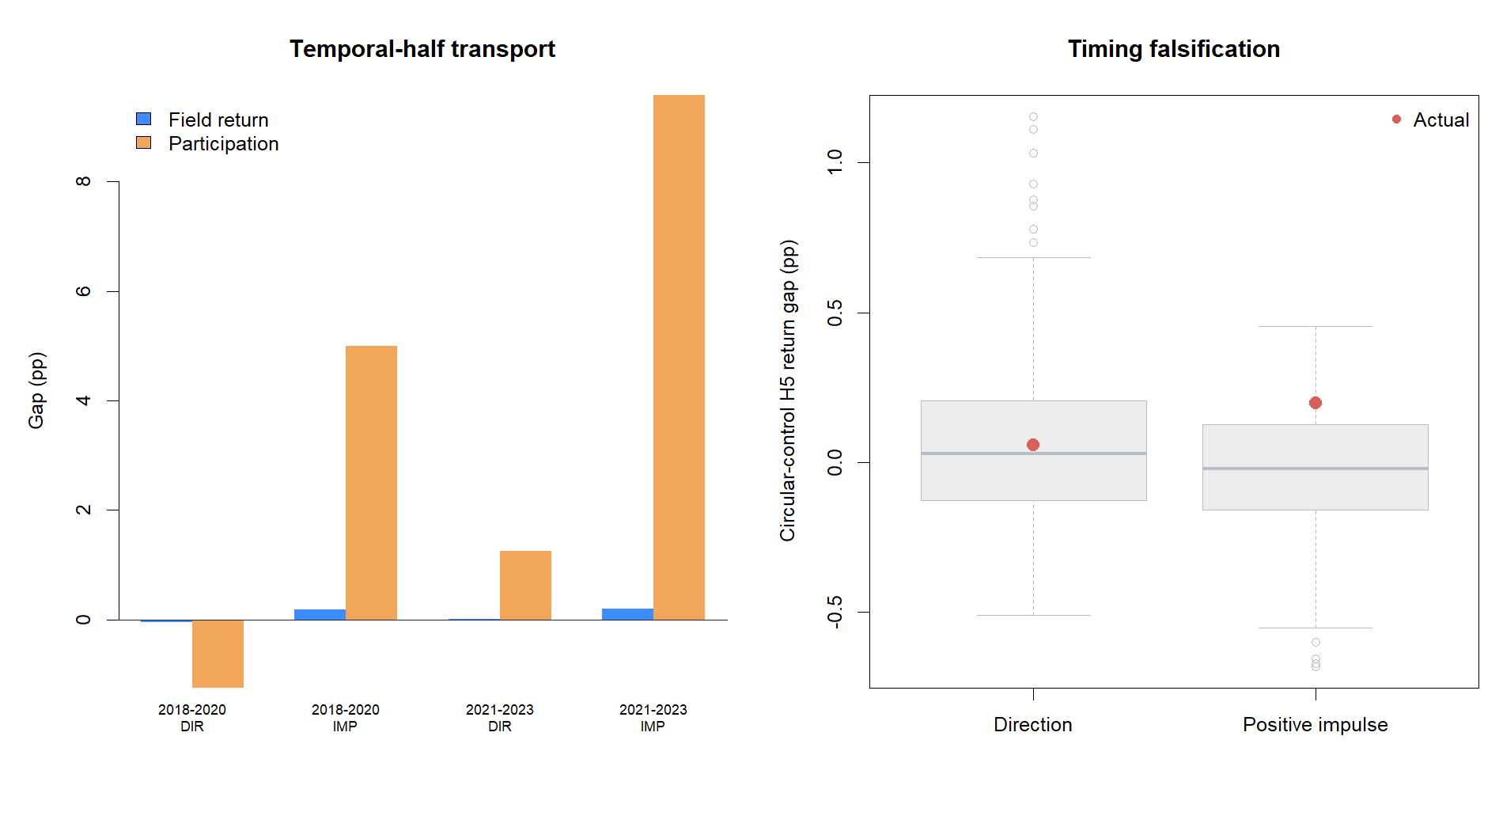
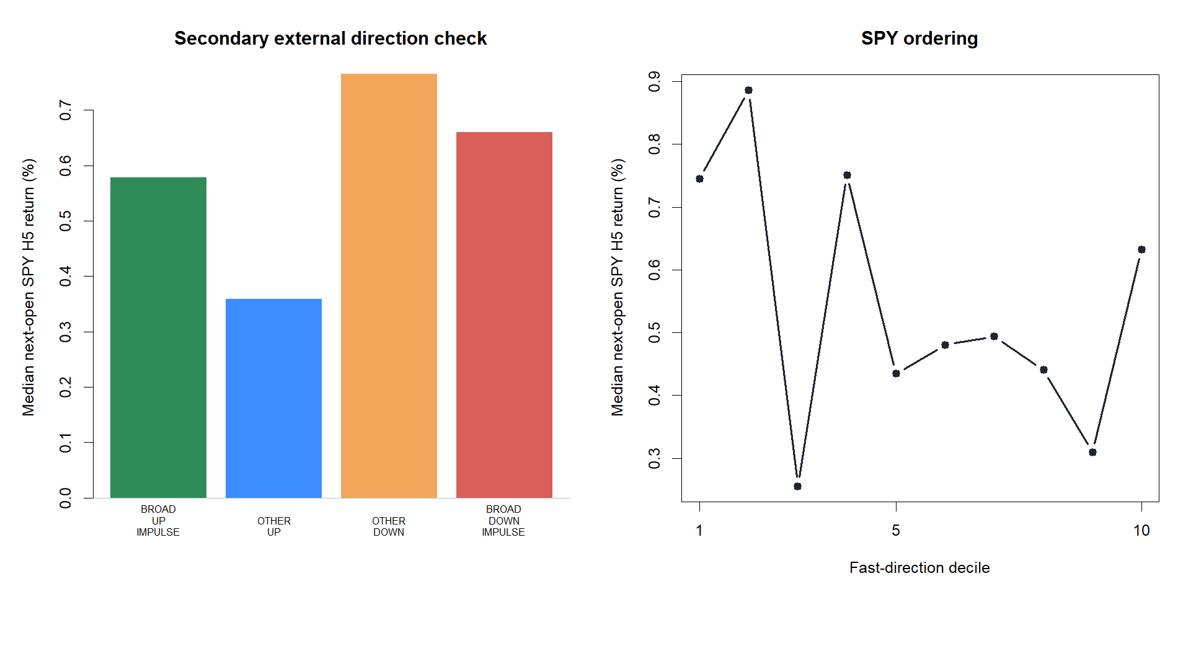
FALSIFICATION SURFACES
Time stability and SPY transport both rejected promotion
2/6 direction years · 2/6 positive-impulse years
SPY gap −0.082 pp · rho −0.030 · AUC 0.525
10
Notes:
Neither calendar transport nor the external SPY target validated the indicator. Both temporal halves had slightly negative direction-return gaps. Circular ranks were near the middle for direction, while the secondary positive-impulse result ranked in the upper 80s but below the frozen 90th-percentile gate.
[Sources]
- C:/Users/Franc/OneDrive/Documents/Francis/Peltata Project/Time-Series-Modeling-Gen5/runs/research_workbench/operator_hypothesis_lab/hyp_reg_04_2_fast_cross_sectional_trend_impulse_20260815/hyp_reg_04_2_period_summary.csv
- C:/Users/Franc/OneDrive/Documents/Francis/Peltata Project/Time-Series-Modeling-Gen5/runs/research_workbench/operator_hypothesis_lab/hyp_reg_04_2_fast_cross_sectional_trend_impulse_20260815/hyp_reg_04_2_calendar_summary.csv
- C:/Users/Franc/OneDrive/Documents/Francis/Peltata Project/Time-Series-Modeling-Gen5/runs/research_workbench/operator_hypothesis_lab/hyp_reg_04_2_fast_cross_sectional_trend_impulse_20260815/hyp_reg_04_2_circular_readout.csv
- C:/Users/Franc/OneDrive/Documents/Francis/Peltata Project/Time-Series-Modeling-Gen5/runs/research_workbench/operator_hypothesis_lab/hyp_reg_04_2_fast_cross_sectional_trend_impulse_20260815/hyp_reg_04_2_spy_summary.csv

Slide 11
DECISION BOUNDARY
Keep ATR%; set down simple horizon-shortening
1 / 10
What we learned
A five-session field is more reactive, but reaction is not continuity.
gates passed
The H5 broadening clue is recorded; it is not strategy authority.
STOP_FAST_TREND_IMPULSE_GATES_FAILED
NO_CONFIRMATION_ATR_JOIN_OR_STRATEGY
H10 reversal blocks ATR%, TSLA/AMD, and unchanged-strategy overlays.
Do not rescue the lane with a speed grid or threshold tuning.
The next regime concept needs a newly justified information source or estimand.
2024+ remained sealed
Accepted ATR% remains untouched and independent.
11
Notes:
Close with the research boundary. The fast derivative POC answers the speed question cleanly: simple shortening did not create a reliable forward trend regime axis. The accepted ATR% volatility measurement remains intact, but no confirmation or strategy join is authorized from this result.
[Sources]
- operator_hypothesis_lab/docs/HYP_REG_04_2_FAST_CROSS_SECTIONAL_TREND_IMPULSE_RESULTS.md
- docs/GEN5_HYP_REG_04_2_FAST_CROSS_SECTIONAL_TREND_IMPULSE_CONTRACT.md
- docs/GEN5_CROSS_SECTIONAL_MARKET_CONTEXT_CANDIDATE_MAP.md
- docs/GEN5_4_DECISION_DIALOGUE_INDEX.md#d133
- C:/Users/Franc/OneDrive/Documents/Francis/Peltata Project/Time-Series-Modeling-Gen5/runs/research_workbench/operator_hypothesis_lab/hyp_reg_04_2_fast_cross_sectional_trend_impulse_20260815/hyp_reg_04_2_gates.csv

