Slide 1
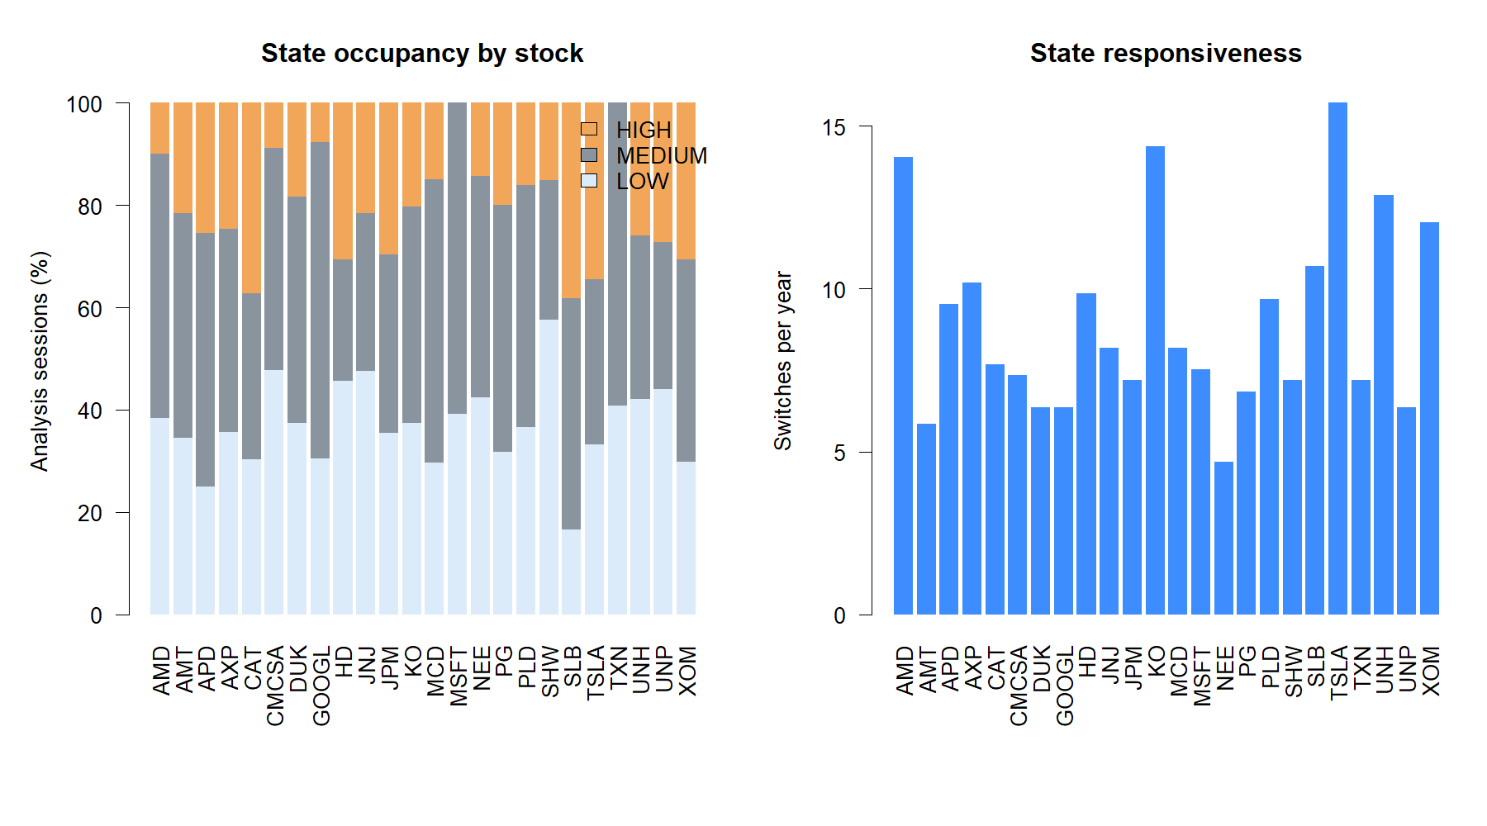
HYP-REG-08.1
Variance ratio measured persistence cleanly—
but the hard SMA entry gate did not
Lo–MacKinlay VR(5) primary · VR(10) durability · 26 assets · 2018–2023
STOP · Stage A 7/7 · Strategy 3/9
1
Notes:
Lead with the two-stage verdict. The variance-ratio construction behaved as intended and produced causal, usable states. The approved strategy question was narrower: does HIGH positive return dependence improve fresh SMA8/14 entries? It did not.
[Sources]
- runs/research_workbench/operator_hypothesis_lab/hyp_reg_08_1_variance_ratio_20260816/hyp_reg_08_1_report.md
- runs/research_workbench/operator_hypothesis_lab/hyp_reg_08_1_variance_ratio_20260816/hyp_reg_08_1_stage_a_gates.csv
- runs/research_workbench/operator_hypothesis_lab/hyp_reg_08_1_variance_ratio_20260816/hyp_reg_08_1_strategy_gates.csv

Slide 2
FROZEN DESIGN
A measurement question came before a strategy question
Stage A · Measurement
Stage B · Policy
Can a causal rolling variance ratio distinguish negative, neutral, and positive serial dependence—and remain usable across assets?
Does permitting fresh next-open SMA8/14 entries only in HIGH improve the unchanged long/cash parent?
Frozen boundaries
Daily adjusted log-close returns; 252-return estimator and 252-score causal rank
VR(5) primary; VR(10) durability only; no threshold or horizon search
2018–2023 development panel; 24 stocks plus SPY and QQQ
2024+ confirmation sealed unless the strategy-relative gates pass
2
Notes:
The lane was frozen as two sequential stages. Strategy outcomes were not accessed until all Stage A construction gates passed. VR(10) was allowed only as a durability check, never as an alternative chosen after seeing results.
[Sources]
- runs/research_workbench/operator_hypothesis_lab/hyp_reg_08_1_variance_ratio_20260816/hyp_reg_08_1_run_spec.csv
- runs/research_workbench/operator_hypothesis_lab/hyp_reg_08_1_variance_ratio_20260816/hyp_reg_08_1_report.md

Slide 3
THEORY · LO–MACKINLAY
Variance ratio asks whether returns accumulate like independent increments
VR(q) = Var[r(t)+...+r(t−q+1)] / (q × Var[r(t)])
VR < 1
VR ≈ 1
VR > 1
Negative dependence
Independent increments
Positive dependence
Reversals partially cancel; mean-reversion-like path
The q-period variance scales roughly linearly
Returns reinforce; persistence or momentum-like path
VR is not a direction forecast, a stationarity proof, or alpha. It describes dependence in completed returns at a chosen scale.
3
Notes:
Chan introduces variance-ratio testing as a way to distinguish random-walk-like behavior from mean-reverting or momentum-like dependence. Lo and MacKinlay developed the specification test and finite-sample treatment. Our implementation used the overlapping, heteroskedasticity-robust form because financial return variance is not constant.
[Sources]
- C:/Users/Franc/OneDrive/Documents/Francis/Trading Literature/Algorithmic Trading - Winning Strategies and Their Rationale 2013.pdf, printed pp. 44-46 / PDF pp. 62-64
- https://web.mit.edu/~alo/www/Papers/lo-mackinlay-88.html
- https://web.mit.edu/Alo/www/Papers/lo-mackinlay-89.html

Slide 4
CAUSAL STATE MACHINE
The state ranks today's robust z-score against only prior evidence
252 completed log returns → robust VR(5) z-score → prior 252-score percentile → hysteretic state
LOW
MEDIUM
HIGH
enter: z < 0 and percentile ≤ 30
remain: z < 0 and percentile ≤ 40
all other finite observations
neutral bridge between signed states
enter: z > 0 and percentile ≥ 70
remain: z > 0 and percentile ≥ 60
p-values were reported for interpretation, never used as a capital gate. Early observations remained NA when the full causal history was unavailable.
4
Notes:
The sign requirement prevents a high percentile among negative z-scores from being mislabeled as positive dependence. Hysteresis reduces one-day state chatter. The first finite state was 2018-01-03 because the provider supplied 503 prehistory sessions—enough for both frozen 252 windows but short of the preferred 550-session buffer. We retained NA states rather than shorten or backfill either window.
[Sources]
- runs/research_workbench/operator_hypothesis_lab/hyp_reg_08_1_variance_ratio_20260816/hyp_reg_08_1_run_spec.csv
- runs/research_workbench/operator_hypothesis_lab/hyp_reg_08_1_variance_ratio_20260816/hyp_reg_08_1_stage_a_gates.csv
- runs/research_workbench/operator_hypothesis_lab/hyp_reg_08_1_variance_ratio_20260816/hyp_reg_08_1_report.md

Slide 5
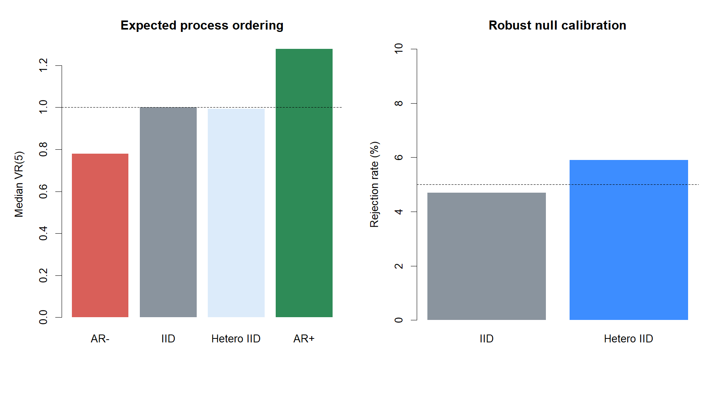
STAGE A · CALIBRATION
Synthetic processes behaved in the required order
0.779
AR− median VR(5)
1.000 / 0.993
IID / hetero-IID median
1.277
AR+ median VR(5)
Robust null rejection: 4.7% IID · 5.9% hetero-IID
5
Notes:
This is the core implementation sanity check. Negative autocorrelation produced VR below one, IID processes stayed near one, and positive autocorrelation produced VR above one. The robust null rejection rates remained near the nominal five-percent level for both homoskedastic and heteroskedastic IID simulations.
[Sources]
- runs/research_workbench/operator_hypothesis_lab/hyp_reg_08_1_variance_ratio_20260816/hyp_reg_08_1_stage_a_gates.csv
- C:/Users/Franc/OneDrive/Documents/Francis/Peltata Project/Time-Series-Modeling-Gen5/runs/research_workbench/operator_hypothesis_lab/hyp_reg_08_1_variance_ratio_20260816/hyp_reg_08_1_synthetic_summary.csv
- https://web.mit.edu/Alo/www/Papers/lo-mackinlay-89.html

Slide 6
STAGE A · USABILITY
The real panel produced broad, stable-enough state coverage
22 / 24
stocks with ≥5% HIGH and LOW
37 / 43 / 21%
median LOW / MEDIUM / HIGH
0
append-invariance difference
All 7/7 construction gates passed before strategy contact.
6
Notes:
State usability asks whether the indicator creates meaningful labels rather than living almost entirely in one state. Twenty-two of twenty-four strategy stocks had at least five percent occupancy in both HIGH and LOW. Append invariance and sign semantics were exact.
[Sources]
- runs/research_workbench/operator_hypothesis_lab/hyp_reg_08_1_variance_ratio_20260816/hyp_reg_08_1_stage_a_gates.csv
- C:/Users/Franc/OneDrive/Documents/Francis/Peltata Project/Time-Series-Modeling-Gen5/runs/research_workbench/operator_hypothesis_lab/hyp_reg_08_1_variance_ratio_20260816/hyp_reg_08_1_state_diagnostics.csv
- C:/Users/Franc/OneDrive/Documents/Francis/Peltata Project/Time-Series-Modeling-Gen5/runs/research_workbench/operator_hypothesis_lab/hyp_reg_08_1_variance_ratio_20260816/hyp_reg_08_1_causality_audit.csv

Slide 7
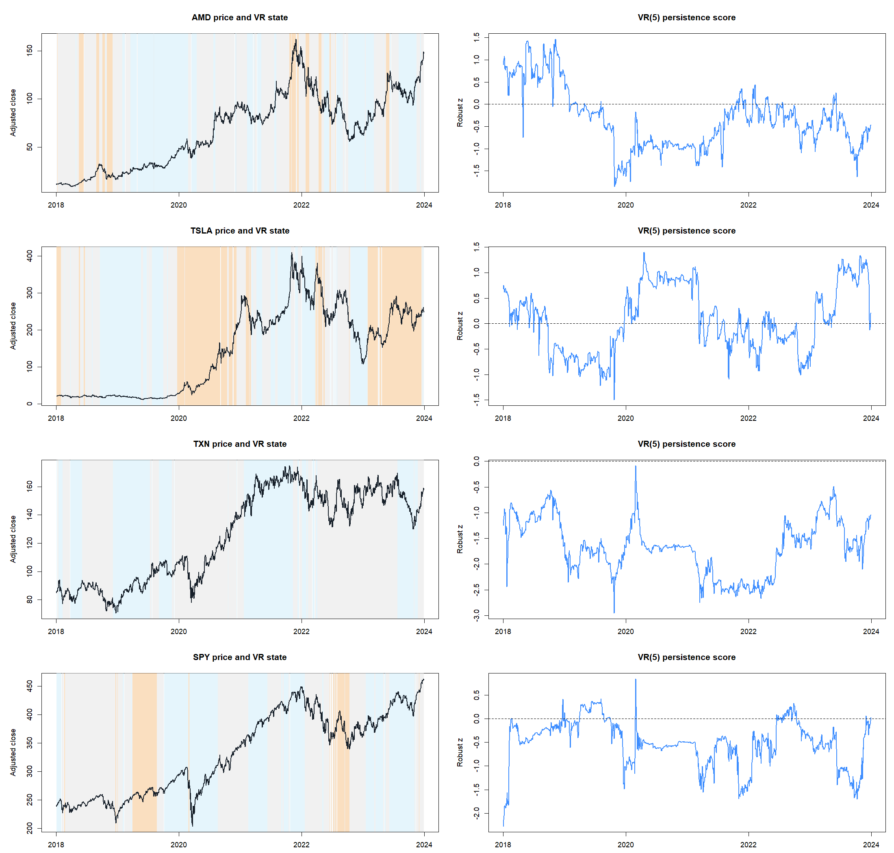
MEASUREMENT TAPES
Variance-ratio states describe completed return dependence
7
Notes:
Use these tapes to read the state correctly. Orange HIGH shading means the completed-return path had unusually positive serial dependence relative to that asset's own prior history. It does not mean the asset must rise next; a persistent decline can also be HIGH.
[Sources]
- C:/Users/Franc/OneDrive/Documents/Francis/Peltata Project/Time-Series-Modeling-Gen5/runs/research_workbench/operator_hypothesis_lab/hyp_reg_08_1_variance_ratio_20260816/hyp_reg_08_1_ledger.csv
- C:/Users/Franc/OneDrive/Documents/Francis/Peltata Project/Time-Series-Modeling-Gen5/runs/research_workbench/operator_hypothesis_lab/hyp_reg_08_1_variance_ratio_20260816/hyp_reg_08_1_representative_selection.csv
- runs/research_workbench/operator_hypothesis_lab/hyp_reg_08_1_variance_ratio_20260816/hyp_reg_08_1_report.md

Slide 8
STAGE A PASSED
A coherent measurement
still has to earn the right
to gate a strategy
Next question: did HIGH improve fresh SMA8/14 entries?
8
Notes:
Pause before strategy results. Passing construction means the estimator is behaving and the labels are causal and usable. It does not establish that HIGH identifies better entries for any particular policy.
[Sources]
- runs/research_workbench/operator_hypothesis_lab/hyp_reg_08_1_variance_ratio_20260816/hyp_reg_08_1_stage_a_gates.csv
- runs/research_workbench/operator_hypothesis_lab/hyp_reg_08_1_variance_ratio_20260816/hyp_reg_08_1_report.md

Slide 9
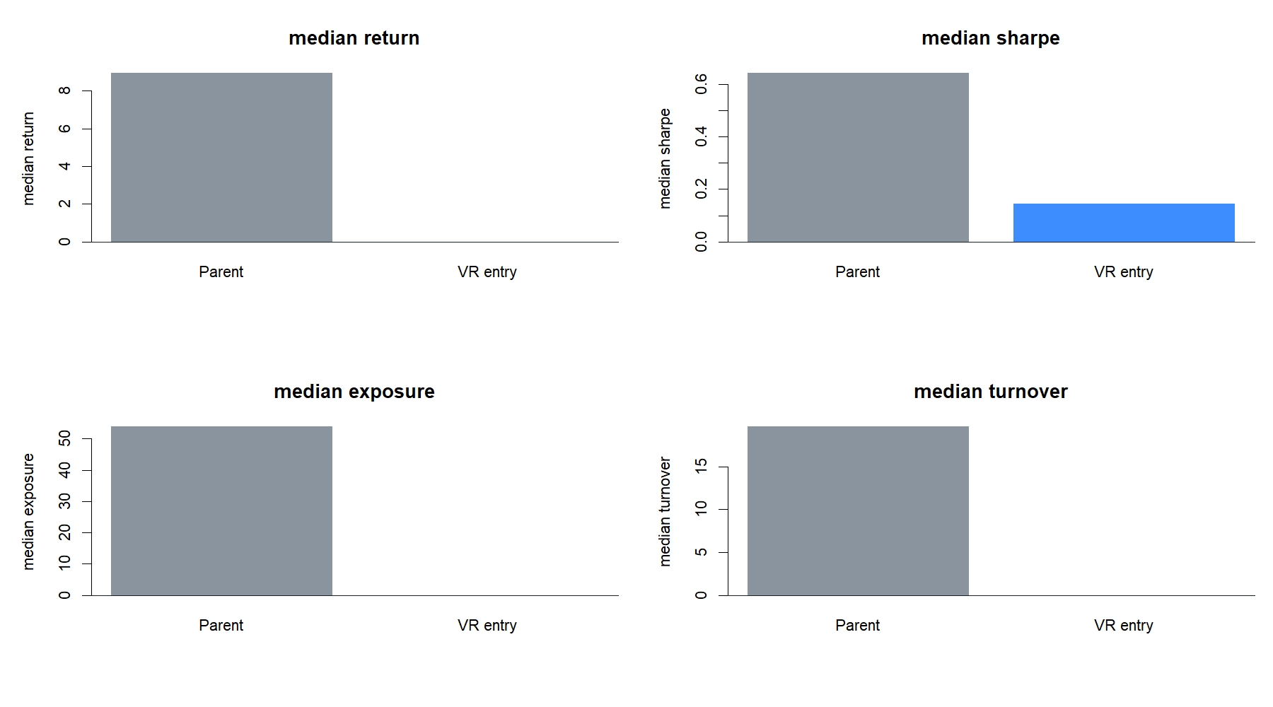
STAGE B · POLICY
Only fresh entries changed; the SMA parent remained frozen
Frozen mechanics
Fresh SMA8 > SMA14 cross at close
Next-open long entry at 1x only if state = HIGH
Skipped signals are not deferred
Exit only on parent SMA8 < SMA14 cross
5 bp per side primary; 10 bp stress
Annual cell reset; profits compound within the cell
This is a hard entry-permission test, not a continuous position-sizing overlay.
9
Notes:
The parent policy was reproduced exactly before comparison. The overlay never changes exits and never enters later if a cross was rejected. This isolates one causal question: was HIGH a useful condition at the moment a fresh parent entry appeared?
[Sources]
- runs/research_workbench/operator_hypothesis_lab/hyp_reg_08_1_variance_ratio_20260816/hyp_reg_08_1_run_spec.csv
- C:/Users/Franc/OneDrive/Documents/Francis/Peltata Project/Time-Series-Modeling-Gen5/runs/research_workbench/operator_hypothesis_lab/hyp_reg_08_1_variance_ratio_20260816/hyp_reg_08_1_parent_reproduction.csv
- runs/research_workbench/operator_hypothesis_lab/hyp_reg_08_1_variance_ratio_20260816/hyp_reg_08_1_strategy_gates.csv

Slide 10
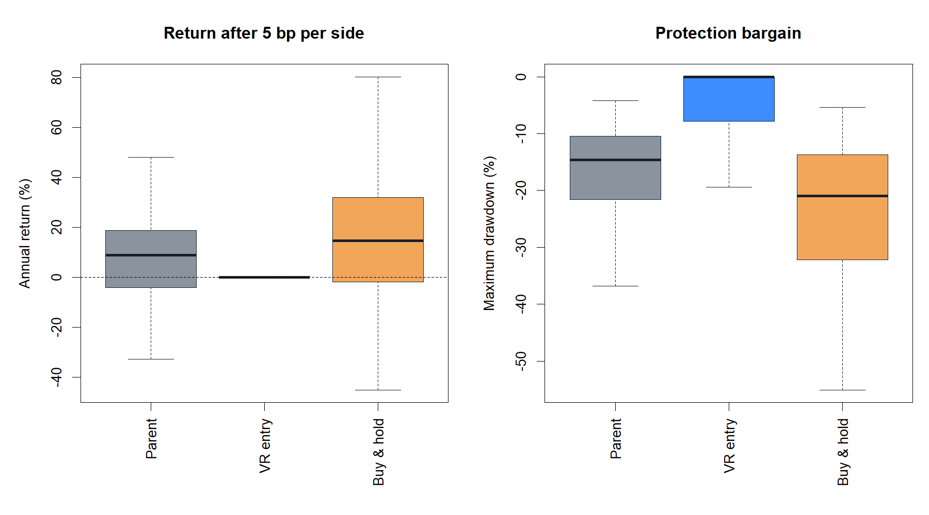
STAGE B · HEADLINE OUTCOME
The hard gate protected capital by mostly becoming cash
0.00%
overlay median annual return
8.95%
parent median annual return
0.0%
overlay median exposure
256 overlay trades vs 1,394 parent trades
10
Notes:
The overlay reduced drawdown, but the bargain was not acceptable: median annual exposure was zero, return was zero, and Sharpe was 0.497 lower than the parent. Avoid describing this as successful risk control; in the median annual cell, the gate simply did not participate.
[Sources]
- runs/research_workbench/operator_hypothesis_lab/hyp_reg_08_1_variance_ratio_20260816/hyp_reg_08_1_policy_panel.csv
- runs/research_workbench/operator_hypothesis_lab/hyp_reg_08_1_variance_ratio_20260816/hyp_reg_08_1_strategy_gates.csv
- runs/research_workbench/operator_hypothesis_lab/hyp_reg_08_1_variance_ratio_20260816/hyp_reg_08_1_report.md

Slide 11
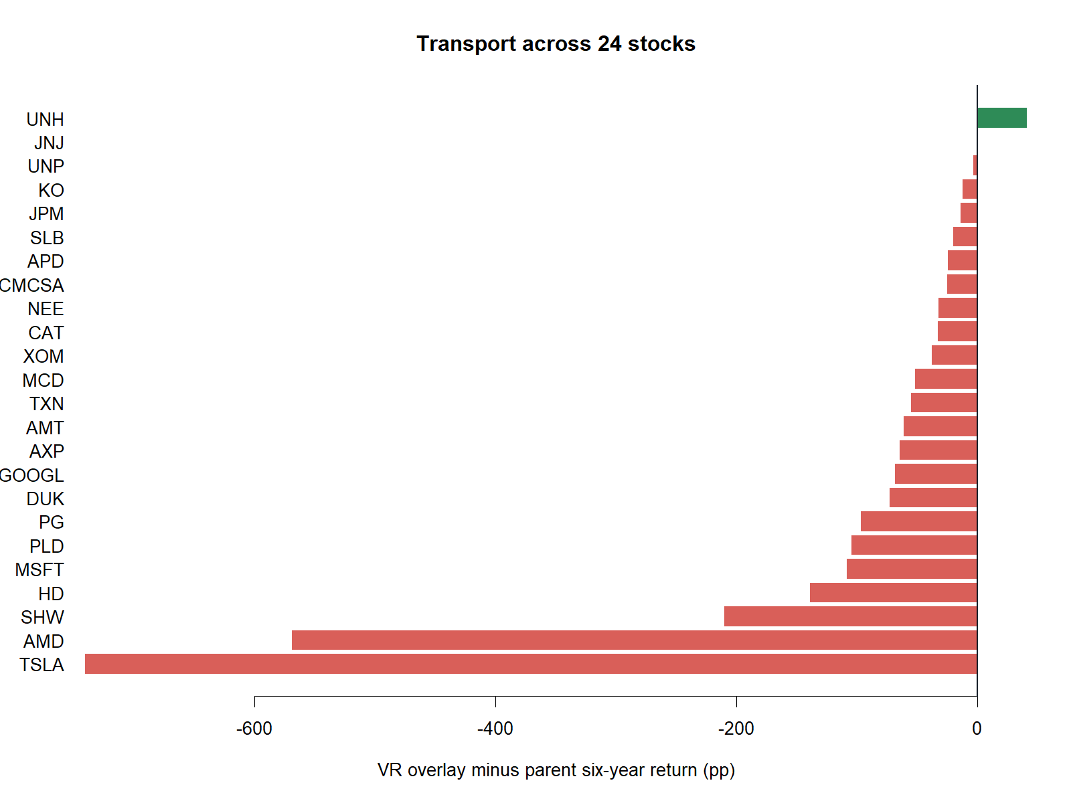
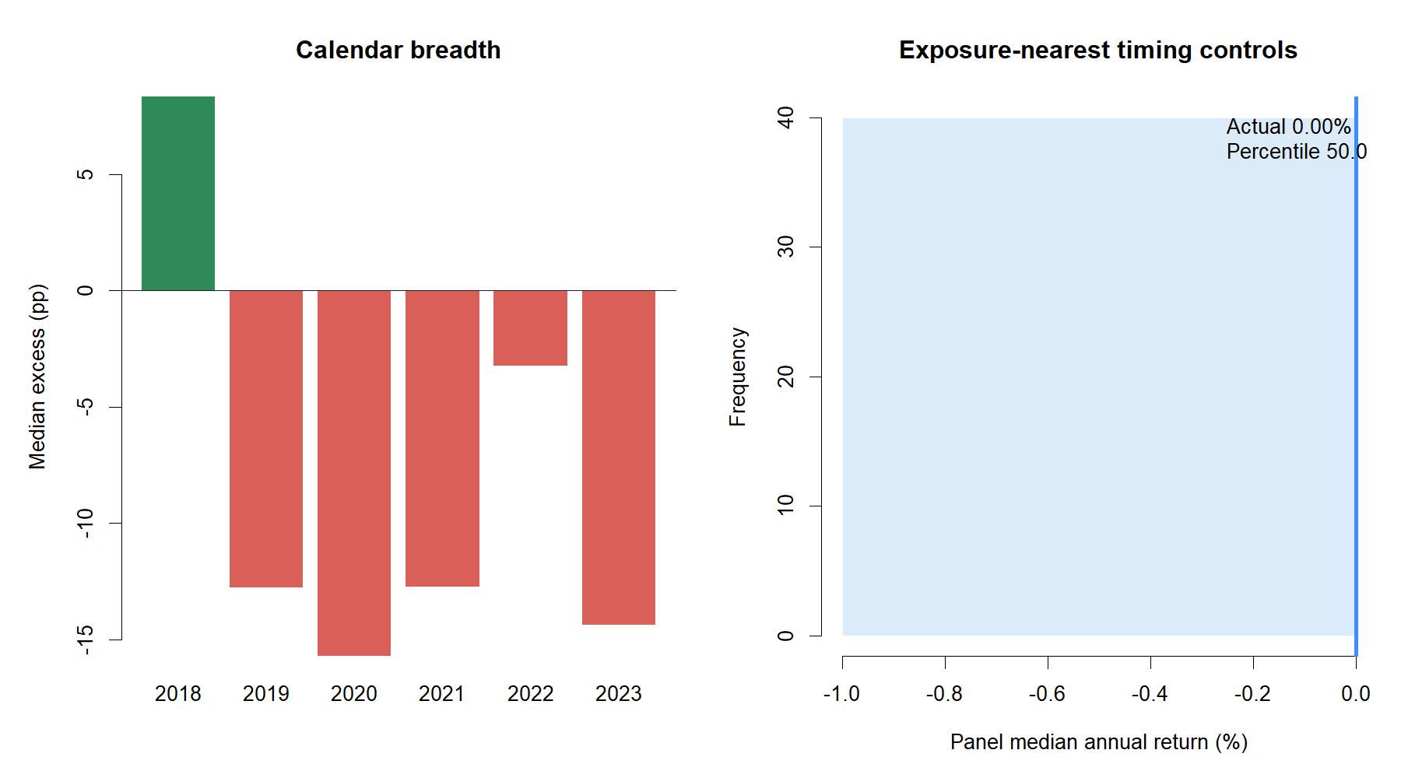
BREADTH · TIME
The result did not transport across assets or calendar years
1 / 24
1 / 6
assets improved over six years
years with positive median excess
Only UNH improved. The positive year was 2018; all five later development years were negative.
11
Notes:
Asset and year breadth are essential because a pooled median can conceal concentration. Only one asset improved across the full development period, and only one of six years had positive median excess return. This is not a narrow miss.
[Sources]
- runs/research_workbench/operator_hypothesis_lab/hyp_reg_08_1_variance_ratio_20260816/hyp_reg_08_1_asset_summary.csv
- runs/research_workbench/operator_hypothesis_lab/hyp_reg_08_1_variance_ratio_20260816/hyp_reg_08_1_year_summary.csv
- runs/research_workbench/operator_hypothesis_lab/hyp_reg_08_1_variance_ratio_20260816/hyp_reg_08_1_strategy_gates.csv

Slide 12
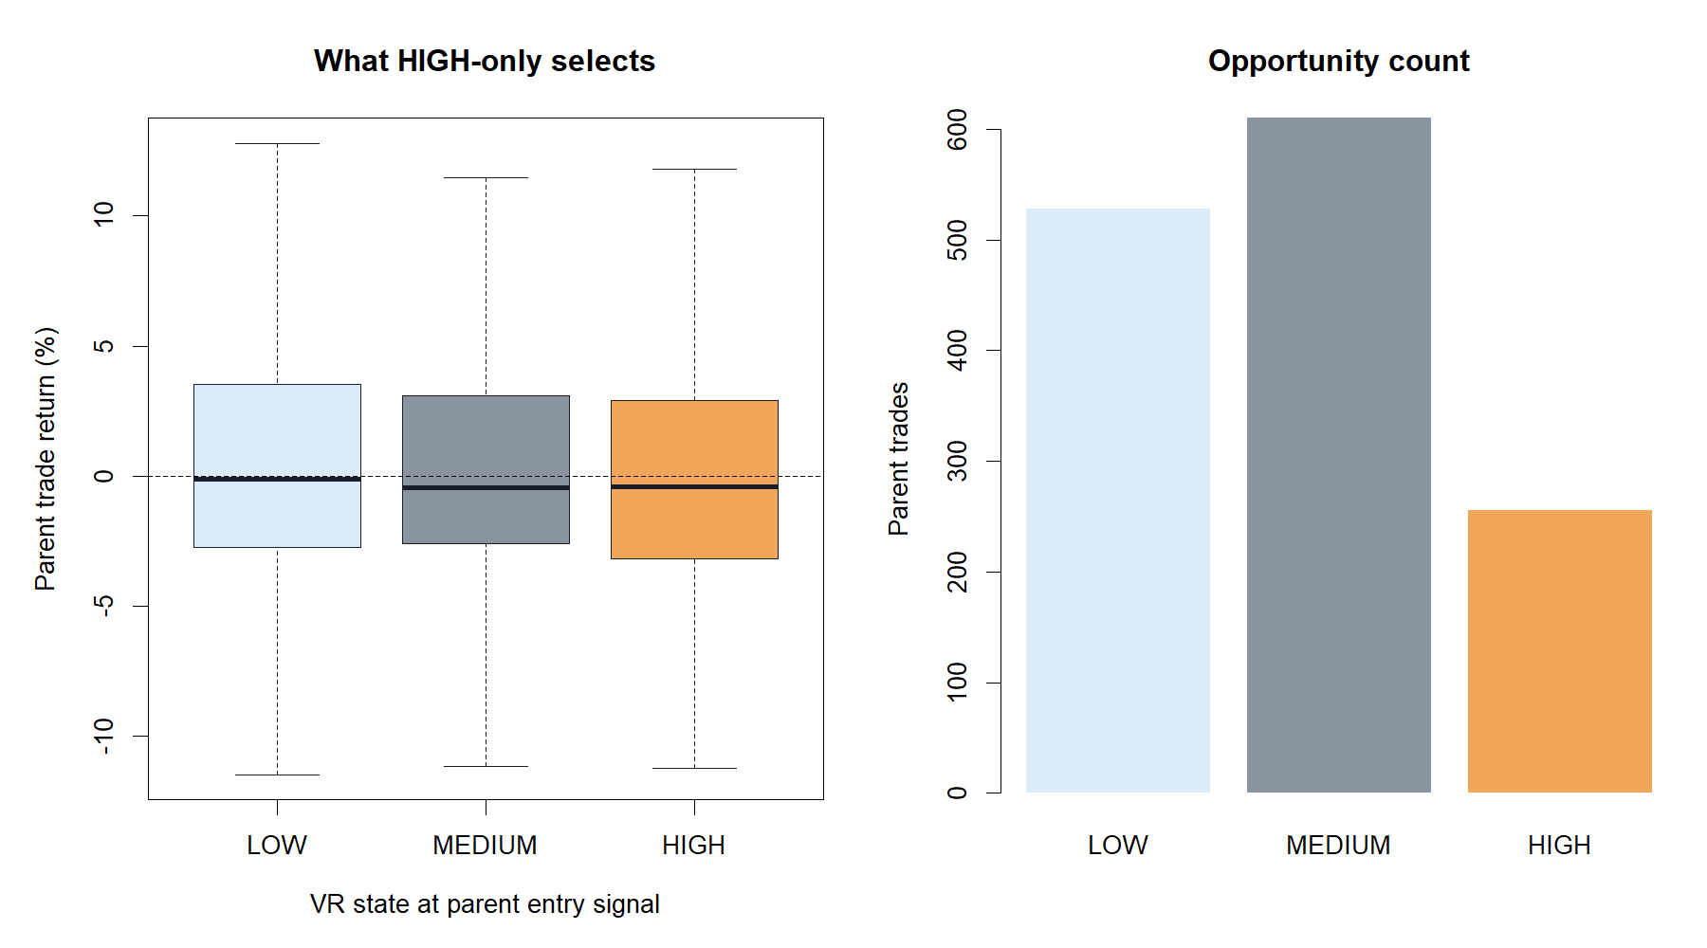
ENTRY-STATE AUDIT
HIGH did not identify better parent trades
44.1%
HIGH entry hit rate
−0.43%
HIGH median trade return
48.3%
LOW entry hit rate
The HIGH group ranked below LOW on hit rate and median return.
12
Notes:
This audit asks the intuitive question directly: among the parent trades that actually occurred, were those initiated in HIGH better? No. HIGH trades had a lower hit rate and a more negative median than LOW trades. Mean returns were positive in all states because a small number of large winners matter, but HIGH did not lead.
[Sources]
- runs/research_workbench/operator_hypothesis_lab/hyp_reg_08_1_variance_ratio_20260816/hyp_reg_08_1_entry_state_audit.csv
- C:/Users/Franc/OneDrive/Documents/Francis/Peltata Project/Time-Series-Modeling-Gen5/runs/research_workbench/operator_hypothesis_lab/hyp_reg_08_1_variance_ratio_20260816/hyp_reg_08_1_trades.csv
- runs/research_workbench/operator_hypothesis_lab/hyp_reg_08_1_variance_ratio_20260816/hyp_reg_08_1_strategy_gates.csv

Slide 13
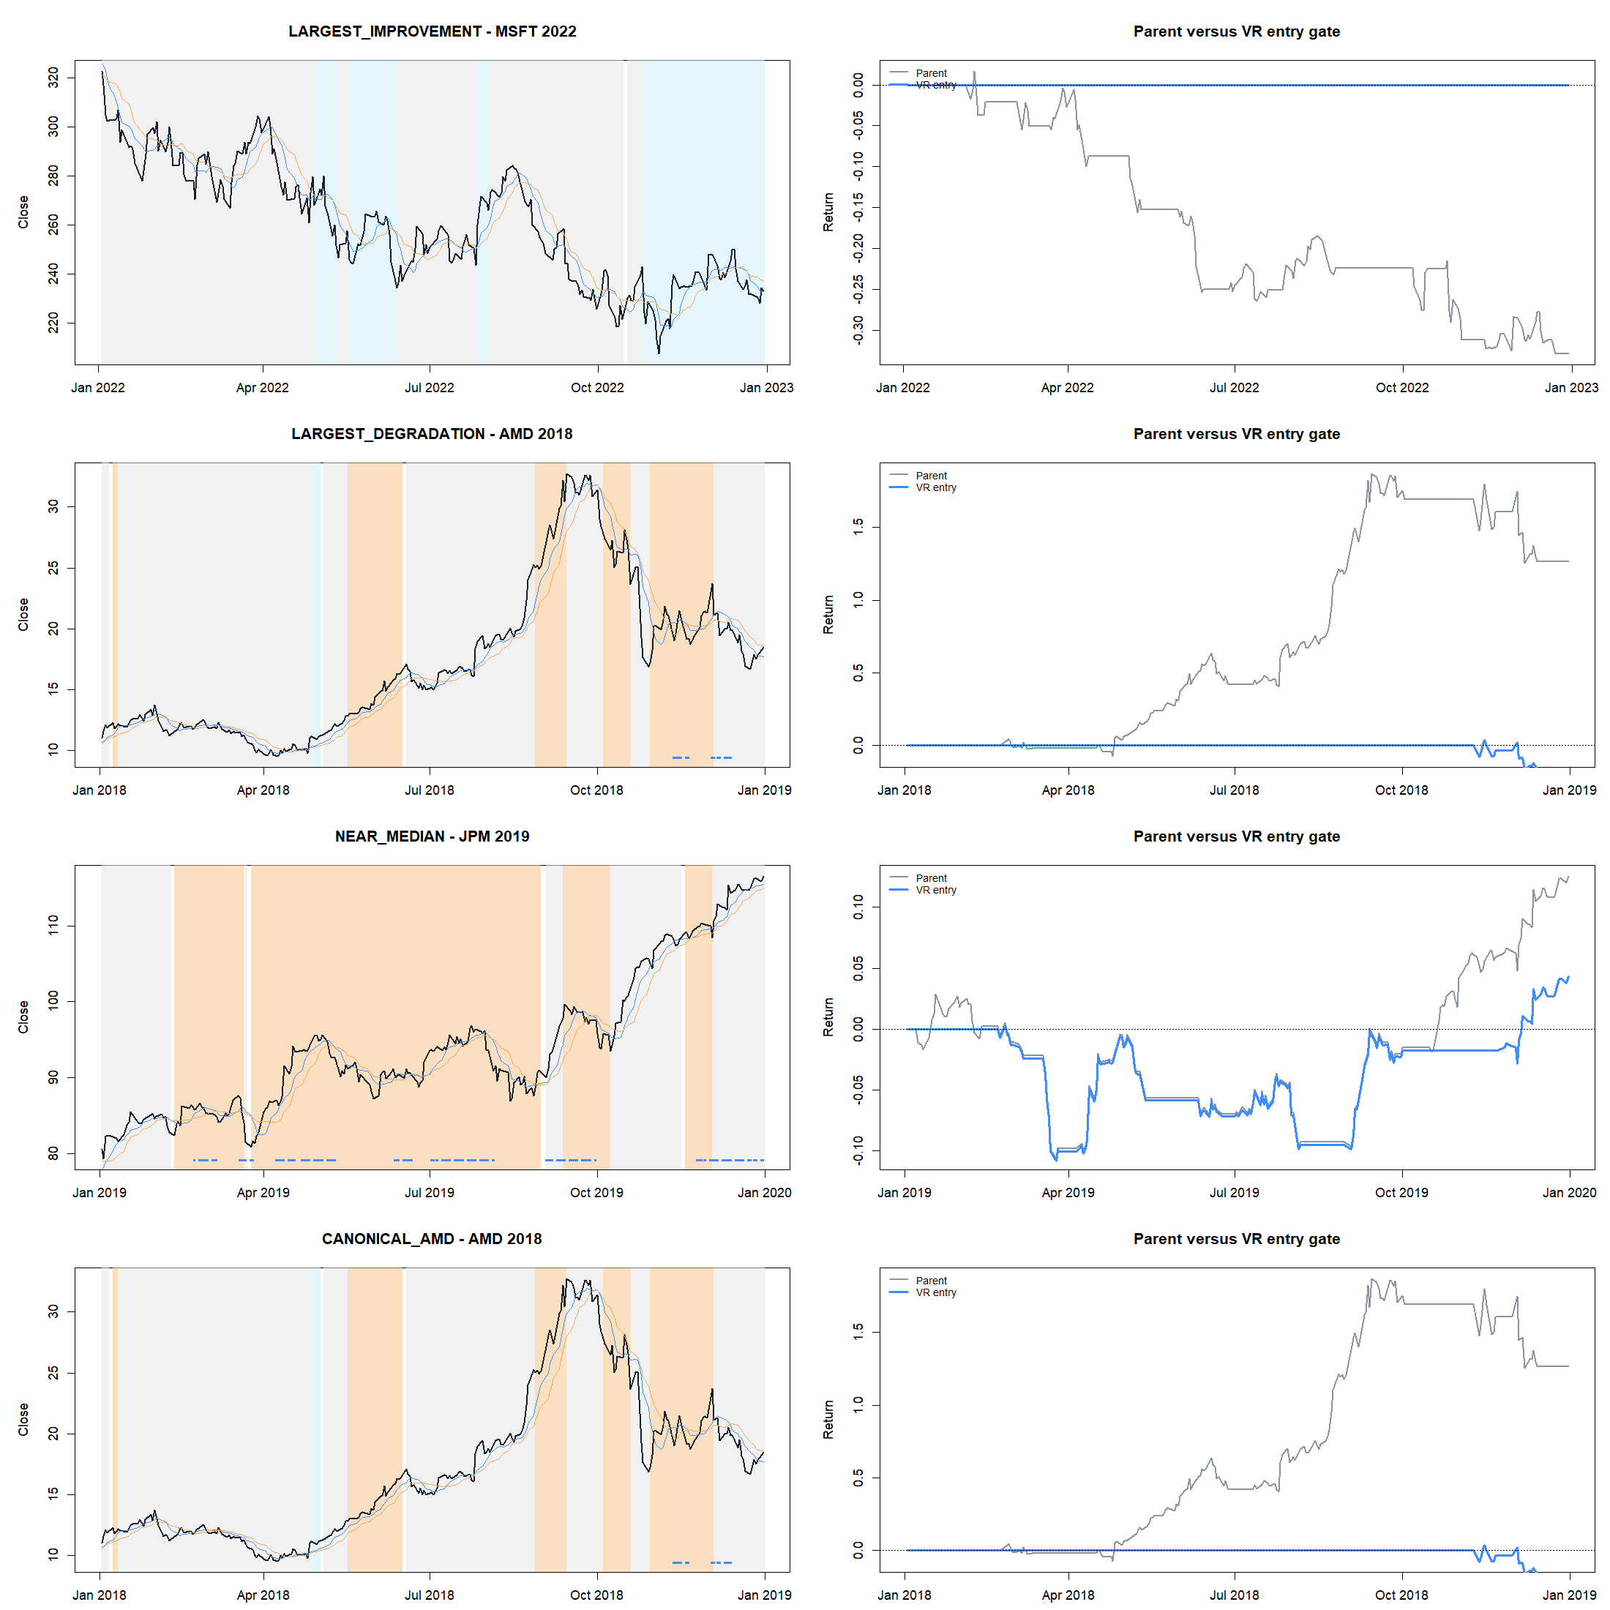
REPRESENTATIVE BEHAVIOR
Trade tapes reveal both protection and opportunity-cost failure
50th pct
timing-control rank
0.00%
actual and nearest-control return
Interpretation
The hard gate was not better timed than calendar-preserving pseudo-states with similarly tiny exposure.
13
Notes:
MSFT 2022 is the best protection example: refusing entries avoided parent losses. AMD 2018 is the central failure: the gate missed a major parent momentum run. Across the panel, the actual timing ranked at the median of circular controls, and exposure-nearest controls were also cash-like.
[Sources]
- runs/research_workbench/operator_hypothesis_lab/hyp_reg_08_1_variance_ratio_20260816/hyp_reg_08_1_control_panel.csv
- C:/Users/Franc/OneDrive/Documents/Francis/Peltata Project/Time-Series-Modeling-Gen5/runs/research_workbench/operator_hypothesis_lab/hyp_reg_08_1_variance_ratio_20260816/hyp_reg_08_1_placebo_readout.csv
- C:/Users/Franc/OneDrive/Documents/Francis/Peltata Project/Time-Series-Modeling-Gen5/runs/research_workbench/operator_hypothesis_lab/hyp_reg_08_1_variance_ratio_20260816/hyp_reg_08_1_representative_selection.csv
- runs/research_workbench/operator_hypothesis_lab/hyp_reg_08_1_variance_ratio_20260816/hyp_reg_08_1_strategy_gates.csv

Slide 14
DECISION BOUNDARY
Retain the measurement; set down the hard entry gate
7 / 7
3 / 9
What survives
construction gates
strategy gates
A tested causal Lo–MacKinlay VR implementation
Usable signed LOW / MEDIUM / HIGH states
STOP_VARIANCE_RATIO_STRATEGY_RELATIVE_
GATES_FAILED_CONFIRMATION_NOT_RUN
A clean example of measurement validity ≠ policy value
What remains closed
No threshold, horizon, or asset rescue
Next roadmap discussion: T2 robust slope/fit asks a different trend-quality question. It is not authorized by this STOP alone.
No ATR stacking or alternate strategy contact
No 2024+ confirmation inspection
14
Notes:
Close without rescue. Stage A produced a valuable, literature-grounded measurement artifact. Stage B decisively rejected this hard HIGH-only entry-permission use. The 2024+ confirmation period remained sealed. The next roadmap concept requires a separate operator decision.
[Sources]
- runs/research_workbench/operator_hypothesis_lab/hyp_reg_08_1_variance_ratio_20260816/hyp_reg_08_1_report.md
- runs/research_workbench/operator_hypothesis_lab/hyp_reg_08_1_variance_ratio_20260816/hyp_reg_08_1_stage_a_gates.csv
- runs/research_workbench/operator_hypothesis_lab/hyp_reg_08_1_variance_ratio_20260816/hyp_reg_08_1_strategy_gates.csv
- runs/research_workbench/operator_hypothesis_lab/hyp_reg_08_1_variance_ratio_20260816/hyp_reg_08_1_run_spec.csv

