Slide 1
EDGE DISCOVERY LAB · NARROW FALSIFICATION
Attention-stock distinction
20
The positive effect does not reproduce.
matched pairs
Yet the matching itself fails balance—showing that attention and core events occupy meaningfully different pre-outcome environments.
INCONCLUSIVE · MATCH BALANCE FAILED
No matcher rescue after outcomes
Notes:
This sequel tests the wide-atlas clue that attention stocks carried most of the apparent five-session rebound. The result has two layers: the positive distinction fails in the matched sample, and the predeclared balance gate also fails.
[Sources]
- Local report: runs/research_workbench/edge_discovery_lab/edl_ms_01_attention_falsification_20260831/report.md
- Local falsification status: runs/research_workbench/edge_discovery_lab/edl_ms_01_attention_falsification_20260831/falsification_status.csv
- Local primary day-five test: runs/research_workbench/edge_discovery_lab/edl_ms_01_attention_falsification_20260831/primary_day5_test.csv
[/Sources]

Slide 2
EDGE DISCOVERY LAB · EDL-MS-01
The comparison was frozen before forward returns were attached
One target state, one outcome horizon, one paired inferential test.
20
4
5
0.25
same-year pairs
matching variables
forward sessions
balance limit
1:1 without replacement
all observed before outcome
sole inferential horizon
maximum absolute SMD
MATCH ON EVENT GEOMETRY
PREDECLARED PASS LOGIC
Minimum intraday return: breach severity.
Mean attention-minus-core day-five return must be positive.
Close-location value: strength of reclaim.
Exact one-sided sign-flip p ≤ .05.
Log abnormal dollar volume: event attention/scale.
All leave-one-year and leave-one-attention-symbol means stay positive.
Event date: calendar proximity within year.
Adjusted daily · 2018–2023 TRAIN · matched falsification
02
Notes:
The matching pool contained only stock events in the triggered-proxy and strong-reclaim state. Matching occurred inside exact calendar year and was completed before outcomes were attached.
[Sources]
- Local frozen run specification: runs/research_workbench/edge_discovery_lab/edl_ms_01_attention_falsification_20260831/run_spec.csv
- Local matching enrollment audit: runs/research_workbench/edge_discovery_lab/edl_ms_01_attention_falsification_20260831/matching_enrollment_audit.csv
[/Sources]

Slide 3
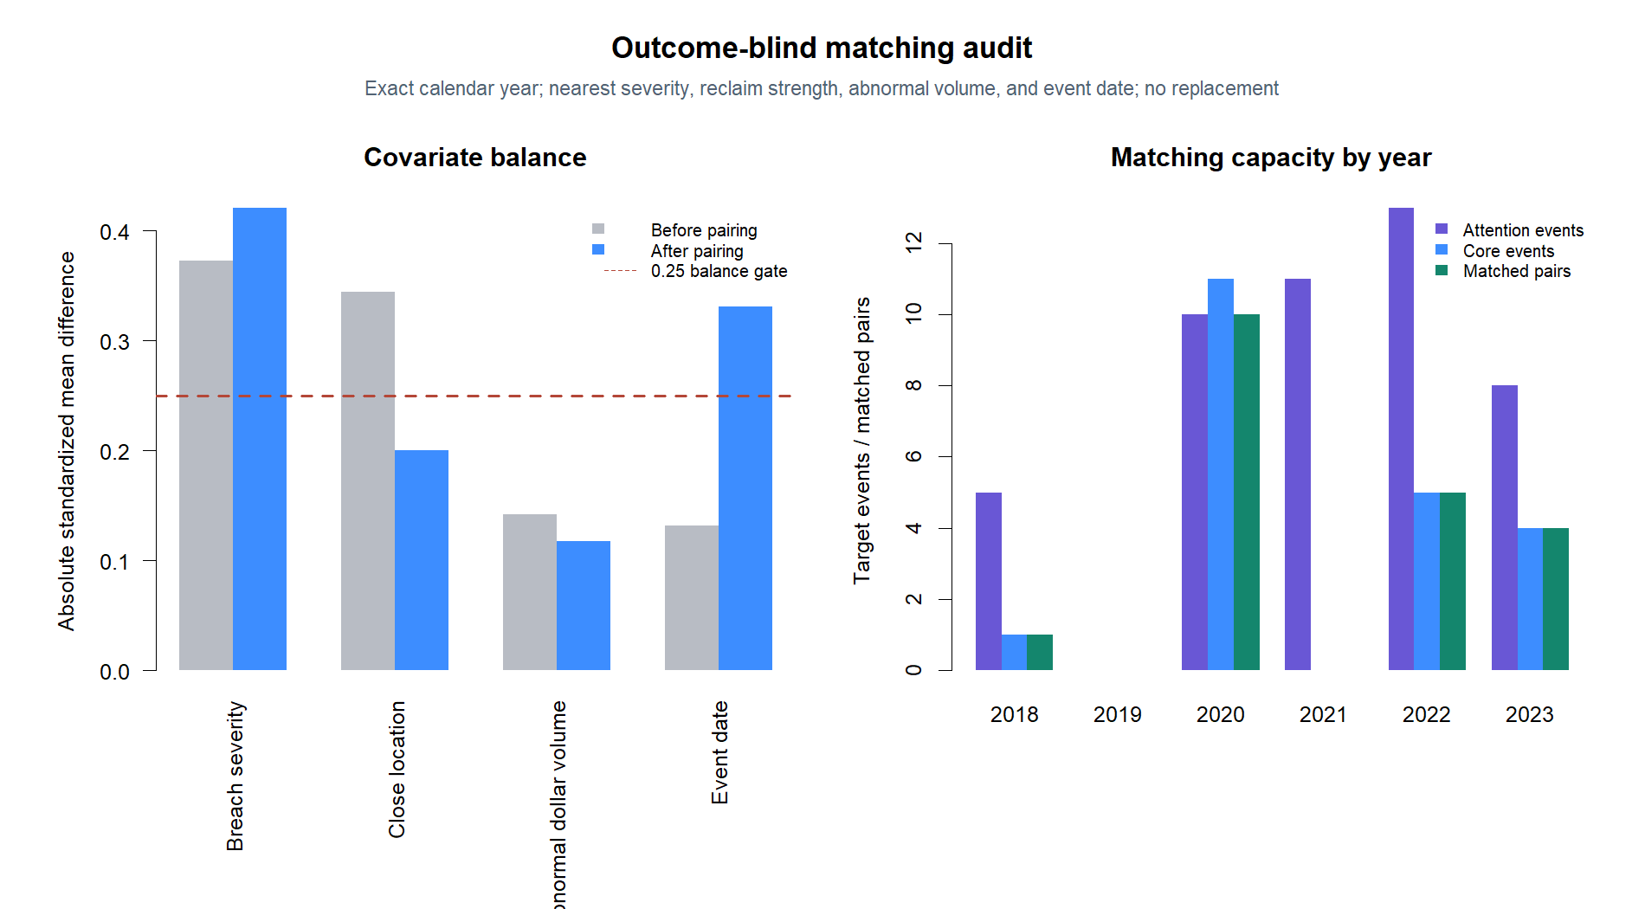
EDGE DISCOVERY LAB · EDL-MS-01
The matcher cannot make the two cohorts sufficiently comparable
Two of four pre-outcome variables remain beyond the frozen 0.25 balance limit.
0.421
breach severity
post-match SMD
0.331
event timing
post-match SMD
2021 contributes 11 attention events but no same-year core comparator.
Adjusted daily · 2018–2023 TRAIN · matched falsification
03
Notes:
Close-location value and log abnormal dollar volume pass the balance limit. Breach severity and event date do not. Twenty pairs come from 2018, 2020, 2022, and 2023; 2021 attention events cannot enter because the core pool has no target event that year.
[Sources]
- Local matching balance: runs/research_workbench/edge_discovery_lab/edl_ms_01_attention_falsification_20260831/matching_balance.csv
- Local matching enrollment audit: runs/research_workbench/edge_discovery_lab/edl_ms_01_attention_falsification_20260831/matching_enrollment_audit.csv
[/Sources]

Slide 4
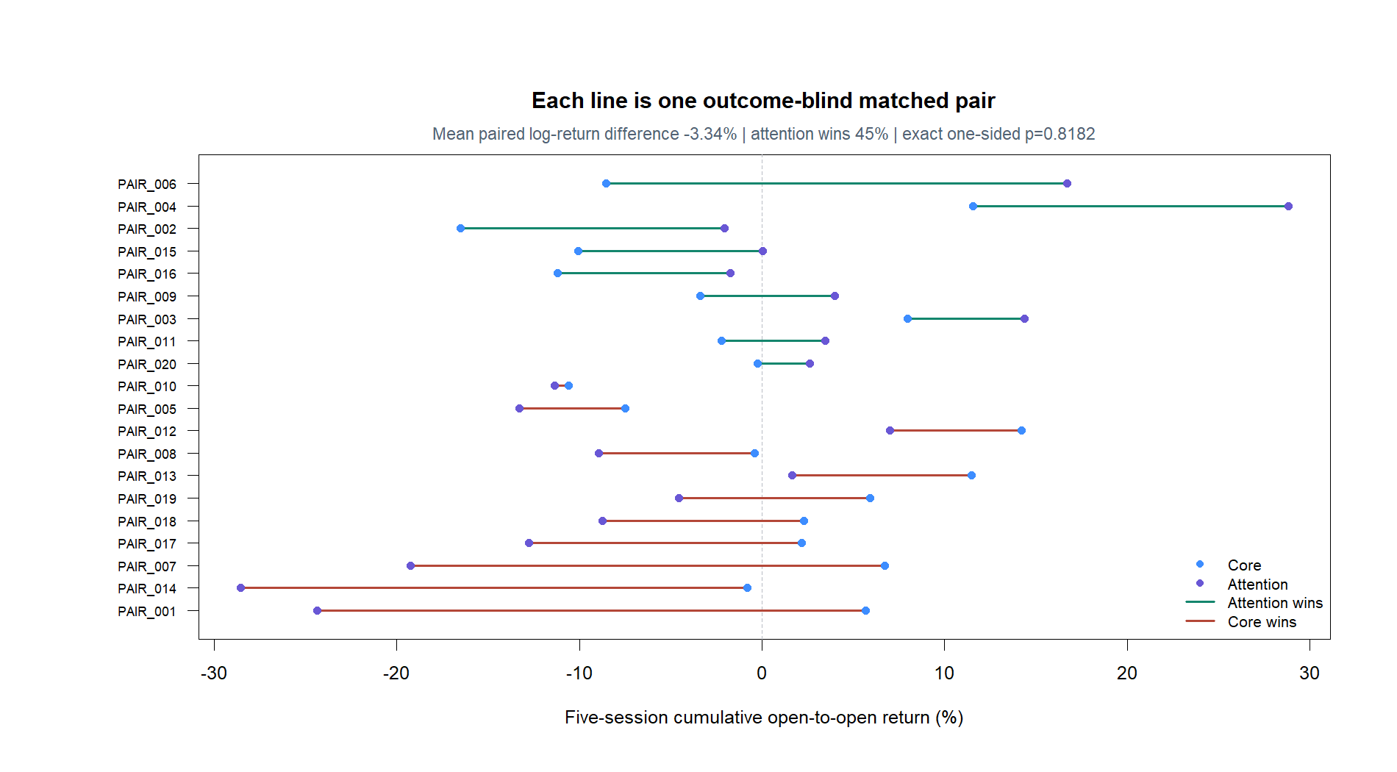
EDGE DISCOVERY LAB · EDL-MS-01
Within the available pairs, attention stocks perform worse by day five
The direction is opposite the wide-atlas clue, with no one-sided evidence for a positive difference.
−3.34 pp
mean paired log-return
difference
45%
attention win rate
p = .818
exact one-sided sign flip
Adjusted daily · 2018–2023 TRAIN · matched falsification
04
Notes:
The exact test enumerates all 1,048,576 sign assignments for the 20 paired differences. The negative point estimate and large one-sided p-value show that the earlier positive attention-stock pattern does not reproduce in this matched sample.
[Sources]
- Local primary day-five test: runs/research_workbench/edge_discovery_lab/edl_ms_01_attention_falsification_20260831/primary_day5_test.csv
[/Sources]

Slide 5
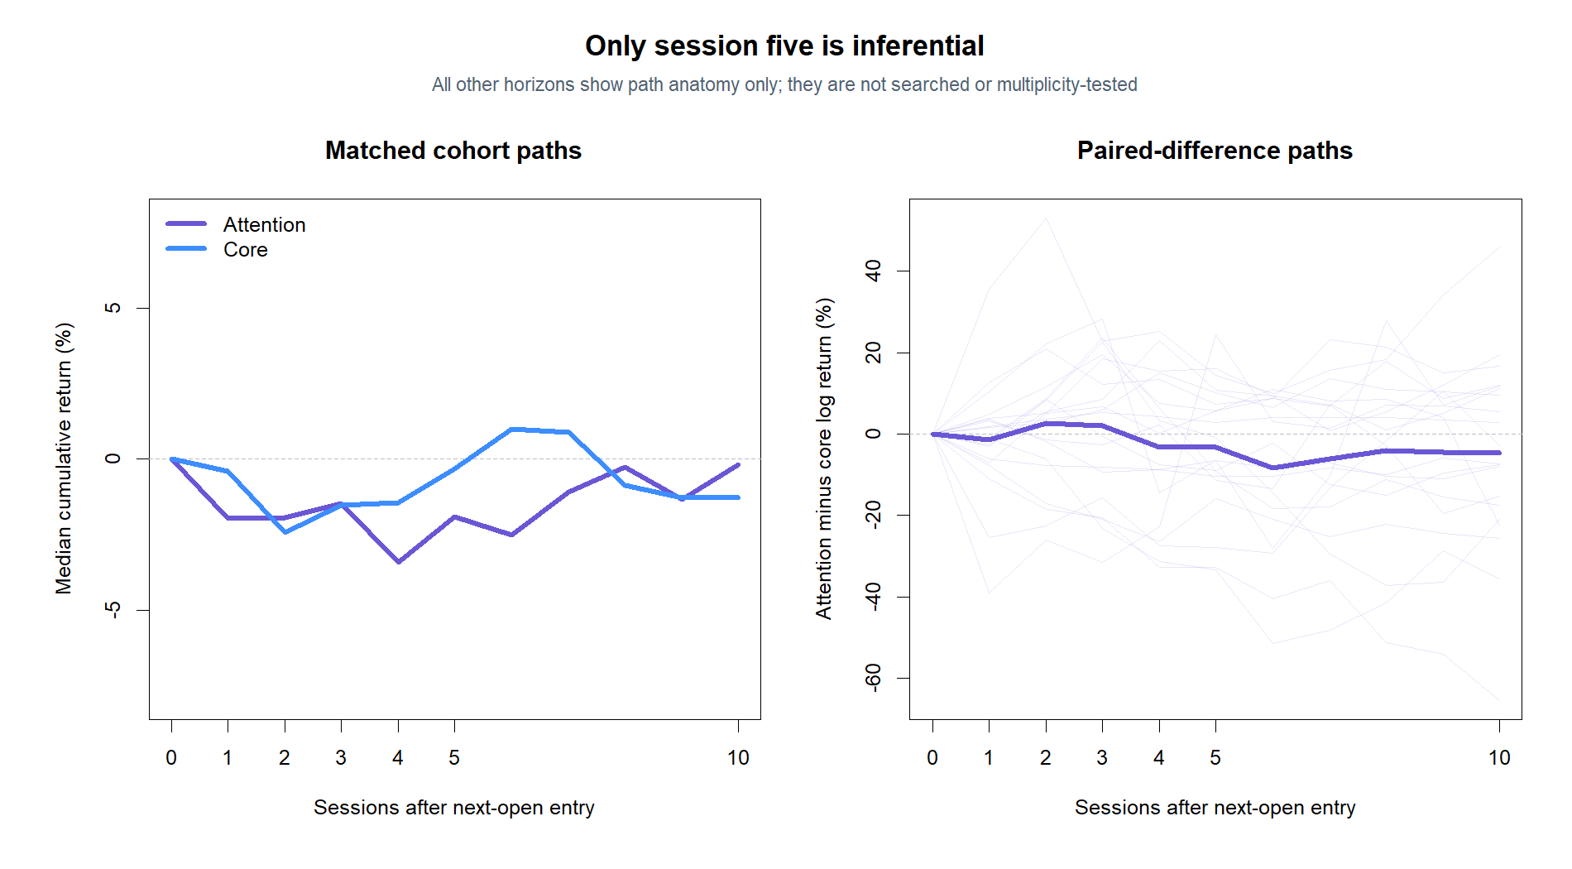
EDGE DISCOVERY LAB · EDL-MS-01
The contextual path shows no hidden day-five recovery advantage
Only session five is inferential; sessions 0–10 are displayed to understand shape.
Adjusted daily · 2018–2023 TRAIN · matched falsification
05
Notes:
The paired mean difference is below zero around the predeclared day-five horizon. The surrounding path is descriptive context and was not searched to nominate another holding period.
[Sources]
- Local matched path summary: runs/research_workbench/edge_discovery_lab/edl_ms_01_attention_falsification_20260831/matched_path_summary.csv
- Local primary day-five test: runs/research_workbench/edge_discovery_lab/edl_ms_01_attention_falsification_20260831/primary_day5_test.csv
[/Sources]

Slide 6
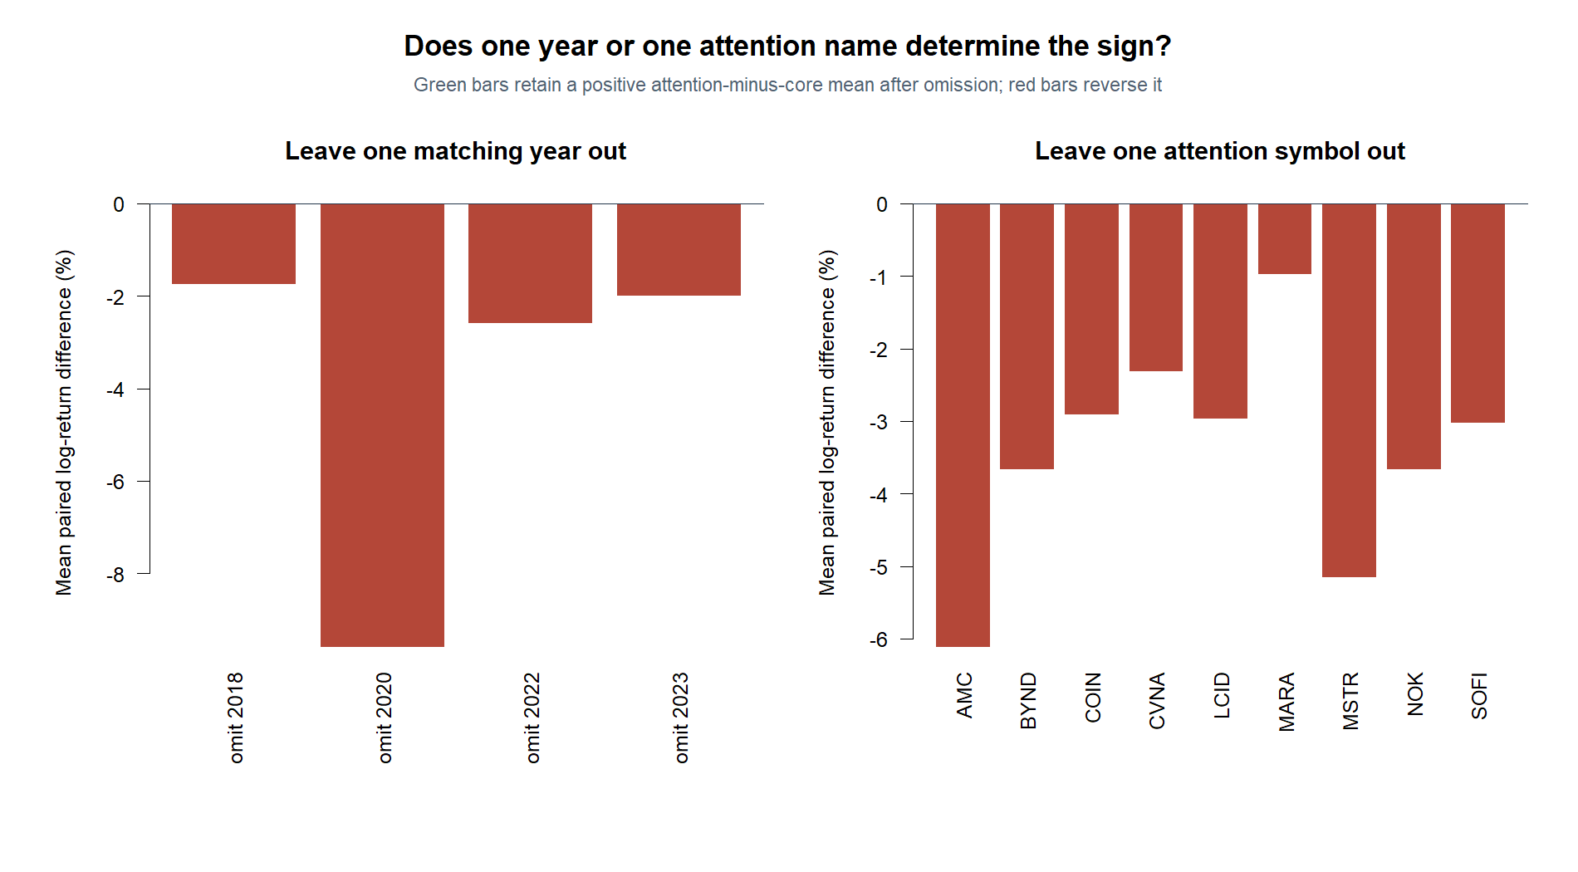
EDGE DISCOVERY LAB · EDL-MS-01
No single year or attention symbol creates the negative result
Every leave-one-out mean remains negative—the opposite of the frozen robustness condition.
0 / 4
leave-one-year means
remain positive
0 / all
leave-one-symbol means
remain positive
Adjusted daily · 2018–2023 TRAIN · matched falsification
06
Notes:
Omitting each matched calendar year in turn leaves a negative attention-minus-core mean. Omitting each attention symbol in turn also leaves a negative mean. This is robust against simple single-era and single-name explanations within the matched sample.
[Sources]
- Local leave-one-year-out sensitivity: runs/research_workbench/edge_discovery_lab/edl_ms_01_attention_falsification_20260831/leave_one_year_out.csv
- Local leave-one-attention-symbol-out sensitivity: runs/research_workbench/edge_discovery_lab/edl_ms_01_attention_falsification_20260831/leave_one_attention_symbol_out.csv
[/Sources]

Slide 7
EDGE DISCOVERY LAB · EDL-MS-01
The cohort label fails; the environment difference becomes the next question
We close this falsification without edge promotion or post-outcome matcher changes.
WHAT WE CAN SAY
WHAT WE CANNOT SAY
The attention-stock advantage does not reproduce.
This is not a clean matched-estimand rejection.
Matched point estimate is negative, not merely weak.
Severity and timing remain materially imbalanced.
All year and symbol leave-outs remain negative.
Changing the matcher now would be post-outcome rescue.
NEXT SEPARATELY FROZEN SLICE
Quantify the pre-outcome features that separate these event environments—starting with breach severity and calendar timing, then carefully chosen asset traits.
Adjusted daily · 2018–2023 TRAIN · matched falsification
07
Notes:
The earlier positive cohort clue is not promoted. The inability to balance the two pools is itself a finding: the target events occur in different environments. A new slice may quantify those separators, but its feature vocabulary and outcomes must be frozen separately.
[Sources]
- Local falsification status: runs/research_workbench/edge_discovery_lab/edl_ms_01_attention_falsification_20260831/falsification_status.csv
- Local matching balance: runs/research_workbench/edge_discovery_lab/edl_ms_01_attention_falsification_20260831/matching_balance.csv
- Local primary day-five test: runs/research_workbench/edge_discovery_lab/edl_ms_01_attention_falsification_20260831/primary_day5_test.csv
- Local report: runs/research_workbench/edge_discovery_lab/edl_ms_01_attention_falsification_20260831/report.md
[/Sources]

Slide 8
EDGE DISCOVERY LAB · EDL-MS-01
Rule 201, in plain English: the rebound clue did not generalize
The study improved our diagnosis without producing a tradable rule.
THE STORY
THE VERDICT
A dramatic drop and strong close looked promising.
The attention-stock explanation failed its follow-up.
Pilot: median rebound near +3.7% by session five.
Matched difference: −3.34 pp; one-sided p = .818.
Balanced 88-stock core: roughly −0.24%.
Balance also failed: the cohorts came from different environments.
CURRENT STOP
Do not trade the label. Carry forward the question: which measurable, pre-outcome features separate rebound environments from non-rebound environments?
Adjusted daily · 2018–2023 TRAIN · matched falsification
08
Notes:
This slide summarizes the complete Rule 201 investigation in plain English. The original ten-stock pilot showed a temporary median rebound near session five. The balanced 88-stock core did not reproduce it. The apparent attention-stock explanation then reversed in the frozen matched follow-up, while the match-balance gate also failed. The result is a better-defined research question, not a tradable rule.
[Sources]
- Local forward-path report: runs/research_workbench/edge_discovery_lab/edl_ms_01_rule201_forward_path_20260830/report.md
- Local wide-atlas report: runs/research_workbench/edge_discovery_lab/edl_ms_01_rule201_wide_atlas_20260830/report.md
- Local attention falsification report: runs/research_workbench/edge_discovery_lab/edl_ms_01_attention_falsification_20260831/report.md
[/Sources]

