Slide 1
GEN5 MECHANISM-FIRST RESEARCH
M1 cross-sectional
momentum
Frozen evidence readout • 27 July 2026
Decision trail D53
Notes:
[Sources]
- C:/Users/Franc/OneDrive/Documents/Francis/Peltata Project/Time-Series-Modeling-Gen5/docs/GEN5_M1_CROSS_SECTIONAL_MOMENTUM_POC_CONTRACT.md
- C:/Users/Franc/OneDrive/Documents/Francis/Peltata Project/Time-Series-Modeling-Gen5/runs/research_workbench/retail_quant_mechanisms/m1_cross_sectional_momentum_20260727/m1_run_spec.csv

Slide 2
The contract separated ranking evidence from portfolio storytelling
M1A had to show a repeated, non-random, non-concentrated ranking mechanism. M1B portfolio compounding was permitted only after all six mechanism gates passed.
24
12−1
36
fixed equity ETFs
across 3 groups
month log-return rank
with next-open outcomes
untouched confirmation
months (2022–2024)
2
Notes:
[Sources]
- C:/Users/Franc/OneDrive/Documents/Francis/Peltata Project/Time-Series-Modeling-Gen5/docs/GEN5_M1_CROSS_SECTIONAL_MOMENTUM_POC_CONTRACT.md

Slide 3
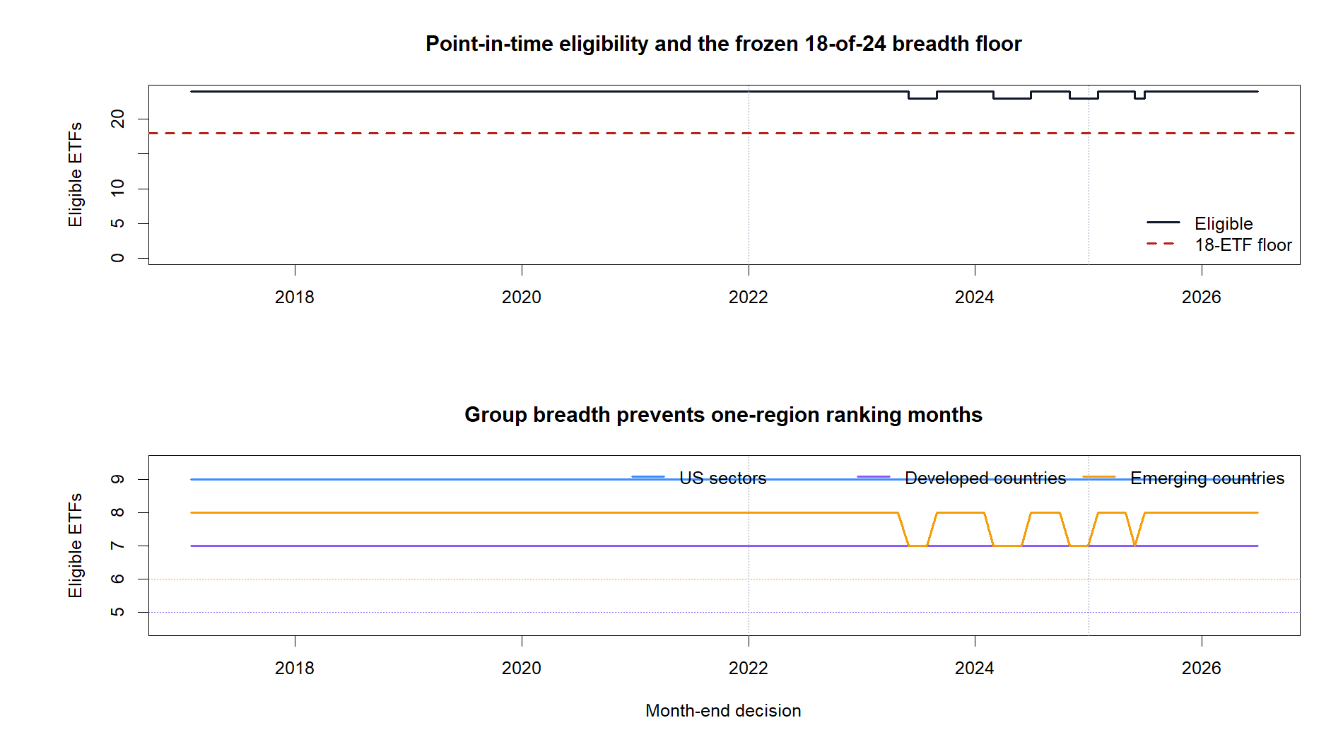
Coverage was strong enough to test the mechanism cleanly
25 / 25
Every ranked ETF plus BIL shared all 2,638 reference sessions from 2016-01-04 through 2026-07-01.
All 11 integrity and timing checks passed. Eligibility stayed above every frozen breadth floor.
3
Notes:
[Sources]
- C:/Users/Franc/OneDrive/Documents/Francis/Peltata Project/Time-Series-Modeling-Gen5/runs/research_workbench/retail_quant_mechanisms/m1_cross_sectional_momentum_20260727/m1_session_coverage_audit.csv
- C:/Users/Franc/OneDrive/Documents/Francis/Peltata Project/Time-Series-Modeling-Gen5/runs/research_workbench/retail_quant_mechanisms/m1_cross_sectional_momentum_20260727/m1_integrity_audit.csv
- C:/Users/Franc/OneDrive/Documents/Francis/Peltata Project/Time-Series-Modeling-Gen5/runs/research_workbench/retail_quant_mechanisms/m1_cross_sectional_momentum_20260727/visuals/m1_eligibility_coverage.png

Slide 4
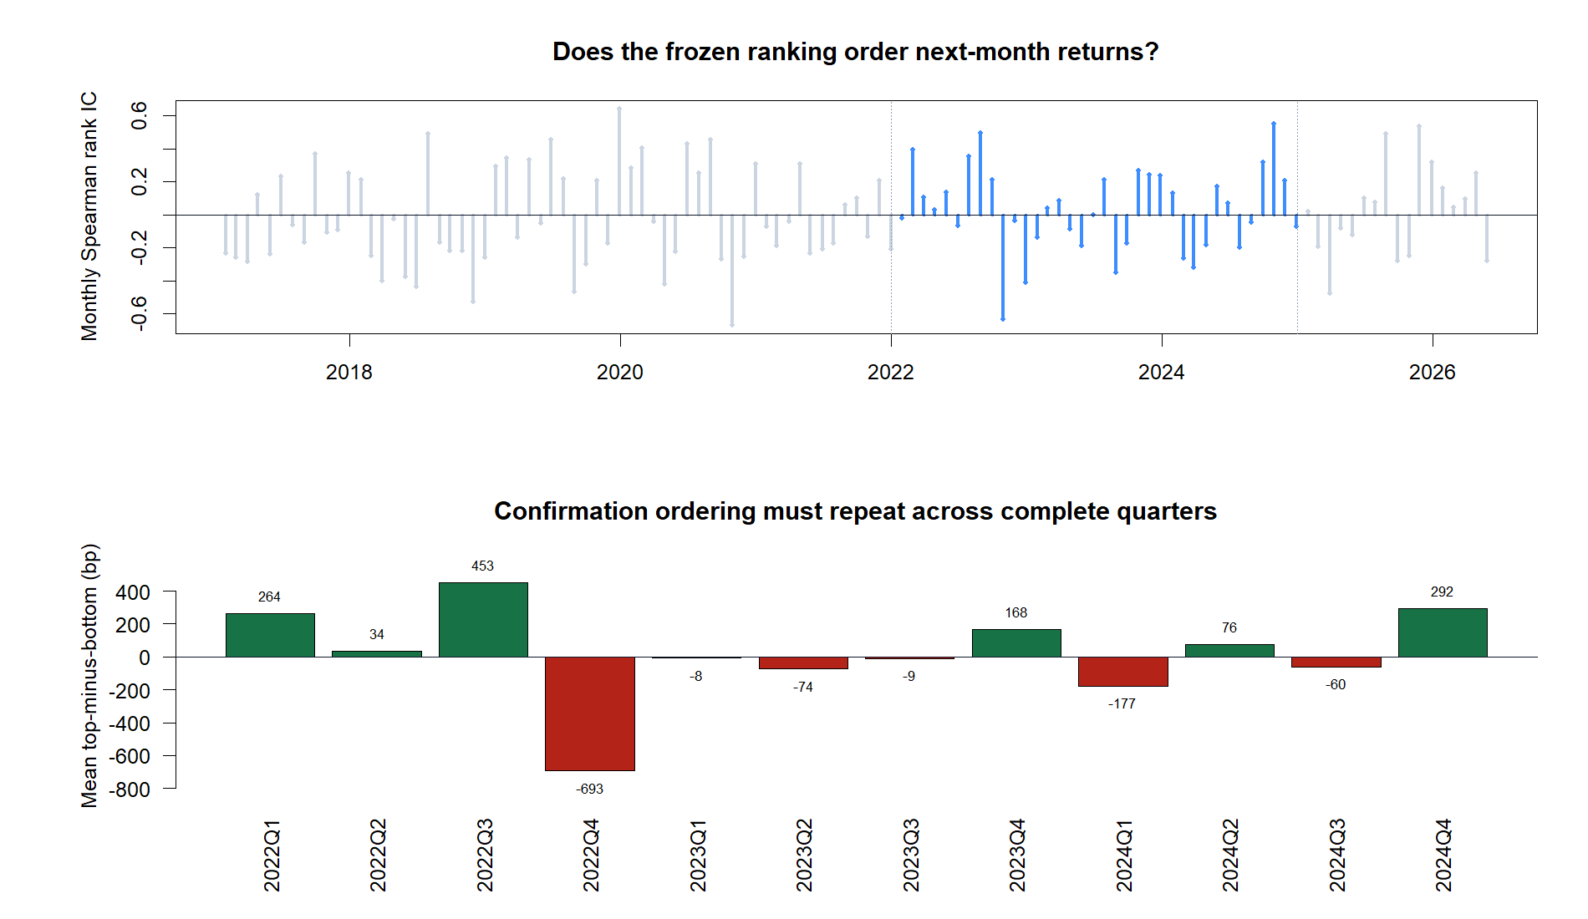
A positive average did not become a repeated ordering effect
+0.029
mean rank IC
19 / 36
positive months
required: 21
6 / 12
positive quarters
required: 7
4
Notes:
[Sources]
- C:/Users/Franc/OneDrive/Documents/Francis/Peltata Project/Time-Series-Modeling-Gen5/runs/research_workbench/retail_quant_mechanisms/m1_cross_sectional_momentum_20260727/m1_monthly_measurement.csv
- C:/Users/Franc/OneDrive/Documents/Francis/Peltata Project/Time-Series-Modeling-Gen5/runs/research_workbench/retail_quant_mechanisms/m1_cross_sectional_momentum_20260727/m1_quarterly_measurement.csv
- C:/Users/Franc/OneDrive/Documents/Francis/Peltata Project/Time-Series-Modeling-Gen5/runs/research_workbench/retail_quant_mechanisms/m1_cross_sectional_momentum_20260727/visuals/m1_rank_ordering.png

Slide 5
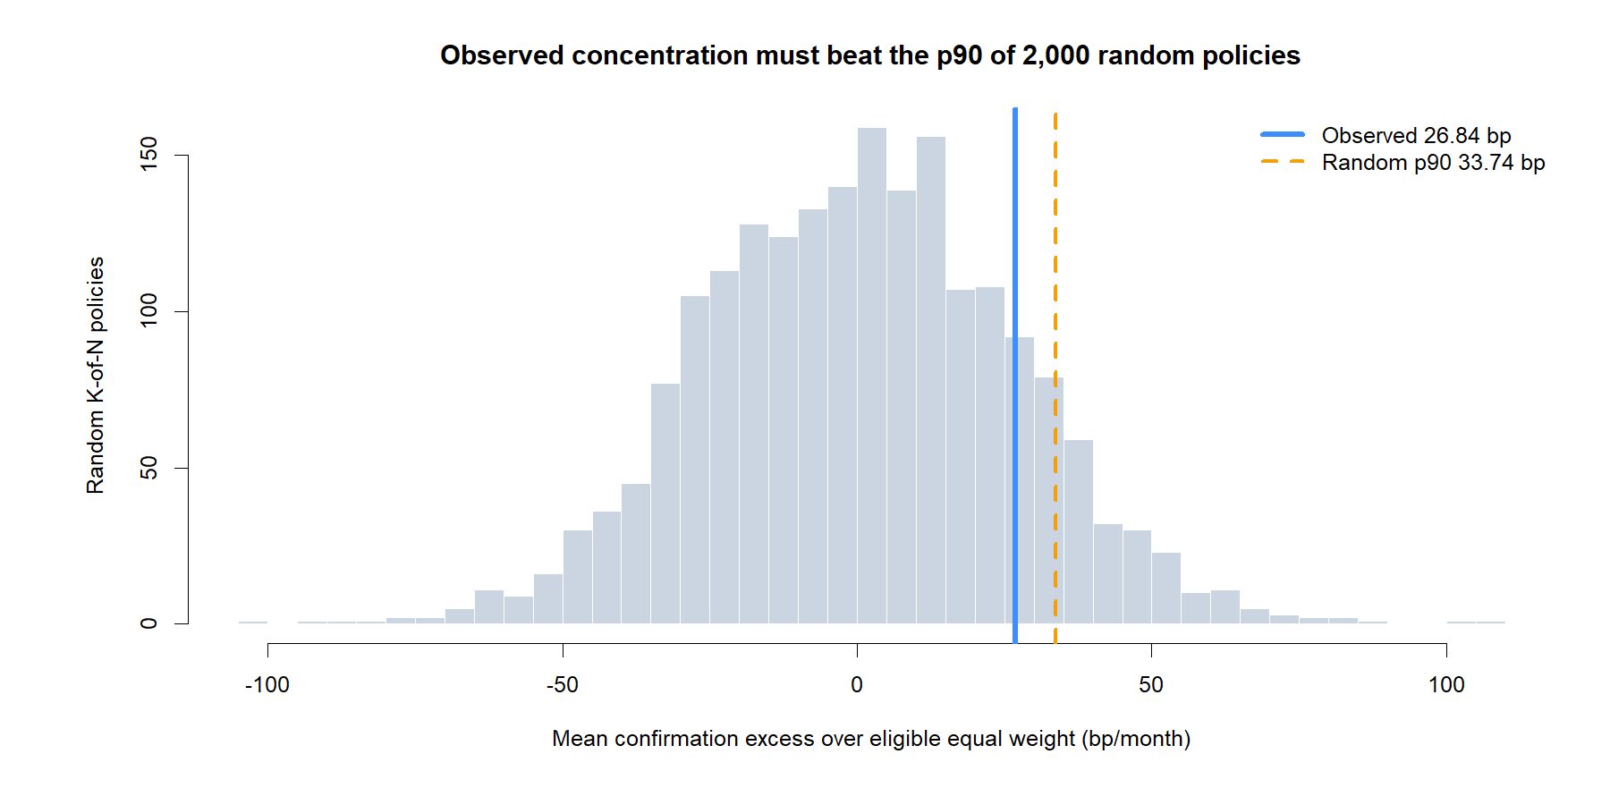
The top quartile did not beat randomized concentration
26.84 bp
observed top-K excess
33.74 bp
random-policy p90
The observed concentration was better than average randomness—but not exceptional enough for the frozen gate.
5
Notes:
[Sources]
- C:/Users/Franc/OneDrive/Documents/Francis/Peltata Project/Time-Series-Modeling-Gen5/runs/research_workbench/retail_quant_mechanisms/m1_cross_sectional_momentum_20260727/m1_random_policy_distribution.csv
- C:/Users/Franc/OneDrive/Documents/Francis/Peltata Project/Time-Series-Modeling-Gen5/runs/research_workbench/retail_quant_mechanisms/m1_cross_sectional_momentum_20260727/visuals/m1_random_control.png

Slide 6
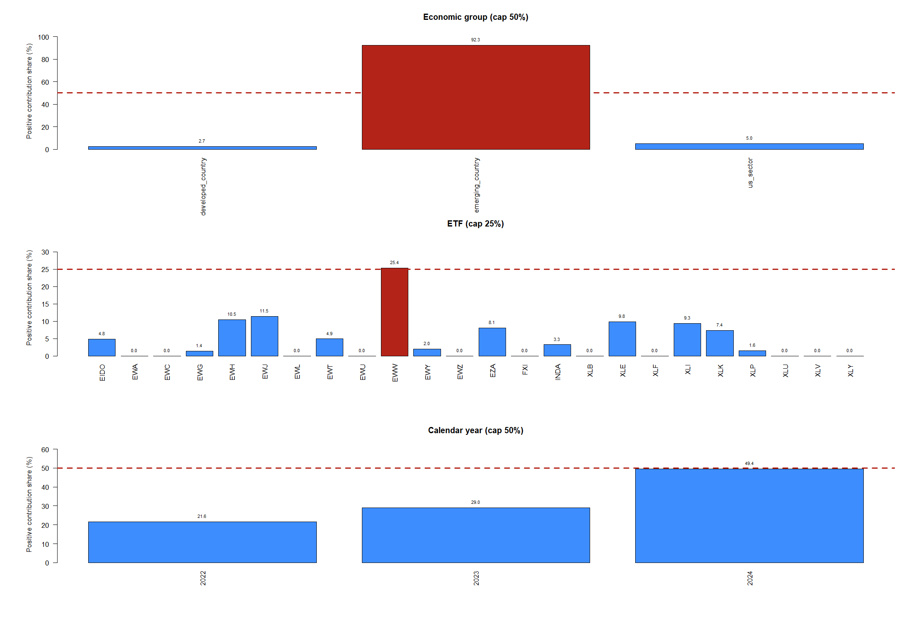
Most positive spread contribution came from one economic group
92.3%
emerging-country share
cap: 50%
25.4%
largest ETF share
cap: 25%
6
Notes:
[Sources]
- C:/Users/Franc/OneDrive/Documents/Francis/Peltata Project/Time-Series-Modeling-Gen5/runs/research_workbench/retail_quant_mechanisms/m1_cross_sectional_momentum_20260727/m1_attribution_by_group.csv
- C:/Users/Franc/OneDrive/Documents/Francis/Peltata Project/Time-Series-Modeling-Gen5/runs/research_workbench/retail_quant_mechanisms/m1_cross_sectional_momentum_20260727/m1_attribution_by_asset.csv
- C:/Users/Franc/OneDrive/Documents/Francis/Peltata Project/Time-Series-Modeling-Gen5/runs/research_workbench/retail_quant_mechanisms/m1_cross_sectional_momentum_20260727/m1_attribution_by_year.csv
- C:/Users/Franc/OneDrive/Documents/Francis/Peltata Project/Time-Series-Modeling-Gen5/runs/research_workbench/retail_quant_mechanisms/m1_cross_sectional_momentum_20260727/visuals/m1_contribution_concentration.png

Slide 7
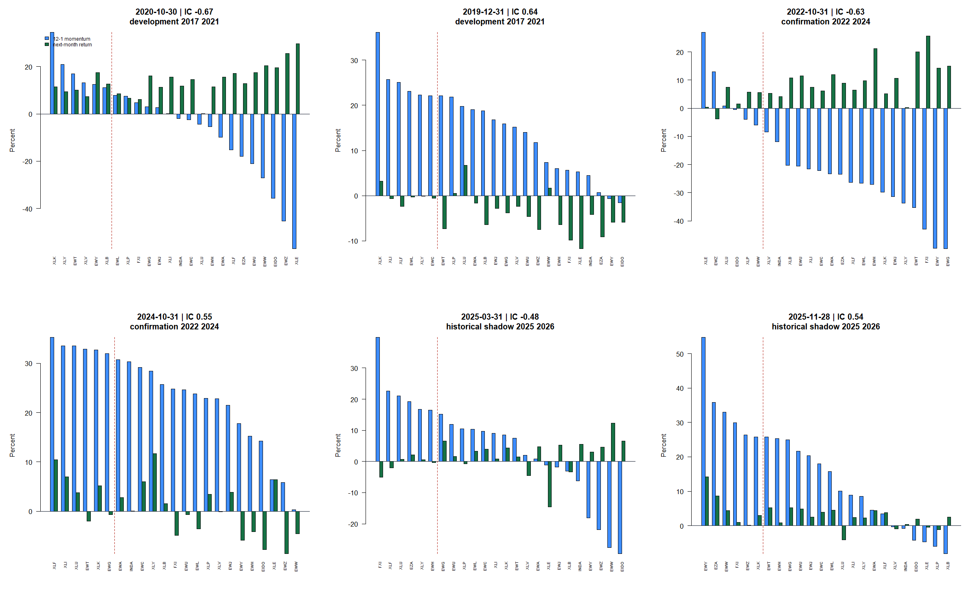
Representative months reveal genuine rank reversals
7
Notes:
[Sources]
- C:/Users/Franc/OneDrive/Documents/Francis/Peltata Project/Time-Series-Modeling-Gen5/runs/research_workbench/retail_quant_mechanisms/m1_cross_sectional_momentum_20260727/m1_observation_panel.csv
- C:/Users/Franc/OneDrive/Documents/Francis/Peltata Project/Time-Series-Modeling-Gen5/runs/research_workbench/retail_quant_mechanisms/m1_cross_sectional_momentum_20260727/visuals/m1_representative_ranking_tapes.png

Slide 8
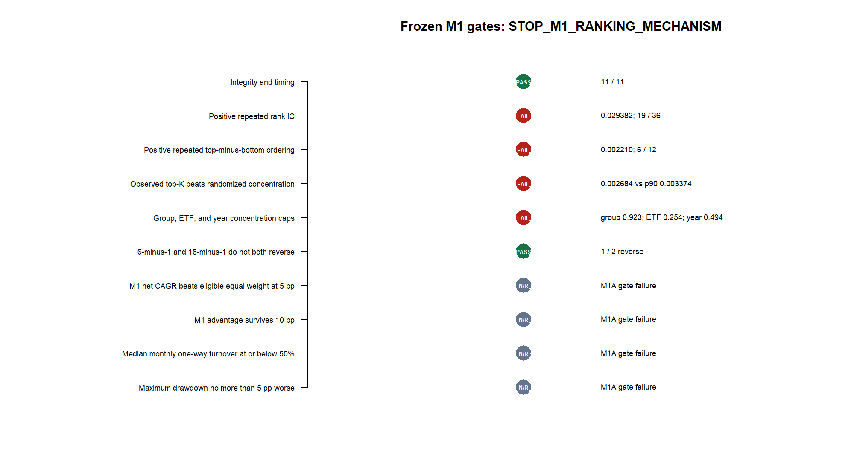
M1A stopped the experiment before any portfolio replay
No CAGR, drawdown, or portfolio P&L was computed.
8
Notes:
[Sources]
- C:/Users/Franc/OneDrive/Documents/Francis/Peltata Project/Time-Series-Modeling-Gen5/runs/research_workbench/retail_quant_mechanisms/m1_cross_sectional_momentum_20260727/m1_gate_summary.csv
- C:/Users/Franc/OneDrive/Documents/Francis/Peltata Project/Time-Series-Modeling-Gen5/runs/research_workbench/retail_quant_mechanisms/m1_cross_sectional_momentum_20260727/m1_report.md
- C:/Users/Franc/OneDrive/Documents/Francis/Peltata Project/Time-Series-Modeling-Gen5/runs/research_workbench/retail_quant_mechanisms/m1_cross_sectional_momentum_20260727/visuals/m1_gate_summary.png

Slide 9
DECISION
Stop M1.
Keep the lesson.
Cross-sectional momentum had a positive average spread, but not a robust standalone ranking mechanism in this frozen retail ETF panel.
Next: return to theory and choose a genuinely distinct mechanism—without retuning M1.
Notes:
[Sources]
- C:/Users/Franc/OneDrive/Documents/Francis/Peltata Project/Time-Series-Modeling-Gen5/runs/research_workbench/retail_quant_mechanisms/m1_cross_sectional_momentum_20260727/m1_report.md
- C:/Users/Franc/OneDrive/Documents/Francis/Peltata Project/Time-Series-Modeling-Gen5/docs/GEN5_RETAIL_QUANT_MECHANISM_POC_ATLAS.md

