Slide 1
OPERATOR HYPOTHESIS LAB
Can the S&P 500 replication be point-in-time safe?
HYP-MOM-04.1 · S&P 500 data-feasibility audit
Notes:
This deck records the data-feasibility gate that preceded any S&P 500 Ridge replication. It is not a performance deck.
[Sources]
- operator_hypothesis_lab/docs/HYP_MOM_04_1_SP500_PIT_DATA_AUDIT_CONTRACT.md
- Chat decision: point-in-time membership required; survivor-based S&P 500 replication rejected (2026-08-10).
[/Sources]

Slide 2
The universe audit was frozen before any model fit
Pinned roster
Independent check
Provider + exits
Membership
Quarter-end intervals from one exact public commit.
Identity check
Historical Wikipedia revision plus contemporaneous GICS sector.
Bars + outcomes
Alpaca through 2020 only; terminal exits must be defensible.
2
Notes:
The audit used 2017Q1-2020Q3 signal rosters and targets only through 2020Q4. No Ridge model, lambda selection, 2021+ bar, or OOS outcome entered this packet.
[Sources]
- operator_hypothesis_lab/docs/HYP_MOM_04_1_SP500_PIT_DATA_AUDIT_CONTRACT.md
- https://github.com/fja05680/sp500/tree/c31ac3cc56f28cf9a02b4e694eff7ceab596a0ff
- runs/research_workbench/operator_hypothesis_lab/hyp_mom_04_1_sp500_pit_data_audit_20260810/sp500_pit_wikipedia_revision_ledger.csv
[/Sources]

Slide 3
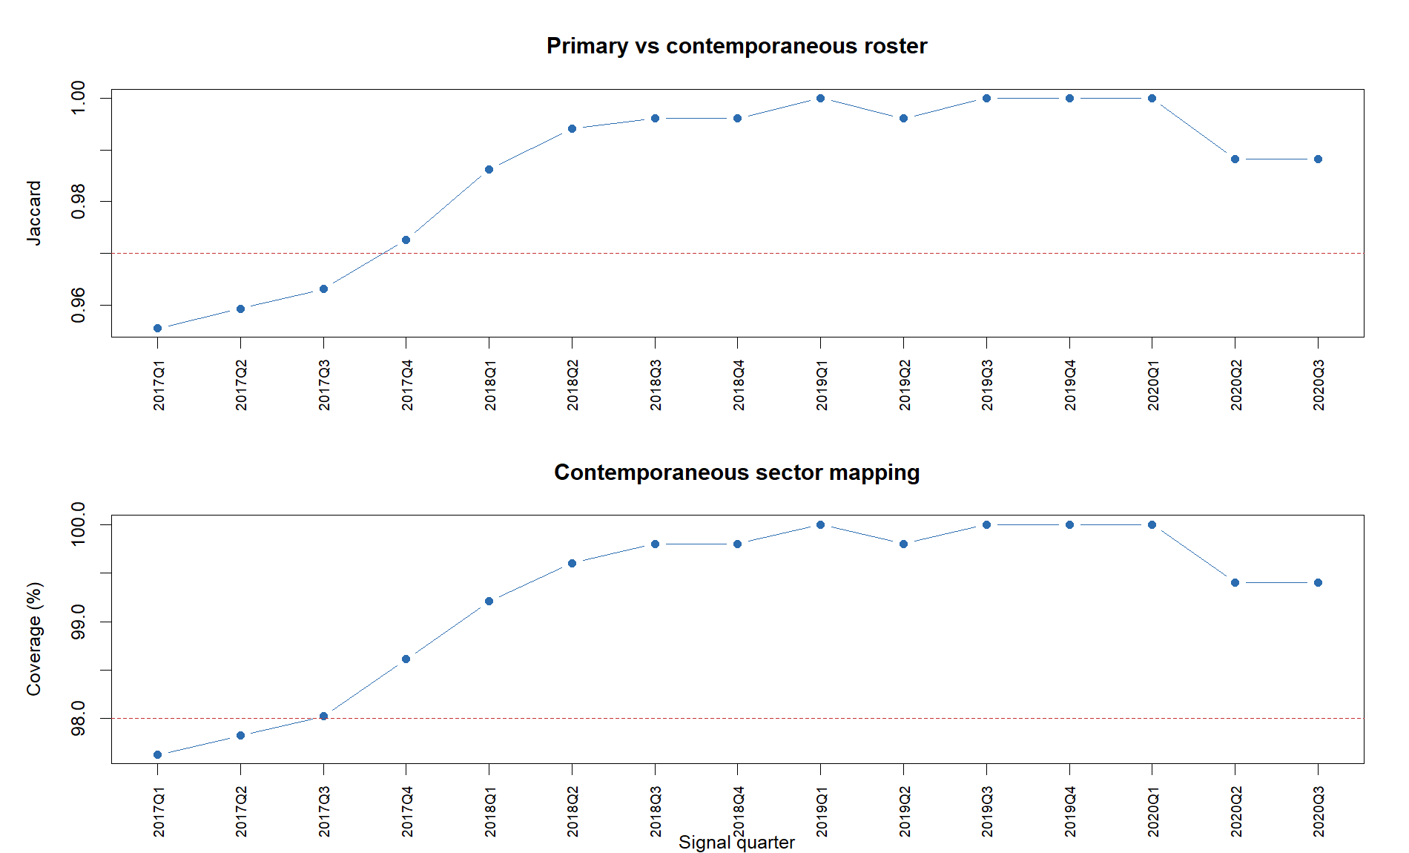
Later aliases broke roster agreement
2017Q1 Jaccard: 0.9555
The primary ledger used later aliases such as BKNG, TPR and WELL where the contemporaneous roster used PCLN, COH and HCN.
Membership was economically close—but the identity labels were not truly point-in-time.
3
Notes:
The primary interval and historical snapshot files agreed exactly with each other, but both used later ticker aliases in early quarters. The independent contemporaneous revisions exposed the mismatch.
[Sources]
- runs/research_workbench/operator_hypothesis_lab/hyp_mom_04_1_sp500_pit_data_audit_20260810/sp500_pit_roster_summary.csv
- runs/research_workbench/operator_hypothesis_lab/hyp_mom_04_1_sp500_pit_data_audit_20260810/sp500_pit_wikipedia_revision_ledger.csv
- fja05680/sp500 commit c31ac3cc56f28cf9a02b4e694eff7ceab596a0ff
[/Sources]

Slide 4
Provider breadth was strong enough to be useful
Coverage
Every quarter cleared the 95% complete-bar gate; worst ordinary coverage was 97.63%. Strong price coverage passed—but it could not repair metadata and terminal-outcome gaps.
591
7,580
184 / 185
unique point-in-time identities
member-quarter rows
removed names with history
4
Notes:
Alpaca coverage was not the main blocker. Ordinary feature-plus-target coverage exceeded 97.6% in every quarter, and all but one non-current identity had some provider history.
[Sources]
- runs/research_workbench/operator_hypothesis_lab/hyp_mom_04_1_sp500_pit_data_audit_20260810/sp500_pit_coverage_summary.csv
- runs/research_workbench/operator_hypothesis_lab/hyp_mom_04_1_sp500_pit_data_audit_20260810/sp500_pit_removed_security_summary.csv
[/Sources]

Slide 5
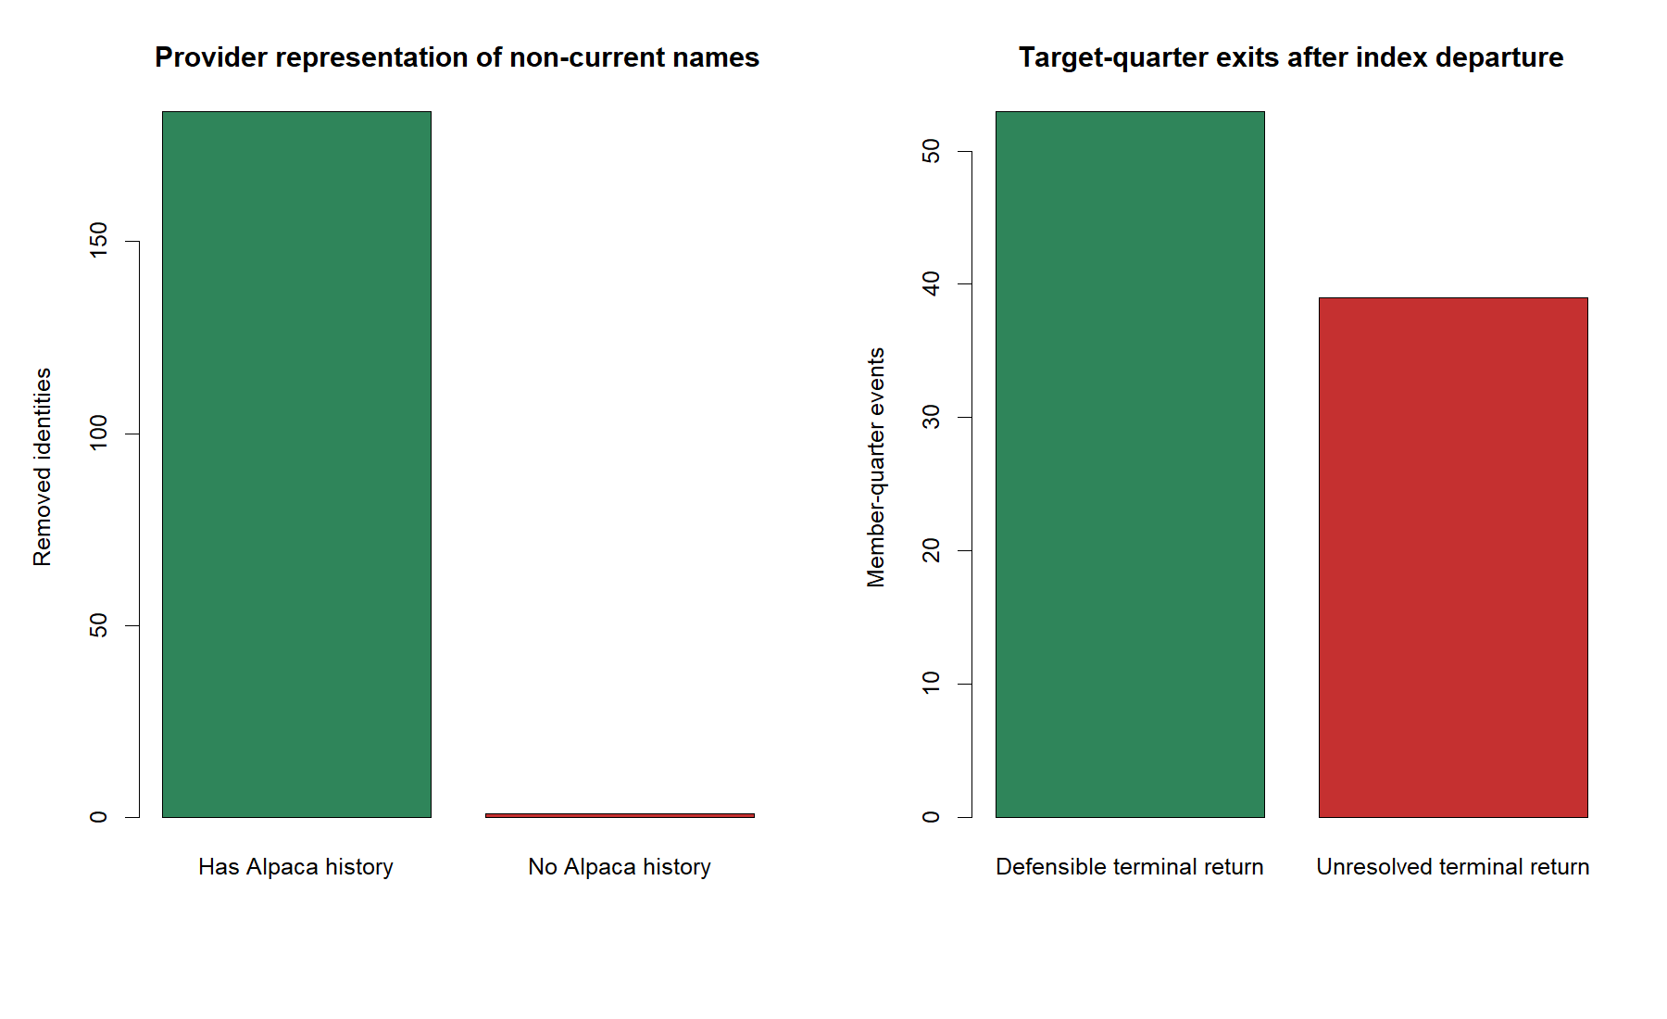
Thirty-nine exits remained unresolved
92 index departures
53 still had both scheduled entry and exit opens.
39 did not. A last pre-merger bar is not the frozen quarter-end exit and cannot stand in for merger consideration.
Alpaca bars alone are insufficient.
5
Notes:
Index removal alone is not a terminal-data problem when the stock continues trading through the scheduled exit. The unresolved group is the 39 member-quarter outcomes without both frozen entry and exit opens; event settlement data would be required.
[Sources]
- runs/research_workbench/operator_hypothesis_lab/hyp_mom_04_1_sp500_pit_data_audit_20260810/sp500_pit_terminal_event_ledger.csv
- operator_hypothesis_lab/docs/HYP_MOM_04_1_SP500_PIT_DATA_AUDIT_CONTRACT.md
[/Sources]

Slide 6
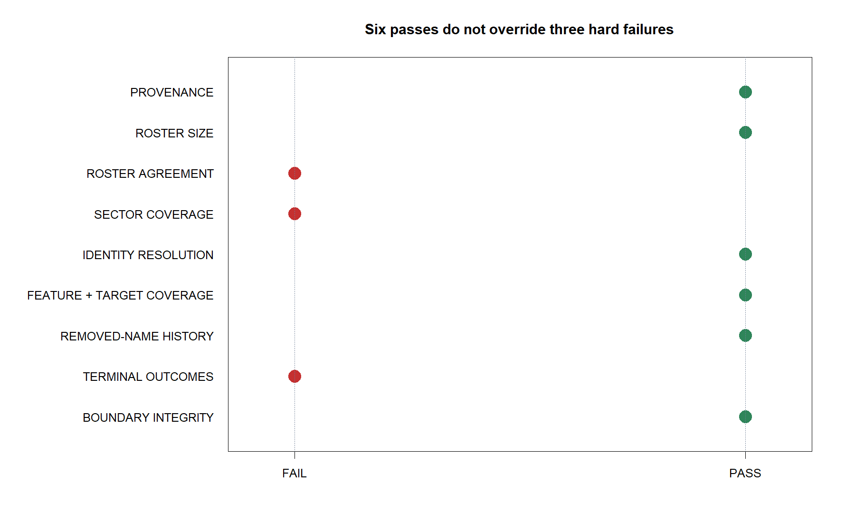
Three data gates failed
Passed
Provenance, roster size, identity resolution, ordinary bar coverage, removed-name representation and boundary integrity.
Failed
Roster agreement, sector coverage and terminal-event completeness.
Hard gates are conjunctive.
6
Notes:
The 0.97 roster-agreement, 98% sector-coverage, and complete terminal-outcome requirements were frozen before the audit. They were not softened after observing the data.
[Sources]
- runs/research_workbench/operator_hypothesis_lab/hyp_mom_04_1_sp500_pit_data_audit_20260810/sp500_pit_gate_matrix.csv
- operator_hypothesis_lab/docs/HYP_MOM_04_1_SP500_PIT_DATA_AUDIT_CONTRACT.md
[/Sources]

Slide 7
DECISION
Stop before replication.
No Ridge fit or lambda selection
No 2021+ outcome queried
Reopen only with alias-safe membership + event returns
Notes:
Status: STOP_SP500_PIT_DATA_GATES_FAILED_REPLICATION_NOT_RUN. The appropriate next step is a data-source decision, not a model tweak.
[Sources]
- operator_hypothesis_lab/docs/HYP_MOM_04_1_SP500_PIT_DATA_AUDIT_RESULTS.md
- runs/research_workbench/operator_hypothesis_lab/hyp_mom_04_1_sp500_pit_data_audit_20260810/sp500_pit_run_spec.csv
- Chat decision: point-in-time membership required; survivor-based S&P 500 replication rejected (2026-08-10).
[/Sources]

