Slide 1
SESSION 9
Historical news plumbing works;
index access is account-blocked.
239 articles | five pages | metadata only | no signal claims
S9/01
Notes:
SESSION 9 - ALPACA CONTEXT CAPABILITY
Purpose
Prove which non-OHLCV streams the existing Alpaca account can retrieve before defining any feature or research hypothesis.
Conversation: codex://threads/019f741e-615f-7fd0-90f7-edce12b5cb66
Find in chat: maybe even a simple POC where we display and prove that we indeed just pulled some data
Artifact: docs/GEN5_4_ALPACA_CONTEXT_CAPABILITY_POC.md
Boundary: retrieval and audit only; no sentiment, features, outcomes, models, or live behavior.

Slide 2
The capability POC proves retrieval - not predictive value
NEWS REQUEST
AUDIT CONTRACT
INDEX PROBE
Five symbols, seven days
metadata only
Raw JSON, page tokens,
IDs and timestamps
VIX, SPX, NDX through
the new index endpoint
Sentiment, features, outcomes, OHLCV joins, and model fits: zero.
D28/02
Notes:
DECISION D28 - FROZEN N0/I0 CONTRACT
N0 news
Request AAPL, AMD, NVDA, TSLA, and MSTR from 2024-01-02 through 2024-01-08. Traverse every page token. Normalize metadata but exclude article content and images from the research table.
I0 index values
Probe VIX, SPX, and NDX through /v1beta1/indices/values. HTTP 200 proves account access; HTTP 403 records an entitlement boundary.
Success
Authenticated retrieval, complete pagination, raw provenance, unique IDs, complete timestamps and headlines, readable samples, and simple inspection charts.
Official sources
News guide: https://docs.alpaca.markets/us/docs/historical-news-data
News endpoint: https://docs.alpaca.markets/us/reference/news-3
Index changelog: https://docs.alpaca.markets/us/changelog/2026-06-03-market-data-9dddd18
Conversation: codex://threads/019f741e-615f-7fd0-90f7-edce12b5cb66
Find in chat: Okay, let's proceed
Run spec: C:/Users/Franc/OneDrive/Documents/Francis/Peltata Project/Time-Series-Modeling-Gen5/runs/research_workbench/gen54_ml_decision_engine/g54_alpaca_context_n0_i0_20260721/capability_run_spec.csv

Slide 3
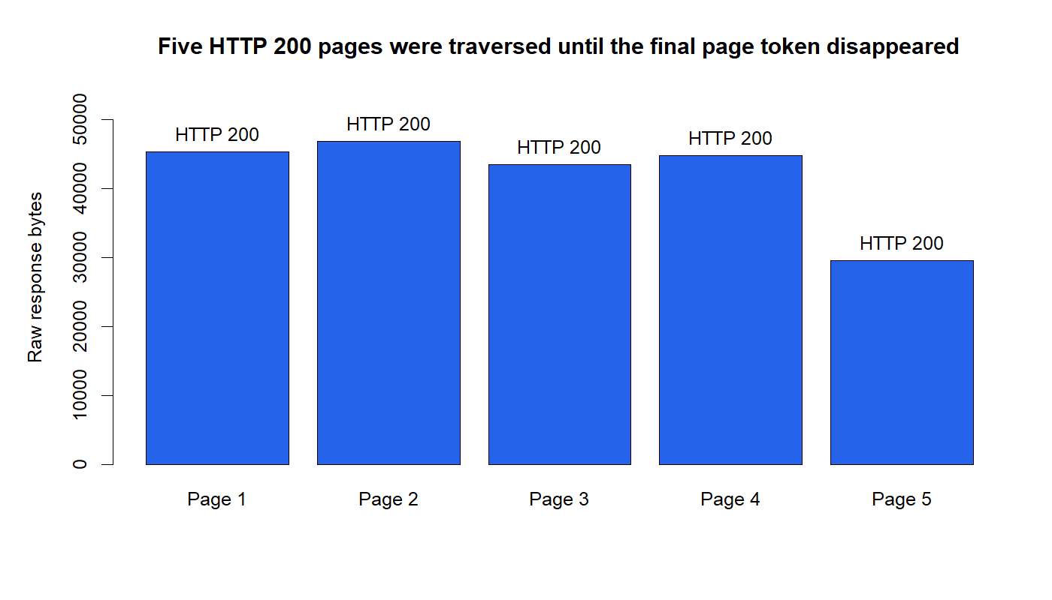
Five pages prove the archive was fully traversed
D29/03
Notes:
DECISION D29 - NEWS PAGINATION PASSES
Evidence
Five pages returned HTTP 200. The first four pages supplied a next-page token; the fifth did not. Total raw response size was 209,710 bytes.
Meaning
The wrapper did not silently stop after the first 50 records. It traversed the complete requested result set and retained each raw page locally for audit.
Conversation: codex://threads/019f741e-615f-7fd0-90f7-edce12b5cb66
Find in chat: Okay, let's proceed
Report: C:/Users/Franc/OneDrive/Documents/Francis/Peltata Project/Time-Series-Modeling-Gen5/runs/research_workbench/gen54_ml_decision_engine/g54_alpaca_context_n0_i0_20260721/context_capability_report.md

Slide 4
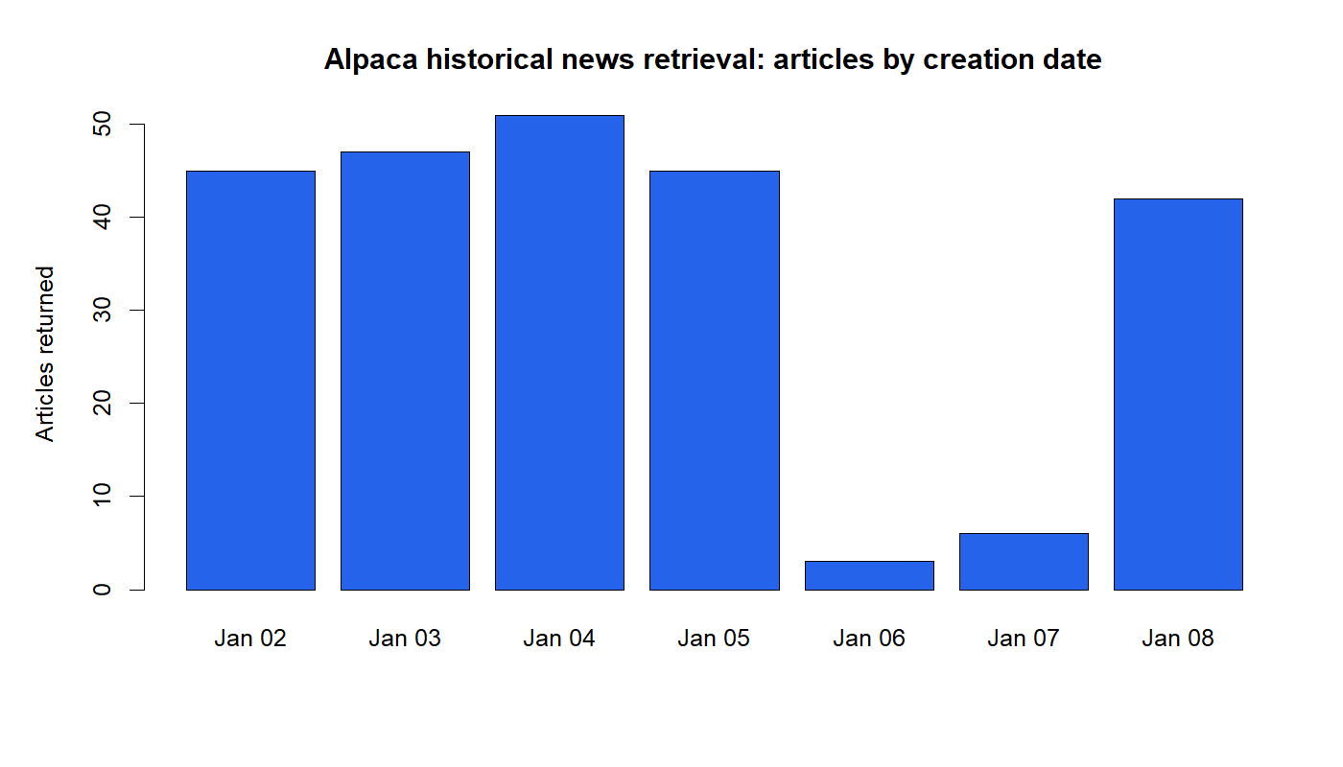
The retrieved week is visible and auditable
D29/04
Notes:
DECISION D29 - HISTORICAL NEWS AVAILABILITY PASSES
Evidence
The account returned 239 articles dated from January 2 through January 8, 2024. There were zero duplicate article IDs, zero missing headlines, zero missing created or updated timestamps, and zero created dates outside the request window.
Meaning
Historical news is accessible through the existing credentials and can support later point-in-time design discussions. Article counts are inventory evidence, not signal evidence.
Conversation: codex://threads/019f741e-615f-7fd0-90f7-edce12b5cb66
Find in chat: get my feet wet
Report: C:/Users/Franc/OneDrive/Documents/Francis/Peltata Project/Time-Series-Modeling-Gen5/runs/research_workbench/gen54_ml_decision_engine/g54_alpaca_context_n0_i0_20260721/context_capability_report.md

Slide 5
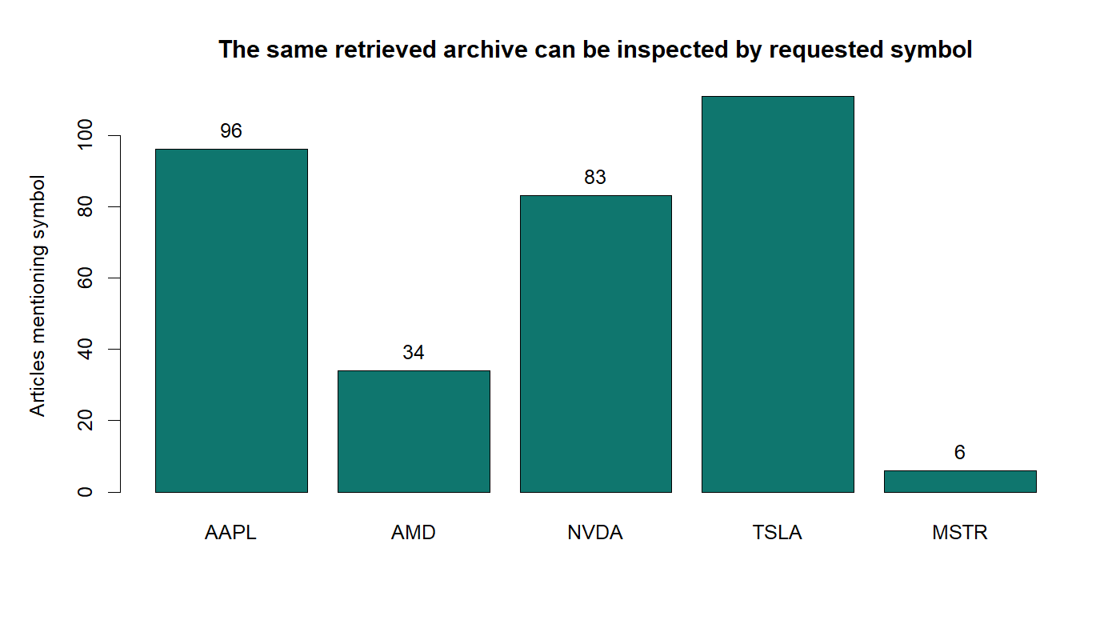
News access passes; index entitlement stops
OVERALL: PARTIAL CAPABILITY PASS
PASS Historical news: 239 articles
PASS Pagination: 5 complete pages
PASS IDs, headlines, timestamps
STOP Index values: HTTP 403
STOP No news representation yet
Sentiment / features / models: 0
D29/05
Notes:
DECISION D29 - PARTIAL_PASS_NEWS_AVAILABLE_INDEX_NOT_AUTHORIZED
Readout
Historical news works through the existing Alpaca account and is auditable by date and symbol. Alpaca's newly added historical index-values endpoint returned HTTP 403 with "not authorized for index data."
Authority
Five HTTP 200 news pages; 239 normalized metadata rows; zero duplicate IDs; complete headline, created_at, and updated_at fields; raw pages retained locally. Normalized tables exclude full article content and images.
Next theory gate
Decide whether to stop after capability proof or freeze a point-in-time news-representation contract. Do not begin with generic sentiment or inspect market outcomes before that contract exists.
Conversation: codex://threads/019f741e-615f-7fd0-90f7-edce12b5cb66
Find in chat: Okay, let's proceed
Report: C:/Users/Franc/OneDrive/Documents/Francis/Peltata Project/Time-Series-Modeling-Gen5/runs/research_workbench/gen54_ml_decision_engine/g54_alpaca_context_n0_i0_20260721/context_capability_report.md
Status: PARTIAL_PASS_NEWS_AVAILABLE_INDEX_NOT_AUTHORIZED.

