Slide 1
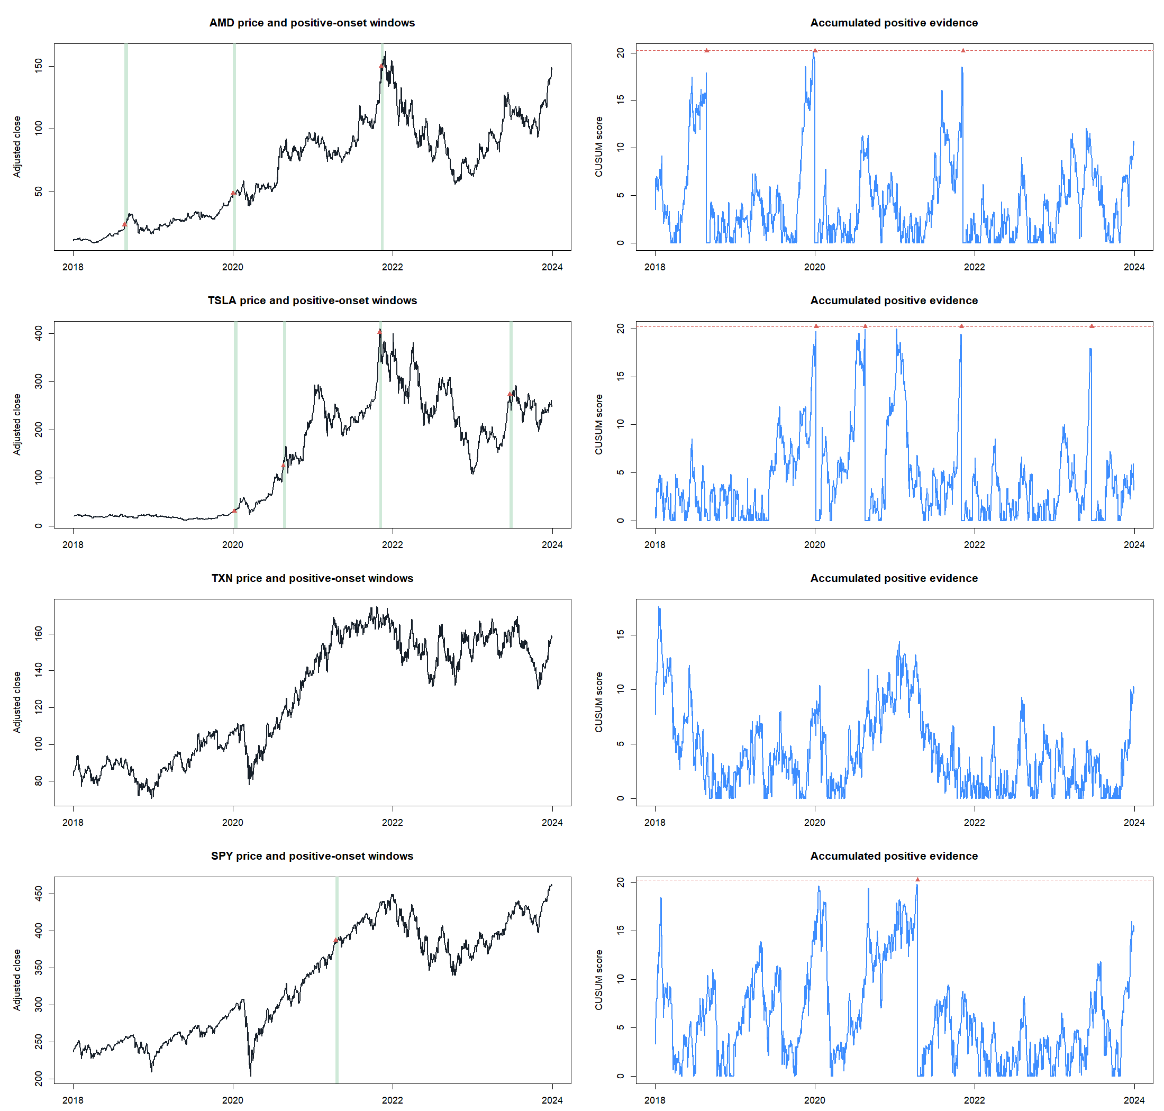
HYP-REG-11.1
The detector was honest—
and too slow to use
A causal positive CUSUM controlled false alarms, but failed sensitivity and real-panel usability before SMA8/14 strategy contact.
STAGE A STOP · 5/7 GATES · STRATEGY NOT RUN · 2024+ SEALED
Notes:
Open with the methodological win: the lane stopped before trading performance because its detector could not meet the frozen sensitivity and usability requirements.
[Sources]
- C:/Users/Franc/OneDrive/Documents/Francis/Peltata Project/Time-Series-Modeling-Gen5/docs/GEN5_HYP_REG_11_1_CAUSAL_CHANGE_POINT_CONTRACT.md
- C:/Users/Franc/OneDrive/Documents/Francis/Peltata Project/Time-Series-Modeling-Gen5/runs/research_workbench/operator_hypothesis_lab/hyp_reg_11_1_causal_change_point_20260816/hyp_reg_11_1_report.md

Slide 2
CONCEPT AND LITERATURE
CUSUM asks whether evidence has accumulated—not whether price merely rose
Sequential monitoring
Our narrow question
Page’s construction carries a running score forward and signals only after accumulated evidence crosses a boundary. Brown, Durbin, and Evans brought cumulative residual monitoring into time-series stability analysis; Zeileis and colleagues distinguish live monitoring from retrospective break dating.
Can a newly detected positive return process improve only fresh SMA8/14 entries?
Not authorized
Retrospective break labels · short trades · alarm-driven exits · ATR% stacking · threshold selection from performance
The exact equity statistic and policy are operator-designed; no source is presented as publishing this trading rule.
02
Notes:
The literature anchors the sequential-monitoring family, not the exact POC. Full-sample break dating would leak future information and is explicitly prohibited.
[Sources]
- https://doi.org/10.1093/biomet/41.1-2.100
- https://doi.org/10.1111/j.2517-6161.1975.tb01532.x
- https://www.zeileis.org/papers/Zeileis%2BLeisch%2BKleiber-2005.pdf
- C:/Users/Franc/OneDrive/Documents/Francis/Peltata Project/Time-Series-Modeling-Gen5/docs/GEN5_HYP_REG_11_1_CAUSAL_CHANGE_POINT_CONTRACT.md

Slide 3
CONSTRUCTION
Positive evidence must persist long enough to overcome a daily allowance
Prior volatility only
rₜ = log(Pₜ / Pₜ₋₁)
Today’s return is scaled by the preceding 20 completed returns.
zₜ = clip[rₜ / σₜ₋₁,₂₀, −3, +3]
Clipped contribution
Sₜ = max(0, Sₜ₋₁ + zₜ − 0.10)
One extreme day cannot create enough accumulated evidence by itself.
alarm when Sₜ ≥ h
Reset after alarm
A fixed 10-session refractory and eligibility window prevents repeated evidence from extending the state.
03
Notes:
Explain the allowance as the evidence each new return must beat before the score can grow. The max with zero discards stale negative evidence rather than letting it create a permanent debt.
[Sources]
- https://doi.org/10.1093/biomet/41.1-2.100
- C:/Users/Franc/OneDrive/Documents/Francis/Peltata Project/Time-Series-Modeling-Gen5/docs/GEN5_HYP_REG_11_1_CAUSAL_CHANGE_POINT_CONTRACT.md

Slide 4
CALIBRATION DESIGN
The threshold was selected without looking at market or strategy returns
1
Generate nulls
1,000 Gaussian, Student-t₅, and volatility-step paths; 504 sessions each.
2
Set the boundary
Choose the smallest h with ≤20% alarm probability in every null family.
3
Measure sensitivity
Audit +0.15 and +0.30 drift shifts at a known causal change date.
4
Try to falsify
Negative drift and one +5σ jump must not masquerade as sustained positive onset.
Sensitivity can fail after specificity succeeds—and that is what happened.
04
Notes:
The threshold algorithm is objective: maximize sensitivity by taking the lowest grid value that satisfies the frozen false-alarm ceiling. No real return or strategy outcome participates.
[Sources]
- C:/Users/Franc/OneDrive/Documents/Francis/Peltata Project/Time-Series-Modeling-Gen5/docs/GEN5_HYP_REG_11_1_CAUSAL_CHANGE_POINT_CONTRACT.md
- C:/Users/Franc/OneDrive/Documents/Francis/Peltata Project/Time-Series-Modeling-Gen5/runs/research_workbench/operator_hypothesis_lab/hyp_reg_11_1_causal_change_point_20260816/hyp_reg_11_1_null_rates.csv
- C:/Users/Franc/OneDrive/Documents/Francis/Peltata Project/Time-Series-Modeling-Gen5/runs/research_workbench/operator_hypothesis_lab/hyp_reg_11_1_causal_change_point_20260816/hyp_reg_11_1_shift_summary.csv

Slide 5
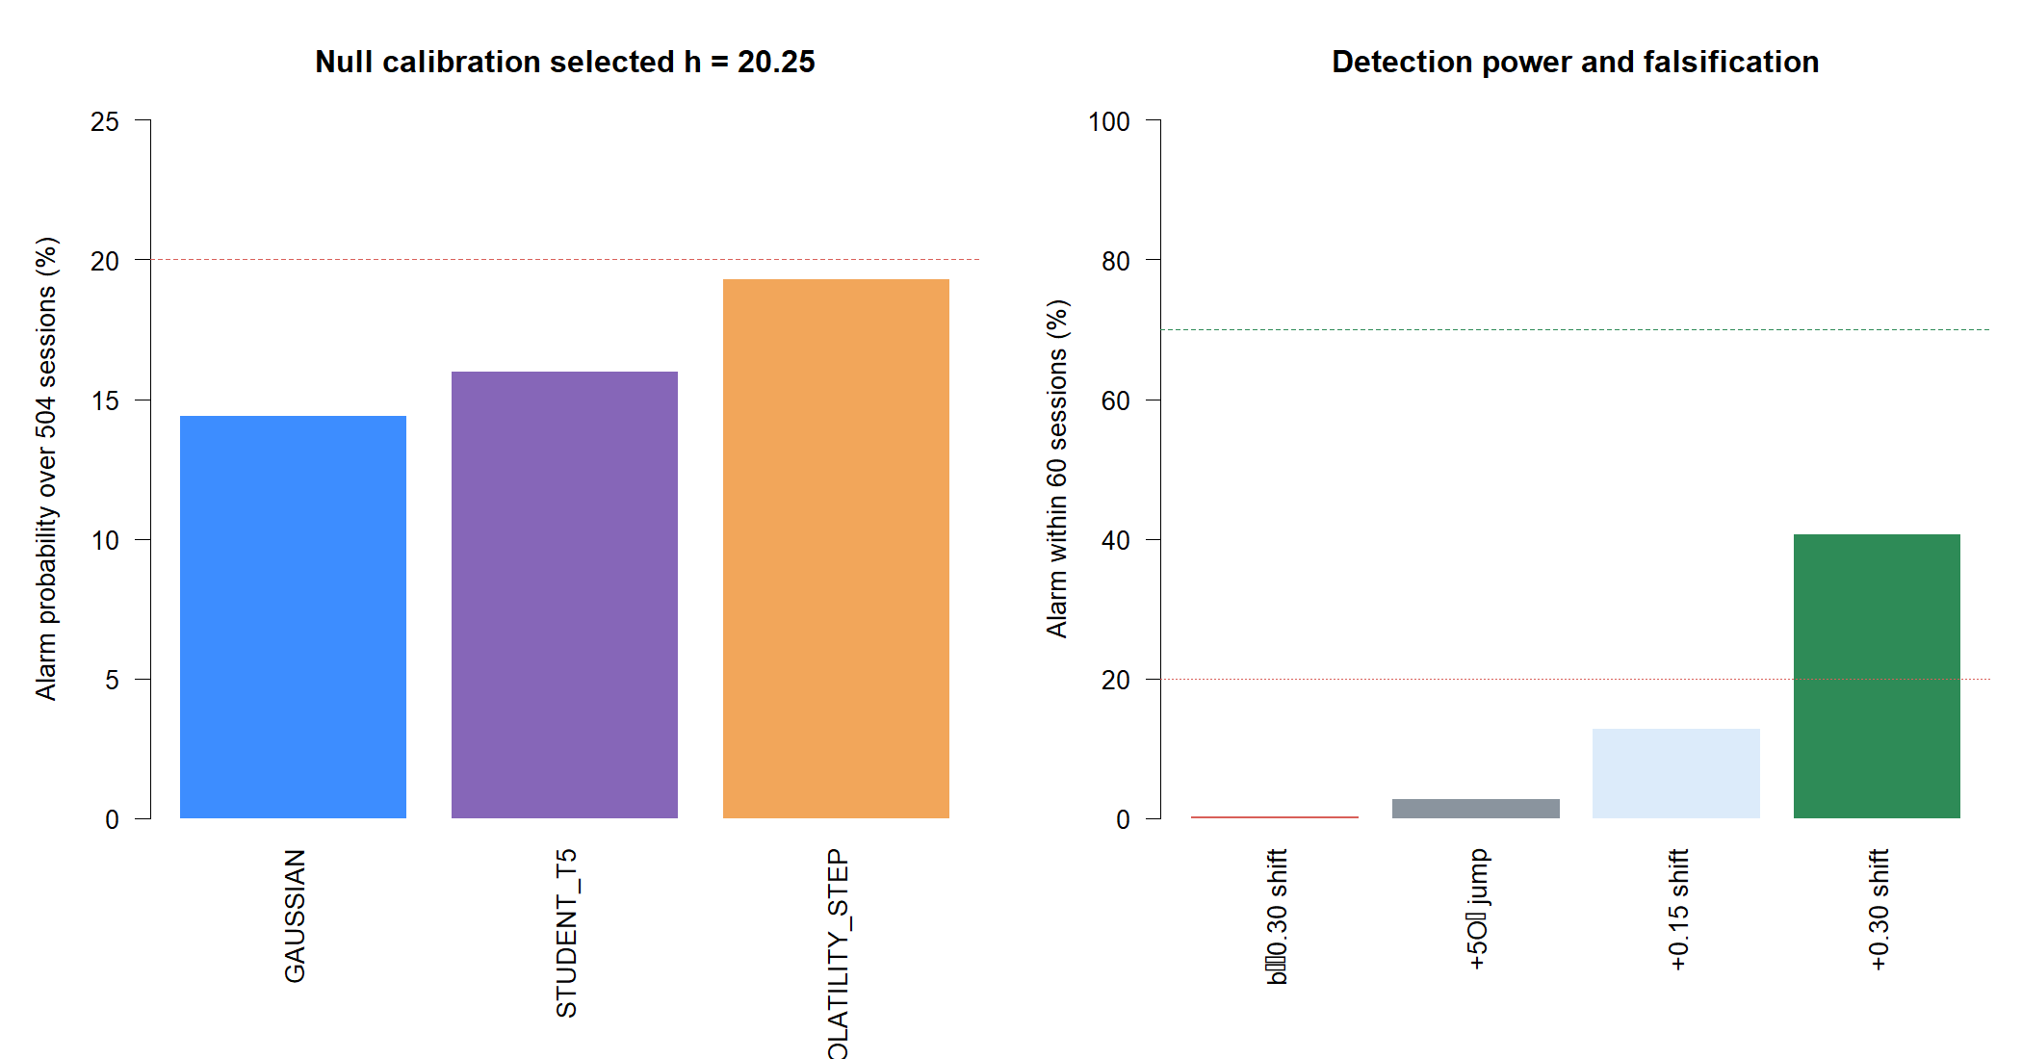
SYNTHETIC EVIDENCE
False alarms were controlled, but strong-shift detection reached only 40.7%
h = 20.25
smallest boundary meeting all null budgets
40.7%
+0.30σ/day shifts caught within 60 sessions
45 sessions
median delay among timely detections; gate ≤40
05
Notes:
All three no-change families stayed below 20%: Gaussian 14.4%, Student-t5 16.0%, volatility-step 19.3%. The cost was low power and slow detection even for a deliberately strong sustained positive shift.
[Sources]
- C:/Users/Franc/OneDrive/Documents/Francis/Peltata Project/Time-Series-Modeling-Gen5/runs/research_workbench/operator_hypothesis_lab/hyp_reg_11_1_causal_change_point_20260816/hyp_reg_11_1_null_rates.csv
- C:/Users/Franc/OneDrive/Documents/Francis/Peltata Project/Time-Series-Modeling-Gen5/runs/research_workbench/operator_hypothesis_lab/hyp_reg_11_1_causal_change_point_20260816/hyp_reg_11_1_shift_summary.csv
- C:/Users/Franc/OneDrive/Documents/Francis/Peltata Project/Time-Series-Modeling-Gen5/runs/research_workbench/operator_hypothesis_lab/hyp_reg_11_1_causal_change_point_20260816/visuals/synthetic_calibration.png

Slide 6
STAGE A GATES
Five construction checks passed; sensitivity and usability stopped the lane
Result
Gate
Observed
PASS
Data and boundary
26/26 complete; 2024+ absent
PASS
Null false alarms
Worst family 19.3% at h = 20.25
FAIL
Positive shift
40.7% within 60; 45-session median delay
PASS
Falsification
Negative 0.2%; one jump 2.7%
PASS
Causal and scale invariant
5/5 append checks; max difference 5.24e−13
PASS
Window semantics
0 semantic or spacing violations
FAIL
Real-panel usability
2/24 alarm-usable; 0/24 cross-usable
Stage B was never authorized to read performance.
06
Notes:
The table is the decision surface. A correct causal implementation is not enough: a transition detector must also recognize meaningful changes with adequate speed and create usable policy contact.
[Sources]
- C:/Users/Franc/OneDrive/Documents/Francis/Peltata Project/Time-Series-Modeling-Gen5/runs/research_workbench/operator_hypothesis_lab/hyp_reg_11_1_causal_change_point_20260816/hyp_reg_11_1_stage_a_gates.csv
- C:/Users/Franc/OneDrive/Documents/Francis/Peltata Project/Time-Series-Modeling-Gen5/runs/research_workbench/operator_hypothesis_lab/hyp_reg_11_1_causal_change_point_20260816/hyp_reg_11_1_report.md

Slide 7
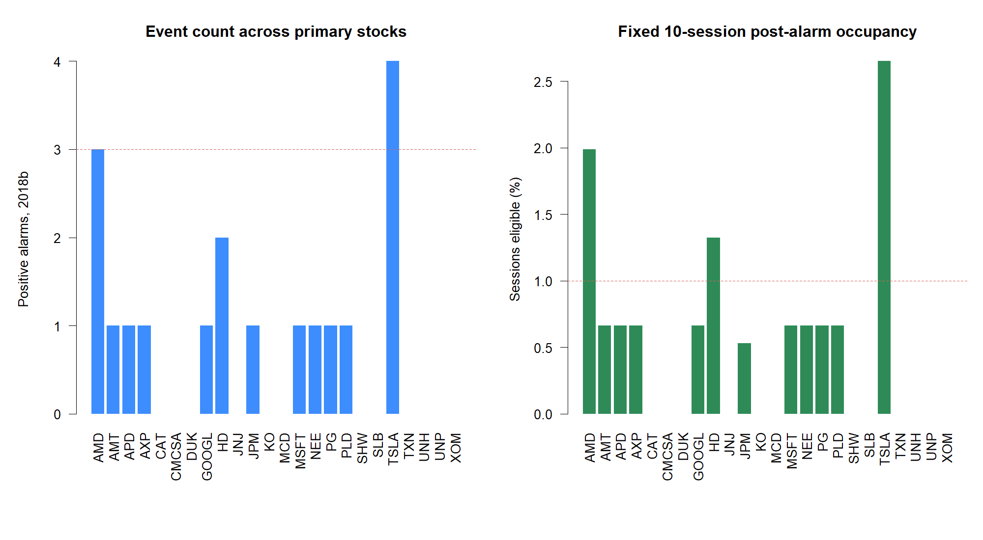
REAL-PANEL BEHAVIOR
The calibrated event was almost absent in six years of real data
2 / 24
stocks produced at least three alarms
0 / 24
stocks had a fresh SMA cross inside an eligible window
0.3%
median session occupancy
07
Notes:
TSLA had four alarms and AMD three, but the fixed event windows did not overlap any fresh SMA8/14 cross in any primary stock. Running a strategy would therefore be mechanically empty or nearly empty.
[Sources]
- C:/Users/Franc/OneDrive/Documents/Francis/Peltata Project/Time-Series-Modeling-Gen5/runs/research_workbench/operator_hypothesis_lab/hyp_reg_11_1_causal_change_point_20260816/hyp_reg_11_1_state_diagnostics.csv
- C:/Users/Franc/OneDrive/Documents/Francis/Peltata Project/Time-Series-Modeling-Gen5/runs/research_workbench/operator_hypothesis_lab/hyp_reg_11_1_causal_change_point_20260816/visuals/real_alarm_usability.png

Slide 8
MEASUREMENT TAPES
The tapes show why ‘onset’ became an occasional late confirmation
How to read
Red triangle
Alarm date
Green band
Fixed 10-session eligibility
Blue line
Accumulated positive evidence
Red dashed line
h = 20.25
TXN never alarms; SPY alarms once; AMD and TSLA alarm only after unusually persistent evidence.
08
Notes:
These are measurement examples, not selected profitable trades. The visual confirms exact event semantics and the extreme sparsity created by the calibrated boundary.
[Sources]
- C:/Users/Franc/OneDrive/Documents/Francis/Peltata Project/Time-Series-Modeling-Gen5/runs/research_workbench/operator_hypothesis_lab/hyp_reg_11_1_causal_change_point_20260816/visuals/representative_measurement_tapes.png
- C:/Users/Franc/OneDrive/Documents/Francis/Peltata Project/Time-Series-Modeling-Gen5/docs/GEN5_HYP_REG_11_1_CAUSAL_CHANGE_POINT_CONTRACT.md

Slide 9
RESEARCH DISCIPLINE
Running the strategy anyway would answer the wrong question
What the contract required
Correct STOP
The detector first had to recognize a known positive shift with adequate power and produce enough causal event windows to contact fresh SMA entries.
Do not interpret no trades as protection.
Do not relax h after seeing sparsity.
Do not lengthen the window until a crossover appears.
Do not inspect returns, controls, or 2024+.
What the evidence supplied
Low sensitivity, 45-session delay, 0.3% occupancy, and zero eligible crossovers across the primary panel.
Stage A protected Stage B from a meaningless backtest.
09
Notes:
The strategy code exists behind the gate for reproducibility, but the runner exits before reading retained parent evidence or calculating performance. This is a stronger result than an empty backtest dressed up as low drawdown.
[Sources]
- C:/Users/Franc/OneDrive/Documents/Francis/Peltata Project/Time-Series-Modeling-Gen5/docs/GEN5_HYP_REG_11_1_CAUSAL_CHANGE_POINT_CONTRACT.md
- C:/Users/Franc/OneDrive/Documents/Francis/Peltata Project/Time-Series-Modeling-Gen5/runs/research_workbench/operator_hypothesis_lab/hyp_reg_11_1_causal_change_point_20260816/hyp_reg_11_1_report.md
- C:/Users/Franc/OneDrive/Documents/Francis/Peltata Project/Time-Series-Modeling-Gen5/runs/research_workbench/operator_hypothesis_lab/hyp_reg_11_1_causal_change_point_20260816/STATUS.txt

Slide 10
INTERPRETATION
The failure is a quantitative sensitivity–specificity tradeoff—not a coding failure
Lower boundary
Frozen boundary
Earlier and more frequent alarms
More contact with SMA entries
But more noise, tail events, and volatility transitions mislabeled as directional change
Null behavior remained controlled
Negative drift and one jump rarely fooled it
But detection was slow and events became unusably sparse
Changing the bargain after seeing this result would create a new hypothesis—not repair HYP-REG-11.1.
10
Notes:
CUSUM behaved coherently. Its problem is the economics of daily equity returns: directional drift is small relative to volatility, so strict false-alarm control demands a high evidence boundary.
[Sources]
- C:/Users/Franc/OneDrive/Documents/Francis/Peltata Project/Time-Series-Modeling-Gen5/docs/GEN5_HYP_REG_11_1_CAUSAL_CHANGE_POINT_CONTRACT.md
- C:/Users/Franc/OneDrive/Documents/Francis/Peltata Project/Time-Series-Modeling-Gen5/runs/research_workbench/operator_hypothesis_lab/hyp_reg_11_1_causal_change_point_20260816/hyp_reg_11_1_null_rates.csv
- C:/Users/Franc/OneDrive/Documents/Francis/Peltata Project/Time-Series-Modeling-Gen5/runs/research_workbench/operator_hypothesis_lab/hyp_reg_11_1_causal_change_point_20260816/hyp_reg_11_1_shift_summary.csv

Slide 11
DECISION
Retain the detector as an audited lesson; move to breakout persistence
STOP
Next gate
Discuss T5 range position and breakout persistence—and first decide whether it is truly a regime measurement or a direct momentum strategy.
Stage A: 5 / 7
Keep
• causal standardization and reset mechanics
• synthetic specificity/power harness
• exact event-window ledger and tapes
• proof that strategy contact was withheld
Post-series bookmark
If T5 also stops, open the literature-first HMM discussion. Causal filtered probabilities only; no retrospective smoothed state presented as live-known.
11
Notes:
Close by separating the reusable infrastructure from the stopped policy. T5 is only the next discussion gate. HMM remains bookmarked until the five-candidate series concludes without promotion.
[Sources]
- C:/Users/Franc/OneDrive/Documents/Francis/Peltata Project/Time-Series-Modeling-Gen5/runs/research_workbench/operator_hypothesis_lab/hyp_reg_11_1_causal_change_point_20260816/hyp_reg_11_1_report.md
- C:/Users/Franc/OneDrive/Documents/Francis/Peltata Project/Time-Series-Modeling-Gen5/docs/GEN5_TREND_INDICATOR_POC_ROADMAP.md
- C:/Users/Franc/OneDrive/Documents/Francis/Peltata Project/Time-Series-Modeling-Gen5/docs/GEN5_HYP_REG_11_1_CAUSAL_CHANGE_POINT_CONTRACT.md

