Slide 1
OPERATOR HYPOTHESIS LAB | HYP-MOM-02.2
A faster exit,
with a catch
Qualified SMA200 entry | SMA50 exit | strict new-cross re-entry
Notes:
HYP-MOM-02.2 keeps the fresh-SMA200 entry concept but adds an SMA50 entry-coherence check, SMA50 exit, and strict new-cross re-entry. The result is a composite state-machine test, not an exit-only attribution.
[Sources]
- C:\Users\Franc\OneDrive\Documents\Francis\Peltata Project\Time-Series-Modeling-Gen5\operator_hypothesis_lab\docs\HYP_MOM_02_2_SMA200_ENTRY_SMA50_EXIT_DISCOVERY_CONTRACT.md
- C:\Users\Franc\OneDrive\Documents\Francis\Peltata Project\Time-Series-Modeling-Gen5\operator_hypothesis_lab\docs\HYP_MOM_02_2_SMA200_ENTRY_SMA50_EXIT_DISCOVERY_RESULTS.md

Slide 2
Three related views answer three different questions
HYP-MOM-02.1
HYP-MOM-02.2
State ownership: warm-start above SMA200
Fresh-cross ownership: start cash; wait for a new cross
Qualified SMA200 entry
SMA50 long-state exit
Strict new-cross re-entry
A substantive mechanics revision
Primary comparator: authoritative fresh-cross 02.1 | warm-start remains a separate estimand
2
Notes:
The investigation retains both 02.1 estimands because warm-start state ownership and fresh-cross event ownership answer different questions. The fresh-cross version is the authoritative comparator for 02.2.
[Sources]
- C:\Users\Franc\OneDrive\Documents\Francis\Peltata Project\Time-Series-Modeling-Gen5\operator_hypothesis_lab\docs\HYP_MOM_02_2_SMA200_ENTRY_SMA50_EXIT_DISCOVERY_CONTRACT.md
- C:\Users\Franc\OneDrive\Documents\Francis\Peltata Project\Time-Series-Modeling-Gen5\operator_hypothesis_lab\docs\HYP_MOM_02_2_SMA200_ENTRY_SMA50_EXIT_DISCOVERY_RESULTS.md

Slide 3
A slow entry gate and fast-reacting exit define one strict state machine
SMA_N(t) = (1/N) sum[k=0..N-1] Close(t-k) | N in {200, 50}
QUALIFIED ENTRY
EXIT + LOCKOUT
Fresh cross above SMA200
and close above SMA50
Buy at the next open
First close at/below SMA50
Sell at the next open
New SMA200 cross required
Every path starts cash | completed-close signals | next-open fills | 5 / 10 bp per-side costs
3
Notes:
SMA_N(t) is the inclusive mean of the last N completed adjusted closes. A signal close must cross above SMA200 and finish above SMA50; entry and exit occur only at the next open. After an SMA50 exit, recovery above SMA50 alone cannot re-enter.
[Sources]
- C:\Users\Franc\OneDrive\Documents\Francis\Peltata Project\Time-Series-Modeling-Gen5\operator_hypothesis_lab\docs\HYP_MOM_02_2_SMA200_ENTRY_SMA50_EXIT_DISCOVERY_CONTRACT.md
- C:\Users\Franc\OneDrive\Documents\Francis\Peltata Project\Time-Series-Modeling-Gen5\runs\research_workbench\operator_hypothesis_lab\hyp_mom_02_2_sma200_entry_sma50_exit_wide_discovery_20260809\run_spec.csv

Slide 4
SMA50 is not always the earlier exit threshold
WHY IT CAN EXIT EARLIER
WHY IT CAN EXIT LATER
In established uptrends, SMA50 often sits above SMA200
Price reaches the faster anchor first
After weakness, SMA50 can sit below SMA200
Price may cross the slow anchor first
Faster describes responsiveness—not vertical position. Audit earlier, same-session, and later exits.
4
Notes:
SMA50 reacts faster to price but can sit below SMA200 after weakness. Therefore crossing below SMA50 is not guaranteed to occur first. The matched-exit audit explicitly separates earlier, same-session, and later exits.
[Sources]
- C:\Users\Franc\OneDrive\Documents\Francis\Peltata Project\Time-Series-Modeling-Gen5\operator_hypothesis_lab\docs\HYP_MOM_02_2_SMA200_ENTRY_SMA50_EXIT_DISCOVERY_CONTRACT.md
- C:\Users\Franc\OneDrive\Documents\Francis\Peltata Project\Time-Series-Modeling-Gen5\runs\research_workbench\operator_hypothesis_lab\hyp_mom_02_2_sma200_entry_sma50_exit_wide_discovery_20260809\matched_entry_exit_summary.csv

Slide 5
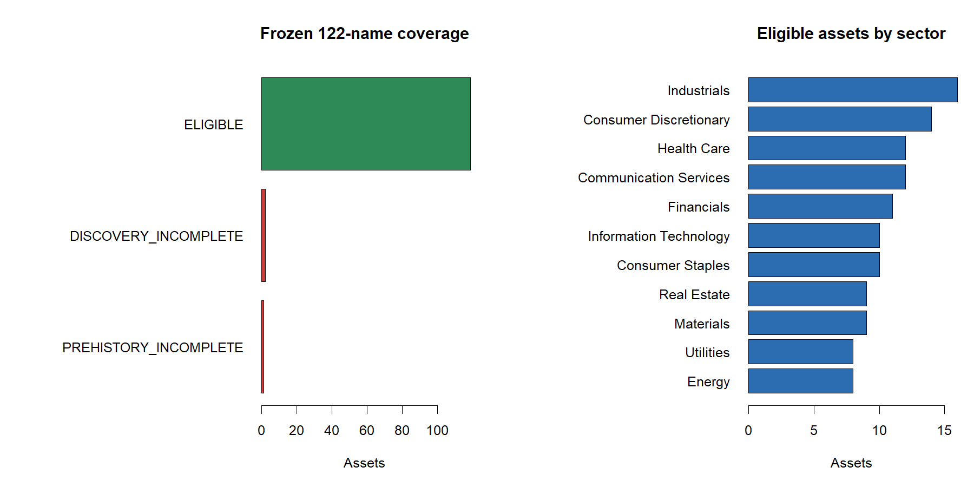
The same wide panel keeps the comparison honest: 119 of 122 eligible
5
Notes:
The same combined registry and discovery calendar as 02.1 produced 119 eligible assets. APHA, SNE, and LI remained excluded without replacement.
[Sources]
- C:\Users\Franc\OneDrive\Documents\Francis\Peltata Project\Time-Series-Modeling-Gen5\runs\research_workbench\operator_hypothesis_lab\hyp_mom_02_2_sma200_entry_sma50_exit_wide_discovery_20260809\coverage.csv
- C:\Users\Franc\OneDrive\Documents\Francis\Peltata Project\Time-Series-Modeling-Gen5\runs\research_workbench\operator_hypothesis_lab\hyp_mom_02_2_sma200_entry_sma50_exit_wide_discovery_20260809\visuals\coverage_and_composition.png

Slide 6
The composite improved defense—but mostly by spending far more time in cash
+0.38%
-22.20 pp
16.76%
+11.09 pp
median 02.2 return
median excess vs ownership
median 02.2 exposure
median DD change vs 02.1
versus -2.73% fresh-cross 02.1
only 32 of 119 beat ownership
versus 43.48% for fresh-cross 02.1
105 of 119 improved drawdown
65/119 higher return vs 02.1 | 105/119 better drawdown | 64/119 improved both
6
Notes:
Median 02.2 return was +0.38% versus -2.73% for fresh-cross 02.1, but median exposure fell to 16.76%. The direct median asset-level drawdown change was +11.09 points. Ownership still beat 02.2 in 87 assets.
[Sources]
- C:\Users\Franc\OneDrive\Documents\Francis\Peltata Project\Time-Series-Modeling-Gen5\runs\research_workbench\operator_hypothesis_lab\hyp_mom_02_2_sma200_entry_sma50_exit_wide_discovery_20260809\panel_summary.csv
- C:\Users\Franc\OneDrive\Documents\Francis\Peltata Project\Time-Series-Modeling-Gen5\runs\research_workbench\operator_hypothesis_lab\hyp_mom_02_2_sma200_entry_sma50_exit_wide_discovery_20260809\asset_variant_comparison.csv
- C:\Users\Franc\OneDrive\Documents\Francis\Peltata Project\Time-Series-Modeling-Gen5\operator_hypothesis_lab\docs\HYP_MOM_02_2_SMA200_ENTRY_SMA50_EXIT_DISCOVERY_RESULTS.md

Slide 7
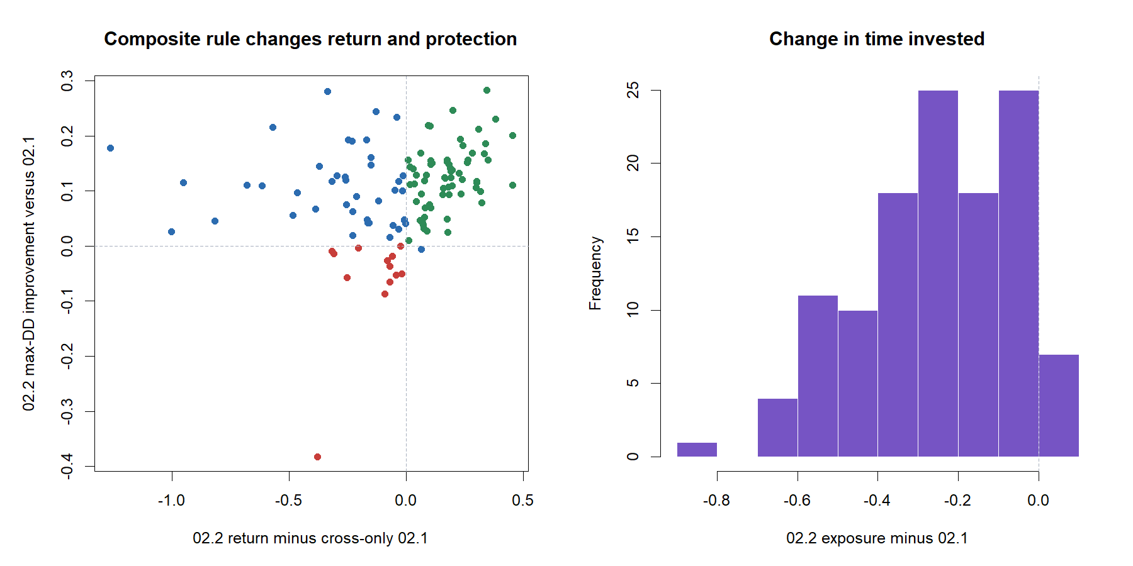
The composite improved both return and drawdown in 64 of 119 assets
7
Notes:
Every point compares 02.2 with authoritative fresh-cross 02.1. Sixty-four assets improved both return and maximum drawdown; only one improved return while worsening drawdown.
[Sources]
- C:\Users\Franc\OneDrive\Documents\Francis\Peltata Project\Time-Series-Modeling-Gen5\runs\research_workbench\operator_hypothesis_lab\hyp_mom_02_2_sma200_entry_sma50_exit_wide_discovery_20260809\asset_variant_comparison.csv
- C:\Users\Franc\OneDrive\Documents\Francis\Peltata Project\Time-Series-Modeling-Gen5\runs\research_workbench\operator_hypothesis_lab\hyp_mom_02_2_sma200_entry_sma50_exit_wide_discovery_20260809\visuals\variant_return_drawdown_comparison.png

Slide 8
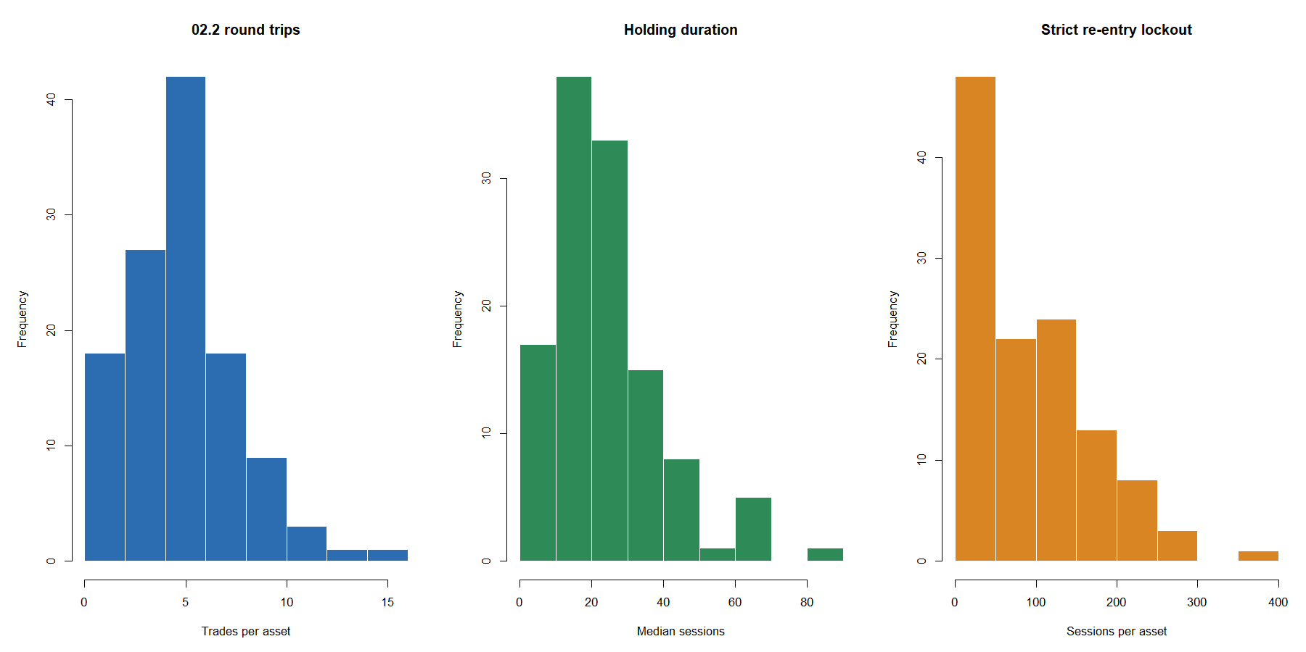
Selectivity reduced trades—and created long re-entry lockouts
656
skipped entry signals
637 round trips
75 median lockout sessions
18-session pooled median hold
53.2% lasted <=20 sessions
Cash discipline was the mechanism—and the opportunity cost.
8
Notes:
The strict state machine rejected 656 SMA200 crosses below SMA50, completed 637 trades, and imposed 75 median lockout sessions per asset. Pooled hit rate was 34.69%, median trade -1.72%, and mean trade +0.08%.
[Sources]
- C:\Users\Franc\OneDrive\Documents\Francis\Peltata Project\Time-Series-Modeling-Gen5\runs\research_workbench\operator_hypothesis_lab\hyp_mom_02_2_sma200_entry_sma50_exit_wide_discovery_20260809\trades_022.csv
- C:\Users\Franc\OneDrive\Documents\Francis\Peltata Project\Time-Series-Modeling-Gen5\runs\research_workbench\operator_hypothesis_lab\hyp_mom_02_2_sma200_entry_sma50_exit_wide_discovery_20260809\panel_summary.csv
- C:\Users\Franc\OneDrive\Documents\Francis\Peltata Project\Time-Series-Modeling-Gen5\runs\research_workbench\operator_hypothesis_lab\hyp_mom_02_2_sma200_entry_sma50_exit_wide_discovery_20260809\visuals\trade_mechanics_and_lockout.png

Slide 9
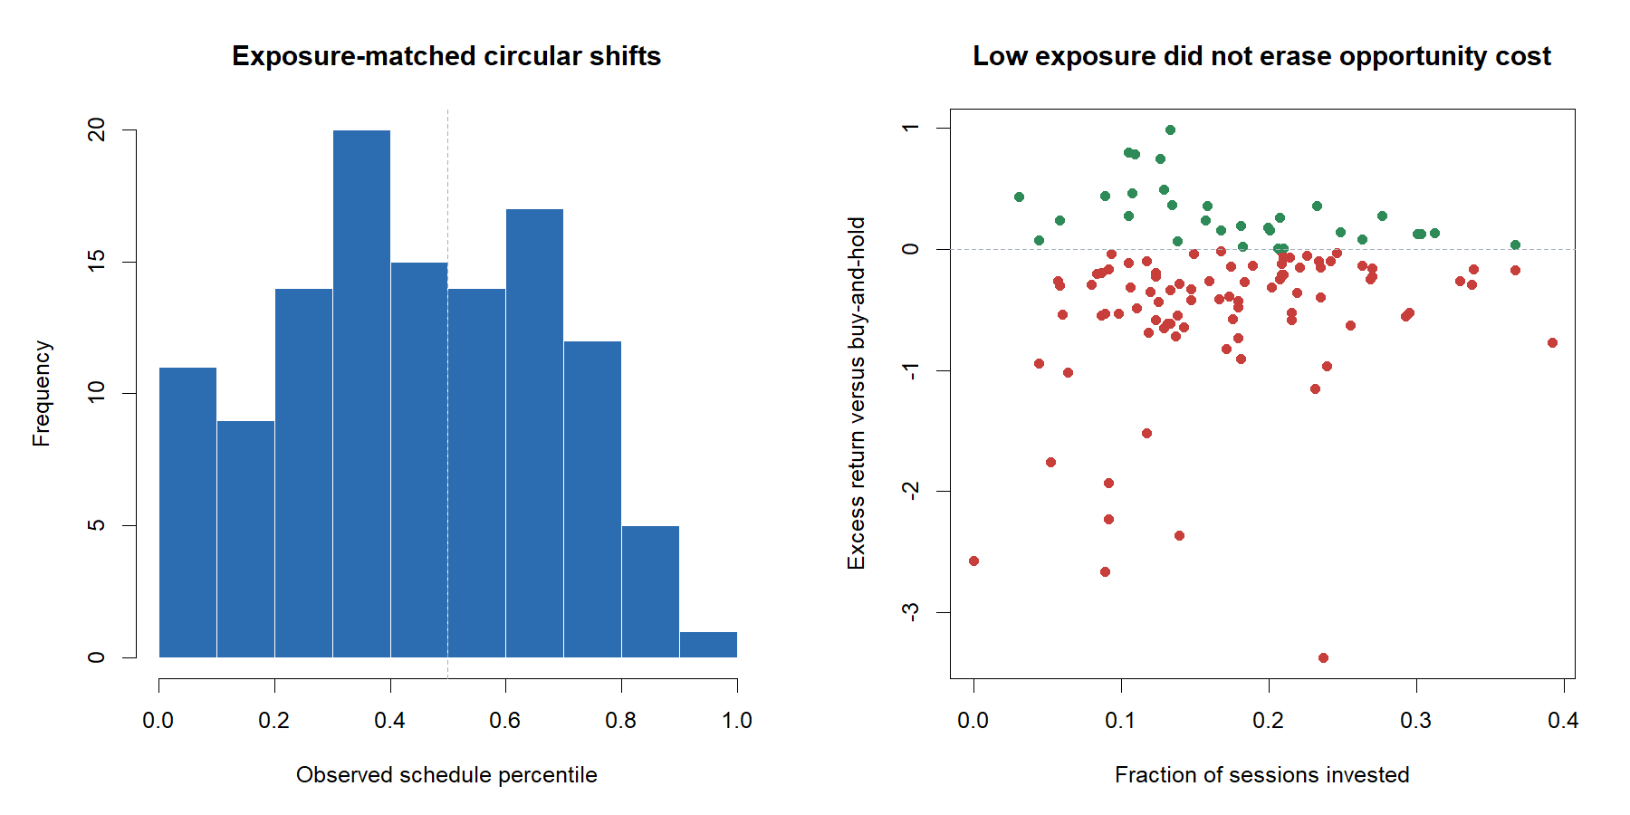
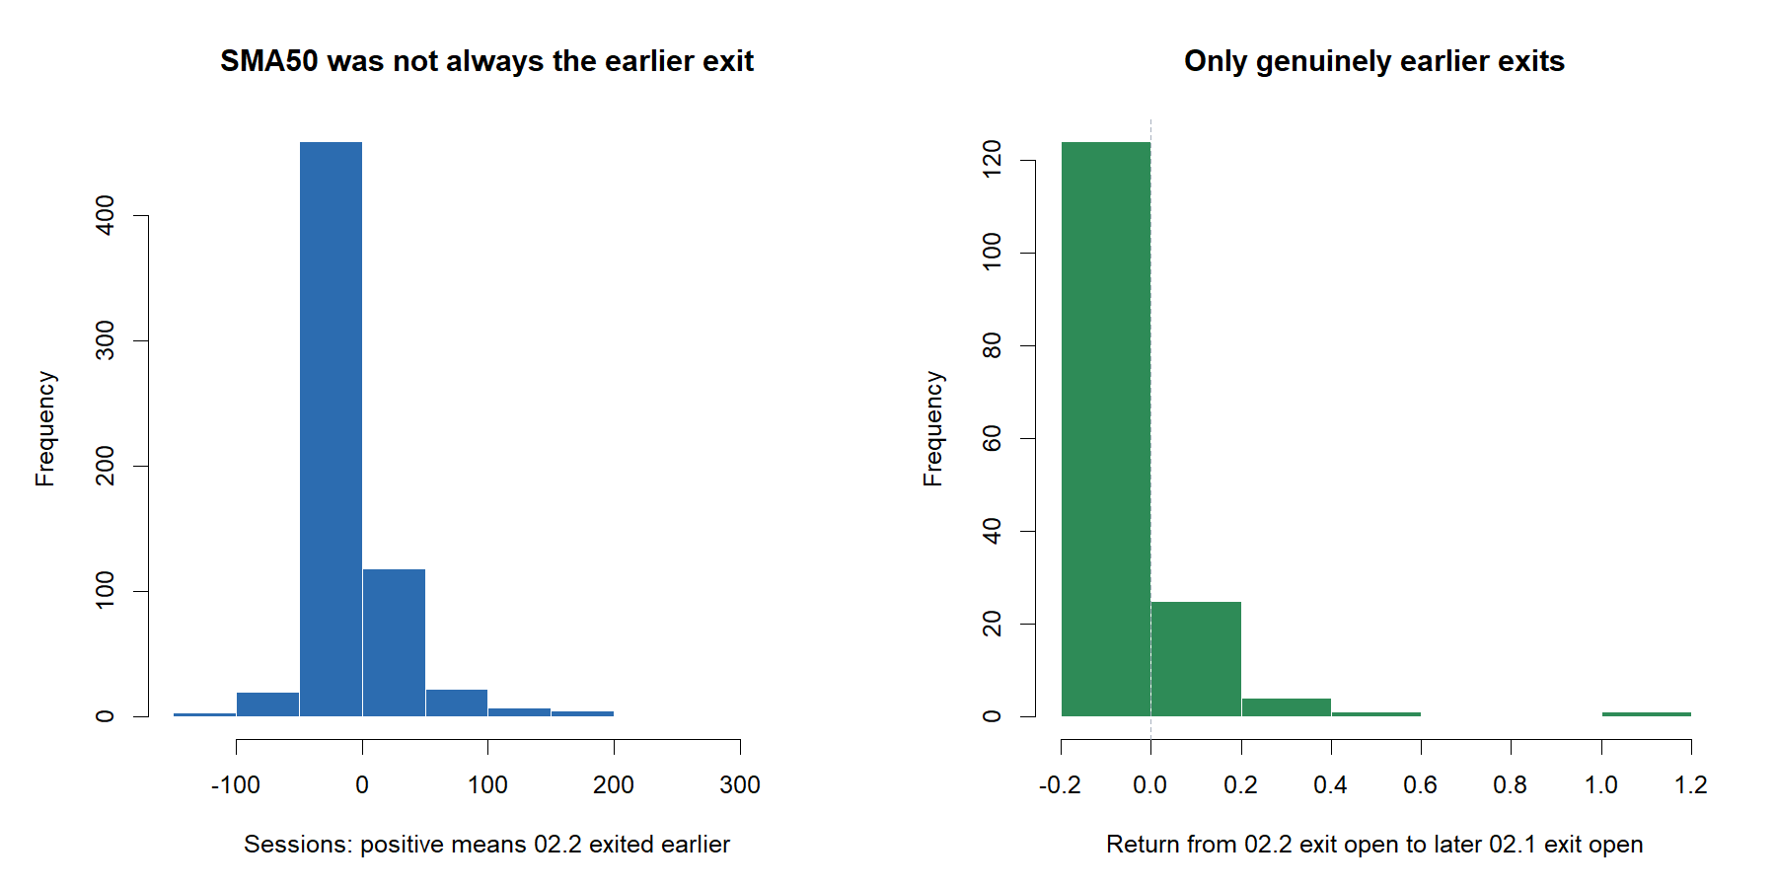
SMA50 exited earlier in only 155 of 637 matched entries
9
Notes:
Across 637 matched entries, 02.2 exited earlier 155 times, on the same session 176 times, and later 306 times. Among genuinely earlier exits, 123 saved downside and 31 forfeited upside; the median lead was 16 sessions.
[Sources]
- C:\Users\Franc\OneDrive\Documents\Francis\Peltata Project\Time-Series-Modeling-Gen5\runs\research_workbench\operator_hypothesis_lab\hyp_mom_02_2_sma200_entry_sma50_exit_wide_discovery_20260809\matched_entry_exit_audit.csv
- C:\Users\Franc\OneDrive\Documents\Francis\Peltata Project\Time-Series-Modeling-Gen5\runs\research_workbench\operator_hypothesis_lab\hyp_mom_02_2_sma200_entry_sma50_exit_wide_discovery_20260809\matched_entry_exit_summary.csv
- C:\Users\Franc\OneDrive\Documents\Francis\Peltata Project\Time-Series-Modeling-Gen5\runs\research_workbench\operator_hypothesis_lab\hyp_mom_02_2_sma200_entry_sma50_exit_wide_discovery_20260809\visuals\matched_exit_consequences.png

Slide 10
Actual 02.2 timing still ranked below exposure-matched shifts
10
Notes:
The actual 02.2 schedule ranked at the 42.9th median percentile of 500 exposure-matched circular shifts. This is a diagnostic, not a p-value or an executable control. Low exposure explains much of the protection but not favorable calendar alignment.
[Sources]
- C:\Users\Franc\OneDrive\Documents\Francis\Peltata Project\Time-Series-Modeling-Gen5\runs\research_workbench\operator_hypothesis_lab\hyp_mom_02_2_sma200_entry_sma50_exit_wide_discovery_20260809\random_controls_022.csv
- C:\Users\Franc\OneDrive\Documents\Francis\Peltata Project\Time-Series-Modeling-Gen5\runs\research_workbench\operator_hypothesis_lab\hyp_mom_02_2_sma200_entry_sma50_exit_wide_discovery_20260809\asset_summary_022.csv
- C:\Users\Franc\OneDrive\Documents\Francis\Peltata Project\Time-Series-Modeling-Gen5\runs\research_workbench\operator_hypothesis_lab\hyp_mom_02_2_sma200_entry_sma50_exit_wide_discovery_20260809\visuals\timing_control_and_ownership.png

Slide 11
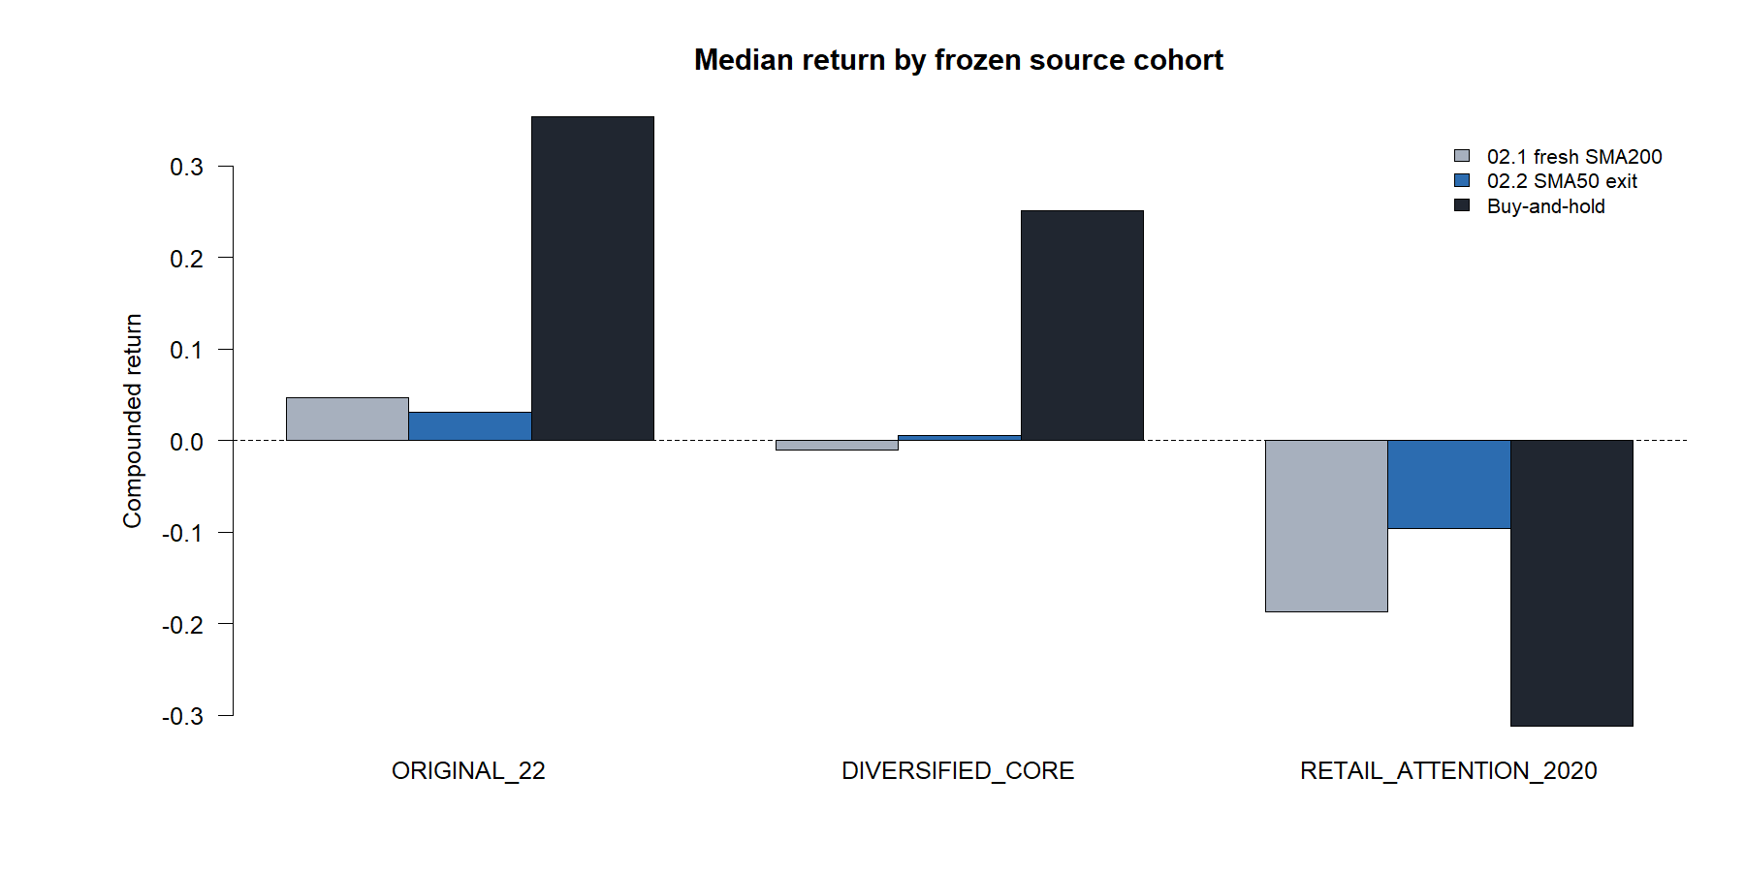
Defense improved most where continuous ownership struggled
RETAIL ATTENTION
-9.6% 02.2
-18.7% fresh-cross 02.1
-31.3% ownership
ORIGINAL 22
+3.1% 02.2
+4.6% fresh-cross 02.1
+35.4% ownership
Frozen cohort context—not a selection rule.
11
Notes:
The retail-attention cohort again shows loss mitigation rather than positive alpha. The original 22 cohort slightly deteriorated versus 02.1. Frozen cohort results remain descriptive and cannot authorize selection.
[Sources]
- C:\Users\Franc\OneDrive\Documents\Francis\Peltata Project\Time-Series-Modeling-Gen5\runs\research_workbench\operator_hypothesis_lab\hyp_mom_02_2_sma200_entry_sma50_exit_wide_discovery_20260809\panel_summary.csv
- C:\Users\Franc\OneDrive\Documents\Francis\Peltata Project\Time-Series-Modeling-Gen5\runs\research_workbench\operator_hypothesis_lab\hyp_mom_02_2_sma200_entry_sma50_exit_wide_discovery_20260809\visuals\cohort_variant_comparison.png

Slide 12
PAIRED PATH AUDIT
Cash discipline
rescued some paths—
and abandoned others
Six frozen roles map to six assets; every tape compares 02.2 with fresh-cross 02.1.
12
Notes:
Six mechanically selected roles expose the range of behaviors. Unlike the prior 02.1 tape manifest, all six roles map to unique assets in this run.
[Sources]
- C:\Users\Franc\OneDrive\Documents\Francis\Peltata Project\Time-Series-Modeling-Gen5\operator_hypothesis_lab\docs\HYP_MOM_02_2_SMA200_ENTRY_SMA50_EXIT_DISCOVERY_CONTRACT.md
- C:\Users\Franc\OneDrive\Documents\Francis\Peltata Project\Time-Series-Modeling-Gen5\runs\research_workbench\operator_hypothesis_lab\hyp_mom_02_2_sma200_entry_sma50_exit_wide_discovery_20260809\representative_tape_manifest.csv

Slide 13
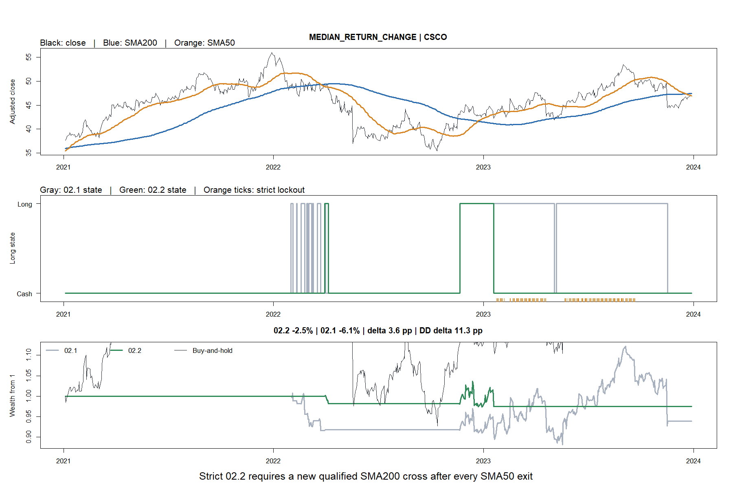
The median improvement still left both strategies losing
13
Notes:
CSCO is the median return-change asset. 02.2 lost 2.5% versus a 6.1% loss for 02.1, improving drawdown by 11.3 points while still lagging ownership.
[Sources]
- C:\Users\Franc\OneDrive\Documents\Francis\Peltata Project\Time-Series-Modeling-Gen5\runs\research_workbench\operator_hypothesis_lab\hyp_mom_02_2_sma200_entry_sma50_exit_wide_discovery_20260809\representative_tape_manifest.csv
- C:\Users\Franc\OneDrive\Documents\Francis\Peltata Project\Time-Series-Modeling-Gen5\runs\research_workbench\operator_hypothesis_lab\hyp_mom_02_2_sma200_entry_sma50_exit_wide_discovery_20260809\visuals\paired_tape_1_csco.png

Slide 14
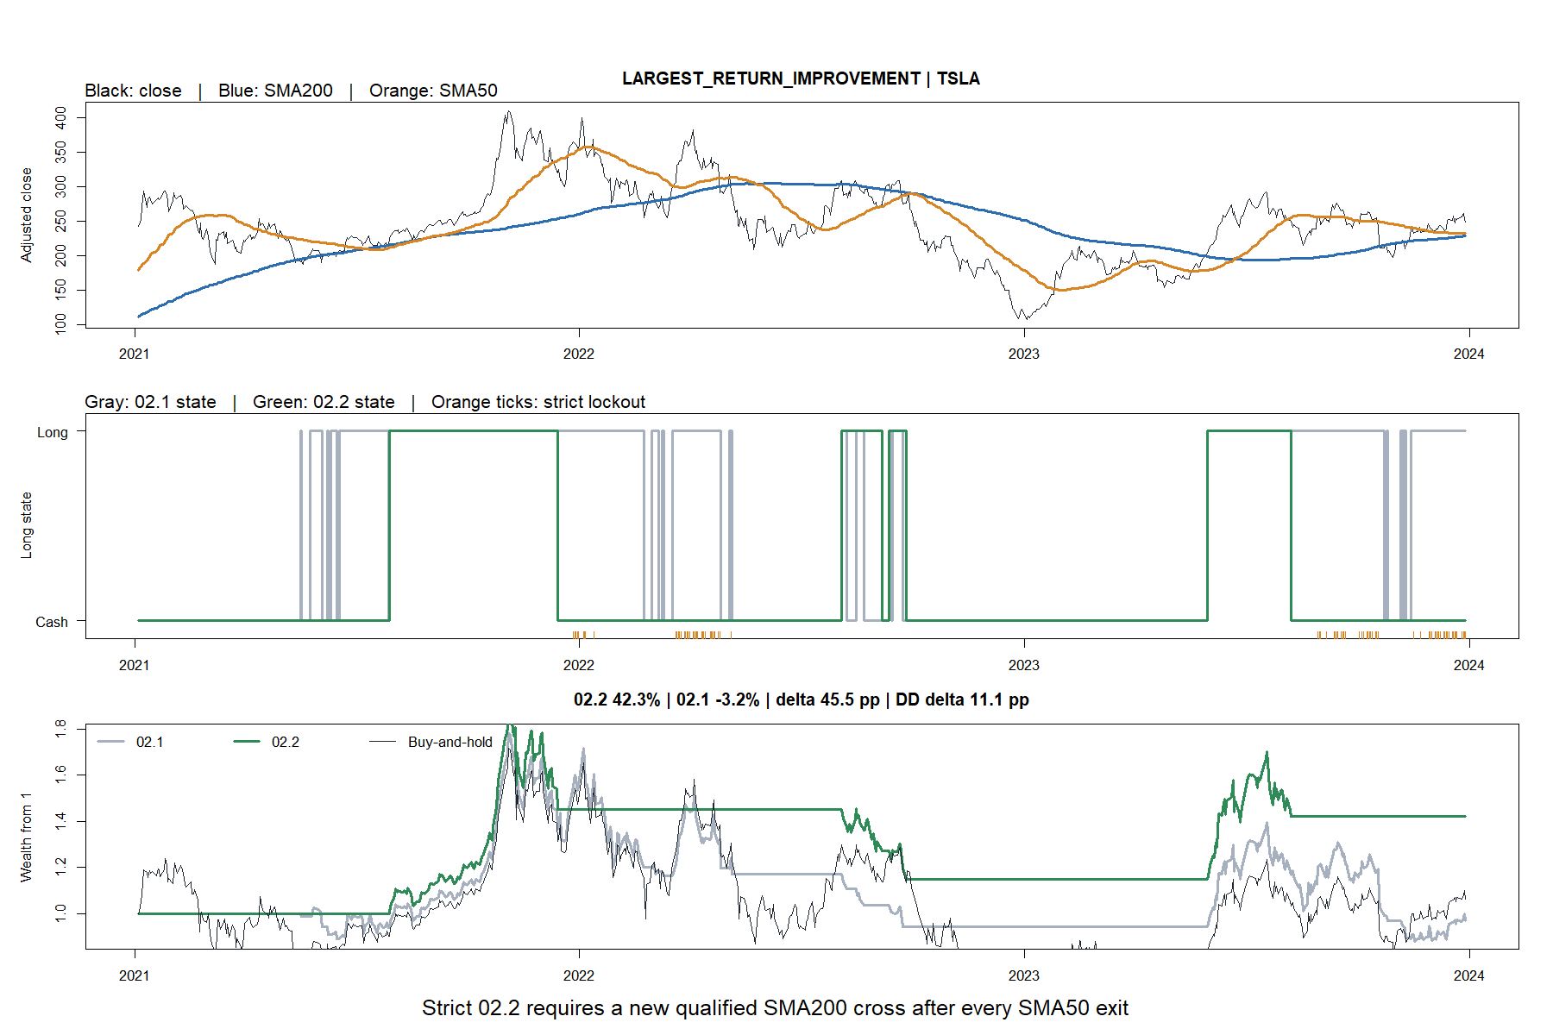
TSLA shows selective participation rescuing a difficult path
14
Notes:
TSLA is the largest return improvement: +42.3% under 02.2 versus -3.2% under 02.1, with an 11.1-point drawdown improvement. It is a favorable path example, not selection authority.
[Sources]
- C:\Users\Franc\OneDrive\Documents\Francis\Peltata Project\Time-Series-Modeling-Gen5\runs\research_workbench\operator_hypothesis_lab\hyp_mom_02_2_sma200_entry_sma50_exit_wide_discovery_20260809\representative_tape_manifest.csv
- C:\Users\Franc\OneDrive\Documents\Francis\Peltata Project\Time-Series-Modeling-Gen5\runs\research_workbench\operator_hypothesis_lab\hyp_mom_02_2_sma200_entry_sma50_exit_wide_discovery_20260809\visuals\paired_tape_2_tsla.png

Slide 15
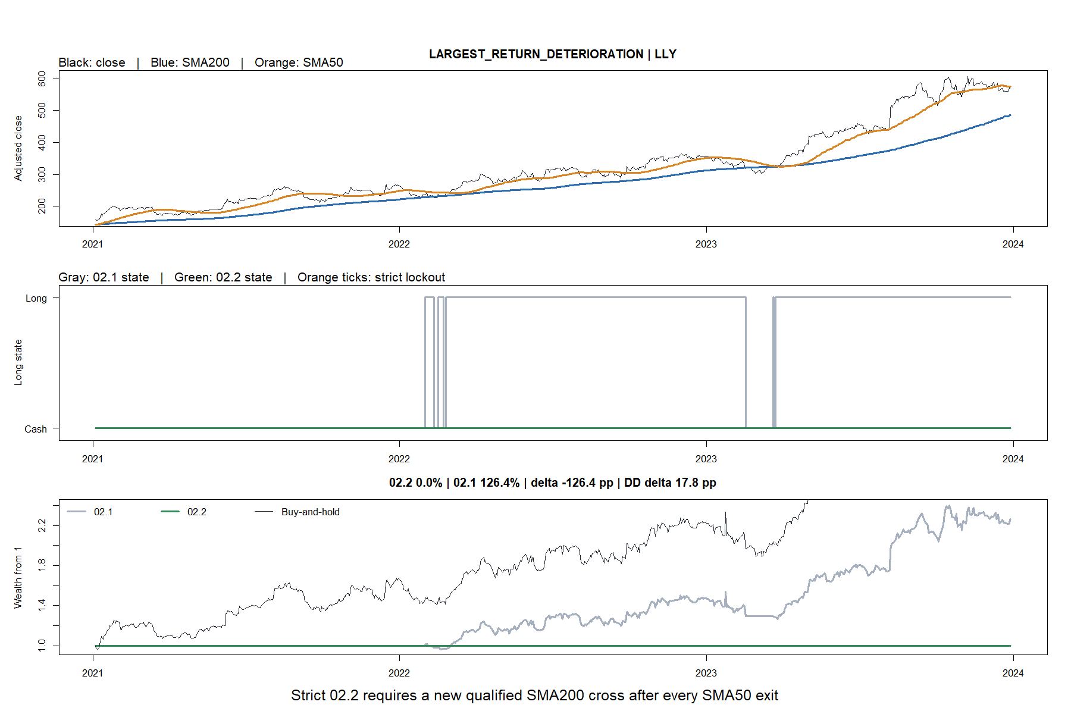
LLY shows the cost of disqualifying every SMA200 cross
15
Notes:
LLY is the largest deterioration. All five SMA200 crosses were disqualified below SMA50, leaving 02.2 in cash while 02.1 gained 126.4% and ownership gained 257.0%.
[Sources]
- C:\Users\Franc\OneDrive\Documents\Francis\Peltata Project\Time-Series-Modeling-Gen5\runs\research_workbench\operator_hypothesis_lab\hyp_mom_02_2_sma200_entry_sma50_exit_wide_discovery_20260809\representative_tape_manifest.csv
- C:\Users\Franc\OneDrive\Documents\Francis\Peltata Project\Time-Series-Modeling-Gen5\runs\research_workbench\operator_hypothesis_lab\hyp_mom_02_2_sma200_entry_sma50_exit_wide_discovery_20260809\visuals\paired_tape_3_lly.png

Slide 16
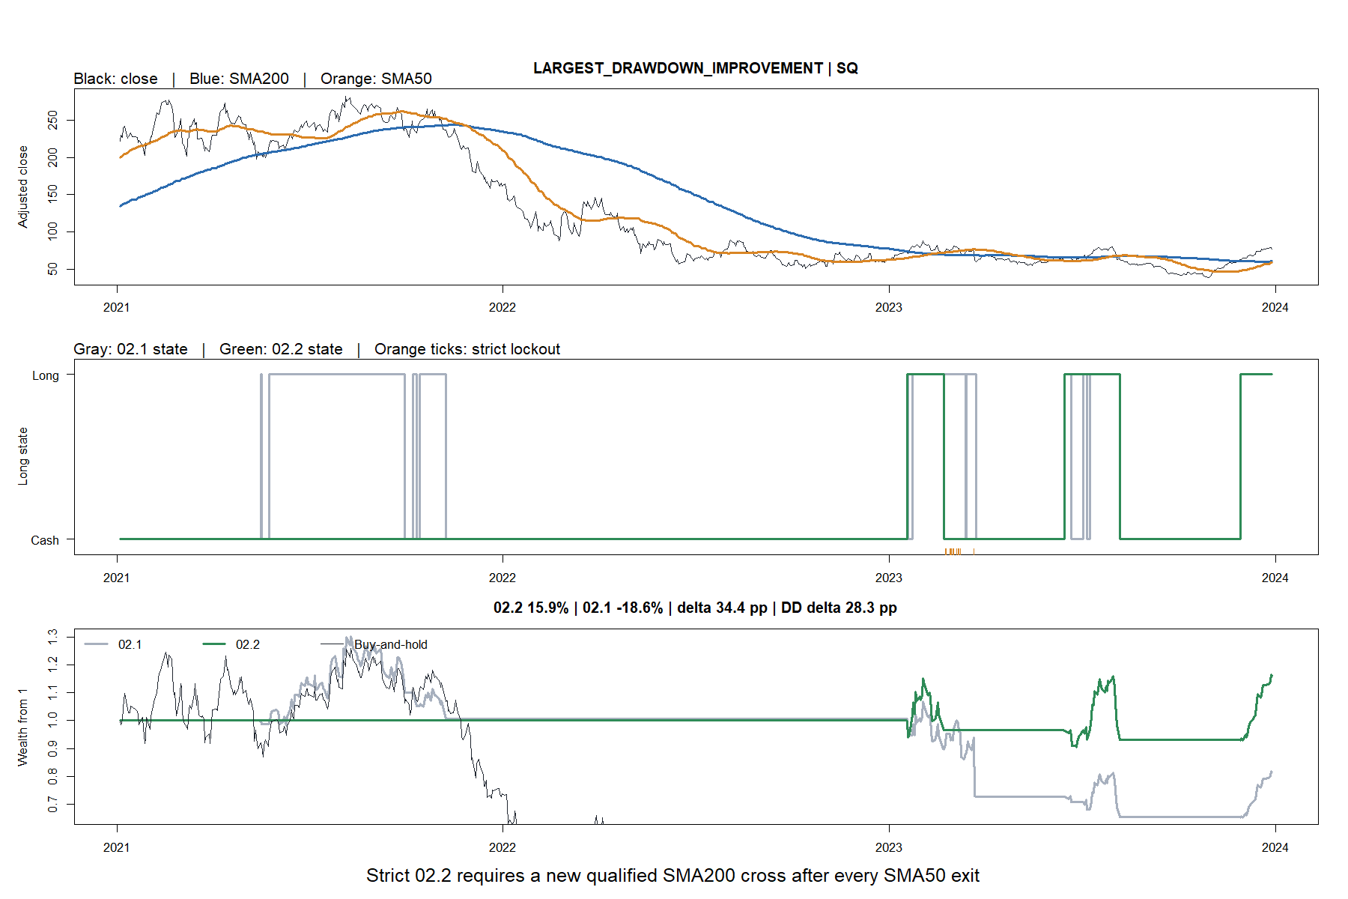
SQ shows the strongest drawdown rescue
16
Notes:
SQ has the largest drawdown improvement versus 02.1. 02.2 gained 15.9% versus an 18.6% loss for 02.1, with drawdown improving by 28.3 points.
[Sources]
- C:\Users\Franc\OneDrive\Documents\Francis\Peltata Project\Time-Series-Modeling-Gen5\runs\research_workbench\operator_hypothesis_lab\hyp_mom_02_2_sma200_entry_sma50_exit_wide_discovery_20260809\representative_tape_manifest.csv
- C:\Users\Franc\OneDrive\Documents\Francis\Peltata Project\Time-Series-Modeling-Gen5\runs\research_workbench\operator_hypothesis_lab\hyp_mom_02_2_sma200_entry_sma50_exit_wide_discovery_20260809\visuals\paired_tape_4_sq.png

Slide 17
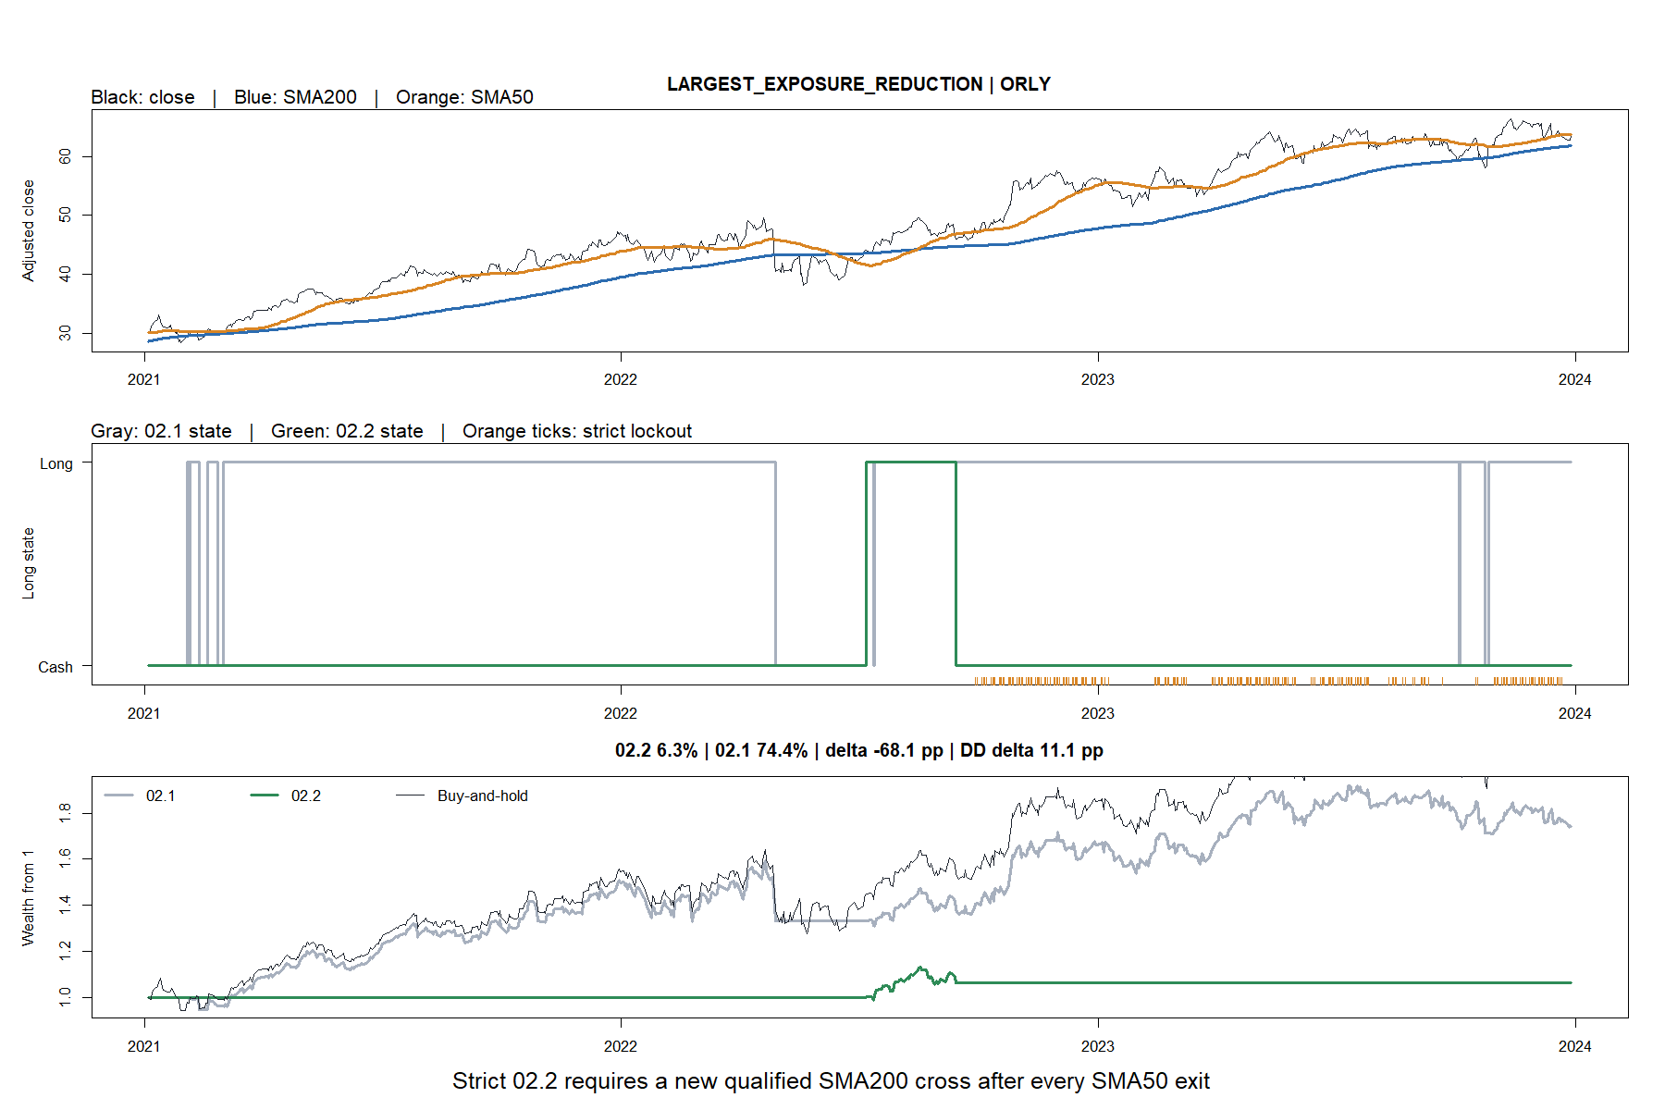
ORLY shows how lockout can abandon a persistent trend
17
Notes:
ORLY has the greatest exposure reduction. 02.2 gained 6.3% versus 74.4% for 02.1 and 107.8% for ownership. Strict lockout missed most of a persistent trend.
[Sources]
- C:\Users\Franc\OneDrive\Documents\Francis\Peltata Project\Time-Series-Modeling-Gen5\runs\research_workbench\operator_hypothesis_lab\hyp_mom_02_2_sma200_entry_sma50_exit_wide_discovery_20260809\representative_tape_manifest.csv
- C:\Users\Franc\OneDrive\Documents\Francis\Peltata Project\Time-Series-Modeling-Gen5\runs\research_workbench\operator_hypothesis_lab\hyp_mom_02_2_sma200_entry_sma50_exit_wide_discovery_20260809\visuals\paired_tape_5_orly.png

Slide 18
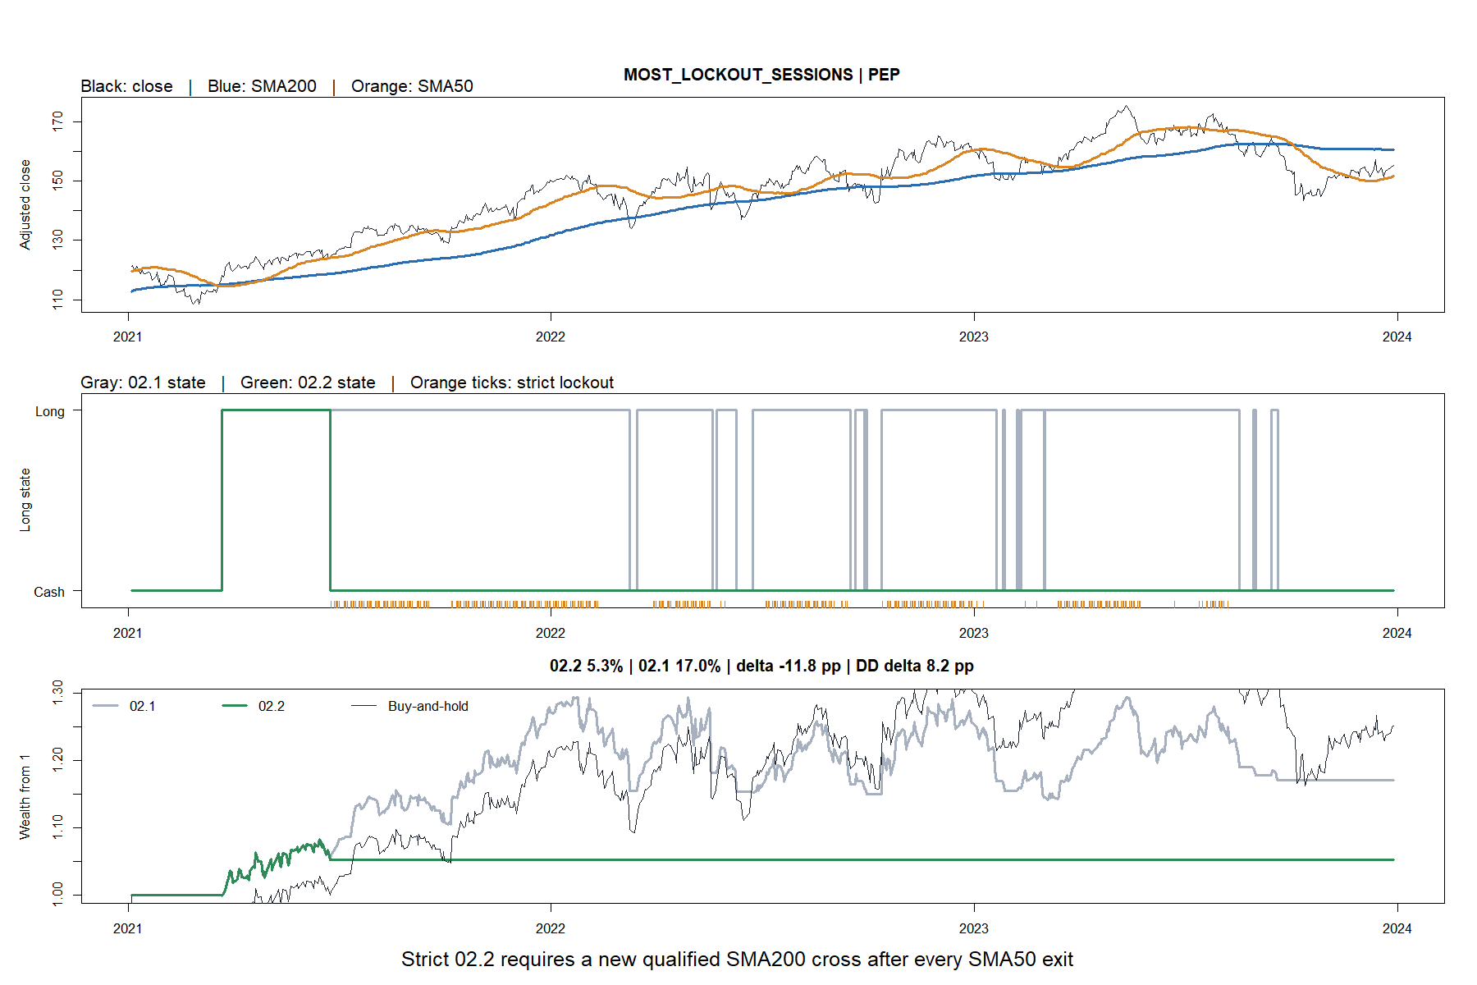
PEP spent 355 sessions locked out after exit
18
Notes:
PEP accumulated 355 strict-lockout sessions. 02.2 gained 5.3% versus 17.0% for 02.1 and 25.1% for ownership, demonstrating the opportunity cost of requiring a new SMA200 cross.
[Sources]
- C:\Users\Franc\OneDrive\Documents\Francis\Peltata Project\Time-Series-Modeling-Gen5\runs\research_workbench\operator_hypothesis_lab\hyp_mom_02_2_sma200_entry_sma50_exit_wide_discovery_20260809\representative_tape_manifest.csv
- C:\Users\Franc\OneDrive\Documents\Francis\Peltata Project\Time-Series-Modeling-Gen5\runs\research_workbench\operator_hypothesis_lab\hyp_mom_02_2_sma200_entry_sma50_exit_wide_discovery_20260809\visuals\paired_tape_6_pep.png

Slide 19
HYP-MOM-02.2 improved the defensive tradeoff—not timing authority
WHAT THE WIDE STUDY SUPPORTS
WHAT IT DOES NOT SUPPORT
64/119 improved both versus 02.1
113/119 reduced drawdown versus ownership
Genuinely early exits usually saved downside
Optimality of SMA50
Generic outperformance versus ownership
Exit-only causal attribution
Portfolio or live authority
The next question must separate entry confirmation, exit timing, and re-entry policy on distinct evidence.
19
Notes:
Record WIDE_DISCOVERY_COMPLETE_NO_PROMOTION_AUTHORITY. The composite improved the defensive tradeoff versus 02.1, but did so with low exposure, extensive signal rejection, and weak matched-timing evidence. Do not tune the averages, change re-entry, select assets, inspect 2024+, or open portfolio/live authority from this packet.
[Sources]
- C:\Users\Franc\OneDrive\Documents\Francis\Peltata Project\Time-Series-Modeling-Gen5\operator_hypothesis_lab\docs\HYP_MOM_02_2_SMA200_ENTRY_SMA50_EXIT_DISCOVERY_CONTRACT.md
- C:\Users\Franc\OneDrive\Documents\Francis\Peltata Project\Time-Series-Modeling-Gen5\operator_hypothesis_lab\docs\HYP_MOM_02_2_SMA200_ENTRY_SMA50_EXIT_DISCOVERY_RESULTS.md
- C:\Users\Franc\OneDrive\Documents\Francis\Peltata Project\Time-Series-Modeling-Gen5\runs\research_workbench\operator_hypothesis_lab\hyp_mom_02_2_sma200_entry_sma50_exit_wide_discovery_20260809\panel_summary.csv
- C:\Users\Franc\OneDrive\Documents\Francis\Peltata Project\Time-Series-Modeling-Gen5\runs\research_workbench\operator_hypothesis_lab\hyp_mom_02_2_sma200_entry_sma50_exit_wide_discovery_20260809\asset_variant_comparison.csv

