Slide 1
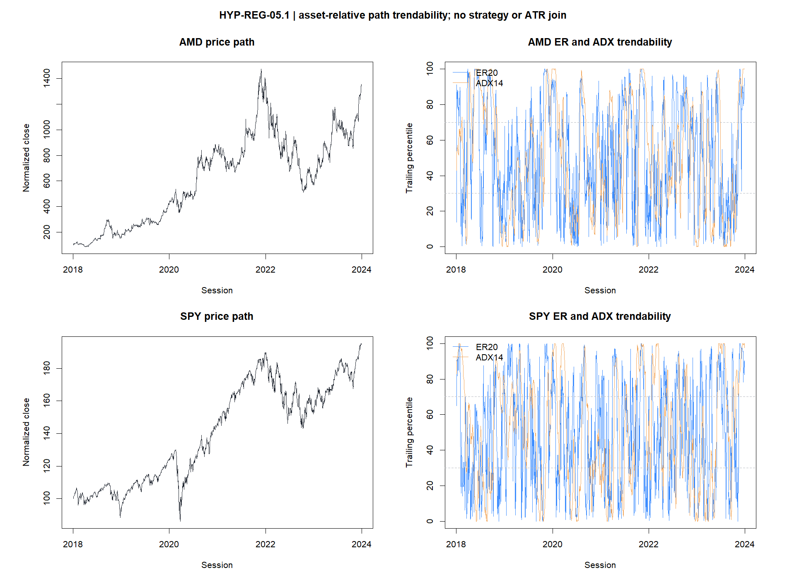
HYP-REG-05.1
ADX forms usable states—
but neither ADX nor ER predicts a straighter future path
Kaufman ER(20) primary · Wilder ADX(14) benchmark · 26 assets · 2018–2023
STOP · ER 1/9 gates · ADX 2/9
1
Notes:
Open with the distinction. ADX produced coherent historical states, and ER contained a small direction-survival clue. The frozen question was harder: do these measurements predict a straighter next-open future path? They did not.
[Sources]
- docs/GEN5_HYP_REG_05_1_PATH_TRENDABILITY_DIAGNOSTIC_CONTRACT.md
- operator_hypothesis_lab/docs/HYP_REG_05_1_PATH_TRENDABILITY_RESULTS.md
- C:/Users/Franc/OneDrive/Documents/Francis/Peltata Project/Time-Series-Modeling-Gen5/runs/research_workbench/operator_hypothesis_lab/hyp_reg_05_1_path_trendability_20260815/hyp_reg_05_1_candidate_decision.csv

Slide 2
WHY THIS LANE?
The question changed from direction to path geometry
Recent breadth and trend-field POCs struggled to say whether price would go up or down. ADX and ER offer a different proposition: ask whether movement itself is likely to be orderly.
Direction
Volatility
Trendability
Will the asset finish higher or lower?
How large are movements likely to be?
Will the path travel efficiently or repeatedly reverse?
A trendability diagnostic could eventually complement ATR%—but only after it succeeds independently.
2
Notes:
This lane is orthogonal to signed direction. Volatility measures amplitude; direction measures sign; trendability measures path geometry. The ATR% join was explicitly conditional on passing the standalone diagnostic and therefore was not run.
[Sources]
- docs/GEN5_4_DECISION_DIALOGUE_INDEX.md#d134
- docs/GEN5_HYP_REG_05_1_PATH_TRENDABILITY_DIAGNOSTIC_CONTRACT.md
- operator_hypothesis_lab/docs/HYP_REG_01_1_ATR_PERCENT_VOLATILITY_RESULTS.md

Slide 3
PRIMARY CANDIDATE · ER(20)
Kaufman ER asks: how direct was the journey?
ER20(t) = |C(t) − C(t−20)| / Σ |C(i) − C(i−1)|
Numerator
Net distance: how far price ended from where it began.
Denominator
Total distance: every absolute step along the route.
Interpretation
Near 1 = direct path; near 0 = much travel, little net progress.
Important
ER has no direction. A smooth decline can score just as highly as a smooth rise.
Our ER state was causal: each percentile used only the asset's prior 252 valid ER values.
3
Notes:
Explain ER as a route-efficiency ratio. It is bounded between zero and one in ordinary use. The experiment did not use a universal raw ER threshold; it converted ER to an asset-relative percentile from prior observations so the state meaning could travel across assets.
[Sources]
- https://onlinelibrary.wiley.com/doi/book/10.1002/9781119202561
- docs/GEN5_HYP_REG_05_1_PATH_TRENDABILITY_DIAGNOSTIC_CONTRACT.md
- operator_hypothesis_lab/registries/hyp_reg_05_1_path_trendability_registry.csv

Slide 4
BENCHMARK · ADX(14)
ADX asks: how separated is directional movement?
1
Compare today's high/low extensions
derive +DM and −DM
2
Normalize with Wilder true range
+DI = 100 × smoothed +DM / ATR; likewise −DI
3
Measure directional separation
DX = 100 × |+DI − −DI| / (+DI + −DI)
4
Wilder-smooth DX
ADX14 = smoothed trend-strength index
ADX measures strength, not sign. A high ADX can describe a strong uptrend or a strong downtrend—and it may peak after the trend has matured.
4
Notes:
ADX belongs to Wilder's directional movement system. +DI and -DI encode directional movement; ADX smooths their absolute separation, so it deliberately discards sign. That makes it a sensible benchmark for trend strength, while also explaining its lag risk.
[Sources]
- https://books.google.com/books/about/New_Concepts_in_Technical_Trading_System.html?id=WesJAQAAMAAJ
- docs/GEN5_HYP_REG_05_1_PATH_TRENDABILITY_DIAGNOSTIC_CONTRACT.md
- operator_hypothesis_lab/registries/hyp_reg_05_1_path_trendability_registry.csv

Slide 5
FROZEN DESIGN
The target begins at next open and measures future path efficiency
FutureEff(t,H) = |log(C(t+H) / O(t+1))|
÷ sum of absolute future log-price steps
Nine gates per candidate
Integrity
H10 continuous order
Signal close
→
next open
→
H5 / H10 / H20 path
H10 state separation
H20 durability
Secondary semantics
Path semantics
All H10 offsets
Direction survival: does the initial sign persist?
Time/year transport
Turn rate: how often does the future path change sign?
Circular timing control
State usability
All required · no strategy contact
5
Notes:
The future target starts at the next open, so neither the ER close nor the ADX close is inside the measured future path. H10 is primary, H5 tests onset, and H20 tests durability. Direction survival and turn rate verify that a favorable result means what trendability should mean.
[Sources]
- docs/GEN5_HYP_REG_05_1_PATH_TRENDABILITY_DIAGNOSTIC_CONTRACT.md
- C:/Users/Franc/OneDrive/Documents/Francis/Peltata Project/Time-Series-Modeling-Gen5/runs/research_workbench/operator_hypothesis_lab/hyp_reg_05_1_path_trendability_20260815/hyp_reg_05_1_run_spec.csv
- C:/Users/Franc/OneDrive/Documents/Francis/Peltata Project/Time-Series-Modeling-Gen5/runs/research_workbench/operator_hypothesis_lab/hyp_reg_05_1_path_trendability_20260815/hyp_reg_05_1_gates.csv

Slide 6
PRIMARY H10 READOUT
Neither indicator ordered future path efficiency
ER(20)
ADX(14)
−0.023
6 / 26
−0.049
8 / 26
median per-asset rho
assets with rho > 0
median per-asset rho
assets with rho > 0
0.956x
1 / 9
0.966x
2 / 9
HIGH / LOW efficiency
gates passed
HIGH / LOW efficiency
gates passed
Higher recent ER or ADX did not imply a straighter next-open ten-session path.
At H20, ER was essentially flat (+0.003 rho) and ADX remained negative (−0.035).
6
Notes:
The headline test is deliberately simple: within each asset, does a higher prior-relative indicator percentile accompany higher future path efficiency? The median relationship was negative for both candidates, and the HIGH states were slightly less efficient than LOW at H10.
[Sources]
- C:/Users/Franc/OneDrive/Documents/Francis/Peltata Project/Time-Series-Modeling-Gen5/runs/research_workbench/operator_hypothesis_lab/hyp_reg_05_1_path_trendability_20260815/hyp_reg_05_1_panel_summary.csv
- C:/Users/Franc/OneDrive/Documents/Francis/Peltata Project/Time-Series-Modeling-Gen5/runs/research_workbench/operator_hypothesis_lab/hyp_reg_05_1_path_trendability_20260815/hyp_reg_05_1_candidate_decision.csv
- operator_hypothesis_lab/docs/HYP_REG_05_1_PATH_TRENDABILITY_RESULTS.md

Slide 7
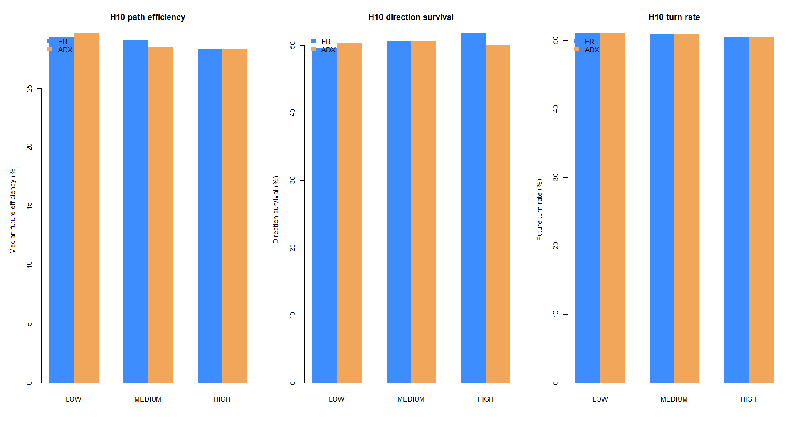
A CLUE, NOT A PASS
ER preserved sign more often—but did not predict a straighter path
+5.5 pp
ER HIGH–LOW direction survival
20 / 26
assets with positive survival gap
0.956x
ER HIGH/LOW future efficiency
A path may keep its sign yet still chop repeatedly. Survival alone cannot substitute for the frozen path-efficiency construct.
7
Notes:
This is the most interesting result to retain. HIGH ER states were more likely to preserve their initial future direction, and that gap was broad across assets. But the same paths were not more efficient, offset timing failed, and turn-rate improvement was small. Sign persistence and path smoothness are related but not interchangeable.
[Sources]
- C:/Users/Franc/OneDrive/Documents/Francis/Peltata Project/Time-Series-Modeling-Gen5/runs/research_workbench/operator_hypothesis_lab/hyp_reg_05_1_path_trendability_20260815/hyp_reg_05_1_state_summary.csv
- C:/Users/Franc/OneDrive/Documents/Francis/Peltata Project/Time-Series-Modeling-Gen5/runs/research_workbench/operator_hypothesis_lab/hyp_reg_05_1_path_trendability_20260815/hyp_reg_05_1_asset_summary.csv
- operator_hypothesis_lab/docs/HYP_REG_05_1_PATH_TRENDABILITY_RESULTS.md

Slide 8
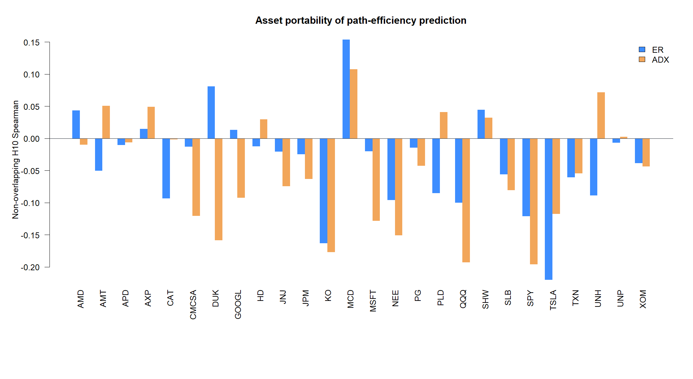
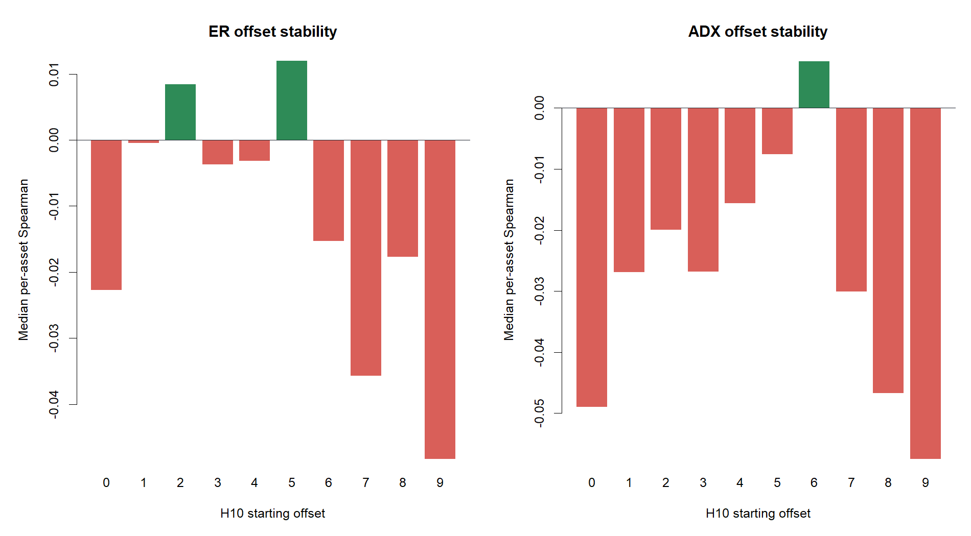
BREADTH + OFFSET AUDIT
Portability and non-overlapping offsets rejected the timing
ER: 0 / 10 jointly favorable offsets
ADX: 0 / 10 jointly favorable offsets
8
Notes:
The asset view prevents one pooled series from hiding heterogeneous behavior. The offset view asks whether the result depends on the arbitrary starting point of a horizon-spaced sample. Neither candidate had a single H10 offset with both positive median rho and a HIGH/LOW ratio above one.
[Sources]
- C:/Users/Franc/OneDrive/Documents/Francis/Peltata Project/Time-Series-Modeling-Gen5/runs/research_workbench/operator_hypothesis_lab/hyp_reg_05_1_path_trendability_20260815/hyp_reg_05_1_asset_summary.csv
- C:/Users/Franc/OneDrive/Documents/Francis/Peltata Project/Time-Series-Modeling-Gen5/runs/research_workbench/operator_hypothesis_lab/hyp_reg_05_1_path_trendability_20260815/hyp_reg_05_1_offset_summary.csv
- operator_hypothesis_lab/docs/HYP_REG_05_1_PATH_TRENDABILITY_RESULTS.md

Slide 9
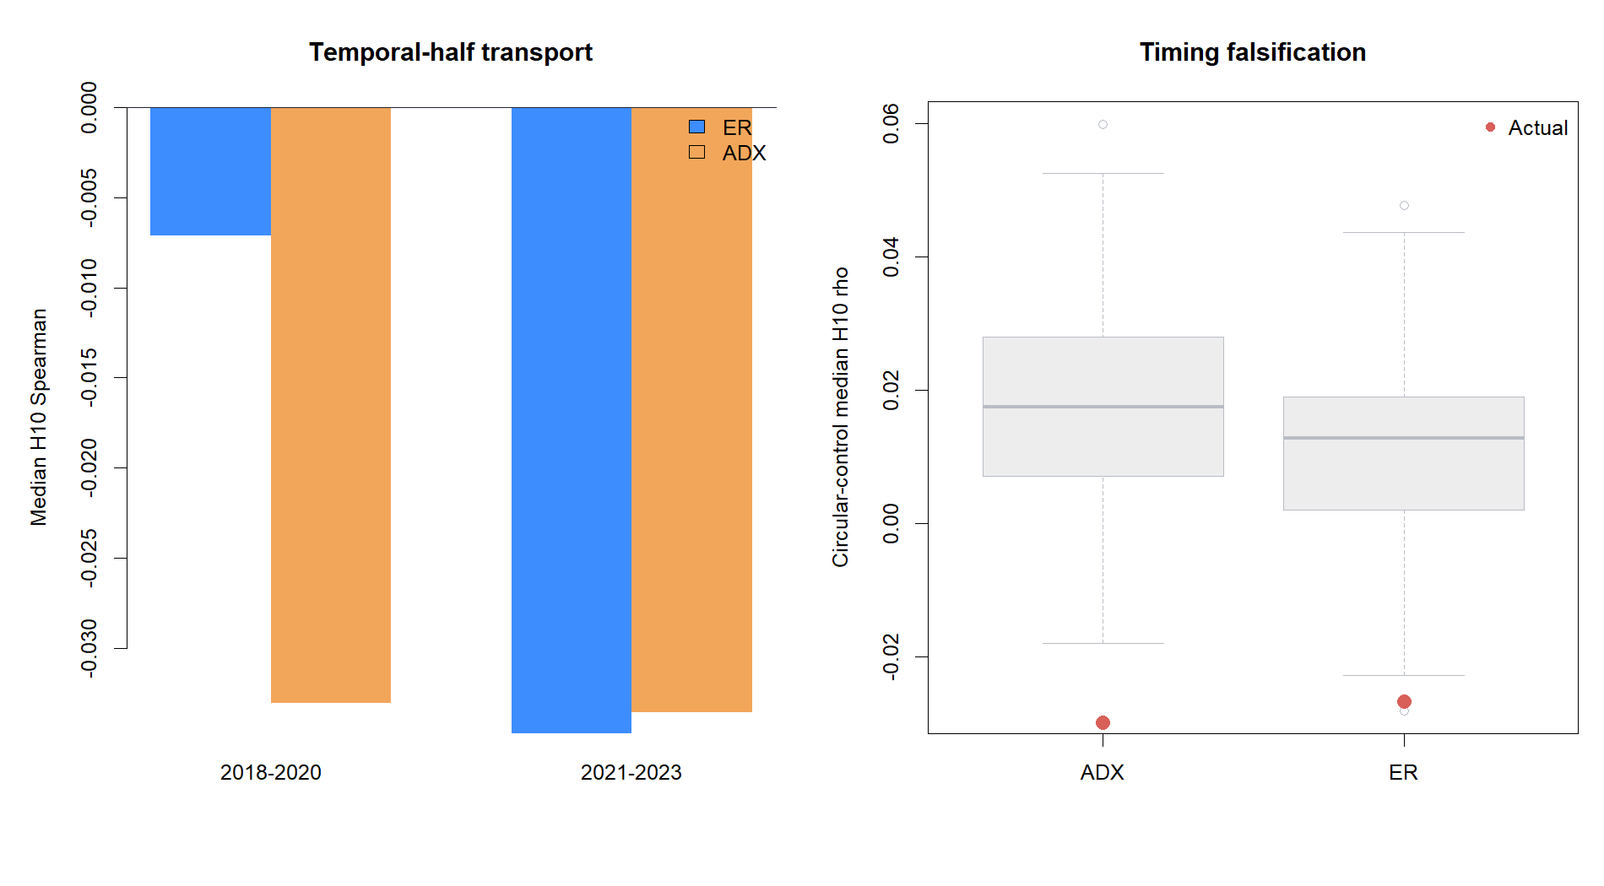
FALSIFICATION
Temporal and circular controls placed both signals near the bottom
1 / 6
ER favorable years
0 / 6
ADX favorable years
0.5th / 0th
ER / ADX circular rho percentile
A clean-looking historical state is not evidence of useful timing. The actual alignment was worse than almost every calendar-preserving pseudo-signal.
9
Notes:
Circular controls shift the indicator within each asset and year, preserving the calendar distribution while breaking exact timing. For a forward trendability hypothesis, a good signal should rank near the top. ER and ADX ranked near the bottom instead; both temporal halves were also unfavorable.
[Sources]
- C:/Users/Franc/OneDrive/Documents/Francis/Peltata Project/Time-Series-Modeling-Gen5/runs/research_workbench/operator_hypothesis_lab/hyp_reg_05_1_path_trendability_20260815/hyp_reg_05_1_temporal_summary.csv
- C:/Users/Franc/OneDrive/Documents/Francis/Peltata Project/Time-Series-Modeling-Gen5/runs/research_workbench/operator_hypothesis_lab/hyp_reg_05_1_path_trendability_20260815/hyp_reg_05_1_calendar_summary.csv
- C:/Users/Franc/OneDrive/Documents/Francis/Peltata Project/Time-Series-Modeling-Gen5/runs/research_workbench/operator_hypothesis_lab/hyp_reg_05_1_path_trendability_20260815/hyp_reg_05_1_circular_readout.csv

Slide 10
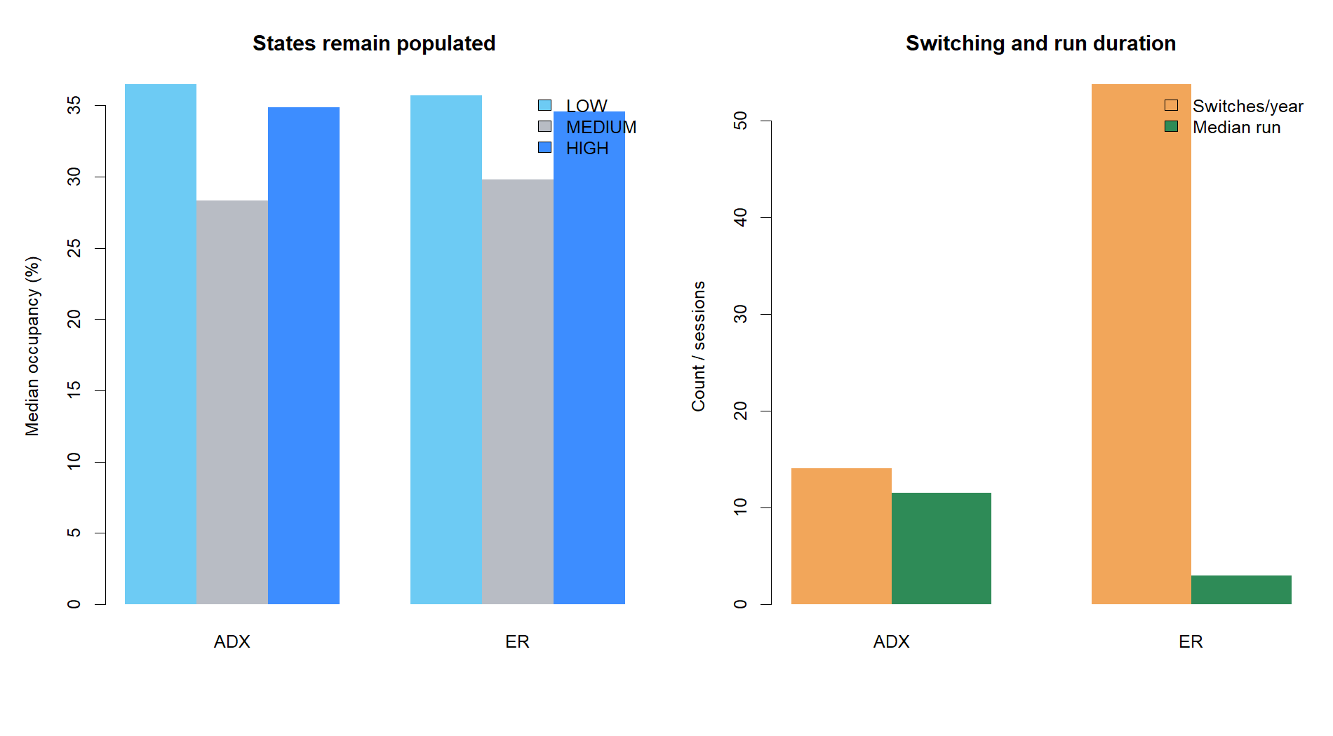
USABILITY ≠ PREDICTIVE VALIDITY
ADX is the better state machine; ER is the more reactive descriptor
14 / year
11.5
ADX switches
ADX median run
54 / year
3
ER switches
ER median run
Operational lesson
A stable label can be convenient without being predictive. A reactive label can contain a clue while chattering too much to gate behavior.
10
Notes:
ADX alone passed the state-usability gate: balanced occupancy, about fourteen switches per year, an 11.5-session median run, and no one-session reversals. ER states changed about four times as often. Those operational differences do not reverse the failed predictive evidence.
[Sources]
- C:/Users/Franc/OneDrive/Documents/Francis/Peltata Project/Time-Series-Modeling-Gen5/runs/research_workbench/operator_hypothesis_lab/hyp_reg_05_1_path_trendability_20260815/hyp_reg_05_1_state_diagnostics.csv
- operator_hypothesis_lab/docs/HYP_REG_05_1_PATH_TRENDABILITY_RESULTS.md
- https://books.google.com/books/about/New_Concepts_in_Technical_Trading_System.html?id=WesJAQAAMAAJ
- https://onlinelibrary.wiley.com/doi/book/10.1002/9781119202561

Slide 11
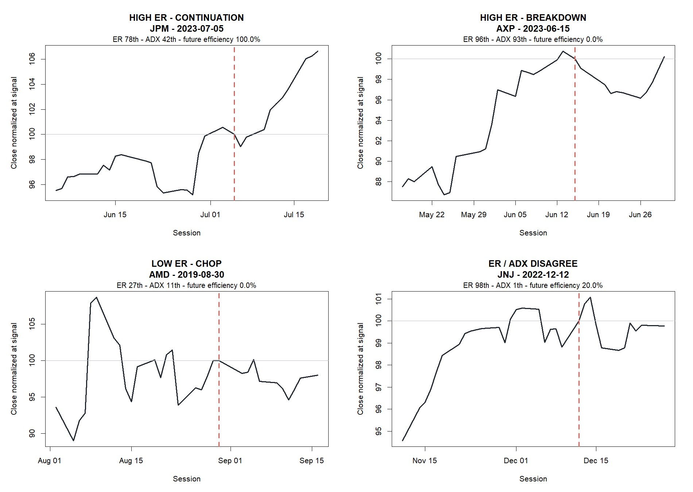
PATH TAPES
Representative paths show why a high score is not a promise
11
Notes:
The four tapes are deliberately mixed rather than cherry-picked winners. JPM shows a high-ER continuation; AXP shows a high-ER/high-ADX breakdown; AMD shows low-ER chop; JNJ shows strong disagreement between ER and ADX. The vertical line is the signal close and the future target begins next open.
[Sources]
- C:/Users/Franc/OneDrive/Documents/Francis/Peltata Project/Time-Series-Modeling-Gen5/runs/research_workbench/operator_hypothesis_lab/hyp_reg_05_1_path_trendability_20260815/hyp_reg_05_1_representative_paths.csv
- operator_hypothesis_lab/docs/HYP_REG_05_1_PATH_TRENDABILITY_RESULTS.md

Slide 12
DECISION BOUNDARY
Set down this specification without discarding the concepts
ER 1 / 9
ADX 2 / 9
Preserve
ADX as a coherent descriptive state label
ER's broad direction-survival clue
STOP_PATH_TRENDABILITY_GATES_FAILED
NO_ATR_JOIN_OR_STRATEGY
The separation of amplitude, sign, and path geometry
Do not do
Tune lengths or hysteresis after inspection
Variance ratio remains a serious separate literature-based diagnostic because it tests multi-scale return dependence. It is not authorized as a rescue of 05.1.
Invert into mean reversion or select favorable assets
Join ATR%, run a strategy, or inspect 2024+
2024+ remained sealed
12
Notes:
Close with the research boundary. The specification failed, but the exercise clarified two useful dimensions: ADX state stability and ER sign persistence. Neither is strategy authority. A variance-ratio diagnostic would require a new frozen lane because it asks a distinct question about return dependence across scales.
[Sources]
- operator_hypothesis_lab/docs/HYP_REG_05_1_PATH_TRENDABILITY_RESULTS.md
- docs/GEN5_HYP_REG_05_1_PATH_TRENDABILITY_DIAGNOSTIC_CONTRACT.md
- docs/GEN5_4_DECISION_DIALOGUE_INDEX.md#d134
- https://web.mit.edu/Alo/www/Papers/lo-mackinlay-89.html
- C:/Users/Franc/OneDrive/Documents/Francis/Peltata Project/Time-Series-Modeling-Gen5/runs/research_workbench/operator_hypothesis_lab/hyp_reg_05_1_path_trendability_20260815/hyp_reg_05_1_gates.csv

