Slide 1
OPERATOR HYPOTHESIS LAB | STOCK ATLAS 02
Breadth changed
the conclusion
HYP-MOM-01.1 | 116 assets | 4,015 trades | discovery evidence only
Notes:
The 22-asset diagnostic atlas produced several intriguing descriptive hints. This frozen breadth extension asks whether they survive a much wider stock panel. The answer is consequential: the basic loss-tail problem persists, while the strongest original diagnostic candidates shrink materially.
[Sources]
- C:\Users\Franc\OneDrive\Documents\Francis\Peltata Project\Time-Series-Modeling-Gen5\operator_hypothesis_lab\docs\HYP_MOM_01_1_STOCK_ATLAS_02_BREADTH_EXTENSION_CONTRACT.md
- C:\Users\Franc\OneDrive\Documents\Francis\Peltata Project\Time-Series-Modeling-Gen5\operator_hypothesis_lab\docs\HYP_MOM_01_1_STOCK_ATLAS_02_BREADTH_EXTENSION_RESULTS.md

Slide 2
The strategy and audit were held fixed while only the asset breadth changed
UNCHANGED RULE
FROZEN DATA
SAME AUDIT
Two completed green gap-ups
Next-open entry
Five open-to-open sessions
Long-only; one asset at a time
2021-2023 discovery
1,000 matched sessions
Adjusted daily OHLCV
2024+ excluded
Ownership + random timing
Gap/body + trend states
Momentum + market context
Day 1-4 path checkpoints
Evidence stage: DISCOVERY_REUSED_WINDOW - breadth improves diagnosis, not validation authority.
2
Notes:
The only intended change is the asset registry. Trade mechanics, costs, diagnostic definitions, matching logic, and the already inspected 2021-2023 window are unchanged. This preserves comparability but means the merged analysis remains discovery evidence.
[Sources]
- C:\Users\Franc\OneDrive\Documents\Francis\Peltata Project\Time-Series-Modeling-Gen5\operator_hypothesis_lab\docs\HYP_MOM_01_1_STOCK_ATLAS_02_BREADTH_EXTENSION_CONTRACT.md
- C:\Users\Franc\OneDrive\Documents\Francis\Peltata Project\Time-Series-Modeling-Gen5\literature_studies\registries\gen5_lit_mom_01_2_stock_atlas_02_2020_breadth_attention_registry.csv

Slide 3
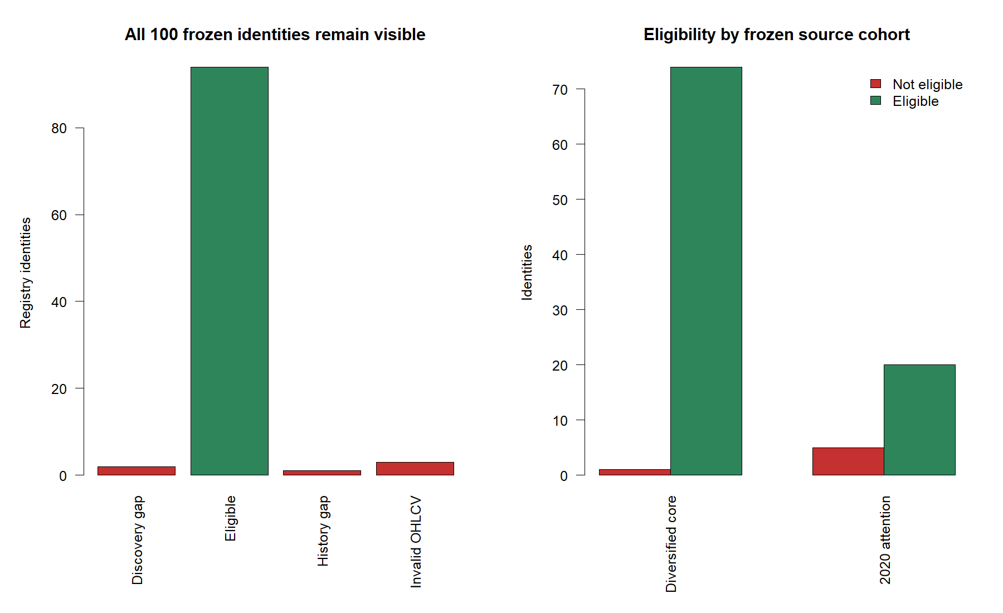
A frozen 100-name registry yielded 94 eligible additions and 116 assets combined
3
Notes:
The reused registry contributed 74 of 75 diversified-core names and 20 of 25 retail-attention names. DOW, NIO, and ADT failed valid adjusted OHLCV; APHA and SNE lacked the required discovery history; LI lacked the frozen 220-session prehistory. No failures were replaced. Provider warnings remain visible, but all 94 analyzed additions pass the exact requested window and prehistory gates.
[Sources]
- C:\Users\Franc\OneDrive\Documents\Francis\Peltata Project\Time-Series-Modeling-Gen5\literature_studies\registries\gen5_lit_mom_01_2_stock_atlas_02_2020_breadth_attention_registry.csv
- C:\Users\Franc\OneDrive\Documents\Francis\Peltata Project\Time-Series-Modeling-Gen5\runs\research_workbench\operator_hypothesis_lab\hyp_mom_01_1_stock_atlas_02_breadth_extension_20260804\hyp_mom_01_1_breadth_coverage.csv
- C:\Users\Franc\OneDrive\Documents\Francis\Peltata Project\Time-Series-Modeling-Gen5\runs\research_workbench\operator_hypothesis_lab\hyp_mom_01_1_stock_atlas_02_breadth_extension_20260804\hyp_mom_01_1_breadth_query_health.csv
- C:\Users\Franc\OneDrive\Documents\Francis\Peltata Project\Time-Series-Modeling-Gen5\runs\research_workbench\operator_hypothesis_lab\hyp_mom_01_1_stock_atlas_02_breadth_extension_20260804\visuals\breadth_coverage_and_composition.png

Slide 4
The wider pool kept the positive median - and the negative mean
4,015
52.40%
+0.181%
-0.030%
combined trades
hit rate
median trade
mean trade
821 original plus 3,194 eligible Atlas 02 trades
A slight majority of trades finished positive
The typical trade remained modestly positive
Larger losses outweighed the slight win majority
Mean winner +3.09% | mean nonpositive trade -3.47% | 5th percentile -7.37%
4
Notes:
Breadth confirms a distribution-shape problem rather than a simple hit-rate problem. The signal wins slightly more than half the time, but the average loss is larger than the average gain and the downside tail is heavier. Primary costs are five basis points per side.
[Sources]
- C:\Users\Franc\OneDrive\Documents\Francis\Peltata Project\Time-Series-Modeling-Gen5\runs\research_workbench\operator_hypothesis_lab\hyp_mom_01_1_stock_atlas_02_breadth_extension_20260804\hyp_mom_01_1_breadth_panel_summary.csv
- C:\Users\Franc\OneDrive\Documents\Francis\Peltata Project\Time-Series-Modeling-Gen5\operator_hypothesis_lab\docs\HYP_MOM_01_1_STOCK_ATLAS_02_BREADTH_EXTENSION_RESULTS.md

Slide 5
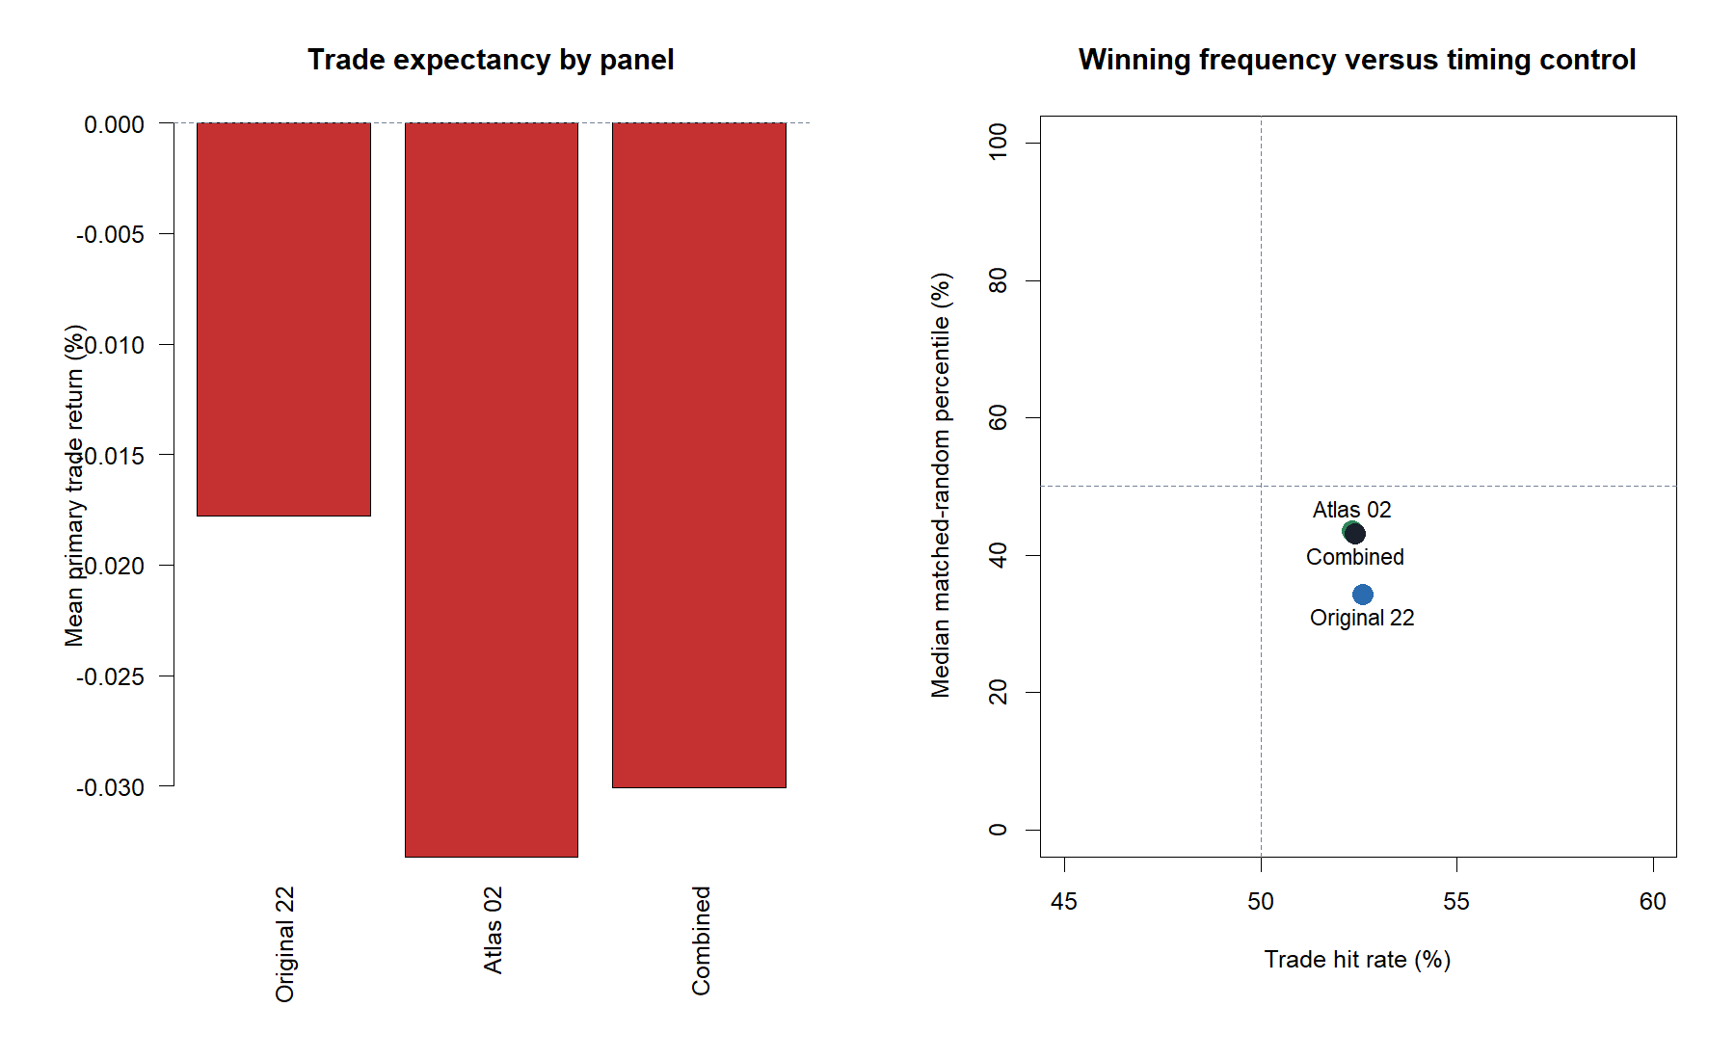
Atlas 02 did not rescue the rule; it reproduced its core tension
5
Notes:
Original and new panels have nearly identical hit rates and positive medians, but both have negative mean trade returns after primary costs. The median new-panel asset was nearly flat rather than convincingly positive. This is useful replication of the failure shape, not evidence of a deployable edge.
[Sources]
- C:\Users\Franc\OneDrive\Documents\Francis\Peltata Project\Time-Series-Modeling-Gen5\runs\research_workbench\operator_hypothesis_lab\hyp_mom_01_1_stock_atlas_02_breadth_extension_20260804\hyp_mom_01_1_breadth_panel_summary.csv
- C:\Users\Franc\OneDrive\Documents\Francis\Peltata Project\Time-Series-Modeling-Gen5\runs\research_workbench\operator_hypothesis_lab\hyp_mom_01_1_stock_atlas_02_breadth_extension_20260804\visuals\panel_strategy_comparison.png

Slide 6
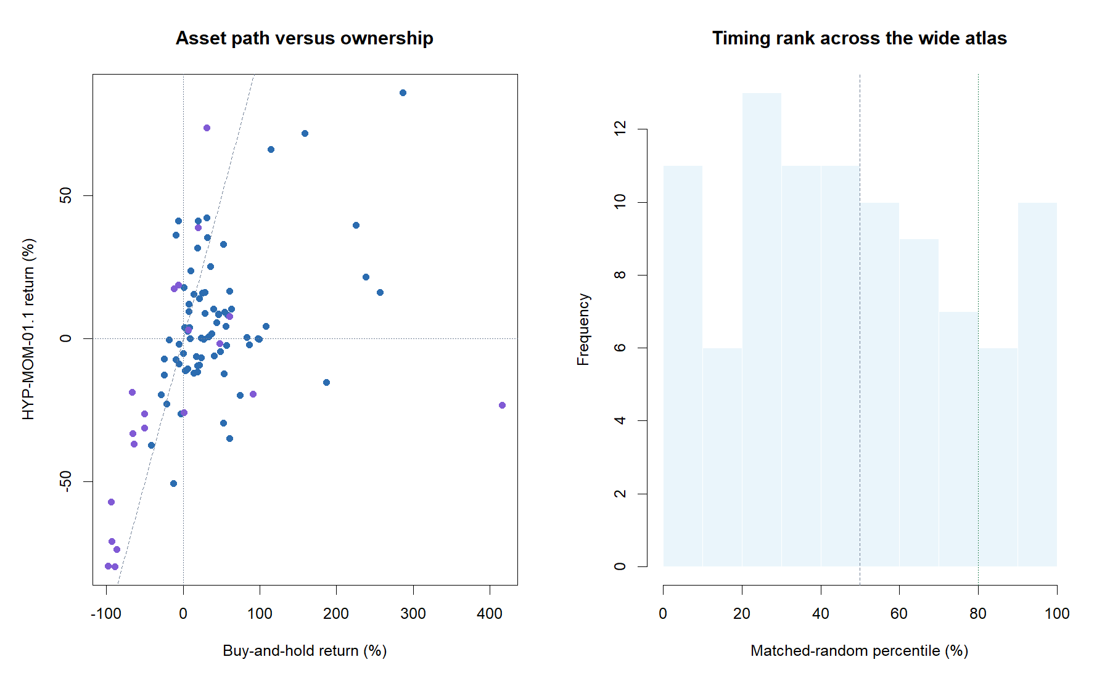
Ordinary ownership and matched random timing remain difficult controls
6
Notes:
Only 34 of 116 assets beat their own buy-and-hold return over the discovery window. The median asset ranked at the 43.05th percentile of matched random-entry controls; only 20 assets exceeded the 80th percentile. The rule therefore lacks a broad generic timing advantage.
[Sources]
- C:\Users\Franc\OneDrive\Documents\Francis\Peltata Project\Time-Series-Modeling-Gen5\runs\research_workbench\operator_hypothesis_lab\hyp_mom_01_1_stock_atlas_02_breadth_extension_20260804\hyp_mom_01_1_breadth_asset_summary.csv
- C:\Users\Franc\OneDrive\Documents\Francis\Peltata Project\Time-Series-Modeling-Gen5\runs\research_workbench\operator_hypothesis_lab\hyp_mom_01_1_stock_atlas_02_breadth_extension_20260804\hyp_mom_01_1_breadth_random_controls.csv
- C:\Users\Franc\OneDrive\Documents\Francis\Peltata Project\Time-Series-Modeling-Gen5\runs\research_workbench\operator_hypothesis_lab\hyp_mom_01_1_stock_atlas_02_breadth_extension_20260804\visuals\wide_asset_ownership_and_random_controls.png

Slide 7
THE PERSISTENCE TEST
Do the original
diagnostic hints survive
94 new assets?
This is where breadth changes the answer.
7
Notes:
The original 22-asset atlas left normalized gap size and SPY above SMA200 as the most interesting descriptive candidates. The next section compares those exact estimands with the new 94-asset panel and the merged 116-asset pool.
[Sources]
- C:\Users\Franc\OneDrive\Documents\Francis\Peltata Project\Time-Series-Modeling-Gen5\operator_hypothesis_lab\docs\HYP_MOM_01_1_DIAGNOSTIC_ATLAS_01_RESULTS.md
- C:\Users\Franc\OneDrive\Documents\Francis\Peltata Project\Time-Series-Modeling-Gen5\operator_hypothesis_lab\docs\HYP_MOM_01_1_STOCK_ATLAS_02_BREADTH_EXTENSION_RESULTS.md

Slide 8
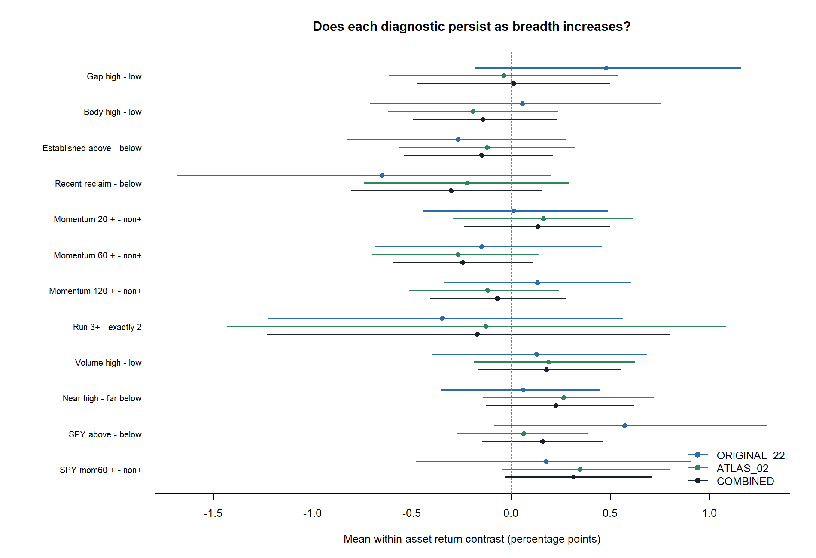
Every diagnostic effect is unstable, narrow, or both
8
Notes:
These contrasts first estimate each condition difference within each asset and then give every asset one vote. All combined 95% asset-bootstrap intervals cross zero and sign breadth stays close to half. No condition clears a generalization standard.
[Sources]
- C:\Users\Franc\OneDrive\Documents\Francis\Peltata Project\Time-Series-Modeling-Gen5\runs\research_workbench\operator_hypothesis_lab\hyp_mom_01_1_stock_atlas_02_breadth_extension_20260804\hyp_mom_01_1_breadth_diagnostic_contrasts.csv
- C:\Users\Franc\OneDrive\Documents\Francis\Peltata Project\Time-Series-Modeling-Gen5\runs\research_workbench\operator_hypothesis_lab\hyp_mom_01_1_stock_atlas_02_breadth_extension_20260804\visuals\diagnostic_contrast_panel_comparison.png

Slide 9
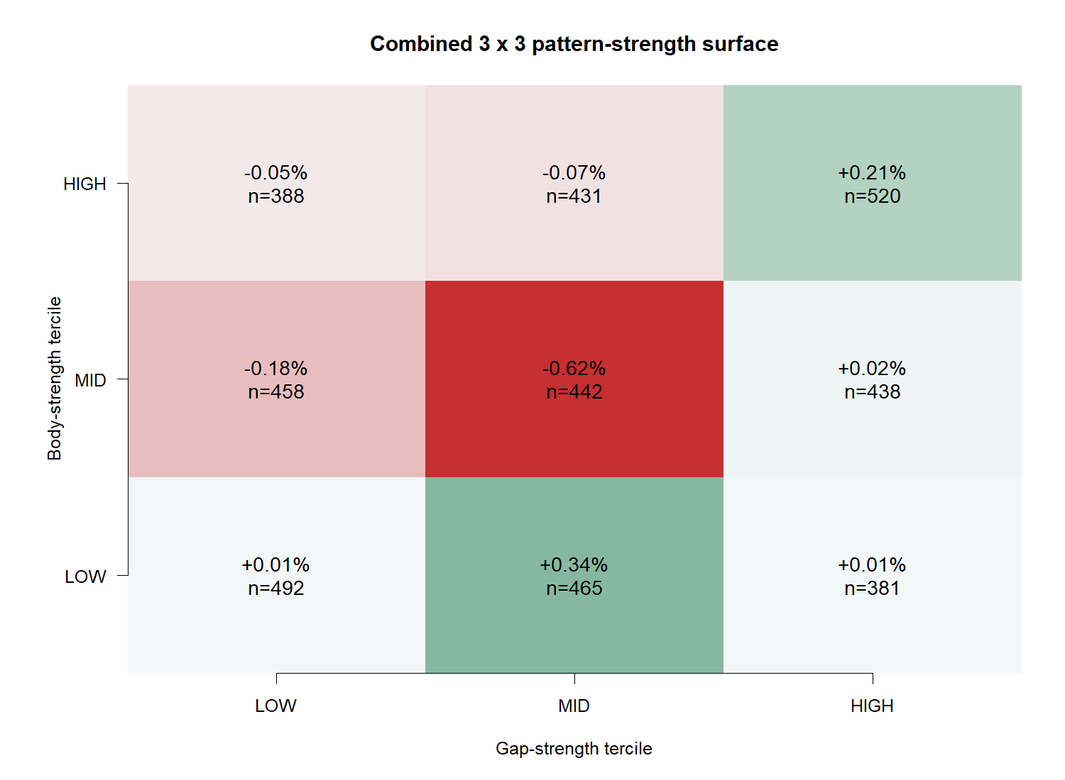
Stronger-looking candles still do not produce a monotonic outcome surface
9
Notes:
The nine combined cells do not increase steadily with gap or body strength. High-gap/high-body averaged only about +0.21%, while low-body/middle-gap averaged about +0.34%; the middle-body/middle-gap cell was negative. Selecting a cell after seeing this surface would be post-hoc threshold mining.
[Sources]
- C:\Users\Franc\OneDrive\Documents\Francis\Peltata Project\Time-Series-Modeling-Gen5\runs\research_workbench\operator_hypothesis_lab\hyp_mom_01_1_stock_atlas_02_breadth_extension_20260804\hyp_mom_01_1_breadth_conditional_summary.csv
- C:\Users\Franc\OneDrive\Documents\Francis\Peltata Project\Time-Series-Modeling-Gen5\runs\research_workbench\operator_hypothesis_lab\hyp_mom_01_1_stock_atlas_02_breadth_extension_20260804\visuals\combined_gap_body_heatmap.png

Slide 10
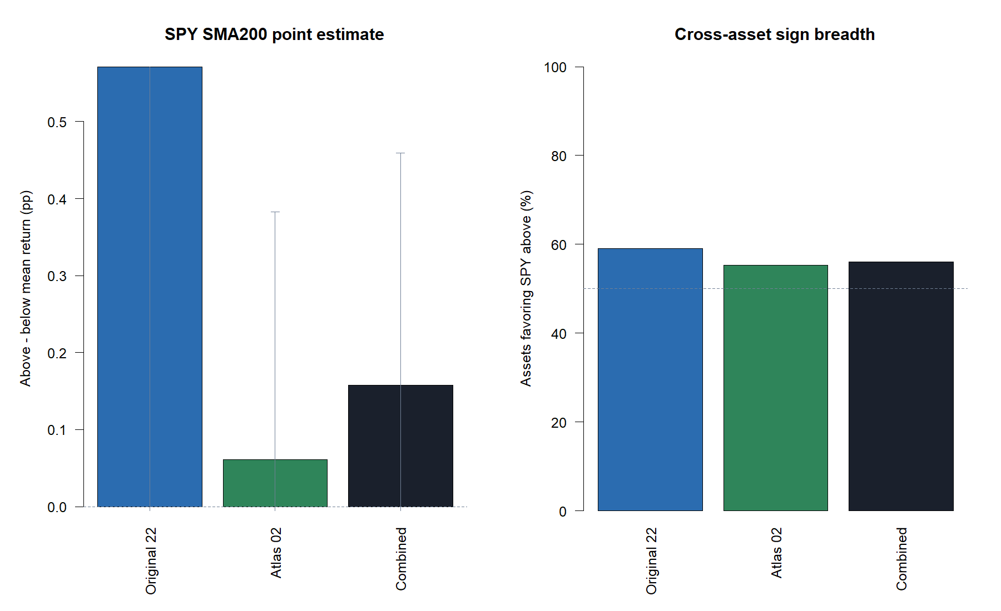
The strongest original candidate shrank from +0.57 pp to +0.06 pp
10
Notes:
SPY above versus below SMA200 was +0.571 percentage points in the original panel but only +0.061 in the 94-asset extension. The combined estimate is +0.158 with a 95% interval from -0.147 to +0.459 and 56% positive asset contrasts. This no longer justifies opening a replication lane from this evidence alone.
[Sources]
- C:\Users\Franc\OneDrive\Documents\Francis\Peltata Project\Time-Series-Modeling-Gen5\runs\research_workbench\operator_hypothesis_lab\hyp_mom_01_1_stock_atlas_02_breadth_extension_20260804\hyp_mom_01_1_breadth_diagnostic_contrasts.csv
- C:\Users\Franc\OneDrive\Documents\Francis\Peltata Project\Time-Series-Modeling-Gen5\operator_hypothesis_lab\docs\HYP_MOM_01_1_DIAGNOSTIC_ATLAS_01_RESULTS.md
- C:\Users\Franc\OneDrive\Documents\Francis\Peltata Project\Time-Series-Modeling-Gen5\runs\research_workbench\operator_hypothesis_lab\hyp_mom_01_1_stock_atlas_02_breadth_extension_20260804\visuals\spy_sma200_persistence.png

Slide 11
Pooled trades and equal-asset evidence answer different questions
POOLED TRADE VIEW
EQUAL-ASSET VIEW
Above asset SMA200
+0.064% mean trade
Below asset SMA200
-0.181% mean trade
delta_j = mean(A,j) - mean(B,j)
equal delta = average(delta_j)
Result: -0.151 pp
Assets with more signals receive more weight.
Every asset receives one vote; this is primary.
The sign reversal is a composition warning, not a contradiction.
11
Notes:
Pooling trades weights assets by their signal counts. Equal-asset contrasts calculate the condition effect inside each asset and then average those asset effects. Because the question is whether a condition generalizes across assets, equal-asset is primary. The sign reversal around the asset SMA200 shows why this distinction matters.
[Sources]
- C:\Users\Franc\OneDrive\Documents\Francis\Peltata Project\Time-Series-Modeling-Gen5\runs\research_workbench\operator_hypothesis_lab\hyp_mom_01_1_stock_atlas_02_breadth_extension_20260804\hyp_mom_01_1_breadth_diagnostic_contrasts.csv
- C:\Users\Franc\OneDrive\Documents\Francis\Peltata Project\Time-Series-Modeling-Gen5\operator_hypothesis_lab\docs\HYP_MOM_01_1_STOCK_ATLAS_02_BREADTH_EXTENSION_RESULTS.md

Slide 12
No secondary feature supplied a robust substitute
20-day momentum
+0.133 pp
52.6% assets positive
95% interval -0.239 to +0.497 pp
SPY 60-day momentum
+0.313 pp
45.7% assets positive
95% interval -0.029 to +0.710 pp
Largest median rank rho
+0.026
20-day momentum
All continuous gradients near zero
Point estimates are hypotheses; cross-asset breadth and intervals decide whether they deserve another lane.
12
Notes:
The 20-session asset momentum point estimate is small and only slightly more than half the assets agree. SPY 60-session momentum has a larger point estimate but fewer than half of asset contrasts are positive, indicating minority large effects. Continuous within-asset correlations are close to zero, so no monotonic filter appears.
[Sources]
- C:\Users\Franc\OneDrive\Documents\Francis\Peltata Project\Time-Series-Modeling-Gen5\runs\research_workbench\operator_hypothesis_lab\hyp_mom_01_1_stock_atlas_02_breadth_extension_20260804\hyp_mom_01_1_breadth_diagnostic_contrasts.csv
- C:\Users\Franc\OneDrive\Documents\Francis\Peltata Project\Time-Series-Modeling-Gen5\runs\research_workbench\operator_hypothesis_lab\hyp_mom_01_1_stock_atlas_02_breadth_extension_20260804\hyp_mom_01_1_breadth_correlation_summary.csv
- C:\Users\Franc\OneDrive\Documents\Francis\Peltata Project\Time-Series-Modeling-Gen5\operator_hypothesis_lab\docs\HYP_MOM_01_1_STOCK_ATLAS_02_BREADTH_EXTENSION_RESULTS.md

Slide 13
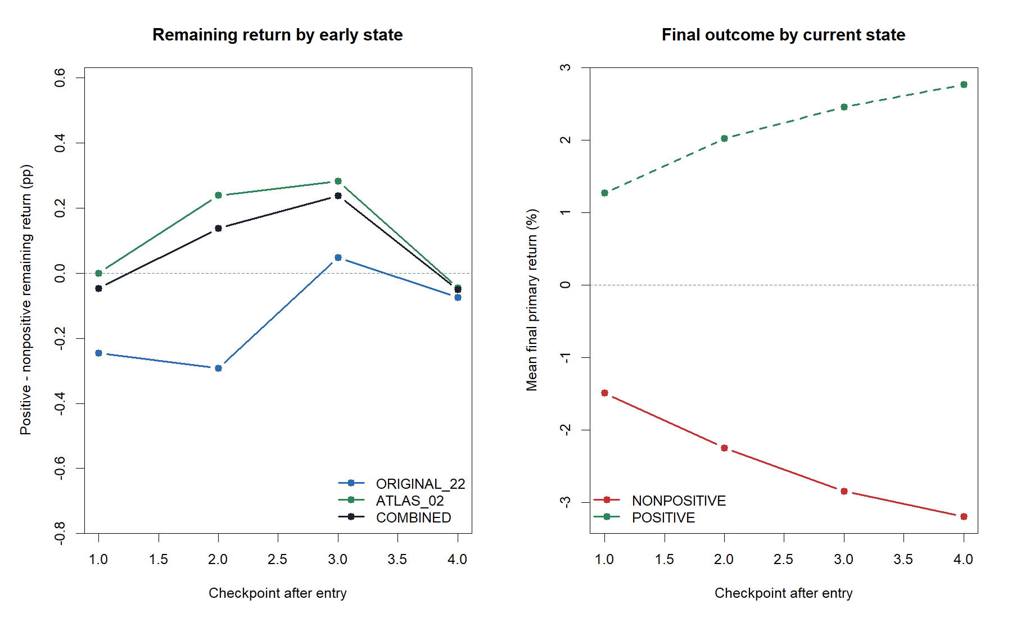
Early trade state describes sunk P&L better than it predicts what remains
13
Notes:
Trades already positive by each checkpoint naturally finish better on average, but the relevant exit question is the return still remaining after that checkpoint. Equal-asset remaining-return contrasts are small, unstable, and change sign. Day three is a near miss in reused data, not authority for a stop, add, or continuation rule.
[Sources]
- C:\Users\Franc\OneDrive\Documents\Francis\Peltata Project\Time-Series-Modeling-Gen5\runs\research_workbench\operator_hypothesis_lab\hyp_mom_01_1_stock_atlas_02_breadth_extension_20260804\hyp_mom_01_1_breadth_checkpoint_contrasts.csv
- C:\Users\Franc\OneDrive\Documents\Francis\Peltata Project\Time-Series-Modeling-Gen5\runs\research_workbench\operator_hypothesis_lab\hyp_mom_01_1_stock_atlas_02_breadth_extension_20260804\visuals\checkpoint_persistence.png

Slide 14
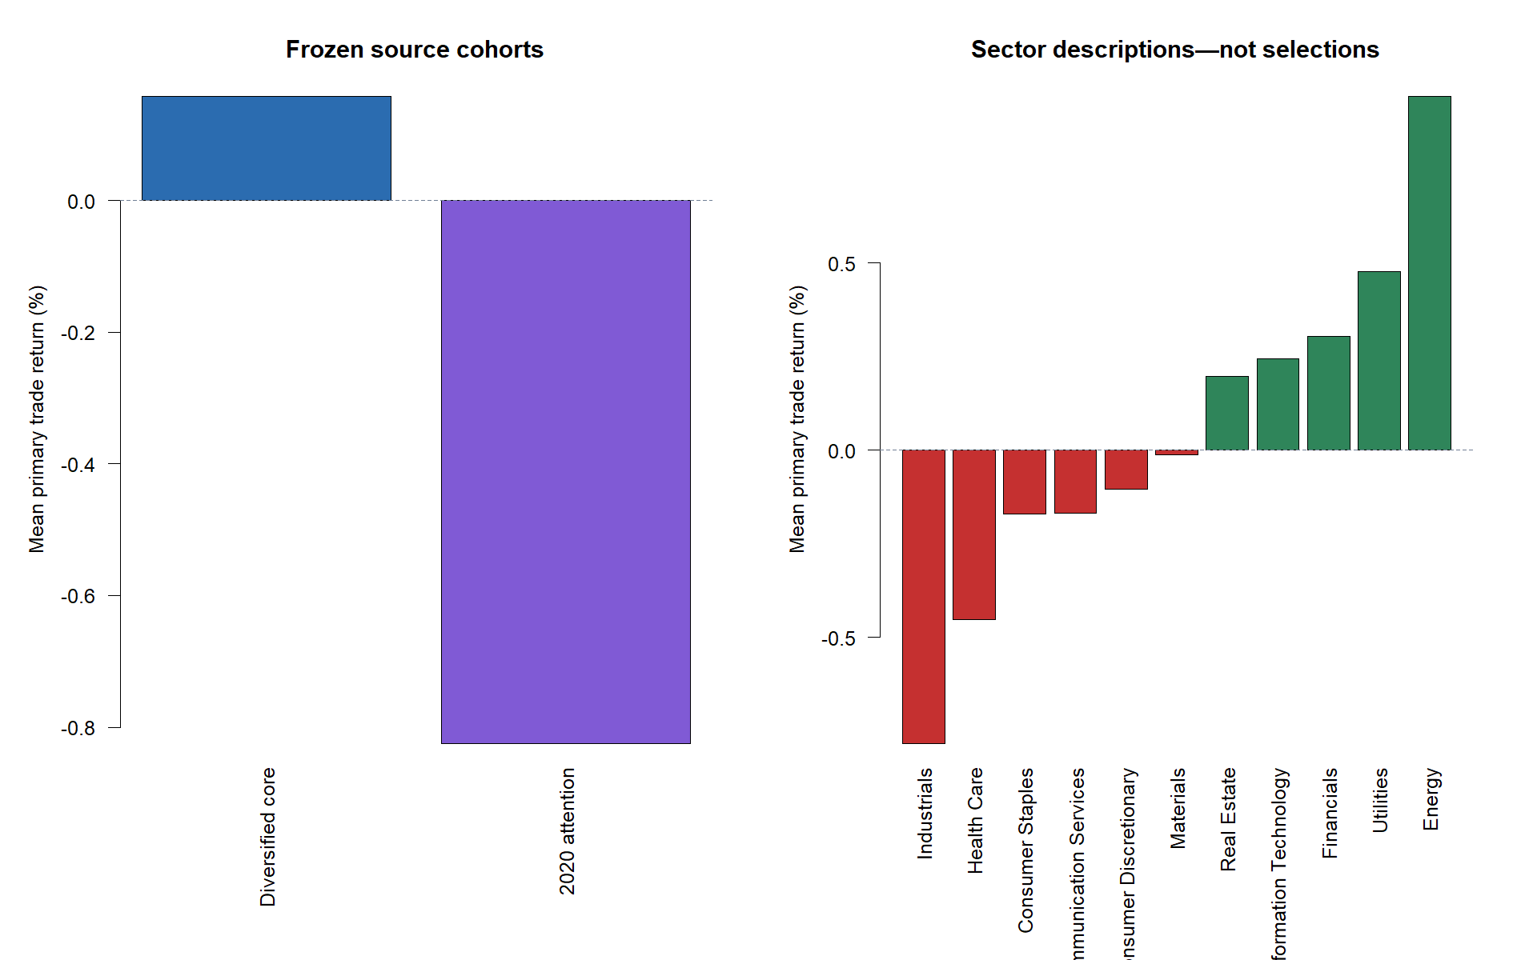
The loss tail concentrates in the attention cohort - a clue, not a filter
14
Notes:
The diversified-core additions averaged +0.159% per trade, while the frozen 2020 retail-attention cohort averaged -0.826% and had a median asset return of -24.64%. The cohorts differ in volatility, sector, listing history, and construction purpose, so this is descriptive heterogeneity rather than validated selection authority. Sector ordering must not be mined.
[Sources]
- C:\Users\Franc\OneDrive\Documents\Francis\Peltata Project\Time-Series-Modeling-Gen5\runs\research_workbench\operator_hypothesis_lab\hyp_mom_01_1_stock_atlas_02_breadth_extension_20260804\hyp_mom_01_1_breadth_cohort_summary.csv
- C:\Users\Franc\OneDrive\Documents\Francis\Peltata Project\Time-Series-Modeling-Gen5\runs\research_workbench\operator_hypothesis_lab\hyp_mom_01_1_stock_atlas_02_breadth_extension_20260804\hyp_mom_01_1_breadth_sector_summary.csv
- C:\Users\Franc\OneDrive\Documents\Francis\Peltata Project\Time-Series-Modeling-Gen5\runs\research_workbench\operator_hypothesis_lab\hyp_mom_01_1_stock_atlas_02_breadth_extension_20260804\visuals\cohort_and_sector_outcomes.png

Slide 15
TRADE-TAPE AUDIT
The same formula can look
convincing, ordinary, or
disastrous
Six frozen archetypes connect the distribution to actual price paths.
15
Notes:
The representative tapes were selected mechanically before individual inspection: pooled median, best, worst, SPY-above median, SPY-below median, and high-gap/high-body median. They illustrate the aggregate result without replacing it.
[Sources]
- C:\Users\Franc\OneDrive\Documents\Francis\Peltata Project\Time-Series-Modeling-Gen5\runs\research_workbench\operator_hypothesis_lab\hyp_mom_01_1_stock_atlas_02_breadth_extension_20260804\hyp_mom_01_1_breadth_tape_manifest.csv
- C:\Users\Franc\OneDrive\Documents\Francis\Peltata Project\Time-Series-Modeling-Gen5\operator_hypothesis_lab\docs\HYP_MOM_01_1_STOCK_ATLAS_02_BREADTH_EXTENSION_CONTRACT.md

Slide 16
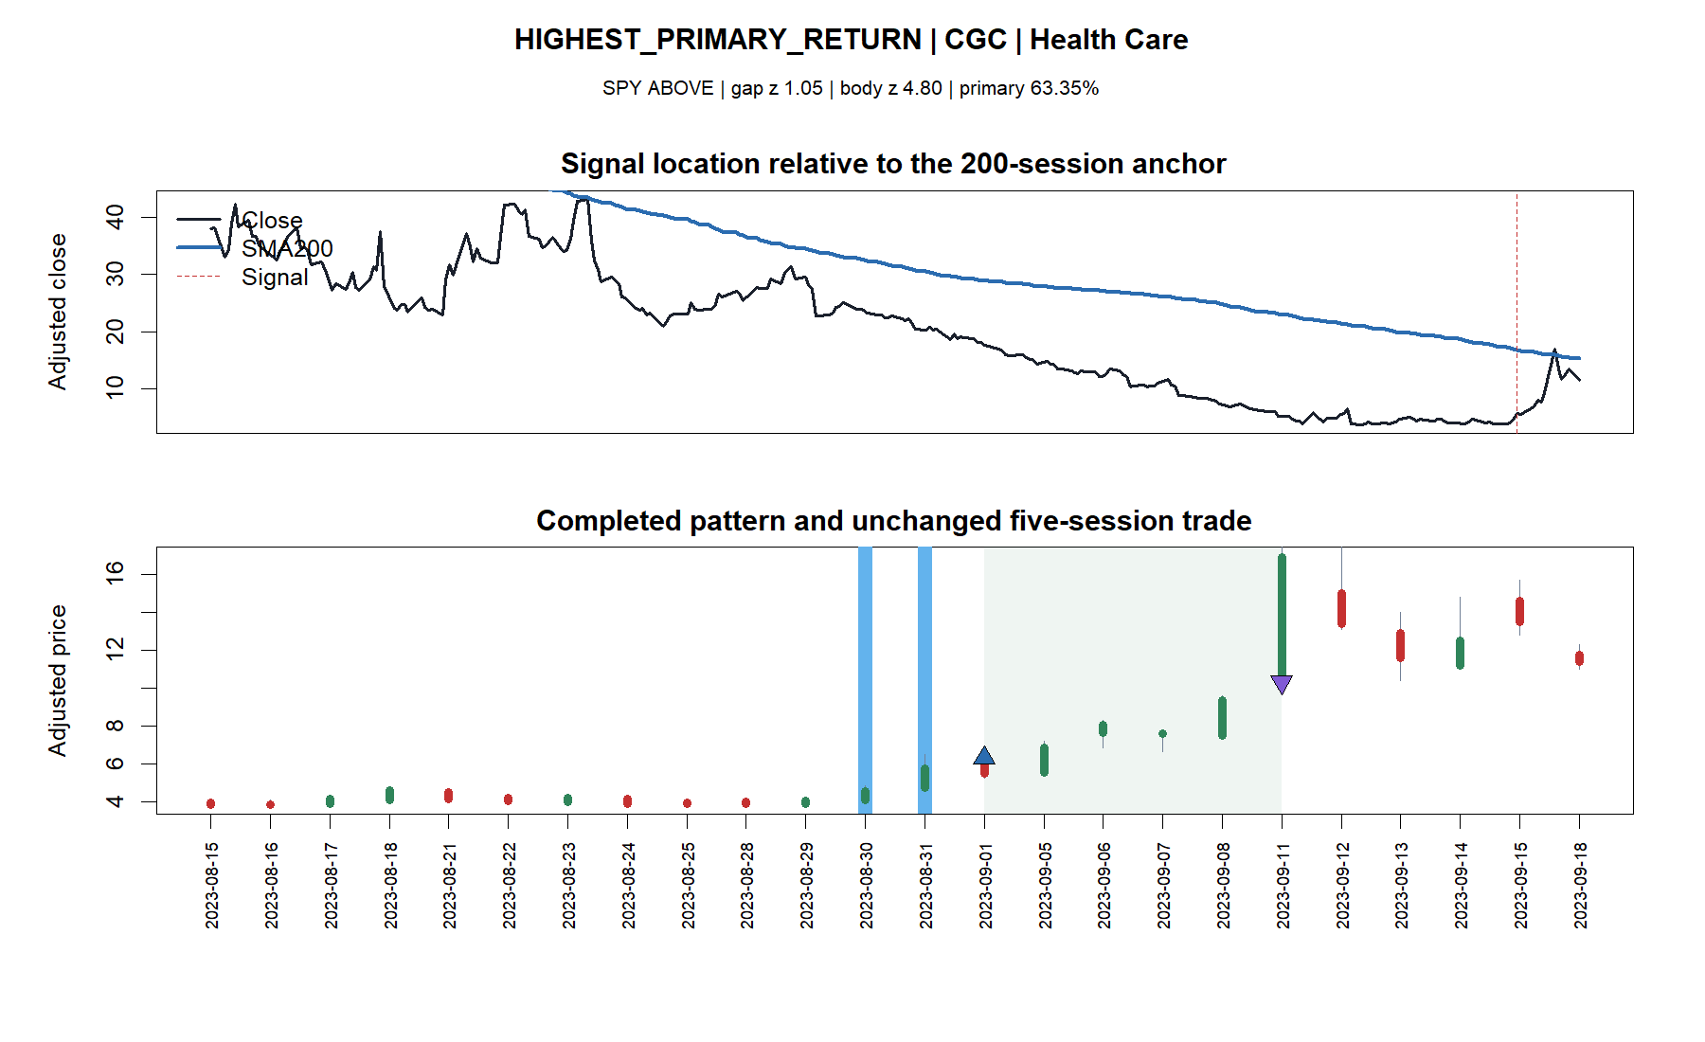
The best trade was a violent rebound, not a clean trend continuation
16
Notes:
CGC gained 63.35% after a violent rebound from a long decline. SPY was above SMA200, but the asset itself was far below its falling SMA200. The extreme winner shows why a positive hit rate can coexist with heterogeneous mechanisms inside the same formula.
[Sources]
- C:\Users\Franc\OneDrive\Documents\Francis\Peltata Project\Time-Series-Modeling-Gen5\runs\research_workbench\operator_hypothesis_lab\hyp_mom_01_1_stock_atlas_02_breadth_extension_20260804\hyp_mom_01_1_breadth_tape_manifest.csv
- C:\Users\Franc\OneDrive\Documents\Francis\Peltata Project\Time-Series-Modeling-Gen5\runs\research_workbench\operator_hypothesis_lab\hyp_mom_01_1_stock_atlas_02_breadth_extension_20260804\visuals\breadth_tape_02_highest_primary_return_cgc.png

Slide 17
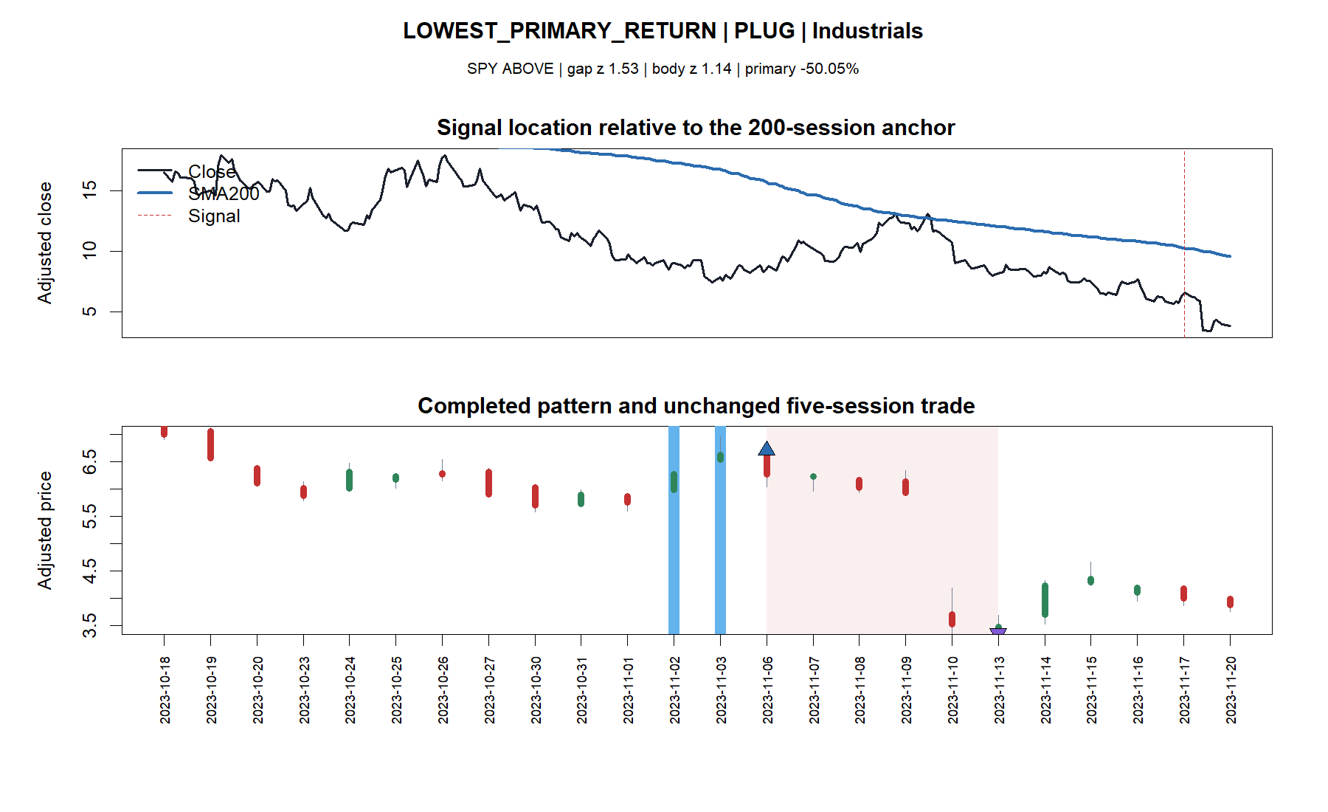
The worst trade shows the downside tail the hit rate conceals
17
Notes:
PLUG lost 50.05% as an apparently strong two-gap pattern failed into a collapse. SPY was above SMA200 here too. Market permission did not remove idiosyncratic tail risk.
[Sources]
- C:\Users\Franc\OneDrive\Documents\Francis\Peltata Project\Time-Series-Modeling-Gen5\runs\research_workbench\operator_hypothesis_lab\hyp_mom_01_1_stock_atlas_02_breadth_extension_20260804\hyp_mom_01_1_breadth_tape_manifest.csv
- C:\Users\Franc\OneDrive\Documents\Francis\Peltata Project\Time-Series-Modeling-Gen5\runs\research_workbench\operator_hypothesis_lab\hyp_mom_01_1_stock_atlas_02_breadth_extension_20260804\visuals\breadth_tape_03_lowest_primary_return_plug.png

Slide 18
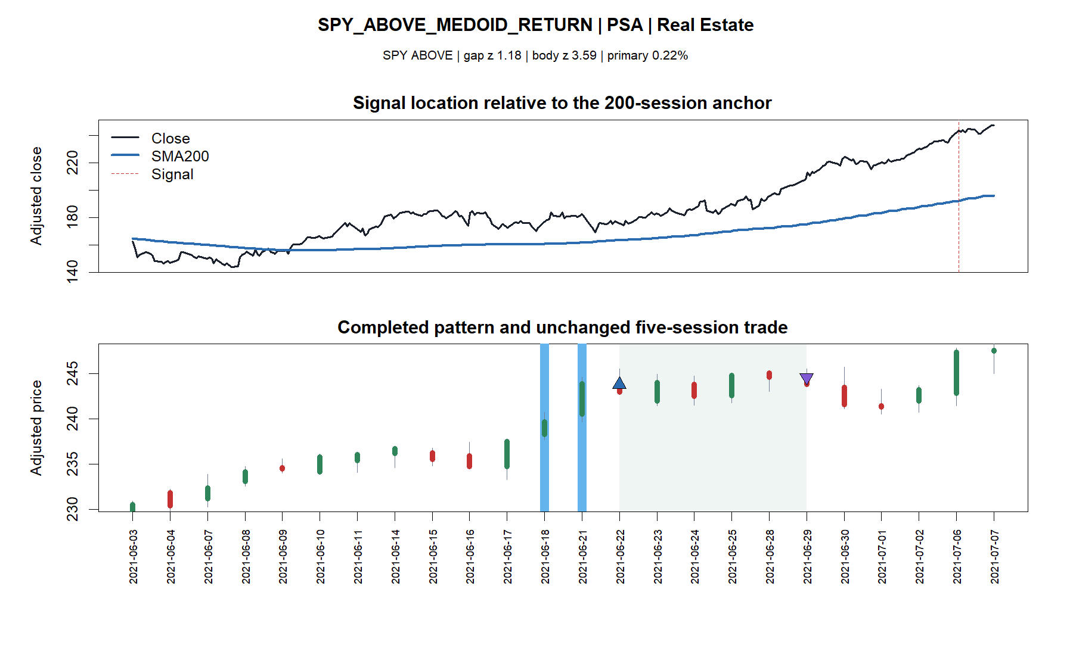
The SPY-above medoid is an ordinary +0.22% trade
18
Notes:
PSA is the frozen medoid-return trade among signals generated while SPY was above SMA200. The result is modest rather than transformative, matching the weak new-panel equal-asset contrast.
[Sources]
- C:\Users\Franc\OneDrive\Documents\Francis\Peltata Project\Time-Series-Modeling-Gen5\runs\research_workbench\operator_hypothesis_lab\hyp_mom_01_1_stock_atlas_02_breadth_extension_20260804\hyp_mom_01_1_breadth_tape_manifest.csv
- C:\Users\Franc\OneDrive\Documents\Francis\Peltata Project\Time-Series-Modeling-Gen5\runs\research_workbench\operator_hypothesis_lab\hyp_mom_01_1_stock_atlas_02_breadth_extension_20260804\visuals\breadth_tape_04_spy_above_medoid_return_psa.png

Slide 19
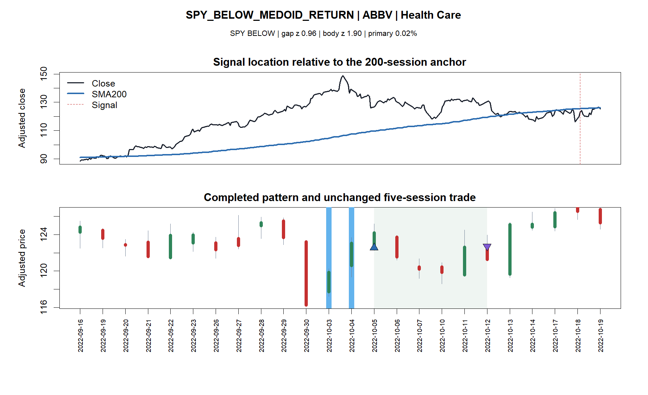
The SPY-below medoid is also ordinary at +0.02%
19
Notes:
ABBV is the frozen medoid-return trade while SPY was below SMA200. Comparing it with PSA makes the widened quantitative result tangible: the median examples are nearly indistinguishable even though the pooled state means differ.
[Sources]
- C:\Users\Franc\OneDrive\Documents\Francis\Peltata Project\Time-Series-Modeling-Gen5\runs\research_workbench\operator_hypothesis_lab\hyp_mom_01_1_stock_atlas_02_breadth_extension_20260804\hyp_mom_01_1_breadth_tape_manifest.csv
- C:\Users\Franc\OneDrive\Documents\Francis\Peltata Project\Time-Series-Modeling-Gen5\runs\research_workbench\operator_hypothesis_lab\hyp_mom_01_1_stock_atlas_02_breadth_extension_20260804\visuals\breadth_tape_05_spy_below_medoid_return_abbv.png

Slide 20
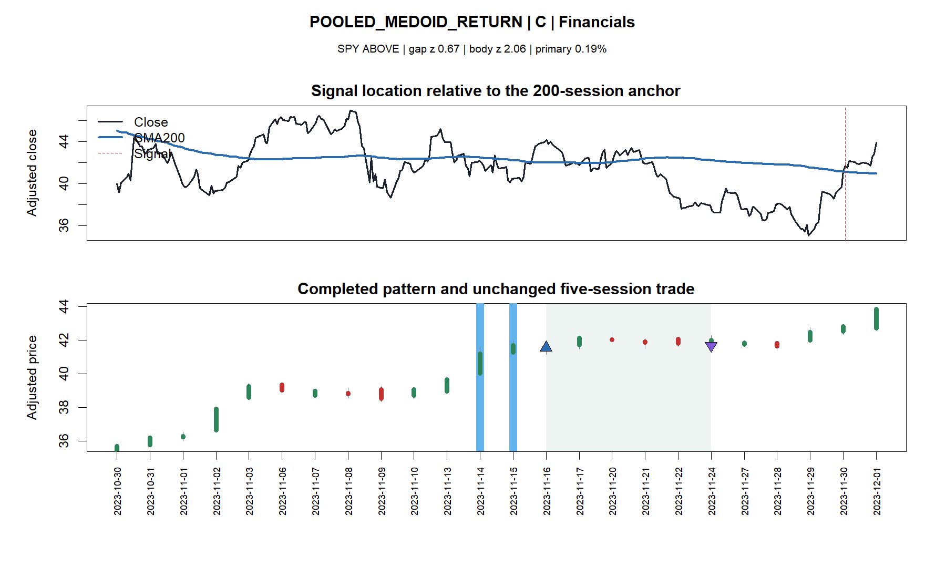
The pooled medoid remained nearly flat despite a large candle body
20
Notes:
C is the combined pooled medoid-return trade at +0.19%. The normalized body was large, but the five-session outcome was ordinary.
[Sources]
- C:\Users\Franc\OneDrive\Documents\Francis\Peltata Project\Time-Series-Modeling-Gen5\runs\research_workbench\operator_hypothesis_lab\hyp_mom_01_1_stock_atlas_02_breadth_extension_20260804\hyp_mom_01_1_breadth_tape_manifest.csv
- C:\Users\Franc\OneDrive\Documents\Francis\Peltata Project\Time-Series-Modeling-Gen5\runs\research_workbench\operator_hypothesis_lab\hyp_mom_01_1_stock_atlas_02_breadth_extension_20260804\visuals\breadth_tape_01_pooled_medoid_return_c.png

Slide 21
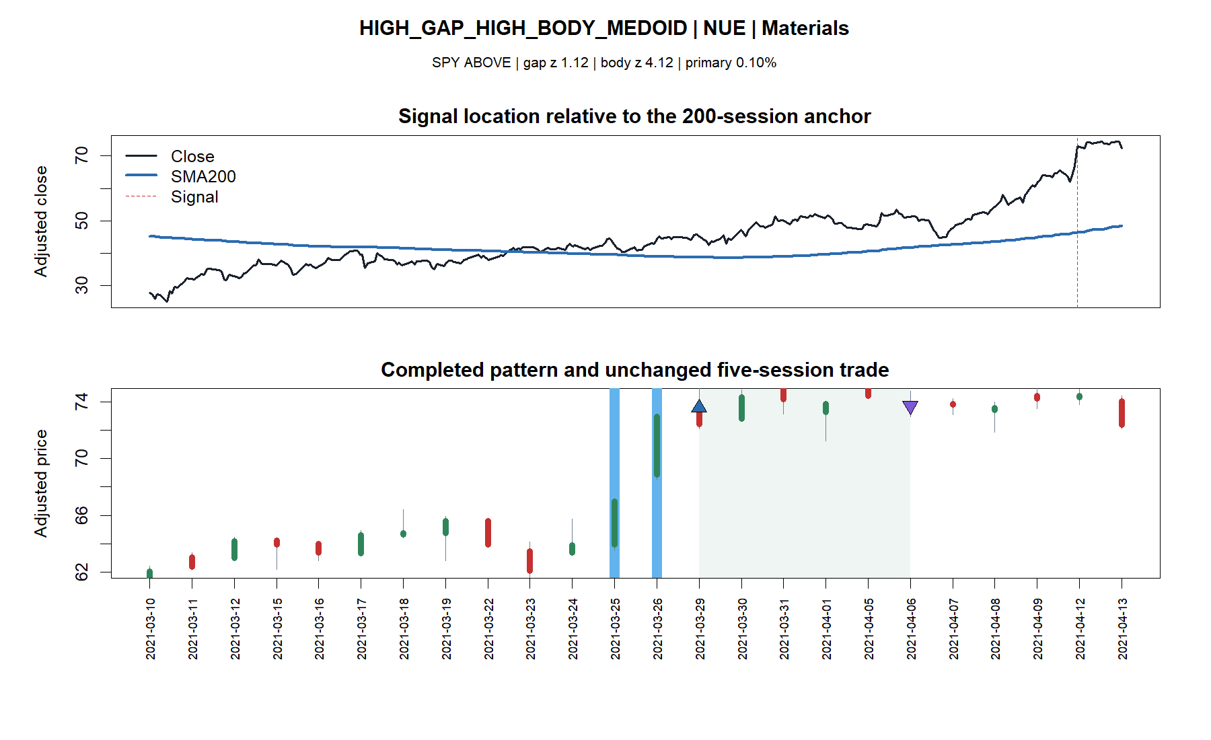
High gap plus high body still produced an ordinary +0.10% trade
21
Notes:
NUE is the frozen medoid inside the high-gap/high-body cell. Its nearly flat outcome reinforces the nonmonotonic heatmap: visual pattern intensity does not reliably separate stronger five-session outcomes.
[Sources]
- C:\Users\Franc\OneDrive\Documents\Francis\Peltata Project\Time-Series-Modeling-Gen5\runs\research_workbench\operator_hypothesis_lab\hyp_mom_01_1_stock_atlas_02_breadth_extension_20260804\hyp_mom_01_1_breadth_tape_manifest.csv
- C:\Users\Franc\OneDrive\Documents\Francis\Peltata Project\Time-Series-Modeling-Gen5\runs\research_workbench\operator_hypothesis_lab\hyp_mom_01_1_stock_atlas_02_breadth_extension_20260804\visuals\breadth_tape_06_high_gap_high_body_medoid_nue.png

Slide 22
The thoughtful next move is to preserve the result - not rescue the rule
WHAT BREADTH ESTABLISHED
DO NOT PROMOTE
- Slight-majority hit rate is real
- Positive median is real
- Loss tail dominates the mean
- Original filter hints do not generalize
- No SPY-SMA200 01.2 from this result
- No best heatmap cell
- No cohort or sector filter
- No reactive stop or averaging rule
A useful diagnostic conclusion.
Future work needs a new economic question and distinct evidence.
DISCOVERY_BREADTH_EXTENSION_COMPLETE_NO_STRATEGY_AUTHORITY | 2024+ SEALED
22
Notes:
The wider atlas did exactly what it should: it converted intriguing small-panel hints into a more reliable null. This does not make the investigation unproductive. It clarifies that future progress should start from a new mechanism or a distinct predeclared question rather than tuning thresholds inside the same 116 assets and 2021-2023 window.
[Sources]
- C:\Users\Franc\OneDrive\Documents\Francis\Peltata Project\Time-Series-Modeling-Gen5\operator_hypothesis_lab\docs\HYP_MOM_01_1_STOCK_ATLAS_02_BREADTH_EXTENSION_RESULTS.md
- C:\Users\Franc\OneDrive\Documents\Francis\Peltata Project\Time-Series-Modeling-Gen5\operator_hypothesis_lab\docs\HYP_MOM_01_1_STOCK_ATLAS_02_BREADTH_EXTENSION_CONTRACT.md
- C:\Users\Franc\OneDrive\Documents\Francis\Peltata Project\Time-Series-Modeling-Gen5\runs\research_workbench\operator_hypothesis_lab\hyp_mom_01_1_stock_atlas_02_breadth_extension_20260804\hyp_mom_01_1_breadth_panel_summary.csv
- C:\Users\Franc\OneDrive\Documents\Francis\Peltata Project\Time-Series-Modeling-Gen5\runs\research_workbench\operator_hypothesis_lab\hyp_mom_01_1_stock_atlas_02_breadth_extension_20260804\hyp_mom_01_1_breadth_diagnostic_contrasts.csv

