Slide 1
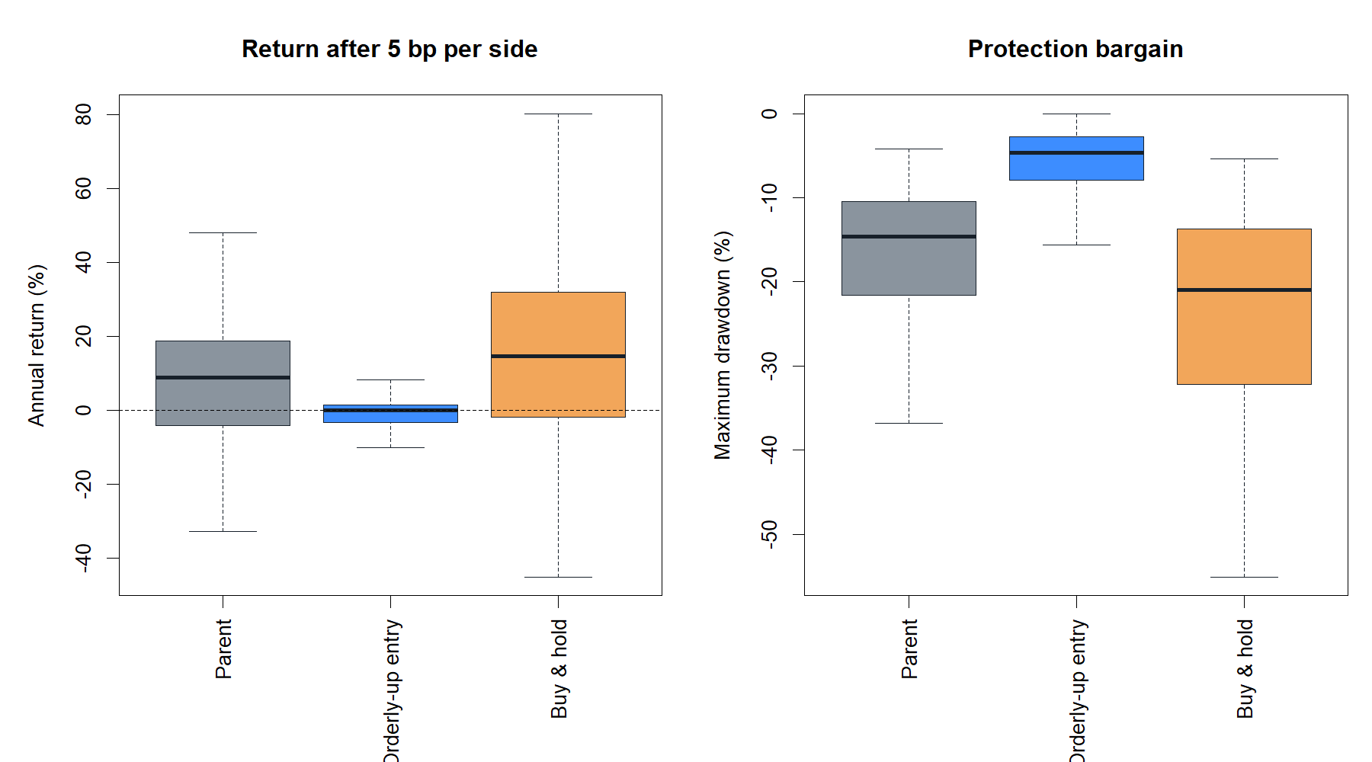
HYP-REG-09.1
Robust slope and path quality worked as a measurement—
not as an SMA entry permission
Theil–Sen 60-session primary · 120-session durability · 26 assets · 2018–2023
STOP · Stage A 7/7 · Strategy 3/9
1
Notes:
Lead with the two-stage verdict. The causal measurement passed every construction gate. The approved strategy question was narrower: should positive robust slope plus unusually high path quality permit a fresh SMA8/14 entry? The answer was no.
[Sources]
- operator_hypothesis_lab/docs/HYP_REG_09_1_ROBUST_SLOPE_FIT_RESULTS.md
- runs/research_workbench/operator_hypothesis_lab/hyp_reg_09_1_robust_slope_fit_20260816/hyp_reg_09_1_stage_a_gates.csv
- runs/research_workbench/operator_hypothesis_lab/hyp_reg_09_1_robust_slope_fit_20260816/hyp_reg_09_1_strategy_gates.csv

Slide 2
FROZEN QUESTION
Three trend properties were kept separate
DIRECTION
STRENGTH
QUALITY
sign of robust slope
slope ÷ realized noise
rank monotonicity
Is the fitted path rising or falling?
How large is the fitted move relative to volatility?
How orderly was the completed path, regardless of sign?
Frozen boundaries
60 completed closes primary; 120 only as durability evidence
Quality ranked against the prior 252 completed values; current row excluded
2018–2023 reused development panel: 24 stocks plus SPY and QQQ
2024+ sealed; no grid, rescue threshold, ATR join, leverage, or asset selection
2
Notes:
The design avoids collapsing every intuitive notion of trend into one score. Direction, economic strength, and path quality are individually inspectable. Strategy outcomes were inaccessible until all Stage A gates passed.
[Sources]
- docs/GEN5_HYP_REG_09_1_ROBUST_SLOPE_FIT_CONTRACT.md
- runs/research_workbench/operator_hypothesis_lab/hyp_reg_09_1_robust_slope_fit_20260816/hyp_reg_09_1_run_spec.csv

Slide 3
THEORY · ROBUST DIRECTION
Theil–Sen replaces one fragile fitted line with a median of pairwise slopes
bTS = median [ log(Pj) − log(Pi) ] / (j − i) for every i < j
Plain-English intuition
What it does not prove
Draw a slope between every pair of observations
It does not establish stationarity or future continuation
Take the middle slope rather than minimizing squared errors
Overlapping log-price levels are not independent regression errors
A single price spike affects many pairs, but cannot dictate the median as easily as it dictates OLS
We use the fitted slope descriptively—not a classical t-test or alpha claim
The sign of bTS supplies direction; its raw magnitude is not yet cross-asset comparable.
3
Notes:
Theil introduced rank-invariant regression in 1950. Sen's 1968 formulation describes the point estimator as the median of slopes joining all observation pairs. We adopt this robust point estimate, not Sen's confidence interval, because the financial rolling-window errors are strongly overlapping and the POC question is descriptive state construction.
[Sources]
- https://ir.cwi.nl/pub/18445
- https://doi.org/10.1080/01621459.1968.10480934
- docs/GEN5_HYP_REG_09_1_ROBUST_SLOPE_FIT_CONTRACT.md

Slide 4
CONSTRUCTION · NORMALIZATION
Strength and path quality answer different questions
normalized strength
path quality
bTS × √(n−1) / sd[Δ log(P)]
| Spearman(time, log price) |
signed fitted displacement relative to random-walk-scale realized noise
absolute rank monotonicity; high for an orderly rise or decline
Why absolute Spearman?
Rank correlation is insensitive to price scale and does not require a linear price path
Absolute value deliberately removes direction so quality cannot quietly become another momentum score
A reversal can have low quality even when its beginning and ending prices differ materially
High quality describes the path that just occurred. It is not, by itself, evidence that the next return is positive.
4
Notes:
The normalization makes a given fitted slope smaller when recent daily log-return noise is larger. Spearman's rank association is used as a monotonicity measure between session order and log price; taking its absolute value intentionally gives the same quality to an orderly rise and orderly decline. Direction remains solely in the robust slope sign.
[Sources]
- https://doi.org/10.2307/1412159
- docs/GEN5_HYP_REG_09_1_ROBUST_SLOPE_FIT_CONTRACT.md
- operator_hypothesis_lab/docs/HYP_REG_09_1_ROBUST_SLOPE_FIT_RESULTS.md

Slide 5
CAUSAL STATE MACHINE
Only path quality becomes a causal asset-relative state
60-close quality → rank versus prior 252 quality values → hysteretic LOW / MEDIUM / HIGH
LOW QUALITY
MEDIUM QUALITY
HIGH QUALITY
enter ≤30 · remain ≤40
all other finite values
enter ≥70 · remain ≥60
Strategy eligibility = positive normalized strength AND HIGH QUALITY
A rejected SMA cross is skipped, not queued. The 120-session view cannot override the 60-session primary.
5
Notes:
The quality state uses only the asset's own prior completed history and excludes the current row. Hysteresis reduces threshold chatter. Direction never changes the quality label; it is added only when constructing the one frozen strategy eligibility rule.
[Sources]
- docs/GEN5_HYP_REG_09_1_ROBUST_SLOPE_FIT_CONTRACT.md
- runs/research_workbench/operator_hypothesis_lab/hyp_reg_09_1_robust_slope_fit_20260816/hyp_reg_09_1_stage_a_gates.csv
- runs/research_workbench/operator_hypothesis_lab/hyp_reg_09_1_robust_slope_fit_20260816/hyp_reg_09_1_run_spec.csv

Slide 6
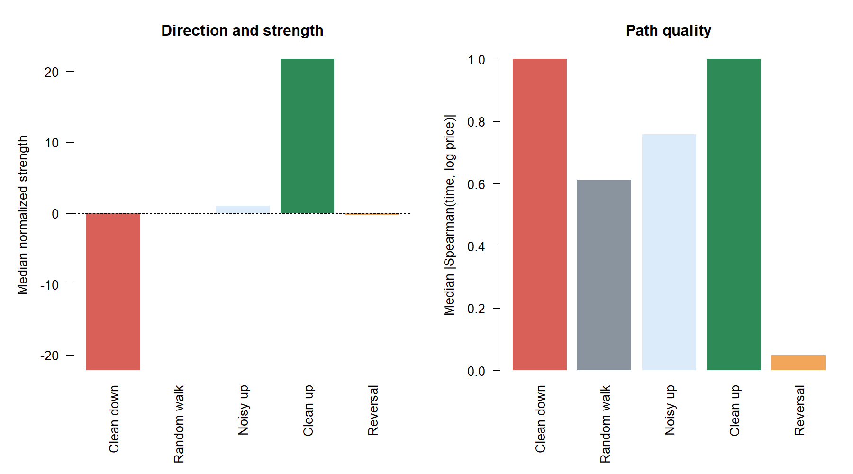
STAGE A · SYNTHETIC CALIBRATION
Seeded paths separated direction from path quality as intended
±22
clean up/down strength
1.000
clean path quality
0.049
reversal path quality
Noisy rise 0.758 · random walk 0.612
6
Notes:
Clean upward and downward paths had equal maximum quality but opposite slope signs. The noisy upward path retained positive direction with lower quality. Random walks were less monotone, and a deliberate reversal had near-zero quality. The observed ordering passed every frozen margin.
[Sources]
- runs/research_workbench/operator_hypothesis_lab/hyp_reg_09_1_robust_slope_fit_20260816/hyp_reg_09_1_stage_a_gates.csv
- C:/Users/Franc/OneDrive/Documents/Francis/Peltata Project/Time-Series-Modeling-Gen5/runs/research_workbench/operator_hypothesis_lab/hyp_reg_09_1_robust_slope_fit_20260816/hyp_reg_09_1_synthetic_summary.csv
- operator_hypothesis_lab/docs/HYP_REG_09_1_ROBUST_SLOPE_FIT_RESULTS.md

Slide 7
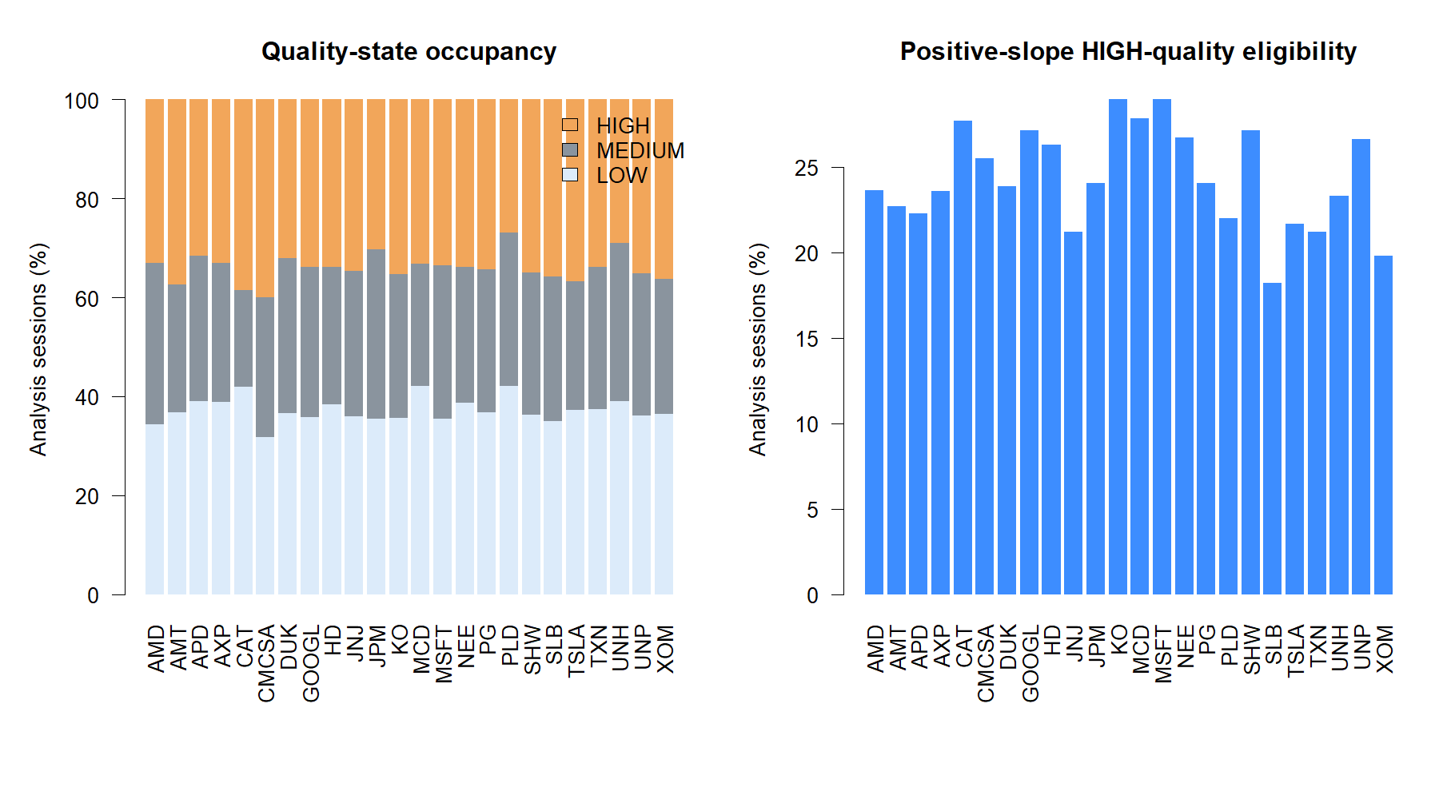
STAGE A · REAL-PANEL USABILITY
The real panel produced usable states across every primary stock
24 / 24
stocks with usable HIGH and LOW
24.0%
median eligible sessions
0
semantic or append violations
All 7/7 construction gates passed before strategy contact.
7
Notes:
The construction did not collapse into one state or fail on particular assets. All twenty-four primary stocks had at least five percent HIGH and LOW occupancy and at least three percent eligible sessions. Scale invariance, append invariance, and exact state semantics passed.
[Sources]
- runs/research_workbench/operator_hypothesis_lab/hyp_reg_09_1_robust_slope_fit_20260816/hyp_reg_09_1_stage_a_gates.csv
- C:/Users/Franc/OneDrive/Documents/Francis/Peltata Project/Time-Series-Modeling-Gen5/runs/research_workbench/operator_hypothesis_lab/hyp_reg_09_1_robust_slope_fit_20260816/hyp_reg_09_1_state_diagnostics.csv
- C:/Users/Franc/OneDrive/Documents/Francis/Peltata Project/Time-Series-Modeling-Gen5/runs/research_workbench/operator_hypothesis_lab/hyp_reg_09_1_robust_slope_fit_20260816/hyp_reg_09_1_causality_audit.csv

Slide 8
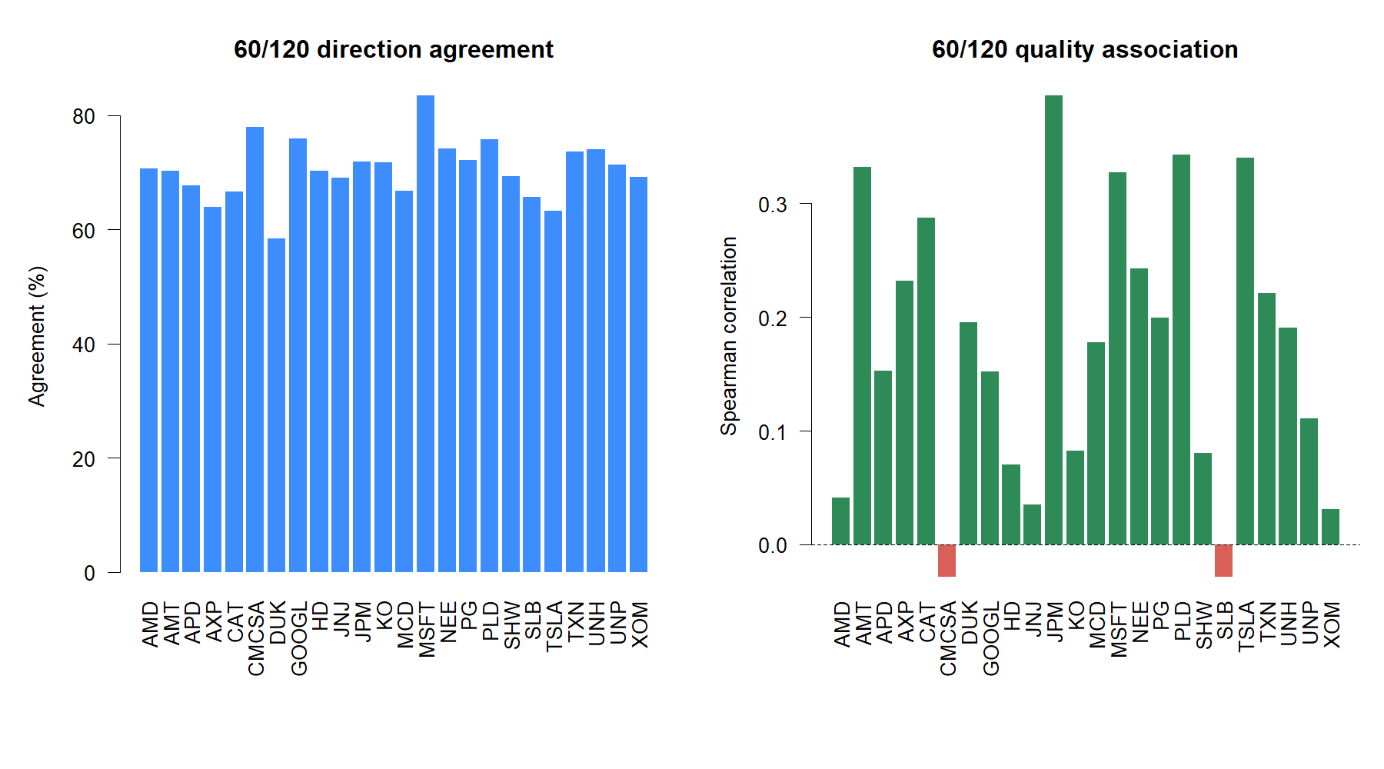
DURABILITY CHECK
The 120-session view was related—but not redundant
70.5%
median direction agreement
0.184
median quality association
Interpretation
Direction often agreed, while quality was scale-specific. That validates 120 as context—not a rescue candidate.
8
Notes:
The two windows often agreed on whether the fitted path was rising or falling, but their path-quality scores were only weakly associated. This is why the 120-session construction was predeclared as a durability view and prohibited from replacing the 60-session primary after outcomes.
[Sources]
- C:/Users/Franc/OneDrive/Documents/Francis/Peltata Project/Time-Series-Modeling-Gen5/runs/research_workbench/operator_hypothesis_lab/hyp_reg_09_1_robust_slope_fit_20260816/hyp_reg_09_1_state_diagnostics.csv
- runs/research_workbench/operator_hypothesis_lab/hyp_reg_09_1_robust_slope_fit_20260816/hyp_reg_09_1_stage_a_gates.csv
- docs/GEN5_HYP_REG_09_1_ROBUST_SLOPE_FIT_CONTRACT.md

Slide 9
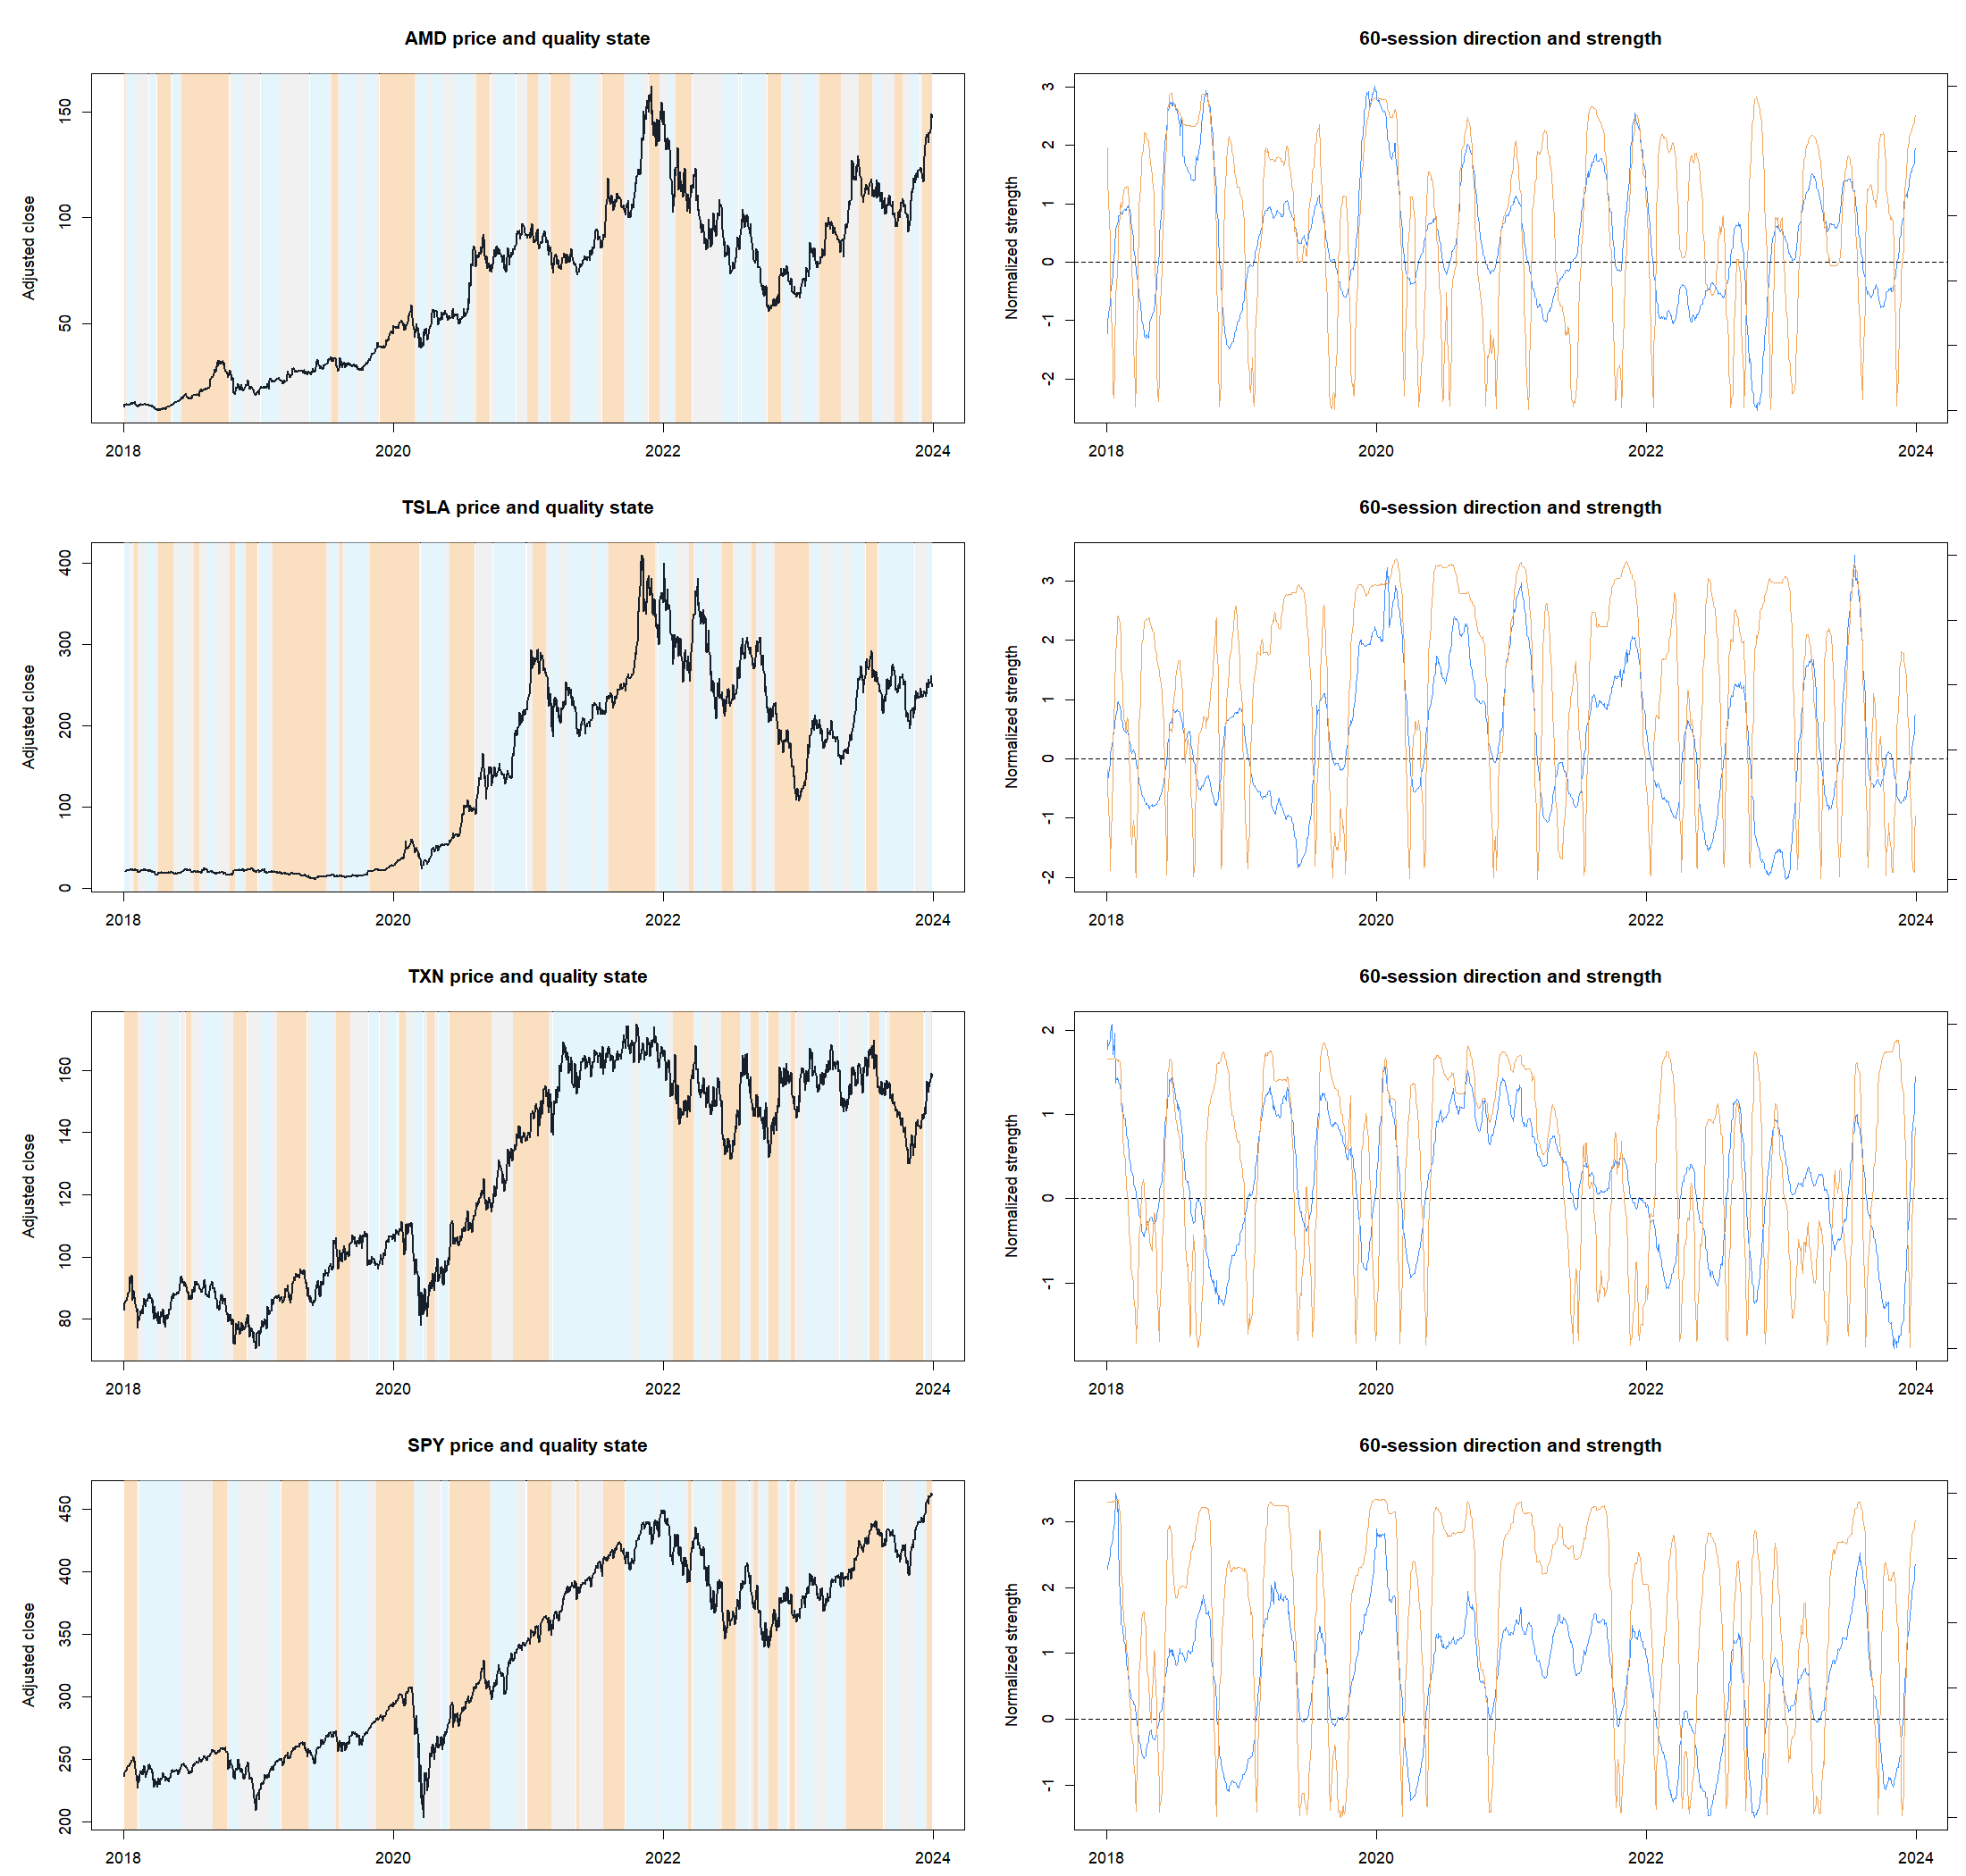
REPRESENTATIVE MEASUREMENT TAPES
Measurement tapes show a descriptive state—not a forecast
9
Notes:
Read the background colors as completed-path quality, not bullishness. Orange HIGH can accompany an orderly rise or decline; the strategy additionally required positive 60-session slope. The blue and orange strength lines demonstrate why 60- and 120-session views can diverge around reversals and inflections.
[Sources]
- C:/Users/Franc/OneDrive/Documents/Francis/Peltata Project/Time-Series-Modeling-Gen5/runs/research_workbench/operator_hypothesis_lab/hyp_reg_09_1_robust_slope_fit_20260816/hyp_reg_09_1_ledger.csv
- operator_hypothesis_lab/docs/HYP_REG_09_1_ROBUST_SLOPE_FIT_RESULTS.md
- docs/GEN5_HYP_REG_09_1_ROBUST_SLOPE_FIT_CONTRACT.md

Slide 10
STAGE A PASSED
A well-formed description
still has to improve the
next strategy decision
Next question: did orderly positive paths improve fresh SMA8/14 entries?
10
Notes:
Passing Stage A means the measurement is causal, interpretable, and usable. It does not establish that the state improves a specific strategy. Stage B keeps the parent unchanged and tests only the approved entry-permission interpretation.
[Sources]
- runs/research_workbench/operator_hypothesis_lab/hyp_reg_09_1_robust_slope_fit_20260816/hyp_reg_09_1_stage_a_gates.csv
- docs/GEN5_HYP_REG_09_1_ROBUST_SLOPE_FIT_CONTRACT.md

Slide 11
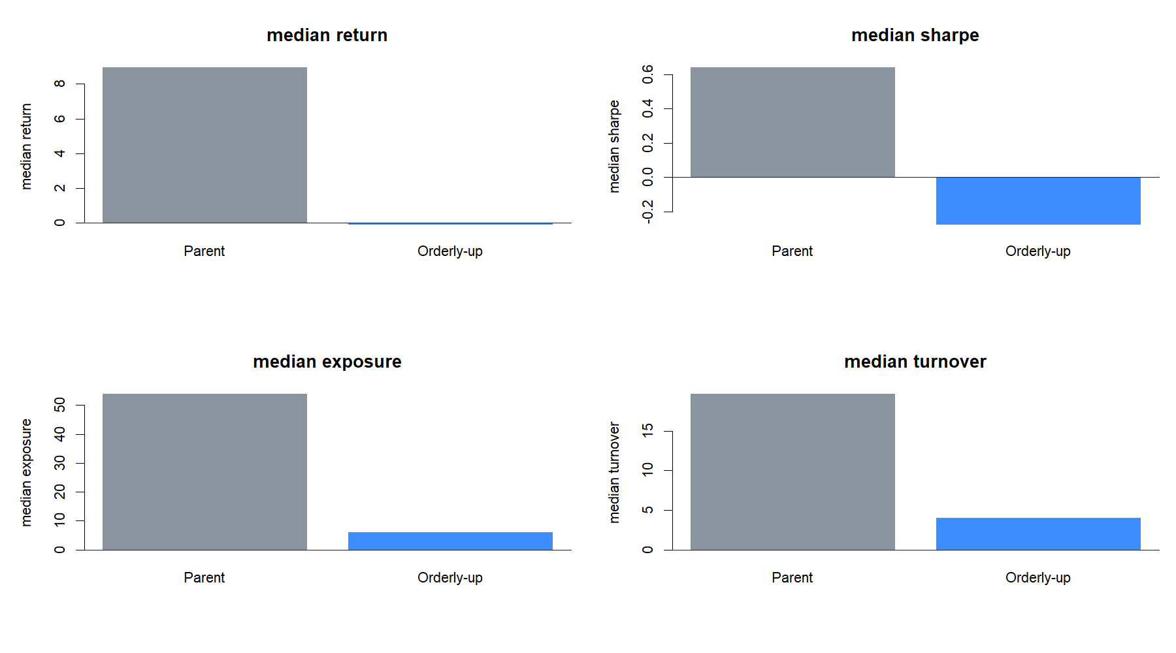
STAGE B · HEADLINE OUTCOME
The gate made the parent much safer by making it mostly cash
8.95% → −0.11%
median annual return
0.642 → −0.278
median Sharpe
53.88% → 6.02%
median exposure
Drawdown improved from −14.59% to −4.63%—but the return/Sharpe bargain failed.
11
Notes:
The unchanged parent reproduced all 156 retained cells. The overlay kept only 273 of 1,394 parent trades. Lower drawdown is real, but it is largely explained by median exposure falling to six percent. A valid protection claim must also satisfy return and Sharpe gates; this policy did not.
[Sources]
- runs/research_workbench/operator_hypothesis_lab/hyp_reg_09_1_robust_slope_fit_20260816/hyp_reg_09_1_policy_panel.csv
- runs/research_workbench/operator_hypothesis_lab/hyp_reg_09_1_robust_slope_fit_20260816/hyp_reg_09_1_strategy_gates.csv
- operator_hypothesis_lab/docs/HYP_REG_09_1_ROBUST_SLOPE_FIT_RESULTS.md

Slide 12
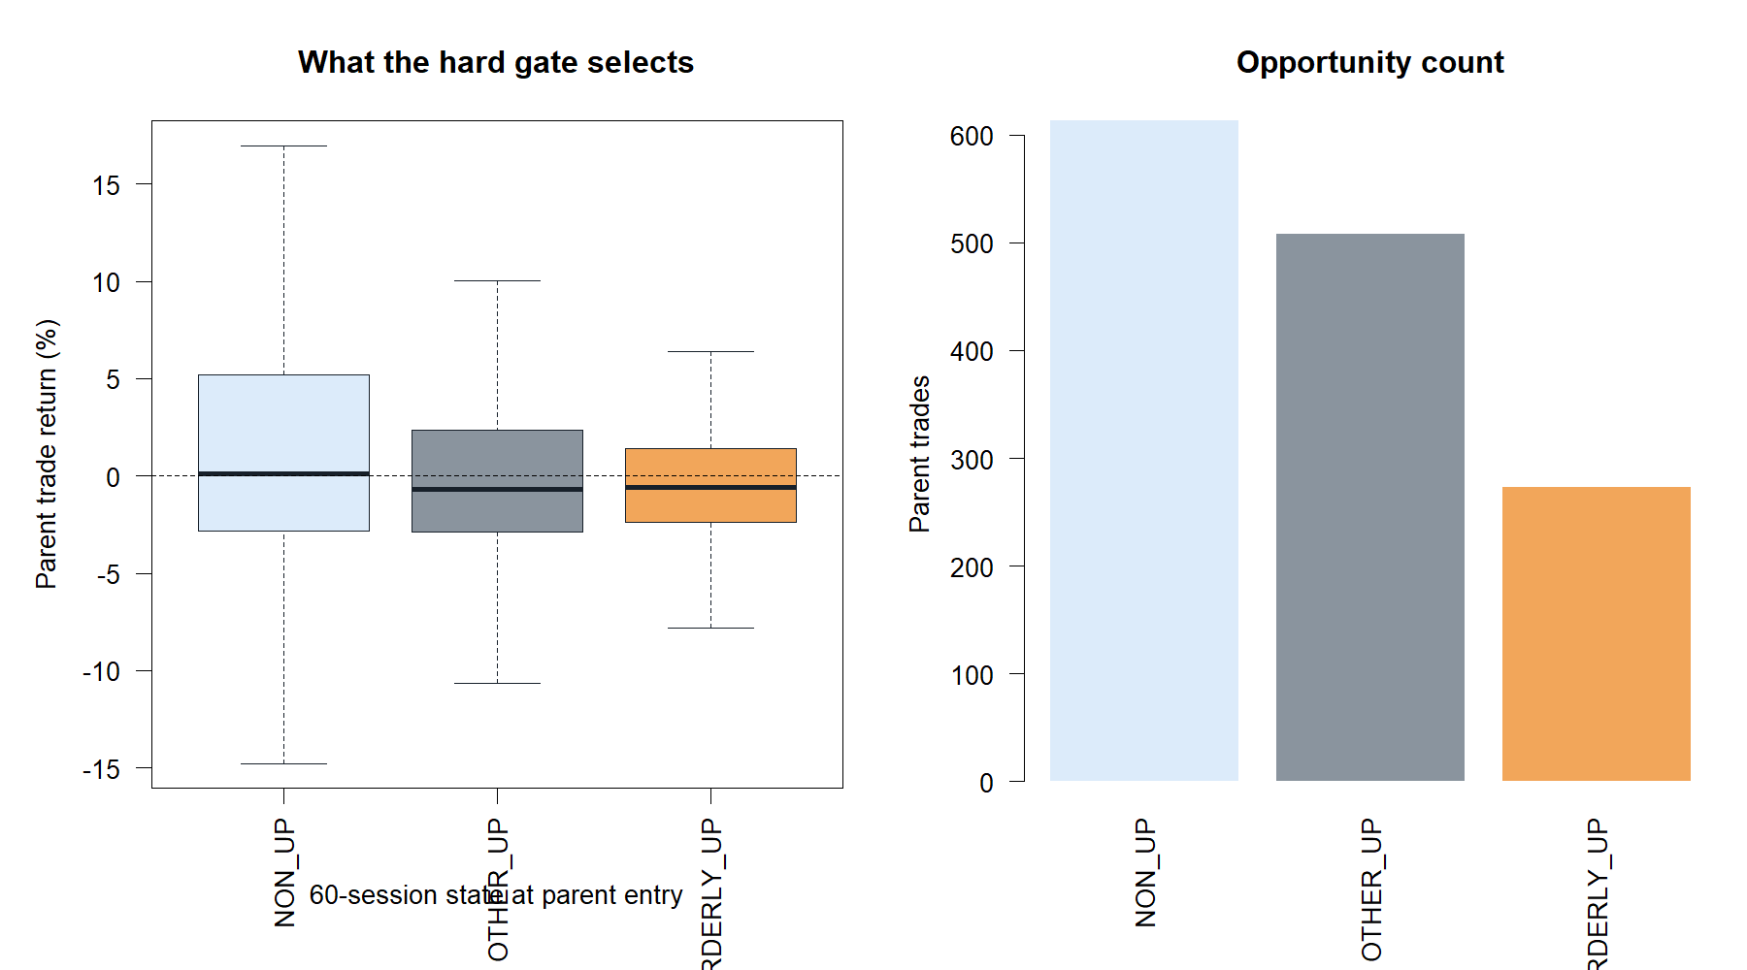
ENTRY-STATE AUDIT
Orderly-up did not contain the best parent trades
43.96%
ORDERLY_UP hit rate
−0.57%
ORDERLY_UP median trade
+0.25%
ORDERLY_UP mean trade
Non-positive-slope entries had the strongest hit rate and mean trade in this parent.
12
Notes:
The hard gate did not rank parent trades as intended. ORDERLY_UP trades had a negative median and only a small positive mean. The non-positive-slope group had a 50.57% hit rate and 2.21% mean trade, emphasizing that an SMA cross can begin after a prior decline or reversal rather than after a mature 60-session rise.
[Sources]
- runs/research_workbench/operator_hypothesis_lab/hyp_reg_09_1_robust_slope_fit_20260816/hyp_reg_09_1_entry_state_audit.csv
- C:/Users/Franc/OneDrive/Documents/Francis/Peltata Project/Time-Series-Modeling-Gen5/runs/research_workbench/operator_hypothesis_lab/hyp_reg_09_1_robust_slope_fit_20260816/hyp_reg_09_1_trades.csv
- operator_hypothesis_lab/docs/HYP_REG_09_1_ROBUST_SLOPE_FIT_RESULTS.md

Slide 13
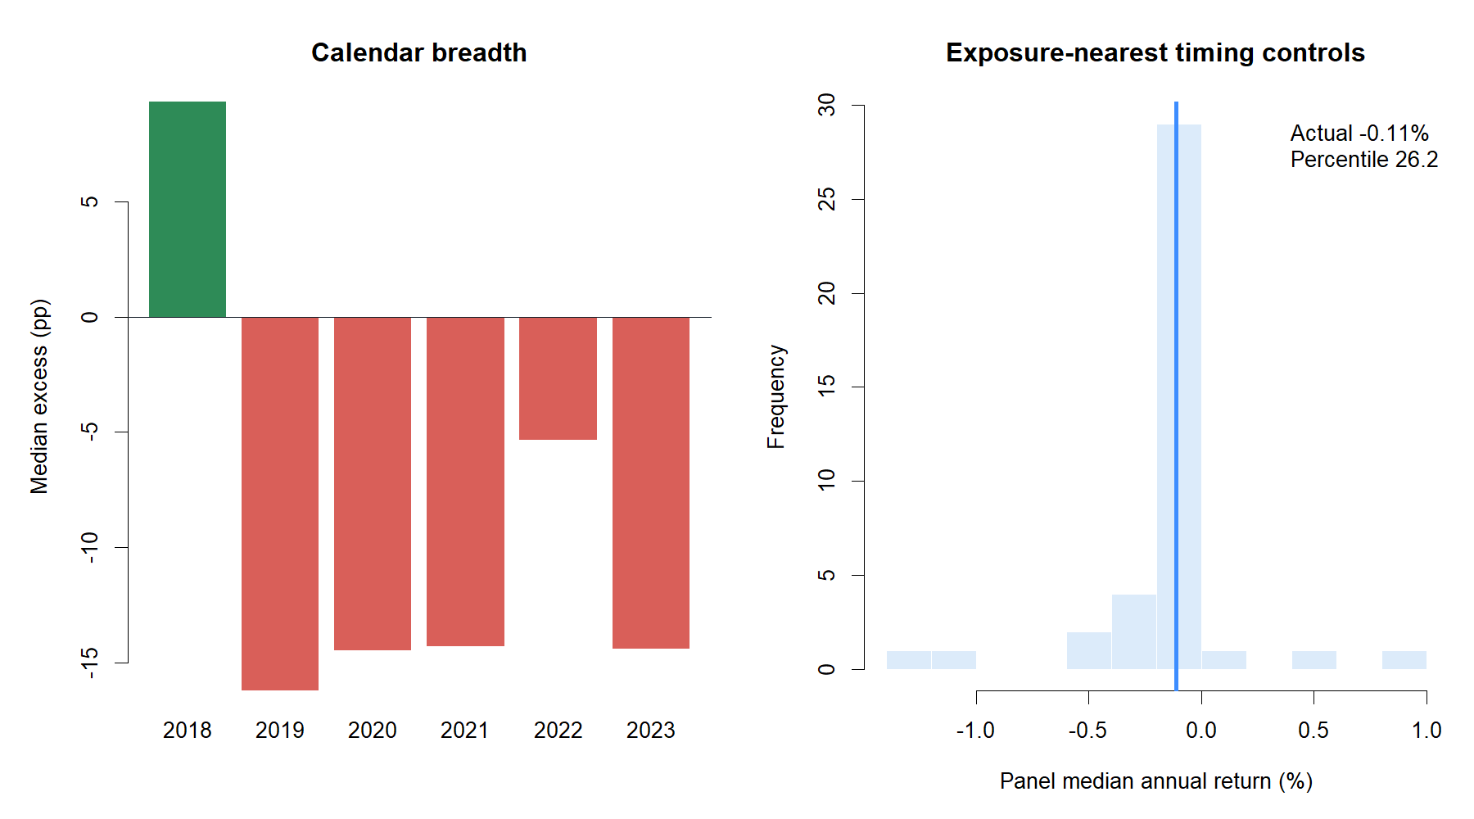
FALSIFICATION · BREADTH AND CONTROLS
The 2018 exception did not transport
2 / 24
stocks improved
1 / 6
positive-excess years
26.2nd pct
timing-control rank
2019–2023 were all negative at the panel median.
13
Notes:
The policy's one positive panel-median year was 2018. Only JPM and UNH improved over six years. Against forty exposure-nearest controls selected from two hundred deterministic circular shifts, actual timing ranked at the 26.2nd percentile. The result is therefore worse than ordinary opportunity thinning, not merely lower exposure.
[Sources]
- runs/research_workbench/operator_hypothesis_lab/hyp_reg_09_1_robust_slope_fit_20260816/hyp_reg_09_1_asset_summary.csv
- runs/research_workbench/operator_hypothesis_lab/hyp_reg_09_1_robust_slope_fit_20260816/hyp_reg_09_1_year_summary.csv
- runs/research_workbench/operator_hypothesis_lab/hyp_reg_09_1_robust_slope_fit_20260816/hyp_reg_09_1_placebo_readout.csv
- runs/research_workbench/operator_hypothesis_lab/hyp_reg_09_1_robust_slope_fit_20260816/hyp_reg_09_1_strategy_gates.csv

Slide 14
DECISION BOUNDARY
Retain the measurement; set down the binary entry gate
7 / 7
3 / 9
What survives
construction gates
strategy gates
Causal robust direction, normalized strength, and quality ledgers
A usable asset-relative quality-state implementation
STOP_ROBUST_SLOPE_FIT_STRATEGY_GATES_
FAILED_CONFIRMATION_NOT_RUN
Evidence that descriptive trend quality ≠ entry-timing value
What remains closed
No window, threshold, strength, asset, or year rescue
Next roadmap discussion: T3 multi-horizon agreement asks a different cross-scale question. It is not authorized by this STOP alone.
No ATR stacking, alternate SMA mechanics, or leverage
No 2024+ confirmation inspection
14
Notes:
Close without rescue. The measurement implementation is a successful educational artifact. The specific binary entry-permission hypothesis is decisively rejected on the reused development surface, and the 2024+ confirmation period remains sealed. T3 requires a separate operator discussion and frozen contract.
[Sources]
- operator_hypothesis_lab/docs/HYP_REG_09_1_ROBUST_SLOPE_FIT_RESULTS.md
- runs/research_workbench/operator_hypothesis_lab/hyp_reg_09_1_robust_slope_fit_20260816/hyp_reg_09_1_stage_a_gates.csv
- runs/research_workbench/operator_hypothesis_lab/hyp_reg_09_1_robust_slope_fit_20260816/hyp_reg_09_1_strategy_gates.csv
- runs/research_workbench/operator_hypothesis_lab/hyp_reg_09_1_robust_slope_fit_20260816/hyp_reg_09_1_run_spec.csv

