Slide 1
METHODOLOGY FORK
Selection policy may be the hidden difference between Gen4 and Gen5.1
Same data.
Same PCA.
Same grid.
Different winner selection.
The next screen should isolate how state-level winners are chosen before we change the live bridge or rerun broader research.
July 2026
Gen5.1 selection-policy hypothesis
01

Slide 2
THE DISCOVERY
Matching the visible settings did not recreate Gen4 authority
The temporary bridge matched the Gen4-like basket, context universe, PCA mode, 5x5 state grid, and daily_default strategy grid. The selected state maps still diverged sharply.
3
3
1
exact model matches across five symbols and 25 states each
family matches where parameters still differed
field that explained it: Gen4 selection_mode
The difference is not just live replay. It is a winner-selection policy embedded in the research architecture.
Gen5.1 selection-policy hypothesis
02

Slide 3
TWO POLICIES
The fork is family-first versus full-spec-first
Gen4 style
Gen5.1 style
pooled_family_asset_variant
asset_state_direct_spec
• Choose the state’s best family from pooled evidence.
• Then choose asset-specific parameters inside that family.
• Lower variance, clearer state meaning, possible asset-level constraint.
• Choose the full asset/state spec directly.
• Family and parameters are selected together.
• More asset-specific flexibility, possible sparse-state overfit.
Gen5.1 selection-policy hypothesis
03

Slide 4
WHY IT MATTERS
A live-signal mismatch can be a methodology mismatch
If Gen4’s family-first policy is more robust, the bridge and some research screens may need to support it. If Gen5.1’s direct policy is stronger, signal differences may be acceptable rather than bugs.
Do not convert the bridge just for fidelity.
Do not keep Gen5.1 direct selection by assumption.
Make selection policy a declared factor.
First determine whether fidelity improves robustness.
Its flexibility may help or overfit depending on state depth.
Then live and research outputs can be compared honestly.
Gen5.1 selection-policy hypothesis
04

Slide 5
PAIRED SCREEN
The first test should vary only the selection policy
Hold the rest of the Gen4-like bridge surface constant so the comparison answers one question.
Hold constant
Vary only
• AMD,NVDA,PLTR,TSLA,SOFI
• Gen4 RESEARCH_ASSETS context
• pooled asset-day PCA
• 5x5 quantile states
• Gen4 daily_default implemented grid
• entry-state owns trade until exit
asset_state_direct_spec
pooled_family_asset_variant
Start with Q2 and Q3 2026, then add adjacent quarters only if the first readout shows a meaningful difference.
Gen5.1 selection-policy hypothesis
05

Slide 6
DECISION GATE
The output should support a policy decision, not a leaderboard
Evidence to inspect
Stop before changing
• Selected-state agreement and disagreement
• State coverage and sparse-state forcing
• Family stability across quarters
• Trade behavior and drawdown
• Portfolio accounting as inspection only
• the live bridge selection policy
• accepted default research settings
• prior context-universe conclusions
• daily automation confidence
Next step: implement the paired selection-policy wrapper, then decide whether Gen5.1 should preserve direct spec selection or add Gen4-style pooled family selection as a first-class policy.
Gen5.1 selection-policy hypothesis
06

Slide 7
FIRST READOUT
The policies were closer than the Gen4 file comparison implied
Inside the Gen5.1 bridge surface, direct and pooled-family authority maps matched on 321 of 375 asset-state rows across Q1-Q3 2026. Replay still diverged because a few state/spec changes can alter entries, exits, and quarter handoff.
85.6%
AMD
NVDA + TSLA
selected map agreement
drove much of the Q3 pooled advantage
favored direct in both tested windows
Meaning: do not convert the bridge just for fidelity, but do not dismiss the pooled-family hypothesis either.
Gen5.1 selection-policy hypothesis
07

Slide 8
BROADER TEST
The next comparison needs two clearly labeled evidence lanes
Screen A
Screen B
Current live basket
Historical substitute basket
• AMD,NVDA,PLTR,TSLA,SOFI
• Gen4 RESEARCH_ASSETS context
• Best evidence for live bridge policy
• History limited by newer symbols
• AMD,NVDA,TSLA,AAPL,MSTR
• Long-history active-plus-risk context
• Older-regime robustness evidence
• Not a literal live-basket replication
The results should be read side by side, not collapsed into one leaderboard.
Gen5.1 selection-policy hypothesis
08

Slide 9
A-LIVE RESULT
The live-basket lane favors direct selection, with one AMD-heavy exception
The completed A-live packet spans 2025Q4 through 2026Q3 on AMD,NVDA,PLTR,TSLA,SOFI with the Gen4 RESEARCH_ASSETS context. It is still inspection evidence, not allocation acceptance.
85.92%
3 of 4
4 of 4
AMD
asset-state map agreement
windows favored direct on mean trace return
windows favored direct on win rate and Sharpe proxy
drove pooled Q3
Meaning
The live-basket screen does not justify switching the bridge default to pooled-family. It does justify keeping pooled-family as a research contender because the AMD/Q3 behavior is too interesting to discard.
Gen5.1 selection-policy hypothesis
09

Slide 10
B-HIST RESULT
Older substitute history turns the question into a tradeoff
B_hist swapped SOFI and PLTR for AAPL and MSTR to reach 2019, 2020, 2022, and 2025 windows. This is robustness evidence, not a literal live-basket replication.
81.84%
3 of 5
2 of 5
MSTR
exact map agreement across 10 authority quarters
windows favored direct on mean trace return
weak windows favored pooled defensiveness
drove direct 2025Q1 upside
Meaning
B_hist does not overturn A_live. It says pooled-family is not merely a Gen4 compatibility artifact: it may be a constrained, sometimes defensive research policy worth testing explicitly.
Gen5.1 selection-policy hypothesis
10

Slide 11
DECISION POSTURE
Do not crown a winner; declare selection policy as a research factor
The two lanes answer different questions. A_live is the bridge-relevance lane; B_hist is the older-regime robustness lane. They should be read side by side, not collapsed into one leaderboard.
Keep now
Stop before
• Direct full-spec selection as the temporary bridge default.
• Pooled-family selection as a first-class research contender.
• A/B lane labels whenever live and substitute evidence are mixed.
• Changing live bridge behavior for Gen4 fidelity alone.
• Rerunning major context/state screens under a hidden policy swap.
• Treating these compact proxies as allocation evidence.
Recommended next slice: compare selection policy only inside a small, declared research grid using the strongest current context/state-map settings.
Gen5.1 selection-policy hypothesis
11

Slide 12
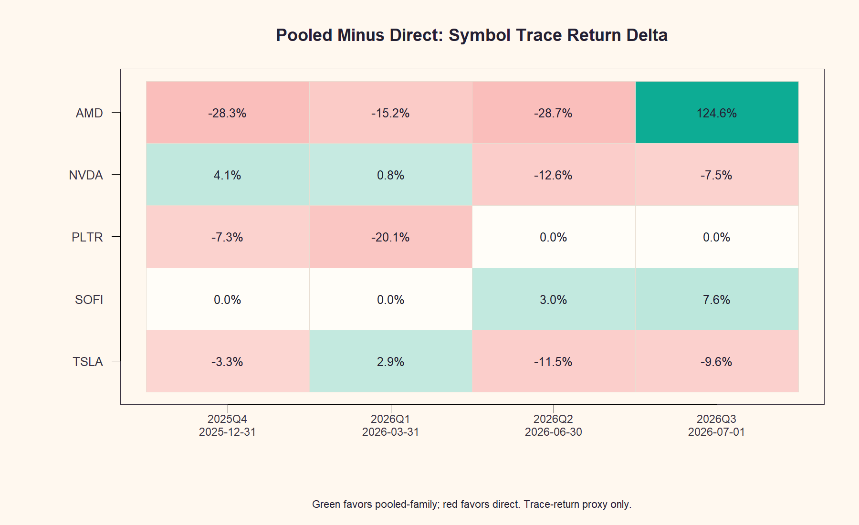
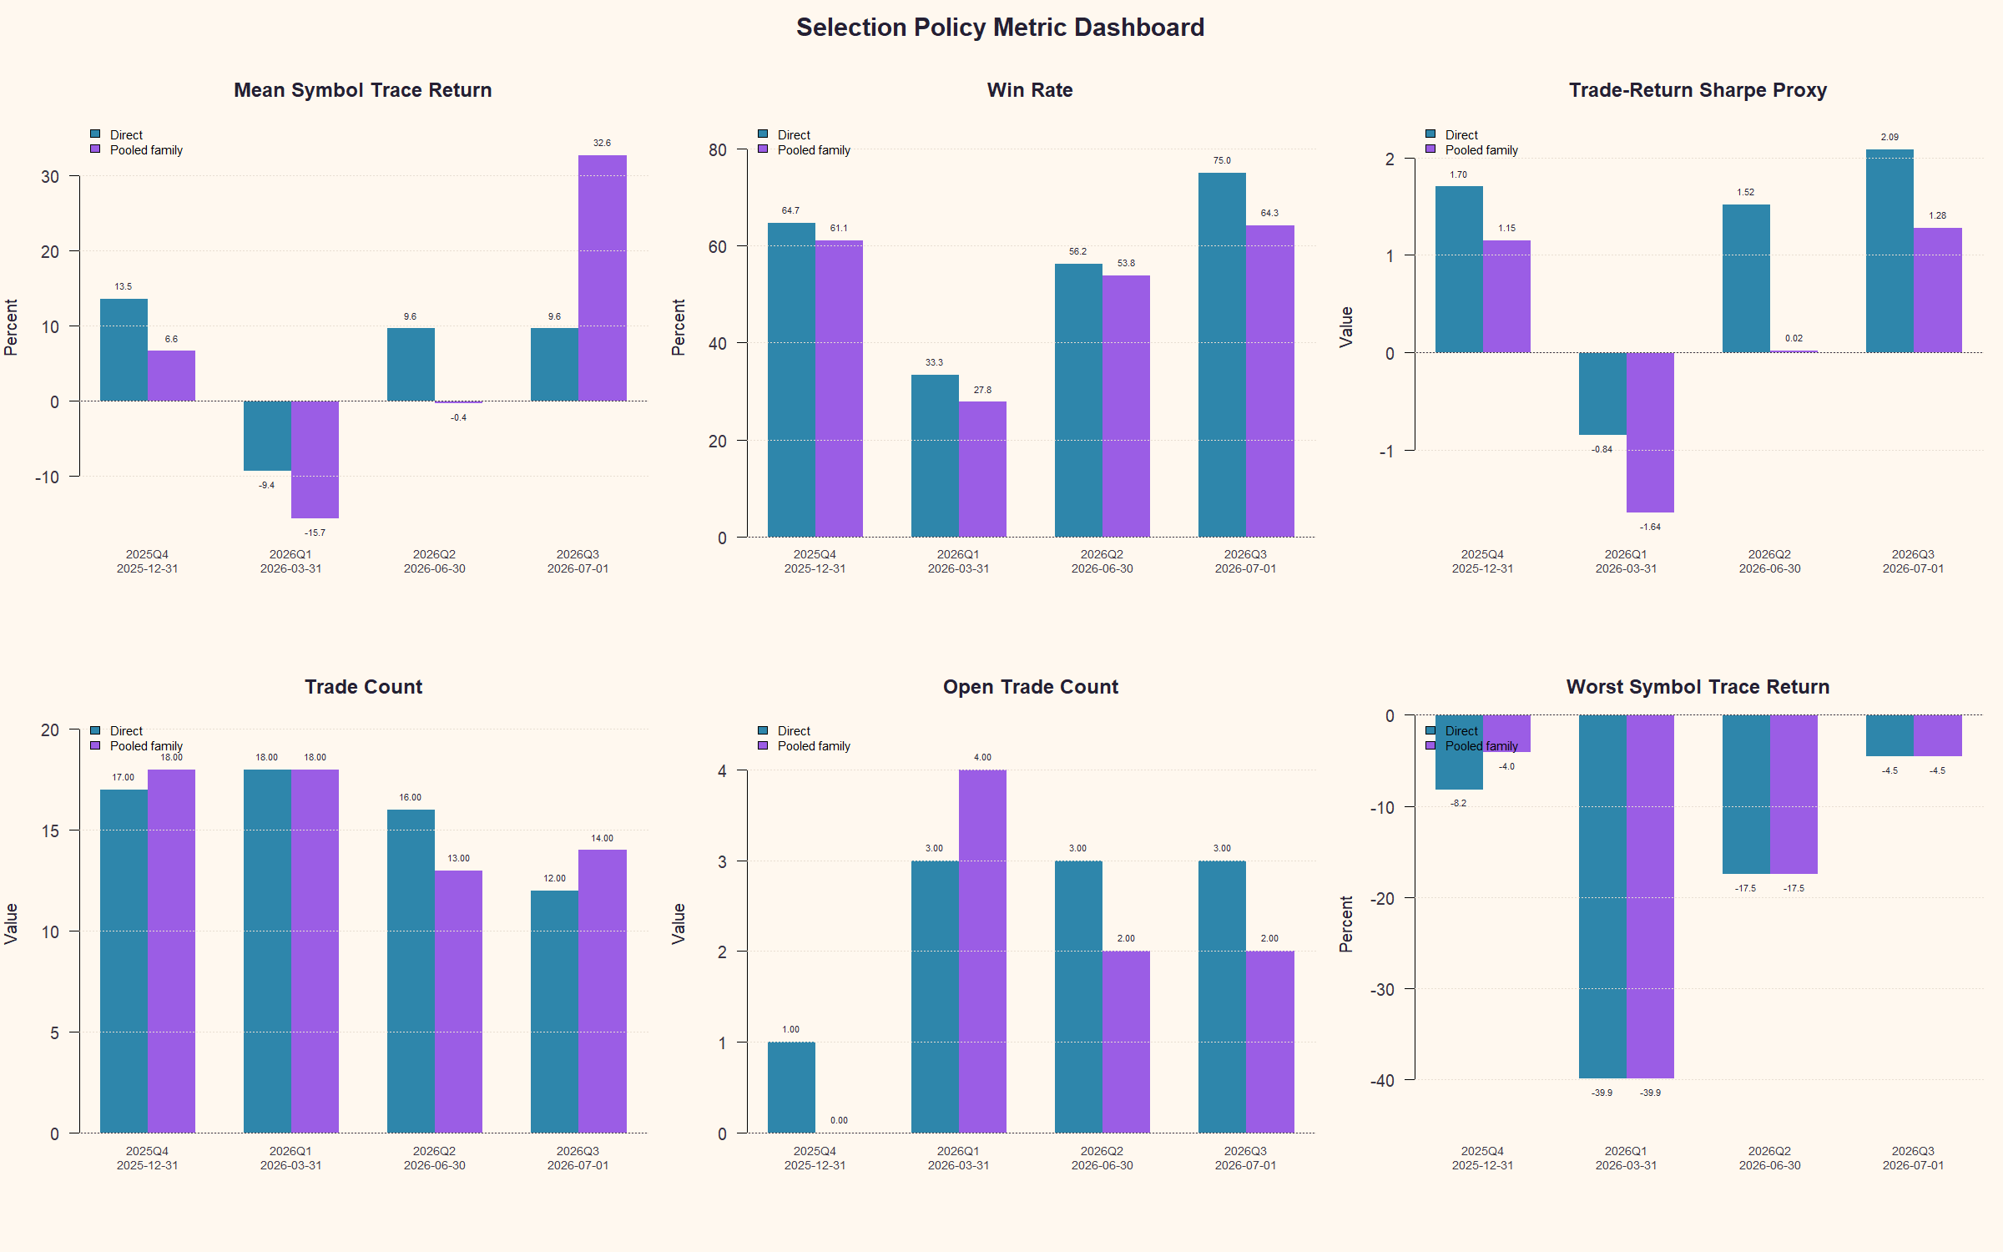
VISUAL EVIDENCE
The A-live charts show steady direct advantage plus one pooled AMD outlier
Green cells favor pooled-family; red cells favor direct. The metric dashboard shows direct leading win rate and Sharpe proxy across all four windows.
Gen5.1 selection-policy hypothesis
12

Slide 13
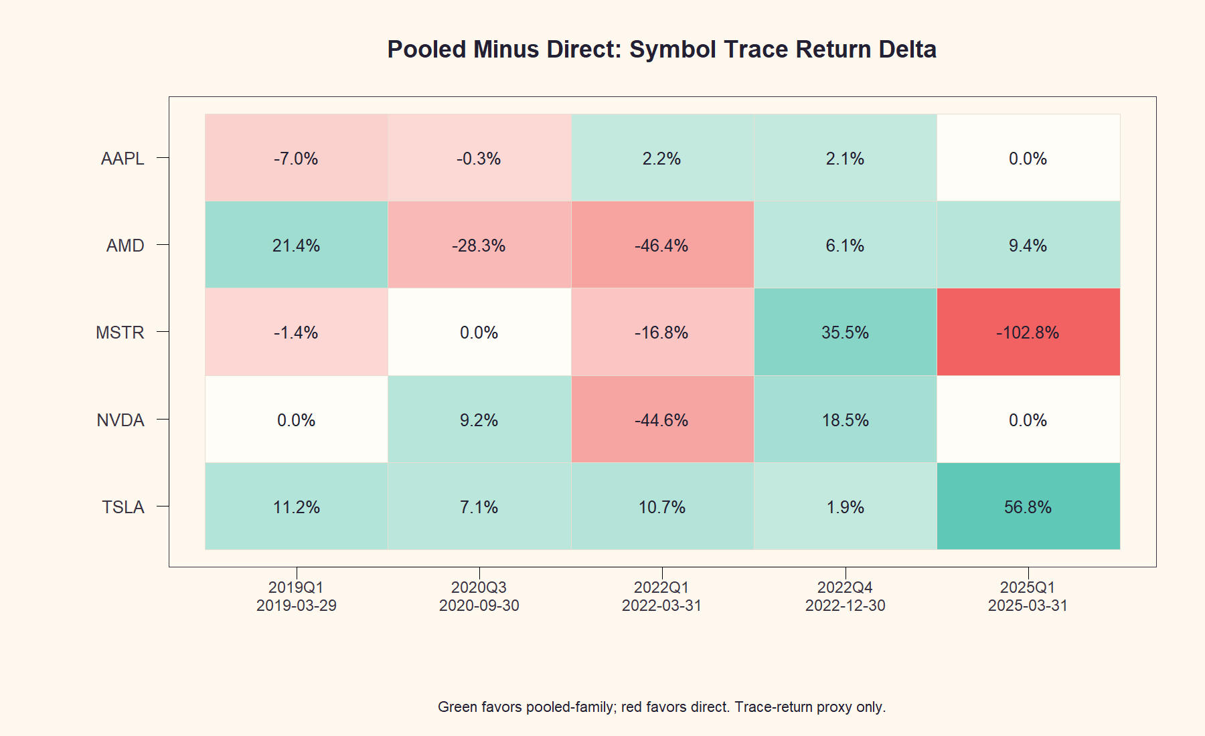
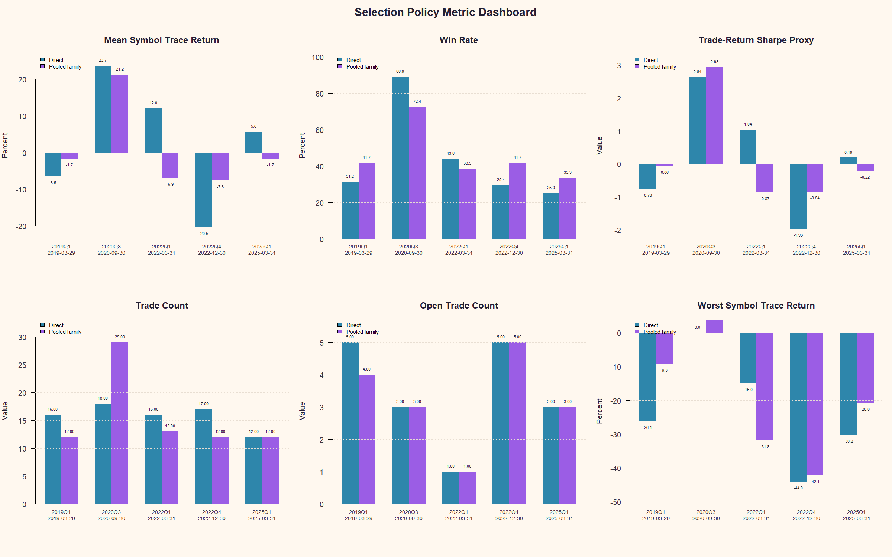
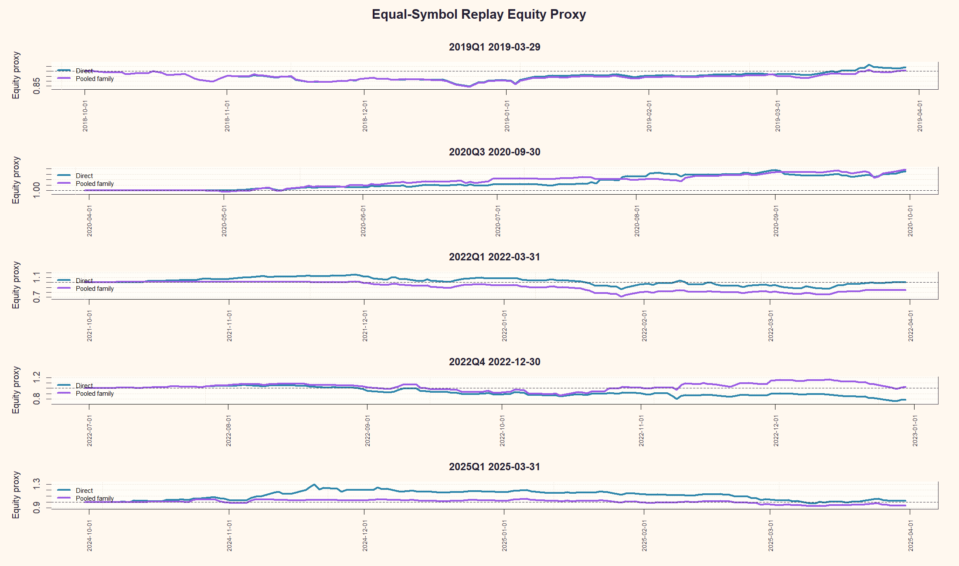
VISUAL EVIDENCE
The B-hist charts show defensive pooled windows and direct upside windows
Green cells favor pooled-family; red cells favor direct. The equity overlay makes the path behavior visible across weak and strong historical windows.
Gen5.1 selection-policy hypothesis
13

