Slide 1
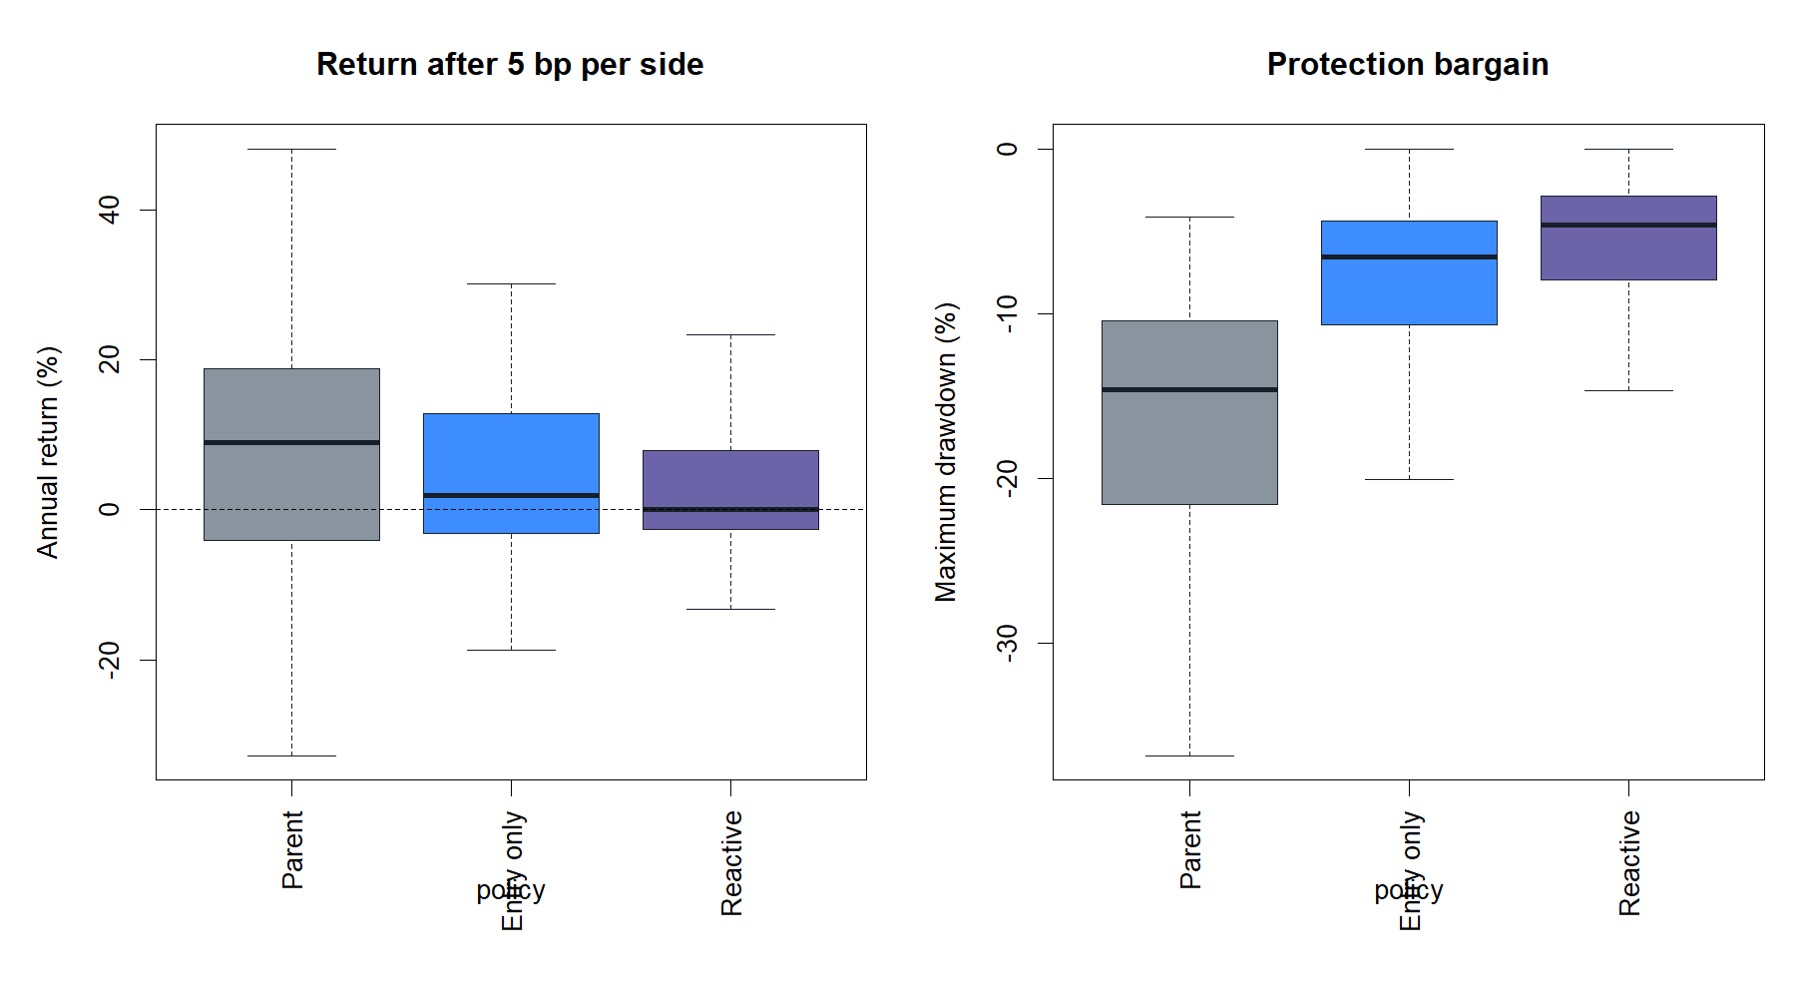
HYP-REG-05.2
HIGH ADX selected better entries—
but the hard gate made the strategy worse
Unchanged SMA8/SMA14 parent · 24 stocks · 2018–2023 reused development window
STOP · entry-only 4/8 gates
reactive 3/8 gates
1
Notes:
Lead with the distinction: present-state information existed, but the binary policy did not improve the full strategy. The conclusion is a stopped implementation, not a rejection of contemporaneous state measurement.
[Sources]
- docs/GEN5_HYP_REG_05_2_ADX_STRATEGY_RELATIVE_OVERLAY_CONTRACT.md
- operator_hypothesis_lab/docs/HYP_REG_05_2_ADX_STRATEGY_RELATIVE_OVERLAY_RESULTS.md
- C:/Users/Franc/OneDrive/Documents/Francis/Peltata Project/Time-Series-Modeling-Gen5/runs/research_workbench/operator_hypothesis_lab/hyp_reg_05_2_adx_strategy_overlay_20260815/hyp_reg_05_2_decision.csv

Slide 2
THE CONCEPTUAL CORRECTION
A regime label need not forecast itself to be useful
There are two different claims. We had tested the first. This lane tests the second.
Forecasting claim
Routing claim
State today
→
future path / future state
State today
→
better next action
HYP-REG-05.1 failed this specific forward-path claim.
Recalculate after each close; change action next open if the state changes.
The required evidence changes: judge the state against a named strategy, causal execution delay, costs, exposure, and matched timing controls.
2
Notes:
Regime models in the Hamilton tradition describe latent state processes, but a trading policy need not require a state-duration forecast at every decision. The narrower operational claim is whether information available now improves the action executed next. This experiment tests that claim directly.
[Sources]
- docs/GEN5_4_DECISION_DIALOGUE_INDEX.md#d135
- https://econweb.ucsd.edu/~jhamilto/pub_metrics
- docs/GEN5_HYP_REG_05_2_ADX_STRATEGY_RELATIVE_OVERLAY_CONTRACT.md

Slide 3
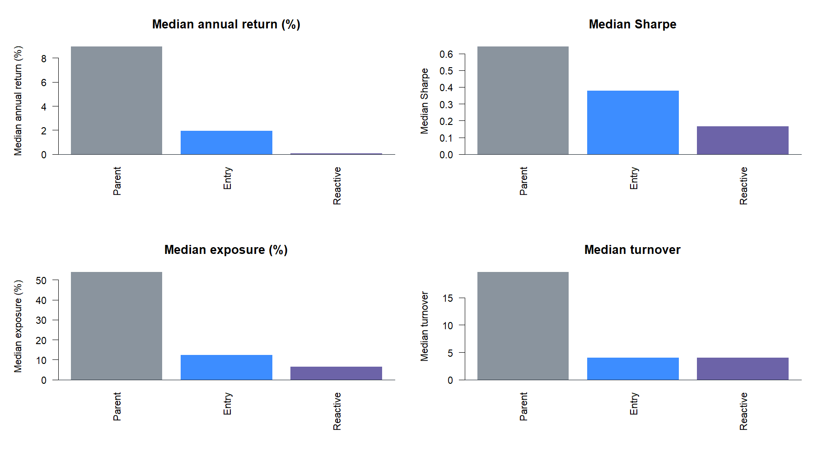
FROZEN POLICY MECHANICS
One parent, one primary overlay, one reactive challenger
UNFILTERED
Fresh SMA8>SMA14 cross: enter next open. Fresh cross-down: exit next open.
ENTRY HIGH ONLY
Admit only a fresh cross-up whose signal-close ADX state is HIGH. Keep the parent exit.
REACTIVE HIGH ONLY
Same entry. Also exit next open when ADX leaves HIGH; require a new parent cross-up before re-entry.
ADX(14) measures trend strength, not direction.
3
Notes:
The decimal version changes mechanics substantively while leaving all indicator parameters frozen. ADX is Wilder's smoothed directional-movement strength index; the accepted state is an asset-relative prior-252 percentile with hysteresis, not a fitted raw threshold.
[Sources]
- docs/GEN5_HYP_REG_05_2_ADX_STRATEGY_RELATIVE_OVERLAY_CONTRACT.md
- https://books.google.com/books/about/New_Concepts_in_Technical_Trading_System.html?id=WesJAQAAMAAJ
- C:/Users/Franc/OneDrive/Documents/Francis/Peltata Project/Time-Series-Modeling-Gen5/runs/research_workbench/operator_hypothesis_lab/hyp_reg_05_2_adx_strategy_overlay_20260815/hyp_reg_05_2_run_spec.csv

Slide 4
INTEGRITY BEFORE PERFORMANCE
The causal join and exact parent reproduction passed
26 / 26
24
156 / 156
4.44e−15
complete state/strategy coverage
stocks in the decision panel
parent asset-year cells reproduced
maximum return difference
Causal timing
Preserved boundaries
State and SMA signal known after close t
1x only; 5 bp primary and 10 bp stress
Any policy change executes at open t+1
2024+ confirmation remained sealed
Every year begins in cash; fresh in-year cross required
No alternate state, threshold, asset subset, or strategy
Any failure below is a research result—not a data or reproduction failure.
4
Notes:
The state ledger has 1,509 analysis sessions per asset; the inherited strategy surface has 1,499 because of ten previously documented SIP archive gap sessions. No strategy date lacks a causal state. The runner reproduced the retained parent before interpreting either overlay.
[Sources]
- docs/GEN5_HYP_REG_05_2_ADX_STRATEGY_RELATIVE_OVERLAY_CONTRACT.md
- C:/Users/Franc/OneDrive/Documents/Francis/Peltata Project/Time-Series-Modeling-Gen5/runs/research_workbench/operator_hypothesis_lab/hyp_reg_05_2_adx_strategy_overlay_20260815/hyp_reg_05_2_coverage.csv
- C:/Users/Franc/OneDrive/Documents/Francis/Peltata Project/Time-Series-Modeling-Gen5/runs/research_workbench/operator_hypothesis_lab/hyp_reg_05_2_adx_strategy_overlay_20260815/hyp_reg_05_2_parent_reproduction.csv

Slide 5
WHOLE-POLICY OUTCOME
Less exposure bought protection—but surrendered too much return
8.95% → 1.95%
median return: parent → entry-only
0.642 → 0.378
median Sharpe: parent → entry-only
−14.59% → −6.56%
median drawdown: parent → entry-only
This is a tradeoff, not alpha.
Protection improved; risk-adjusted return did not.
5
Notes:
The gate required drawdown to be no worse and Sharpe to be no lower. Entry-only improved drawdown materially but failed the joint standard because it excluded too much profitable exposure. Reactive was still more defensive and still less viable.
[Sources]
- C:/Users/Franc/OneDrive/Documents/Francis/Peltata Project/Time-Series-Modeling-Gen5/runs/research_workbench/operator_hypothesis_lab/hyp_reg_05_2_adx_strategy_overlay_20260815/hyp_reg_05_2_policy_panel.csv
- C:/Users/Franc/OneDrive/Documents/Francis/Peltata Project/Time-Series-Modeling-Gen5/runs/research_workbench/operator_hypothesis_lab/hyp_reg_05_2_adx_strategy_overlay_20260815/hyp_reg_05_2_gates.csv
- operator_hypothesis_lab/docs/HYP_REG_05_2_ADX_STRATEGY_RELATIVE_OVERLAY_RESULTS.md

Slide 6
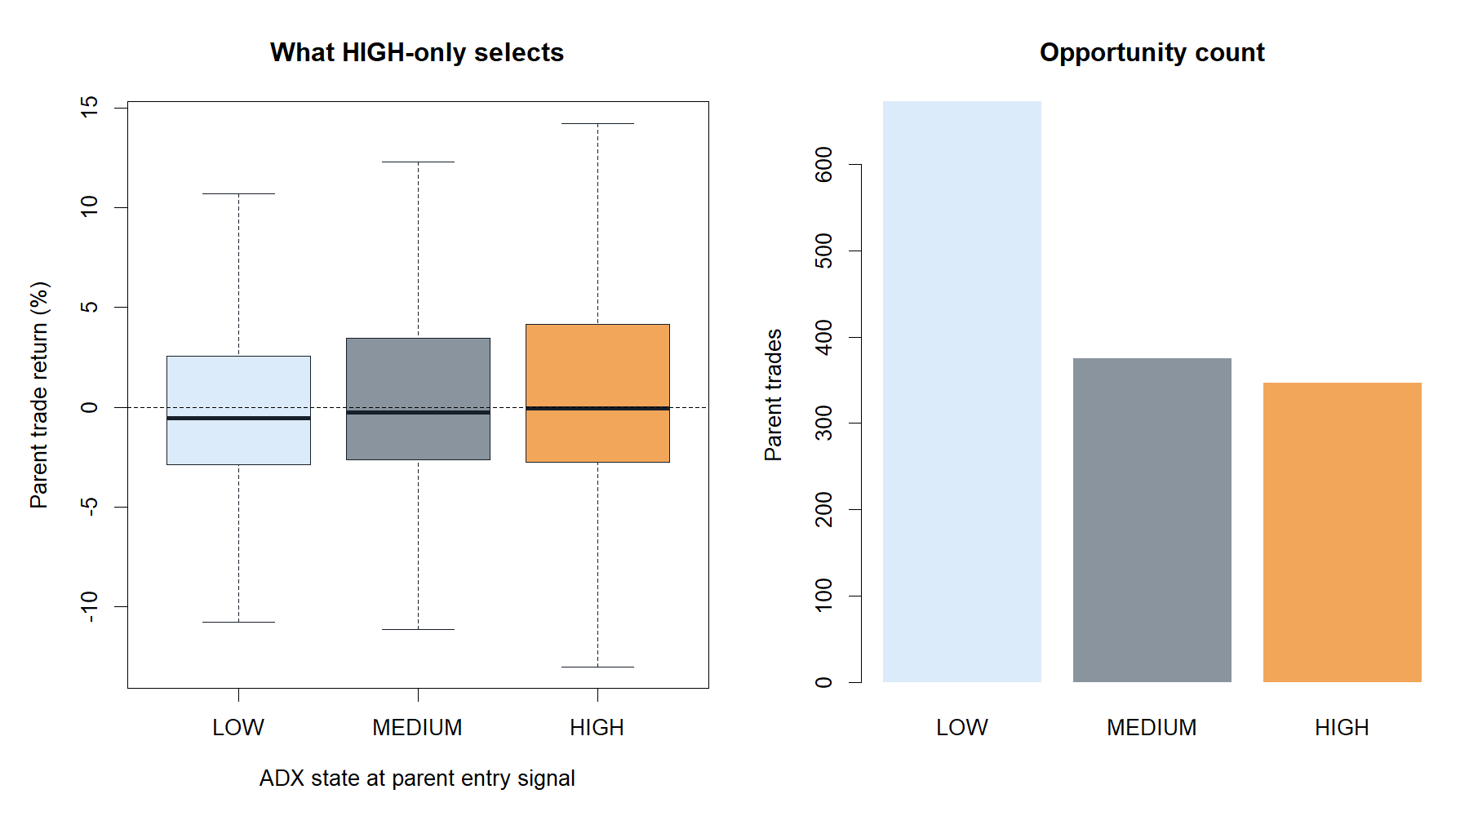
DESCRIPTIVE INFORMATION WAS PRESENT
HIGH ADX did identify the better parent-entry subset
2.01%
mean HIGH-state parent trade
48.70%
HIGH-state parent-trade hit rate
347 / 1,394
parent entries occurring in HIGH
Useful conditional ranking
≠ useful binary permission rule
6
Notes:
LOW, MEDIUM, and HIGH parent entries had mean trade returns of 0.64%, 1.66%, and 2.01%, respectively. The hit rate also rose. This supports a narrow conditional relationship, but the strategy test shows that deleting every non-HIGH entry is too severe.
[Sources]
- C:/Users/Franc/OneDrive/Documents/Francis/Peltata Project/Time-Series-Modeling-Gen5/runs/research_workbench/operator_hypothesis_lab/hyp_reg_05_2_adx_strategy_overlay_20260815/hyp_reg_05_2_entry_state_audit.csv
- C:/Users/Franc/OneDrive/Documents/Francis/Peltata Project/Time-Series-Modeling-Gen5/runs/research_workbench/operator_hypothesis_lab/hyp_reg_05_2_adx_strategy_overlay_20260815/hyp_reg_05_2_trades.csv
- operator_hypothesis_lab/docs/HYP_REG_05_2_ADX_STRATEGY_RELATIVE_OVERLAY_RESULTS.md

Slide 7
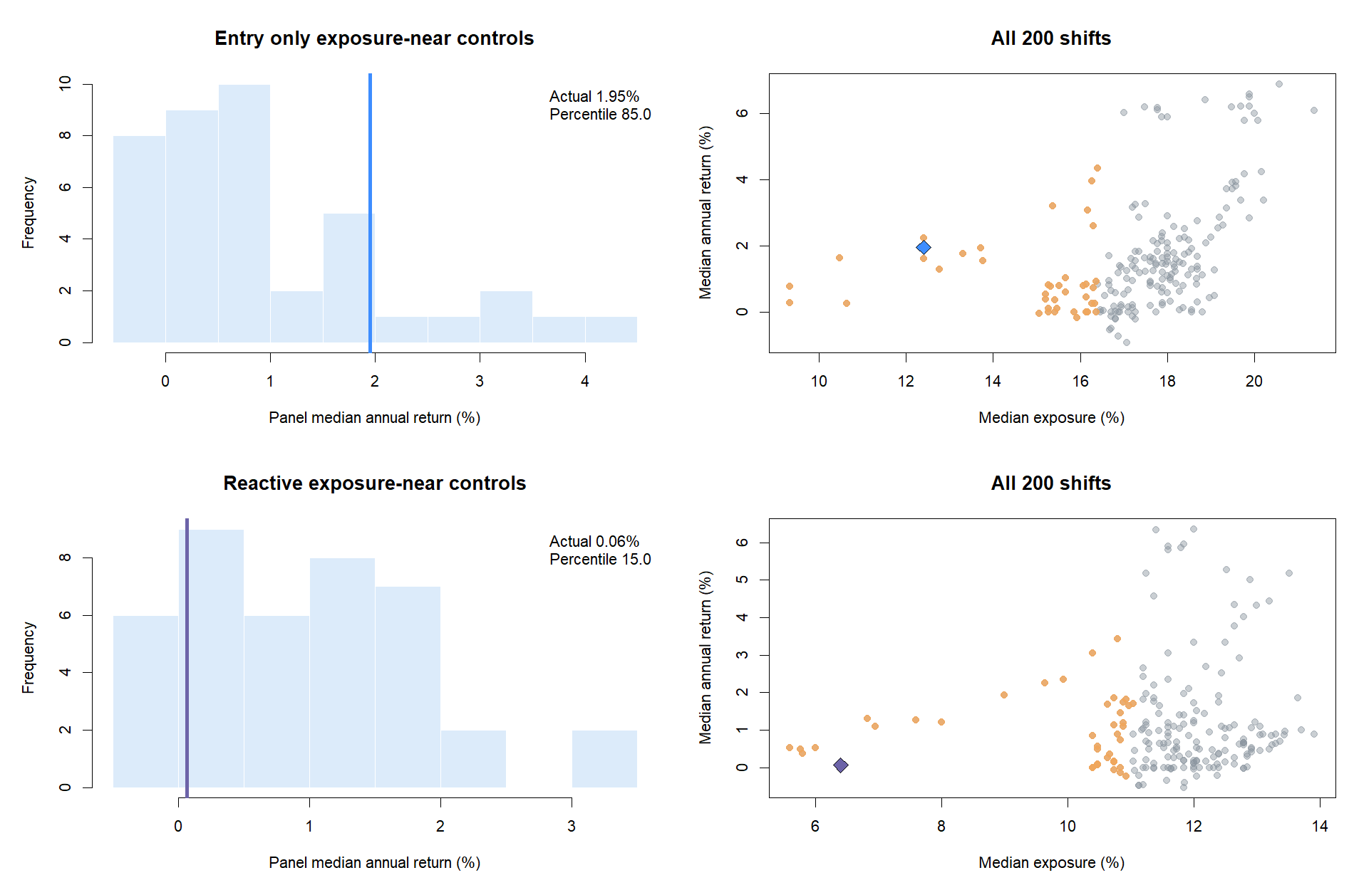
STATE SPECIFICITY CONTROL
Only entry timing beat equally restrictive mistimed states
85th
entry-only timing percentile
+1.20 pp
entry-only vs control median
15th / −0.80 pp
reactive percentile / excess
Controls preserve state occupancy and run structure within each asset-year while breaking exact historical alignment.
7
Notes:
Exposure matching prevents the real rule from winning merely because it spends less time invested. Entry-only passed this falsification check: real HIGH timing did better than most equally restrictive circular shifts. Reactive failed badly, indicating that leaving-HIGH exits were not specifically aligned with useful liquidation timing.
[Sources]
- C:/Users/Franc/OneDrive/Documents/Francis/Peltata Project/Time-Series-Modeling-Gen5/runs/research_workbench/operator_hypothesis_lab/hyp_reg_05_2_adx_strategy_overlay_20260815/hyp_reg_05_2_placebo_readout.csv
- C:/Users/Franc/OneDrive/Documents/Francis/Peltata Project/Time-Series-Modeling-Gen5/runs/research_workbench/operator_hypothesis_lab/hyp_reg_05_2_adx_strategy_overlay_20260815/hyp_reg_05_2_control_panel.csv
- docs/GEN5_HYP_REG_05_2_ADX_STRATEGY_RELATIVE_OVERLAY_CONTRACT.md

Slide 8
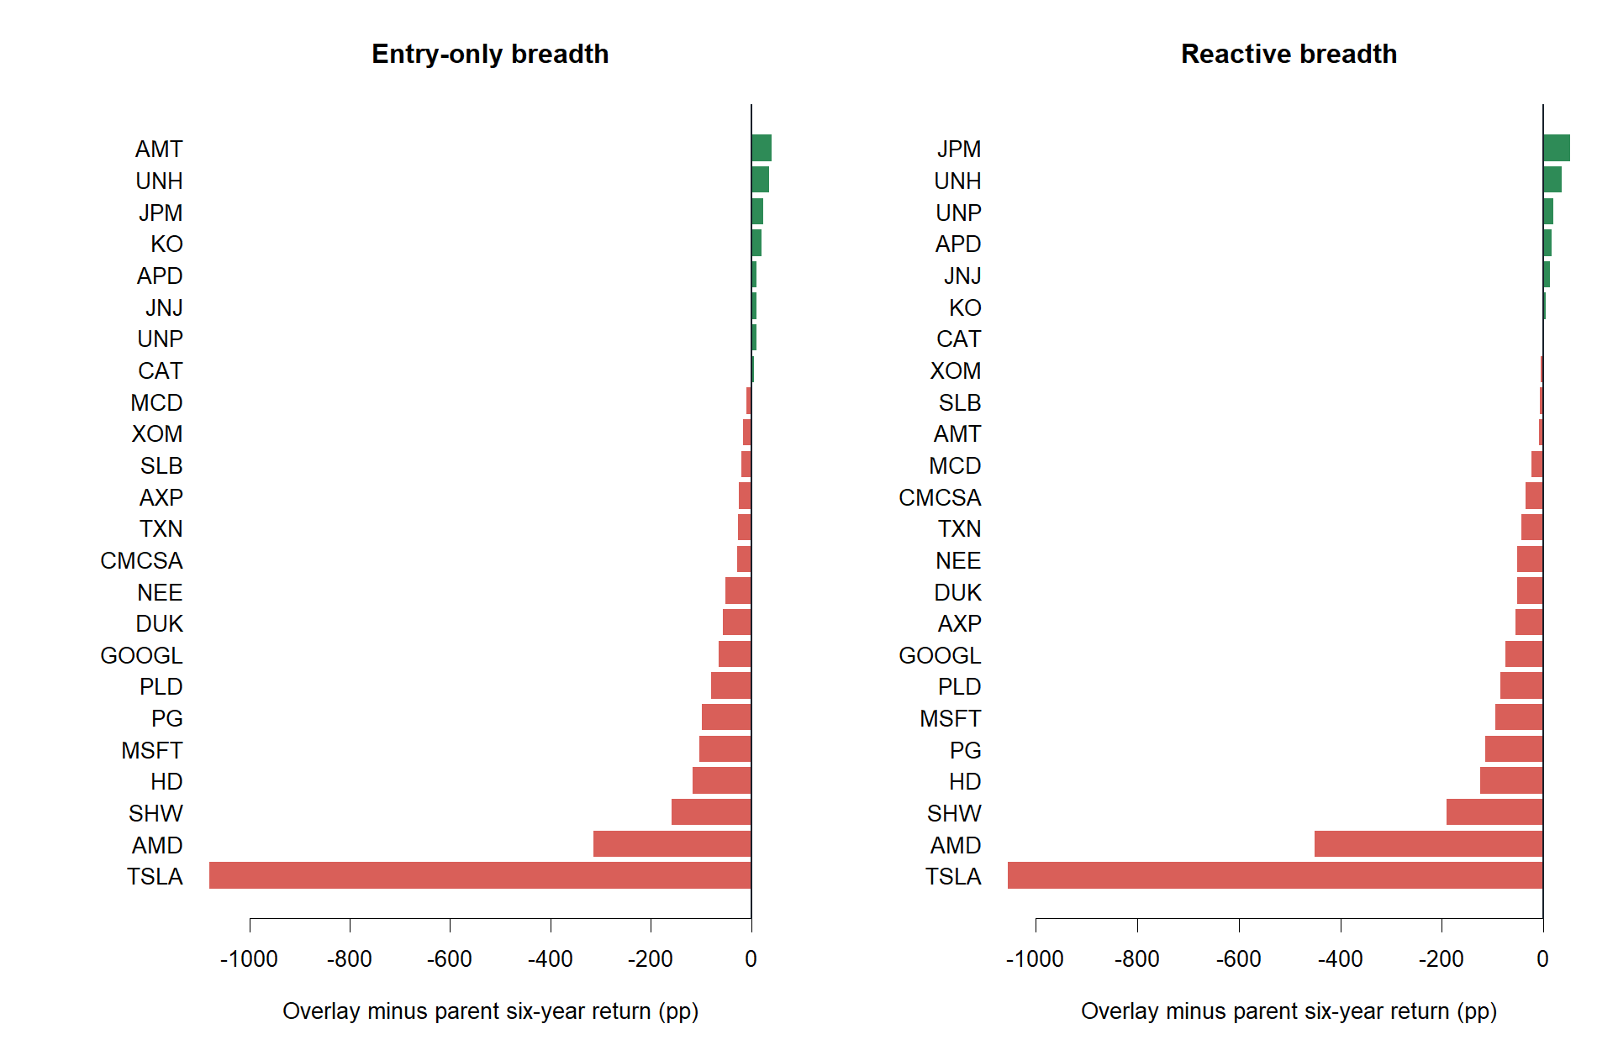
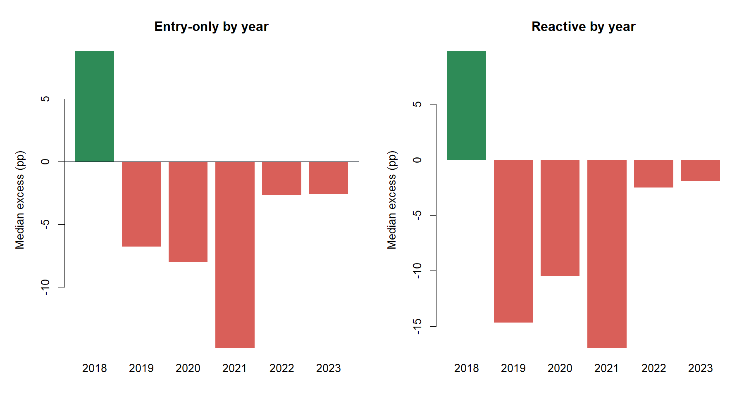
BREADTH AND CALENDAR AUDIT
The clue did not transport across assets or years
Entry-only: 8 / 24 assets improved
Both policies: only 1 / 6 positive years
8
Notes:
2018 was the only favorable calendar year for either overlay. The asset view also shows severe opportunity cost in AMD, TSLA, MSFT, SHW, and other strong parent trends. The gate was designed to reject a rule whose apparent merit depended on a narrow slice.
[Sources]
- C:/Users/Franc/OneDrive/Documents/Francis/Peltata Project/Time-Series-Modeling-Gen5/runs/research_workbench/operator_hypothesis_lab/hyp_reg_05_2_adx_strategy_overlay_20260815/hyp_reg_05_2_asset_summary.csv
- C:/Users/Franc/OneDrive/Documents/Francis/Peltata Project/Time-Series-Modeling-Gen5/runs/research_workbench/operator_hypothesis_lab/hyp_reg_05_2_adx_strategy_overlay_20260815/hyp_reg_05_2_year_summary.csv
- operator_hypothesis_lab/docs/HYP_REG_05_2_ADX_STRATEGY_RELATIVE_OVERLAY_RESULTS.md

Slide 9
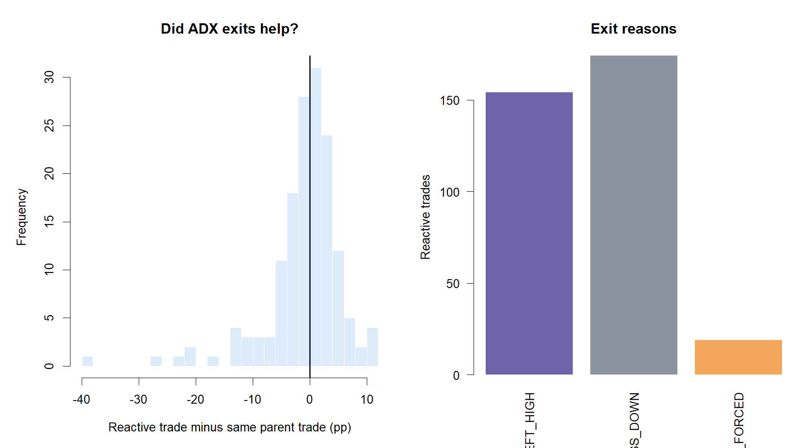
REACTIVE POLICY AUDIT
Leaving HIGH was too blunt to serve as a mandatory exit
154
exits caused by ADX leaving HIGH
+0.03 pp
median delta vs matching parent trade
−0.96 pp
mean delta vs matching parent trade
A few protective exits existed.
The average false-exit cost dominated.
9
Notes:
The near-zero positive median can look reassuring, but the negative mean reveals asymmetric false exits. A smoothed state can accurately summarize recent trend strength while changing too late—or too often relative to a specific trade—to own liquidation authority.
[Sources]
- C:/Users/Franc/OneDrive/Documents/Francis/Peltata Project/Time-Series-Modeling-Gen5/runs/research_workbench/operator_hypothesis_lab/hyp_reg_05_2_adx_strategy_overlay_20260815/hyp_reg_05_2_reactive_exit_summary.csv
- C:/Users/Franc/OneDrive/Documents/Francis/Peltata Project/Time-Series-Modeling-Gen5/runs/research_workbench/operator_hypothesis_lab/hyp_reg_05_2_adx_strategy_overlay_20260815/hyp_reg_05_2_reactive_trade_audit.csv
- operator_hypothesis_lab/docs/HYP_REG_05_2_ADX_STRATEGY_RELATIVE_OVERLAY_RESULTS.md

Slide 10
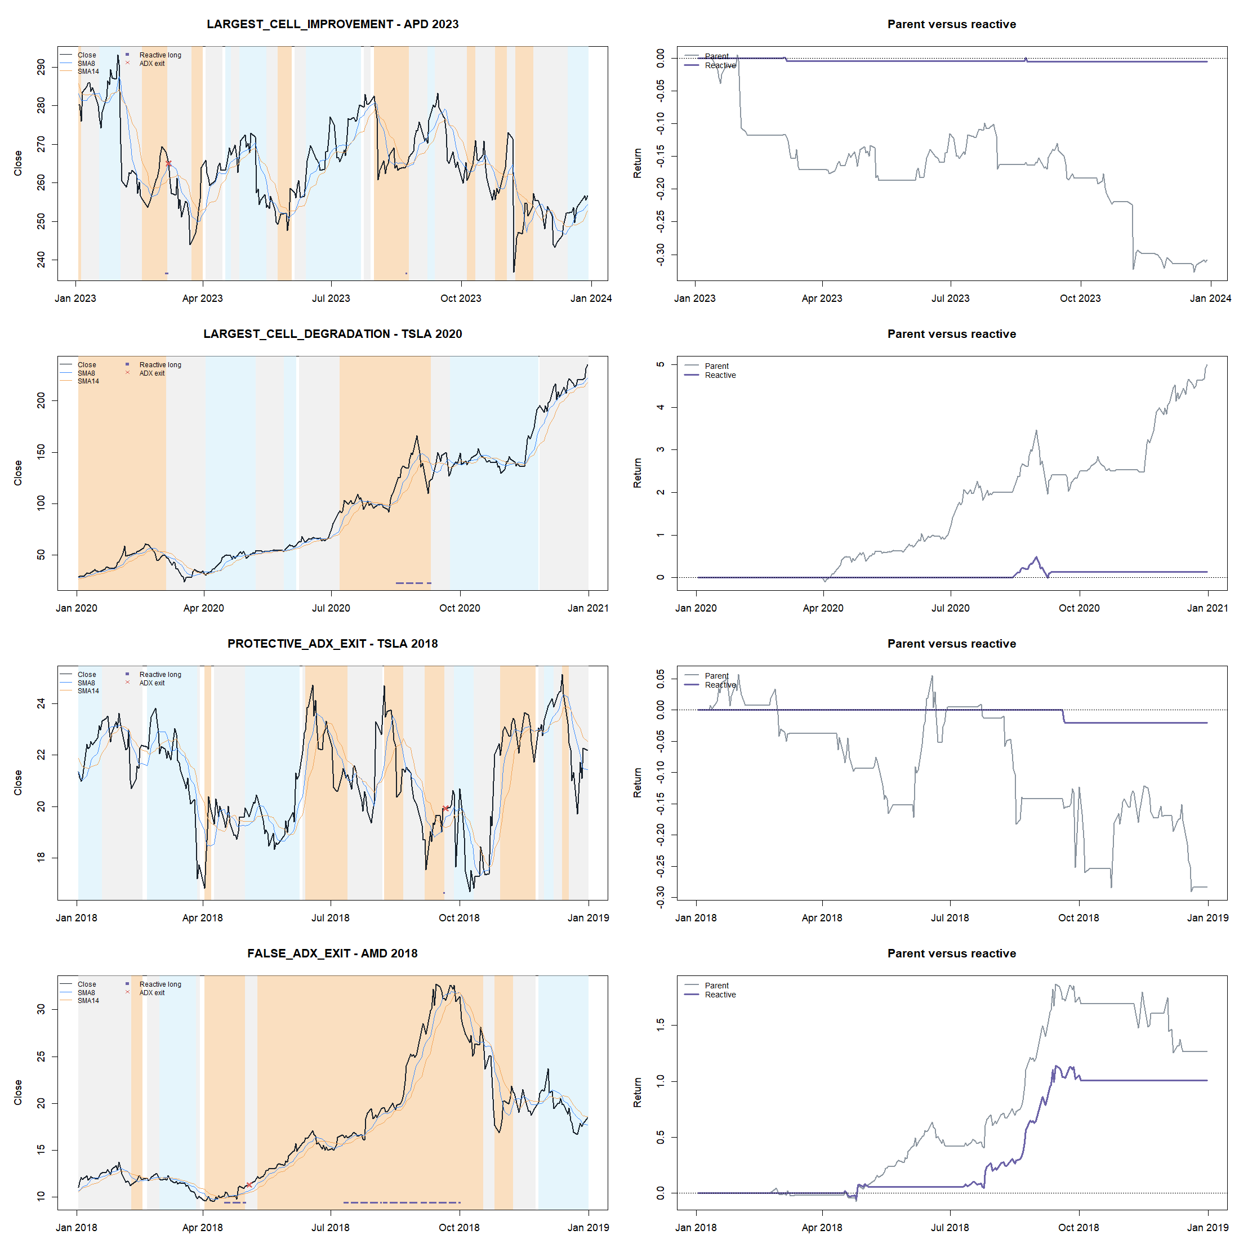
REPRESENTATIVE STATE ROUTING
Trade tapes expose both protection and opportunity cost
10
Notes:
The examples were selected by predeclared behavioral roles, not as candidates for promotion: APD 2023 largest cell improvement, TSLA 2020 largest degradation, TSLA 2018 protective ADX exit, and AMD 2018 false ADX exit. State shading is descriptive; markers show actual causal actions.
[Sources]
- C:/Users/Franc/OneDrive/Documents/Francis/Peltata Project/Time-Series-Modeling-Gen5/runs/research_workbench/operator_hypothesis_lab/hyp_reg_05_2_adx_strategy_overlay_20260815/hyp_reg_05_2_representative_selection.csv
- C:/Users/Franc/OneDrive/Documents/Francis/Peltata Project/Time-Series-Modeling-Gen5/runs/research_workbench/operator_hypothesis_lab/hyp_reg_05_2_adx_strategy_overlay_20260815/hyp_reg_05_2_reconstructed_daily.rds
- operator_hypothesis_lab/docs/HYP_REG_05_2_ADX_STRATEGY_RELATIVE_OVERLAY_RESULTS.md

Slide 11
PREDECLARED DECISION
The complete gate stack rejects both policies
ENTRY HIGH ONLY
REACTIVE HIGH ONLY
4 / 8
85th
3 / 8
15th
gates passed
timing percentile
gates passed
timing percentile
Shared failed gates
Reactive-only additional failure
Panel return
Asset breadth
State specificity
Calendar breadth
Real exit timing was worse than most exposure-near rotations.
Protection + Sharpe
STOP_ADX_STRATEGY_RELATIVE_GATES_FAILED_CONFIRMATION_NOT_RUN
11
Notes:
All eight gates were required. Entry-only passed integrity, reproduction, positive absolute return, and state specificity. Reactive passed integrity, reproduction, and positive absolute return. Neither earned access to confirmation.
[Sources]
- C:/Users/Franc/OneDrive/Documents/Francis/Peltata Project/Time-Series-Modeling-Gen5/runs/research_workbench/operator_hypothesis_lab/hyp_reg_05_2_adx_strategy_overlay_20260815/hyp_reg_05_2_gates.csv
- C:/Users/Franc/OneDrive/Documents/Francis/Peltata Project/Time-Series-Modeling-Gen5/runs/research_workbench/operator_hypothesis_lab/hyp_reg_05_2_adx_strategy_overlay_20260815/hyp_reg_05_2_decision.csv
- docs/GEN5_HYP_REG_05_2_ADX_STRATEGY_RELATIVE_OVERLAY_CONTRACT.md

Slide 12
WHAT THIS CHANGES
Keep the conceptual lesson; set down these mechanics
Preserve
Do not infer
Present-state utility is strategy-relative, not synonymous with state forecasting
That HIGH-only gating improves the SMA strategy
Causal update cadence can be enough when the policy is allowed to react next open
That leaving HIGH should force liquidation
HIGH ADX contained real entry-ranking information
That 2018 or favorable assets can be selected
Matched exposure and timing controls are essential
That thresholds, softened states, stacked filters, or 2024+ may be inspected here
An informative feature can fail as an all-or-nothing rule. Any graded or interaction-based use is a new hypothesis—not a rescue tweak.
12
Notes:
This experiment answers the operator's question directly. Forecasting future state is not a universal prerequisite. But accurate present description earns authority only if the proposed action improves under causal, costed, transportable evidence. Here, ADX supplied a clue and failed as a binary gate.
[Sources]
- operator_hypothesis_lab/docs/HYP_REG_05_2_ADX_STRATEGY_RELATIVE_OVERLAY_RESULTS.md
- docs/GEN5_HYP_REG_05_2_ADX_STRATEGY_RELATIVE_OVERLAY_CONTRACT.md
- docs/GEN5_4_DECISION_DIALOGUE_INDEX.md#d135
- C:/Users/Franc/OneDrive/Documents/Francis/Peltata Project/Time-Series-Modeling-Gen5/runs/research_workbench/operator_hypothesis_lab/hyp_reg_05_2_adx_strategy_overlay_20260815/STATUS.txt

