Slide 1
LITERATURE-GROUNDED STRATEGY RESEARCH | 28 JUL 2026
LIT-MR-02.1 from example to breadth
USO-GLD remains the canonical literature example. Two panels, two positive controls, and a 25-pair relationship atlas now test what the exact 20-session template can and cannot do.
Notes:
The deck now preserves the original example, Panels A and B, the 2018 and source-period positive controls, and Relationship Atlas 01 as a separate frozen instance batch.
[Sources]
- C:/Users/Franc/OneDrive/Documents/Francis/Peltata Project/Time-Series-Modeling-Gen5/docs/GEN5_LIT_MR_02_1_ADAPTIVE_SPREAD_BOLLINGER_POC_CONTRACT.md
- C:/Users/Franc/OneDrive/Documents/Francis/Peltata Project/Time-Series-Modeling-Gen5/docs/GEN5_LIT_MR_02_1_RELATIONSHIP_ATLAS_01_CONTRACT.md
- C:/Users/Franc/OneDrive/Documents/Francis/Peltata Project/Time-Series-Modeling-Gen5/docs/GEN5_4_DECISION_DIALOGUE_INDEX.md — D73 and D75

Slide 2
This is not single-asset Bollinger Bands
Chan first estimates a rolling raw-price hedge ratio, builds the two-asset unit-portfolio spread, and only then standardizes that spread. Example 3.2 explicitly reuses the raw-price construction from Example 3.1.
USO - β·GLD
20 sessions
Price, not log
Adaptive raw-price spread —not either ETF alone
Rolling OLS beta and spread standardization
Source-faithful transform Log price is a separate test
2
Notes:
The book compares price spread, log-price spread, and ratio separately. Example 3.2 reuses the raw-price spread construction from Example 3.1.
[Sources]
- C:/Users/Franc/OneDrive/Documents/Francis/Trading Literature/Algorithmic Trading - Winning Strategies and Their Rationale 2013.pdf, printed pp. 66-72; PDF pp. 84-90
- C:/Users/Franc/OneDrive/Documents/Francis/Peltata Project/Time-Series-Modeling-Gen5/docs/GEN5_LITERATURE_SOURCE_LEDGER.md

Slide 3
The hedge ratio is a local price-unit conversion
At each close, regress Y on X using only the latest 20 closes: Y = alpha + beta X + error. Beta is an OLS slope, not correlation and not a claim of causality.
β = Cov(X,Y) / Var(X)
α = Ȳ − βX̄
Backward only
Slope: expected price-unit change in Y per one-unit change in X
Estimated in the regression but omitted from the traded spread
The window ends at close t No future observations
3
Notes:
OLS chooses alpha and beta to minimize the sum of squared residuals in the rolling window. Beta expresses price units: if beta is 2, one unit of X hedges roughly two price units of Y under the local fitted relationship.
[Sources]
- C:/Users/Franc/OneDrive/Documents/Francis/Trading Literature/Algorithmic Trading - Winning Strategies and Their Rationale 2013.pdf, printed pp. 66-72; PDF pp. 84-90
- C:/Users/Franc/OneDrive/Documents/Francis/Peltata Project/Time-Series-Modeling-Gen5/docs/GEN5_LIT_MR_02_1_PANEL_A_CONTRACT.md

Slide 4
The z-score asks how unusual today's spread is
First form the two-asset spread. Then compare today's spread with its own recent level and volatility. The bands belong to the relationship, not to either asset alone.
Sₜ = Yₜ − βₜXₜ
μₜ and σₜ
zₜ = (Sₜ − μₜ) / σₜ
A low spread means Y is cheap relative to the fitted X leg
Rolling mean and standard deviation of the latest 20 spread values
Distance from the rolling mean measured in recent spread volatility
4
Notes:
A z-score is unitless. It says how many rolling standard deviations the current spread is from its rolling mean. It does not by itself prove stationarity, cointegration, or profitable convergence.
[Sources]
- C:/Users/Franc/OneDrive/Documents/Francis/Trading Literature/Algorithmic Trading - Winning Strategies and Their Rationale 2013.pdf, printed pp. 66-72; PDF pp. 84-90
- C:/Users/Franc/OneDrive/Documents/Francis/Peltata Project/Time-Series-Modeling-Gen5/docs/GEN5_LIT_MR_02_1_PANEL_A_CONTRACT.md

Slide 5
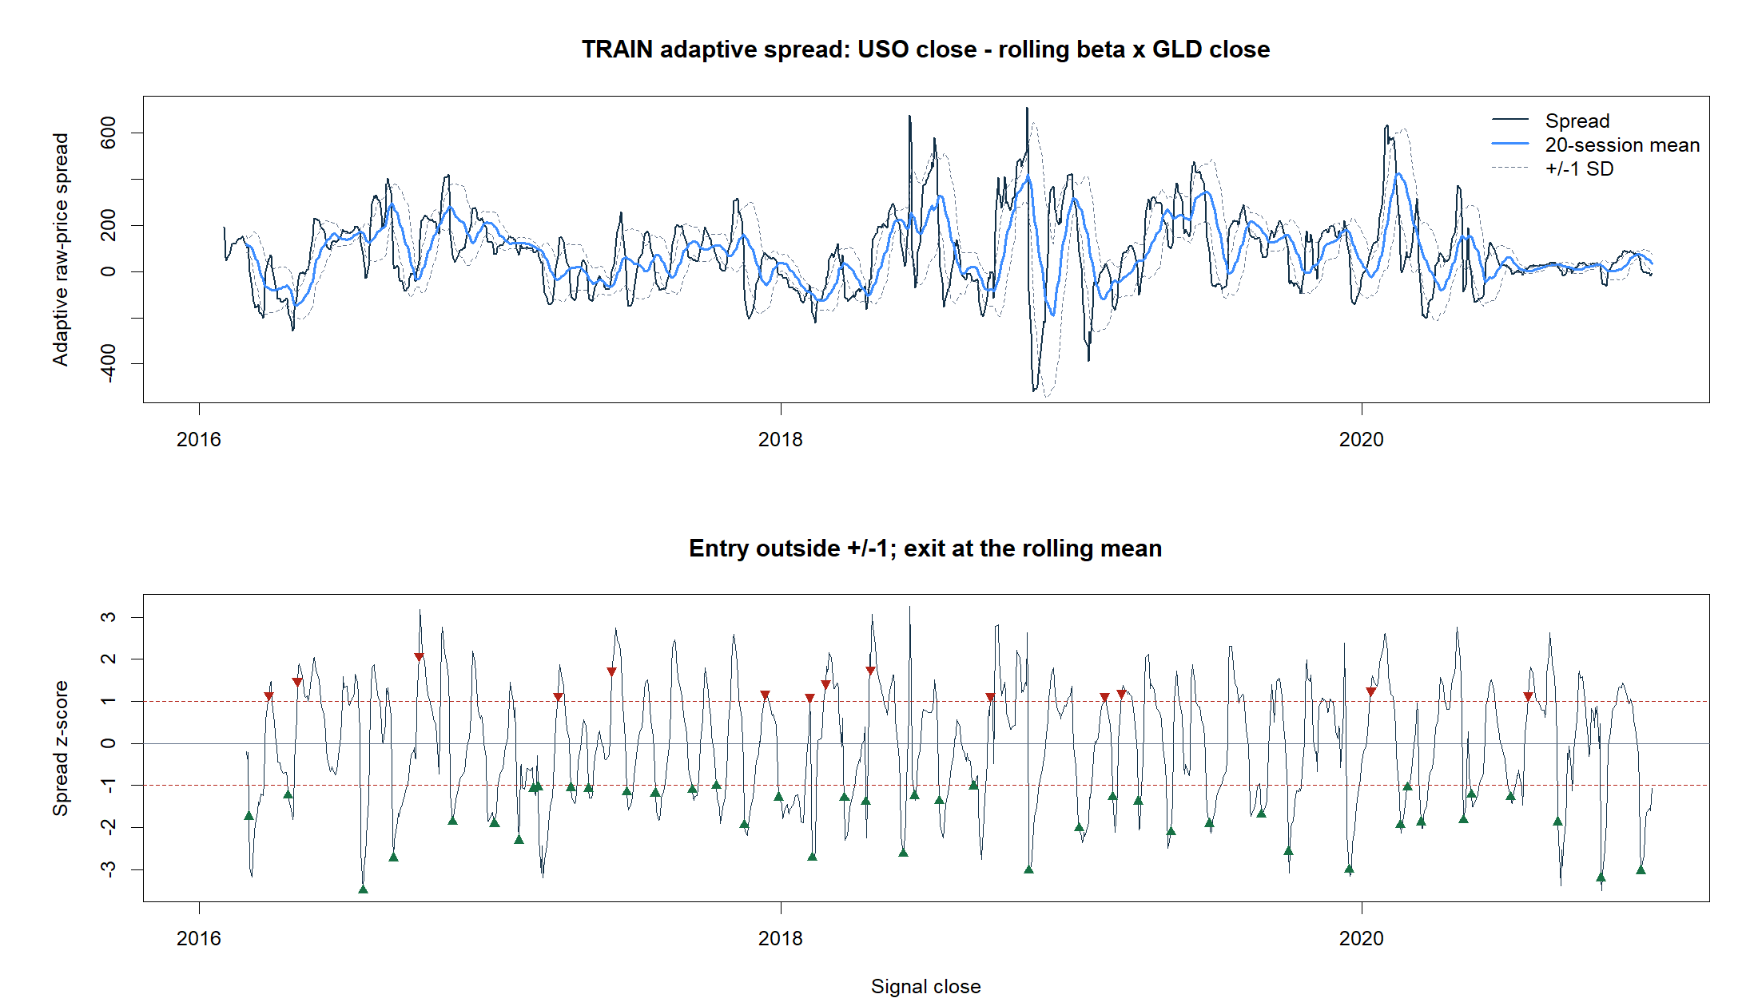
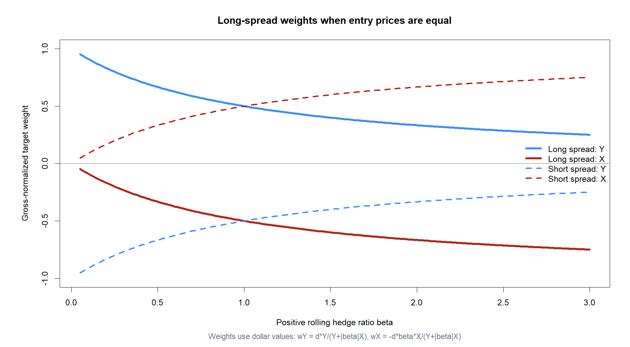
A spread signal becomes two executable dollar weights
Direction d = +1 when z < −1 Direction d = −1 when z > +1 Exit when z crosses zero wY = dY / (Y + |β|X) wX = −dβX / (Y + |β|X) Gross exposure sums to one. Signal at close; trade next open. Daily beta changes create turnover. Primary cost: 5 bp per one-way weight change.
5
Notes:
The denominator gross-normalizes the two legs. The numerator preserves the beta-scaled price-unit hedge. Because beta is recomputed daily, weights can change even while the directional position remains open.
[Sources]
- C:/Users/Franc/OneDrive/Documents/Francis/Peltata Project/Time-Series-Modeling-Gen5/docs/GEN5_LIT_MR_02_1_ADAPTIVE_SPREAD_BOLLINGER_POC_CONTRACT.md
- C:/Users/Franc/OneDrive/Documents/Francis/Peltata Project/Time-Series-Modeling-Gen5/docs/GEN5_LIT_MR_02_1_PANEL_A_CONTRACT.md
- C:/Users/Franc/OneDrive/Documents/Francis/Peltata Project/Time-Series-Modeling-Gen5/runs/research_workbench/literature_grounded/lit_mr_02_1_panel_a_20260728/visuals/mr02_weight_mechanics.png

Slide 6
Positive and negative beta imply different trades
The algebra can fit co-moving or oppositely moving assets, but the portfolio meaning changes. We therefore trade only positive-beta pairs in this panel and treat inverse relationships as diagnostics.
β > 0
β < 0
β sign flips
Relative value: long one leg, short the other
Long spread can mean long both assets; not the same market-neutral trade
Position semantics can change inside one backtest
6
Notes:
For beta below zero, S = Y - beta X becomes Y + |beta|X. That can be statistically meaningful but it no longer describes the same opposite-leg relative-value strategy. A tradable inverse-pair design would require a new frozen variant.
[Sources]
- C:/Users/Franc/OneDrive/Documents/Francis/Peltata Project/Time-Series-Modeling-Gen5/docs/GEN5_LIT_MR_02_1_PANEL_A_CONTRACT.md
- C:/Users/Franc/OneDrive/Documents/Francis/Peltata Project/Time-Series-Modeling-Gen5/runs/research_workbench/literature_grounded/lit_mr_02_1_panel_a_20260728/mr02_panel_inverse_diagnostics.csv

Slide 7
The books supply the ingredients; Gen5 supplies the checklist
Chan motivates the mechanics and the evidence categories. The exact eight-gate conjunction, thresholds, and controls are our transparent research rule—not a claim that the books prescribe them.
Literature
Gen5 design
All eight
Spread mechanics, costs, trade/bar evaluation hit rate, stability, uncertainty
Exact thresholds, bootstrap, random-sign control integrity and timing checks
A conjunction, not a score One failure prevents escalation
7
Notes:
The literature supports evaluating both trades and bars, charging costs, examining hit rate and stability, and using statistical diagnostics. The project turns those ingredients into an auditable admission rule.
[Sources]
- C:/Users/Franc/OneDrive/Documents/Francis/Trading Literature/Algorithmic Trading - Winning Strategies and Their Rationale 2013.pdf, printed pp. 42-47 and 66-72; PDF pp. 60-65 and 84-90
- C:/Users/Franc/OneDrive/Documents/Francis/Peltata Project/Time-Series-Modeling-Gen5/docs/GEN5_LITERATURE_SOURCE_LEDGER.md
- C:/Users/Franc/OneDrive/Documents/Francis/Peltata Project/Time-Series-Modeling-Gen5/docs/GEN5_LIT_MR_02_1_PANEL_B_CONTRACT.md

Slide 8
G1-G3 are firm admissibility gates
These gates ask whether the result is valid, has the intended opposite-leg meaning, and contains enough two-sided observations to interpret. Failing one makes downstream performance evidence inadmissible.
G1 · integrity
G2 · β ≥95%
G3 · ≥30
All timing, partition, accounting checks pass Otherwise the backtest is invalid
Positive-beta indicator coverage after warm-up Preserves opposite-leg semantics
Completed trades, with ≥10 long and ≥10 short Minimum two-sided support
8
Notes:
G1 is non-negotiable. G2 protects strategy identity: negative beta changes a long-spread trade into same-side exposure. G3 is a pragmatic minimum, not a theorem, but prevents tiny samples from carrying the conclusion.
[Sources]
- C:/Users/Franc/OneDrive/Documents/Francis/Peltata Project/Time-Series-Modeling-Gen5/docs/GEN5_LIT_MR_02_1_ADAPTIVE_SPREAD_BOLLINGER_POC_CONTRACT.md
- C:/Users/Franc/OneDrive/Documents/Francis/Peltata Project/Time-Series-Modeling-Gen5/docs/GEN5_LIT_MR_02_1_PANEL_B_CONTRACT.md

Slide 9
G4-G6 ask whether trades survive economics and chance
These are economic-evidence gates. G4 requires a cost-surviving positive mean with uncertainty; G5 is a softer convergence diagnostic; G6 asks whether the signal beats matched random directions.
G4 · mean >0
G5 · hit >50%
G6 · > p90
And moving-block 95% lower bound >0 Primary turnover costs included
Soft, intuitive convergence check Not universal for every strategy payoff shape
Observed mean beats matched random-sign p90 Same timing, paths, holds, and costs
9
Notes:
G4 is intentionally demanding because a positive point estimate alone is fragile. G5 is useful here because the mechanism claims frequent convergence, but a below-50% hit rate can be valid in positively skewed strategies. G6 is a targeted falsification control, not a generic market benchmark.
[Sources]
- C:/Users/Franc/OneDrive/Documents/Francis/Trading Literature/Algorithmic Trading - Winning Strategies and Their Rationale 2013.pdf, printed pp. 42-47 and 66-72; PDF pp. 60-65 and 84-90
- C:/Users/Franc/OneDrive/Documents/Francis/Peltata Project/Time-Series-Modeling-Gen5/docs/GEN5_LIT_MR_02_1_ADAPTIVE_SPREAD_BOLLINGER_POC_CONTRACT.md
- C:/Users/Franc/OneDrive/Documents/Francis/Peltata Project/Time-Series-Modeling-Gen5/docs/GEN5_LIT_MR_02_1_PANEL_B_CONTRACT.md

Slide 10
G7-G8 add stability and mechanism; multiplicity stays visible
A result should recur through time and show the forecast sign the strategy actually claims. Even a full pass would open only a sealed-confirmation discussion—not authorize winner selection or deployment.
G7 · 3/5
G8 · corr <0
Pass ≠ deploy
TRAIN years with positive primary-cost bar return Pragmatic soft stability rule
z vs next-5 spread return 95% bootstrap upper bound also <0
Fixed registry order; no winner selection Only earns sealed-confirmation discussion
10
Notes:
G7 asks whether profitability is concentrated in one year. The 3-of-5 threshold is deliberately simple and soft. G8 is the direct mechanism test: a high spread z-score should predict a lower subsequent spread return. Reporting every frozen pair controls the narrative even though no formal family-wise selection correction is used.
[Sources]
- C:/Users/Franc/OneDrive/Documents/Francis/Peltata Project/Time-Series-Modeling-Gen5/docs/GEN5_LIT_MR_02_1_ADAPTIVE_SPREAD_BOLLINGER_POC_CONTRACT.md
- C:/Users/Franc/OneDrive/Documents/Francis/Peltata Project/Time-Series-Modeling-Gen5/docs/GEN5_LIT_MR_02_1_PANEL_A_CONTRACT.md
- C:/Users/Franc/OneDrive/Documents/Francis/Peltata Project/Time-Series-Modeling-Gen5/docs/GEN5_LIT_MR_02_1_PANEL_B_CONTRACT.md

Slide 11
The frozen rule preserved the book's core mechanics
Signal after close Execute next open Enter long below -1z Enter short above +1z Exit at zero One gross-normalized unit Daily adaptive rehedging 5 bp per one-way weight change No stop, target, max hold, or retuning.
11
Notes:
Canonical USO-GLD mechanics remain unchanged: raw adjusted prices, 20 sessions, +/-1 entry, zero exit, next-open execution, daily adaptive rehedging, and explicit turnover costs.
[Sources]
- C:/Users/Franc/OneDrive/Documents/Francis/Trading Literature/Algorithmic Trading - Winning Strategies and Their Rationale 2013.pdf, printed pp. 67-72; PDF pp. 85-90
- C:/Users/Franc/OneDrive/Documents/Francis/Peltata Project/Time-Series-Modeling-Gen5/docs/GEN5_LIT_MR_02_1_ADAPTIVE_SPREAD_BOLLINGER_POC_CONTRACT.md
- C:/Users/Franc/OneDrive/Documents/Francis/Peltata Project/Time-Series-Modeling-Gen5/runs/research_workbench/literature_grounded/lit_mr_02_1_bollinger_20260728/visuals/mr02_signal_tape.png

Slide 12
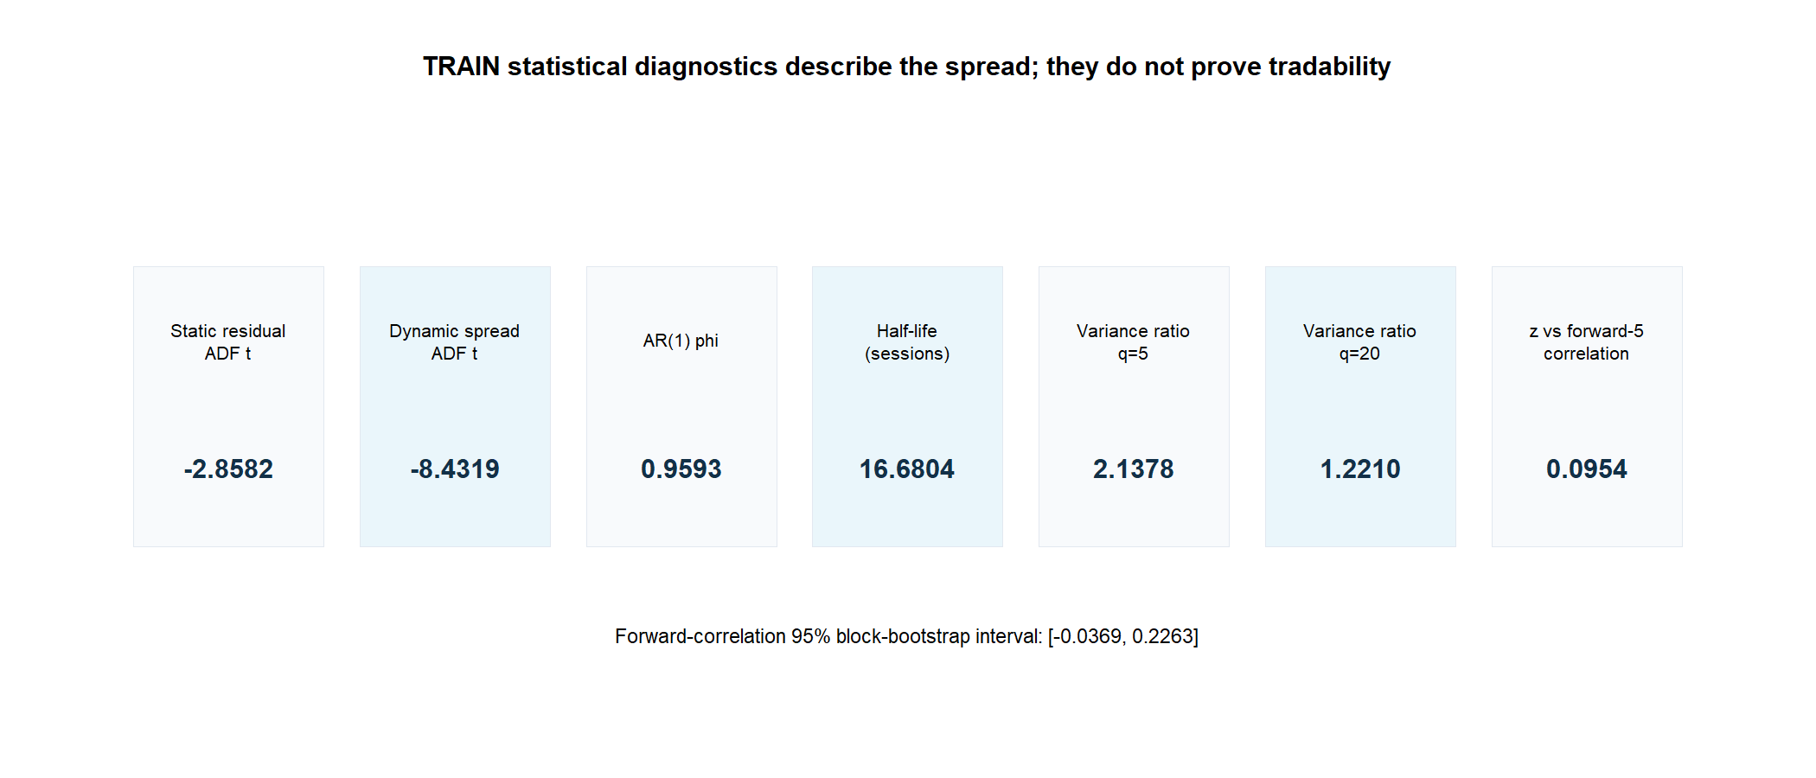
A stationary-looking spread was not a trading edge
The dynamic spread produced a strongly negative ADF-style statistic and a 16.7-session half-life. But variance ratios exceeded one, and high z-scores predicted higher—not lower—forward spread returns.
-8.43
+0.095
Dynamic-spread ADF t Descriptive, not a verdict
z vs forward-five return Wrong sign for reversion
12
Notes:
ADF, half-life, variance ratio, and conditional forward return test different ideas. A rolling-beta spread is not the same object as a fixed cointegrating residual.
[Sources]
- C:/Users/Franc/OneDrive/Documents/Francis/Peltata Project/Time-Series-Modeling-Gen5/runs/research_workbench/literature_grounded/lit_mr_02_1_bollinger_20260728/mr02_train_statistical_diagnostics.csv
- C:/Users/Franc/OneDrive/Documents/Francis/Peltata Project/Time-Series-Modeling-Gen5/runs/research_workbench/literature_grounded/lit_mr_02_1_bollinger_20260728/mr02_train_forward_convergence_summary.csv
- C:/Users/Franc/OneDrive/Documents/Francis/Peltata Project/Time-Series-Modeling-Gen5/runs/research_workbench/literature_grounded/lit_mr_02_1_bollinger_20260728/visuals/mr02_statistical_diagnostics.png
- C:/Users/Franc/OneDrive/Documents/Francis/Trading Literature/Algorithmic Trading - Winning Strategies and Their Rationale 2013.pdf, printed pp. 42-47 and 66-72

Slide 13
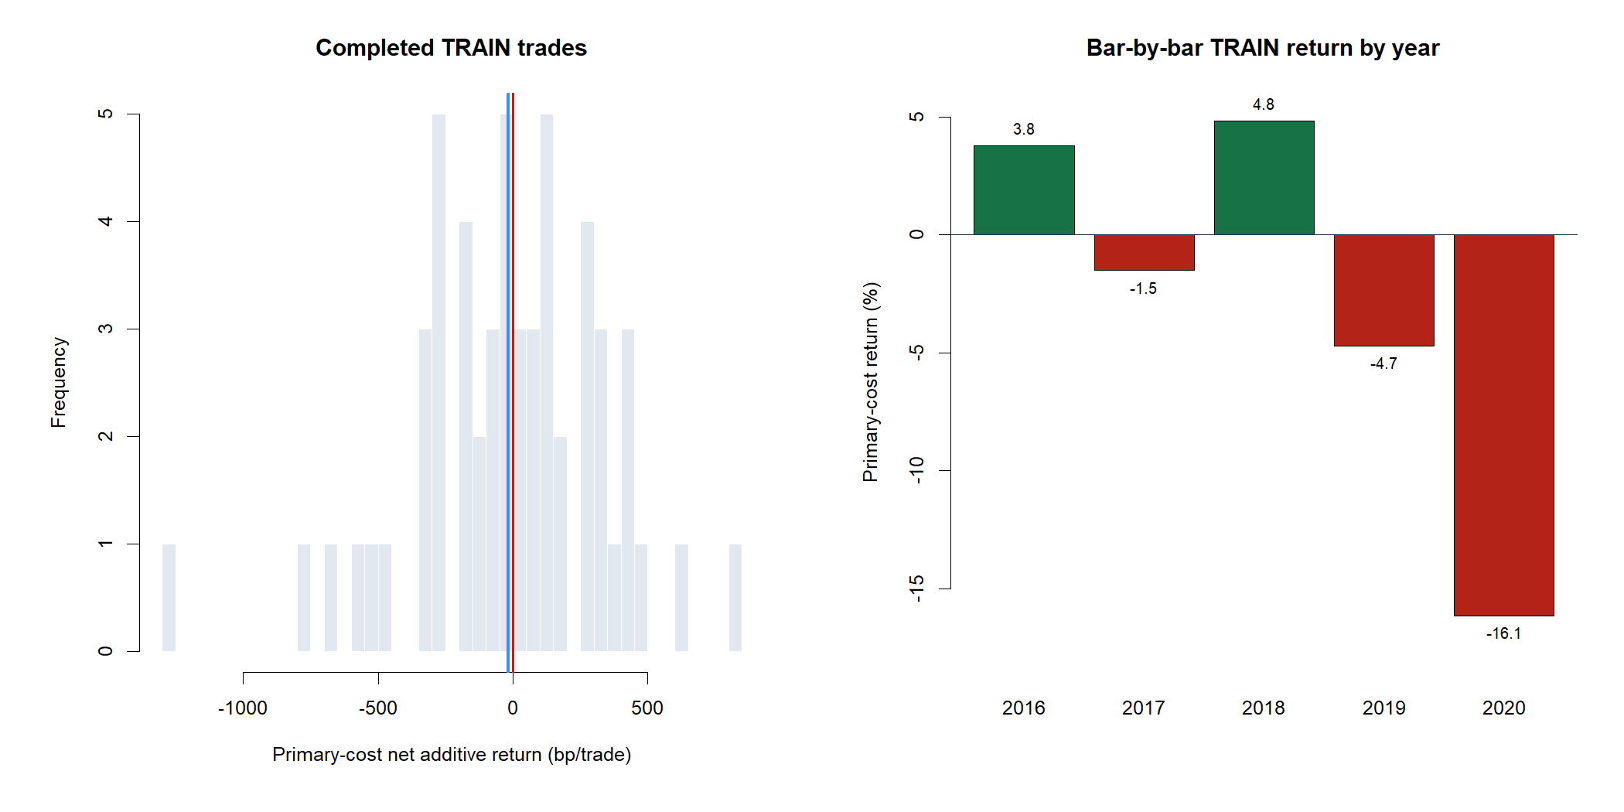
Trade-level and bar-level evidence both failed
The rule generated enough trades in both directions, but the mean trade lost money, the hit rate was below 50%, and only two of five TRAIN years were positive.
-17.68 bp
49.1%
Mean primary-cost net return per trade
Completed-trade hit rate
13
Notes:
Completed trades include entries, adaptive-hedge turnover, and exits. Bar returns are next-open to next-open and use the prior close's frozen target.
[Sources]
- C:/Users/Franc/OneDrive/Documents/Francis/Peltata Project/Time-Series-Modeling-Gen5/runs/research_workbench/literature_grounded/lit_mr_02_1_bollinger_20260728/mr02_train_trades.csv
- C:/Users/Franc/OneDrive/Documents/Francis/Peltata Project/Time-Series-Modeling-Gen5/runs/research_workbench/literature_grounded/lit_mr_02_1_bollinger_20260728/mr02_train_bar_replay.csv
- C:/Users/Franc/OneDrive/Documents/Francis/Peltata Project/Time-Series-Modeling-Gen5/runs/research_workbench/literature_grounded/lit_mr_02_1_bollinger_20260728/mr02_train_year_summary.csv

Slide 14
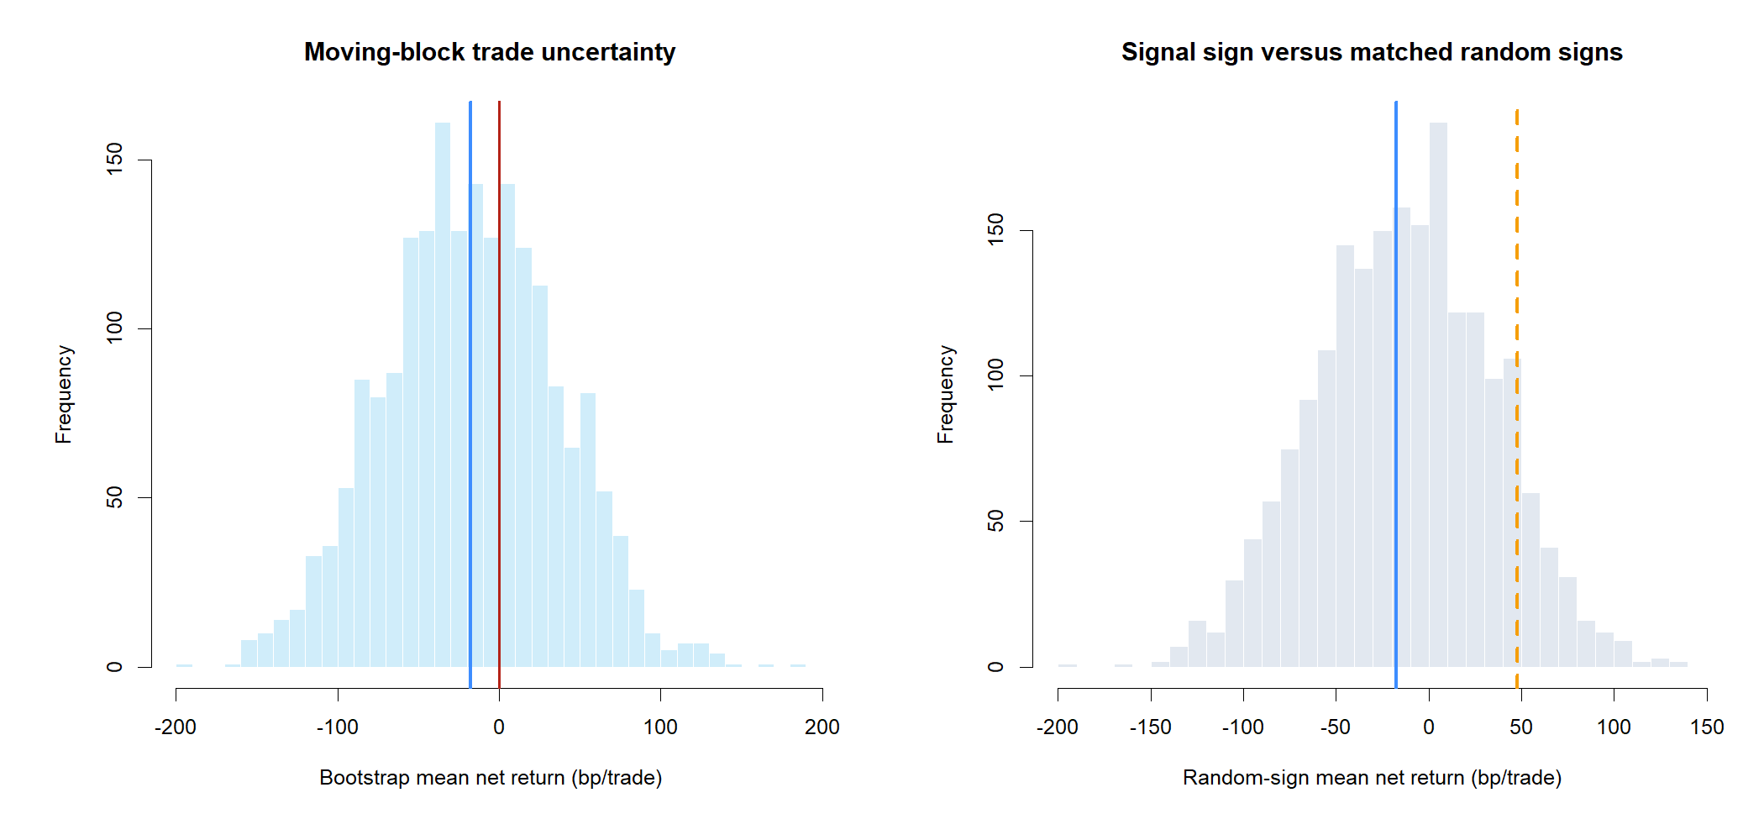
Uncertainty and falsification offered no rescue
The mean sat inside a very wide interval and below the p90 of random trade directions with the same timing, pair path, holding periods, and primary costs.
[-121, +83]
+47.88 bp
95% interval bp per trade
Matched random-sign p90 Observed: -17.68 bp
14
Notes:
The matched random-sign control breaks only the mapping from signal sign to pair direction while preserving opportunities, holding periods, realized paths, and costs.
[Sources]
- C:/Users/Franc/OneDrive/Documents/Francis/Peltata Project/Time-Series-Modeling-Gen5/runs/research_workbench/literature_grounded/lit_mr_02_1_bollinger_20260728/mr02_train_trade_bootstrap_summary.csv
- C:/Users/Franc/OneDrive/Documents/Francis/Peltata Project/Time-Series-Modeling-Gen5/runs/research_workbench/literature_grounded/lit_mr_02_1_bollinger_20260728/mr02_train_random_sign_distribution.csv
- C:/Users/Franc/OneDrive/Documents/Francis/Peltata Project/Time-Series-Modeling-Gen5/runs/research_workbench/literature_grounded/lit_mr_02_1_bollinger_20260728/visuals/mr02_resampling.png

Slide 15
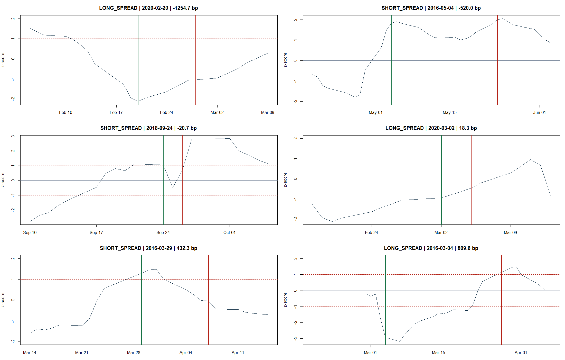
Representative trades show why zero-crossing is not enough
The tape includes both long- and short-spread trades across the return distribution. Some z-scores crossed zero only after large adverse pair moves. A normalized z-score crossing does not guarantee that the tradable legs produced a positive return. Worst shown: -1,254.7 bp Best shown: +809.6 bp
15
Notes:
A z-score crossing its rolling zero is a signal-state event, not a P&L guarantee: beta, the mean, and both tradable leg prices evolve.
[Sources]
- C:/Users/Franc/OneDrive/Documents/Francis/Peltata Project/Time-Series-Modeling-Gen5/runs/research_workbench/literature_grounded/lit_mr_02_1_bollinger_20260728/mr02_train_trades.csv
- C:/Users/Franc/OneDrive/Documents/Francis/Peltata Project/Time-Series-Modeling-Gen5/runs/research_workbench/literature_grounded/lit_mr_02_1_bollinger_20260728/mr02_train_indicators.csv
- C:/Users/Franc/OneDrive/Documents/Francis/Peltata Project/Time-Series-Modeling-Gen5/runs/research_workbench/literature_grounded/lit_mr_02_1_bollinger_20260728/visuals/mr02_representative_trades.png

Slide 16
Six substantive failures force a structural STOP
All 12 integrity checks passed and trade support was adequate. Positive-beta coverage, cost survival, hit rate, random-sign separation, yearly stability, and forward convergence all failed.
2 / 8
6 / 8
0
TRAIN gates passed Integrity and support
TRAIN gates failed Mechanism not admitted
Later partitions opened No later evidence exists
16
Notes:
The canonical USO-GLD example passed integrity and trade-support gates only. Later partitions remained sealed.
[Sources]
- C:/Users/Franc/OneDrive/Documents/Francis/Peltata Project/Time-Series-Modeling-Gen5/runs/research_workbench/literature_grounded/lit_mr_02_1_bollinger_20260728/mr02_gate_summary.csv
- C:/Users/Franc/OneDrive/Documents/Francis/Peltata Project/Time-Series-Modeling-Gen5/runs/research_workbench/literature_grounded/lit_mr_02_1_bollinger_20260728/mr02_integrity_audit.csv
- C:/Users/Franc/OneDrive/Documents/Francis/Peltata Project/Time-Series-Modeling-Gen5/runs/research_workbench/literature_grounded/lit_mr_02_1_bollinger_20260728/mr02_run_spec.csv

Slide 17
The panel was fixed before any outcomes were inspected
All 12 primary pairs use the identical 2016-2020 TRAIN window, raw-price orientation, 20-session rule, thresholds, execution timing, costs, diagnostics, and eight gates.
5 near substitutes
7 related exposures
2 inverse diagnostics
IVV-SPY · IAU-GLD · SOXX-SMH VEA-EFA · VWO-EEM
QQQ-XLK · IJR-IWM · KRE-XLF · IBB-XLV USO-XLE · TLT-IEF · HYG-LQD
GLD-UUP · TLT-SPY Semantics tested; no trades
17
Notes:
Pair names, Y/X orientation, categories, window, strategy mechanics, costs, and gates were frozen before running. The panel is breadth evidence, not an optimizer.
[Sources]
- C:/Users/Franc/OneDrive/Documents/Francis/Peltata Project/Time-Series-Modeling-Gen5/docs/GEN5_LIT_MR_02_1_PANEL_A_CONTRACT.md
- C:/Users/Franc/OneDrive/Documents/Francis/Peltata Project/Time-Series-Modeling-Gen5/runs/research_workbench/literature_grounded/lit_mr_02_1_panel_a_20260728/mr02_panel_pair_registry.csv
- C:/Users/Franc/OneDrive/Documents/Francis/Peltata Project/Time-Series-Modeling-Gen5/runs/research_workbench/literature_grounded/lit_mr_02_1_panel_a_20260728/mr02_panel_run_spec.csv

Slide 18
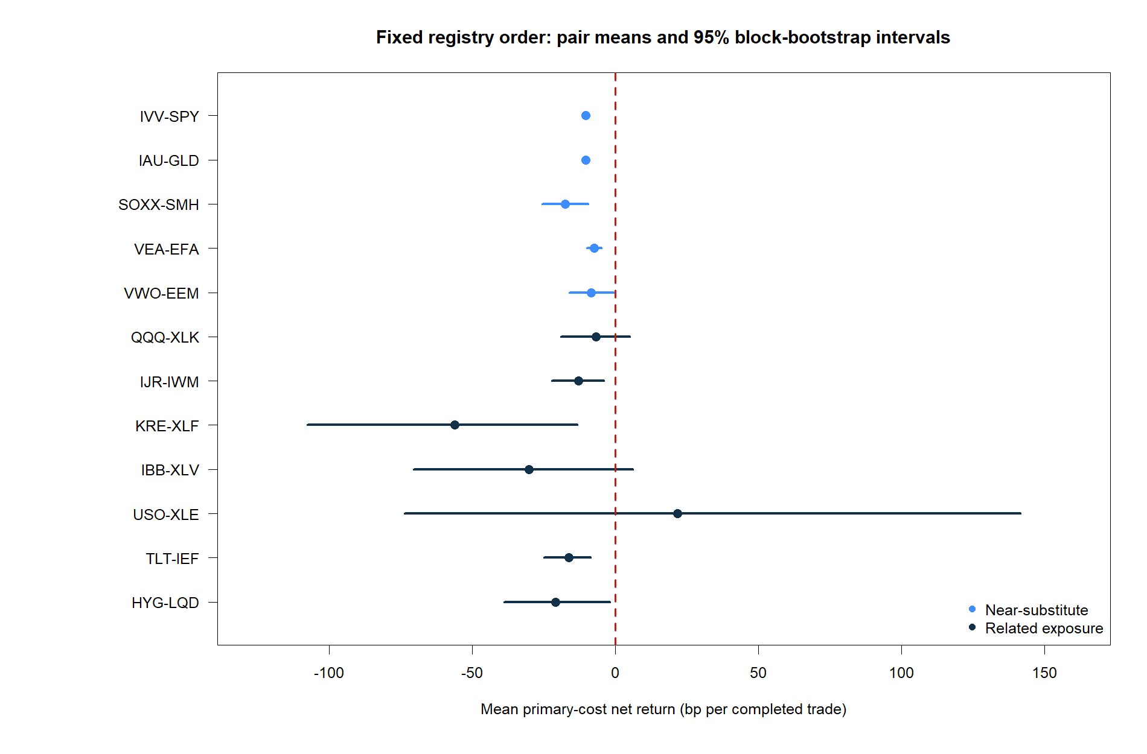
The fixed panel produced no full validation pass
Eleven of twelve primary pairs had negative mean net trade returns. Confidence intervals and forward-convergence tests prevented the one positive point estimate from becoming a selected winner.
0 / 12
1 / 12
Primary pairs passing all eight gates
Positive mean net return USO-XLE only
18
Notes:
The plot retains the predeclared registry order. It is not outcome-sorted. USO-XLE's positive point estimate had a wide interval spanning zero and failed the random-sign and forward-convergence gates.
[Sources]
- C:/Users/Franc/OneDrive/Documents/Francis/Peltata Project/Time-Series-Modeling-Gen5/runs/research_workbench/literature_grounded/lit_mr_02_1_panel_a_20260728/mr02_panel_pair_summary.csv
- C:/Users/Franc/OneDrive/Documents/Francis/Peltata Project/Time-Series-Modeling-Gen5/runs/research_workbench/literature_grounded/lit_mr_02_1_panel_a_20260728/mr02_panel_gate_summary.csv
- C:/Users/Franc/OneDrive/Documents/Francis/Peltata Project/Time-Series-Modeling-Gen5/runs/research_workbench/literature_grounded/lit_mr_02_1_panel_a_20260728/visuals/mr02_panel_pair_net_return_ci.png

Slide 19
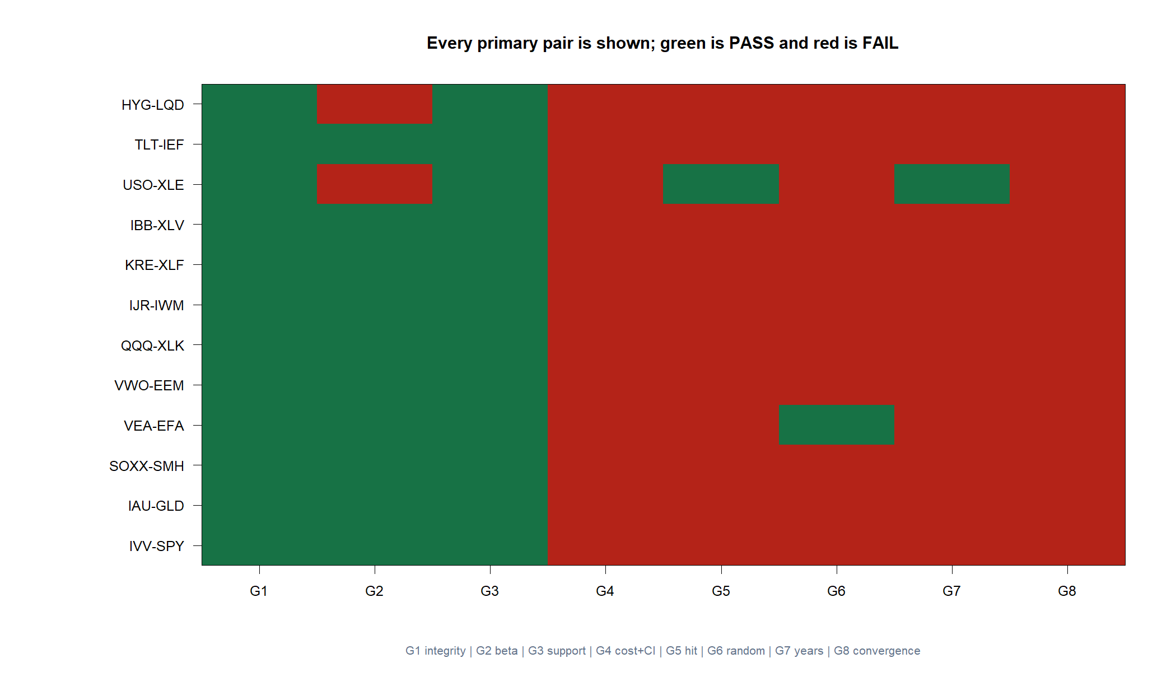
Breadth did not rescue the 20-session template
Every primary pair failed the positive-mean-with-positive-lower-bound gate. Every primary pair also failed the forward-convergence requirement that the upper confidence bound remain below zero. This matters: a spread can look statistically structured yet still offer no robust, cost-surviving directional forecast.
19
Notes:
G4 is the cost-surviving trade-return gate. G8 is the signed forward-convergence gate. No primary pair passed either gate under the frozen definitions.
[Sources]
- C:/Users/Franc/OneDrive/Documents/Francis/Peltata Project/Time-Series-Modeling-Gen5/runs/research_workbench/literature_grounded/lit_mr_02_1_panel_a_20260728/mr02_panel_gate_summary.csv
- C:/Users/Franc/OneDrive/Documents/Francis/Peltata Project/Time-Series-Modeling-Gen5/runs/research_workbench/literature_grounded/lit_mr_02_1_panel_a_20260728/mr02_panel_forward_convergence_summary.csv
- C:/Users/Franc/OneDrive/Documents/Francis/Peltata Project/Time-Series-Modeling-Gen5/runs/research_workbench/literature_grounded/lit_mr_02_1_panel_a_20260728/visuals/mr02_panel_gate_heatmap.png

Slide 20
The categories failed for different reasons
This is more informative than a single failed pair: tight substitutes had too little gross movement after costs; looser exposures offered more movement but unreliable convergence; inverse pairs changed the trade itself.
0 / 5
1 / 7
No trades
Near substitutes with positive mean Costs overwhelmed tiny convergence
Related exposures with positive mean USO-XLE still failed four gates
Inverse challengers had same-side semantics and unstable beta signs
20
Notes:
IVV-SPY and IAU-GLD were especially instructive: the relation was tight, but round-trip costs dominated the small gross spread movement. GLD-UUP and TLT-SPY showed frequent beta-sign changes, reinforcing the semantic warning.
[Sources]
- C:/Users/Franc/OneDrive/Documents/Francis/Peltata Project/Time-Series-Modeling-Gen5/runs/research_workbench/literature_grounded/lit_mr_02_1_panel_a_20260728/mr02_panel_category_summary.csv
- C:/Users/Franc/OneDrive/Documents/Francis/Peltata Project/Time-Series-Modeling-Gen5/runs/research_workbench/literature_grounded/lit_mr_02_1_panel_a_20260728/mr02_panel_inverse_diagnostics.csv
- C:/Users/Franc/OneDrive/Documents/Francis/Peltata Project/Time-Series-Modeling-Gen5/runs/research_workbench/literature_grounded/lit_mr_02_1_panel_a_20260728/mr02_panel_pair_summary.csv

Slide 21
Panel B broadened the test across 15 ordinary industries
The pairs were fixed before outcomes and deliberately avoid individual meme stocks. Every pair uses the same 2016-2020 TRAIN window, mechanics, costs, diagnostics, and eight gates.
9 sector pairs
5 industry pairs
1 producer link
Staples through materials SPDR / Vanguard near-substitute exposures
Defense · devices · retail homebuilders · biotech
GDX-GLD Gold miners versus physical gold
21
Notes:
Panel B was designed for economic variety, not expected profitability. The nine sector pairs compare broad providers; the industry pairs test related but less interchangeable exposures; GDX-GLD tests a producer/commodity relationship.
[Sources]
- C:/Users/Franc/OneDrive/Documents/Francis/Peltata Project/Time-Series-Modeling-Gen5/docs/GEN5_LIT_MR_02_1_PANEL_B_CONTRACT.md
- C:/Users/Franc/OneDrive/Documents/Francis/Peltata Project/Time-Series-Modeling-Gen5/runs/research_workbench/literature_grounded/lit_mr_02_1_panel_b_20260728/mr02_panel_pair_registry.csv
- C:/Users/Franc/OneDrive/Documents/Francis/Peltata Project/Time-Series-Modeling-Gen5/runs/research_workbench/literature_grounded/lit_mr_02_1_panel_b_20260728/mr02_panel_run_spec.csv

Slide 22
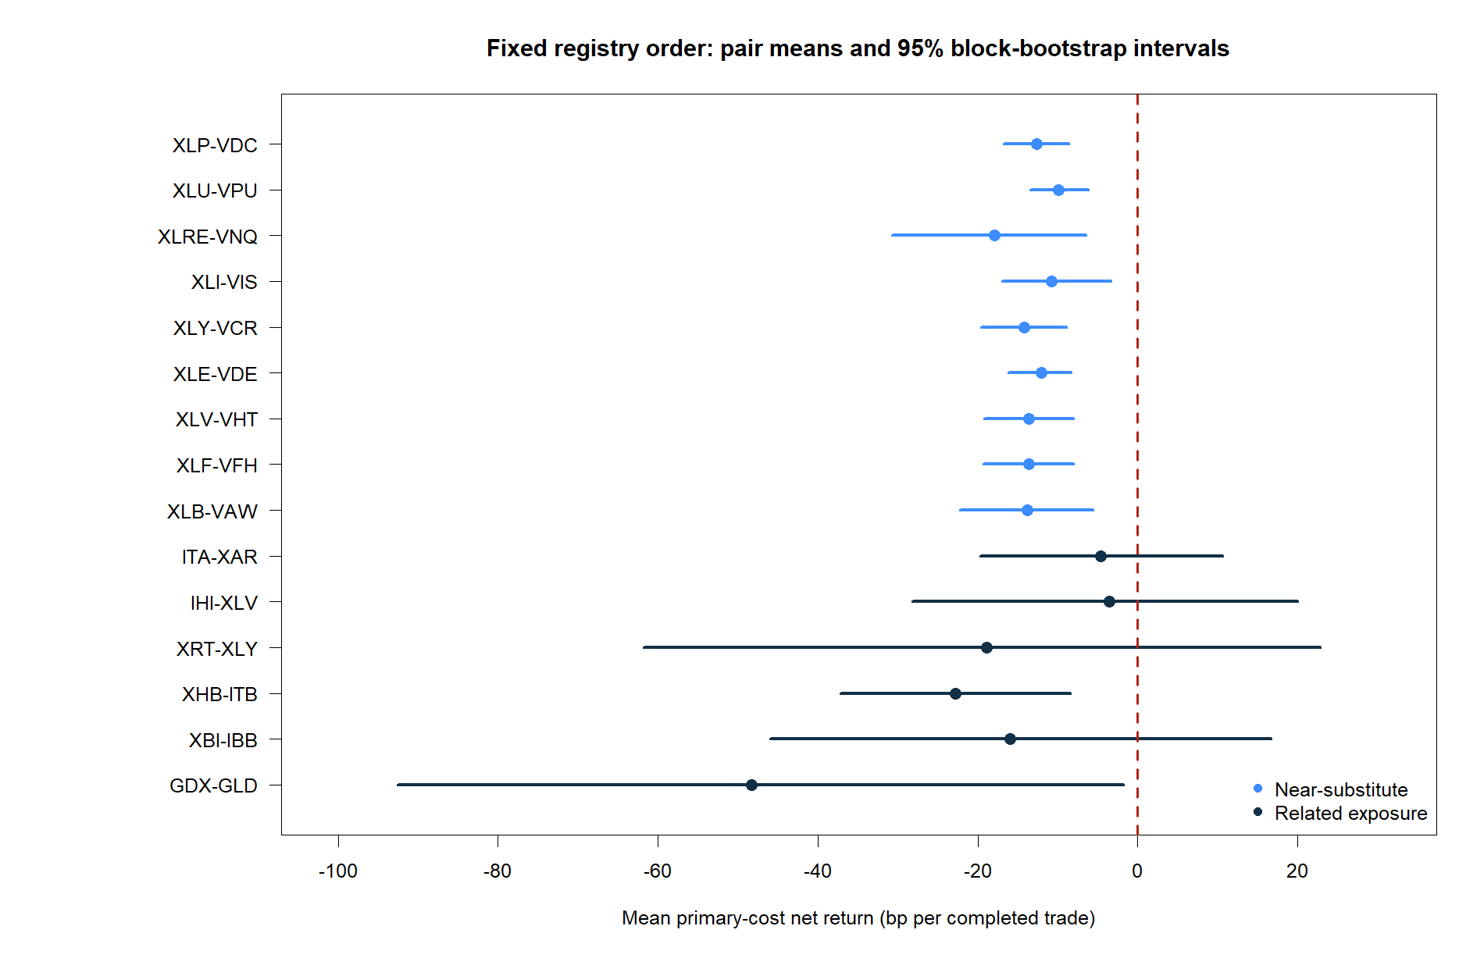
Panel B also produced no full validation pass
All 15 pairs generated two-sided trades. Yet every pair had a negative primary-cost mean net trade return, and no moving-block uncertainty interval cleared zero.
0 / 15
0 / 15
Primary pairs passing all eight gates
Positive mean net return Primary costs included
22
Notes:
The chart is fixed in the predeclared B01-B15 order. IHI-XLV was least negative at -3.56 bp per trade; the Panel B median was -13.64 bp. No pair had a positive mean.
[Sources]
- C:/Users/Franc/OneDrive/Documents/Francis/Peltata Project/Time-Series-Modeling-Gen5/runs/research_workbench/literature_grounded/lit_mr_02_1_panel_b_20260728/mr02_panel_pair_summary.csv
- C:/Users/Franc/OneDrive/Documents/Francis/Peltata Project/Time-Series-Modeling-Gen5/runs/research_workbench/literature_grounded/lit_mr_02_1_panel_b_20260728/mr02_panel_gate_summary.csv
- C:/Users/Franc/OneDrive/Documents/Francis/Peltata Project/Time-Series-Modeling-Gen5/runs/research_workbench/literature_grounded/lit_mr_02_1_panel_b_20260728/visuals/mr02_panel_pair_net_return_ci.png

Slide 23
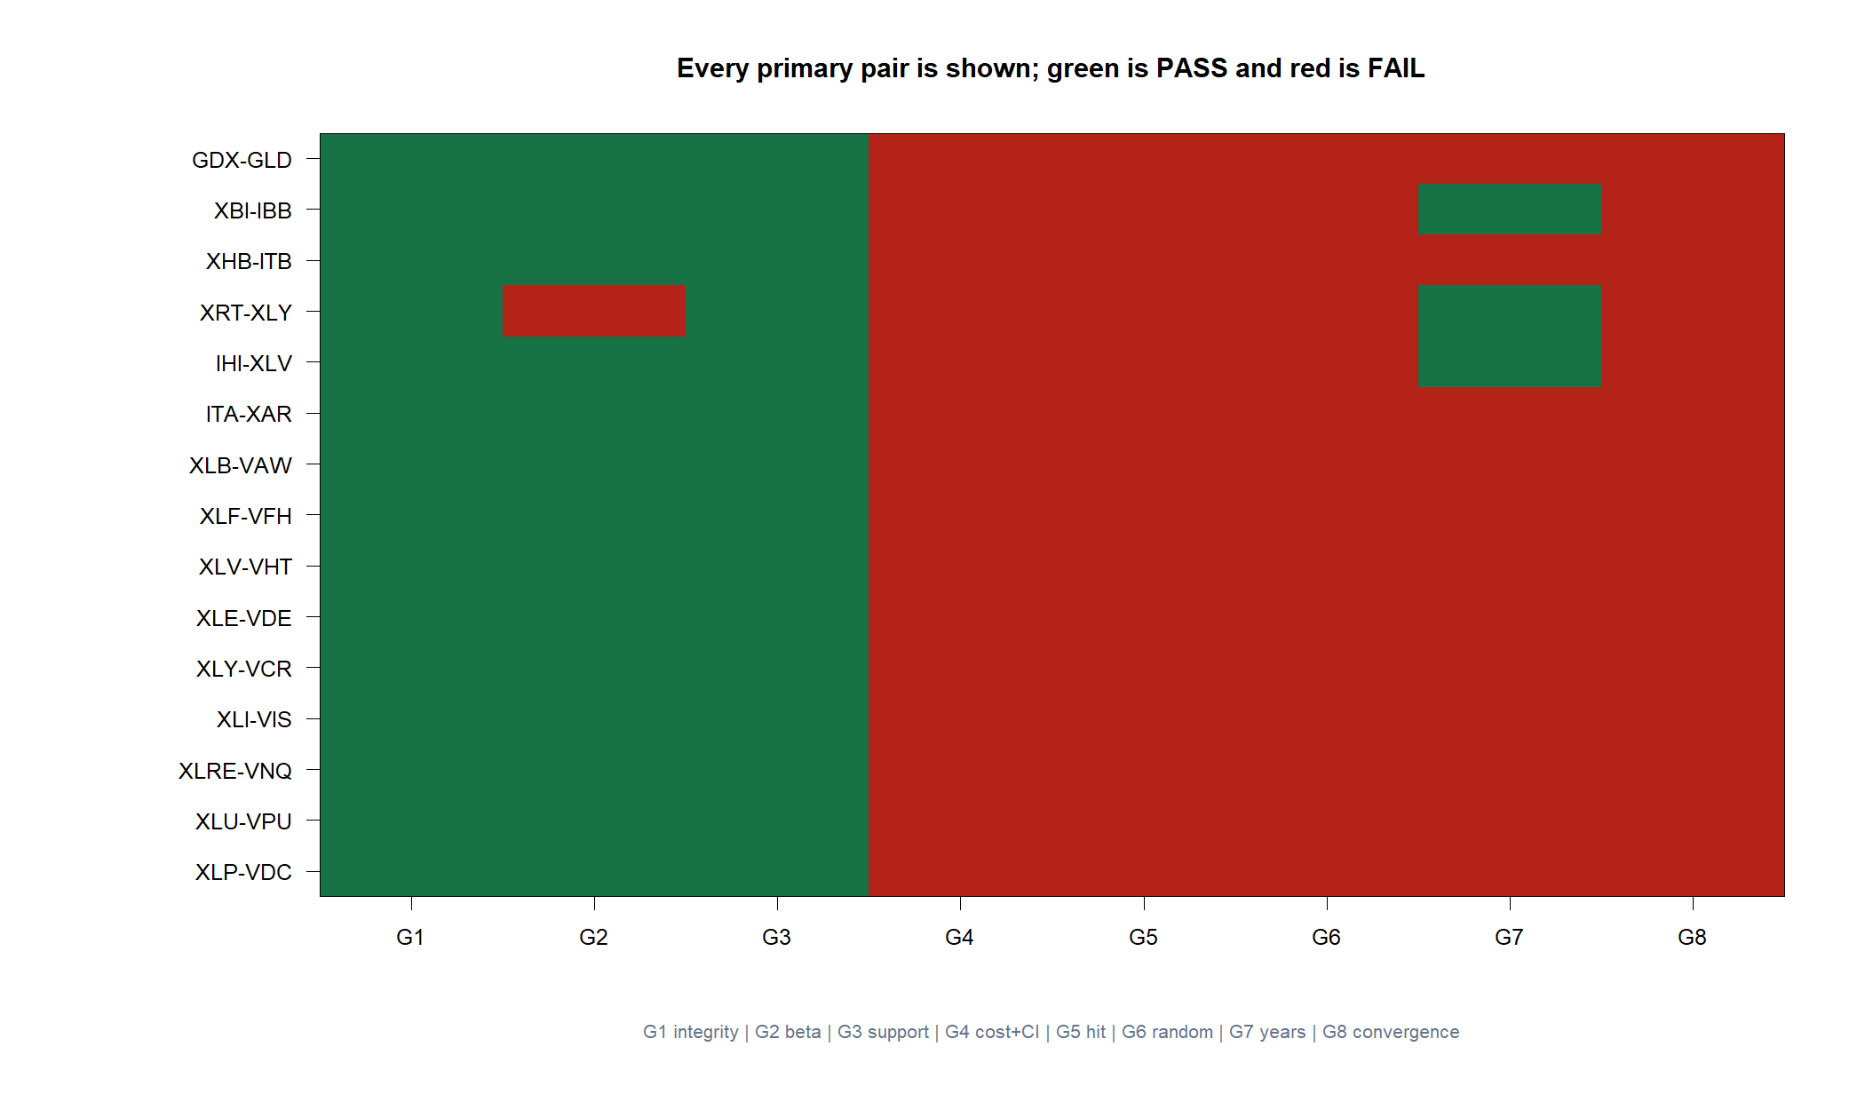
Failure concentrated in the economic and mechanism gates
All 15 passed G1 and G3; 14 of 15 passed G2. Data validity and two-sided trade support were not the problem. No pair passed G4, G5, G6, or G8. Only three passed the 3-of-5-year G7 stability check. The template generated activity—not a cost-surviving or mechanism-confirmed edge.
23
Notes:
XRT-XLY narrowly missed G2 with 94.3% positive-beta coverage. IHI-XLV, XRT-XLY, and XBI-IBB passed G7. Four pairs had negative forward-correlation point estimates, but every confidence interval crossed zero, so none passed G8.
[Sources]
- C:/Users/Franc/OneDrive/Documents/Francis/Peltata Project/Time-Series-Modeling-Gen5/runs/research_workbench/literature_grounded/lit_mr_02_1_panel_b_20260728/mr02_panel_gate_summary.csv
- C:/Users/Franc/OneDrive/Documents/Francis/Peltata Project/Time-Series-Modeling-Gen5/runs/research_workbench/literature_grounded/lit_mr_02_1_panel_b_20260728/mr02_panel_forward_convergence_summary.csv
- C:/Users/Franc/OneDrive/Documents/Francis/Peltata Project/Time-Series-Modeling-Gen5/runs/research_workbench/literature_grounded/lit_mr_02_1_panel_b_20260728/visuals/mr02_panel_gate_heatmap.png

Slide 24
Across 27 primary pairs, the exact template never cleared
Panels A and B tested near substitutes, related exposures, sectors, industries, and a producer link with identical mechanics, costs, and gates. This is breadth falsification—not parameter search.
0 / 27
1 / 27
0 / 27
Full eight-gate passes No later partition opened
Positive mean net return USO-XLE; still failed four gates
Robust G8 mechanism passes No upper interval below zero
24
Notes:
Panel A contained 12 primary pairs and two inverse diagnostics; Panel B added 15 primary pairs. Across the 27 primary pairs, no strategy cleared all eight gates and no pair robustly confirmed the claimed forward-convergence mechanism.
[Sources]
- C:/Users/Franc/OneDrive/Documents/Francis/Peltata Project/Time-Series-Modeling-Gen5/runs/research_workbench/literature_grounded/lit_mr_02_1_panel_a_20260728/mr02_panel_pair_summary.csv
- C:/Users/Franc/OneDrive/Documents/Francis/Peltata Project/Time-Series-Modeling-Gen5/runs/research_workbench/literature_grounded/lit_mr_02_1_panel_a_20260728/mr02_panel_gate_summary.csv
- C:/Users/Franc/OneDrive/Documents/Francis/Peltata Project/Time-Series-Modeling-Gen5/runs/research_workbench/literature_grounded/lit_mr_02_1_panel_b_20260728/mr02_panel_pair_summary.csv
- C:/Users/Franc/OneDrive/Documents/Francis/Peltata Project/Time-Series-Modeling-Gen5/runs/research_workbench/literature_grounded/lit_mr_02_1_panel_b_20260728/mr02_panel_gate_summary.csv

Slide 25
POSITIVE CONTROL | 2018 WORKING REGIME
2018:
the mechanism works
The exact frozen USO-GLD rule produced a positive, cost-aware year. This is a retrospective case study—not a reversal of the five-year STOP.
Notes:
2018 is documented as a positive-control regime for the unchanged LIT-MR-02.1 mechanism. It is descriptive evidence found after the primary five-year TRAIN decision and therefore cannot reverse that STOP.
[Sources]
- C:/Users/Franc/OneDrive/Documents/Francis/Peltata Project/Time-Series-Modeling-Gen5/docs/GEN5_LIT_MR_02_1_CASE_STUDIES.md
- C:/Users/Franc/OneDrive/Documents/Francis/Peltata Project/Time-Series-Modeling-Gen5/runs/research_workbench/literature_grounded/lit_mr_02_1_case_studies_20260729/mr02_case_2018_summary.csv
- C:/Users/Franc/OneDrive/Documents/Francis/Peltata Project/Time-Series-Modeling-Gen5/runs/research_workbench/literature_grounded/lit_mr_02_1_case_studies_20260729/mr02_case_studies_report.md

Slide 26
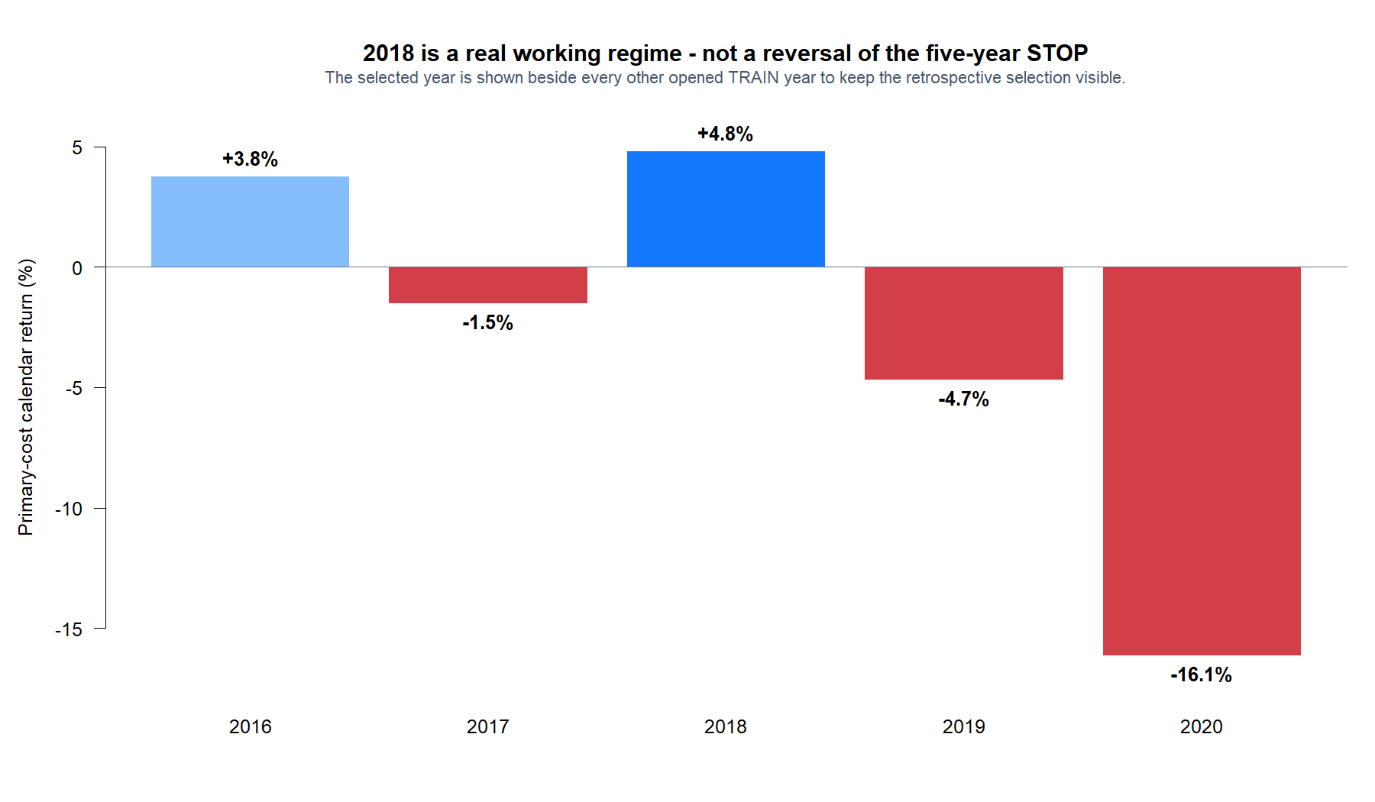
2018 produced a coherent, two-sided working example
The year finished positive after next-open execution and adaptive-hedge turnover costs. Both long- and short-spread trades contributed.
+4.82%
69.2%
Primary-cost
calendar return
Trade hit rate
9 wins / 13 trades
26
Notes:
The exact frozen primary-cost replay returned 4.82% in calendar 2018, with a 0.736 naive annualized Sharpe, a 7.64% maximum drawdown, and nine winners among 13 completed trades. The five-year context remains mixed and ultimately negative.
[Sources]
- C:/Users/Franc/OneDrive/Documents/Francis/Peltata Project/Time-Series-Modeling-Gen5/docs/GEN5_LIT_MR_02_1_CASE_STUDIES.md
- C:/Users/Franc/OneDrive/Documents/Francis/Peltata Project/Time-Series-Modeling-Gen5/runs/research_workbench/literature_grounded/lit_mr_02_1_case_studies_20260729/mr02_case_2018_summary.csv
- C:/Users/Franc/OneDrive/Documents/Francis/Peltata Project/Time-Series-Modeling-Gen5/runs/research_workbench/literature_grounded/lit_mr_02_1_case_studies_20260729/visuals/mr02_case_2018_five_year_context.png

Slide 27
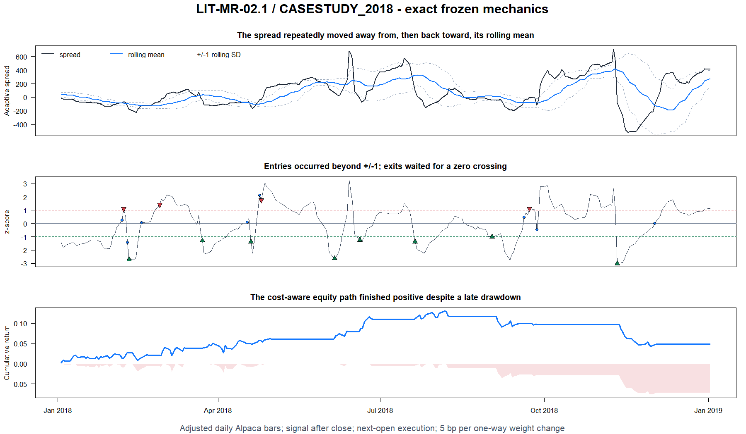
The signal, spread, and equity path line up in one view
27
Notes:
The top panel shows the adaptive raw-price spread and rolling mean plus or minus one standard deviation. The middle panel shows the corresponding z-score state and long/short entries. The bottom panel ties those states to the next-open, cost-aware equity and drawdown path.
[Sources]
- C:/Users/Franc/OneDrive/Documents/Francis/Peltata Project/Time-Series-Modeling-Gen5/docs/GEN5_LIT_MR_02_1_CASE_STUDIES.md
- C:/Users/Franc/OneDrive/Documents/Francis/Peltata Project/Time-Series-Modeling-Gen5/runs/research_workbench/literature_grounded/lit_mr_02_1_case_studies_20260729/mr02_case_2018_summary.csv
- C:/Users/Franc/OneDrive/Documents/Francis/Peltata Project/Time-Series-Modeling-Gen5/runs/research_workbench/literature_grounded/lit_mr_02_1_case_studies_20260729/visuals/mr02_case_2018_strategy_anatomy.png

Slide 28
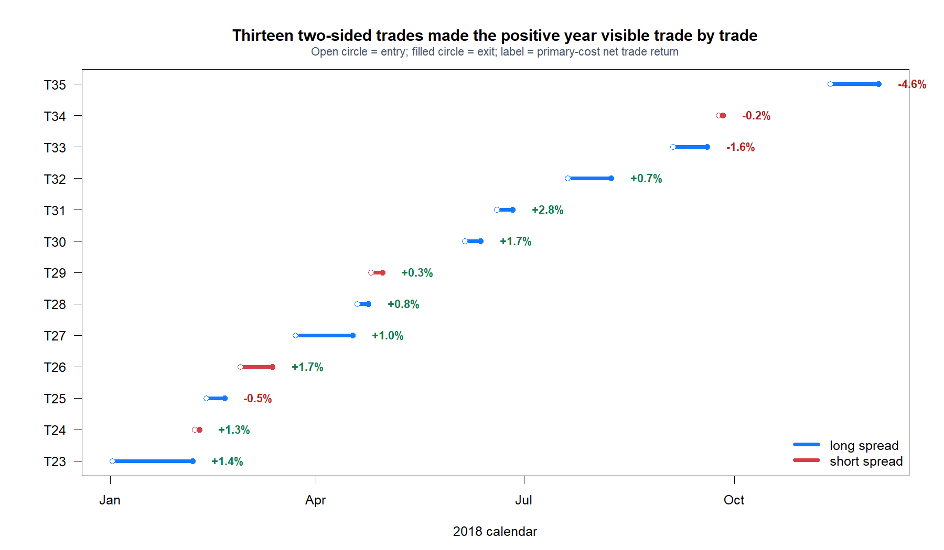
Every 2018 trade is visible—wins, losses, direction, and duration
28
Notes:
The representative tape is the full 2018 trade set: nine long-spread trades and four short-spread trades. It makes the timing, participation, holding periods, and concentration of gains and losses auditable.
[Sources]
- C:/Users/Franc/OneDrive/Documents/Francis/Peltata Project/Time-Series-Modeling-Gen5/docs/GEN5_LIT_MR_02_1_CASE_STUDIES.md
- C:/Users/Franc/OneDrive/Documents/Francis/Peltata Project/Time-Series-Modeling-Gen5/runs/research_workbench/literature_grounded/lit_mr_02_1_case_studies_20260729/mr02_case_2018_trades.csv
- C:/Users/Franc/OneDrive/Documents/Francis/Peltata Project/Time-Series-Modeling-Gen5/runs/research_workbench/literature_grounded/lit_mr_02_1_case_studies_20260729/visuals/mr02_case_2018_trade_timeline.png

Slide 29
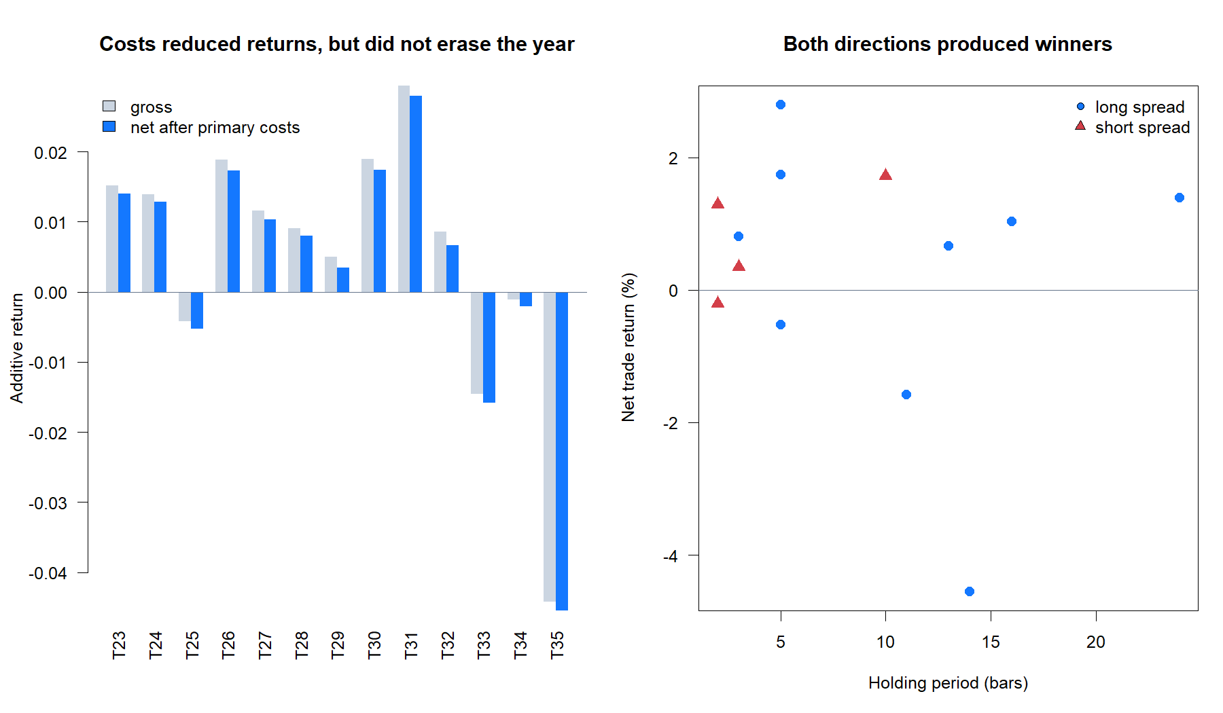
Costs mattered, yet both directions still produced winners
29
Notes:
The left panel shows cost drag for each completed trade. The right panel separates long- and short-spread outcomes by holding period. Costs reduced every trade, while winners remained present in both directions.
[Sources]
- C:/Users/Franc/OneDrive/Documents/Francis/Peltata Project/Time-Series-Modeling-Gen5/docs/GEN5_LIT_MR_02_1_CASE_STUDIES.md
- C:/Users/Franc/OneDrive/Documents/Francis/Peltata Project/Time-Series-Modeling-Gen5/runs/research_workbench/literature_grounded/lit_mr_02_1_case_studies_20260729/mr02_case_2018_trades.csv
- C:/Users/Franc/OneDrive/Documents/Francis/Peltata Project/Time-Series-Modeling-Gen5/runs/research_workbench/literature_grounded/lit_mr_02_1_case_studies_20260729/visuals/mr02_case_2018_trade_economics.png

Slide 30
SOURCE REPRODUCTION | CHAN EXAMPLE 3.2
2006–2012:
the published regime
Yahoo adjusted daily reference bars reproduce the source-era behavior. We show the book-style account and the stricter Gen5 translation separately.
Notes:
This section reproduces the exact interval printed in Chan's Example 3.2 using quarantined Yahoo adjusted daily bars. The bars are reference evidence only and do not alter the canonical Alpaca-only Gen5 provider contract.
[Sources]
- C:/Users/Franc/OneDrive/Documents/Francis/Trading Literature/Algorithmic Trading - Winning Strategies and Their Rationale 2013.pdf — printed pages 71–72; PDF pages 89–90
- C:/Users/Franc/OneDrive/Documents/Francis/Peltata Project/Time-Series-Modeling-Gen5/docs/GEN5_LITERATURE_SOURCE_LEDGER.md
- C:/Users/Franc/OneDrive/Documents/Francis/Peltata Project/Time-Series-Modeling-Gen5/runs/research_workbench/literature_grounded/lit_mr_02_1_case_studies_20260729/mr02_source_reference_audit.csv
- C:/Users/Franc/OneDrive/Documents/Francis/Peltata Project/Time-Series-Modeling-Gen5/runs/research_workbench/literature_grounded/lit_mr_02_1_case_studies_20260729/mr02_source_reference_urls.csv

Slide 31
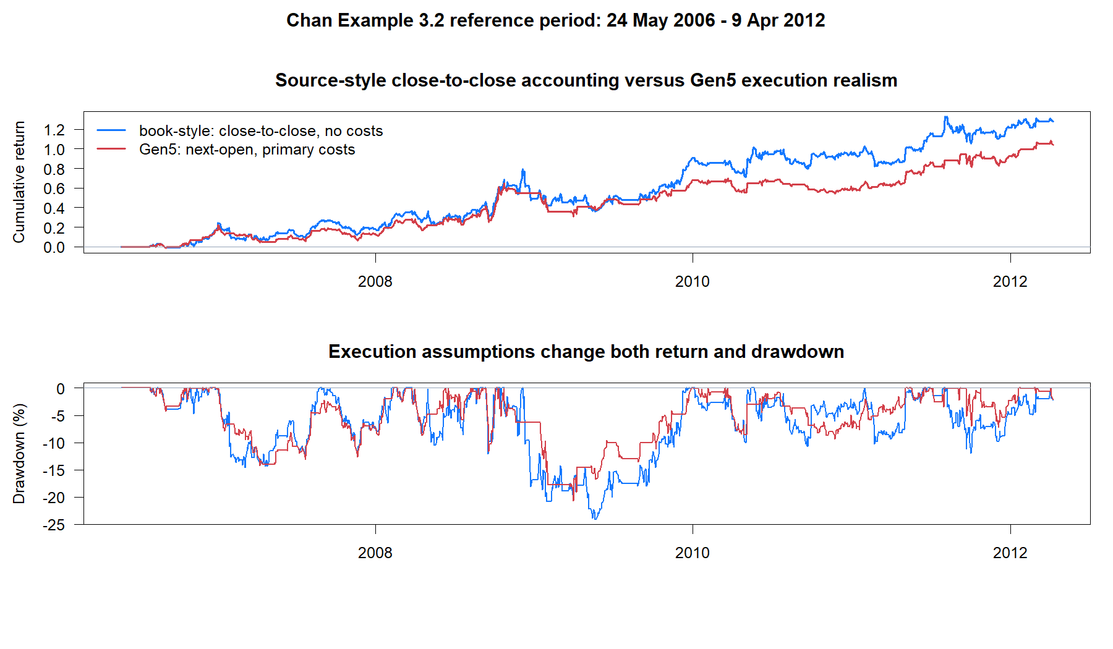
The source-period edge survives Gen5 timing and costs
31
Notes:
The blue line approximates the book's lagged-position, close-to-close, no-cost accounting. The red line applies the same signal mechanism with Gen5 next-open timing and five basis points per one-way weight change. Both accounts remain positive, though their paths and drawdowns differ.
[Sources]
- C:/Users/Franc/OneDrive/Documents/Francis/Trading Literature/Algorithmic Trading - Winning Strategies and Their Rationale 2013.pdf — printed pages 68 and 71–72; PDF pages 86 and 89–90
- C:/Users/Franc/OneDrive/Documents/Francis/Peltata Project/Time-Series-Modeling-Gen5/docs/GEN5_LIT_MR_02_1_CASE_STUDIES.md
- C:/Users/Franc/OneDrive/Documents/Francis/Peltata Project/Time-Series-Modeling-Gen5/runs/research_workbench/literature_grounded/lit_mr_02_1_case_studies_20260729/mr02_source_period_book_style_replay.csv
- C:/Users/Franc/OneDrive/Documents/Francis/Peltata Project/Time-Series-Modeling-Gen5/runs/research_workbench/literature_grounded/lit_mr_02_1_case_studies_20260729/mr02_source_period_gen5_replay.csv
- C:/Users/Franc/OneDrive/Documents/Francis/Peltata Project/Time-Series-Modeling-Gen5/runs/research_workbench/literature_grounded/lit_mr_02_1_case_studies_20260729/visuals/mr02_source_period_reproduction.png

Slide 32
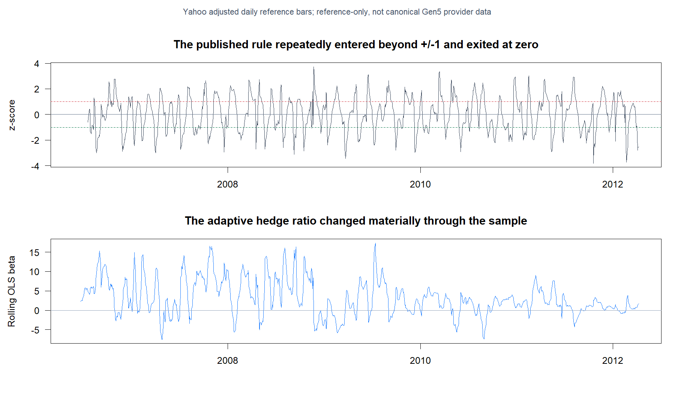
The reproduction lands near Chan’s published headline
Current Yahoo-adjusted data does not match the original data vintage exactly. The difference is retained—not tuned away.
15.07%
12.93%
Book-style APR
Sharpe 0.845
Gen5 APR
Sharpe 0.933
32
Notes:
Chan reports 17.8% APR and 0.96 Sharpe. Using current Yahoo-adjusted bars, the book-style account reaches 15.07% APR and 0.845 Sharpe; the Gen5 translation reaches 12.93% APR and 0.933 Sharpe. We retain the discrepancy because the original data vintage and preprocessing are not available.
[Sources]
- C:/Users/Franc/OneDrive/Documents/Francis/Trading Literature/Algorithmic Trading - Winning Strategies and Their Rationale 2013.pdf — printed pages 71–72; PDF pages 89–90
- C:/Users/Franc/OneDrive/Documents/Francis/Peltata Project/Time-Series-Modeling-Gen5/docs/GEN5_LIT_MR_02_1_CASE_STUDIES.md
- C:/Users/Franc/OneDrive/Documents/Francis/Peltata Project/Time-Series-Modeling-Gen5/runs/research_workbench/literature_grounded/lit_mr_02_1_case_studies_20260729/mr02_source_period_comparison.csv
- C:/Users/Franc/OneDrive/Documents/Francis/Peltata Project/Time-Series-Modeling-Gen5/runs/research_workbench/literature_grounded/lit_mr_02_1_case_studies_20260729/mr02_source_reference_audit.csv
- C:/Users/Franc/OneDrive/Documents/Francis/Peltata Project/Time-Series-Modeling-Gen5/runs/research_workbench/literature_grounded/lit_mr_02_1_case_studies_20260729/visuals/mr02_source_period_signal_tape.png

Slide 33
DECISION
The mechanism can work.
It did not persist broadly.
Keep the 2018 and 2006–2012 results as positive controls. Keep the five-year and 27-pair STOPs intact, and move on without rescuing or retuning LIT-MR-02.1.
Notes:
The source-period reproduction and the 2018 case study establish that the formula can produce a coherent trading result in real historical regimes. They do not create a prospective selection rule, do not clear the predeclared eight-gate modern TRAIN contract, and do not authorize retuning.
[Sources]
- C:/Users/Franc/OneDrive/Documents/Francis/Peltata Project/Time-Series-Modeling-Gen5/docs/GEN5_LIT_MR_02_1_CASE_STUDIES.md
- C:/Users/Franc/OneDrive/Documents/Francis/Peltata Project/Time-Series-Modeling-Gen5/runs/research_workbench/literature_grounded/lit_mr_02_1_case_studies_20260729/mr02_case_studies_report.md
- C:/Users/Franc/OneDrive/Documents/Francis/Peltata Project/Time-Series-Modeling-Gen5/runs/research_workbench/literature_grounded/lit_mr_02_1_case_studies_20260729/mr02_case_2018_summary.csv
- C:/Users/Franc/OneDrive/Documents/Francis/Peltata Project/Time-Series-Modeling-Gen5/runs/research_workbench/literature_grounded/lit_mr_02_1_case_studies_20260729/mr02_source_period_comparison.csv
- C:/Users/Franc/OneDrive/Documents/Francis/Peltata Project/Time-Series-Modeling-Gen5/docs/GEN5_LIT_MR_02_1_ADAPTIVE_SPREAD_BOLLINGER_POC_CONTRACT.md

Slide 34
LIT-MR-02.1 INSTANCE BATCH | 29 JUL 2026
Relationship Atlas 01:
hypotheses, not fishing
A finite generator crosses instrument topology with economic mechanism, then reports every 2016–2020 TRAIN result in frozen order.
Notes:
This section is a high-throughput demonstration of disciplined hypothesis generation. It does not change the pair mechanics or mine outcomes.
[Sources]
- C:/Users/Franc/OneDrive/Documents/Francis/Peltata Project/Time-Series-Modeling-Gen5/docs/GEN5_LIT_MR_02_1_RELATIONSHIP_ATLAS_01_CONTRACT.md
- C:/Users/Franc/OneDrive/Documents/Francis/Peltata Project/Time-Series-Modeling-Gen5/runs/research_workbench/literature_grounded/lit_mr_02_1_relationship_atlas_01_20260729/mr02_panel_pair_registry.csv
- C:/Users/Franc/OneDrive/Documents/Francis/Peltata Project/Time-Series-Modeling-Gen5/docs/GEN5_4_DECISION_DIALOGUE_INDEX.md — D73

Slide 35
The atlas generates relationships before it sees returns
Each hypothesis receives an instrument topology, an economic mechanism, an orientation, and a rationale. Five candidates are frozen in each cell; repeated anchors remain visible rather than silently pooled.
5 cells
25 pairs
1 rule
ETF substitutes · related ETFs
ETF–component · peers · asset proxies
Five predeclared candidates per cell
All outcomes retained
Unchanged 20-session adaptive spread
Same costs and eight TRAIN gates
35
Notes:
The generator is categorical and economic, not performance-ranked. ETF–component and producer/asset-proxy relationships are explicitly distinguished from ETF–ETF and stock–stock hypotheses.
[Sources]
- C:/Users/Franc/OneDrive/Documents/Francis/Peltata Project/Time-Series-Modeling-Gen5/docs/GEN5_LIT_MR_02_1_RELATIONSHIP_ATLAS_01_CONTRACT.md
- C:/Users/Franc/OneDrive/Documents/Francis/Peltata Project/Time-Series-Modeling-Gen5/runs/research_workbench/literature_grounded/lit_mr_02_1_relationship_atlas_01_20260729/mr02_panel_pair_registry.csv
- C:/Users/Franc/OneDrive/Documents/Francis/Peltata Project/Time-Series-Modeling-Gen5/docs/GEN5_4_DECISION_DIALOGUE_INDEX.md — D73

Slide 36
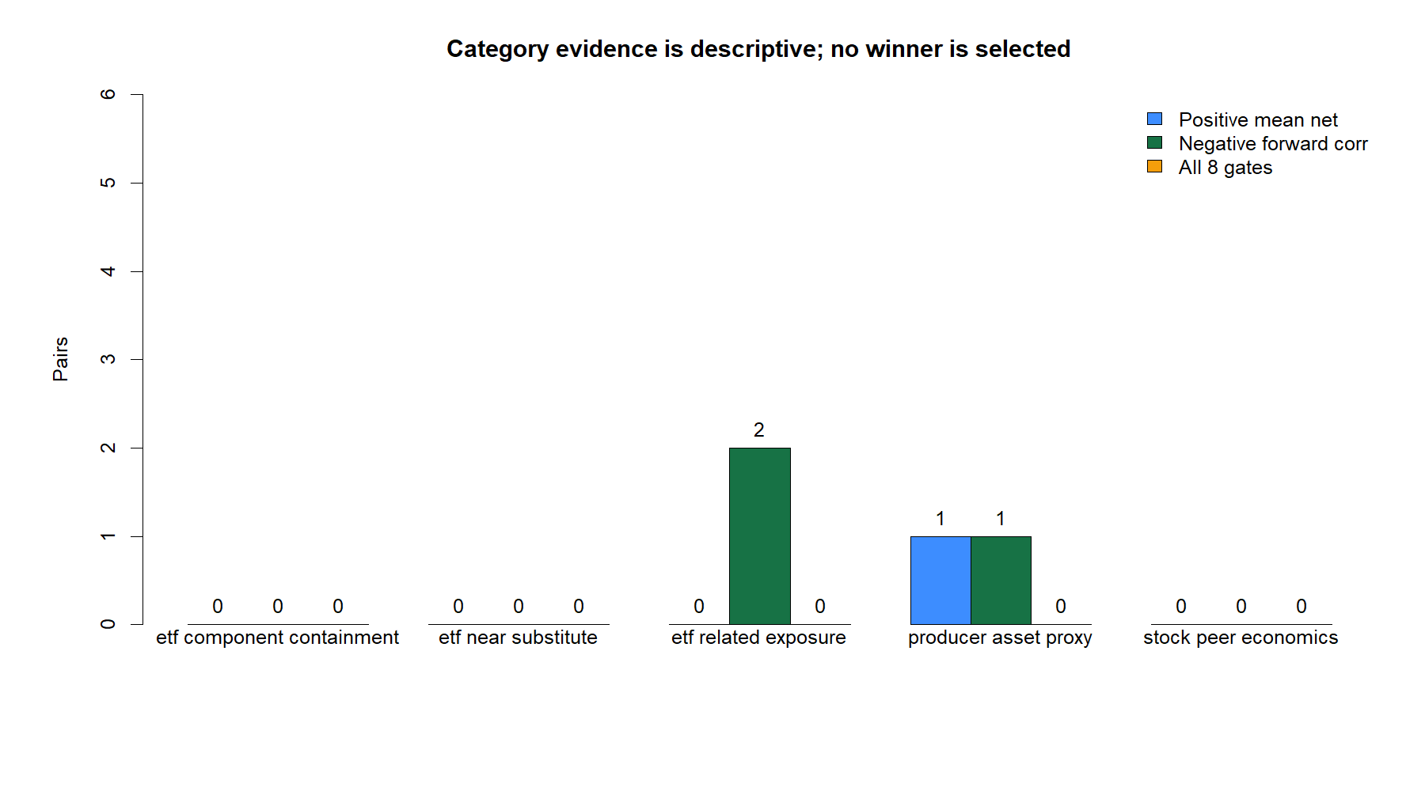
The categories reveal breadth, not a winner
36
Notes:
Only the producer/asset-proxy cell contained a positive mean-net pair. No category produced a full eight-gate pass. The chart is descriptive; the atlas did not select a winning cell.
[Sources]
- C:/Users/Franc/OneDrive/Documents/Francis/Peltata Project/Time-Series-Modeling-Gen5/runs/research_workbench/literature_grounded/lit_mr_02_1_relationship_atlas_01_20260729/mr02_panel_category_summary.csv
- C:/Users/Franc/OneDrive/Documents/Francis/Peltata Project/Time-Series-Modeling-Gen5/runs/research_workbench/literature_grounded/lit_mr_02_1_relationship_atlas_01_20260729/visuals/mr02_panel_category_summary.png
- C:/Users/Franc/OneDrive/Documents/Francis/Peltata Project/Time-Series-Modeling-Gen5/docs/GEN5_LIT_MR_02_1_RELATIONSHIP_ATLAS_01_CONTRACT.md

Slide 37
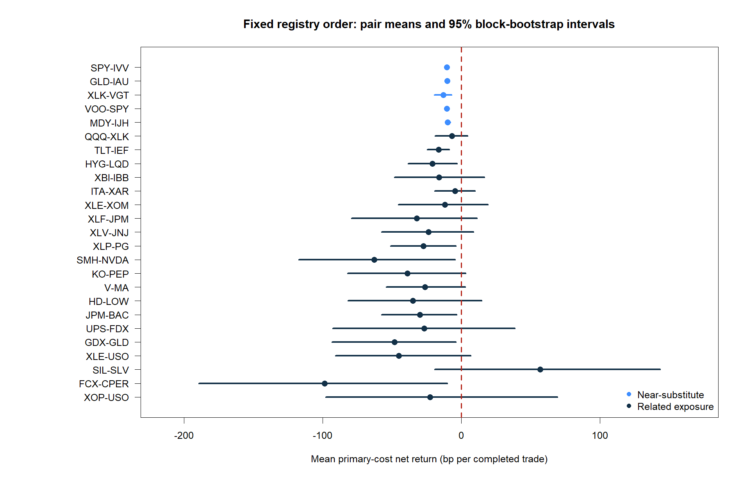
One positive mean did not become a selected pair
SIL–SLV produced a positive TRAIN mean, but its 95% moving-block interval crossed zero and the forward-convergence upper bound remained barely positive.
0 / 25
1 / 25
Pairs passing
all eight TRAIN gates
Positive mean net return
SIL–SLV only
37
Notes:
SIL–SLV averaged +56.8 bp per completed trade, but its 95% interval was approximately -19.3 to +143.3 bp. It passed six of eight gates and was not selected because the contract requires all eight.
[Sources]
- C:/Users/Franc/OneDrive/Documents/Francis/Peltata Project/Time-Series-Modeling-Gen5/runs/research_workbench/literature_grounded/lit_mr_02_1_relationship_atlas_01_20260729/mr02_panel_pair_summary.csv
- C:/Users/Franc/OneDrive/Documents/Francis/Peltata Project/Time-Series-Modeling-Gen5/runs/research_workbench/literature_grounded/lit_mr_02_1_relationship_atlas_01_20260729/visuals/mr02_panel_pair_net_return_ci.png
- C:/Users/Franc/OneDrive/Documents/Francis/Peltata Project/Time-Series-Modeling-Gen5/docs/GEN5_4_DECISION_DIALOGUE_INDEX.md — D75

Slide 38
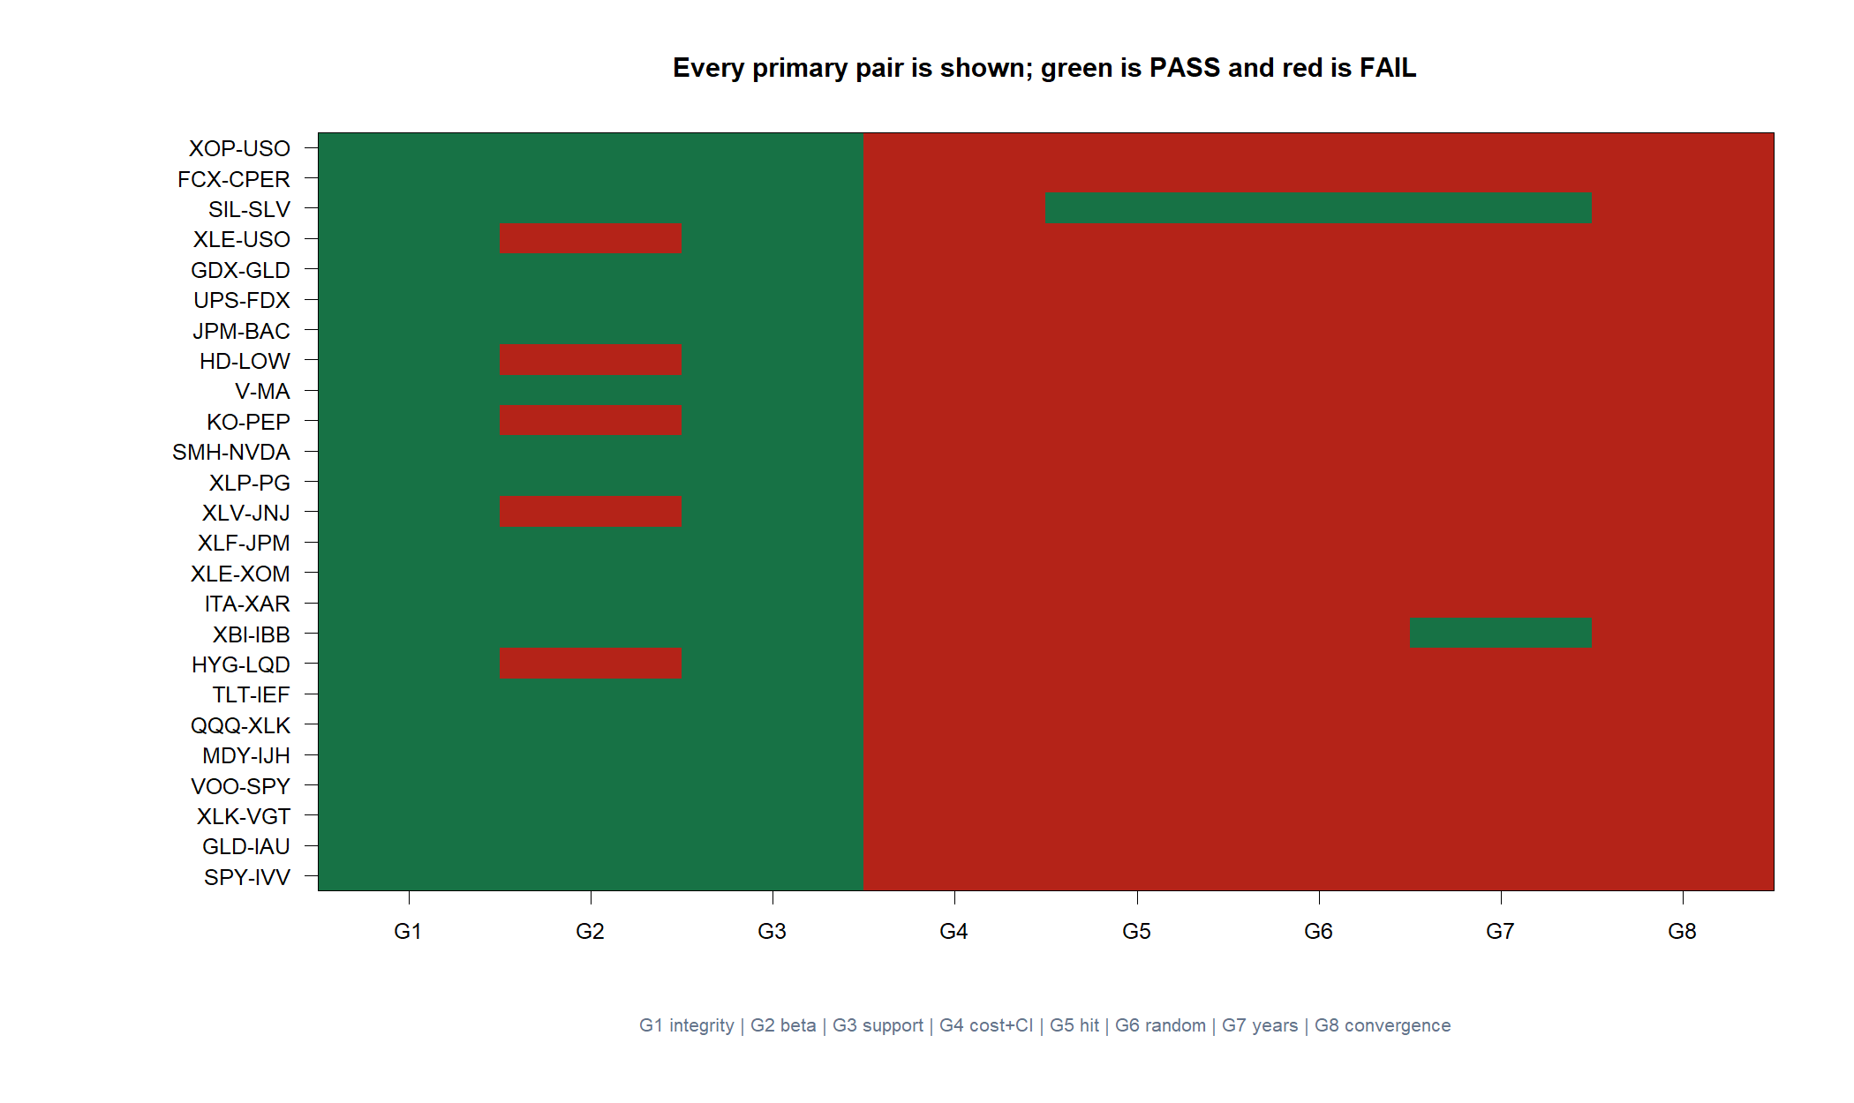
Validity and activity were common; robust economics were not
All 25 pairs passed integrity and two-sided trade support. Most retained positive-beta semantics.
Only one had a positive net mean; none cleared its uncertainty interval. Three had negative forward-correlation point estimates, but none had a robust upper bound below zero.
Because no pair cleared TRAIN, DEVELOPMENT was never opened.
38
Notes:
The cold/partial-cache WARNs record the pre-refresh state. The runner refreshed all affected 2016–2020 ranges, each pair passed requested coverage, and the analysis health used by the gates was PASS.
[Sources]
- C:/Users/Franc/OneDrive/Documents/Francis/Peltata Project/Time-Series-Modeling-Gen5/runs/research_workbench/literature_grounded/lit_mr_02_1_relationship_atlas_01_20260729/mr02_panel_gate_detail.csv
- C:/Users/Franc/OneDrive/Documents/Francis/Peltata Project/Time-Series-Modeling-Gen5/runs/research_workbench/literature_grounded/lit_mr_02_1_relationship_atlas_01_20260729/mr02_panel_pair_coverage.csv
- C:/Users/Franc/OneDrive/Documents/Francis/Peltata Project/Time-Series-Modeling-Gen5/runs/research_workbench/literature_grounded/lit_mr_02_1_relationship_atlas_01_20260729/mr02_panel_workbench_query_health.csv
- C:/Users/Franc/OneDrive/Documents/Francis/Peltata Project/Time-Series-Modeling-Gen5/docs/GEN5_4_DECISION_DIALOGUE_INDEX.md — D75

Slide 39
RELATIONSHIP ATLAS 01 | STOP AT TRAIN
The atlas worked.
The pair rule still did not.
We now have a reusable, category-labeled generator and a stronger falsification result: 0 of 25 new instances cleared TRAIN, so no OOS performance claim was made.
Notes:
The research mechanism succeeded operationally: hypotheses were generated, labeled, frozen, and fully reported. The trading mechanism did not earn OOS evaluation.
[Sources]
- C:/Users/Franc/OneDrive/Documents/Francis/Peltata Project/Time-Series-Modeling-Gen5/runs/research_workbench/literature_grounded/lit_mr_02_1_relationship_atlas_01_20260729/mr02_panel_report.md
- C:/Users/Franc/OneDrive/Documents/Francis/Peltata Project/Time-Series-Modeling-Gen5/docs/GEN5_LIT_MR_02_1_RELATIONSHIP_ATLAS_01_CONTRACT.md
- C:/Users/Franc/OneDrive/Documents/Francis/Peltata Project/Time-Series-Modeling-Gen5/docs/GEN5_4_DECISION_DIALOGUE_INDEX.md — D75

