Slide 1
Aviation Data Analysis
Student: Franciscar Ndanu Mutie
Class: DSF-PT08P1

Slide 2
Overview
Background
Problem Statement
Key Questions
Data Understanding
Visualizations
Conclusions
Recommendations

Slide 3
Background
Your company is expanding in to new industries to diversify its portfolio. Specifically, they are interested in purchasing and operating airplanes for commercial and private enterprises, but do not know anything about the potential risks of aircraft. You are charged with determining which aircraft are the lowest risk for the company to start this new business endeavor. You must then translate your findings into actionable insights that the head of the new aviation division can use to help decide which aircraft to purchase.

Slide 4
Problem Statement

Slide 5
Key Questions
Which aircraft makes are associated with the fewest total injuries in recorded accidents?
What are the most common causes of aviation accidents?
Which regions are associated with higher risks?

Slide 6
Data Understanding
Data from National Transportation Safety Board that includes aviation accident data from 1962 to 2023 about civil aviation accidents and in the United States.
Data cleaning using pandas
The following fields were used for analysis
Aircraft Make
Aircraft category
Number of fatalities/injuries
Weather Condition
Amateur Built
Location(State)
Purpose of flight

Slide 7
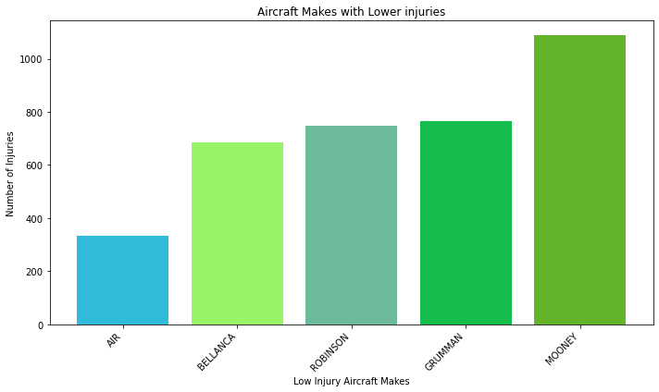
Top 5 Aircraft Makes with lower Injuries

Slide 8
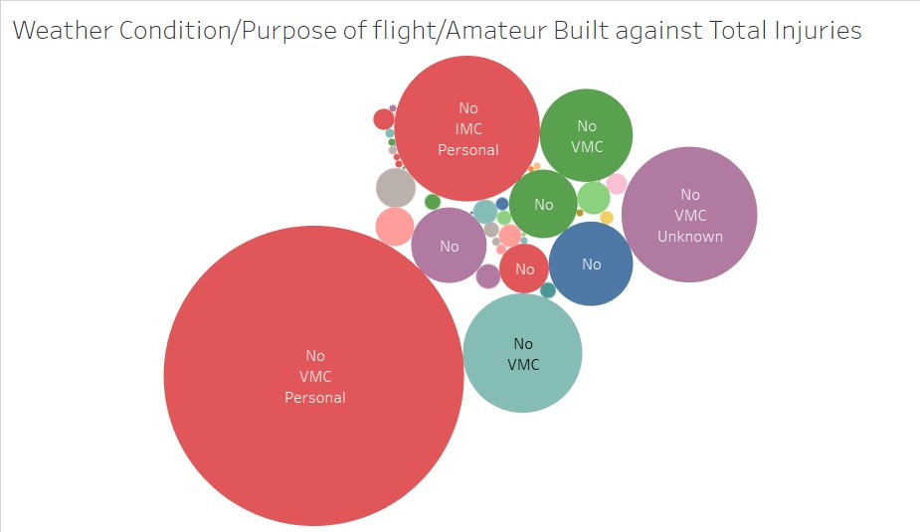
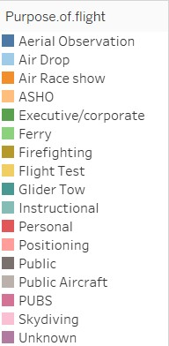
Aviation Accidents

Slide 9
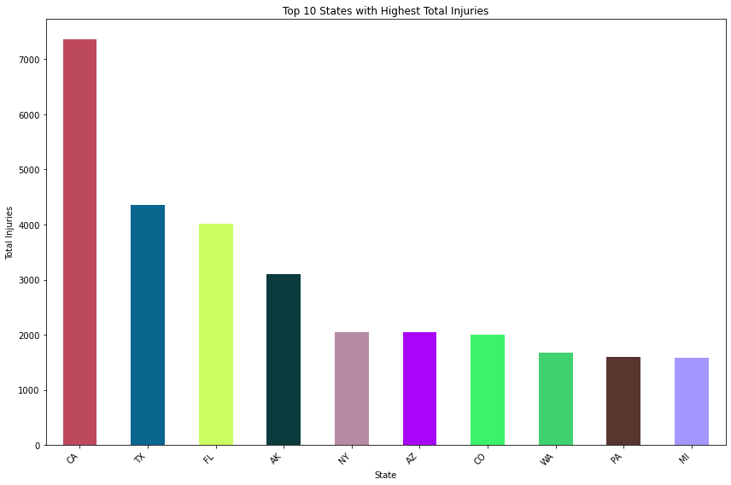
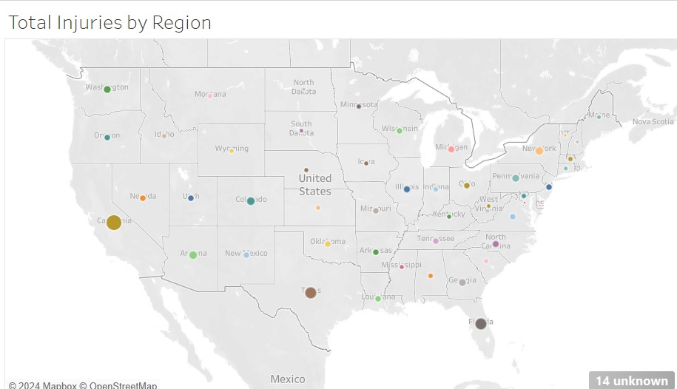
Regions Associated with higher risks

Slide 10
Key Findings
Based on the analysis, Air, Bellanca, Robinson, Grumman and Mooney, aircraft makes show consistently lower injury rates compared to others
Common causes:
Personal flights were observed to have higher injury rates followed by instructional flights.
A majority of accidents occur under Visual Meteorological Conditions (VMC) rather than Instrument Meteorological Conditions (IMC) or Unknown conditions.
The geographical analysis of injury severity highlights states where aviation-related accidents and injuries are more frequent. Certain areas show higher injury rates, potentially due to environmental conditions, air traffic, or regulatory differences.

Slide 11
Conclusions
Focus on Low-Injury Aircraft Makes
Establish advanced training programs for pilots and any personnel affiliated to the aviation industry
Operate in regions with lower accident and injury rates. Avoid high-risk states, and prioritize markets where the probability of injury is lower. This can lower maintenance costs, increase safety compliance, and provide a smoother entry into the aviation market.

Slide 12
Recommendations
Choose safer aircraft models based on lower injury rates.
Implement safety measures targeting common causes of injuries (e.g., weather, mechanical issues).
Focus operations in regions with lower injury risks to minimize exposure to accidents.

Slide 13
Thank You!

