Slide 1


CKKS - Homomorphic Encryption
for Arithmetic of Approximate Numbers
Dr. Sazadur Rahman
Assistant Professor
Department of ECE
Cyber Security and Privacy Cluster

Slide 2



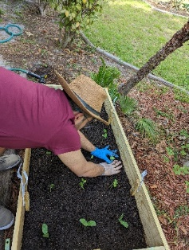





About Myself…
Assistant Professor
Department of Electrical and Computer Engineering
Cyber Security and Privacy Cluster
Contact: mohammad.rahman@ucf.edu, HEC-339, +1-407-823-1425
Web: www.ece.ucf.edu/person/sazadur-rahman
Research: Hardware security, design automation, secure architecture
BSc’2014
Design Engineer
2014-2017
MSc + PhD’2022
PhD Sponsor
Security Architect’2023
Travelling, Gardening

Slide 3
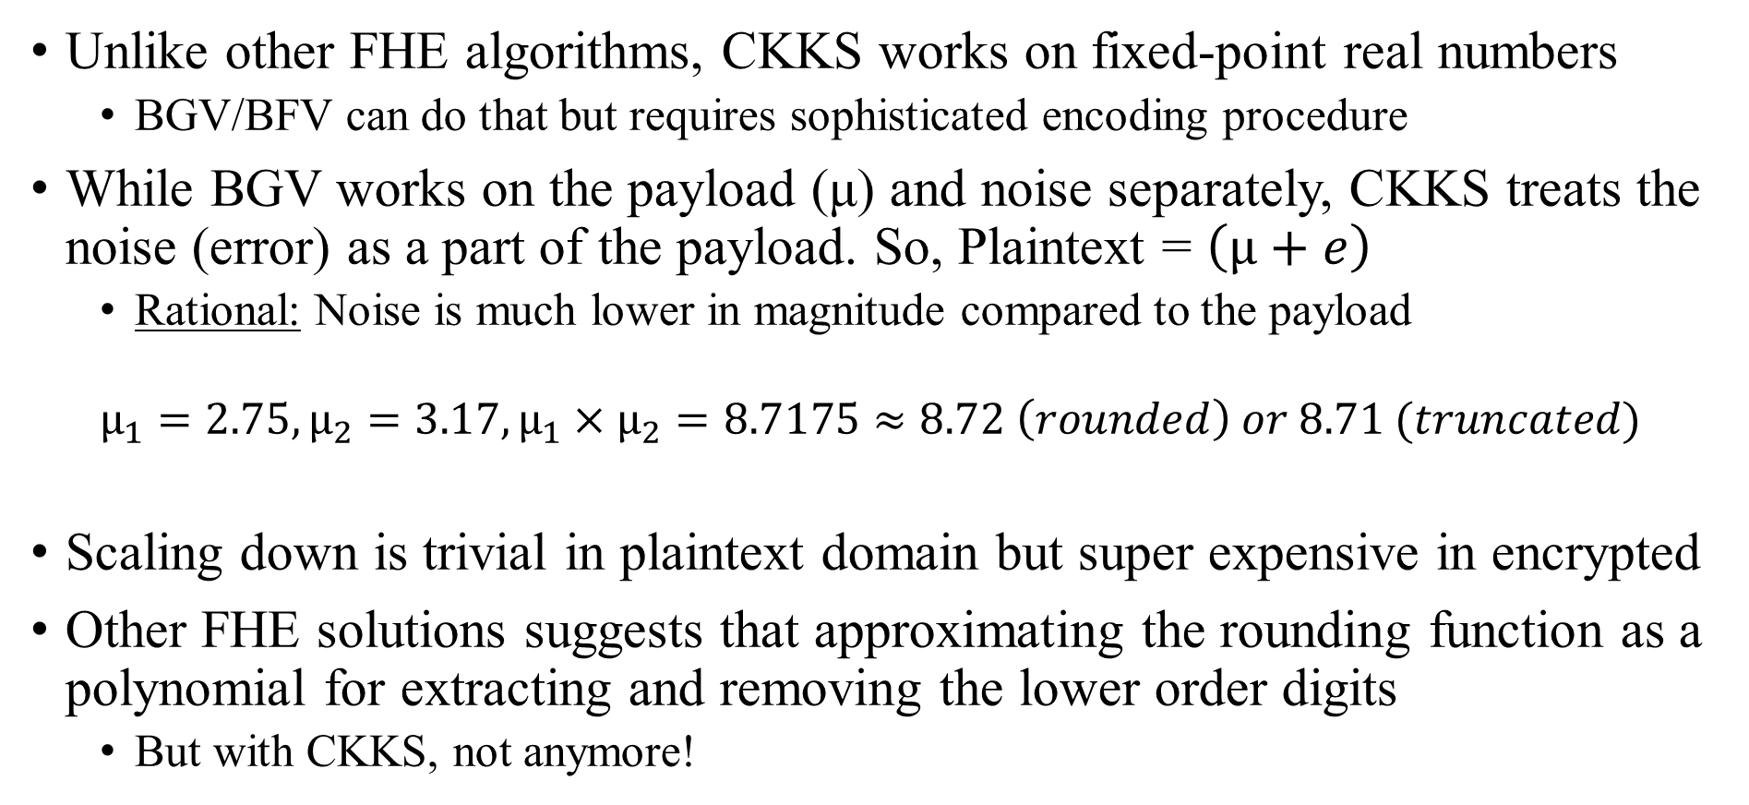
CKKS Algorithm
Unlike other FHE algorithms, CKKS works on fixed-point real numbers
BGV/BFV can do that but requires sophisticated encoding procedure
While BGV works on the payload (μ) and noise separately, CKKS treats the noise (error) as a part of the payload. So, Plaintext = $\left(μ+e\right)$
Rational: Noise is much lower in magnitude compared to the payload
$$μ_{1}=2.75,μ_{2}=3.17,μ_{1}×μ_{2}=8.7175≈8.72 \left(rounded\right) or 8.71 (truncated)$$
Scaling down is trivial in plaintext domain but super expensive in encrypted
Other FHE solutions suggests that approximating the rounding function as a polynomial for extracting and removing the lower order digits
But with CKKS, not anymore!
Notes:
Noise might not have a noticeable effect on the payload or results of computing over the payload
In fact, even in the normal context without considering encryption, computers use fixed-point or floating-point representations to handle real data.
Some real data cannot be represented exactly using these systems, and all we can do is to approximate them with a predefined precision via standard truncation or rounding procedures.
This approximation results in errors that can accumulate and expand during computation. But for most realistic scenarios, the errors are not much significant and the final result is therefore satisfactory. Therefore, we sort of can think of the RLWE error in the encrypted domain as truncation or rounding error in the clear domain.

Slide 4
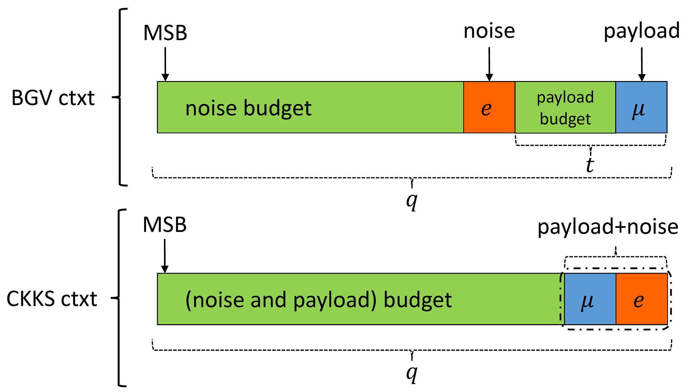
CKKS Algorithm Continues …
At the heart of CKKS scheme is a mechanism called RESCALE
Reduces the magnitude of the plaintext to simulate the truncation procedure efficiently
CKKS uses MODSWITCH to implement this rescaling functionality
Notes:
BGV also uses MODSWITCH but for a different application
The ciphertext in BGV and CKKS (and even for BFV) is typically a pair of polynomials. One polynomial contains the payload information while the other is used for decryption. The coefficients of these polynomials are bounded by the integer q, known as the ciphertext coefficient modulus, that is, they can take any value between 0 and q−1. Without loss of generality and for ease of illustration, suppose the polynomials are of degree 0. In Figure 1, we show the polynomial that contains the payload information in both BGV and CKKS schemes.

Slide 5
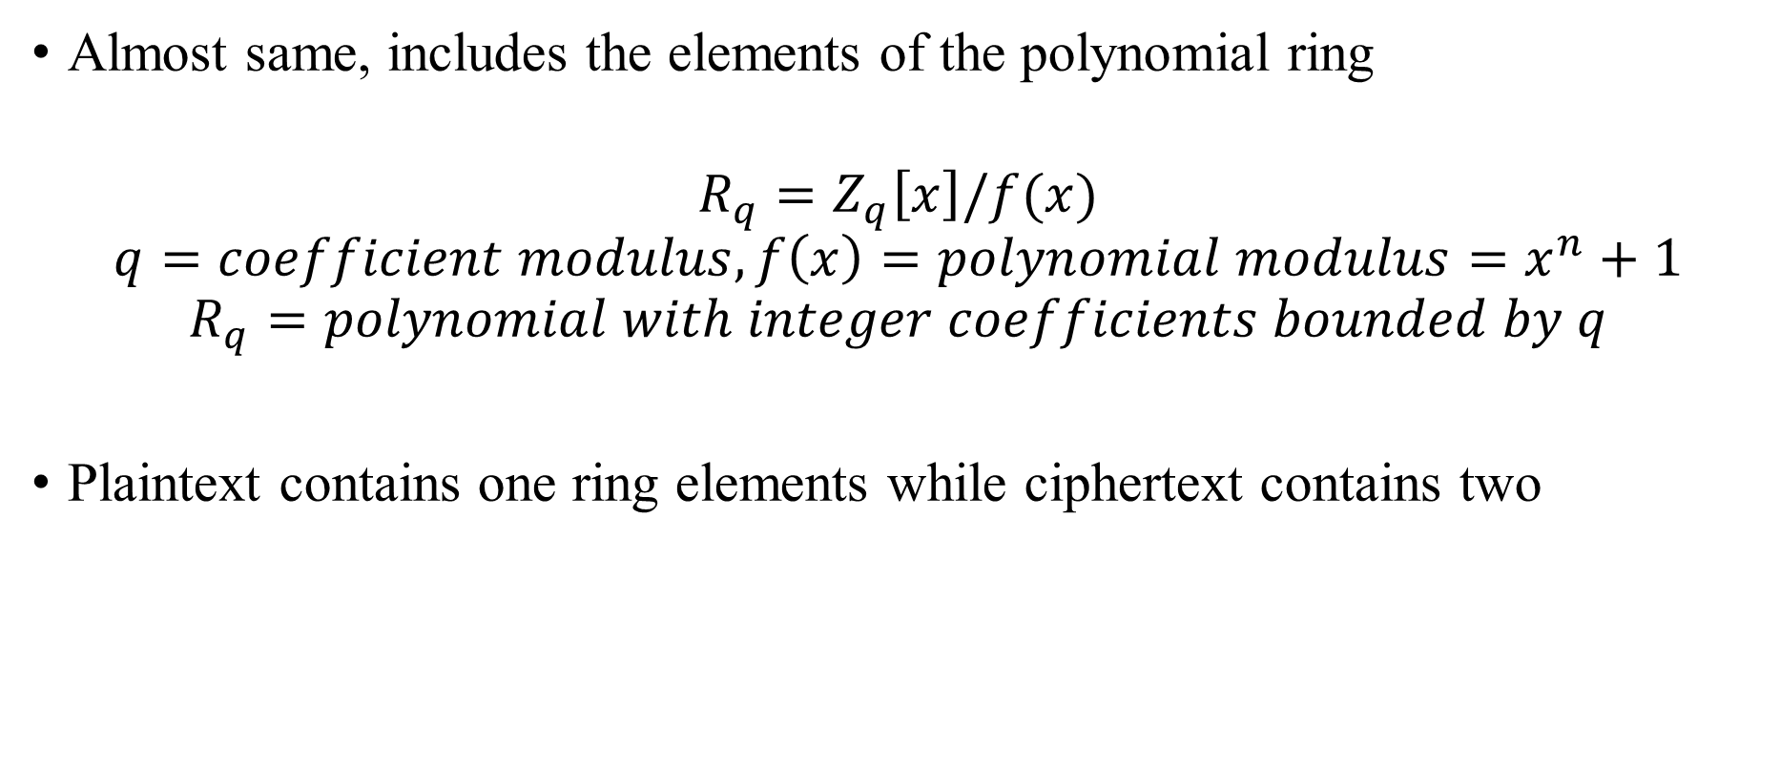
Plaintext and Ciphertext Spaces in CKKS
Almost same, includes the elements of the polynomial ring
$$R_{q}=Z_{q}\left[x\right]/f(x)$$
$$q=coefficient modulus, f\left(x\right)=polynomial modulus=x^{n}+1$$
$$R_{q}=polynomial with integer coefficients bounded by q$$
Plaintext contains one ring elements while ciphertext contains two

Slide 6
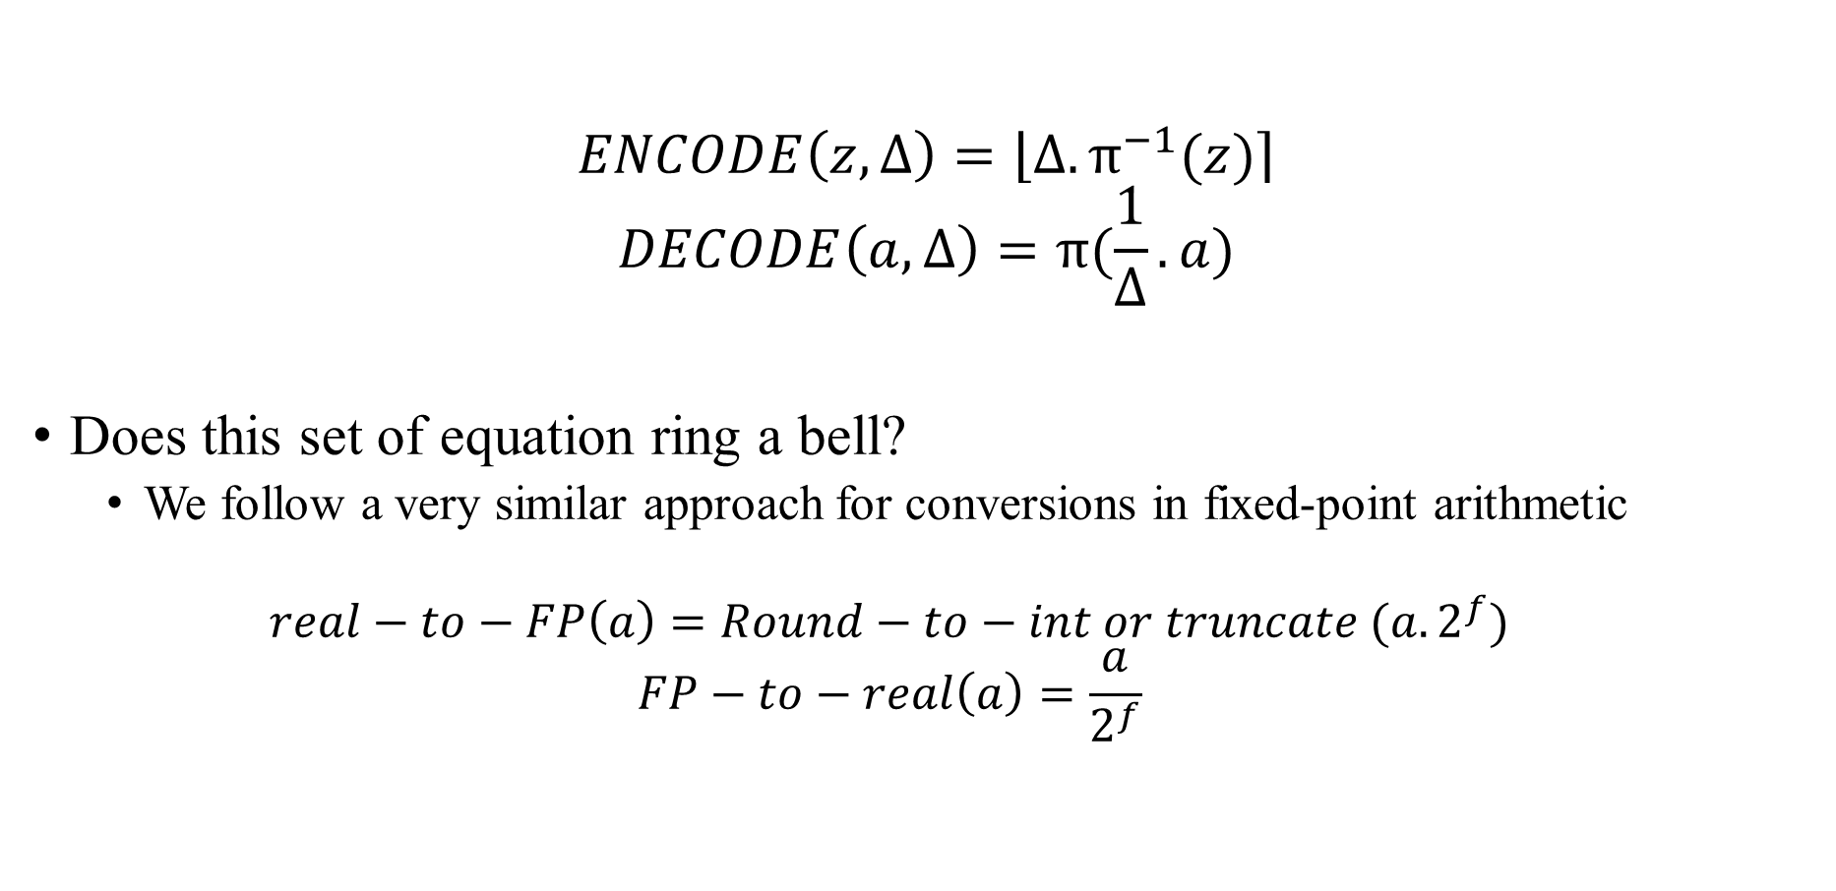
Plaintext Encoding and Decoding
$$ENCODE\left(z,∆\right)=\left\lfloor ∆.π^{−1}\left.(z)\right\rceil \right.$$
$$DECODE\left(a,∆\right)=π(\frac{1}{∆}.a)$$
Does this set of equation ring a bell?
We follow a very similar approach for conversions in fixed-point arithmetic
$$real−to−FP\left(a\right)=Round−to−int or truncate (a.2^{f})$$
$$FP−to−real\left(a\right)=\frac{a}{2^{f}}$$

Slide 7
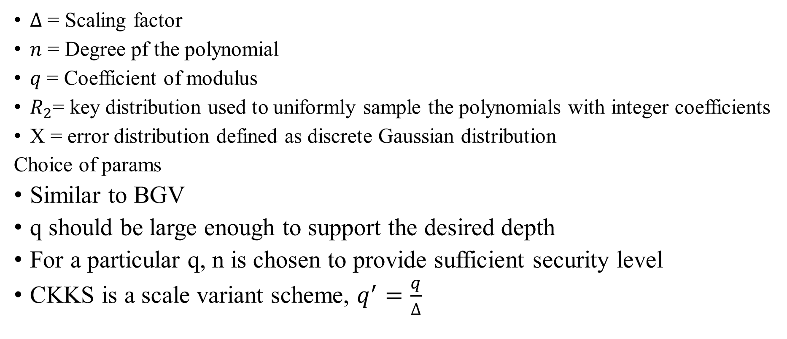
Parameters in CKKS
$∆$ = Scaling factor
$n$ = Degree pf the polynomial
$q$ = Coefficient of modulus
$R_{2}$= key distribution used to uniformly sample the polynomials with integer coefficients
Χ = error distribution defined as discrete Gaussian distribution
Choice of params
Similar to BGV
q should be large enough to support the desired depth
For a particular q, n is chosen to provide sufficient security level
CKKS is a scale variant scheme, $q^{′}=\frac{q}{∆}$

Slide 8
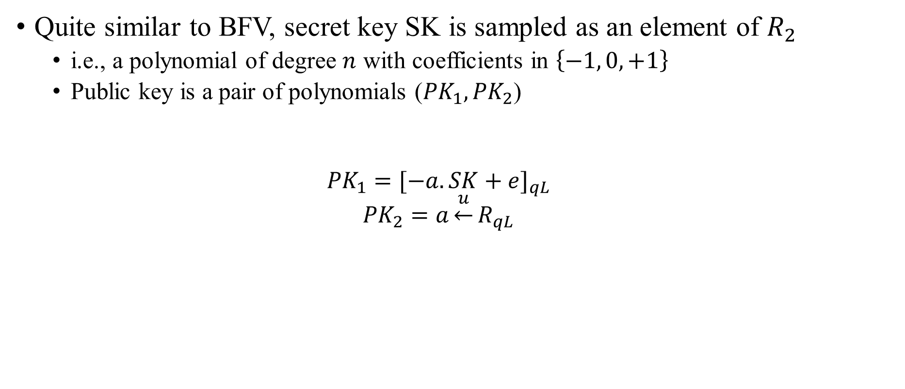
Key Gen
Quite similar to BFV, secret key SK is sampled as an element of $R_{2}$
i.e., a polynomial of degree $n$ with coefficients in $\left\{−1, 0, +1\right\}$
Public key is a pair of polynomials (${PK}_{1},{PK}_{2}$)
$${PK}_{1}={[−a.SK+e]}_{qL}$$
$${PK}_{2}=a\underset{←}{u}R_{qL}$$

Slide 9
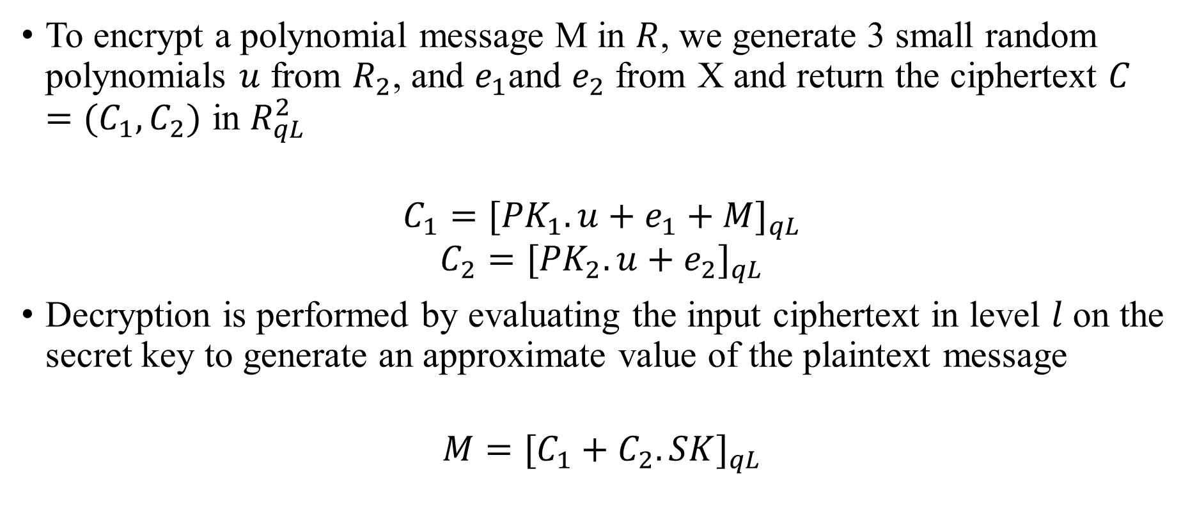
Encryption and Decryption
To encrypt a polynomial message M in $R$, we generate 3 small random polynomials $u$ from $R_{2}$, and $e_{1}$and $e_{2}$ from Χ and return the ciphertext $C=(C_{1},C_{2})$ in $R_{qL}^{2}$
$$C_{1}={[{PK}_{1}.u+e_{1}+M]}_{qL}$$
$$C_{2}={[{PK}_{2}.u+e_{2}]}_{qL}$$
Decryption is performed by evaluating the input ciphertext in level $l$ on the secret key to generate an approximate value of the plaintext message
$$M={[C_{1}+C_{2}.SK]}_{qL}$$

Slide 10

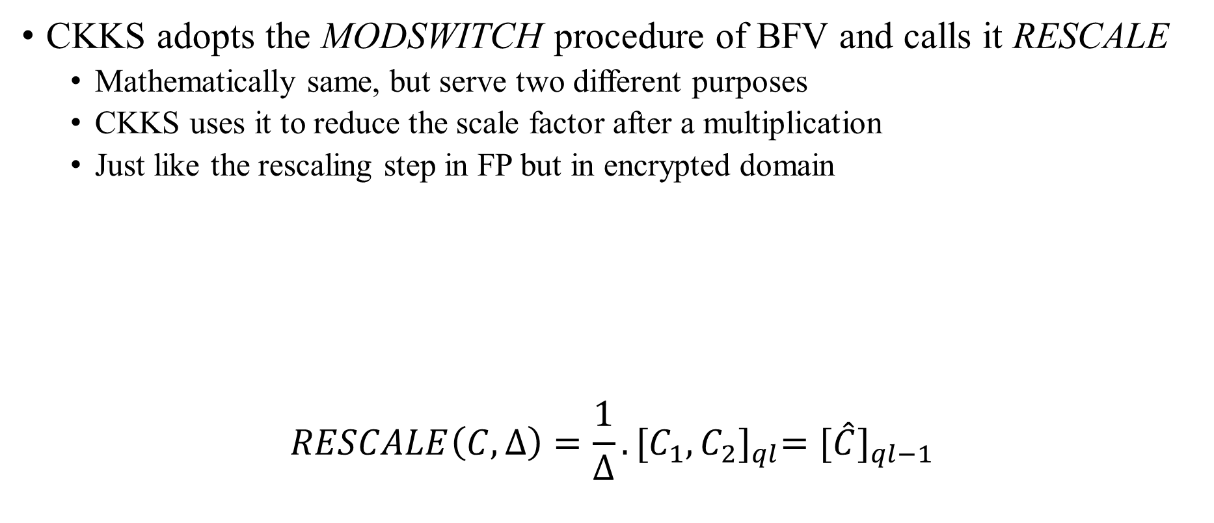

Rescale
CKKS adopts the MODSWITCH procedure of BFV and calls it RESCALE
Mathematically same, but serve two different purposes
CKKS uses it to reduce the scale factor after a multiplication
Just like the rescaling step in FP but in encrypted domain
$$RESCALE\left(C,∆\right)=\frac{1}{∆}.{[C_{1},C_{2}]}_{ql}={[\hat{C}]}_{ql−1}$$
RESCALE
$$C∈R_{qL}^{2}$$
$$\hat{C}∈R_{qL−1}^{2}$$

Slide 11
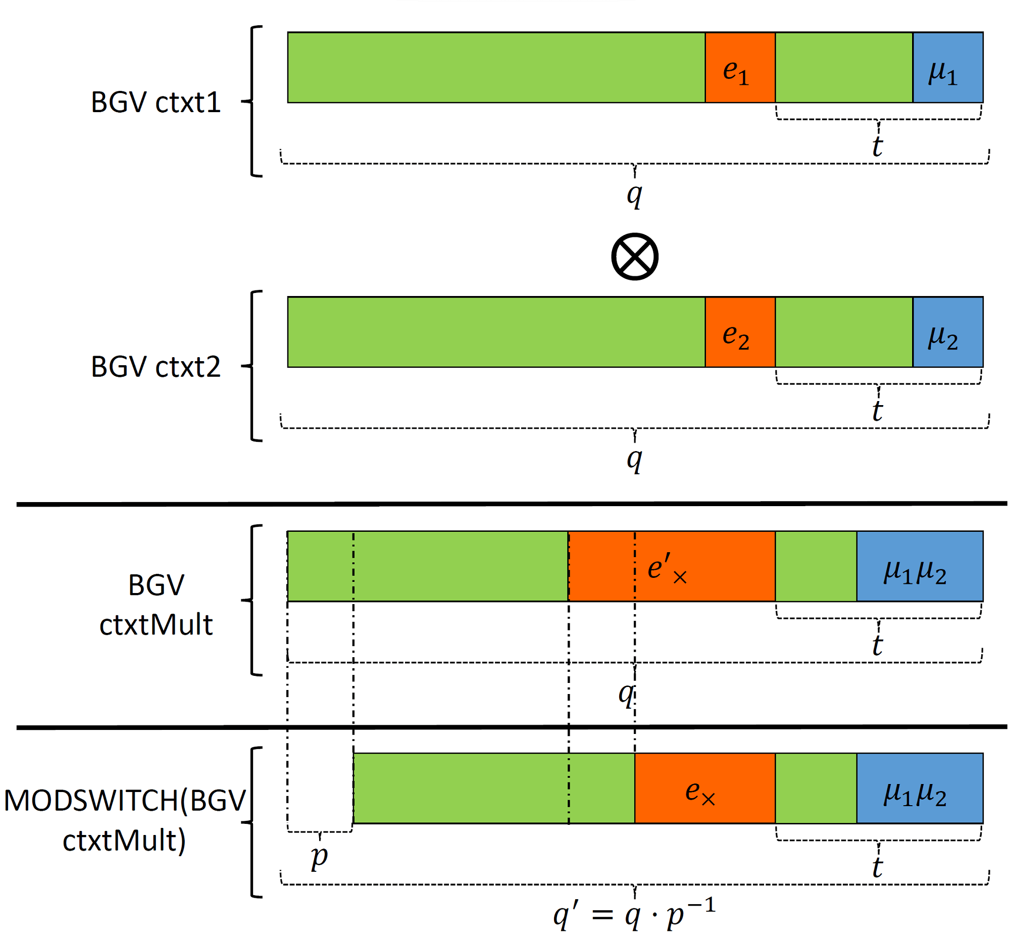
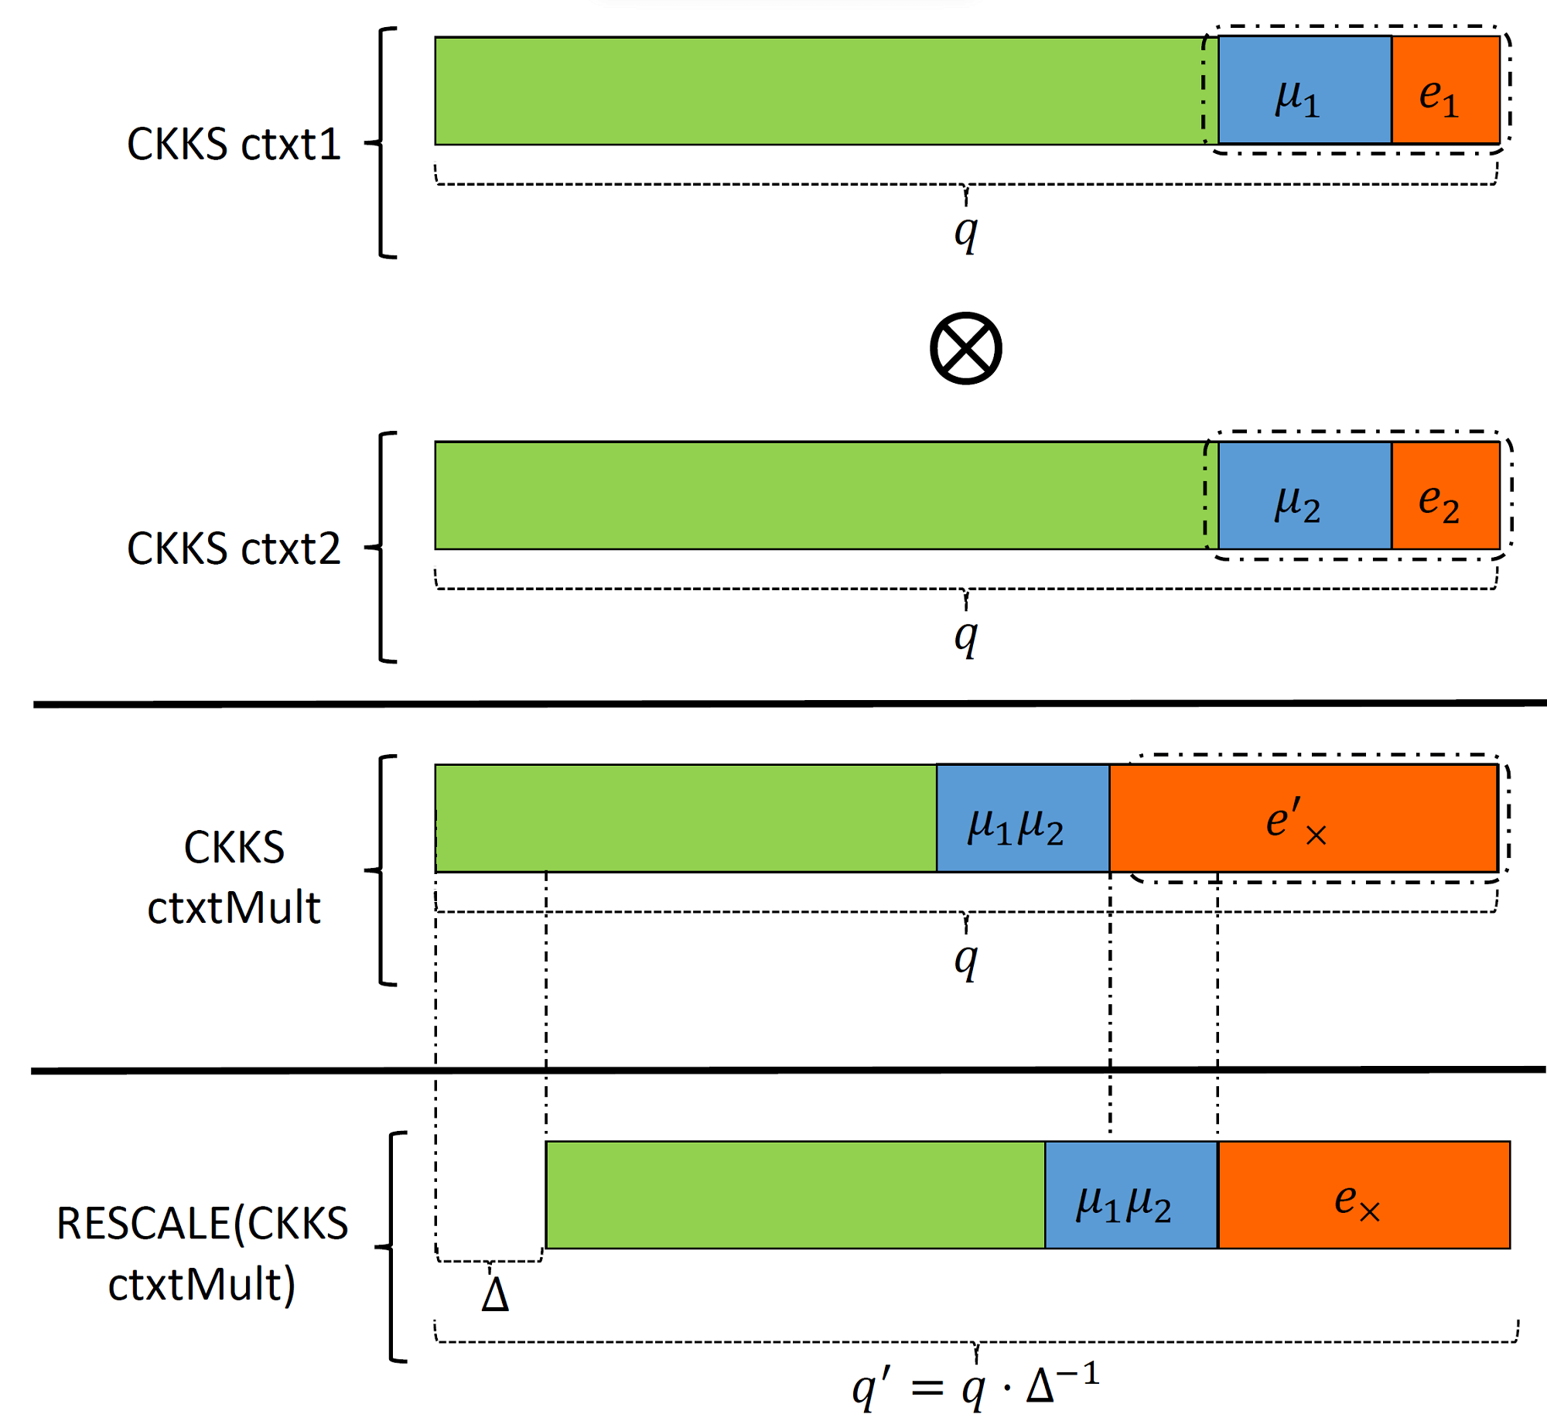
Ciphertext Multiplication in BGV vs CKKS
BGV
CKKS

Slide 12


Closing Slide: Acknowledgements

