Slide 1

Making RLWE FHE practical: CRT and NTT
Di Wu

Slide 2
Outline
1 FHE recap
2 CRT for executable FHE
3 NTT to lower complexity
3 Modular Add/Mul

Slide 3
FHE recap

Slide 4
RLWE
Polynomial ADD/MUL
Polynomial modulo polynomial
/integer
Evaluate
Encrypt
ADD/MUL/Compare
Modulus switching
KeyGen
Recryption
Relinearization
Decrypt
ADD/MUL/Compare
Key switching, etc.

Slide 5
Impractical
Large modulo
mod(X^{N}+1): N is 2^10~2^17
mod(Q): Q is much larger, e.g., 2^180, 2^881
Impossible in existing machines
CPU/GPU usually use 64-bit registers
OpenFHE: Open-Source Fully Homomorphic Encryption Library
Accelerating Number Theoretic Transformations for Bootstrappable Homomorphic Encryption on GPUs

Slide 6
CRT for executable FHE

Slide 7
Concept
Decompose large Q to small q
q will be representable in existing machines, e.g., 64 bits or less
q₁
Q
CRT
q₂
iCRT
Q
q_{k}

Slide 8
Workflow
Parallel computation
Computation on different q[1-k] are independent from each other
q₁
Poly
ops
Q
CRT
q₂
Poly
ops
iCRT
Q
q_{k}
Poly
ops
https://www.youtube.com/watch?v=KIg2B0Ja02c

Slide 9
NTT to lower complexity

Slide 10
Polynomial multiplication
Multiply 2 degree-N polynomials using convolution
O(N²) complexity, still costly
q₁
Poly
mul
Q
CRT
q₂
Poly
mul
iCRT
Q
q_{k}
Poly
mul

Slide 11
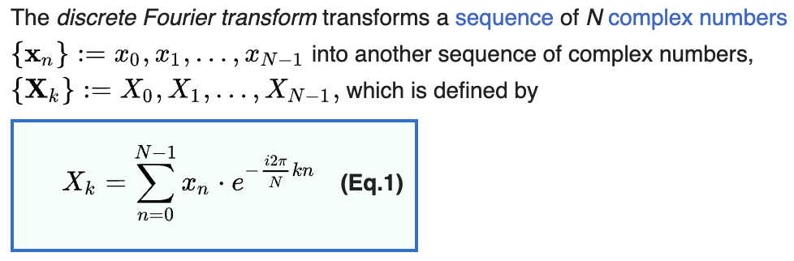
DFT concept
From time domain to frequency domain
https://en.wikipedia.org/wiki/Discrete_Fourier_transform

Slide 12
Convert convolution to multiplication
DFT magic
Time-domain convolution equals frequency-domain multiplication
N² ~ N²
A
A
DFT
N²+N ~ N²
Conv
C
iDFT
C
X
B
N² ~ N²
B
DFT
N ~ 0
N² ~ N²

Slide 13
Convert convolution to multiplication
FFT is better
FFT saves intermediate results while processing
N/2*logN ~ N*logN
A
A
FFT
N/2*logN+N ~ N*logN
Conv
C
iFFT
C
X
B
N² ~ N²
B
FFT
N ~ 0
N/2*logN ~ N*logN
https://www.ni.com/docs/en-US/bundle/diadem/page/genmaths/genmaths/calc_fouriertransform.htm

Slide 14
Conv-DFT vs FFT
N | Conv-DFT | FFT
16~64 | ✓
64~1024 |  | ✓
1024~ |  | ✓✓

Slide 15
NTT concept
Key difference from DFT
Accelerating Number Theoretic Transformations for Bootstrappable Homomorphic Encryption on GPUs

Slide 16
NTT is DFT in FHE
NTT in polynomial multiplication
N²+N ~ N²
A
A
NTT
N²+2N ~ N²
Conv
C
iNTT
C
X
B
N² ~ N²
B
NTT
N ~ 0
N²+N ~ N²

Slide 17
x NTT
Accelerate NTT using FFT tricks
Negative wrapped convolution NWC-NTT, etc.
N/2*logN+N ~ N*logN
A
A
X
NTT
N/2*logN+2N ~ N*logN
Conv
C
X
iNTT
C
X
B
N² ~ N²
B
X
NTT
N ~ 0
N/2*logN+N ~ N*logN

Slide 18
NTT reduces operations
Poly-mul | MUL | ADD
CONV | N² | N²
NTT-iNTT | 3N²+5N | 3N²
X NTT-iNTT | 3N/2*logN+5N | 3N*logN

Slide 19
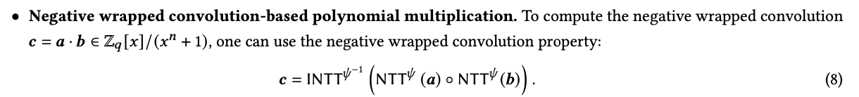
NWC-NTT
Negative wrapped convolution
Number Theoretic Transform and Its Applications in Lattice-based Cryptosystems: A Survey

Slide 20
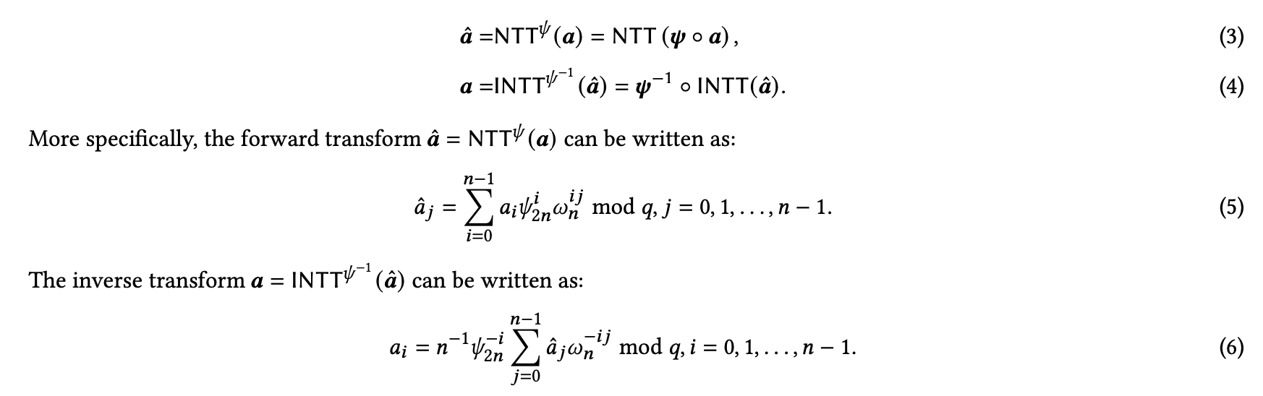
NWC-NTT
Negative wrapped convolution
Number Theoretic Transform and Its Applications in Lattice-based Cryptosystems: A Survey

Slide 21


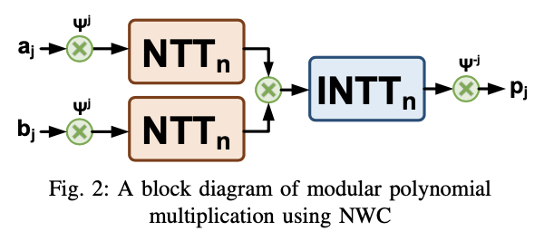
NWC-NTT
Visualization
NTT-Based Polynomial Modular Multiplication for Homomorphic Encryption: A Tutorial

Slide 22
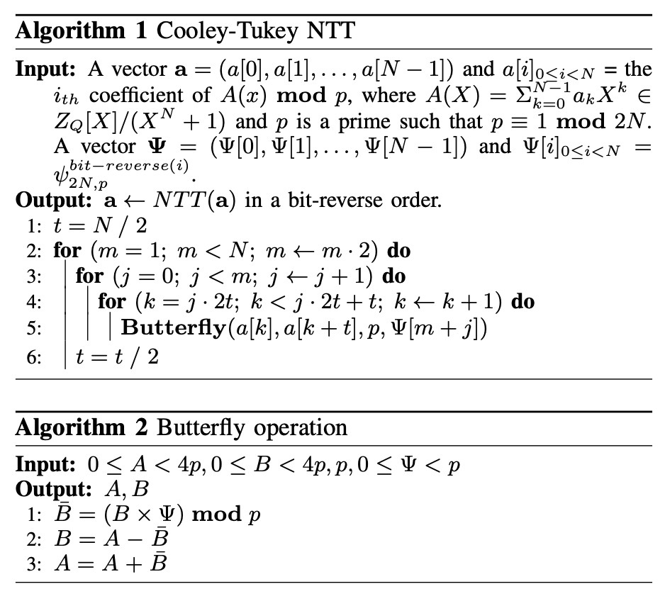
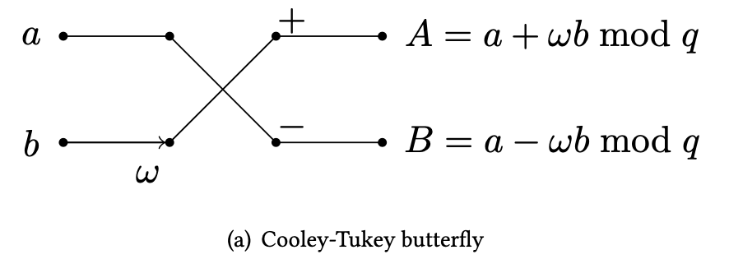
NWC-NTT
FFT butterfly
Accelerating Number Theoretic Transformations for Bootstrappable Homomorphic Encryption on GPUs
Number Theoretic Transform and Its Applications in Lattice-based Cryptosystems: A Survey

Slide 23
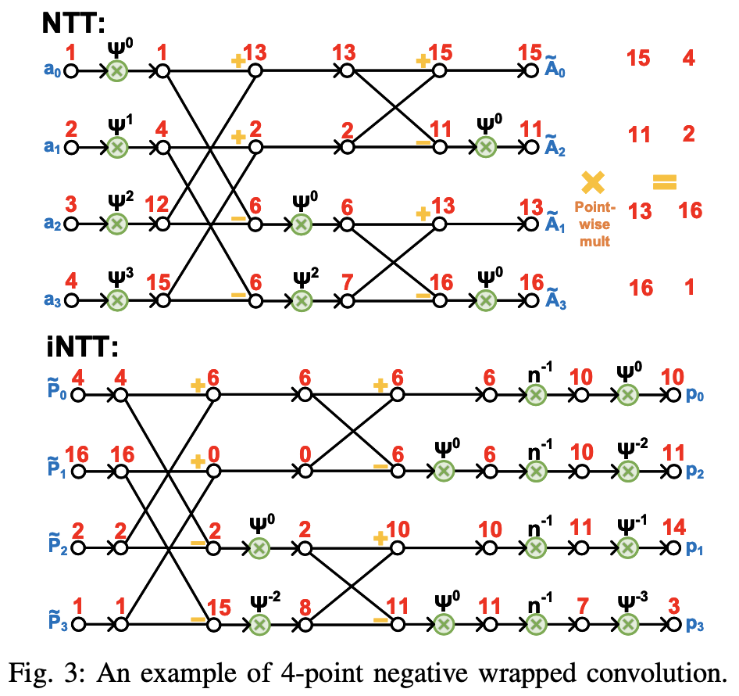
NWC-NTT
FFT butterfly
Accelerating Number Theoretic Transformations for Bootstrappable Homomorphic Encryption on GPUs
Number Theoretic Transform and Its Applications in Lattice-based Cryptosystems: A Survey
NTT-Based Polynomial Modular Multiplication for Homomorphic Encryption: A Tutorial

Slide 24
NWC-NTT
Input and output order:
natural order
00, 01, 10, 11
bit-inverse order
00, 10, 01, 11
NTT-Based Polynomial Modular Multiplication for Homomorphic Encryption: A Tutorial

Slide 25
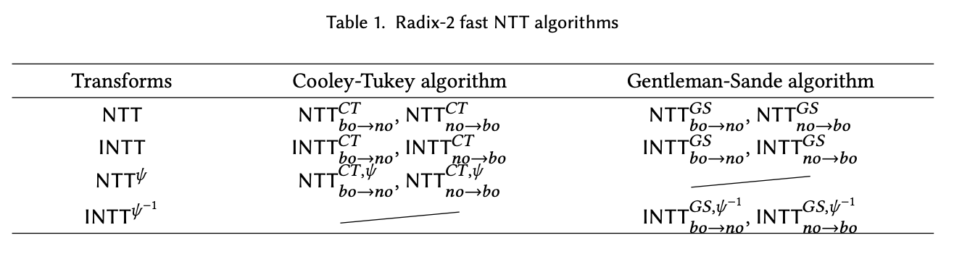
NWC-NTT
What is used in OpenFHE?
Please confirm this
What’s good?
no -> bo -> no
No need to reorder!
NTT-Based Polynomial Modular Multiplication for Homomorphic Encryption: A Tutorial
https://crypto.stackexchange.com/questions/103649/different-ways-to-implement-ntt-in-fhe-confusion-about-ct-gs-butterflies

Slide 26
Modular Add/Mul

Slide 27
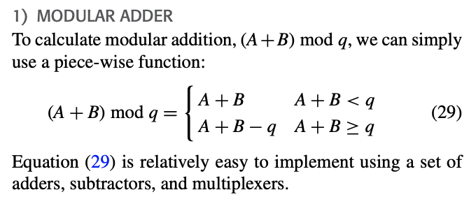
Modular addition
Simple
Conceptual Review on Number Theoretic Transform and Comprehensive Review on Its Implementations

Slide 28
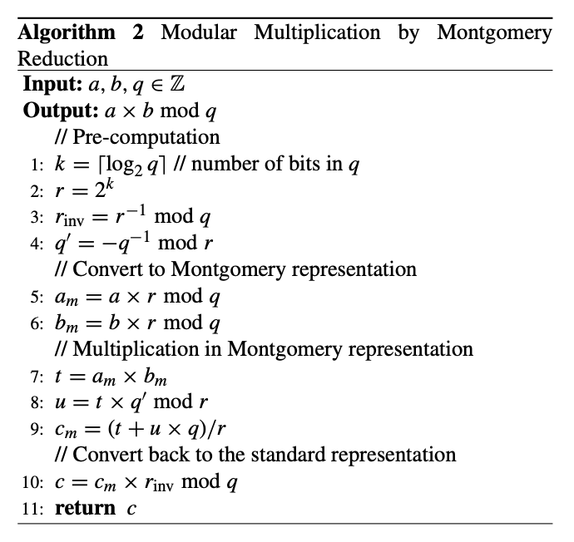
Montgomery reduction
Costly
Conceptual Review on Number Theoretic Transform and Comprehensive Review on Its Implementations
https://www.nayuki.io/page/montgomery-reduction-algorithm

Slide 29











