Slide 1


The Weekly John Update
John Gierlach
FHE Hardware Accelerator
ECE Department

Slide 2
Last Week Accomplishments
ASIP
Able to build a mod functions support with tinycore2
Worked with Mariam to write code for Butterfly operations for NTT
Debugging Errors with mod operation in modified C file

Slide 3
ASIP Mod Operation for Tinycore2
Mod functions were able to be built properly with nML and PDG using ASIP, but it appears the opcode for it is wrong
The code being testing is basically taking an array that is sorted and taking the modulo of each index and storing into another array
0 1 2 3 4 5 6 7 8 9
Array[i] Mod 5
=
0 1 2 3 4 0 1 2 3 4

Slide 4
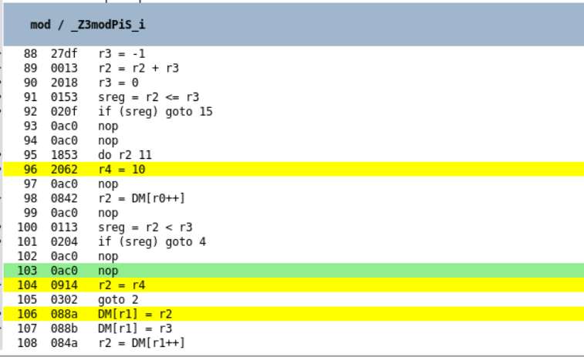
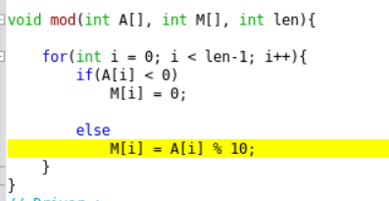
Debugging mod sort code
After running the C code, there appears to be a problem with how the opcode for the mod operation is being called
The current culprit is the image generation of the opcode for % as it is treating “%” as an “=” statement.
Later this week I will intend to solve this error and write tests on a naive module function without the mode operator

Slide 5
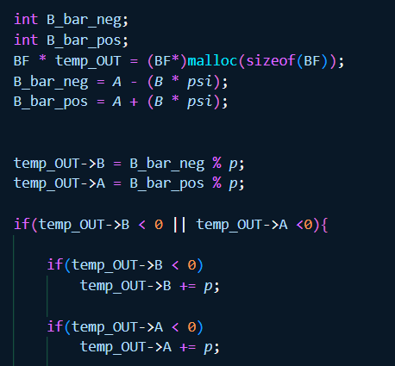
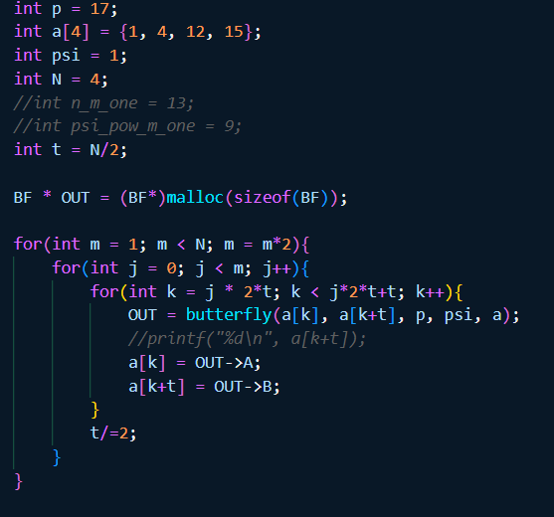
Butterfly C-Sim
Mariam and I took some time this week to write out a C program that will simulate basic butterfly operations for NTT.
The algorithm was based on the ones in the NTT slides a few weeks ago

Slide 6
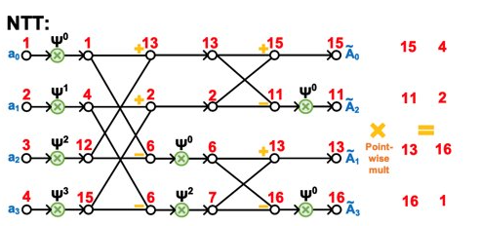
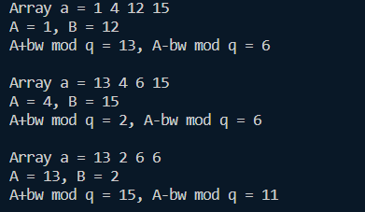
Butterfly C-Sim
This works as intended but how should we handle Ѱ during certain phases of the Cooley-Tukey operation?
Also the ordering the array seems to off unless there will be a unique algorithm we can write in C to enable to Cooley-Tukey method

Slide 7
Plans for this week
ASIP Designer
Debug ASIP nML code to produce working Mod functions
Create another version of mod_sort to do redundant subtraction and compare cycles
Discuss with Devaloy about how he worked with FHE and how to measure memory accesses and transfers
FHE Algorithms
Work with Mariam to continue to improve Butterfly C-sim to fully implement Cooley-Tukey algorithm

Slide 8


Thank you!

