Slide 1
Polynomial Representation and NTT in OpenFHE
Cory Brynds

Slide 2
Outline
1 OpenFHE Library Structure
2 Math Backend of OpenFHE
3 Modular Reduction Method
4 NTT in OpenFHE

Slide 3

Polynomial Definition in NTT
How OpenFHE defines a polynomial ring
Where f(x) is an irreducible polynomial of degree n, and q is an integer modulus.
OpenFHE only supports polynomial rings where the order n is a power of 2

Slide 4
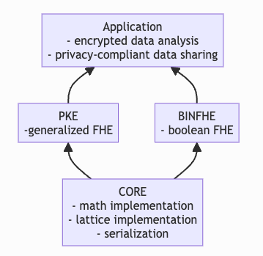
OpenFHE Modules
OpenFHE is broken down into three main modules:
Boolean FHE: evaluation of boolean circuits (DM, FHEW, CGGI, TFHE, etc)
Public Key Encryption: supports the representation of ciphertexts and operations
Core: implements the math and lattice layers necessary for PKE and BINFHE

Slide 5
Core Library
Core Library contains the lattice layer, math, and utility libraries
Lattice layer: contains representations for polynomial rings and operations over those rings
Math: supports mathematical backends for different use cases
Distribution generation
Number theory operations
Hardware abstraction layer (HAL)
Utils: used for debugging, memory management, and parallel/serialization

Slide 6
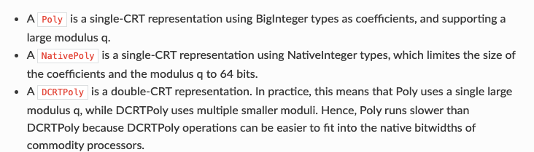
Lattice Layer: Polynomial Representations in OpenFHE
The parameters of Poly and NativePoly are order, modulus, and the root of unity, while DCRTPoly’s parameters are order, double-CRT width, moduli, and the roots of unity

Slide 7
Polynomial Representations in OpenFHE
Each representation consists of two forms:
Coefficient form (aka the raw form): vector of coefficients representing the polynomial ring
Evaluation form: vector transformed under CRT to allow for the element-wise multiplication of two or more ring polynomials
Multiplication is ONLY allowed in the evaluation form in OpenFHE

Slide 8
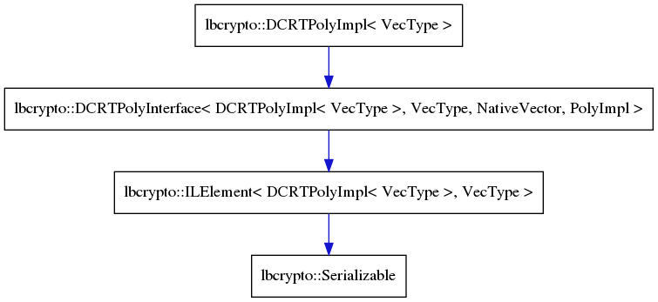

DCRTPoly
Common optimization for lattice encryption
Decomposes a large-modulus polynomial into many smaller-modulus polynomials
Maximum size of degree, coefficients, and modulus is determined by the representation scheme for Big Integer

Slide 9
Hardware Abstraction Layer: Big Integers
Data type for representing integers larger than the supported bit width of the processor (aka native integers)
Implemented as an array of native unsigned integers
32-bit and 64-bit native integers are supported

Slide 10
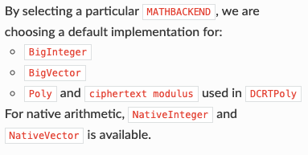
Math Backends
MATHBACKEND 2:
Max size of BigInteger is set with BigIntegerBitLength (default is 3000 bits, max is 3500 bits)
Recommended value is > double the bitwidth of the largest ciphertext modulus
Defined in “hal/bigintfxd/backendfxd.h”
MATHBACKEND 4:
No max size of BigInteger, size grows dynamically and is constrained only by memory
Defined in “hal/bigintdyn/backenddyn.h”
MATHBACKEND 6:
Integrates the NTL (Number Theory Library) with OpenFHE and uses its values as default
Defined in “hal/bigintntl/backendntl.h”
Backend Defined In:

Slide 11
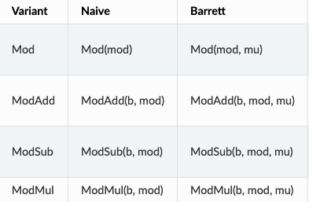
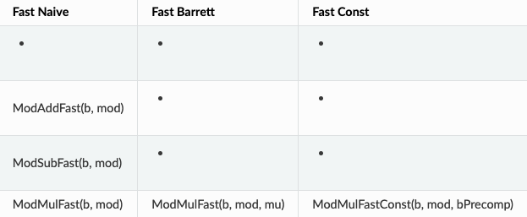
Supported Modular Operations
*Fast indicates that operands are less than the modulus
Table from OpenFHE Library API: Math Backends
Notes:
mu is precomputed using mod.ComputeMu()
Naive approaches use the % operator
bPrecomp is computed by b.PreModMulConst(mod)
Fast Const only works for the NativeInteger class but it is the fastest method

Slide 12
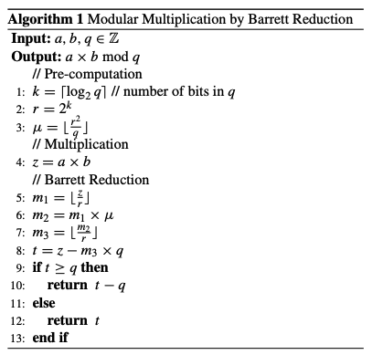
Barrett Modular Reduction
Key idea: approximate division by the modulus with pre-computed value for μ
In OpenFHE, precomputed with ComputeMu() and passed to the ModMul() method

Slide 13
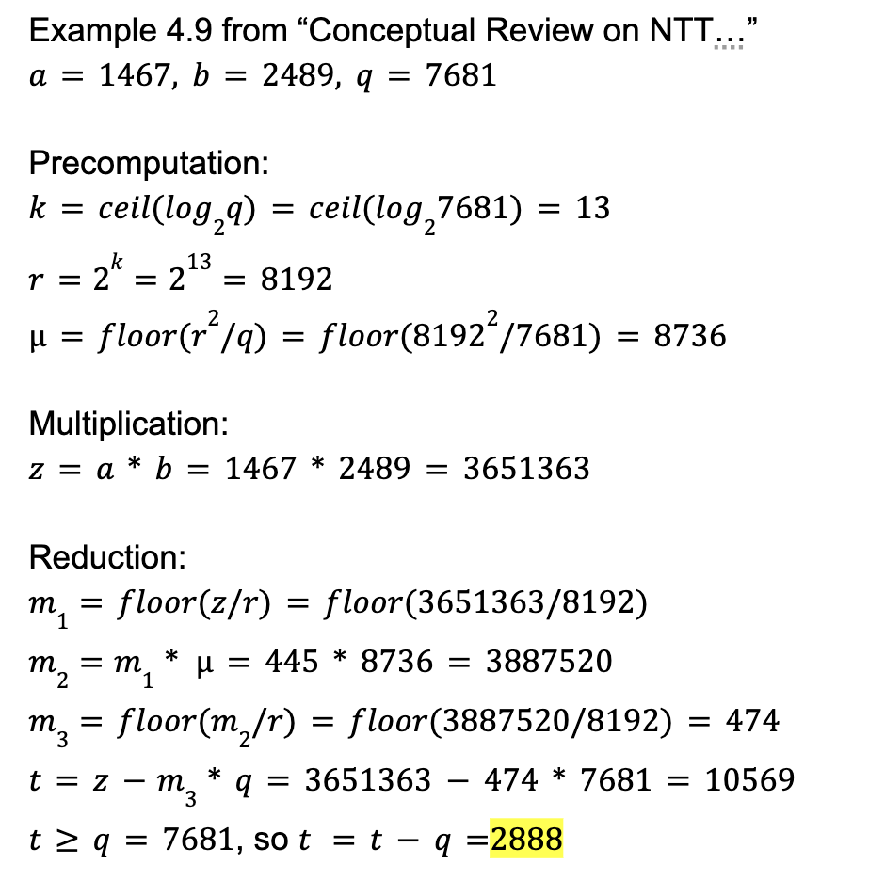
Barrett Reduction Example

Slide 14
Why Barrett over Montgomery?
In Montgomery, must first convert operands to “Montgomery form”
For efficient implementation, must minimize the number of transforms to Montgomery
Barrett reduction consists of less expensive operations, where all of the computations are done in Z
Montgomery is good for modular exponentiation, useful for calculating powers of phi but not for unrelated numbers.
Barrett is suitable for multiplication of unrelated numbers (i.e. multiplying by twiddle factors and element-wise multiplication)
Source: Project Nayuki Barrett Reduction Algorithm,
Notes:
Converting to Montgomery form involves taking a true modulo operation, expensive
Further research needs to be done for the best reduction method in terms of cost and efficiency

Slide 15
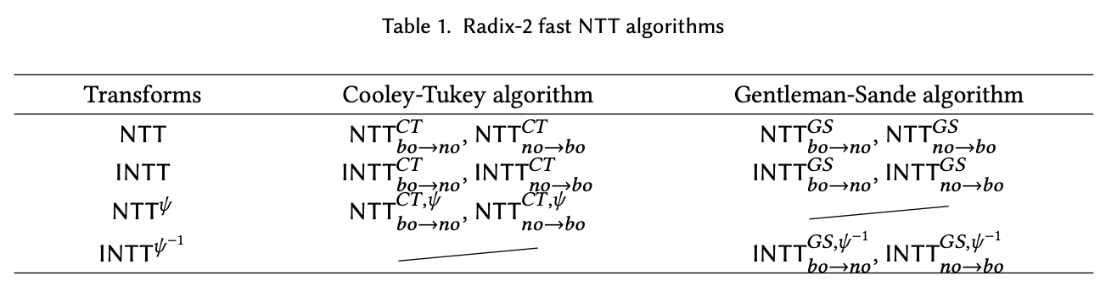
Which NTT/iNTT algorithm is used in OpenFHE?

Slide 16
Which NTT/iNTT Algorithm is implemented in OpenFHE?
Conclusion: Di was right!

Slide 17
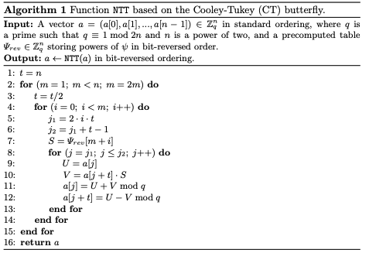
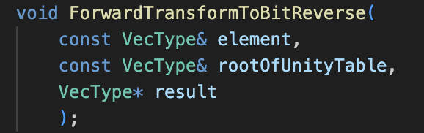
NTT: ForwardTransformToBitReverse()
Defined in “src/core/include/math/hal/bigintdyn/transformdyn-impl.h”
Alt version that computes NTT in-place
*Implementation described in Algorithm 1 of https://eprint.iacr.org/2016/504.pdf
Notes:
Based on MATHBACKEND 4: Dynamic Big Integers

Slide 18
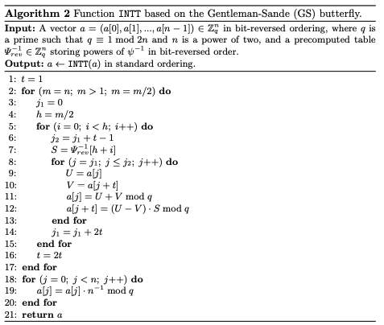
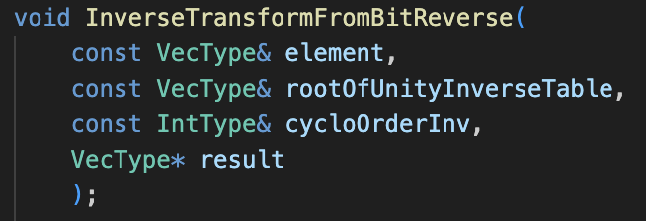
NTT: InverseTransformFromBitReverse()
Defined in “src/core/include/math/hal/bigintdyn/transformdyn-impl.h”
Alt version that computes iNTT in-place
cycloOrderInv: inverse of n mod q (n^-1)
*Implementation described in Algorithm 2 of https://eprint.iacr.org/2016/504.pdf
Notes:
Based on MATHBACKEND 4: Dynamic Big Integers

Slide 19
Future Steps/Areas to Research
1 Cost of implementing Barrett vs Montgomery Reduction
2 Comparing performance/security of HE schemes with
different mathematical backends
3 NTT Optimizations in FHE for certain use cases

