Slide 1


Butterfly/ Hardware implementation
Mariam Rabadi

Slide 2
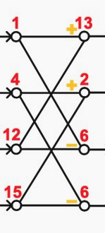
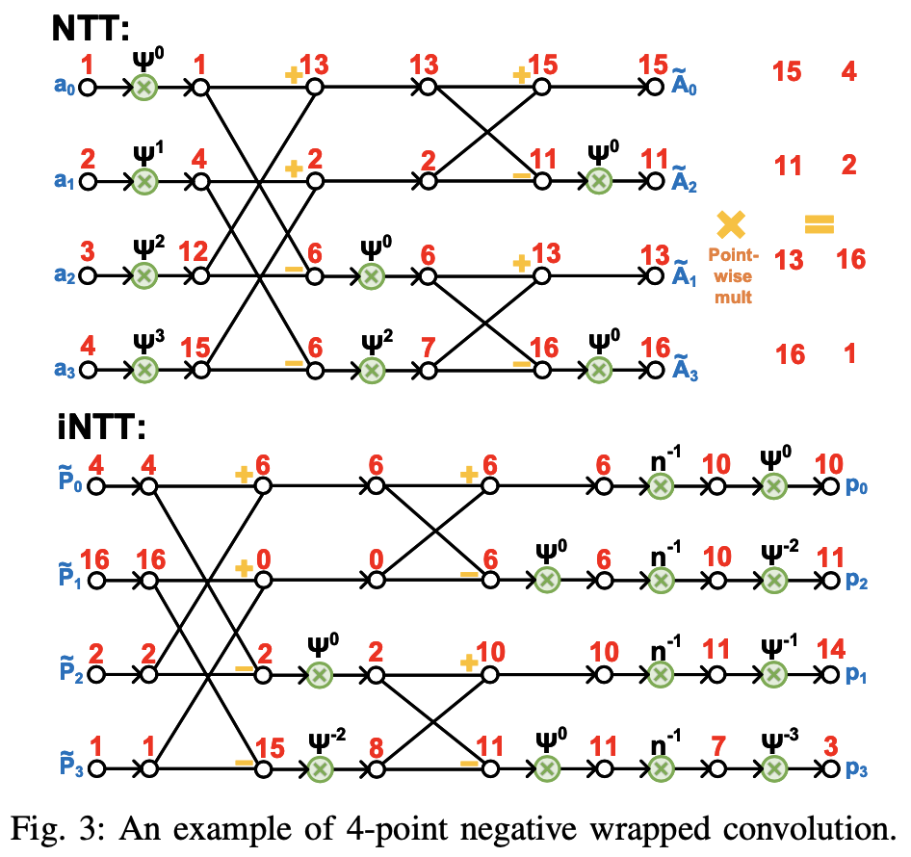
Butterfly code (will need to be modified to get all the desired results)
Notes:
NTT-Based Polynomial Modular Multiplication for Homomorphic Encryption: A Tutorial

Slide 3
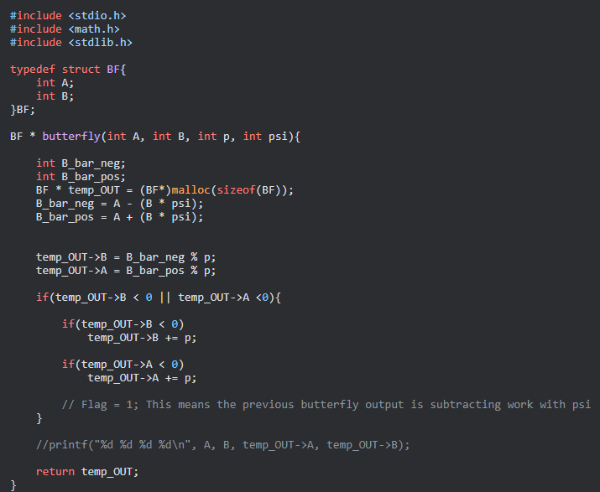
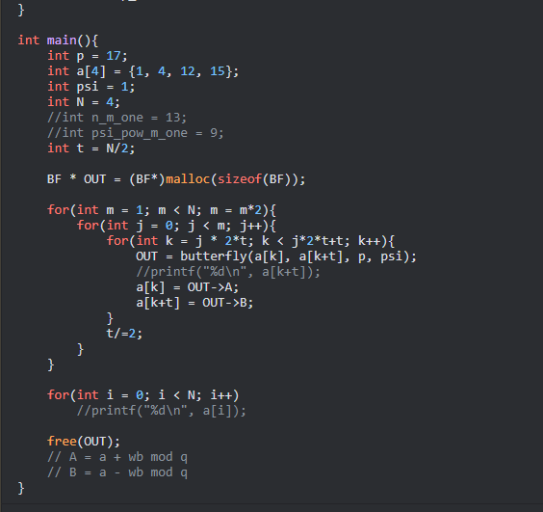

Slide 4
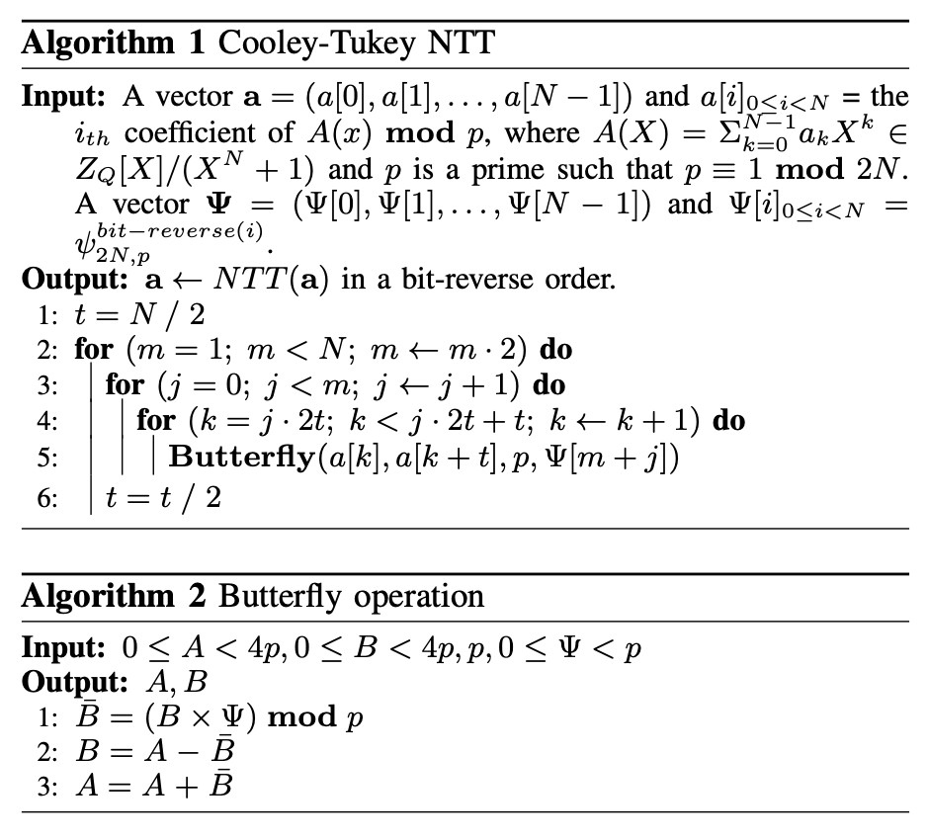
Butterfly code
Notes:
Accelerating Number Theoretic Transformations for Bootstrappable Homomorphic Encryption on GPUs
Number Theoretic Transform and Its Applications in Lattice-based Cryptosystems: A Survey

Slide 5
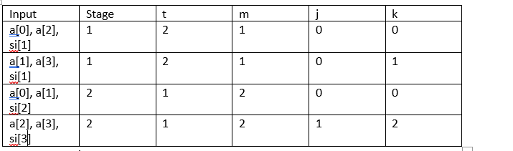
What are the different variables used for?
Simple example using N=4
Requires more analysis to see use of variables other than M.

Slide 6
Use N=16
Input | describe | t | m | j | k
a[0],a[8], si[1] |  | 8 | 1 | 0 | 0
a[1],a[9], si[1] |  | 8 | 1 | 0 | 1
a[2],a[10], si[1] |  | 8 | 1 | 0 | 2
a[3],a[11], si[1] |  | 8 | 1 | 0 | 3
a[4],a[12], si[1] |  | 8 | 1 | 0 | 4
a[5],a[13], si[1] |  | 8 | 1 | 0 | 5
a[6],a[14], si[1] |  | 8 | 1 | 0 | 6
a[7],a[15], si[1] |  | 8 | 1 | 0 | 7

Slide 7
a[0],a[4], si[2] | . | T=4 | M=2 | J=0 | K=0
a[1],a[5], si[2] |  | 4 | 2 | 0 | 1
a[2],a[6], si[2] |  | 4 | 2 | 0 | 2
a[3],a[7], si[2] |  | 4 | 2 | 0 | 3
a[8],a[12], si[3] |  | 4 | 2 | 1 | 8
a[9],a[13], si[3] |  | 4 | 2 | 1 | 9
a[10],a[14], si[3] |  | 4 | 2 | 1 | 10
a[11],a[15], si[3] |  | 4 | 2 | 1 | 11

Slide 8
a[0], a[2], si[4] |  | T=2 | M=4 | J=0 | K=0
a[1],a[3],si[4] |  | 2 | 4 | 0 | 1
a[4],a[6], si[5] |  | 2 | 4 | 1 | 4
a[5],a[7], si[5] |  | 2 | 4 | 1 | 5
a[8],a[10], si[6] |  | 2 | 4 | 2 | 8
a[9],a[11], si[6] |  | 2 | 4 | 2 | 9
a[12],a[14], si[7] |  | 2 | 4 | 3 | 12
a[13],a[15],si[7] |  | 2 | 4 | 3 | 14

Slide 9
a[0],a[1], si[8] |  | T=1 | M=8 | J=0 | K=0
a[2],a[3], si[9] |  | 1 | 8 | 1 | 2
a[4],a[5], si[10] |  | 1 | 8 | 2 | 4
a[6],a[7], si[11] |  | 1 | 8 | 3 | 6
a[8],a[9], si[12] |  | 1 | 8 | 4 | 8
a[10],a[11], si[13] |  | 1 | 8 | 5 | 10
a[12],a[13], si[14] |  | 1 | 8 | 6 | 12
a[14],a[15], si[15] |  | 1 | 8 | 7 | 14

Slide 10
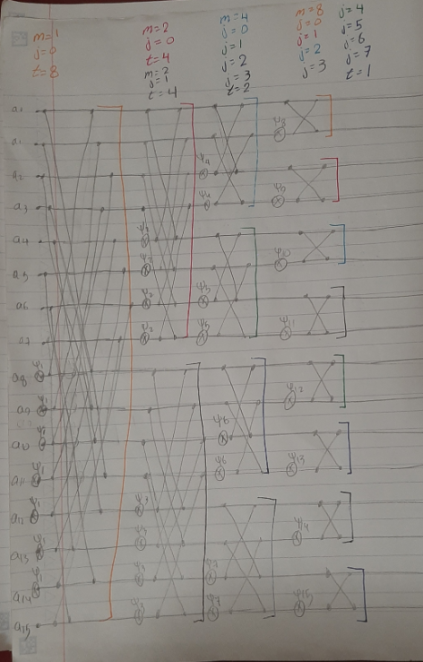

Slide 11
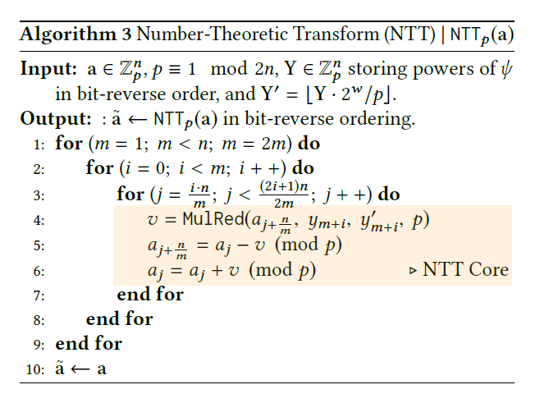
How does it divide NTT into smaller NTTs?

Slide 12
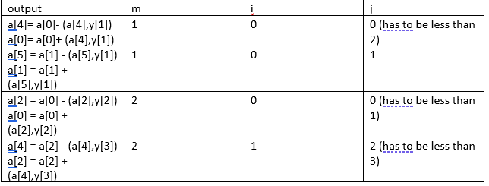
Uses a butterfly to accelerate the process
MulRed multiplies the first two inputs and mods them by q
Table representation with n = 4. There is an error in their code

Slide 13


Thank you!

