Slide 1
Fully Homomorphic Encryption with BGV scheme
Di Wu

Slide 2
Outline
1 Fully homomorphic encryption (FHE)
2 BGV scheme
3 Next step

Slide 3
Fully homomorphic encryption (FHE)
Why and what

Slide 4
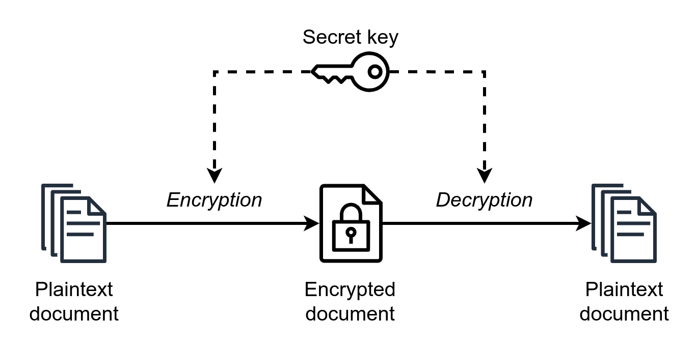
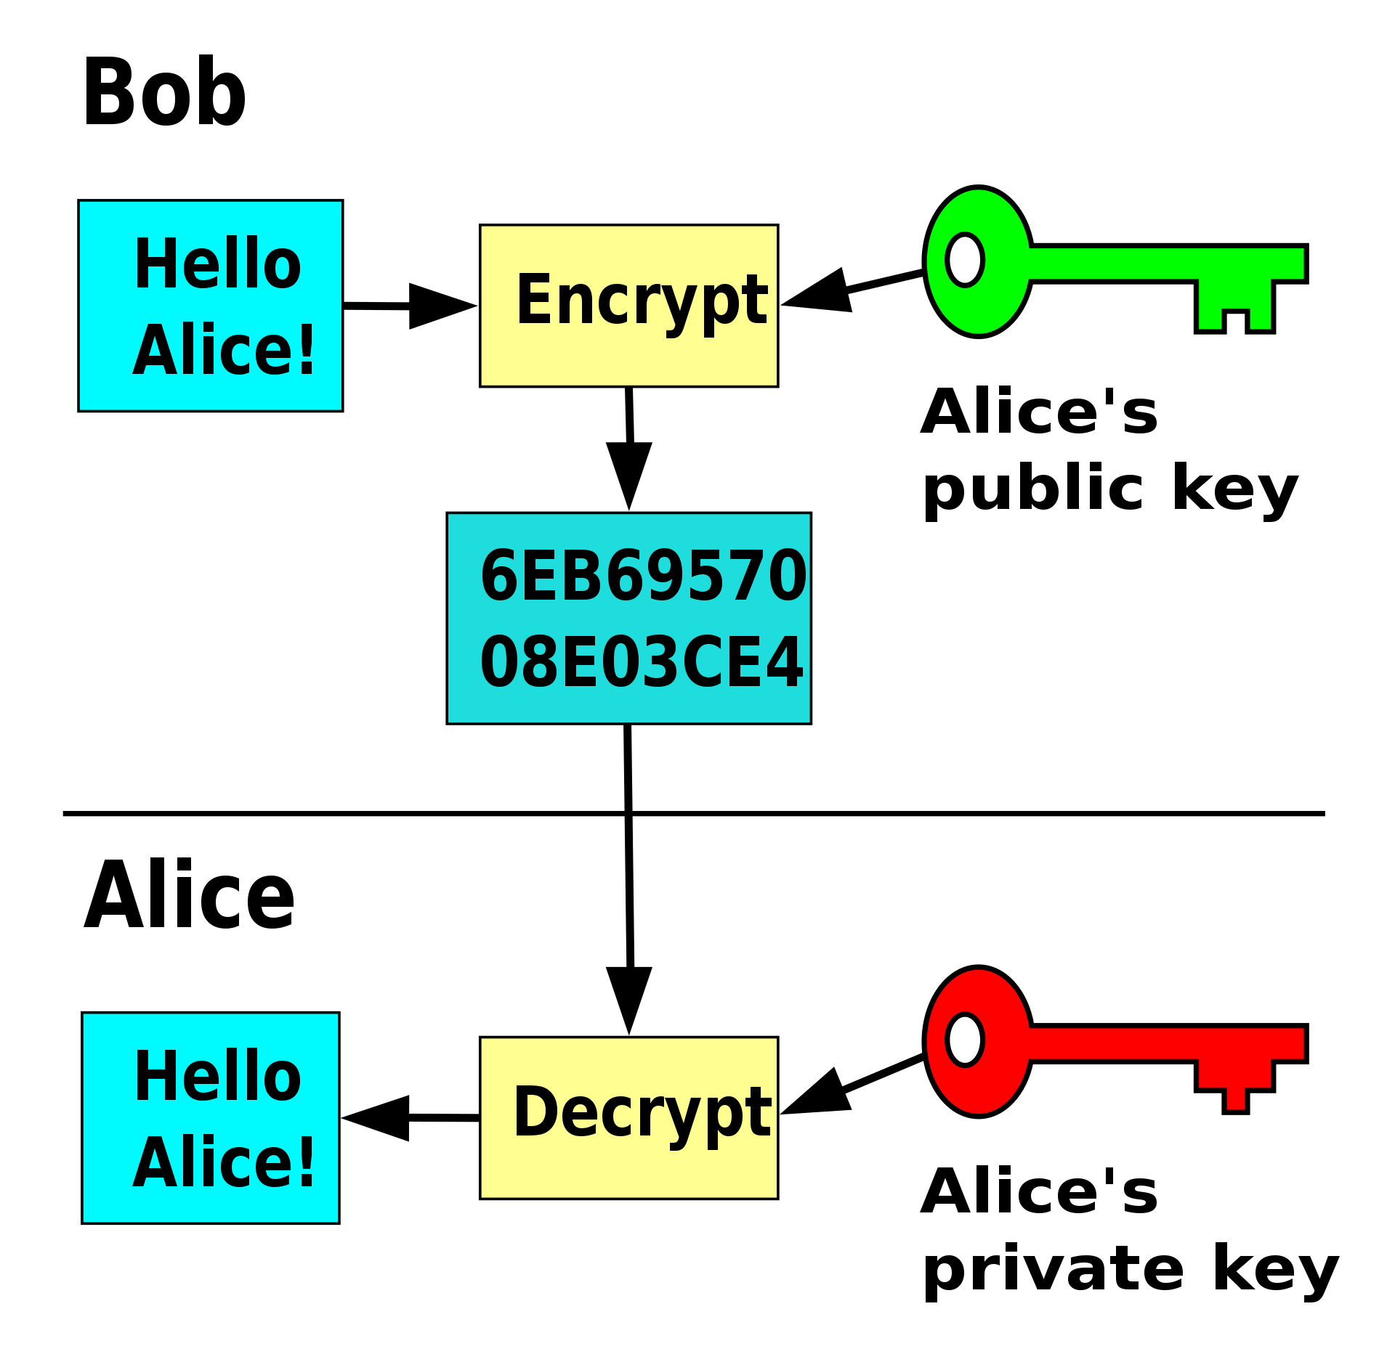
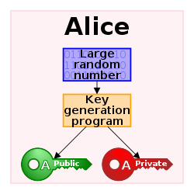
Pre-FHE cryptography
Symmetric-key
e.g., AES
Asymmetric-key (Public-key)
e.g., RSA
Figures are from wikipedia
Notes:
Symmetric-key cryptography: the same key is used for both encryption and decryption

Slide 5
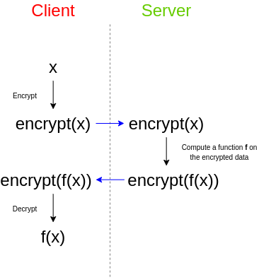
FHE cryptography
Asymmetric-key with the ability to evaluate functions
https://github.com/zademn/EverythingCrypto/blob/master/E3-Homomorphic-Encryption/1.%20Homomorphic%20Encryption.pdf

Slide 6
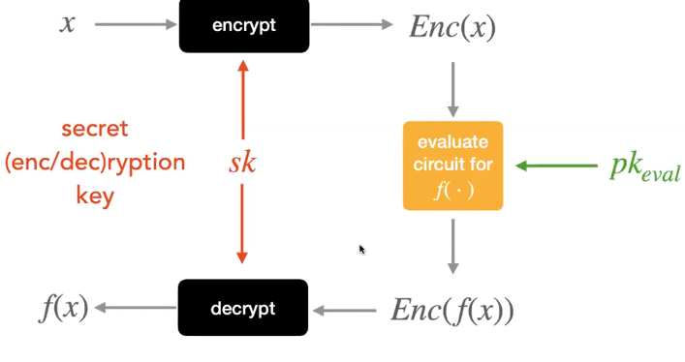
FHE cryptography
Asymmetric-key with the ability to evaluate functions
https://github.com/zademn/EverythingCrypto/blob/master/E3-Homomorphic-Encryption/1.%20Homomorphic%20Encryption.pdf

Slide 7
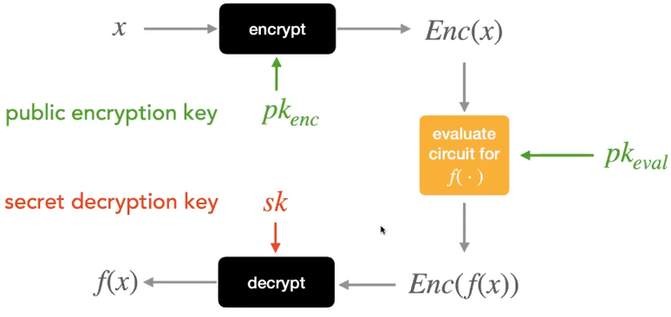
FHE cryptography
Asymmetric-key with the ability to evaluate functions
https://github.com/zademn/EverythingCrypto/blob/master/E3-Homomorphic-Encryption/1.%20Homomorphic%20Encryption.pdf

Slide 8
FHE cryptography
Main steps: KeyGen, Encrypt, Evaluate, Decrypt
https://github.com/zademn/EverythingCrypto/blob/master/E3-Homomorphic-Encryption/1.%20Homomorphic%20Encryption.pdf

Slide 9
BGV scheme
Fully Homomorphic Encryption without Bootstrapping
Zvika Brakerski
Craig Gentry
Vinod Vaikuntanathan

Slide 10
BGV—Overview
Polynomial ADD/MUL
Polynomial modulo polynomial/integer
Evaluate
Encrypt
Modulus switching
KeyGen
ADD
Relinearization
Decrypt
MUL
Key switching, etc.

Slide 11
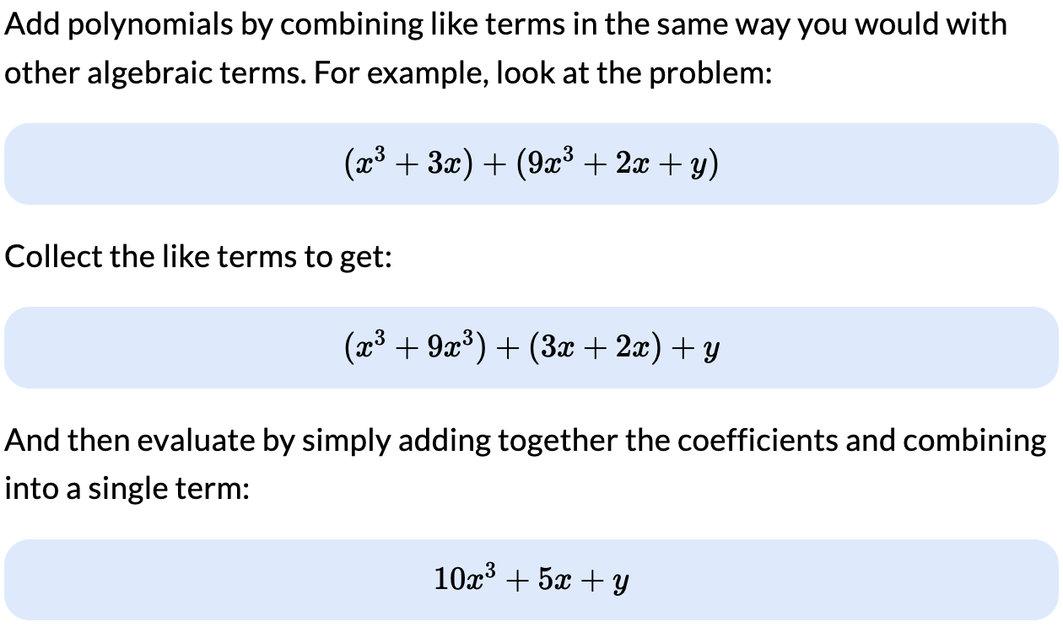
BGV—Polynomial ADD
https://sciencing.com/polynomials-adding-subtracting-dividing-multiplying-13712465.html

Slide 12
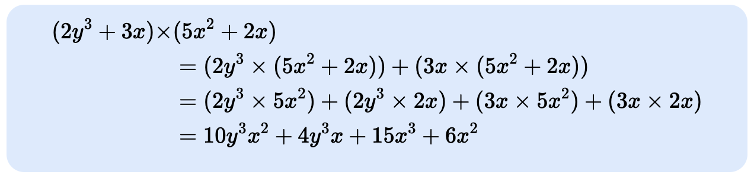
BGV—Polynomial MUL

Slide 13

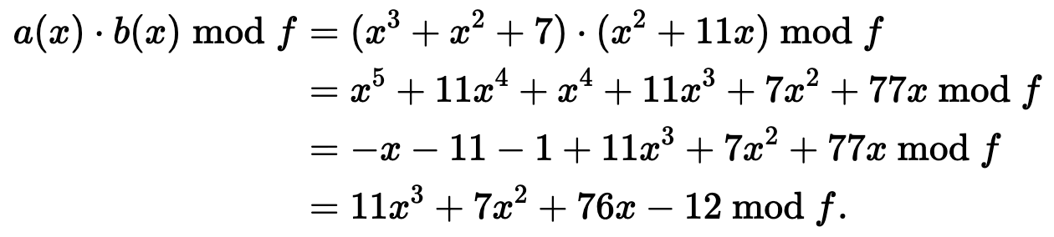
BGV—Polynomial modulo polynomial
Get the remainder of polynomial division

Slide 14

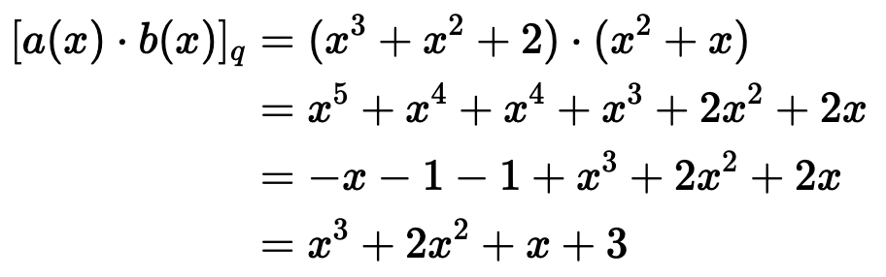
BGV—Polynomial modulo integer
Modulo each coefficient

Slide 15
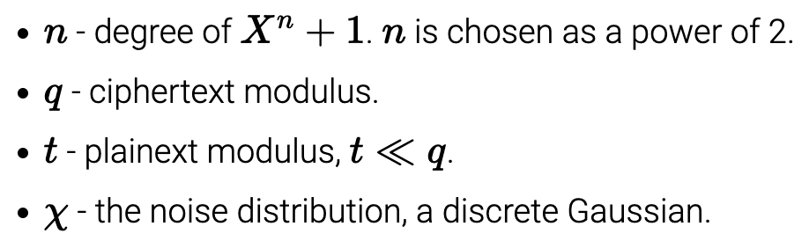
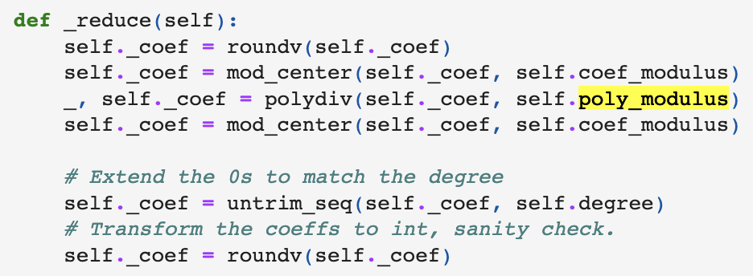
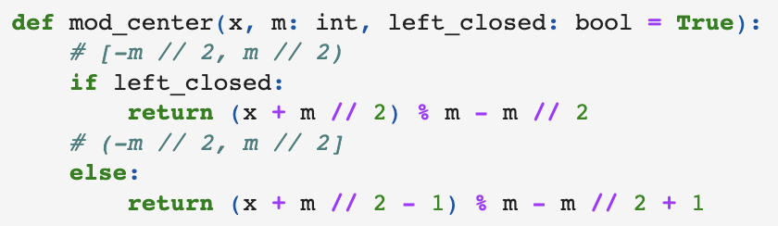
BGV—Prologue
Everything (operation and variable) is polynomial, except
All operations are mod q and mod (X^n+1) by default
https://bit-ml.github.io/blog/post/bgv-fully-homomorphic-encryption-scheme-in-python/
https://github.com/zademn/EverythingCrypto/blob/master/E3-Homomorphic-Encryption/BGV.ipynb
https://www.inferati.com/blog/fhe-schemes-bgv
https://inferati.azureedge.net/docs/inferati-fhe-bgv.pdf

Slide 16
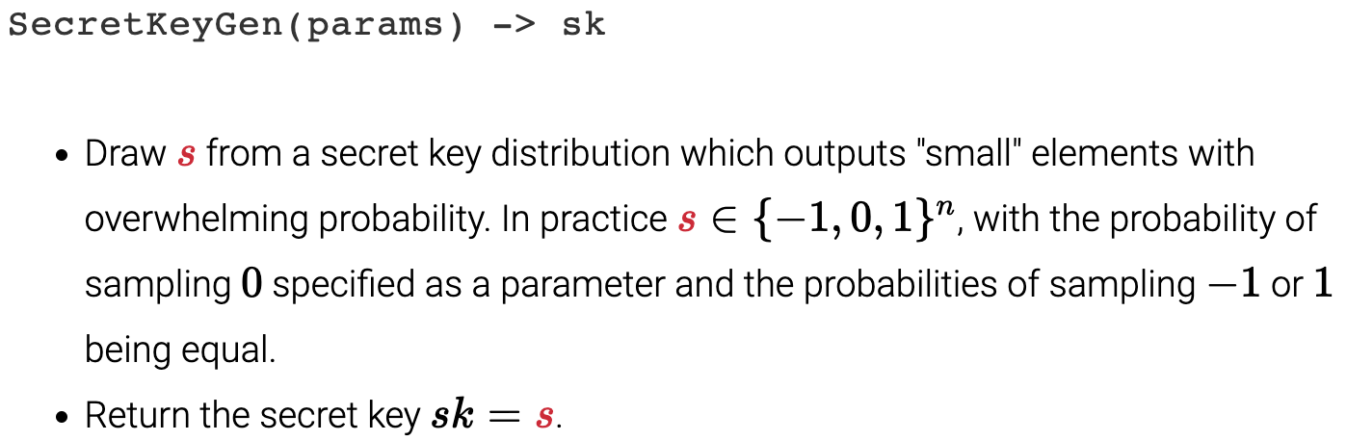
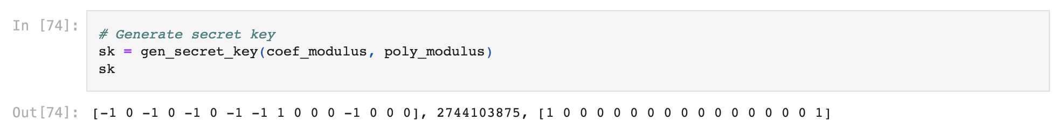


BGV—KeyGen

Slide 17
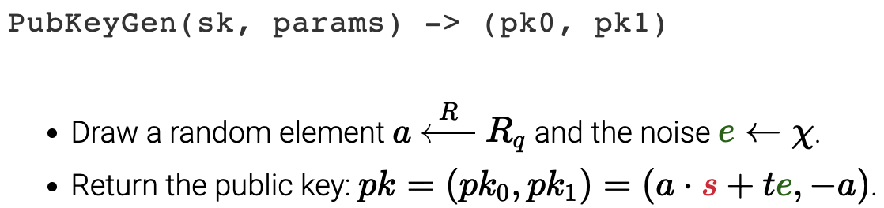

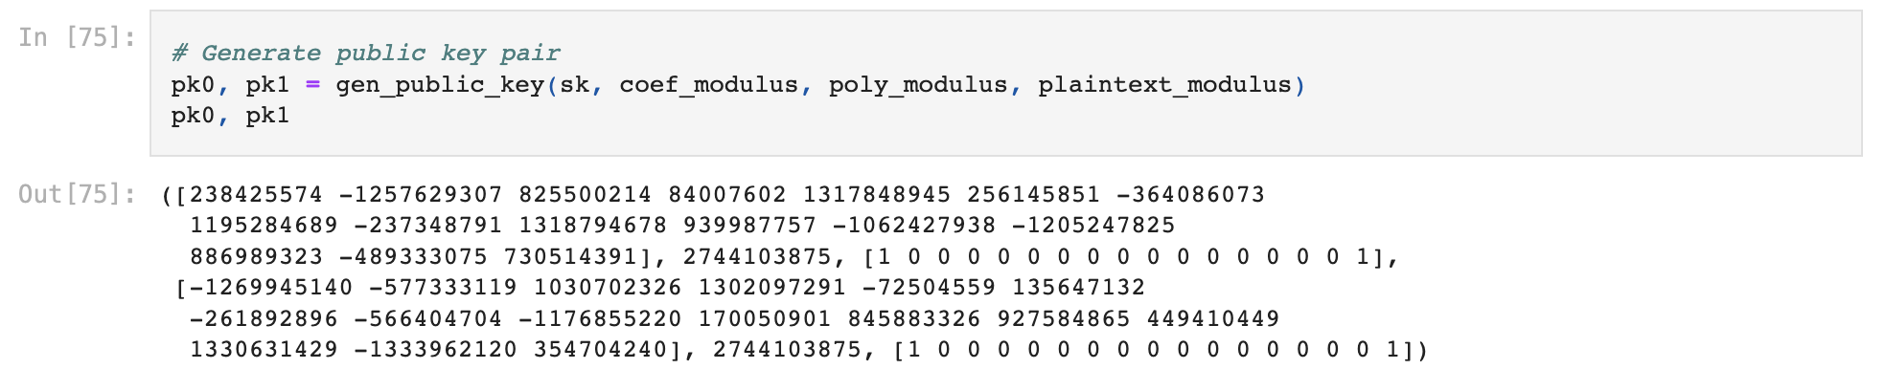
BGV—KeyGen

Slide 18
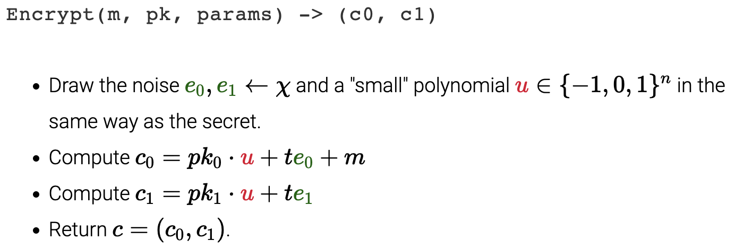

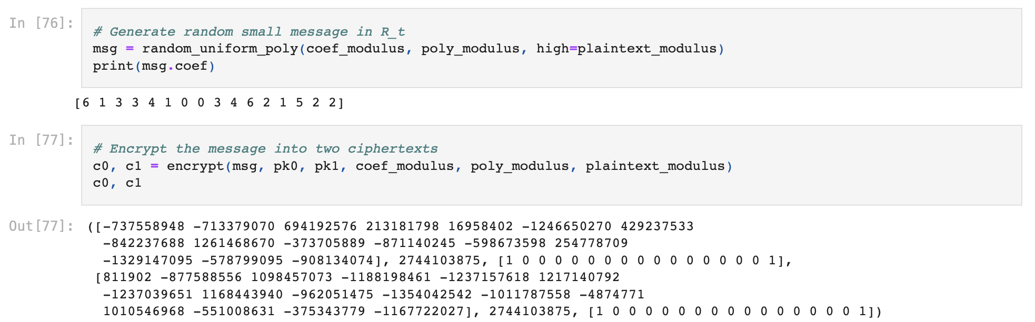
BGV—Encryption

Slide 19
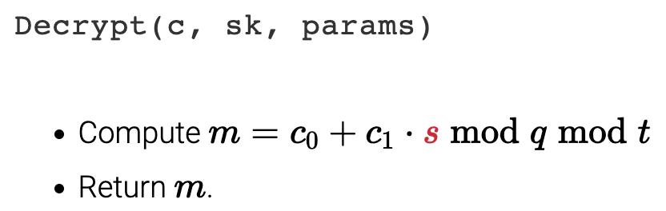

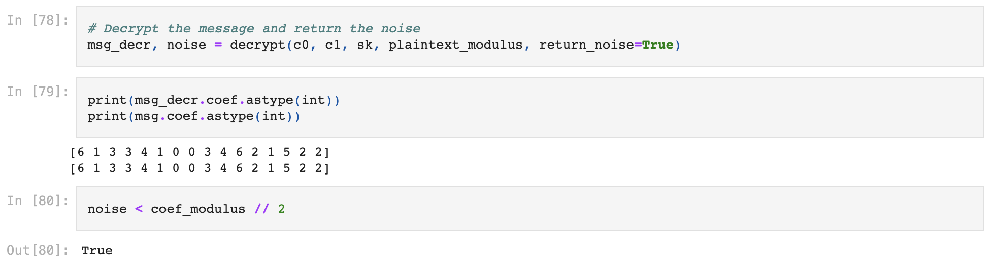
BGV—Decryption

Slide 20
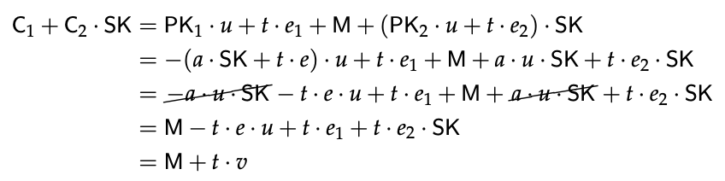
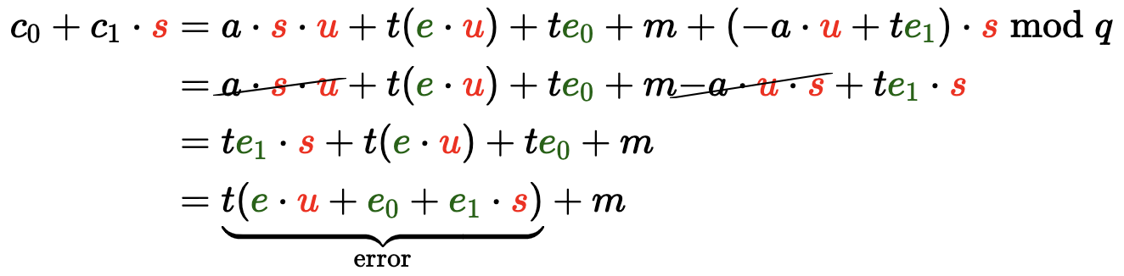
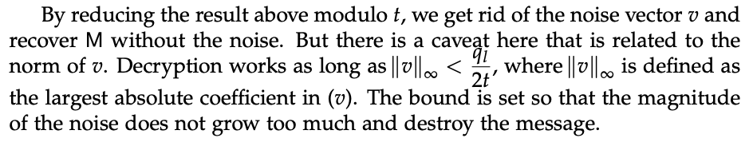
BGV—Decryption continued

Slide 21

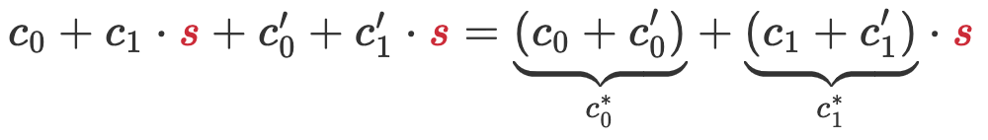


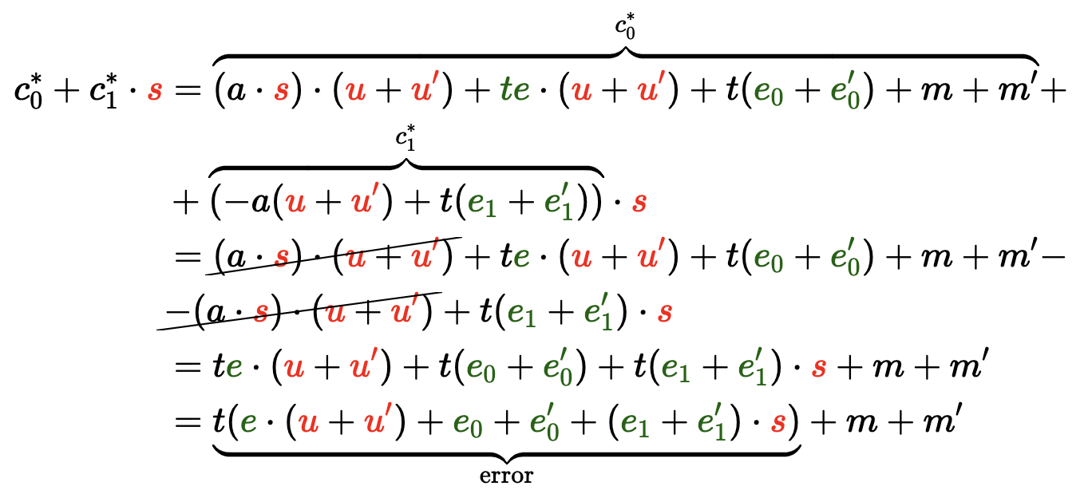
BGV—FHE ADD
Additive noise
Magnitude constraint on the norm of the error term, identical to decryption

Slide 22
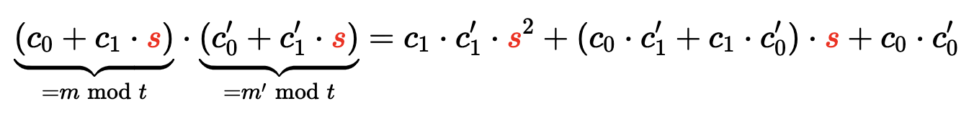
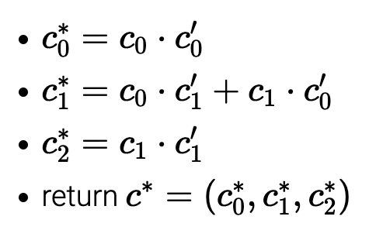
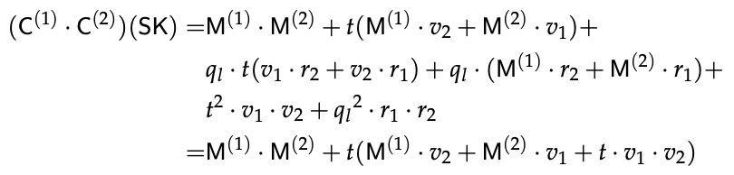
BGV—FHE MUL
Multiplicative noise
Magnitude constraint on the norm of the error term, identical to decryption
3 terms instead of 2, not sustainable
Decryption is linear with 2 terms, incompatible

Slide 23

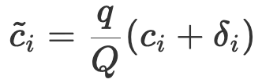
BGV—Modulus switching
Reduce noises after FHE operations
scale down the ciphertext's components by q/Q
smartly round in a way to keep the decryption equation correct

Slide 24



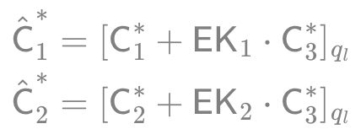
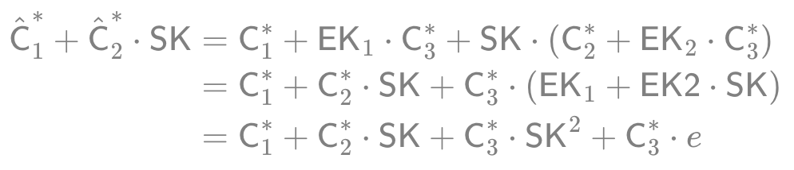


BGV—Relinearization
Reduce terms from 3 to 2 for correct decryption
C*₃ is a random element in R_{q} and it will yield some large noise

Slide 25
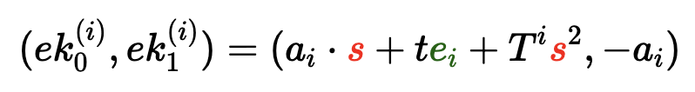
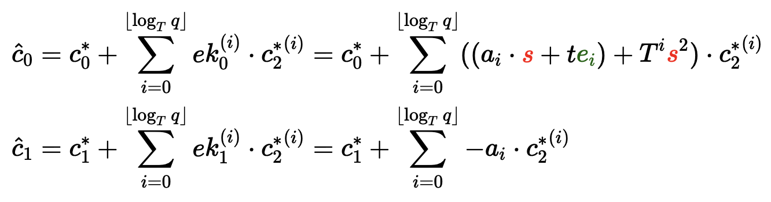
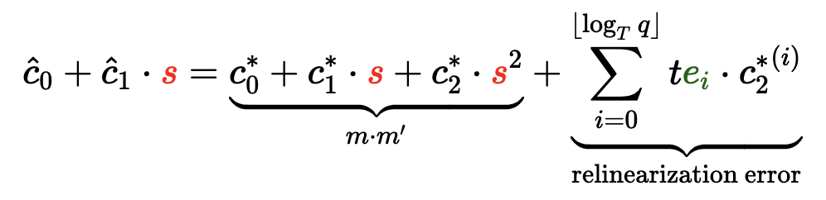
BGV—Relinearization variant
Key switching v1
the error is a multiple of t, it goes away when we decrypt via mod t

Slide 26
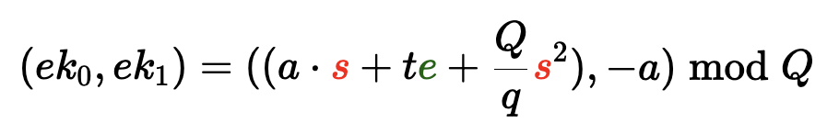
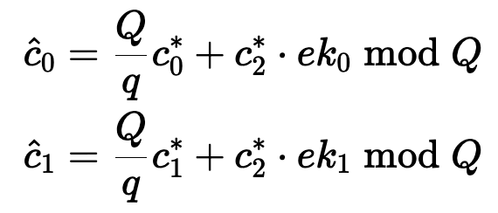
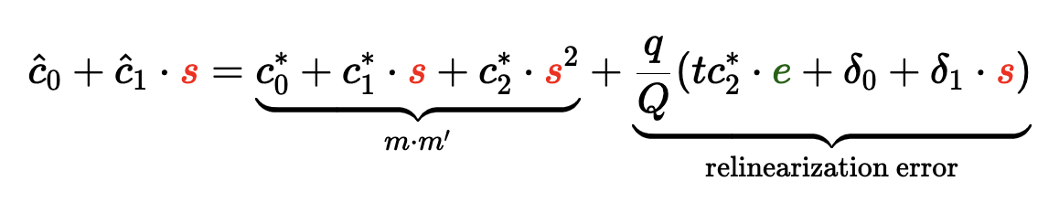
BGV—Relinearization variant
Key switching v2
the error is a multiple of t, it goes away when we decrypt via mod t

Slide 27
Next step
Hands-on practices

Slide 28
Questions to be answered
Bootstrapping
Polynomial MUL acceleration: NTT
Cryptography parameter: OpenFHE, 32-2048 bits?
HW data format: INT32, INT64?
SW operation and schedule: GEMM? NNT? Comparison?
Etc.

Slide 29
Milestones
Algorithm analysis
Performance profiling
ISA definition
Architecture design
Architecture simulation
Physical implementation
Baseline implementation
Works from MIT, NYU, SNU, KAIST, UMich, Duke, etc.
Compiler stack
Metric definition

Slide 30
Thank you Q & A

