Slide 1

TFHE, FHEW
BGV, BFV
TFHE, FHEW
2nd Generation
3rd Generation
BGV, BFV
BGV -> Ciphertext Polynomial
FFT/NTT
TFHE -> Ciphertext Matrix
Matrix multiplication
Scalar/Vector
Matrix
Small value
1

Slide 2


Key
Key
eigenvalue and eigenvector
Ciphertext
Plaintext

Slide 3

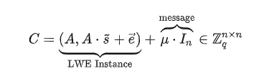
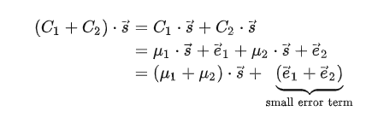
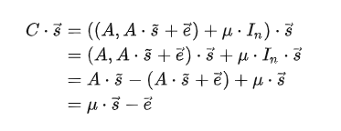
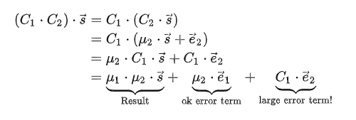
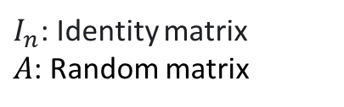
Encryption
$I_{n}$: Identity matrix
$A$: Random matrix
Decryption

Slide 4

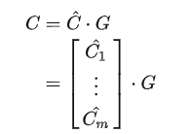
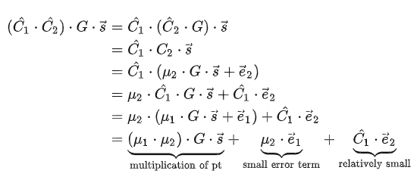

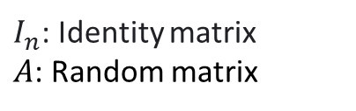
$I_{n}$: Identity matrix
$A$: Random matrix
$\left(\begin{aligned}2, 5 \\ 3, 1\end{aligned}\right)$ = $\left(\begin{aligned}0,1,0, 1,0,1 \\ 0,1,1, 0,0,1\end{aligned}\right)∙G$

Slide 5
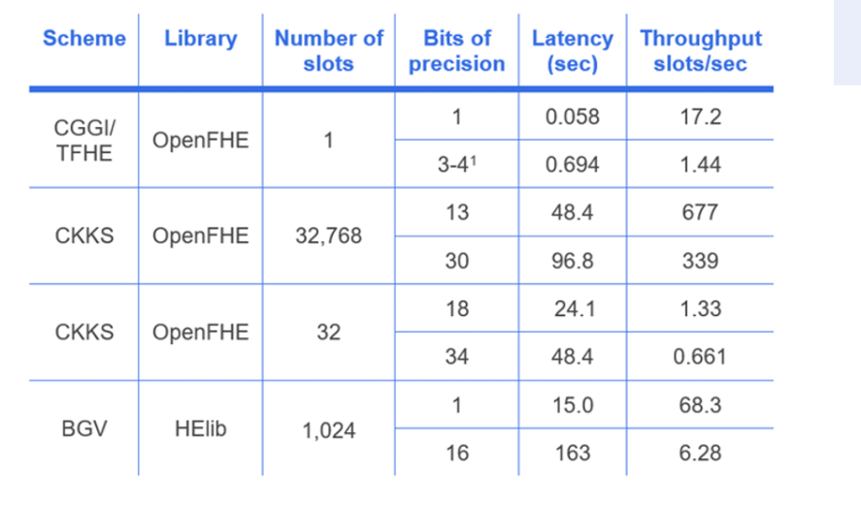
LARGER DATASET
MORE COMPUTE INTENSIVE
Better Bootstrapping Efficiency (slower noise growth)
Resistant to Quantum Computing?

Slide 6

THANK YOU!
Xin Xin
xin.xin@ucf.edu

